Slide 1
Strumenti open-sources o demo

Slide 2
Strumenti disponibili online (versione demo o open source) per svolgere diverse funzioni
Web scraping: estrarre dati dai social network
Analisi del contenuto automatizzata
Analisi delle reti sociali

Slide 3
Web scraping
Intro

Slide 4
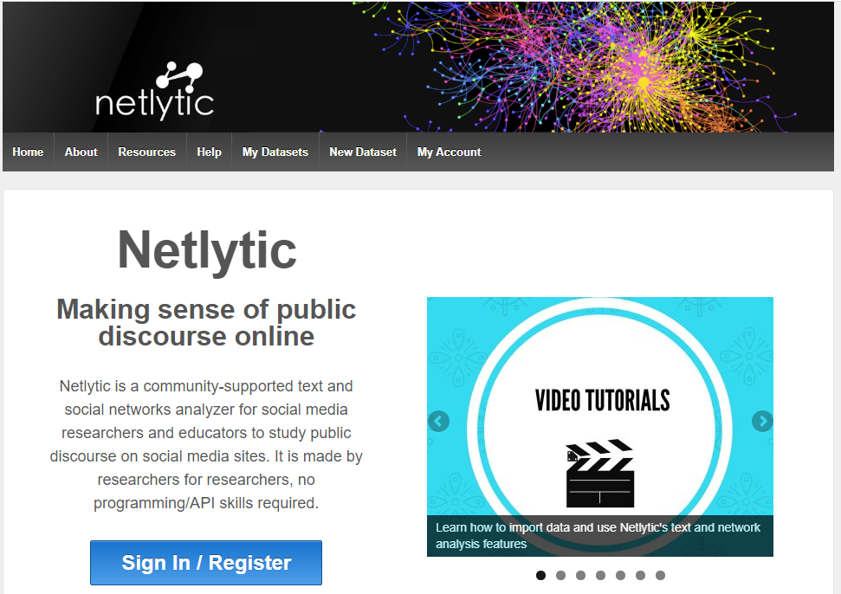
Free software online per web scraping
https://netlytic.org/index.php

Slide 5
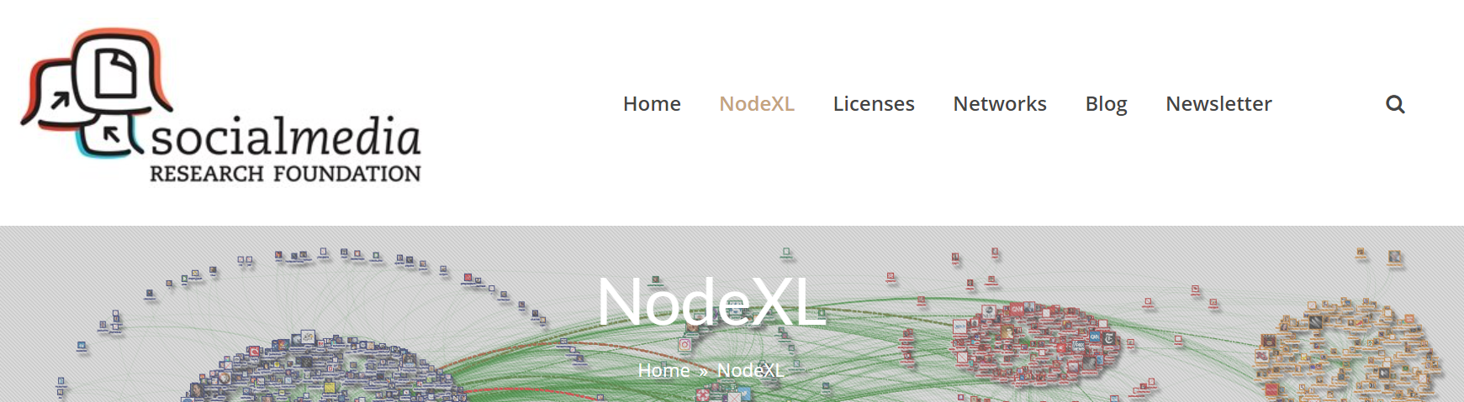
https://www.nodexlgraphgallery.org/Pages/Registration.aspx

Slide 6
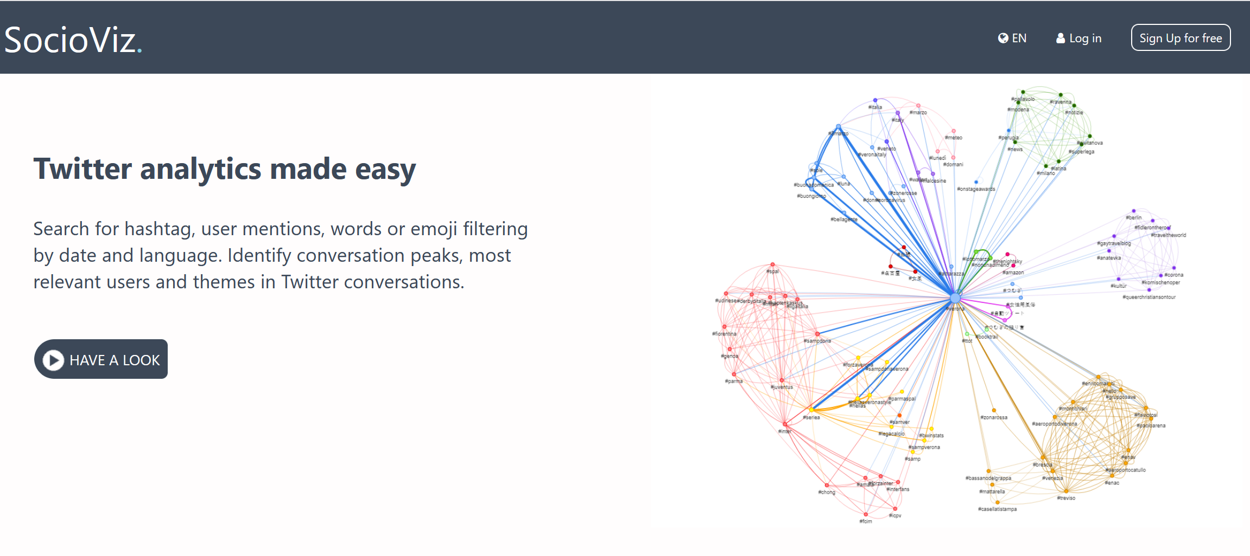
https://socioviz.net/home

Slide 7
Automated content analysis
Intro

Slide 8
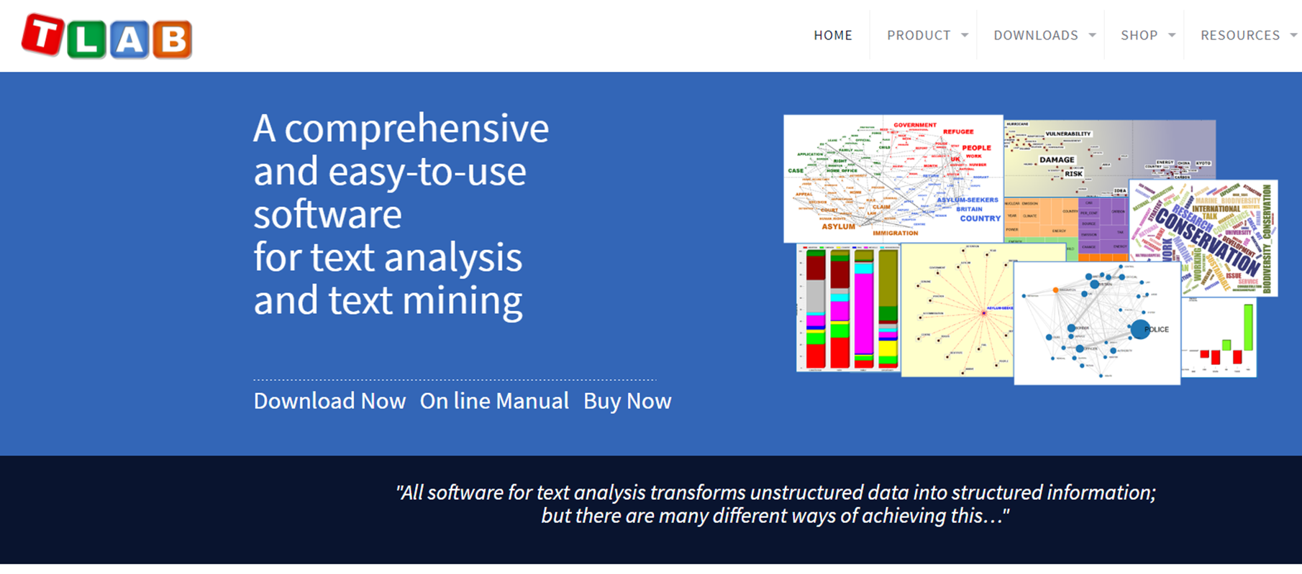
https://www.tlab.it/download/

Slide 9
Social network analysis
Intro

Slide 10
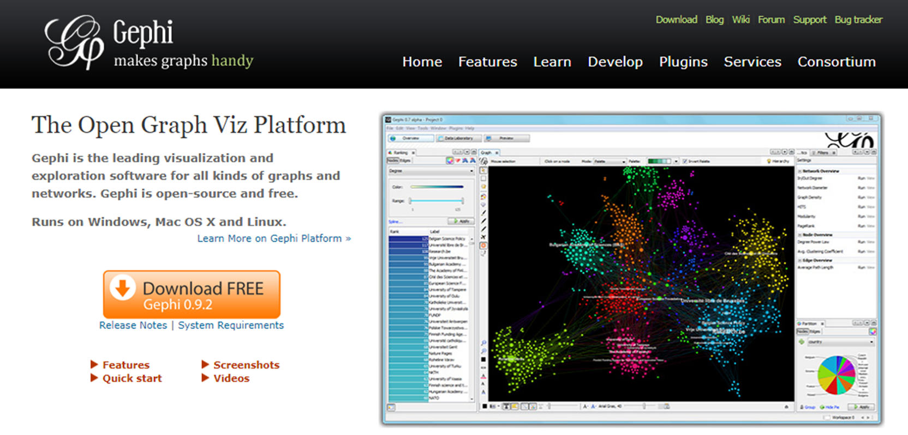
https://gephi.org/users/download/

Slide 11
Altri tools
Intro

Slide 12
#
https://all-hashtag.com/hashtag-generator.php
https://displaypurposes.com/

Slide 13
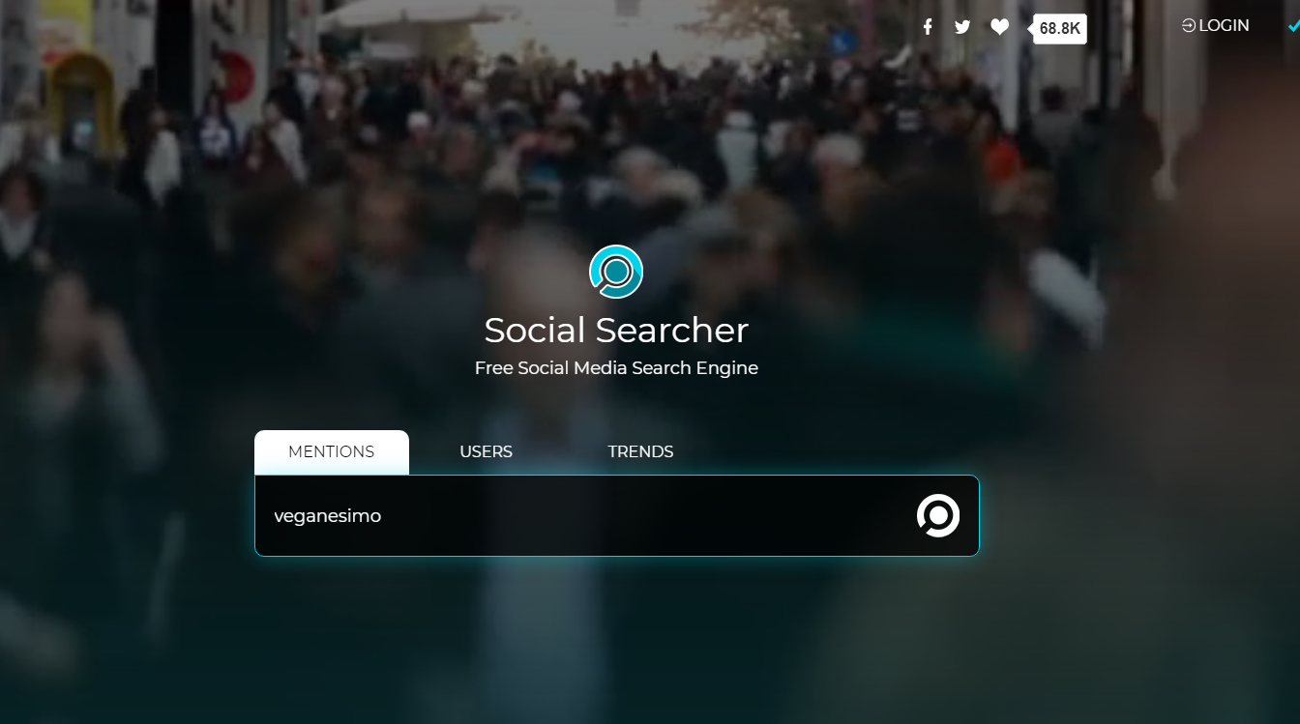
https://www.social-searcher.com/

Slide 14
DATASET
http://snap.stanford.edu/data/

