Slide 1
Inclusion Beyond the Conflict Perspectives on Inclusive Education in the East-Jerusalem Context
Arianna Taddei, Tommaso Santilli, Samah Halwany

Slide 2
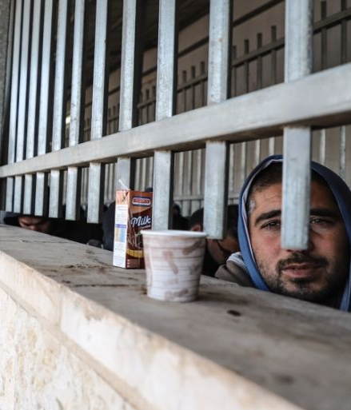
The border
EQUITY
BELONGING
INCLUSION
ALTERITY
OTHERNESS
EXCLUSION
Notes:
We would like to start our presentation with a reflection upon the concept of borders and the different meanings that can be associated with it. Borders can be barriers, thresholds, boundaries, strict limits or overcomable frontiers. They can operate distinctions to facilitate the organisation of reality, but they can also separate elements that would be closer than expected.
In other words, when questioning the meaning of borders, one might reflect upon their power to act as thresholds, margins that contain and possibly limit a specific dimension, dividing it from something to be deemed as extraneous from it, regardless of their possible conceptual, geographical or existential proximity. A border has the potential to produce alterity from equity, otherness from belonging, difference from similarity. If abstract and physical borders have always been part of the human experience, their implications and effects on economic, social and political life are ambiguous and complex.

Slide 3
Anthropological: original act that sabotages human innocence, creating territorial discontinuity (Rousseau, 1775).
Ontological: impassable limit to be pursuit for knowledge (Kant, 1798).
Sociological: existing only
as a suggestion to cross itself (Luhmann (1995).
Geographical: separates by putting into contact - puts into contact by separating (Zanini, 1997).
Political: to be controlled and protected for the sake of Modern States’ sovranity (Marturano, 2021)
Special Pedagogy:
facilitators and barriers to human functioning
(WHO, 2001)
Visible and invisible borders unfold resources for all people, beyond differences. Passages and paths: acknowledging boundaries, reflecting upon their meaning as walkable trajectories. Complementarity of borders and paths.
(Canevaro, 2005)
Notes:
We know for a fact that geographica borders carry social, cultural and political meanings that question the history of humankind. Many lens are offered by multiple disciplines to interpret borders.
ROUSSEAU: ANTRHOPOLOGICAL VIEW AS A POLITICAL STATEMENT - BORDER CREATES INEQUITY Discorso sull’origine e i fondamenti della disuguaglianza fra gli uomini (1755) - L’uguaglianza tra gli uomini si sfascia una volta tracciato un confine, poiché in virtù di esso viene immediatamente introdotto nello spazio comune l’istituto della proprietà privata.
KANT: ONTOLOGICAL VIEW - HUMAN LIMIT Kant, in "Anthropology from a pragmatic point of view" (1798) - "Criticism" in the Kantian sense is the establishment of lim- its, which our minds, our actions and our judgment of taste
in principle are unable to overcome.
LUHMANN, 1995: The Paradoxy of Observing Systems
ZANINI, 1997, Significati del confine. I limiti naturali, storici, mentali
MARTURANO, 2021: Marturano Graziella, “Sui confini della rotta balcanica: pratiche di soldiarietà ai migranti e
processi di criminalizzazione”, Mondi Migranti. Rivista di studi e ricerche sulle migrazioni internazionali, III quadrimestre, pp.43- 63, 2021.
These are only a few examples we can cite, regarding a topic that has its own research branch called “Border Studies”.. However, it is interesting how the concept of border permeates the world of pedagogy as well, especially our area of interest which is Special Pedagogy. In its interpretation, indeed, the border can be seen as a visible or invisible barrier that can obstacle human functioning in a specific context. Such a perspective derives from the International Classification of Functioning, Disability and Health (ICF) (WHO, 2001) and underlines a specific aspect that might bring together all the different perspectives on borders: borders can either habilitate or debilitate people, they can obstacle or promote inclusion, active participation, equality, Quality of Life. They have the power to determine the trajectories of our life paths, our opportunities for self determination, personal development, interpersonal relationships, right, material, physical or emotional wellbeing and so on.
Andrea Canevaro -> Concetto dei confini “visibili e invisibili” che distinguono chi cura e chi è curato, chi ha e chi non ha disabilità. L'educatore ha il compito di porre in essere un’osservazione attenta a questi confini: L’interpretazione di Canevaro interroga il valore di questi confini per il benessere di tutti, come esigenze che riguardano le persone oltre alle loro differenze. > “Quando ci troviamo di fronte a una situazione fortemente problematica, possiamo scoprire qualcosa di utile per quel singolo, in una prospettiva tale da rendere un servizio importante per tutti”
Per ogni confine dovrebbero esserci dei transiti. Esempio dell’inclusione nelle istituzioni scolastiche: l’eliminazione dei confini visibili portò comunque il residuo di quelli invisibili.
Da qui l’alleanza tra “confini” e “sentieri”, che segnalano simbolicamente il passaggio da un individuo all’altro, rispettando questi confini e collocando “nella riflessività queste dogane metaforiche”: abbattere tutti i confini a prescindere non è deterministicamente positivo. Il confine può non essere divisione o barriera, ma distinzione percorribile. Rischi della logica dei confini (chiudersi nella propria identità), e rischi della logica dei sentieri: invasioni involontarie, dato che sono segnalati attraverso forme simboliche: “Chi è abituato a percorrere sentieri, individua a istinto — ma un istinto coltivato, cresciuto, educato — il punto che permette di entrare in casa d’altri. Rispetta il sentiero e in questo modo rispetta il confine”
Combinare e bilanciare le logiche del confine e del sentiero perchè sono complementari, contrariamente a quanto si potrebbe pensare.
postura epistemologica: dialogo multidisciplinare
andare e tornare: riporto quell’incontro alla mia identità, ogni volta che vado lascio qualcosa
https://absborderlands.org/wp-content/uploads/2013/04/Introduction-to-Border-Studies-2.pdf

Slide 4
Intersectionality
Kimberlé Crenshaw’s definition of overlapping social identities and potential related discriminations and oppressions (1989).
Notes:
Cooper, Brittney (2016). "Intersectionality". In Disch, Lisa; Hawkesworth, Mary (eds.). The Oxford Handbook of Feminist Theory. Oxford University Press. pp. 385–406. doi:10.1093/oxfordhb/9780199328581.013.20. ISBN 978-0-19-932858-1.

Slide 5
Borders in Palestine
Internal and external conflicts within complex undemocratic contexts
Barriers to democracy: clientelism, corruption, politicisation of civic organisations, authoritarian and patriarchal culture. Security checkpoints, borders, underdeveloped infrastructure.
Barriers to inclusive education: lack of inclusive policies, insufficient disability services and support systems, lack of sufficient financial support, conservatism, inaccessible learning environment.
Challenges for inclusion, equality, safeguard of rights and democracy,
Notes:
SAMAH- Please do not hesitate to eliminate or condense it. I've inserted lengthy sentences to provide you with flexibility when creating the slide. After reading the previous slide, you can also sub-categorise the barriers as visible and non visible, to have the same continuity of the analysis.
Hashweh's (2002) study on teaching democracy in Palestine brings to light the significance of addressing both external and internal conflicts that arise in an environment that is largely undemocratic. It emphasizes that even though the educational system may reflect undemocratic contexts, educators still have a considerable amount of freedom to explore democratic practices. Taking into account the sensitivity of external political barriers, our intervention focuses on integrating international approaches to inclusion and human rights education while also considering best practices from Palestinian contexts. Additionally, Palestinian professors will emphasize the interplay between external and internal conflicts with their students in class to ensure a democratic and inclusive environment.
When it comes to external barriers to democracy in the West Bank, we encounter challenges such as clientelism, corruption, the politicization of civic organizations, distrust and discrimination, institutional obstacles, as well as an authoritarian and patriarchal culture. We must not forget about the complexity of cultural dynamics and the passive conception of the individual. Moreover, there are physical barriers like political and security checkpoints, borders, and underdeveloped infrastructure with narrow roads that make it impossible for individuals using wheelchairs to access certain areas.
Internal barriers to inclusion in higher education for Palestinian students with disabilities. As noted by Al-Masri, N., Aladini, A., & Alghoula, N. (2023), include a lack of inclusive policies, inadequate university policies, insufficient disability services and support systems, barriers in admission processes and financial support availability. Furthermore, conservatism within educational institutions and skepticism about teaching democracy in undemocratic contexts pose significant hurdles. Students also face challenges related to academics and pedagogical practices as well as assessment barriers. Inaccessible learning environments. For instance, transportation becomes burdensome for parents since institutions often rely on contracted drivers instead of providing their own means of transportation. Financial difficulties make it challenging for families to cover costs associated with transportation and other necessary services.
Internal barriers within the educational system also exist, as explained by the Palestianin Professor-Dr Said:
a) Integration challenges stem from a lack of essential resources such as physical therapy, occupational therapy, speech therapy, educational rehabilitation services, and psychological support. Unfortunately, parents often have to bear the costs of these additional services as they are not provided for free.
b) Lack of representation in decision-making is another issue. Individuals with disabilities often lack awareness or the ability to adequately represent their needs. Limited acceptance and inclusion in schools have historically been prevalent, with special resources like sign language interpretation generally being scarce.
c) Inadequate infrastructure and training pose further challenges. Many schools lack accessible buildings and classrooms, and teachers may not receive adequate training to handle diverse needs within large class sizes, including those of students with disabilities.
d) Insufficient specialized facilities are also a concern. There is a shortage of specialized schools or facilities for students with disabilities, such as those catering specifically to deaf individuals or students with complete blindness.
As a result of numerous socio-political barriers that impede democracy and inclusion, our objective is not to advocate for democracy solely from a standpoint of politics. Rather, we seek to employ it as a mechanism to safeguard the rights of marginalised groups and stimulate substantial transformations in educational methodologies. It is our conviction that the instruction of democracy can function as a means to affirm the rights of individuals who have been marginalised or oppressed and to magnify their voices. Our aim is to establish more equitable, participatory, and empowering learning environments by integrating democratic and inclusion principles into education, we seek to create more equitable, participatory, and empowering learning environments.
References:
Al-Masri, N., Aladini, A., & Alghoula, N. (2023). Accessible and Inclusive Higher Education for Palestinian Students with Disability: Policies and Practices Review. Cambridge Educational Research e-Journal, 10, 102-116.
A. Jamal, Amaney, (2009) Barriers to Democracy: The Other Side of Social Capital in Palestine and the Arab World. Princeton University Press.
Hasweh, M.Z (2002), Conflict and Democracy Education in Palestine, Mediterranean Journal of Educational Studies, Vol.7(1), pp.65-86,

Slide 6
Education in Emergency
For a long time, in the field of international cooperation, agencies provided interventions in humanitarian crisis contexts that were predominantly, if not exclusively, psychosocial and immediate assistance-based, through the distribution of goods and essential materials, excluding educational actions, which would be intended for development projects rather than emergency response.
Notes:
la tragedia della guerra non si ferma alla guerra oggettiva in assenza di educazione

Slide 7
Education in Emergency
In the context of cooperation in humanitarian crisis situations, therefore, the dimensions of emergency, education, and inclusion appeared incompatible in terms of priorities, goals, and sustainability, until international cooperation policies began to adopt an approach that recognizes education and inclusion as essential tools and dimensions for safeguarding children’s rights and their well-being (AICS & RIDS, 2015; EU, 2018).

Slide 8
The role of education
Promotion of Democratic Values
and Inclusion
Education
Means for Social Change
and Liberation
Notes:
Our pedagogical intervention is inspired by the philosophy of John Dewey and Paolo Frere: It combines both positions regarding the importance of education in fostering democracy as well as social change. Our intervention synthesizes Dewey's emphasis on education for democratic values and social continuity with Freire's critical pedagogy focused on empowering students to challenge oppression and transform their realities through dialogue, reflection, and action.
1- Education as a Tool for Democratic Values and Inclusion
John Dewey believed that education is crucial for social continuity and the transmission of cultural and democratic values. He argued that without the communication of ideals, hopes, and standards, social life could not be maintained. Dewey's philosophy suggests that education can be a tool to communicate democratic ideals and standards of inclusion among students. By equipping students with knowledge and skills for democratic participation, education can enlarge and enlighten their experiences, fostering a sense of community and social cohesion.
2- Education as a Tool for Social Change and Liberation
Conversely, Paulo Freire viewed education as a means of liberation from oppression and injustice. Through critical awareness, dialogue, reflection, and action, education empowers individuals to challenge and reshape their social and political realities. Freire's philosophy underscores the critical role of fostering critical thinking and active participation in the educational process, enabling students to become catalysts for change and social transformation. Freire emphasized the intrinsic link between education and power, asserting that all knowledge inherently embodies a notion of power.
Promoting Inclusion in Educational Settings
According to both Dewey's and Freire's perspectives, it is critical to encourage inclusion as a uniting process in educational contexts. Given the current situation in Jerusalem, where advancing standards, best practices, and rights to inclusion are urgently required to protect the rights of children with disabilities, our intervention seeks to address this important issue while also cultivating an ethical consciousness. Through our relationship with Al-Quds University professors, we are preparing future supporting teachers capable of creating democratic and inclusive learning environments.
References
Dewey, J. (1916). Democracy and Education. New York, NY: Macmillan. Link to source
Freire, P. (1970). Pedagogy of the Oppressed. New York, NY: Continuum, pp. 64-66.
Feinberg, S., & Torres, C. (2007). Democracy and Education: John Dewey and Paulo Freire. In Education and Society (3rd ed., pp. 53-69). James Nicolas Publisher Australia. Link to source
Al-Quds University. (n.d.). Embodying Accessibility. Link to source

Slide 9
Participatory Research
«Nothing about us without us»
Deeper insights
Empowerment processes
Increased social value
Community involvement
Scientific Knowledge
Notes:
Participatory research allows to create results that align with the needs and desires of the people whose life is at the center of the research topic. In participatory research, participants are not involved as research subjects, but as active participants. The extent to which participants are involved in participatory research depends on the research question of the academic researchers and could vary between participatory studies and study phases. However, prioritization of the research aim(s) and question(s) could also be based on the participants’ perspectives and input.
Some added values of participatory research include co-creating knowledge, increasing ownership among participants related to the education and inclusion problems and potential solutions, which in turn can promote social change within the community.
“Nulla su di noi senza di noi” (disability activism, 1990s): L’inclusione si realizza con le persone escluse, che spesso sono depositarie dei saperi e delle conoscenze appropriate per dare risposte rispettose dei loro diritti umani (Griffo, 2015). La Convenzione è esplicita (art. 4, comma 3): “Nell’elaborazione e nell’attuazione della legislazione e delle politiche da adottare per attuare la presente Convenzione, così come negli altri processi decisionali relativi a questioni concernenti le persone con disabilità, gli Stati Parti operano in stretta consultazione e coinvolgono attivamente le persone con disabilità, compresi i minori con disabilità, attraverso le loro organizzazioni rappresentative.”. In questo senso, l’approccio della ricerca partecipativa si configura come traiettoria di senso essenziale per l’attuazione di processi inclusivi, e, come dice Giampiero Griffo, è un metodo, un diritto e una responsabilità. https://rivistedigitali.erickson.it/integrazione-scolastica-sociale/en/visualizza/pdf/1050
una proposta educativa decontestualizzata non serve a niente - quell’intervento non si è radicato nel contesto, non è divenuto loro

Slide 10

The co-design project
Promoting inclusion as a unifying process for primary school children in fragmented communities of East Jerusalem. Spreading inclusive education principles and practices to be embraced and applied by primary school teachers.
Development of a training programme on inclusive education for primary school teachers. Collaboration with Al Quds University (Palestine).

Slide 11
Objectives
Overall objective: foster inclusion within educational environment for children in East Jerusalem
Specific objective: training of primary school teachers and educators in the adoption of inclusive approaches and active education practices in their daily work

Slide 12
Methods
Our research presents a case study (Thomas & Myers, 2015) of a co-design experience of inclusive solutions within University of Macerata involving students with and without disabilities.
We adopted a participatory approach (Cornwall & Jewkes, 1995) to design and develop inclusive strategies. Focus groups were held to identify related needs, perceived criticalities and opportunities.
Notes:
Case studies are analyses of persons, events, decisions, periods, projects, policies, institutions or other systems which are studied holistically by one or more methods. The case that is the subject of the inquiry will be an instance of a class of phenomena that provides an analytical frame – an object – within which the study is conducted and which the case illuminates and explicates. According to Thomas & Meyers’ definition of the case study methodology, we can distinguish two parts of the case study: (i) the subject of the study, which is the case itself; and (ii) the object, which is the analytical frame or theory through which the subject is viewed and which the subject explicates.
In this sense we have
SUBJECT OF THE STUDY: case of a co-design activity of teacher training modules (practical unit) (LOCAL KNOWLEDGE CASE)
OBJECT OF THE STUDY: participatory research (analytical, theoretical frame)
Heuristic case studies wherein new causal paths are identified. Outlier cases may be especially valuable here. (Eckstein, 1975) https://uk.sagepub.com/sites/default/files/upm-binaries/68705_Thomas_and_Myers___The_Anatomy_of_Case_Study,_chapter_5.pdf
Participatory research: What is participatory research? Cornwall & Jewkes - Research strategies which emphasize participation, raising personal, professional and political challenges which go beyond the bounds of the production of information.
Focus Group Methodology : Principle and Practice. (Liamputtong, 2011). Qualitative research method that brings together small groups to discuss a topic. Sharing of perceptions, opinions, beliefs, attitudes and insights.
choose a topic
define research hypotheses
determine questions
analyse data
Qualitative content analysis :Schreier M. (2012). Qualitative content analysis in practice. London: Sage

Slide 13
2 rounds
Participatory activity
Definition of key concepts
Design of training modules
Final training modules
Feedback from participants
Integration & redesign
Intercultural exchange for training efficacy
Notes:
This workflow illustrated our process specifically.
We identified and defined the key concepts and contents to be part of the teacher training programme on inclusive education. This operation involved a brainstorming between experts of special pedagogy within our research group in order to define which macro topics would be the core of our training programme
After the definition phase, initial drafts of the training modules were designed. Specifically, we designed 5 training modules on 5 macro topics. Each module would comprehend a powerpoint presentation with graphic elements, a voice recording illustrating it, a link to further explore the presented information through additional resources and an interactive activity
After the first draft, we worked with 3 researchers in education from the Al Quds University. Professores were encouraged to share their perceptions and opinions on the contents and outline of the training modules, identifying strengths, weaknesses, obstacles and information to be integrated in order for them to be applicable in their cultural context.
Feedback from participants was integrated in the training modules. A second round of exchange was held to make sure that the integration could work. Possible additional modifications were conducted in this phase. Feedback integration review meeting.
After the second round of feedback, the final training modules were successfully co-designed.

Slide 14
Results
Co-designed
Inclusive Education
Training Programme
Interpretational approaches to disability
Rights
Accessibility
Planning
Inclusive didactics perspectives
modularity and organicity
Notes:
As a result, a training programme on inclusive education composed of 5 training modules was designed and developed. You can see the five main topics that were chosen, that are Interpretational approaches to disability, rights, accessibility, planning, inclusive didactics perspectives.
History of disability: Elimination and Segregation, Insertion, Integration and Inclusion of students with disability in Italian schools. Highlight on the human rights connected to this transformation process.
Perspectives on Disability: overview of the evolution of the concept of disability. Medical model, Social model, Biopsychosocial model and ecological approach. ICF as a resource to understand the ecological approach. Human rights model. Highlight of the differences between models to develop a critical reflection upon their conceptual frameworks of origin.
Rights and Frameworks: UN Convention on the Rights of Persons with Disability as a guidance document: fundamental rights and critical reflection upon them, in connection with the 2030 Agenda Sustainable Development Goals. Concepts of dignity and individual autonomy, equality and non-discrimination, participation and inclusion, right to education, reasonable accommodation. Focus on international law concerning inclusion as a means through which awareness towards rights and quality of life can be carried out.
Understanding Accessibility: definition of accessibility, definition of usability and presentation of the role of the context as a means through which participation and inclusion is achieved. Distinction between physical, sensory and cultural accessibility.
Universal Design: Universal Design approach and Universal Design for Learning principles and conceptual framework. Focus on the ICF as a resource to understand the role of facilitators and barriers.
Planning as a fundamental resource to achieve inclusion paths tailored on the needs and specificities of each person, inside and outside the school. Focus on Quality of Life and rights to understand the value of planification.
Planning through space: collaboration network that involves school, families, caregivers, professionals and other stakeholders.
Planning through time: focus on the Life Project, planning the inclusion of young adults and their future perspectives, e.g. transition planning for life after school.
Inclusive Didactic Perspectives. Inclusive Education: Special Pedagogy definition, highlight of the differences between General Didactics, Inclusive Didactics and Special Didactics as educational approaches. Concepts of Individualisation and Personalisation as means through which achieving inclusion is possible and connected role of the educational context. Inclusive Tools: brief focus on didactic mediators as possible inclusive education tools. Focus on the different types of mediators and highlight of their potential.
The training programme was designed with a modular approach: that means that the order with which the modules are experienced can be personalised according to the specific needs of the learners. The modules also highlight connections between them, in order to foster a comprehensive view and bigger picture mindset in learners.

Slide 15




Presentation with key information
Voice recording for illustration
Additional resources
Practical
activity
Notes:
So here you can see all the material that was prepared for each training module.
In order to provide multiple means for teaching and learning the content, we provided four main educational paths.
Each module would consist in a Powerpoint presentation combining textual information with key concepts and graphical elements or images in order to channel information also through visual mediators
Each module would include a voice recording illustrating the topic with more detail. In this sense, a simple speaking style was adopted in order to facilitate comprehension for people who would not be familiar with the teams the module deals with, still retaining precise information and terminology where needed. We would like to underline that these choices specifically saw the fundamental participation of Al Quds University representatives.
Each module was integrated with additional resources through links in order to provide opportunities for deeper analysis and work. The resources were chosen on the basis of shared consensus among researchers (Italians and Palestinian)
Each module would include the proposal of a practical activity titled “Your Turn”.. Such proposal would challenge learners in applying the concepts highlighted in the module and put them into practice through experiential tasks.

Slide 16
First draft
Feedback
Definition of accessibility
Definition of usability
Types of accessibility
International regulations
Universal Design
Universal Design for Learning
ICF, barriers and facilitators
Activity
Explain the multiple dimensions of accessibility
Illustrate accessibility in the Palestinian Context
Present the elements that can hinder or enable its processes
Notes:
We would like to show you an example of the co-design process regarding Module 3, which is about accessibility.
The scheme on the left presents the outline of the module draft, and on the right you can see the suggestions emerging from the focus group.
Lastly, you can see the solutions that were implemented in order to accommodate the requests.
We would like to specify that a general result was the integration of a “Palestinian Context” section for each module, reporting information on the Palestinian perspective on the specific topic of the module.

Slide 17
Feedback
Co-designed solutions
Explain the multiple dimensions of accessibility
Illustrate accessibility in the Palestinian Context
Present the elements that can hinder or enable its processes
Practical examples of accessibility in everyday life
“Palestinian Context” section
Resources on emergency measures to accommodate accessibility needs in Palestine
Notes:
Lastly, you can see the solutions that were implemented in order to accommodate the requests.
Firstly, we deepened the topic of accessibility by providing further examples on its dimensions and features. We did not sufficiently consider the starting level of teachers in the Palestinian context and we tried to provide further information to ensure the comprehensibility of the module’s topics
Secondly, we added a Palestinian Context section. We extended this choice to all modules, as we collectively realised that providing a declination of the presented topics in the social and cultural context of reference of learners would have represented an enrichment to the training programme. So this solution was a general one.
Thirdly, we added additional resources on emergency measures to accommodate accessibility needs in Palestine. Specifically, we provided resources on iron gates, checkpoints and other accessibility issues that learners could explore if interested. Again, we chose to extend this solution to all modules, allowing for additional resources with reference to each topic.
We would like to specify that a general result was the integration of a “Palestinian Context” section for each module, reporting information on the Palestinian perspective on the specific topic of the module.

Slide 18
Co-design outcomes
Intercultural dialogue and negotiation, to be channeled through co-design activities, are essential to orient processes that foster inclusion beyond context-specific differences
Reaching a shared vocabulary and planning joint actions is a fundamental trajectory for empowerment and democracy in conflict-affected areas
Teacher education can be a valuable tool for progress and societal transformation when informed with inclusion principles
Notes:
Alongside the outputs of our research, which consists of the final training programme soon to be delivered at the Al Quds University, we wanted to highlight three main outcomes of our research experience, as follows

Slide 19
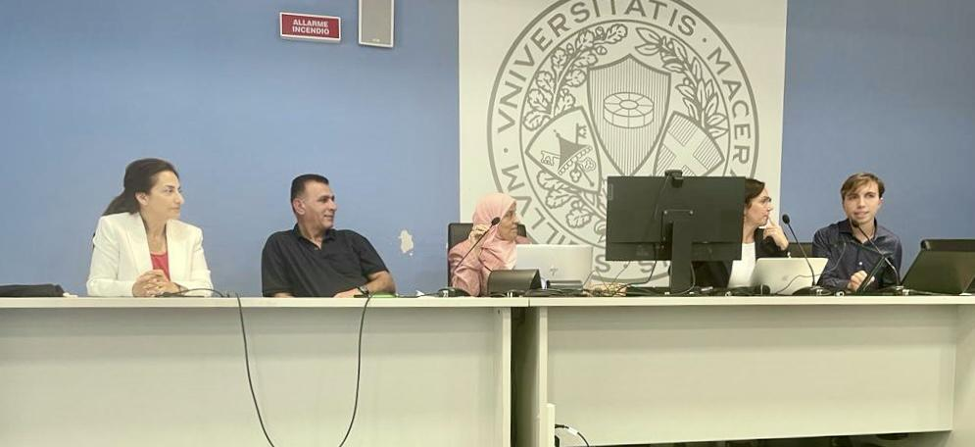
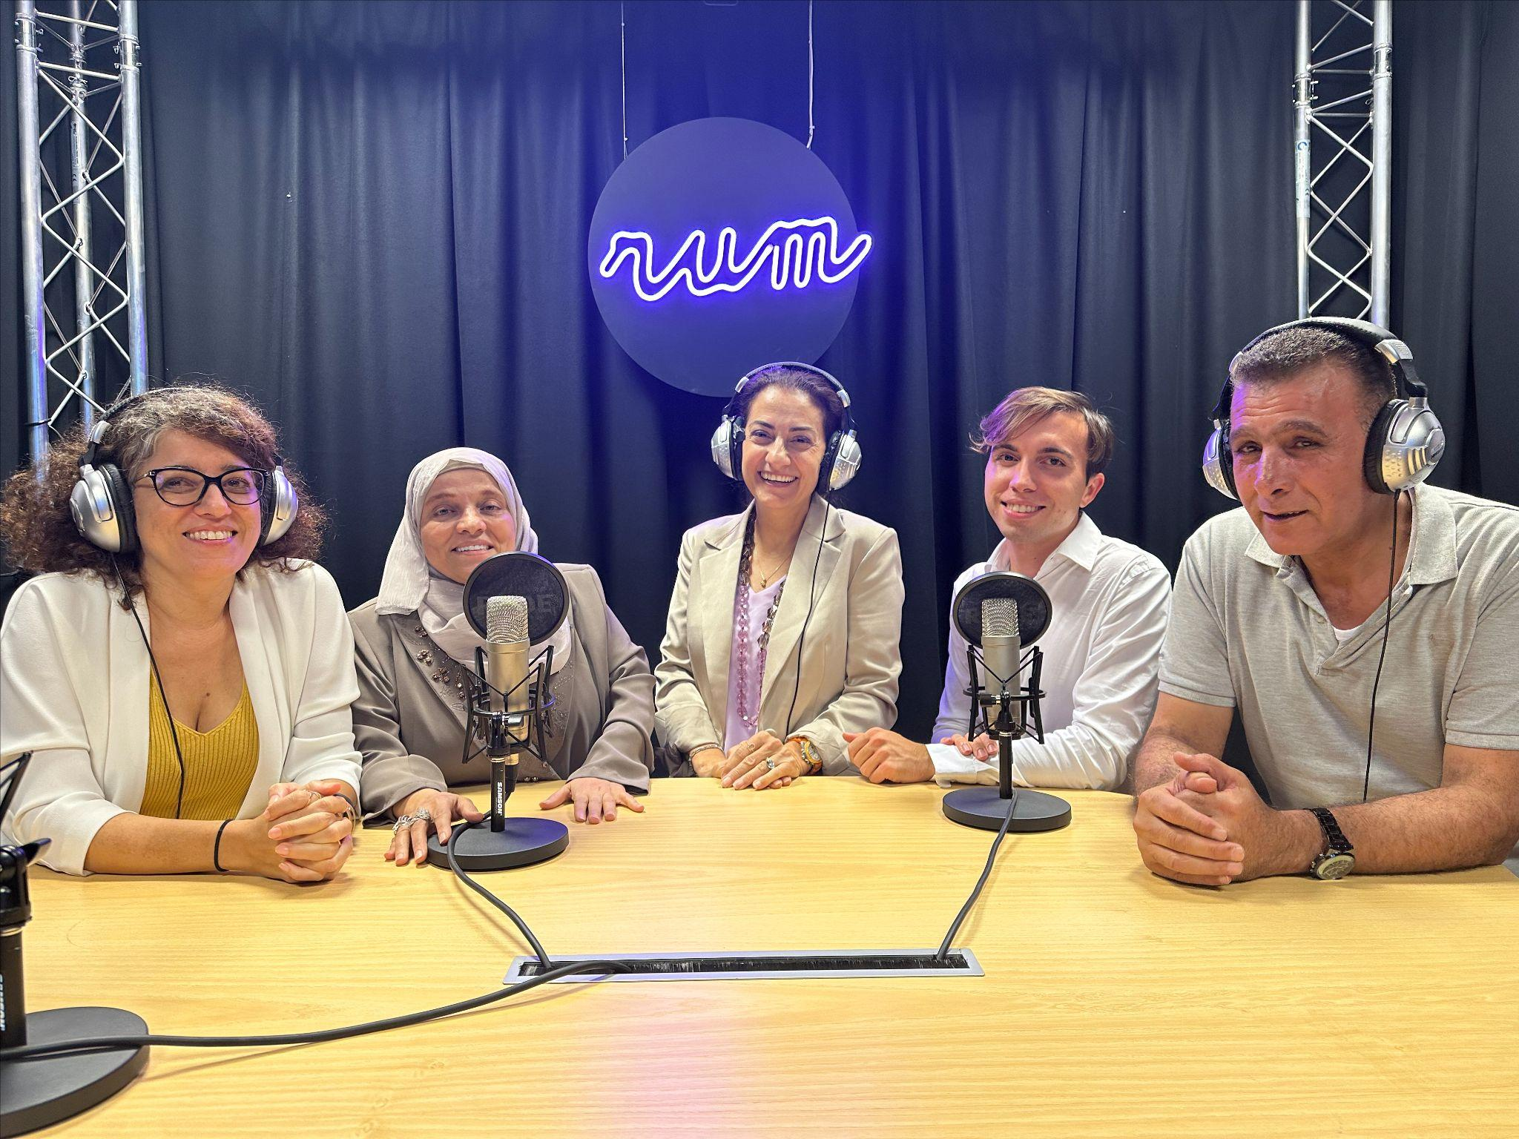
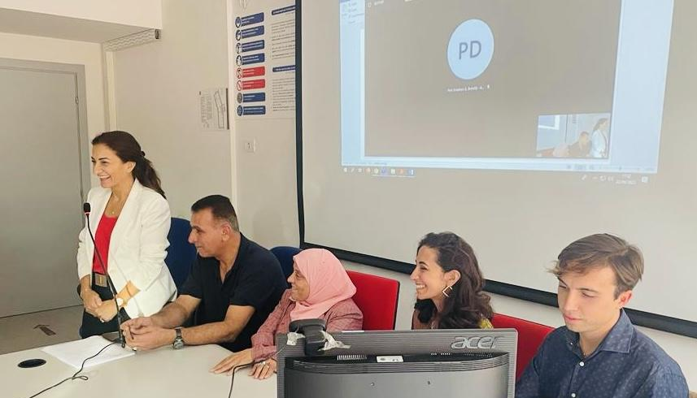
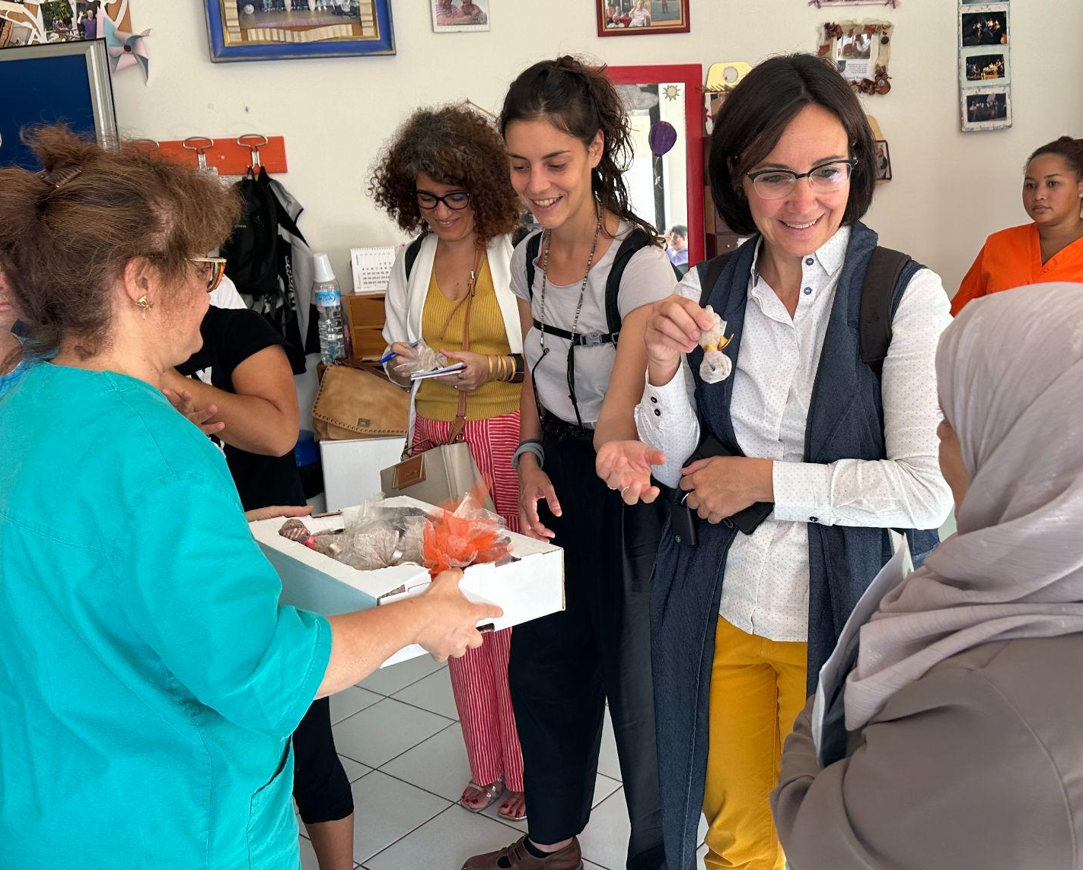
Research visit
Notes:
The co-design activity took place in presence at the Department of Education, Cultural Heritage and Tourism of University of Macerata. Here are some pictures from the visit of Al Quds University Professor. Within the participatory research, we took the occasion to host two international seminars on the topic of inclusive education in Palestine as dissemination activities.

Slide 20
Conclusions
Frameworks belonging to Special Pedagogy can initiate virtuous processes for the achievement of democracy and respect of basic human rights in conflict-affected areas.
Further participatory research should expand qualitative analyses in order to develop interculturally valid frameworks of action within conflict-affected areas for quality and equitable education, beyond borders of any nature.
Notes:
In concussion, this experience allowed us to understand how the achievement of democracy can be supported by programmes in Inclusive Education. Indeed, education still represents a key driver for social change and, when provided equally and inclusively, it can contribute to the creation of fairer societies. The cultural exchange at the basis of this experience highlights how reaching shared meanings and definition is an enrichment for all stakeholders, providing useful perspectives on concepts that might are taken for granted and renewing the commitment to significant trajectories and valuable principles also through research experiences.

Slide 21
Key references
Al-Masri, N., Aladini, A., & Alghoula, N. (2023). Accessible and Inclusive Higher Education for Palestinian Students with Disability: Policies and Practices Review. Cambridge Educational Research e-Journal, 10, 102-116.
Amaney, A.J. (2009) Barriers to Democracy: The Other Side of Social Capital in Palestine and the Arab World. Princeton University Press.
Al-Quds University. (n.d.). Embodying Accessibility. Link to source
Canevaro, A. (2006). Le logiche del confine e del sentiero: una pedagogia dell'inclusione, per tutti, disabibli inclusi. Trento: Edizioni Erickson.
Dewey, J. (1916). Democracy and Education. New York, NY: Macmillan.
Freire, P. (1970). Pedagogy of the Oppressed. New York, NY: Continuum, pp. 64-66.
Feinberg, S., & Torres, C. (2007). Democracy and Education: John Dewey and Paulo Freire. In Education and Society (3rd ed., pp. 53-69). James Nicolas Publisher Australia.
Hasweh, M.Z (2002), Conflict and Democracy Education in Palestine, Mediterranean Journal of Educational Studies, Vol.7(1), pp.65-86,
Inter-agency Network for Education in Emergencies (INEE) (2018). INEE Strategic Framework 2018-2023. New York: INEE. https://inee.org/resources/ineestrategic-framework-2018-2023.
Kant, I. (1996). Anthropology from a Pragmatic Point of View. Translated by Victor Lyle Dowdell. Southern Illinois University Press.
Luhmann, N. (1995). The Paradoxy of Observing Systems. Cultural Critique, 31, pp. 37–55.
Marturano, G, (2021). “Sui confini della rotta balcanica: pratiche di soldiarietà ai migranti e processi di criminalizzazione”, Mondi Migranti. Rivista di studi e ricerche sulle migrazioni internazionali, III quadrimestre, pp.43- 63.
Rousseau, J.J. (1992). Discourse on the Origin of Inequality. Indianapolis, Indiana.
Shah, R., Paulson, J., & Couch, D. (2020). The Rise of Resilience in Education in Emergencies. Journal of Intervention and Statebuilding, 14(3), pp. 303-326.
Taddei, A. (2010). Educational models and concept of childhood in the Gaza Strip. Ricerche di Pedagogia E Didattica. Journal of Theories and Research in Education, 5(2).
Taddei, A. (2021). Inclusive Education in Emergencies: sfide e prospettive. Didattica speciale e trasformazioni organizzative. Ricerche in corso, 2.
Taddei, A., & Pacetti, E. (2018). Rafforzare le comunità educative in contesti vulnerabili: un Index for Inclusion and Empowerment in Palestina. In C. Giaconi & N. Del Bianco (a cura di). In azione. Prove di Inclusione. Milano: FrancoAngeli.
UNESCO (2020). Global Education Monitoring Report, 2020: Inclusion and Edu-cation: All Means All. United Nations Educational, Scientific and Cultural Organization (UNESCO). https://unesdoc.unesco.org/ark:/48223/pf0000373718.
United Nations (2006). Convention on The Rights of Persons with Disabilities. UN, New York.
World Health Organization. (‎2001)‎. International classification of functioning, disability and health: ICF. Geneva: World Health Organization.
Zanini, P. (1997). I significati del confine. Limiti naturali, storici, mentali, Milano: Mondadori.

Slide 22
Thank you for your attention!
Get in touch with us:
arianna.taddei@unimc.it
t.santilli1@unimc.it
s.halwany@unimc.it

