Slide 1

THE PRINCIPLES OF EU ADMINISTRATIVE LAW

Slide 2

EU ADMINISTRATIVE LAW AND THE RULE OF LAW
Development of Administrative Law
Administrative law in Europe began to develop as early as the 18th century
Initially, it developed without democracy and the rule of law
(the so-called police state – Polizeistaat)
Today, administrative law is inseparable from:
  democracy
  the principle of the rule of law
  The rule of law has a crucial influence on administrative law

Slide 3

EU ADMINISTRATIVE LAW AND THE RULE OF LAW
The Rule of Law in the European Human Rights System
The rule of law is established in:
  the 1948 Universal Declaration of Human Rights
  the texts of the Council of Europe
  (1949 Statute, 1950 ECHR)
Different languages use different terms:
  Rule of law, État de droit, Rechtsstaat, Estado de Derecho
👉 It is considered a common heritage of European states.

Slide 4
EU ADMINISTRATIVE LAW AND THE RULE OF LAW
The Contribution of the ECtHR
Lawless (1961) – first judgment on the merits:
  right to liberty and security (Article 5 ECHR)
  right to a fair trial (Article 6 ECHR)
Golder (1975) – first explicit reference to the rule of law
👉 The ECtHR:
  does not provide a single, full-scale definition, but
  develops the concept gradually through case-law

Slide 5
EU ADMINISTRATIVE LAW AND THE RULE OF LAW
Key Elements of the Rule of Law (ECtHR Case-law):
Right of access to a court
Judicial review of decisions of public authorities
Right to a fair trial
Principle of legality
  publicity of laws
  non-retroactivity of criminal law
Separation of powers
Prohibition of discrimination
👉 Particularly important: judicial review of administrative acts

Slide 6
EU ADMINISTRATIVE LAW AND THE RULE OF LAW
Importance for the European Union
All EU Member States are parties to the ECHR
The EU is also expected to accede to the ECHR
This ensures:
  common standards
  effective protection of human rights and the rule of law

Slide 7
EU ADMINISTRATIVE LAW AND THE RULE OF LAW
Venice Commission Report (2011)
Widely used by:
  the CJEU and the ECtHR
  EU legislation
  academic scholarship
Identifies a consensus on the core elements of the rule of law

Slide 8
EU ADMINISTRATIVE LAW AND THE RULE OF LAW
The Rule of Law in EU Law
EU membership is linked to:
  democracy
  respect for the rule of law
Since 2003 (Steffensen case):
  the CJEU has relied on ECtHR case-law
Treaty of Lisbon (2009):
  the Charter of Fundamental Rights became legally binding
  increased references to ECtHR jurisprudence

Slide 9
EU ADMINISTRATIVE LAW AND THE RULE OF LAW
The Rule of Law as an EU Value Explicitly enshrined in:
  Article 2 TEU
  the Charter of Fundamental Rights of the EU
An official definition is provided in:
Regulation (EU, Euratom) 2020/2092 of the European Parliament and of the Council of 16 December 2020 on a general regime of conditionality for the protection of the Union budget
Article 2(a) – Definition of the Rule of Law

Slide 10
EU ADMINISTRATIVE LAW AND THE RULE OF LAW
The EU Definition of the Rule of Law (Simplified)
The rule of law means that:
public authorities act within the limits of the law
laws are adopted through transparent and democratic procedures
arbitrariness of public power is prohibited
independent and impartial courts exist
access to justice is guaranteed
separation of powers
be respected

Slide 11
EU ADMINISTRATIVE LAW AND THE RULE OF LAW
Elements Identified by the Venice Commission
Legality
Legal certainty
Prohibition of arbitrariness
Access to justice
Judicial review of administrative acts
Respect for human rights
Equality before the law
👉 Administrative law is a core component of the rule of law

Slide 12
EU ADMINISTRATIVE LAW AND THE RULE OF LAW
The Rule of Law and The Right to Good Administration
Article 41 of the EU Charter
Council of Europe Recommendation (2007) Includes:
  the duty to give reasons for decisions
  the right to be heard
  impartial and fair administrative decision-making
👉 Good administration is an integral part of the rule of law

Slide 13
EU ADMINISTRATIVE LAW AND THE RULE OF LAW
Question 1
Why is judicial review of administrative acts so important?
Answer:
It protects individuals against arbitrariness and ensures that public administration acts in accordance with the law.

Slide 14
EU ADMINISTRATIVE LAW AND THE RULE OF LAW
Question 2
Is the rule of law only a formal system of compliance with rules?
Answer:
No. It also includes substantive elements, such as human rights, justice, and equality.

Slide 15
EU ADMINISTRATIVE LAW AND THE RULE OF LAW
Question 3
Why is ECtHR case-law important for EU law?
Answer:
It helps interpret fundamental rights and ensures common standards of protection across Europe.

Slide 16
EU ADMINISTRATIVE LAW AND THE RULE OF LAW
Question 4
Can the right to good administration be considered a subjective right?
Answer:
Yes. In EU law, it is explicitly recognised as an individual right.

Slide 17

LEGALITY (THE PRINCIPLE OF LEGALITY)
What Is the Principle of Legality?
There is no single official definition:
  neither in EU primary or secondary law
  nor in the case-law of the CJEU or the ECtHR
The principle of legality is understood through:
  the concept of the rule of law
  judicial practice
  legal doctrine (especially Venice Commission reports)
👉 It is a fundamental, but not precisely defined, principle.

Slide 18

LEGALITY (THE PRINCIPLE OF LEGALITY)
Legality According to the Venice Commission means:
  a transparent
  accountable
  democratic law-making process
Core idea:
  the law must be respected and followed
👉 This obligation applies to:
private individuals
public authorities

Slide 19
LEGALITY (THE PRINCIPLE OF LEGALITY)
Legality and Public Authorities
The principle of legality requires that public authorities:
must act only with authority
must act within the limits of its competence
In EU law this means:
EU legislative and regulatory acts must have a legal basis
individual administrative decisions must also be based on law
👉 No legal basis = no lawful decision. What does it means?
This means that public authorities' actions and decisions must be justified and coordinated with higher-level legal regulation

Slide 20
LEGALITY (THE PRINCIPLE OF LEGALITY)
Legality and Accountability
The Venice Commission emphasises that:
no one may be punished without a previously adopted legal rule
the law must not be violated without consequences
In EU law this is reflected in:
Article 265 TFEU – complaint for failure to act (EU institutions)
Violation procedures against Member States
(Articles 258–260 TFEU)
👉The law must not only be adopted, but also enforced

Slide 21
LEGALITY (THE PRINCIPLE OF LEGALITY)
“Law” and the Principle of Legality
The term law / loi / Gesetz causes debate in EU law
The EU Charter frequently uses:
  “laid down by law”
Article 52 of the Charter:
  limitations of fundamental rights are allowed only if “provided for by law”
👉 Key question:
Does “law” mean only an act of parliament?
Answer:
No, because the „law“ is understood in a broad sense, this term also includes accompanying acts adopted by public administration entities (government, ministry, department, etc.)

Slide 22
LEGALITY (THE PRINCIPLE OF LEGALITY)
The CJEU’s Approach: Who May Limit Rights?
Case C-355/10 (EP v Council):
  serious restrictions on fundamental rights
  require the involvement of the EU legislators
Case C-363/14 (EP v Council):
  not all limitations must be adopted by legislative acts
  less serious limitations may be adopted by non-legislative acts

Slide 23
LEGALITY (THE PRINCIPLE OF LEGALITY)
The ECtHR’s Approach: “Prescribed by Law”
Sunday Times v United Kingdom (1979) “law” includes:
    written law
    unwritten law (case-law)
Requirements for a legal norm:
  Accessibility – the person must be able to know the law
  Predictability - a person can predict the consequences
👉 Absolute precision is not required, but arbitrariness is prohibited

Slide 24
LEGALITY (THE PRINCIPLE OF LEGALITY)
The Charter and ECtHR Standards
Article 52(3) of the Charter:
  Charter rights corresponding to ECHR rights have the same meaning and scope
However:
  EU law may provide more greater protection
Possible development:
  the CJEU may require that rights be limited only by legislative acts
👉 Soft law can never restrict fundamental rights

Slide 25
LEGALITY (THE PRINCIPLE OF LEGALITY)
Legality and Soft Law
In EU law:
  directives must be transfer through obligatory legal acts
It is not allowed to transfer directives through:
  guidelines
  circulars
  recommendations
👉 Soft law:
has no obligatory force
cannot impose obligations or restrictions

Slide 26
LEGALITY (THE PRINCIPLE OF LEGALITY)
Question 1
Why can public authorities not act without a legal basis?
Answer:
Because this would allow arbitrariness and ensure the protection of individual rights and democratic governance.

Slide 27
LEGALITY (THE PRINCIPLE OF LEGALITY)
Question 2
Must all limitations of fundamental rights be laid down by law?
Answer:
Not always. According to CJEU case-law, serious limitations require legislative acts, while less serious ones may be adopted through non-legislative acts.

Slide 28
LEGALITY (THE PRINCIPLE OF LEGALITY)
Question 3
What is the difference between the CJEU’s and the ECtHR’s understanding of “law”?
Answer:
The ECtHR interprets “law” broadly (including unwritten law), while the CJEU leaves the issue open and may apply stricter standards. For instant, CJEU may require that rights be limited only by legislative

Slide 29
LEGALITY (THE PRINCIPLE OF LEGALITY)
Question 4
Why can soft law not limit fundamental rights?
Answer:
Because it is not legally binding and does not meet the requirements of legality and legal certainty.

Slide 30

LEGALITY (LEGAL CERTAINTY )
What Is Legal Certainty?
Legal certainty means that:
  legal rules are clear and precise
  the law is predictable
Individuals must be able to:
  understand their rights and obligations
  plan their behaviour accordingly
👉 The law should not come as a surprise.

Slide 31

LEGALITY (LEGAL CERTAINTY )
Legal Certainty in EU Law
EU legal acts must be:
  understandable
  consistent
Retroactive effect is prohibited:
  legal acts should not normally apply to the past
  exceptions are allowed only in legally justified cases

Slide 32
LEGALITY (LEGAL CERTAINTY )
Case-law of the CJEU
Duff (C-63/93):
  legal rules must be clear and precise
Legal certainty gives rise to:
  the principle of non-retroactivity
  the protection of legitimate expectations
👉 Public authorities may not suddenly change the “rules of the game

Slide 33

LEGALITY (ACCESS TO JUSTICE AND JUDICIAL REVIEW)
Right of Access to a Court
Everyone has the right to appeal to an independent and impartial court
This includes:
  judicial review of administrative acts
  the right to good administration
👉 Without judicial review, there is no rule of law.

Slide 34

LEGALITY (ACCESS TO JUSTICE AND JUDICIAL REVIEW)
The EU as a Community Based on Law
From the very beginning (since 1950):
  the EU has been based on judicial review
Article 19 TEU:
  the CJEU ensures that the law is observed
  Member States must ensure effective judicial protection

Slide 35
LEGALITY (ACCESS TO JUSTICE AND JUDICIAL REVIEW)
Judicial Independence
Case C-64/16 (Portuguese Judges):
  judicial independence is a legal requirement
It is essential for:
  the rule of law
  the effectiveness of EU law
👉Regarding judicial reforms:
• violation procedures have been initiated against some Member States

Slide 36
LEGALITY (ACCESS TO JUSTICE AND JUDICIAL REVIEW)
Article 47 of the Charter
Everyone has the right to:
  an effective judicial protection
  a fair and public trial
  legal assistance, if necessary
👉 Access to justice must be practical and effective, not theoretical

Slide 37
LEGALITY (ACCESS TO JUSTICE AND JUDICIAL REVIEW)
Long-standing CJEU Case-law
Since Nold and Heylens:
  individuals must enjoy effective judicial protection
Inuit Tapiriit Kanatami:
  Member States are not required to create new judicial protection
  but they must not leave individuals without real judicial protection

Slide 38

LEGALITY (RESPECT FOR HUMAN RIGHTS)
Human Rights and the Rule of Law
Are human rights the same as the rule of law?
No. Respect for human rights is not identical to the rule of law, However the rule of law includes respect for fundamental right.

Slide 39

LEGALITY (RESPECT FOR HUMAN RIGHTS)
Which Human Rights Are Relevant?
Not only access to justice
Also:???
  freedom of expression
  the right to criticise public authorities
Sources:
  EU Charter of Fundamental Rights
  European Convention on Human Rights
  general principles of EU law
👉 Public administration must respect fundamental rights.

Slide 40

LEGALITY (NON-DISCRIMINATION AND
EQUALITY BEFORE THE LAW)
Equality before the Law
All persons are:
  equal before the law
Discrimination:
  is prohibited
👉 Public authorities may not treat persons differently without objective justification.

Slide 41

LEGALITY (NON-DISCRIMINATION AND
EQUALITY BEFORE THE LAW)
Title III of the Charter
It covers:
equality before the law
prohibition of discrimination
equality between women and men
rights of the child
rights of the elderly
integration of persons with disabilities
👉 These rights are particularly relevant in administrative law.

Slide 42
LEGALITY (NON-DISCRIMINATION AND
EQUALITY BEFORE THE LAW)
EU Treaties and Non-Discrimination
Article 18 TFEU:
  prohibition of discrimination on grounds of nationality
Article 21 of the Charter:
  prohibition of discrimination based on:
    sex
    racial or ethnic origin
    religion or belief
    age
    Disability
    sexual orientation

Slide 43

LEGALITY
Discussion Questions for Students
Question 1
Why is legal certainty important for individuals?
Answer:
Because it allows individuals to understand their rights and obligations and to plan their behaviour.

Slide 44

LEGALITY
Question 2
Why is judicial independence essential in EU law?
Answer:
Because without independent courts, EU law cannot be applied effectively.

Slide 45
LEGALITY
Question 3
Does the rule of law always mean full protection of human rights?
Answer:
Not necessarily, but in EU law the two are closely connected.

Slide 46
LEGALITY
Question 4
Why is non-discrimination particularly important in administrative law?
Answer:
Because administrative authorities take daily decisions that directly affect individuals’ rights

Slide 47

PROPORTIONALITY
THE PRINCIPLE OF PROPORTIONALITY: WHAT IS IT?
It is a legal principle requiring that measures adopted by the State or EU institutions:
are not excessive,
are suitable for achieving the intended objective,
restrict individual rights as little as possible.
Where is it applied?
EU law
National law
Case-law of courts

Slide 48

PROPORTIONALITY
THE ORIGIN OF PROPORTIONALITY: GERMAN LAW
Historical origin
The principle of proportionality originates from German constitutional law
The Court of Justice of the European Union (CJEU) adopted it already in:
  the 1950s–1960s
Example: Internationale Handelsgesellschaft
Why is it important?
It is one of the most often applied principles in EU law

Slide 49

PROPORTIONALITY
THE GERMAN PROPORTIONALITY TEST (3 STEPS)
1. SUITABILITY (Geeignetheit)
Can the measure help to achieve the objective?
Full achievement of the objective is not required
Assessment is made ex ante (in advance)
2. NECESSITY (Erforderlichkeit)
Is there a less restrictive, milder measure available?
If several effective measures exist → choose the least restrictive one
3. PROPORTIONALITY IN THE STRICT SENSE
Does the benefit for society justify the harm to individual rights?
The essential core of fundamental rights must not be undermined

Slide 50
PROPORTIONALITY
PROPORTIONALITY IN CJEU CASE-LAW
Main difference from Germany
The CJEU does not always explicitly separate the three steps
CJEU judgments are often:
shorter
more result-oriented
Why?
The CJEU:
works with 27 national legal systems
deals with a large number of cases
seeks to protect the overall EU interest

Slide 51
PROPORTIONALITY
OBJECTIVE AND SUBJECTIVE APPROACHES
EU COURTS’ APPROACH
Objective
All interests are assessed:
  State interests
  Public interests
  Market interests
Similar to a cost–benefit balance
GERMAN COURTS’ APPROACH
Subjective
Focus on:
  how seriously the rights of the individual applicant are affected

Slide 52
PROPORTIONALITY
WHEN DOES THE CJEU APPLY A STRICTER TEST?
Stricter review applies when:
Fundamental freedoms are restricted (e.g. free movement, services)
Fundamental rights are restricted (e.g. data protection)
Known cases:
Digital Rights Ireland
Schecke and Eifert
➡️ In such cases, proportionality is examined very strictly

Slide 53
PROPORTIONALITY
PROPORTIONALITY AND MEMBER STATES
Member States must respect proportionality when they:
implement EU law
apply EU law
restrict EU freedoms
Three main situations:
Restrictions on EU freedoms or rights
Violations of EU competition rules
National law implementing EU law
➡️ This led to a “spill-over effect” – proportionality is applied even in non-EU cases

Slide 54
PROPORTIONALITY
THE IMPORTANCE OF PROCEDURE
Differences depending on the type of case
🔹 Violation procedure (Article 258 TFEU)
The CJEU itself assesses proportionality
🔹 Preliminary ruling (Article 267 TFEU)
The CJEU provides criteria
The national court makes the final assessment

Slide 55
PROPORTIONALITY
THE WEISS CASE AND NEW DEBATES
The Weiss case (PSPP)
Conflict between:
  the CJEU
  the German Federal Constitutional Court
Key question:
Do courts overstep their limits when reviewing political decisions?
Core of the debate:
Role of courts
Separation of powers
Democratic legitimacy

Slide 56
PROPORTIONALITY
CONCLUSION
The principle of proportionality originates from German law
The CJEU adapted it to EU-specific needs
The EU model is:
  more flexible
  more focused on balancing interests
It is one of the most important principles of modern public law

Slide 57
PROPORTIONALITY
DISCUSSION QUESTIONS AND ANSWERS
1. Why is the principle of proportionality so important in EU law?
Answer:
Because it allows a balance between the public interest and individual rights and limits the discretion of public authorities.

Slide 58
PROPORTIONALITY
2. Does the CJEU apply a weaker proportionality review than German courts?
Answer:
No – not weaker, but different: more oriented towards an overall balance of interests.

Slide 59
PROPORTIONALITY
3. Why is the test stricter in fundamental rights cases?
Answer:
Because fundamental rights form the core of EU law and any limitation requires particularly strong justification.

Slide 60
PROPORTIONALITY
4. Can the principle of proportionality pose a risk to democracy?
Answer:
Yes, if courts interfere excessively with political decisions – as illustrated by the Weiss case.

Slide 61
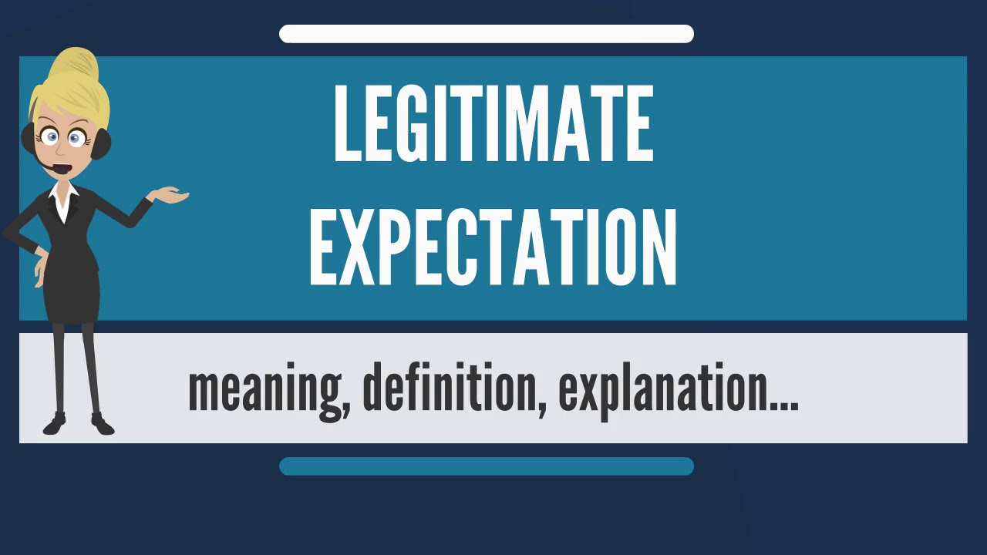
PROTECTION OF LEGITIMATE EXPECTATIONS
What are „legitimate expectations”?
A principle where individuals or companies can expect that public administration decisions will be stable and reliable.
Inspired by German administrative law principle: Vertrauensschutz (protection of trust).
Key points:
  Linked to legal certainty and stability of the legal order.
  Can limit public authorities’ powers.
Discussion question:
Why should the rule of law protect people’s expectations?
Answer:
To ensure trust, stability, and predictability in public administration.

Slide 62

PROTECTION OF LEGITIMATE EXPECTATIONS
Legitimate expectations in EU law
EU law largely follows the German model.
Needs balancing of interests:
  Protect individual legitimate expectations.
  Protect public interest (e.g., stability of the EU internal market).
Example: De Compte (1997) –the person received compensation for false recognition of disability..
  The Court of Justice of the EU (CJEU) support his expectations because the public interest was not harmed..
Discussion question:
When can individual interests outweigh public interests in EU law?
Answer:
hen there is no public interest that could “break” a person’s trust in the legal system

Slide 63
PROTECTION OF LEGITIMATE EXPECTATIONS
Origin and history
CJEU doctrine is mostly based on German law, not UK law.
Early cases:
  SNUPAT (1959) –– cancellation of decisions and legal certainty.
  Lemmerz-Werke (1965) –Was it possible to rely on the legal system?
From the beginning, individuals and companies have often relied on legitimate expectations when laws or administrative rules changed.

Slide 64
PROTECTION OF LEGITIMATE EXPECTATIONS
Three main situations
Cancellation/withdrawal of a decision
  Example: SNUPAT – an old decision replaced by a new one.
Violation of obligation
  Example: Karl L. Meyer – authority promised support but acted differently.
Change in consistent practice
  Example: MCI Inc. – established procedures or rules changed.
Discussion question:
In which situations do people rely most on public authorities’ words or actions?
Answer:
When decisions, promises, or established practices affect personal or business life.

Slide 65
PROTECTION OF LEGITIMATE EXPECTATIONS
Conditions for protection (CJEU)
Accurate, clear, and consistent promises from a trusted source
Promises must create a legitimate expectation.
Promises must comply with applicable standards.
Process:
  Check if expectations were in good faith.
  If yes – perform balancing of interests using proportionality: suitability and necessity,.
Discussion question:
Why must assurances be precise and consistent?
Answer:
So individuals can reliably rely on administrative decisions.

Slide 66
PROTECTION OF LEGITIMATE EXPECTATIONS
Conclusions of Legitimate expectations
Protection of legitimate expectations occurs only after it is confirmed that the expectation existed.
It is a subjective right, related to the person’s legal position.
Many cases are filed on this principle, the court in most cases does not find violations if the expectations are not clear or reasonable
Discussion question:
Why EU law only provides stronger protection when expectations clearly exist
Answer:
To protect truly justified trust and avoid unfair pressure on public authorities.

Slide 67
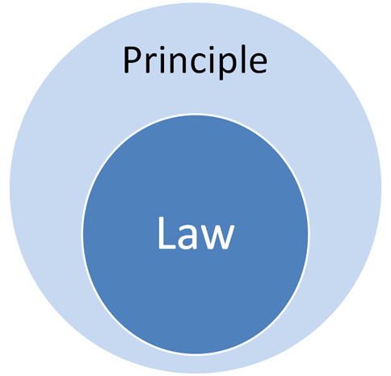
PRINCIPLES OF SUBSTANTIVE LAW RELEVANT TO EU ADMINISTRATIVE LAW
Principles of Substantive Law Relevant to EU Administrative Law
Prohibition of Discrimination on the Basis of Nationality
Freedoms of Movement
Mutual Recognition
Precautionary Principle

Slide 68
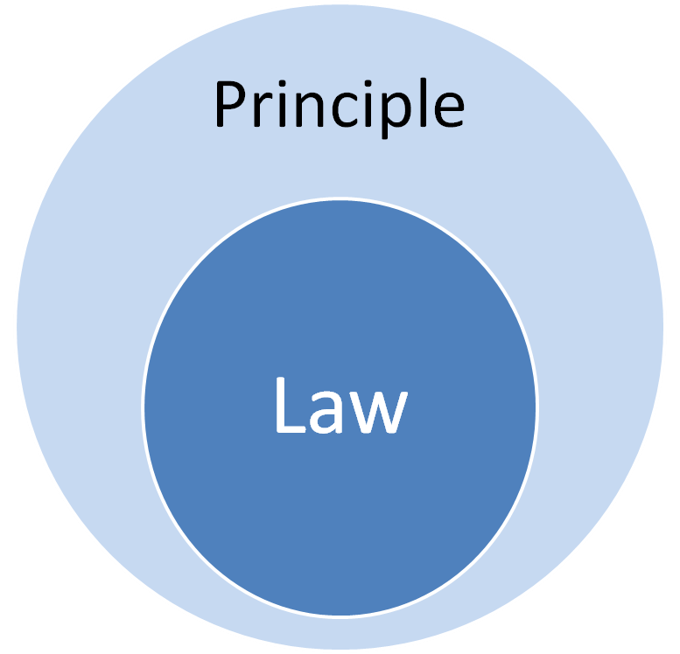
PRINCIPLES OF SUBSTANTIVE LAW RELEVANT TO EU ADMINISTRATIVE LAW
Principles of Substantive Law Relevant to EU Administrative Law:
Developed mainly by CJEU case law.
Responds to disputes between:
  Individuals / companies / associations and the EU Commission
  EU institutions and Member States
Based on treaty principles such as:
  Prohibition of nationality-based discrimination (Paris and Rome Treaties)
  Precautionary principle (Single European Act, environment)
These principles are key for administrative law.
Discussion question:
Why are these principles important for administrative law?
Answer:
They ensure fair treatment, legal certainty, and public interest protection.

Slide 69

PRINCIPLES OF SUBSTANTIVE LAW RELEVANT TO EU ADMINISTRATIVE LAW
Prohibition of Nationality-Based Discrimination
Article 18 TFEU: “Discrimination based on nationality is prohibited.”
Applies to:
  People (natural and legal persons)
  Products
Reverse discrimination: When a Member State treats its own citizens less favorably than other EU citizens – not covered by EU law, but often prohibited by national constitutions.
Discrimination occurs when:
  Similar situations are treated differently
  Different situations are treated similarly
Discussion question:
Can a Member State require citizenship for public service jobs?
Answer:
Yes, but only for jobs linked to public authority or safeguarding public interests (Commission v Belgium, 1979).

Slide 70
PRINCIPLES OF SUBSTANTIVE LAW RELEVANT TO EU ADMINISTRATIVE LAW
Indirect Discrimination
Occurs when a neutral rule disproportionately affects a group.
Example: Sotgiu v Deutsche Bundespost – difference in allowance based on residence in another Member State.
Determining indirect discrimination requires comparing affected groups or products.
Discussion question:
Why is indirect discrimination important in administrative law?
Answer:
It ensures fair treatment even where there are no clear legal distinctions.

Slide 71

PRINCIPLES OF SUBSTANTIVE LAW RELEVANT TO EU ADMINISTRATIVE LAW
Freedoms of Movement
Treaties of 1951 & 1957: Free movement of goods, workers, services, and capital.
Article 26 TFEU: Internal market with no internal borders.
Article 21 TFEU: EU citizens have the right to move and reside freely.
Example: Baumbast case (C-413/99) – migrant worker’s family can reside freely, subject to proportionality.
Administrations must apply EU law even if it conflicts with national law
Discussion question:
How does free movement affect administrative authorities?
Answer:
Authorities must ensure the rights and residence of EU citizens, even if national law conflicts with them

Slide 72

PRINCIPLES OF SUBSTANTIVE LAW RELEVANT TO EU ADMINISTRATIVE LAW
Mutual Recognition
Principle: a product, service, or professional qualification lawfully accepted in one Member State should be recognized in others.
Key cases:
  Dassonville (1974) – strict rules for product certificates can restrict trade.
  Cassis de Dijon (1979) – mutual recognition as a basis for harmonizing national laws.
Applies to internal market, professional qualifications, judicial decisions.
Ensures coordination between Member States.
Discussion question:
Why is mutual recognition important for the EU internal market?
Answer:
It prevents barriers to trade, services, and professional mobility.

Slide 73

PRINCIPLES OF SUBSTANTIVE LAW RELEVANT TO EU ADMINISTRATIVE LAW
Precautionary Principle
Article 191(2) TFEU: EU environmental policy must:
  Be high level of protection
  Apply precautionary principle
  Take preventive action
  Make polluter pay
It applies not only to the environment, but also to: food safety, consumer protection, chemicals, health
Agencies, Commission, and Member States must follow specific procedures, transparency, and access to documents.
Discussion question:
How does the precautionary principle guide administrative actions?
Answer:
Ensures risk prevention, safety, and accountability, even when evidence is uncertain.

Slide 74
Thank you for your attention!!!

