Slide 1

THE SOURCES OF EU ADMINISTRATIVE LAW

Slide 2

Introduction
Abbreviations of terms and documents:
Treaty on European Union (TEU).
Treaty on the Functioning of the European Union (TFEU).
Charter of Fundamental Rights of the European Union (CFR or Charter)
Court of Justice of the European Union (CJEU)
European Convention on Human Rights (ECHR)
European Court of Human Rights (ECtHR)

Slide 3

WHY SHOULD WE STUDY SOURCES OF EU ADMINISTRATIVE LAW?
1. The sources of EU administrative law (Treaties, regulations, directives, general principles, case law, soft law) define:
the powers of EU institutions, bodies, and agencies;
the limits of those powers;
the procedural duties they must respect.

Slide 4
WHY SHOULD WE STUDY SOURCES OF EU ADMINISTRATIVE LAW?
2. EU administrative law is not codified in a single act
Unlike many national systems, EU administrative law:
is fragmented across multiple sources;
has developed largely through Court of Justice (CJEU) case law;
relies heavily on general principles of law.

Slide 5
WHY SHOULD WE STUDY SOURCES OF EU ADMINISTRATIVE LAW?
3. The sources of EU administrative law establish fundamental guarantees such as:
the right to be heard,
access to the file,
duty to give reasons,
legitimate expectations,
proportionality and legal certainty.

Slide 6
WHY SHOULD WE STUDY SOURCES OF EU ADMINISTRATIVE LAW?
4. EU administrative law sources:
guide national authorities when they apply EU law (shared administration);
prevent different national practices;
support the principle of effectiveness and equivalence.
This is crucial in a legal order where EU law is implemented mostly by national administrations.

Slide 7
WHY SHOULD WE STUDY SOURCES OF EU ADMINISTRATIVE LAW?
5. The sources reflect:
the relationship between EU institutions;
the division of competences between the EU and Member States;
the balance between efficiency of administration and fundamental rights.

Slide 8
WHY SHOULD WE STUDY SOURCES OF EU ADMINISTRATIVE LAW?
6. EU administrative law sources:
influence national administrative law reforms;
contribute to the creation of European administrative standards;
inspire principles used in international and global administration.

Slide 9
WHY SHOULD WE STUDY SOURCES OF EU ADMINISTRATIVE LAW?
7. They are essential for legal practice and policymaking
For judges, lawyers, civil servants, and policymakers:
knowing the sources allows correct interpretation and application of EU rules;
helps avoid annulment of decisions, liability and violation procedures
improves the quality and legitimacy of administrative decision-making.

Slide 10
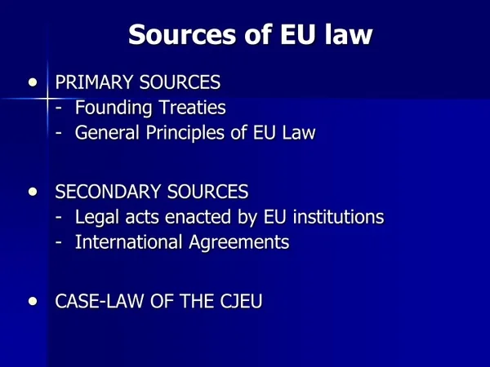
HIERARCHY OF SOURCES AND OF NORMS IN EU LAW
What Are the Sources of EU Administrative Law?
EU administrative law comes from many different sources.
It includes:
Written rules (treaties, regulations, directives);
Unwritten principles (e.g. proportionality, protection of legitimate expectations).
Discussion:
Why can administrative law not rely only on written rules?
Answer:
Because not everything can be foreseen in advance – general principles fill legal gaps.

Slide 11
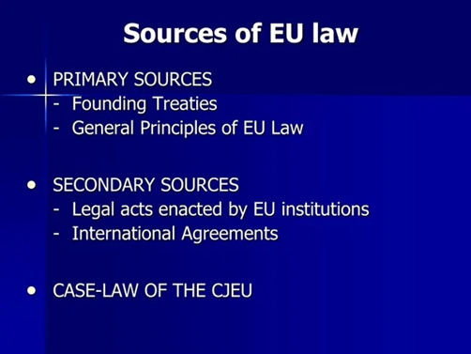
Hierarchy of Sources and of Norms in EU Law
How Does EU Administration Work in Practice?
EU administrative action is carried out in three ways:
Directly – through EU institutions (e.g. the European Commission);
Indirectly – through the administrations of the Member States;
Jointly (composite) – EU and national authorities act together.
Discussion:
Why does the EU often act through Member State authorities?
Answer:
Because Member States are best placed to implement EU law at national level.

Slide 12

Hierarchy of Sources and of Norms in EU Law
The Idea of Hierarchy of Norms
EU law applies a hierarchy of norms (Hans Kelsen’s theory).
Each legal norm:
is based on a higher norm;
is valid because it complies with that higher level.
The ultimate norm from which every legal norm deduces its validity is the Grundnorm, the highest basic norm
Discussion:
Why is it important that law has a hierarchy?
Answer:
It ensures legal coherence and helps resolve conflicts between rules.

Slide 13
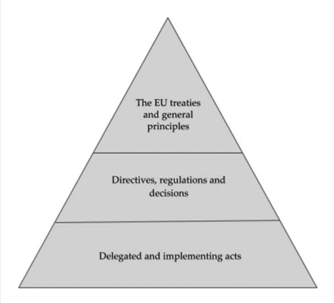
Hierarchy of Sources and of Norms in EU Law
Primary and Secondary EU Law
Primary law – the founding treaties of the EU (TEU, TFEU, the Charter).
Secondary law – acts adopted by EU institutions (regulations, directives, decisions).
Secondary law must comply with primary law.
Primary law is often called the EU’s “constitution”.
Discussion:
Why may secondary law not contradict primary law?
Answer:
Because the treaties define the limits of EU powers.

Slide 14
Hierarchy of Sources and of Norms in EU Law
Does the EU Have a “Real” Constitution?
In 2004, a European Constitutional Treaty was signed, but:
it was not ratified by all Member States;
therefore, it never entered into force.
Today, constitutional rules are spread across the TEU, TFEU, the Charter, and protocols.
Discussion:
Why is it difficult to identify “constitutional” norms in EU law?
Answer:
Because there is no clear criterion for deciding which norms are truly constitutional.

Slide 15
Hierarchy of Sources and of Norms in EU Law
Comparison with National Law
In states:
Constitution → laws → secondary legislation → individual decisions.
The hierarchy is usually clear and written.
In the EU:
The hierarchy is more complex.
Member States are bound by treaties more strictly than by ordinary international treaties.
Discussion:
Why is EU law more complex than national law?
Answer:
Because the EU combines many states and multiple legal levels.

Slide 16
Hierarchy of Sources and of Norms in EU Law
The Unique Nature of EU Law
EU law differs from international law because:
treaties cannot be easily amended;
customary law cannot change primary law;
EU law directly affects individuals and administrations.
Discussion:
Why is EU law considered “unique”?
Answer:
Because it is more than international law, but not state law.

Slide 17

Hierarchy of Sources and of Norms in EU Law
Key Conclusions
The sources of EU administrative law are diverse and multi-layered.
The hierarchy of norms helps to understand:
  which rules are superior;
  which acts may be challenged or annulled.
Primary law is the foundation of the EU legal system.
Discussion:
Is EU law closer to state law or international law?
Answer:
It is an intermediate and unique system that has features of both

Slide 18
Formal Sources of EU Law
Formal Sources of EU Law
EU law has a formal hierarchy.
Primary law stands at the top.
All other EU law must comply with it.
At the lowest level are contracts with third parties.
Discussion:
Why must all EU law comply with primary law?
Answer:
Because primary law defines the foundations and limits of EU action.

Slide 19
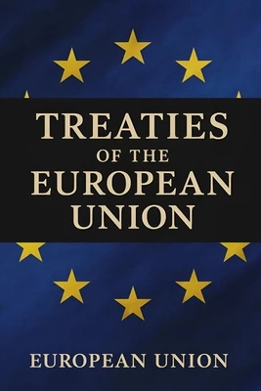
Formal Sources of EU Law
Direct Powers from the EU Treaties In some fields, e.g.:
Common Foreign and Security Policy (CFSP),
Competition law,
EU Treaties:
do not provide legislative procedures,
but directly empower institutions to act.
Discussion:
Why legislation is not always used in these fields?
Answer:
Because they require fast and centralised decision-making

Slide 20
Formal Sources of EU Law
What Is EU Primary Law?
EU primary law in force since 2009 is often called the “Lisbon Treaty”
(formally inaccurate). It actually consists of:
TEU,
TFEU,
Charter of Fundamental Rights,
Protocols,
Euratom Treaty.
Discussion:
Why is the Lisbon Treaty not a single legal text?
Answer:
Because it amended and reorganised earlier treaties.

Slide 21
Formal Sources of EU Law
Scope of EU Primary Law
EU primary law includes:
TEU – 55 articles
TFEU – 358 articles
Charter – 54 articles
38 Protocols – 256 articles
Euratom Treaty
All have equal legal value.
Discussion:
Are protocols legally less important than treaties?
Answer:
No – they have the same legal force.

Slide 22
Formal Sources of EU Law
Role of Protocols and Annexes
Protocols may:
define special procedures (subsidiarity);
regulate institutions (CJEU; European Central Bank);
provide for exceptions for some countries (euro area, Schengen).
Annexes:
add the agreements (lists of products or territories).
Discussion:
Why do some Member States have exceptions?
Answer:
Because EU integration progresses at different speeds.

Slide 23

Formal Sources of EU Law
Legal Consequences
Equal legal value means that:
Secondary law may be annulled if it conflicts with primary law.
Conflicts are solved using lex specialis. (the more precise provision prevails over the more general one according to the usual principles of legal interpretation)
Treaty amendment requires solidarity.
Discussion:
Why is treaty revision so difficult in the EU?
Answer:
Because it depends on national constitutional requirements

Slide 24
Formal Sources of EU Law
Other Documents
Accession Treaties of new Member States are part of primary law (see Article 49 TEU).
Declarations (65):
  have no obligatoryu force, but
  help interpret primary law.
Discussion:
Can political documents still matter in law?
Answer:
Yes – they help explain the context and objectives of legal rules

Slide 25

Formal Sources of EU Law
General principles of EU law are:
unwritten sources of law,
developed by the CJEU,
superior to secondary EU law.
They apply together with:
EU international agreements.
Discussion:
Why are unwritten principles important in EU law?
Answer:
Because not all situations can be regulated by written rules.

Slide 26
Formal Sources of EU Law
What Are General Principles?
The concept of general principles exists in many countries.
In the EU they are considered a source of real law, not just doctrine
Examples:
  proportionality,
  legitimate expectations,
  legal certainty.
Discussion:
Are general principles identical in all Member States?
Answer:
No, but the EU adopts common ideas from national systems

Slide 27
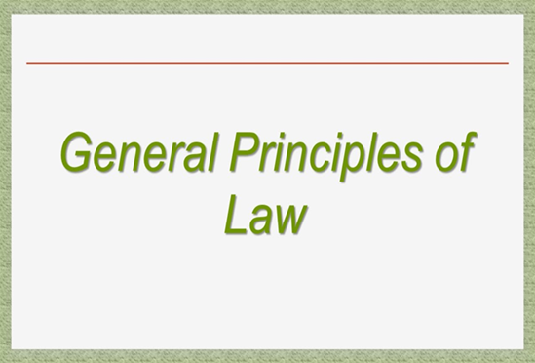
Formal Sources of EU Law
Role of the CJEU
The CJEU has used general principles since the 1950s.
Only the CJEU can recognise a principle as “general”.
Discussion:
Why does only the CJEU have this power?
Answer:
To ensure uniform interpretation of EU law

Slide 28

Formal Sources of EU Law
To whom do the General principles apply?
General principles are used to:
review EU secondary law;
assess Member State actions;
guide national courts.
They bind both the EU institutions and the Member States.
Discussion:
When General principles bind Member States?
Answer:
When they apply EU law.

Slide 29

Formal Sources of EU Law
Where do general principles come from?
The content of the principles (material source) may come from:
Member States’ law;
ECHR;
international law;
EU legislation.
Formal source is always a CJEU judgment.
Discussion:
Must a principle exist in all Member States?
Answer:
No, it must simply be widely recognised

Slide 30
Formal Sources of EU Law
Place in the Hierarchy
General principle
Above secondary EU law.
Below EU primary law.
Secondary law may be annulled if it conflicts with a general principle.
Discussion:
Can a General principle override the Treaties?
Answer:
No – primary law prevails.

Slide 31

Formal Sources of EU Law
EU International Agreements
EU international agreements are growing in importance, especially in:
trade,
environmental law,
human rights.
Example:
Aarhus Convention
European Convention on Human Rights (ECHR).
Discussion:
Why are international agreements important for EU administrative law?
Answer:
Because they shape administrative procedures and rights.

Slide 32

Formal Sources of EU Law
Exclusive vs Mixed Agreements
Exclusive agreements – EU only (e.g. EU–UK TCA).
Mixed agreements – EU + Member States (e.g. EEA).
Problem:
any Member State can block ratification.
Discussion:
Why are mixed agreements problematic?
Answer:
Because unanimity is often required.

Slide 33

Formal Sources of EU Law
Judicial Control
All agreements must comply with:
  EU primary law,
  general principles.
Article 218(11) TFEU allows prior review by the CJEU.
Discussion:
Why is prior review important?
Answer:
Because agreements are very hard to amend later

Slide 34

Formal Sources of EU Law
Key Takeaways
General principles are central to EU law.
The CJEU plays a key constitutional role.
International agreements are powerful legal sources.
Everything must respect the EU legal framework.
Discussion:
Is the CJEU more a creator or a guardian of EU law?
Answer:
Both – it develops and protects the EU legal order.

Slide 35
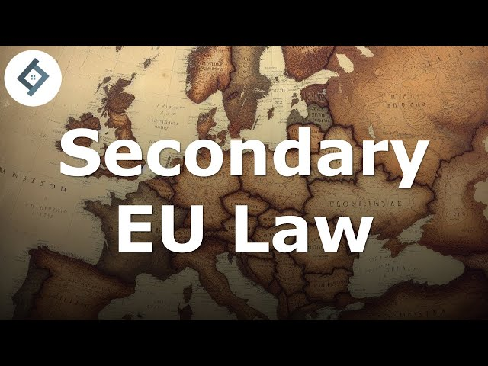
Formal Sources of EU Law
Secondary EU Law: General Idea
Most EU law consists of secondary law.
It is crucial for EU administrative law.
Key points:
directly applicable in Member States;
often no national ratification needed;
applies to authorities and individuals.
Discussion:
Why is secondary law so important in practice?
Answer:
Because it governs everyday application of EU law.

Slide 36

Formal Sources of EU Law
Main Mandatory Acts of Secondary Law
Three main types:
Regulations – directly applicable in all countries (General Data Protection Regulation – GDPR)
Directives – set objectives but allow for a choice of means.
Decisions – mandatory on specific addressees.
All of them are mandatory
Discussion:
What is the main difference between a regulation and a directive?
Answer:
Directives allow national discretion; regulations do not

Slide 37
Formal Sources of EU Law
Horizontal and Sectoral Acts
Horizontal acts – apply across all sectors.
  Example: GDPR.
Sectoral acts – apply to specific fields.
  Example: competition law, agriculture.
Discussion:
Why are horizontal acts important?
Answer:
Because they affect all administrative areas.

Slide 38
Formal Sources of EU Law
Legislative and Non-Legislative Acts
EU law distinguishes:
legislative acts;
non-legislative acts (delegated, implementing, treaty-based).
There is no strict hierarchy like in national systems.
Discussion:
Why is EU hierarchy less clear?
Answer:
Because treaties often grant direct powers to institutions.

Slide 39
Formal Sources of EU Law
Role of the Commission:
In areas like competition law, the Commission acts directly under the Treaties.
No statutory “filter” exists.
Discussion:
Does the Commission have strong powers?
Answer:
Yes, especially where treaties provide direct authority.

Slide 40
Formal Sources of EU Law
“Acts” and Naming Issues
Recent EU legislation uses accessible names:
Digital Markets Act,
Digital Services Act,
Artificial Intelligence Act.
Legally, these are still regulations.
Discussion:
Does the title affect legal force?
Answer:
No – substance matters, not the name

Slide 41

Formal Sources of EU Law
Soft Law
Without obligatory acts, there are:
guidelines,
communications,
notices.
They influence practice through CJEU case-law.
Discussion:
Why is soft law important?
Answer:
Because it shapes administrative behaviour.

Slide 42

Formal Sources of EU Law
CJEU Case-Law as a Source
CJEU case-law is a fundamental source of EU law.
Only the CJEU gives authoritative interpretation.
Discussion:
Why is CJEU case-law essential?
Answer:
It ensures uniform application of EU law

Slide 43
Formal Sources of EU Law
General Principles vs Case-Law
General principles rank above secondary law.
Ordinary case-law may change with legislation.
Discussion:
Can the CJEU change its case-law?
Answer:
Yes, if the legal framework changes

Slide 44

Formal Sources of EU Law
Scholarship as an Indirect Source
Doctrine is not a formal source of law.
However, it influences:
  the opinions of the Advocates General of the CJEU;
  the practice of the EU institutions
Discussion:
Why is EU administrative law scholarship hard to systematise?
Answer:
Because it exists in many languages.

Slide 45
Formal Sources of EU Law
Key Takeaways
Secondary law is central to EU administrative law.
CJEU case law ensures uniformity of law.
Soft law and doctrine have real impact..
Discussion:
Who shapes EU administrative law more: legislators or courts?
Answer:
Both – they interact continuously.

Slide 46
Thank you for your attention!!!

