Slide 1





Humorous responses to offensive humor:
The case of Charlie Hebdo’s cartoons concerning the 2016 earthquake in central Italy and their humorous replies
Carla Canestrari* & Amadeu Viana**
*University of Macerata, Italy
**University of Lleida, Spain
IADA, Bologna
October, 11 – 14, 2017

Slide 2
The focus:
Dialogical humorous replies to disaster humor
The aims:
to determine whether humour can be used as a discursive strategy to reply to offensive humour about natural disasters
and what purposes it serves.

Slide 3
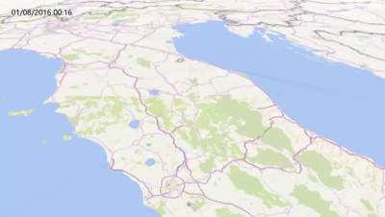

Slide 4
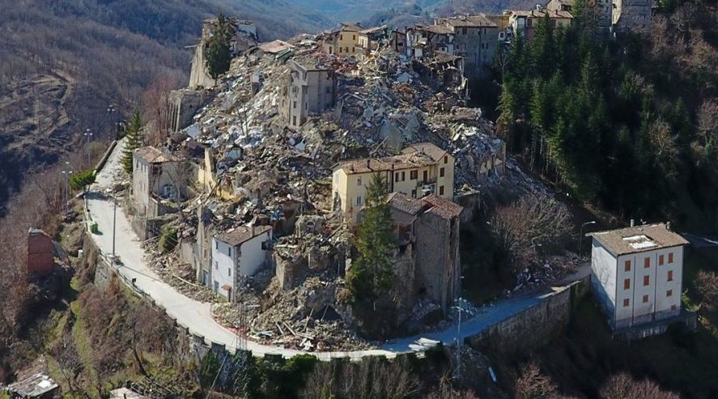
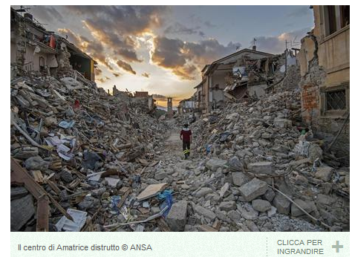
The disaster:
The earthquake in central Italy
300 victims

Slide 5
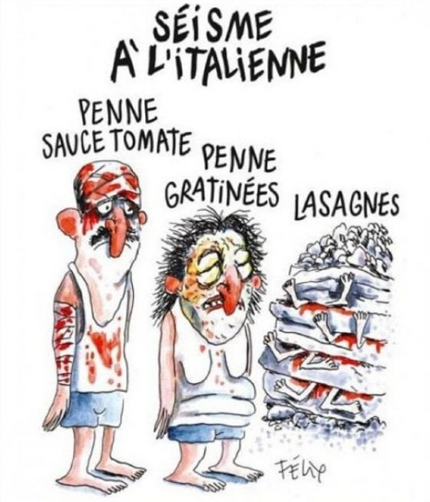
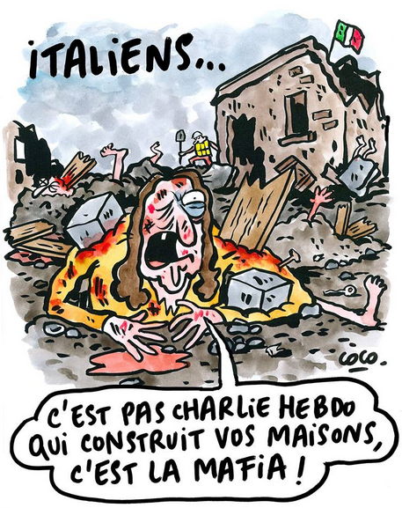
Disaster humor:
Charlie Hebdo cartoons

Slide 6

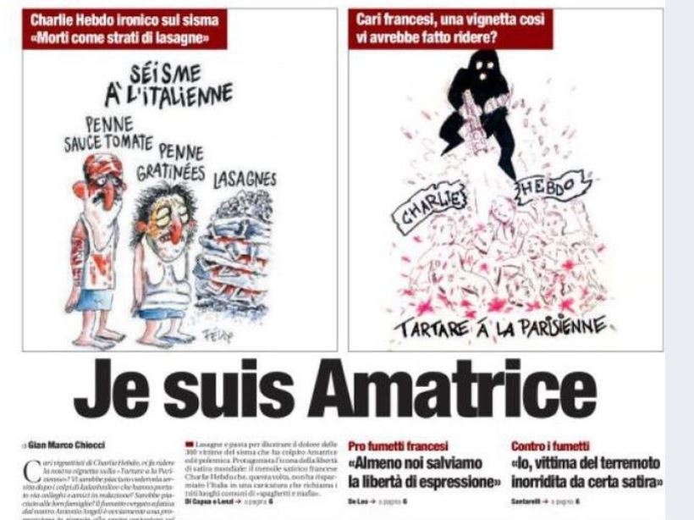
3 /9/2016

Slide 7
Dialogical reactions to disaster humor serious replies
Disaster humor may lead to mood enhancement but may also lead to annoyance and vexation
(Morreall, 1983; Chandler, 1988; Mulkay, 1988; Robinson, 1991; Ryan, 1993; Kuiper, 2014)
Serious reactions from the public and from the political sphere condemned the Charlie Hebdo cartoons
(In this case) Disater humor = offensive humor

Slide 8
Dialogical reactions to jokes
Dialogical reactions to offensive comments
Rejection of the offensive content: confronting the offensive content (counterattack)
Deflection: diverging from the offensive comment
(e.g. Kupfer Snider 1994)
Rejection of the humorous intent (failed humor)
Appreciation of the humorous intent
(e.g. Hay, 2001; Kuipers, 2006; Bell 2017)

Slide 9
Dialogical reactions to disaster humor:
humorous replies
Research question
Is it possible to address an offensive humorous stimulus by rejection, appreciation, or deflection within a playful frame?

Slide 10
Hypothesis: Dialogical humorous reactions to disaster humor
Humorous Response | Target | Discursive function
joining responses appreciation of the humorous intent | the same target as the initial stimulus = the offended | joining in with the initial offender and agreeing with the aggressive humorous content
competing responses Rejection of the humorous intent | the target is the initial offender | going against the offender and disagreeing with the humorous message
deflecting responses Diverging from the offensive comment | the target is neither the initial offender nor the responder | shifting the focus of the humour to a different target

Slide 11
The study:
Dialogue between CH cartoons and the replies posted on the Italian satirical online forum “Spinoza”
Topic to be discussed in the forum:
“Amatrice sues Charlie Hebdo because of the cartoons on the earthquake” (http://goo.gl/oYA5PW)
461 replies were published from 1st to 15th September 2016
431 were identified as humorous by two independent raters
The corpus of 431 humorous responses was analysed according to their targets, which operationalise the three types of response (joining, competing, deflecting responses)

Slide 12
Results
Type of response | Example | Target
Joining responses (agreeing with CH) | “It’s true that Charlie Hebdo cartoons are sometimes heavy going. But never as heavy as a ceiling.” | Italian offended people
 | “So what do you lot put in lasagne, sand or cement?” | Managers in the Italian construction industry
Competing responses (disagreement with CH) | “The first cartoon about pasta, the second about the Mafia. What are they going to come up with for the mandolin?” | Charlie Hebdo
 | “Well, I think we should all apologise to ISIS.” | Charlie Hebdo

Slide 13
Type of response | Example | Target
Deflecting strategies (diverging from the offender and the offended) | “I wanted to ask if Charlie Hebdo could publish a cartoon about Giulio Regeni so at least he would be talked about again.” | Italian journalists who, at the time of the post, were not giving space to the case of the mysterious death of Giulio Regeni
 | “This exciting debate on which issue to focus on and the limits of satire has unjustly pushed the splendid duet with Aurora Ramazzotti and her father into the background.” | Aurora Ramazzotti is the daughter of the famous Italian singer, Eros Ramazzotti. She and her father performed an improvised duet while he was driving and this was posted on Instagram.

Slide 14
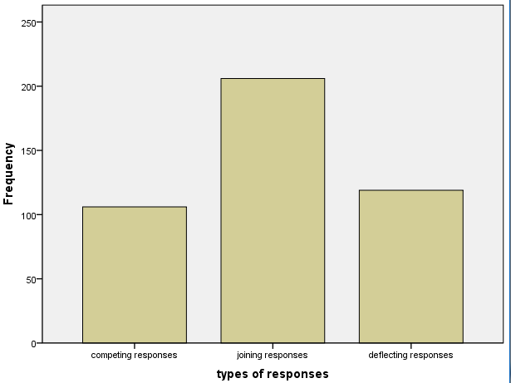
(χ² (2, N=431) = 41.155, p< .001)
Adjusted residuals: all the differences are significant
206
119
106

Slide 15
Conclusion
A dialogue between offensive humor and the addressee can remain within the humorous frame = mode adoption (e.g. Attardo, 2002; Whalen and Pexman; 2017)
Agreeing with the offensive message is more frequent in this corpus than diverging from it and even disagreeing with it.
Joining responses redirect the original target (Italians at large) so that it only refers to corrupt Italians or the Mafia and not to all Italian people

Slide 16
Conclusion
Further issues to be exlored:
How the psychological distance from a disaster modulates the frequency of each strategy (e.g. McGraw et al., 2013)
Psychological identification with the offender or the offended
Affiliation vs disaffiliation to a group
THANK YOU FOR YOUR ATTENTION!

