Slide 1
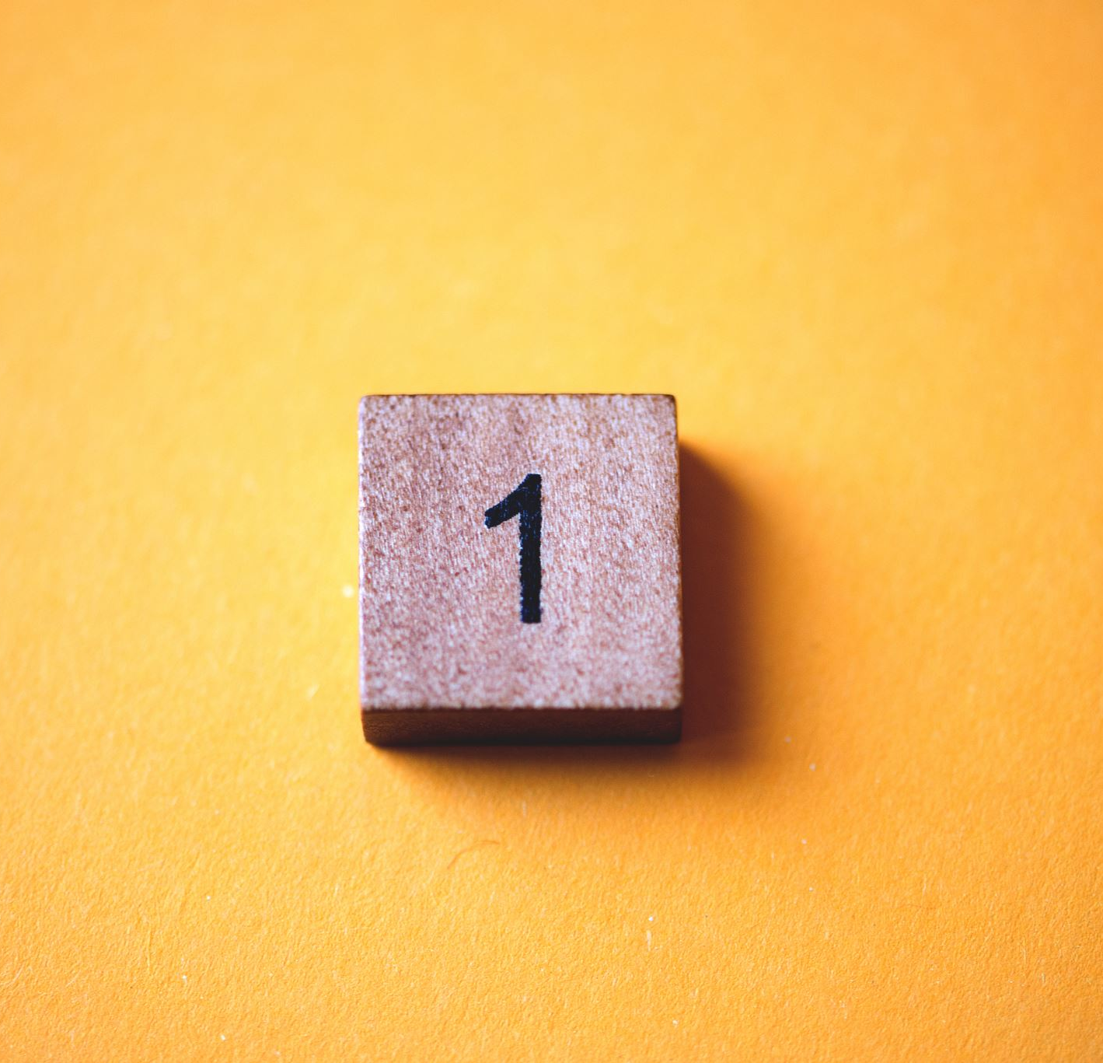



Topic 1: Intro to IP Law
Module: IP and Creative Industries
Macerata University 2023
Dr Angelia Wang, Durham University

Slide 2
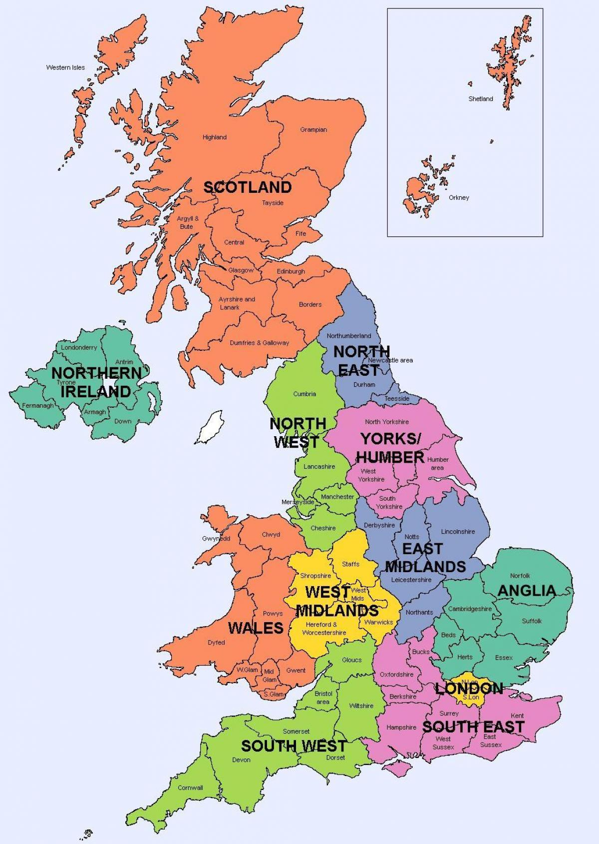
I am from Durham University

Slide 3
Structure of the module
Intellectual property law
Video games
AI-generated content
3D printing
Tokenised artwork
The role of platforms

Slide 4
What will we do?
10 lessons: lectures + discussion (‘in-class exercise’)
Assessment: group presentation
Groups will get an assignment in the second lesson
Each group will give a 20-minute presentation in the last week of teaching of this module
The assessment result will form part of the final assessment at the end of the term

Slide 5
Outline
What is IP, and why is it important?
The international IP legal framework
IP in different legal systems
How to trade IP?

Slide 6
Why is IP important?
Creates And Supports High-Paying Jobs
Drives Economic Growth And Competitiveness
Strong And Enforced IP Rights Protect Consumers And Families
Helps Generate Breakthrough Solutions To Global Challenges
Encourage Innovation And Reward Entrepreneurs

Slide 7
What is intellectual property?
Copyright
Patents
Trademarks
Designs
Geographical indications
Trade secrets
For more info, look at the WIPO website.

Slide 8
Copyright
For literary and artistic works. A ‘work’ must be original. It generally lasts for 70 years after the death of the author. Registration is not compulsory.
Examples: books, music, paintings, sculpture, films, computer programs, advertisements, maps and technical drawings

Slide 9
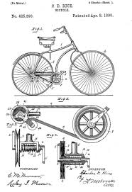
Patents
A patent is an exclusive right granted for an invention. It lasts for 20 years since the disclosure of the invention.
An invention must be novel.
Must be registered.

Slide 10

Trademarks
A trademark is a sign capable of distinguishing the goods or services of one enterprise from those of other enterprises.
It could last forever, depending upon the renewal.

Slide 11
International legal framework
Berne Convention
Paris Convention
Agreement of Trade-Related Aspects to Intellectual Property Rights (TRIPS): the first time that IP rules were incorporated into the multilateral trading system.
World Trade Organization (WTO) dispute settlement, about institutions such as the World Intellectual Property Organization (WIPO) and WTO
International filing systems like the Patent Co-operation Treaty (PCT) or the Madrid Agreement for the international registration of trademarks

Slide 12
IP in different legal systems
The scope of ‘work’ in a copyright sense
The originality test
The limitations and exceptions

Slide 13
The definition of copyrighted ‘work’
Requirements: original works of authorship + fixation + expression
The copyright legislation usually adopts a closed list to define the categories of works
The EU and China: a shift to an open-ended list of ‘work’?

Slide 14
An example of a closed list of copyrighted work: UK CDPA 1988
3. Literary, dramatic and musical works.
3A. Databases
4. Artistic works.
5A. Sound recordings.
5B. Films.
5. Sound recordings and films.
6. Broadcasts.
6A. Safeguards in case of certain satellite broadcasts.
7. Cable programmes.
8. Published editions.

Slide 15
An example of a closed list of copyrighted work: PRC Copyright Law section 3
(1) written works
(2) oral works;
(3) musical, dramatic, quyi, choreographic and acrobatic works;
(4) works of the fine arts and architecture;
(5) photographic works;
(6) cinematographic works and works created by a process analogous to cinematography;
(7) graphic works such as drawings of engineering designs and product designs, maps and sketches, and model works;
(8) computer software; and
(9) other works as provided for in laws and administrative regulations.

Slide 16
A shift to an open-ended list of ‘work’
EU: a graphic user interface has been held as a work that can be protected by copyright (Case C-393/09 [2011] FSR 18)
China: the 3rd Amendment of the Copyright Law, 2021, broadly defines a copyrighted work as original intellectual creation in the fields of literature, art and science.

Slide 17
The test of originality
Personhood -- originality must be from a natural person
Originality should be sufficiently concrete and expressive
Only original expressions can be protected by copyright
Abstract ideas cannot be protected

Slide 18
In-class exercise
Can you think of examples of an ‘abstract idea’ in a copyrighted work? Take a literature work and a film as examples.
Discuss: why abstract ideas should not be protected?

Slide 19
The test of originality
UK: labour, skills and judgment (the Lego case)
US: ‘sweat of the brow’ doctrine (the Feist case)
EU: intellectual creation (the Infopaq case)

Slide 20
Limitations and exceptions
US: fair use (an open-ended test)
EU: exceptions (a closed list)
UK: fair dealing (an approach between an open and a closed system)

Slide 21
US fair use
Section 107 of the US Copyright Act, fair use allows persons other than the copyright owner to make certain limited uses of copyrighted material without the copyright owner's permission (17 U.S.C. § 107). Fair use is an affirmative defense to copyright infringement.

Slide 22
The four-factor test of fair use
Purpose and character of the use. The purposes could be teaching, including private study or classroom use; criticism or commentary, and news reporting.
Nature of the copyrighted work.
Amount and substantiality of the portion used in relation to the copyrighted work as a whole.
Effect of the use on the potential market for or value of the copyrighted work.

Slide 23
UK fair dealing
Sections 29 and 30 of the Copyright, Designs and Patents Act 1988, which outlines three instance where fair dealing is a legitimate defence:
If the use is for the purposes of research or private study;
If it is used for the purposes of criticism, review or quotation;
Where it is utilised for the purposes of reporting current events (this does not apply to photographs)

Slide 24
EU copyright limitations and exceptions
Article 5 of the InfoSoc Directive
Temporary acts of reproduction
use for the sole purpose of illustration for teaching or scientific research
use for disability and of a non-commercial nature
use to comment on current affairs
use for the purpose of caricature, parody or pastiche

Slide 25
In-class exercise
Do you prefer the Anglo-American or EU approaches to the test of originality? Why?
Which system of copyright exceptions works better for the users of works? An open or a closed system? Why?

