Slide 1

Topic 2:
IP and Creative Industries
Module: IP and creative industries
Macerata University 2023
Dr Angelia Wang, Durham University

Slide 2
The IP-intensive industries
There are now 353 IPR-intensive industries in the EU economy
During 2013-2016, IPR-intensive industries generated almost 45% of total economic activity (GDP) in the EU, worth €6.6 trillion.

Slide 3
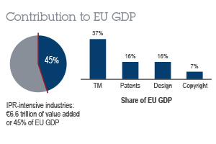

Slide 4
European Union National Institutes for Culture
EUNIC – European Union National Institutes for Culture – is the European network of organisations engaging in cultural relations. Together with our partners, we bring to life European cultural collaboration in more than 90 countries worldwide with a network of 125 clusters, drawing on the broad experience of our members from all EU Member States and associate countries.
European Creative Business Network (ECBN)
The European Creative Business Network (ECBN) is a unique not-for-profit foundation founded in 2011, promoting the interests of the creative industries in Europe. Given the diversity of cultural expressions as well as of cultural and creative markets across Europe, ECBN works – on purposes indirectly and decentralised – by supporting leading agencies, funders and intermediaries on local, regional and/or national levels to help them support their cultural and creative entrepreneurs.

Slide 5
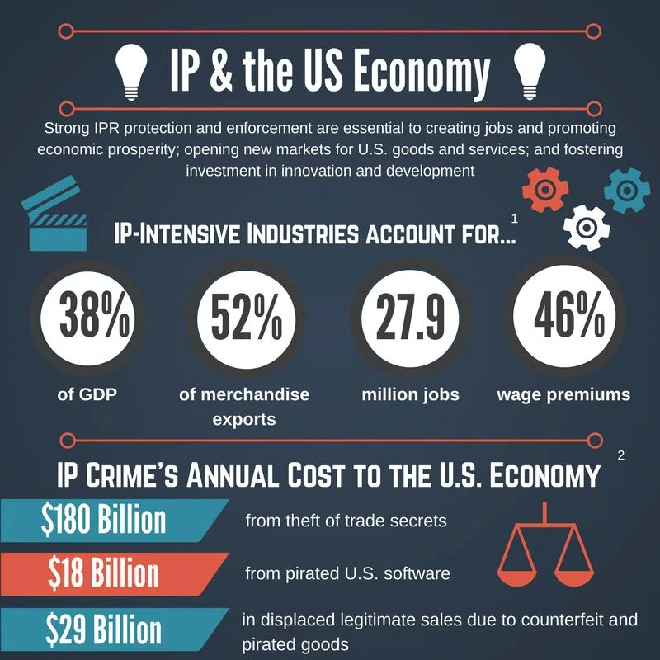

Slide 6
In-class exercise: Mapping the areas of IP involved in different creative industries
Copyright industries: computer software, videogames, books, newspapers, periodicals and journals, motion pictures, recorded music, and radio and TV broadcasting
Manufacturing industry
Software industry

Slide 7
When Industry 4.0 meets the Creative Economy
New technologies provide new tools for the creative industry to leverage individual talents or to share and develop new ideas. New technologies also open new channels to reach consumers.
However, new technologies present significant challenges for the creative industry.

Slide 8
Creative Industry 4.0 and development
Creative Industry 4.0 is not a matter for developed economies only. Middle-income developing countries, such as Indonesia, identify the Creative Economy as a potential “gold mine” in terms of finding new
emerging markets, particularly for SMEs.
For example, high-end fashion items, in addition to crafts, music, and architectural products.
Ethical Fashion Initiative also aims to connect marginalised artisans from the developing world, mostly women, with international fashion houses.
Among the tools used to this end, the project relies on continuous data gathering, mapping and tracking tools.

Slide 9
Impact of new technologies on businesses
Personalization: The creative industries embody our appetite for more and more personalised content and consumption.
Aggregation: The emergence of “time and content consumption crossroads,” such as Google and Facebook, has fuelled market segmentation enabled by big data and the renewed search for relevance.
Community: Social networks and the digitisation of the community-based economy.
Involvement: The role of consumers has changed. They contribute to the production, diffusion, and marketing of cultural and creative works.
Illegal content: Unlawful copies and dissemination deprive creators of revenues, in some cases making it hard to create.
New technological advances, such as blockchain, offer various means of genuineness identification to creative producers.

Slide 10
How to trade IP?
Licensing
Individual license
Collective license
Smart contract
Transfer ownership
Sell an entire work
Sell a work in fractions

Slide 11
SMEs and IP
SMEs require a horizontal approach Most businesses -- engaged in the Creative Economy are SMEs The Creative Industries' fragmented structure – a few large firms and a large numbers of micro, small and middle-sized firms (MSMEs)
Size has impact on the choice of business models

Slide 12
The international trade of IP
Payments for the use of creativity may take the form of patent royalties, trademark royalties, franchises, copyrighted materials, book publishing royalties, music royalties, and art royalties.
Well-known brands and fashion designers can charge royalties for the use of their names and designs.
Publishers and media pay authors, musical artists, and production professionals for the use of their produced, copyrighted material. These payments are reflected in trade in creative services or as repatriation of profits if the exporting plant is filial of a multinational enterprise.

Slide 13
In-class exercise
What are the potential problems with the international trade of IP?
How to solve the problems?

Slide 14
The challenges
Cross-border enforcement of court decisions and arbitration award
court decisions: bilateral agreements
arbitration awards: New York Convention – awards can be enforced between the member states of the Convention

Slide 15
The challenges
Different standards for IP protection
Originality test
Cumulative IP protection
Availability of remedies for IP infringement. Remedies, e.g., punitive damages, are not available in many jurisdictions

Slide 16
The assignment : assessment criteria
A research project for group work
Each group will give a presentation in the third week of April (11&12 April)
Each presentation should be 20 minutes. The talking should be equally divided between group members.
Each presentation will be followed by a 5-minute Q&A session. Everyone is welcome to ask questions.
Submit the PowerPoint slides, indicating the group members, at jia.wang2@durham.ac.uk
The deadline is Friday, 7 April, at noon.

Slide 17
The assignment: the topic
The availability of smaller and cheaper digitalised tools helps developing countries to move out of low-volume hand-made crafts while at the same time preserving the originality of their cultural designs. The commercialisation of creative products and services has become easier and cheaper, allowing businesses to enter new niche markets.
Discuss how technologies change the ecosystem of a creative industry and their impact on the IPs involved in that industry. You may choose the industry of gaming, 3D printing, AI-generated content or the tokenisation of artwork for a discussion. You should discuss the features of the relevant technology, identify the types of IP, and the impact at national and international levels.

Slide 18
Some brainstorm
Having an effective initial group discussion
Which area are you interested in?
The feasibility of conducting a research on the chosen topic (expertise in the topic, accessibility to the relevant research materials)
The division of work

Slide 19
Some brainstorm
Implementing the project
Have regular meetings
Assign a member to take notes and send a memo to group members after each meeting
Design PPT slides
Practise the presentation – control the time

Slide 20
Some brainstorm
Designing the slides
How many slides are suitable for the presentation?
The style of presentation ( lots of words v concise; plain text v graphic)
The order of presenters
Prepare for the questions (What could people ask? What if there is a question that you don’t know the answer to? What if a group member answered a question, but you feel like having something to add up?)

