Slide 1




Topic 3:
IP and Video Games (1)
Module: IP and Creative Industries
Macerata University 2023
Dr Angelia Wang, Durham University

Slide 2

Do you play games?

Slide 3


Do you play these?

Slide 4
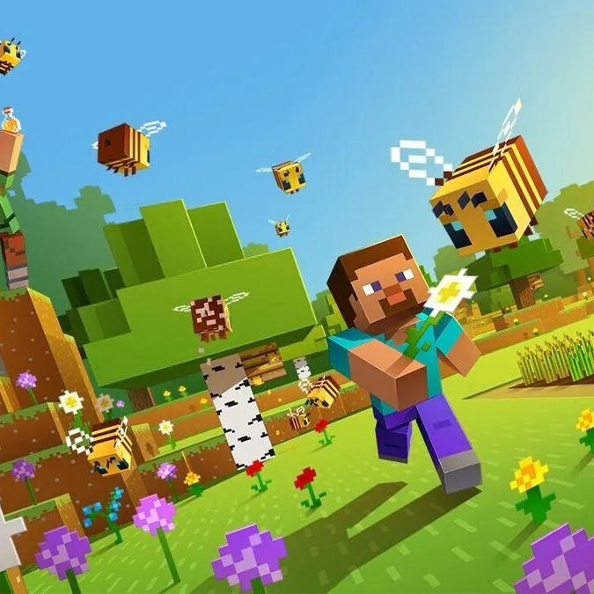
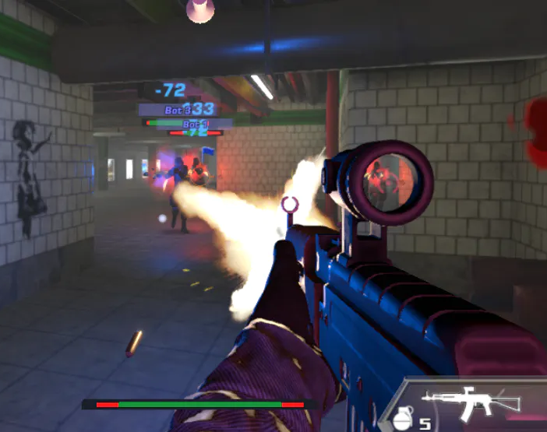
Do you play that?

Slide 5


Or those?
What are the genres of games?

Slide 6
Genres of games
Real-life simulating games. e.g. The Sims (2000); Second Life (2003)
Skill-requiring games, e.g. Call of Duty (2003); Assassin’s Creed (2007)
Games of chance, e.g. video poker or blackjack
Massively multiplayer online role-playing games (MMORPG), e.g. World of Warcraft (2004); Star Wars: The Old Republic (2011)
In summary, real-life simulating games, skill-requiring games and multiple online role-playing games are usually more interactive than games of chance.

Slide 7

In-class exercise: what makes a game interesting/attractive?
Characters
Storyline
Image and audio
The dynamic interaction between players

Slide 8

In-class exercise: what IP rights could a video game have?
Copyright
Patent
Trademark
Design

Slide 9
Patent protection: EU
European Patent Office (EPO) grants inventions for technical solutions to a technical problem.
A successful case: the probability of a character appearing on a game map was varied, in contrast to the previous case, found to be patentable. The Board reasoned that the probability calculation was technical because it solved the problem of how to modify the game programme such that it generated encounters less predictably (see T 0012/08).

Slide 10
Patent protection: China
China: game rules, principles and methods of intellectual activity are not patentable. A patentable invention must offer a solution to a technical problem.
An unsuccessful application: designing game rules to improve a game's playability by combining certain types of quizzes. The design reflects the method of intellectual activity by the designer’s choice, which is not a solution to a technical problem and is not patentable.

Slide 11

Conclusion
The design and arrangement of game rules cannot be granted a patent

Slide 12
In-class exercise: is a video game a ‘work’ in a copyright law sense?
Refer to Topic 1 slides 13-14
No
If a game cannot be protected as a whole, it needs to be divided into composite elements for copyright protection

Slide 13
In-class exercise: what elements in a video game can be protected by copyright?
Image
Text
Music
How about the storyline?
How about historical figures?
How about cloning a game without direct copying?

Slide 14
An international copyright principle: ideas v expression
Expressions are protected by copyright
Abstract ideas are not protected by copyright

Slide 15


Are they similar? (Krisarts SA v Briarfine [1977] FSR 557)
What are the ideas and expressions in the painting (above)and the photograph (below)?

Slide 16
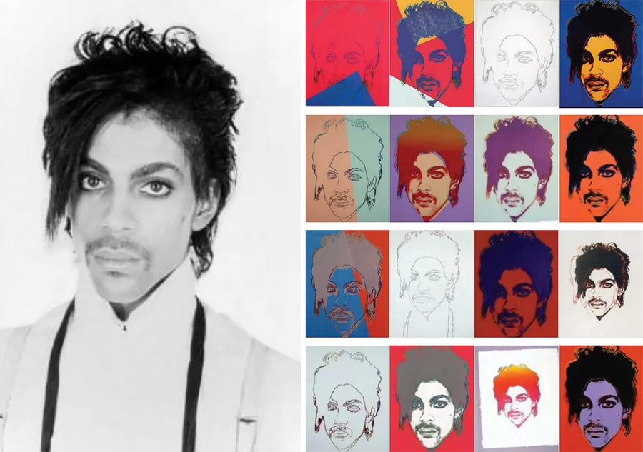
A portrait of Prince taken by Lynn Goldsmith (left) in 1981 and 16 silk-screened images by Andy Warhol

Slide 17
The dilemma for video games: cloning
A cloned game arouses the same playing experience without direct copying the figures, audio-visual effects and scripts.
The negative effect of the legal uncertainty of game cloning – game developers lose confidence in international trade

Slide 18
In-class exercise: what makes a game interesting/attractive?
Characters
Storyline
Image and audio
The dynamic interaction between players

Slide 19
The dilemma for video games: cloning
If figures, audio-visual effects and scripts are not directly copied, what has been cloned?
Can the idea v expression dichotomy be applied?
Let’s discuss this in the next lesson!

