Slide 1




Topic 4:
IP and Video Games (2)
Module: IP and Creative Industries
Macerata University 2023
Dr Angelia Wang, Durham University

Slide 2
Revisions
In the last lessons, we learnt about the IP system and its impact on the international trade
Creative industries in the focus
Video games

Slide 3
The dilemma of video games
Cloning as a chronic problem
Copyright doctrine: idea v expression
What has been copied? Are the copied elements copyrightable?

Slide 4
MDA framework
Introducing the MDA framework (standing for Mechanics, Dynamics, and Aesthetics)
Developed and taught as part of the Game Design and Tuning Workshop at the Game Developers Conference, San Jose 2001-2004.
MDA is a formal approach to understanding games one which attempts to bridge the gap between game design and development, game criticism, and technical game research.

Slide 5
MDA
Designer
Consumer
Game

Slide 6
MDA
rules
system
‘fun’
mechanics
dynamics
aesthetics

Slide 7
Mechanics describes the particular components of the game at the level of data representation and algorithms.
Dynamics describes the run-time behaviour of the mechanics acting on player inputs and each other’s outputs over time.
Aesthetics describes the desirable emotional responses evoked by the player when interacting with the game system.

Slide 8

Aesthetics
1. Sensation: Game as sense-pleasure
2. Fantasy: Game as make-believe

Slide 9
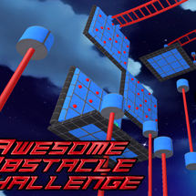
Aesthetics
3. Narrative: Game as drama
4. Challenge: Game as an obstacle course

Slide 10

5. Fellowship: Game as social framework
6. Discovery: Game as uncharted territory

Slide 11

7. Expression: Game as self-discovery
8. Submission: Game as a pastime

Slide 12

In-class exercise
Discuss your favourite game: what emotional responses have you experienced from playing the game?

Slide 13

Dynamics
Dynamics work to create aesthetic experiences.
For example, challenge is created by things like time pressure and opponent play.
Fellowship can be encouraged by sharing information across certain members of a session (a team) or supplying winning conditions that are more difficult to achieve alone (such as capturing an enemy base).

Slide 14
Dynamics
Expression comes from dynamics that encourage individual users to leave their mark: systems for purchasing, building or earning game items, for designing, constructing and changing levels or worlds, and for creating personalised, unique characters.

Slide 15
Mechanics
Mechanics are the various actions, behaviours and control mechanisms afforded to the player within a game context.
Together with the game’s content (levels, assets and so on), the mechanics support overall gameplay dynamics

Slide 16
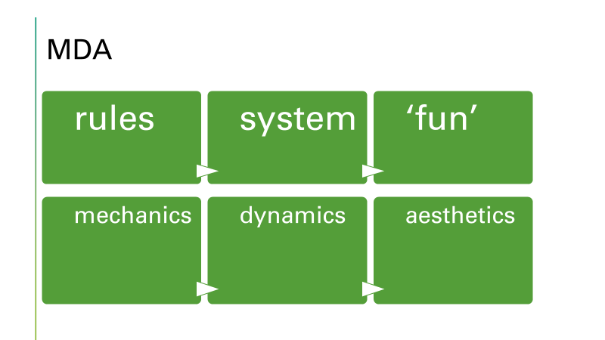
Copyright doctrine: idea v expression
What is lacking in the binary system?

Slide 17
How to fix it?
Is the system/dynamics leaning towards an idea or an expression?
What would be the legal result if it is deemed an idea?
What would be the legal result if it is deemed an expression?
How about adding video games to the current categorisation of copyrighted work?

Slide 18
Impact on international trade of games
The stakeholders:
Game developers; established, emerging, small
Users (players)
Platforms (e.g., app store)
International trade law

Slide 19
In-class exercise
Discuss:
Who would benefit from a more protective regime in favour of the copyrightability of gameplay?
Who would be less in favour of the view that gameplay is copyrightable?
What is the impact on the international trade of video games?

