Slide 1


Topic5
IP and AI-generated content: text

Slide 2
Introduction
When we talk about AI, what do we talk about?
AI is not the Algorithm
AI is not Machine Learning
Machine Learning, particularly Neural Networks or Deep Learning, is a subset of AI techniques that uses statistical methods to enable computers to perceive some characteristics of their environment.
Current techniques are particularly efficient in perceiving images, written or spoken text, as well as the many applications of structured data.
By analysing many thousands of examples (typically a few million), the system can identify commonalities in these examples, enabling it to interpret data that it has never seen before, which is often referred to as prediction.

Slide 3
What is AI
AI includes Machine Learning and is based on algorithms.
The ultimate goal of AI is to develop computer systems that are able to simulate human-like intelligence.
The term Artificial Intelligence was coined in the 50s by John McCarthy, who defined it as the endeavour to develop a machine that could reason like a human and was capable of abstract thought, problem-solving and self-improvement.

Slide 4

What is generative AI?
Generative artificial intelligence (AI) falls under the broad category of machine learning
Generative AI describes algorithms (such as ChatGPT) that can be used to create new content, including audio, code, images, text, simulations, and videos.
A 2022 McKinsey survey shows that AI adoption has more than doubled over the past five years, and investment in AI is increasing.

Slide 5

The main types of machine learning models
Machine learning was largely limited to predictive models, used to observe and classify patterns in content. For example, a classic machine learning problem is to start with an image or several images of, say, adorable cats.
The program would then identify patterns among the images, and then scrutinize random images for ones that would match the adorable cat pattern.
Generative AI can not only identify and match the patterns but create an image or text description of a cat on demand.

Slide 6
Types of output
Text
Image
Audio/sound
Codes

Slide 7

How do text-based machine learning models work?
The first machine learning models to work with text were trained by humans to classify various inputs according to labels set by researchers.
One example would be a model trained to label social media posts as either positive or negative. This type of training is supervised learning because a human is in charge of “teaching” the model what to do.

Slide 8
The next generation of text-based machine learning models relies on self-supervised learning.
This type of training involves feeding a model a massive amount of text, so it becomes able to generate predictions.
For example, some models can predict how a sentence will end based on a few words. These text models become quite accurate with the right amount of sample text. E.g. ChatGPT

Slide 9
What kinds of output can a generative AI model produce? – experiment with ChatGPT
Try the prompts below:
write a poem about Macerata
Sam reads 8 pages per day and finishes a book in 10 days. Linda reads 5 pages per day, how long will she finish the book?
It's a bit complicated. Can you simplify the formula?
Thank you. You are clever!
Try non-English prompts

Slide 10
In-class exercise
What features can you observe from the responses?
Responsive (feedback based)
Good at interacting with natural languages
Look at the responses from ChatGPT, which one(s) look like ‘work’ in a copyright sense?
- idea v expression
- originality

Slide 11
Legal and regulatory steps
The EU’s approach to artificial intelligence centres on excellence and trust, aiming to boost research and industrial capacity while ensuring safety and fundamental rights.
European AI Strategy (2018)
Proposed Liability Rules for Artificial Intelligence (2022)

Slide 12
Is a text output copyrightable?
Do a few more experiments by using the prompts below:
Write a poem about Macerata, Dante Alighieri style, focusing on its glorious history
Write a poem about Macerata, Shakespeare genre, about the Macerata University
Write a poem about Macerata, Shakespeare genre, early modern English style, about the Macerata University

Slide 13
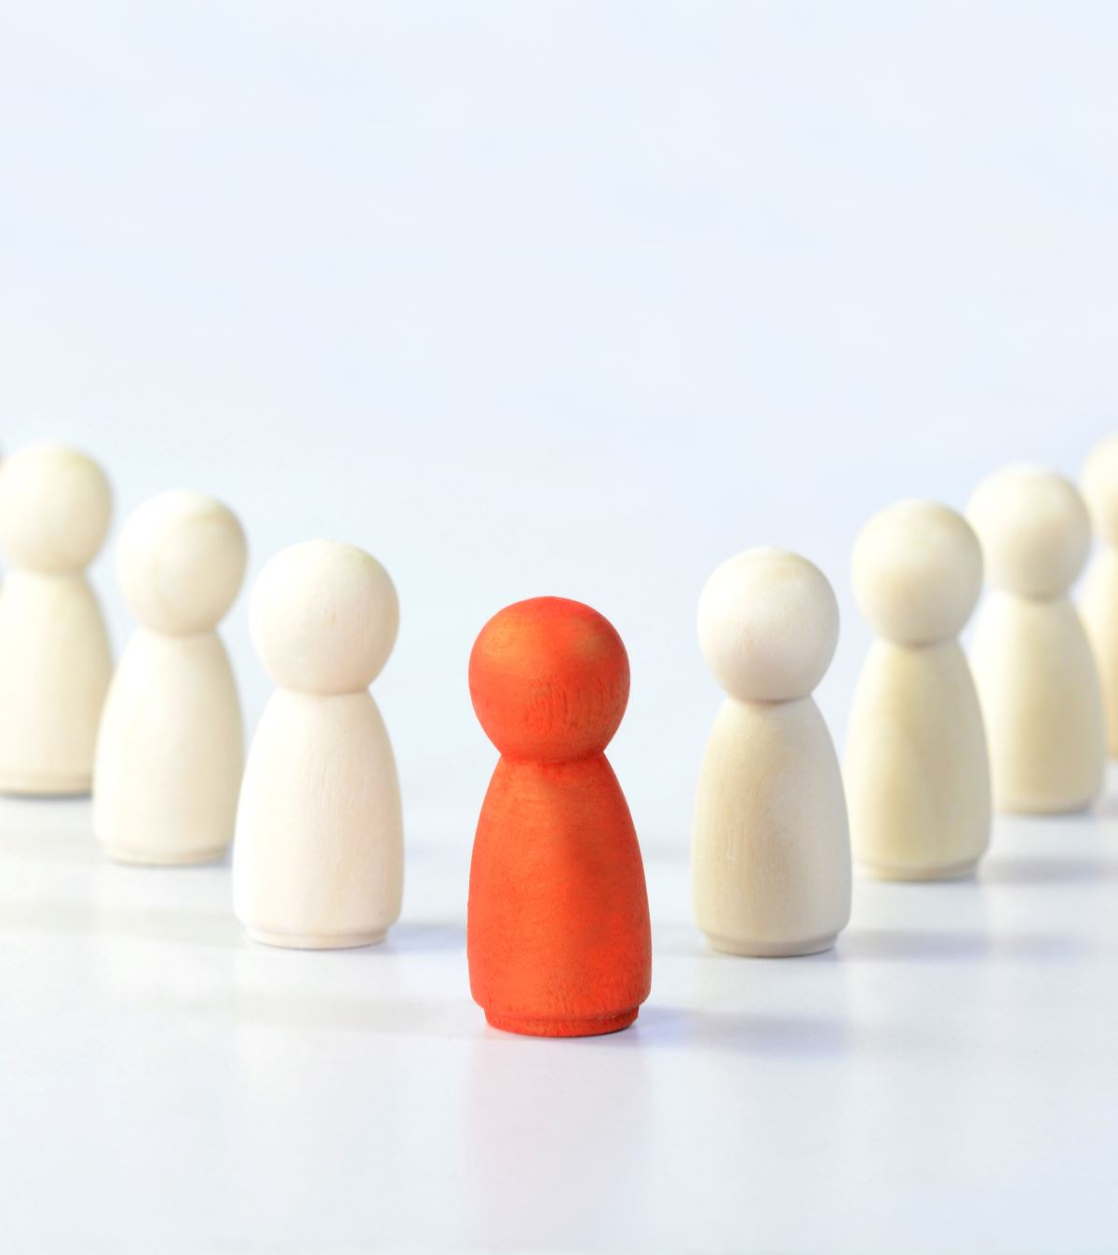
How do copyright laws define a ‘work’?
In-class exercise: Use two minutes to revise Topic 1, slides 13-17
Discussion:
Type: literary work
Originality test: 1. from a human author; 2. expressive

Slide 14

Focusing on the analysis of originality
Who is (are) the author? Can ChatGPT be an author? Can the programmer of ChatGPT be an author? Can you be the author? Can you and ChaptGPT be co-authors?
Is the output text expressive?
Are the prompts expressive?
Do changing prompts affect the output?

Slide 15

In-class exercise
Discuss:
Do you think authorship should be extended to non-human personhood?
If authorship is extended to non-humans, what could be the impact on the legal world?

