Slide 1

Topic 6: IP and AI-generated content: image

Slide 2


Slide 3
Stable Diffusion
Midjourney
DALL-E: now try this!

Slide 4


How does Stable Diffusion work?
Stable Diffusion is a text-to-image model.

Slide 5
Stable Diffusion belongs to a class of deep learning models called diffusion models.
They are generative models, meaning they are designed to generate new data similar to what they have seen in training. In the case of Stable Diffusion, the data are images.

Slide 6
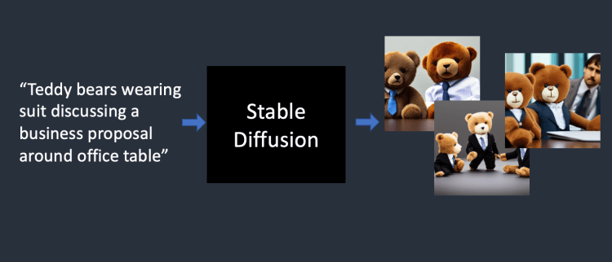

Slide 7
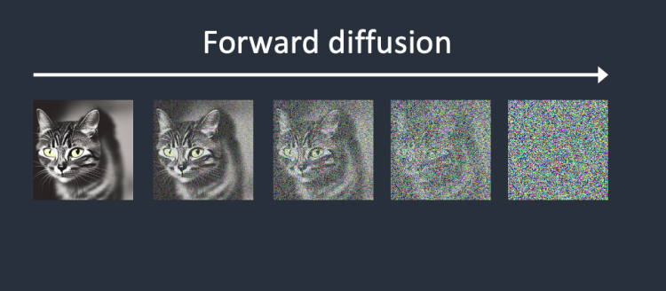

Slide 8
To reverse the diffusion, it needs to know how much noise is added to an image. The diffusion technology teaches a neural network model to predict the noise added. It is called the noise predictor in Stable Diffusion.
After training, the noise predictor is capable of estimating the noise added to an image.
Diffusion models like Google’s Imagen and Open AI’s DALL-E are in pixel space.

Slide 9
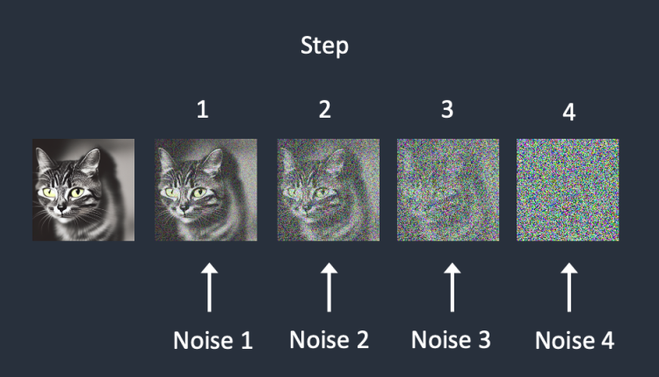

Slide 10
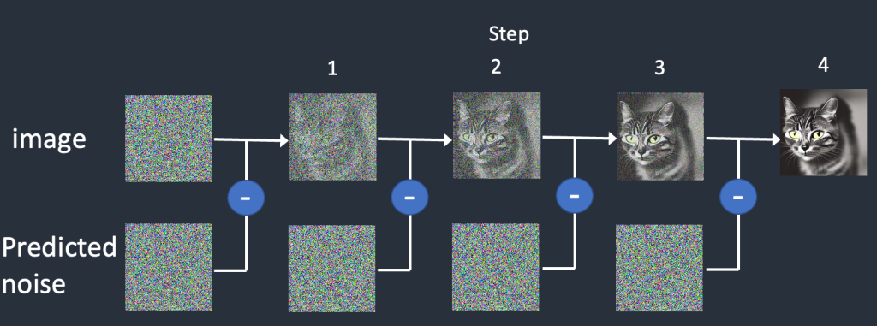

Slide 11
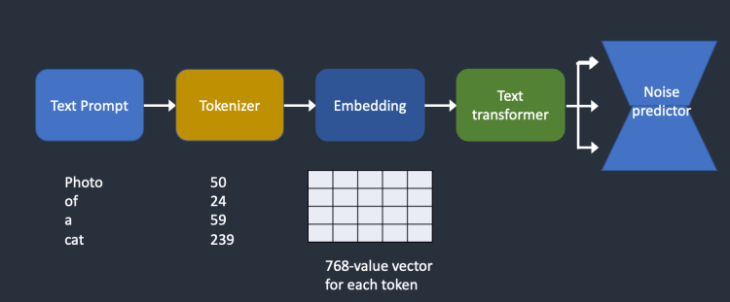
Text conditioning

Slide 12

Prompts
A Prompt is a short text phrase
A Prompt is broken down the words and phrases in a prompt into smaller pieces, called tokens, that can be compared to its training data and then used to generate an image

Slide 13


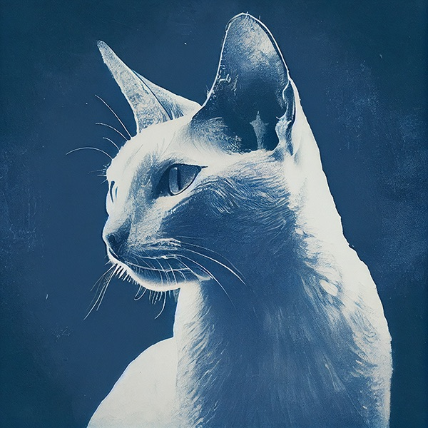

Exploring prompting

Slide 14
Stable Diffusion and Midjourney targeted with copyright lawsuit
The artists allege that these organisations have infringed the rights of “millions of artists” by training their AI tools on five billion images scraped from the web “with­out the con­sent of the orig­i­nal artists.”
It is alleged that the capacity of AI art tools like Stable can be used to create artwork that replicates the style of specific artists.
It is alleged that the tools can “flood the mar­ket with an essen­tially unlim­ited num­ber of infring­ing images will inflict per­ma­nent dam­age on the mar­ket for art and artists.”

Slide 15
The response to the claim
It is incorrect to claim that AI art models “store com­pressed copies of [copyright-protected] train­ing images” and then “recombine” them; functioning as “21st-cen­tury col­lage tool[s].”
AI art models do not store images but mathematical representations of patterns collected from these images.
In addition, the creators of AI art tools generally argue that the training of this software on copyrighted data is covered (in the US at least) by fair use doctrine.

Slide 16
In-class exercise
In this case, what are the legal issues raised by the claimants (plaintiffs)?
The legality of the original data sought from various sources and used for AI training (the input data)
What is copied: an artist’s work or the artist’s style? -- refer to the idea/expression dichotomy (the process)
The effect on the market (the output)
Input
Process
Output

Slide 17
In-class exercise
In this case, what are the defences raised by the defendants?
In response to claim no.1, to use artists’ works for training is a ‘fair use’.
Generative AI modules do not directly ‘copy’; rather, they identify the characteristics of the training data, then predict and denoise.
*For further reading of the fair use rule in Italy, see here.

Slide 18
Another copyright exception: data mining
An act of copying is almost always necessary in order for a machine to be able to read a training set.
To ‘mine’ texts and other content, researchers need to access, copy and process them using computer programmes.
Even if researchers can lawfully access and read the material, for instance, through their university library, copying a substantial part of works may infringe copyright in those works.

Slide 19
Technically, detecting the copyright status of user-generated content from the Internet is complicated since copyright requires no registration. Unlike professional content producers, users and amateur authors usually would not register their works.
The transaction cost can be high in detecting copyrighted works and seeking different licenses for massive materials.
Copyright exceptions as a solution?

Slide 20
EU
In the EU, the Copyright in the Digital Single Market Directive provides an exception for text and data mining for everyone (regardless of the purpose).
Nevertheless, this exception is restrictive since copyright holders can opt out of that exception. For example, they can reserve their rights concerning text and data mining by publishing in their terms and conditions or within the documentation that travels with their content.
This could potentially place a considerable burden on start-ups and businesses, who would need to verify with the rightsholders of the underlying copyright-protected material each time for setting a training set.

Slide 21
UK
The UK government intended to expand the existing text and data mining exception for any purpose.
There has been strong opposition to the proposals. In particular, UK Music said it is “deeply concerned” about the proposals and that the introduction of a blanket exemption for data mining “would allow AI music to be created using copyright content that those controlling the AI do not own, with no compensation to the artists and rights holders whose investment created it”.
Recently, Getty Images lodged legal proceedings at the High Court in London alleging copyright infringement by AI developer Stability AI.

Slide 22
US
The US copyright regime is considered more favourable to data mining practices than what appears to be the case under European laws, also because of the inherent flexibility of the fair use doctrine under §107 of the US Copyright Act as opposed to an EU-style closed system of exceptions and limitations.
Under the US fair use doctrine, the court considers a limited number of factors to determine whether a certain use of a copyrighted work is fair. However, whether the fair use doctrine should apply to machine learning copies is still debatable.

Slide 23
The case of DABUS patents
Thaler invented the AI machine known as ‘Device for Autonomous Bootstrapping of Unified Sentience’ (DABUS) to generate inventions.
With the support of technology law scholar Ryan Abbott and IP firms, Thaler has filed international and national patent applications which mentioned DABUS as an inventor.

Slide 24
The case of DABUS patents
Australian Patent Office refused to proceed with the application. Thaler appealed to the Federal Court and succeeded. Justice Beach analysed the relevant provisions of the Patent Act 1990 and concluded: “[N]one of these provisions exclude an inventor from being a non-human artificial intelligence device or system.” [2021] FCA 879
The European Patent Office rejected the two European patent applications made by Thaler. The Office held that the European Patent Convention (EPC) requires the inventor to be a natural person and an AI machine cannot assign patent rights to the applicant.

Slide 25
The case of DABUS patents
German Patent Office also refused to allow Thaler's applications. Thaler's team took the matter to the Federal Patent Court. On November 11 2021, the court ruled that AI-generated inventions are patentable but a natural person must be named the inventor.
Israel Patent Office refused to accept Thaler's patent applications on March 15, 2023,
South African IP Office granted Thaler’s application. It should be noted that South Africa operates a depository system: the patent office only checks for basic formal requirements. South Africa’s Patent Act 1978 provides several grounds for patent revocation. It remains to be seen whether Thaler’s patent will be challenged.

Slide 26
The case of DABUS patents
The UK IPO refused to proceed with Thaler's applications, arguing that he did not fulfil the statutory requirements concerning inventorship and entitlement. Thaler appealed to the High Court.
High Court: Smith J dismissed the appeal. In his decision, the judge said: “[The] court can only construe legislation and cannot itself legislate, no matter how great the policy need.”
Court of Appeal: an inventor must be a person
Supreme Court: proceeding with the case

Slide 27
The case of DABUS patents
In the Untied States, the USPTO refused to allow the application, stating that legislation and Federal Circuit case law on inventorship “require that an inventor must be a natural person”.
A district court affirmed the USPTO's opinion.
Supreme Court: On March 17, 2023, Thaler and his team filed a petition asking the Supreme Court to clarify whether the US Patent Act restricts the definition of an inventor to only be a human being.

Slide 28
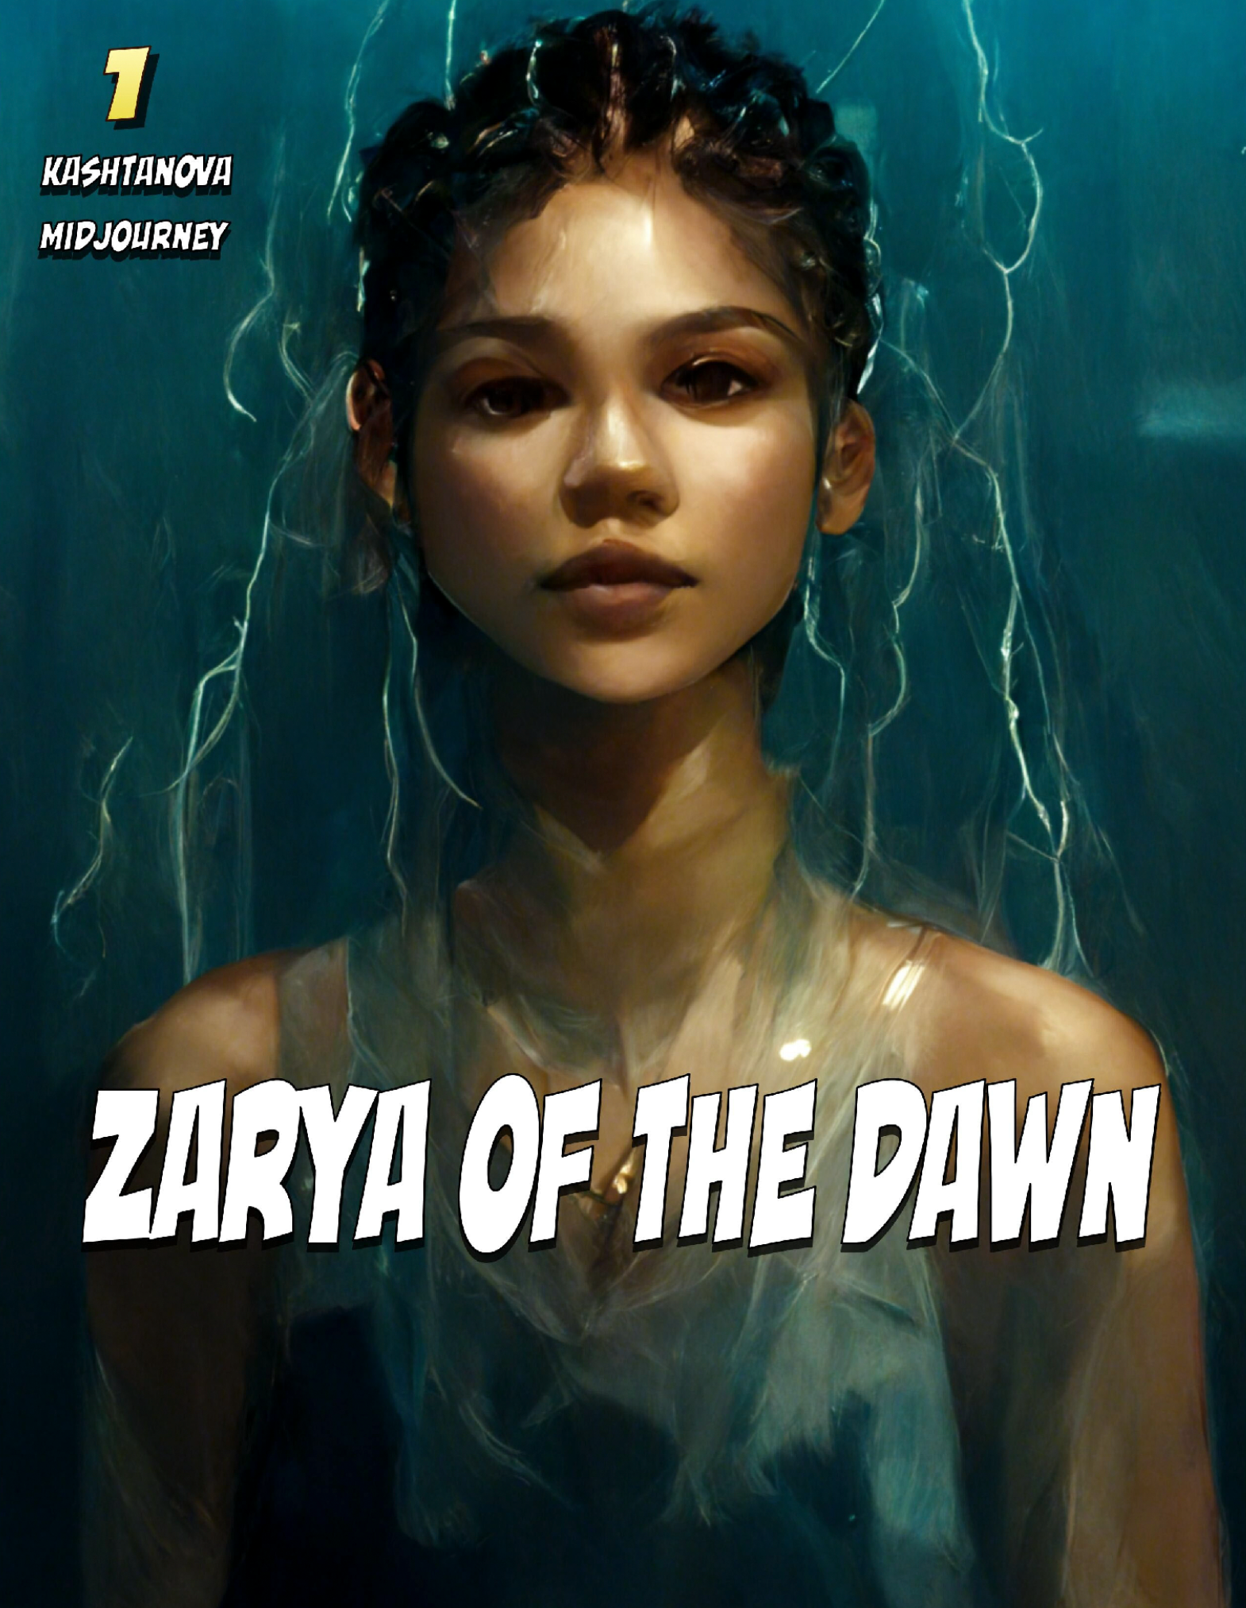
More copyright cases
In 2022, the US Copyright Office had granted copyright protection to a comic book, Zarya of the Dawn, created by Kris Kashtanova with the aid of the text-to-image engine 'Midjourney'.
However, late in 2022, the US Copyright Office reversed its decision.

Slide 29
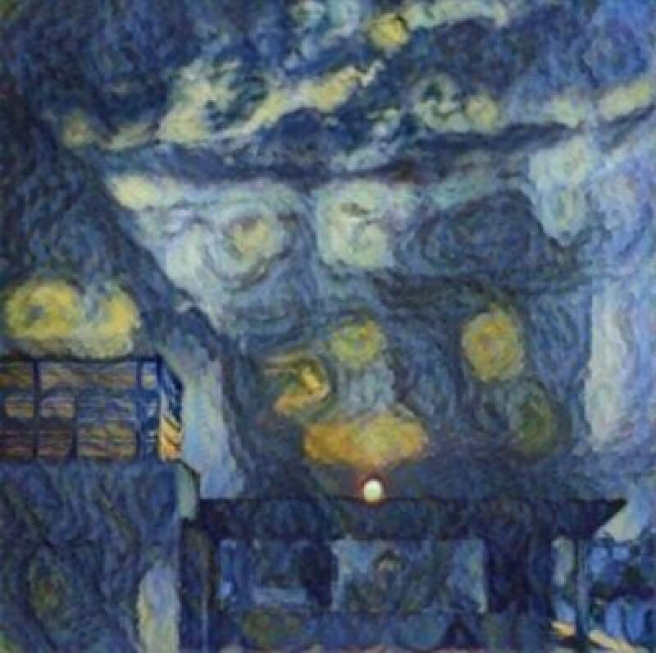
An Indian case

Slide 30
India granted copyright protection in AI works but withdrew the grant.
In 2021, an AI painting app named 'RAGHAV' was registered in India as a co-author in a copyrighted work titled "Suryast". The other co-author was Mr. Ankit Sahni, the owner of the AI App.
Initially, the Indian Copyright Office rejected an application listing the AI ('RAGHAV') as the sole author for an artwork. However, a second application was filed where the owner of the AI and an AI were named as co-authors for another artwork was allowed.

