Slide 1

Topic 8
IP and 3D Printing

Slide 2

What is 3D printing ?

Slide 3
3D Printing is a process for making a physical object from a three-dimensional digital model, typically by laying down many successive thin layers of a material. It brings a digital object (its CAD representation) into its physical form by adding layer by layer of materials.
3D Printing brings two fundamental innovations: the manipulation of objects in their digital format and the manufacturing of new shapes by addition of material.

Slide 4
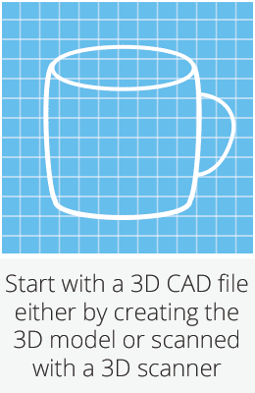

Slide 5
Potential Effects to the Global Economy
3D printing has the potential to bring production closer to the end-user and/or the consumer, thereby reducing the current supply chain restrictions. The customisation value of 3D printing and the ability to produce small production batches on demand is a sure way to engage consumers and reduce or negate inventories and stockpiling.
The shift of production and distribution from the current model to a localised production based on-demand, on-site, customised production model could potentially reduce the imbalance between export and import countries.

Slide 6
The effect of 3D printing on the developing world is a double-edged sword. One example of the positive effect is lowered manufacturing costs through recycled and other local materials. Still, the loss of manufacturing jobs could hit many developing countries severely, which would take time to overcome.
The developed world would benefit the most from 3D printing, where the growing aged society and shift of age demographics has been a concern related to production and work force. Also the health benefits of the medical use of 3D printing would cater well for an aging western society.

Slide 7
Why 3DP? Why now?
Limited choice for design
Platforms
Exploitative behaviours

Slide 8
Between copyright & design protection for CAD files
Rent-seeking: excessive utilisation of copyright protection
no substantive examination
no requirement for registration
a longer period of protection

Slide 9
Crux of the cumulative protection
Aesthetic value v originality
Limited choice v novelty

Slide 10
International Law
Berne Convention permits cumulation
EU: Design Directive; Infopaq; Flos; Cofemel; Brompton
UK: CDPA 1988; industrial copyright
China: partial cumulation

Slide 11

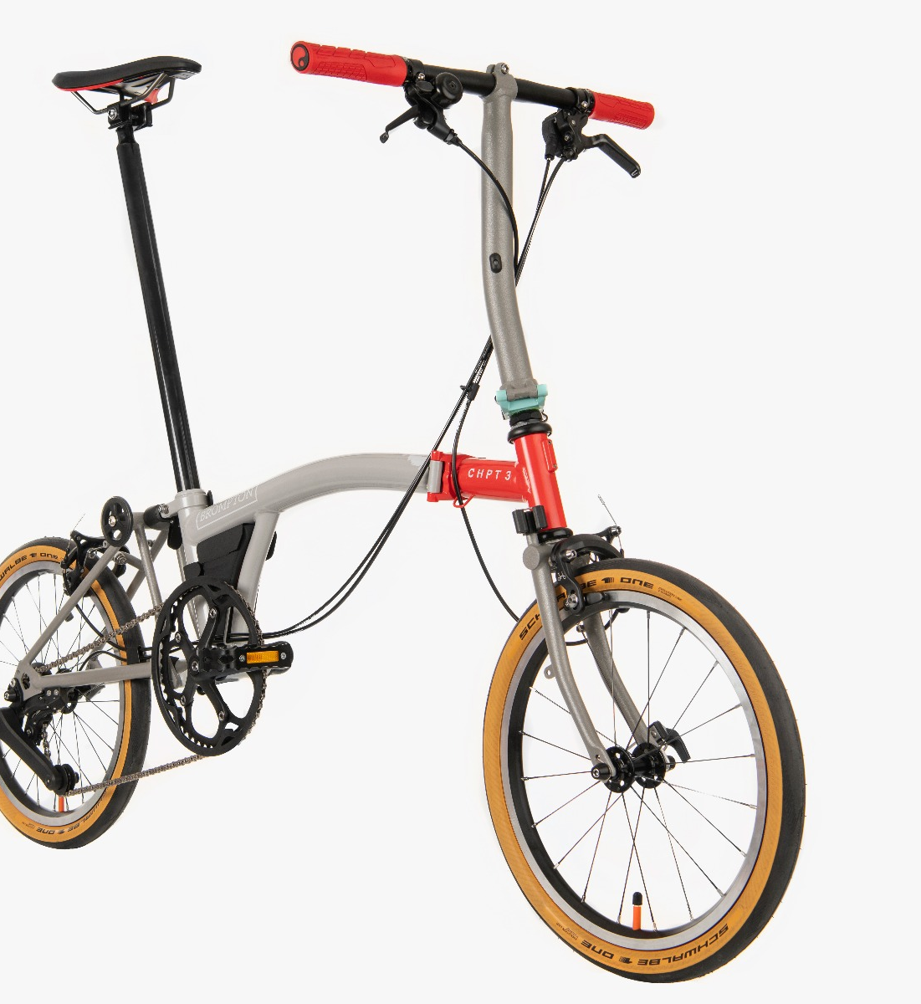
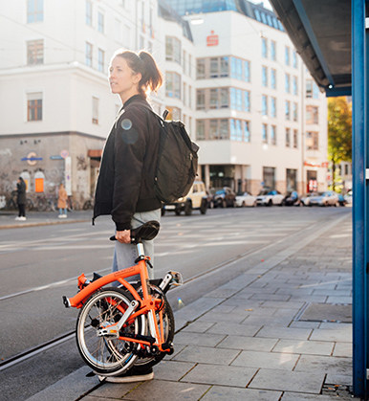
Brompton Bicycle Case
Copyright protection could be granted to an object – specifically, a foldable bicycle – the shape elements of which are necessary to obtain the technical effect.

Slide 12
Brompton Bicycle Case
The CJEU concluded that the shape of the bicycle was necessary to obtain the technical result but that this consideration did not per se prevent the product from being qualified as a ‘work’ that can be protected by copyright, which constitutes an ‘original work resulting from intellectual creation’.
The shape is an expression of the author’s ‘creative ability’. To satisfy this requirement, the author must create the product ‘by making free and creative choices in such a way that that shape reflects his personality’
The CJEU clarifies that the product, the shape of which is solely dictated by its technical function, will not be protected by copyright

Slide 13
Implications
The Brompton judgement has made it clear that in the EU all designs that are the result of an author’s intellectual creation are protected by copyright – even if their shapes are technically dictated.
An artistic achievement of any kind, or any other additional condition, is not required.

Slide 14
The Flos case
In its decision “Flos” the CJEU had to rule on the compatibility of the Italian provisions on the protection of industrial designs with Directive 98/71 on the legal protection of designs after the Court of Milan had made a reference to the court for a preliminary ruling.
The CJEU held that national laws could not refuse copyright protection to designs which were eligible for copyright protection.

Slide 15
The aftermath of the Flos case
As a reaction to the implications of the Flos decision, Ireland followed suit with the UK. It started amending its national copyright law in 2019 to align it with EU standards as defined by the European Court of Justice.
Harmonisation at the EU level

Slide 16
Implications
All designs in the EU are protected by copyright, and companies should therefore ensure that the ownership of the designs created in their business environment must be clearly regulated.
Also, it is advisable for such companies to document with precision their own development processes so that they not only establish their own copyrights but are also able to defend themselves against accusations of infringement of the copyright of third parties.

Slide 17

Assessment of copyright originality in design documents:
Reintroduce aesthetic values
Broader application of the merger doctrine

Slide 18

Revamp the IP system?
Assessment of novelty in designs:
What is prior art
Who is the appraiser

Slide 19
The degree of novelty
What is prior art
Novelty can be a partial novelty

Slide 20
The appraiser
An expert’s perspective
A knowledgeable consumer’s perspective
An average consumer’s perspective
Discuss: what are the differences between the three groups?

Slide 21
In a 3D printing context
A consumer could be simultaneously a designer (customising the design) and a producer (using a home 3D printer), therefore becomes a ‘prosumer’
A ‘prosumer’ is better versed with the relevant knowledge of design and production compared to a passive consumer
Therefore, an appraiser could be a knowledgeable consumer or an average consumer

Slide 22
The way forward
Cumulation remains possible
Avoid rent-seeking
Boost quality registered designs
Maintain unregistered designs
Level up the threshold for copyright protection for design documents

