Slide 1

Digital assets and private law
Angelia Wang
IECoLS Seminar
30 March 2023

Slide 2
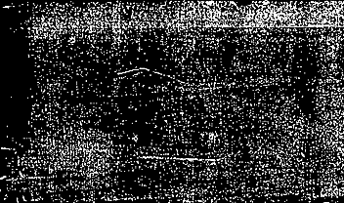


I am from Durham University, UK

Slide 3



Agenda
1. Blockchain and NFT
2. Tokenisation of artwork
3. The legal nature of NFT
4. Comparative analysis

Slide 4

Blockchain and NFT

Slide 5
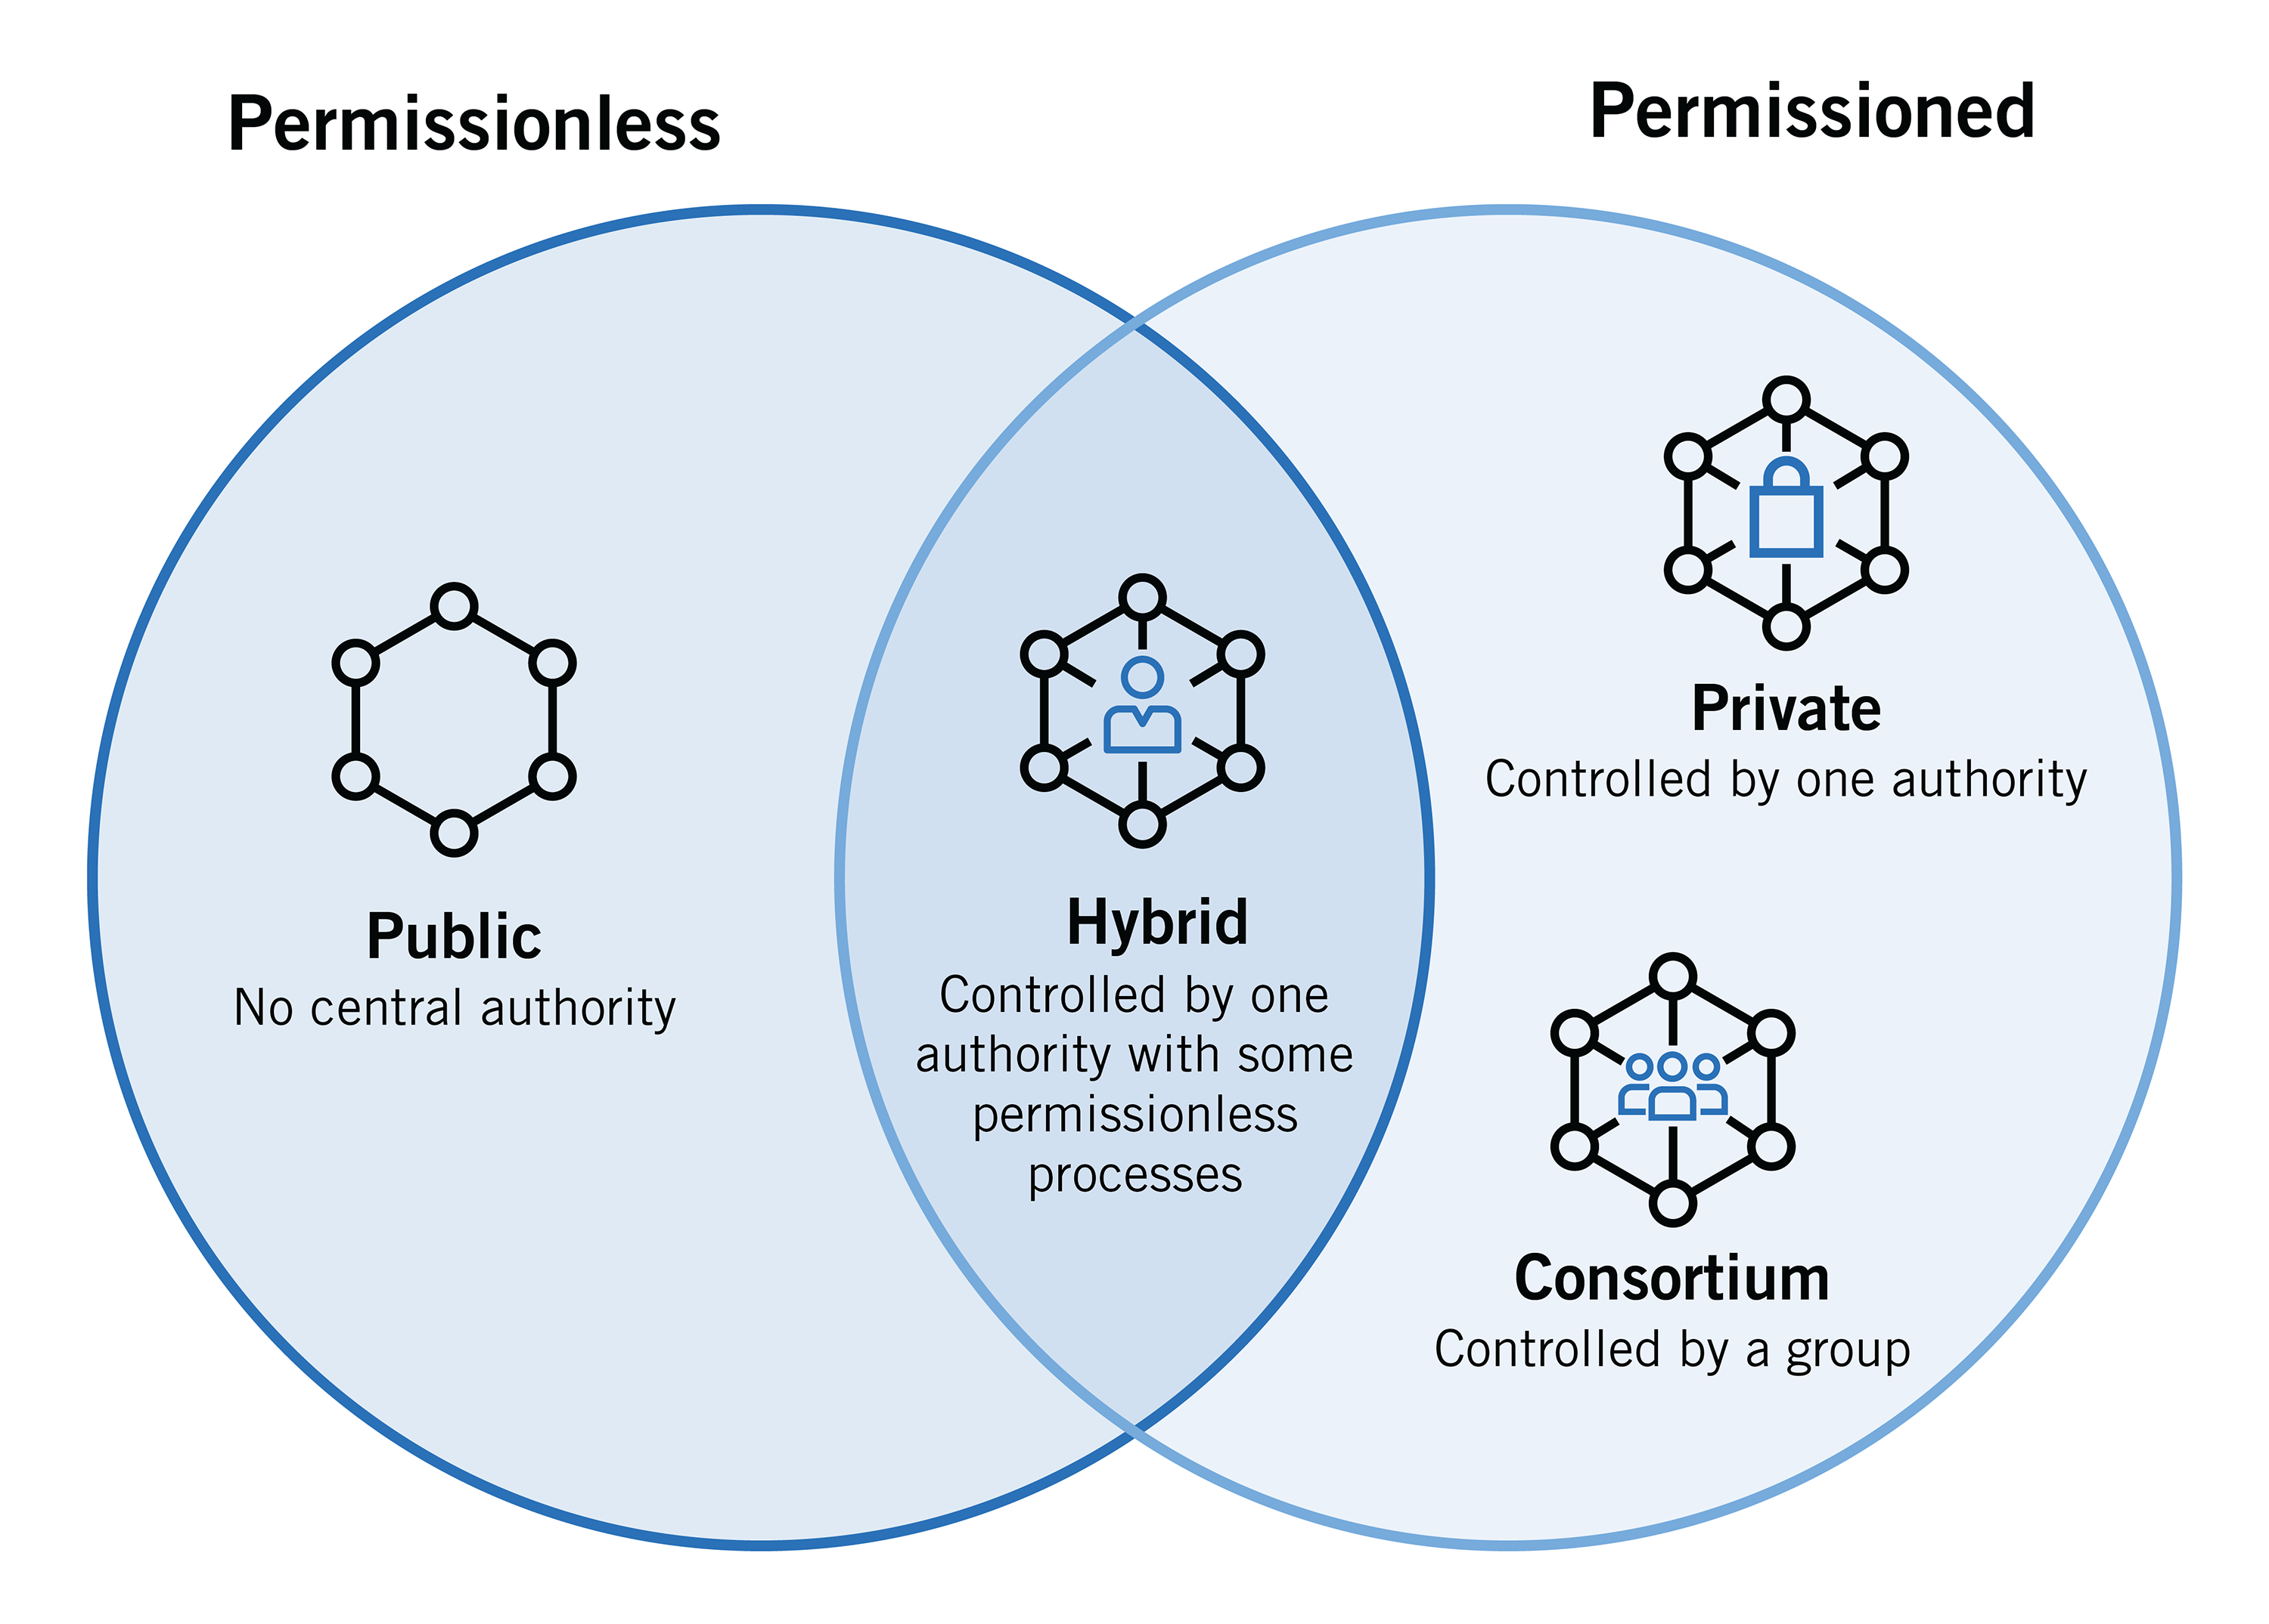
Types of blockchain

Slide 6
Types of blockchain
Public blockchains are permissionless, allow anyone to join, and are completely decentralized. Public blockchains allow all nodes of the blockchain to have equal rights to access the blockchain, create new blocks of data, and validate blocks of data. To date, public blockchains are primarily used for exchanging and mining cryptocurrency.
Private blockchains are permissioned blockchains controlled by a single organisation. The central authority also does not necessarily grant each node with equal rights to perform functions. Private blockchains are only partially decentralized. Examples are the B2B virtual currency exchange network Ripple and Hyperledger.
Consortium blockchains are permissioned blockchains governed by a group of organizations. An example is CargoSmart that developed the Global Shipping Business Network Consortium.

Slide 7
What is NFT
Non-fungible (irreplaceable) token (cf. a bitcoin is fungible)
At a very high level, most NFTs are part of the Ethereum blockchain, though other blockchains have implemented their own version of NFTs. Ethereum is a cryptocurrency, like bitcoin or dogecoin, but its blockchain also keeps track of who’s holding and trading NFTs.
NFTs help create ‘digital scarcity’ – an artificial scarcity created by unique blocks proving ownership

Slide 8
MINTING NFTs
Minting platform allows an individual to create a free account and mint a token in connection with digital art
The authors created an account and clicked “Start Minting Now” and then “Create a New Item.” Before going any further, the authors were required to link a digital wallet with the Mintable account.
Connecting to a wallet is necessary because payment for a mintable NFT, if purchased, is made using Ethereum’s cryptocurrency
The underlying smart contract allows an option between the transfer of ownership and non-transfer transactions

Slide 9
Types of tokens
Subset | Purpose | Inherent value
Cryptocurrency | Digital tokens based on blockchain technology, such as Bitcoin. | None
Asset-backed token | A representation of ownership of a physical asset (for example, natural resources such as gold or oil). | Derives its value based on the underlying asset.
Utility token | Providing users with access to a product or service. It does not entail any ownership in a company’s platform or assets and, although it might be traded between holders. | Value is derived from the demand for the issuer’s service or product.
Security token | Similar in nature to traditional securities | Value is derived from the success of the entity

Slide 10
Tokenization of artwork

Slide 11
How to trade artwork
Pre-digital era
Digital era
Transfer of ownership: the possession of the artwork is separate from the right to display
Licensing(non-transfer of ownership)
Disadvantages of licensing
-- agent cost is high
-- inaccurate or unable to trace the source of the work
Blockchain-based and cryptocurrency-based transactions
De-centralized and de-intermediary
Addressing the disadvantages of licensing
-- accuracy in tracing the source and collecting payment
-- transaction cost is lower

Slide 12
How to make and sell an NFT
NFT marketplaces list their products in digital currency, the most widely used of which is Ethereum (ETH). Once an NFT is purchased, ownership is transferred from the seller to the buyer, and publicly recorded on the blockchain.
Since the NFT surge in 2021, there has been a number of new NFT marketplaces cropping up, each one trying to find a specific ‘niche’ within the market, and each having its own pros and cons.

Slide 13
I have questions about this emerging... um... art form? Platform?

Slide 14
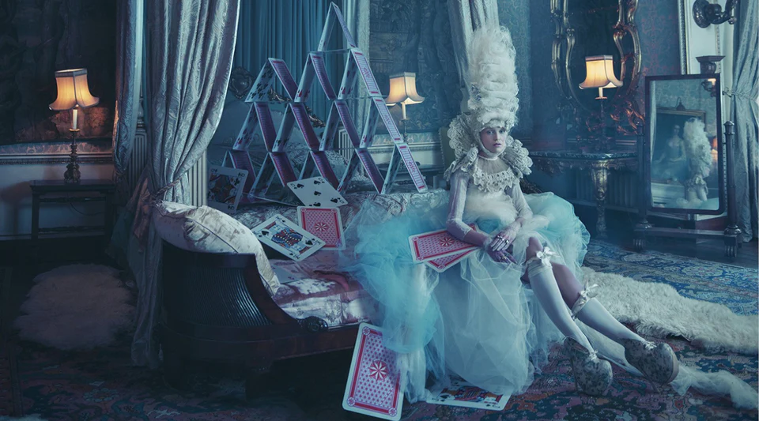
Platforms and Marketplaces For NFT Art

Slide 15

Platforms and Marketplaces For NFT Art
OpenSea: The Most Popular & Established NFT Marketplace
Superrare: The NFT Marketplace Most Like An Art Gallery
Foundation - The Premium NFT Marketplace For Exclusive Art

Slide 16
Platforms and Marketplaces For NFT Art
In China, after concern about the speculation around non-fungible tokens (NFT), the four tech giants Tencent, Ant, Baidu and JD self-imposed a ban on the secondary trading of digital collectibles in mid-2022.
China launches a state-sanctioned secondary digital asset exchange for NFTs on 1 January 2023
China announced that NFTs launched the network would not have any links to cryptocurrency, with all NFT transactions settled in Yuan.

Slide 17

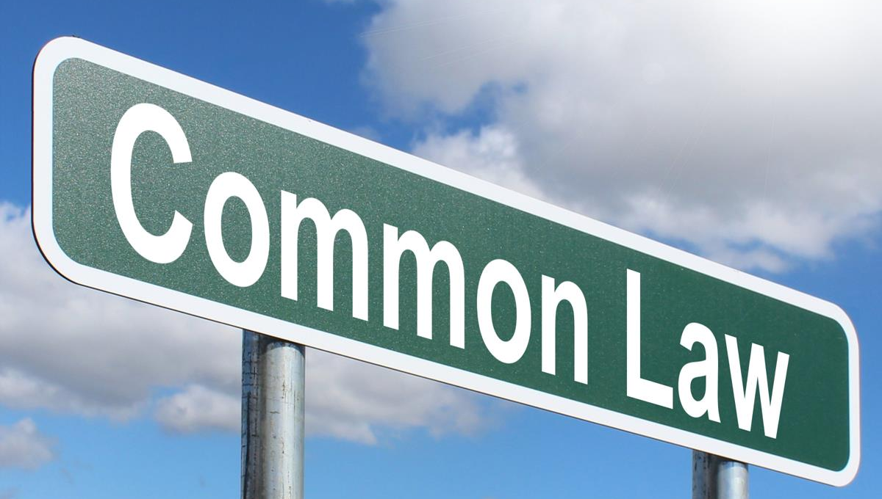
The question is …
This Photo by Unknown Author is licensed under CC BY-SA-NC
What is the legal nature of NFTed digital artwork?
This Photo by Unknown Author is licensed under CC BY-SA

Slide 18
Comparative remarks
Civil law, following Roman, has tended to deny the possibility of legal possession of anything that cannot be touched. English and American law, by contrast, generally are more open to the notion that one may be possessed of a right, a power, or a privilege.
In the case of land, civil law tends to give possession to the owner of the land and to be reluctant to recognise property rights in anyone other than the owner. Anglo-American law, however, recognises multiple possessory rights in land and hence tends to speak not of ownership of the land but of ownership of an interest in land—i.e., of an intangible legal abstraction in a tangible thing.

Slide 19
Ownership: unitary vs fragmented
Separability between a physical object and an intangible legal abstraction arising from it
So, the question is ...
Is NFT a digital title deed?
Is NFT a transaction recording ledger?
Or what else?

Slide 20
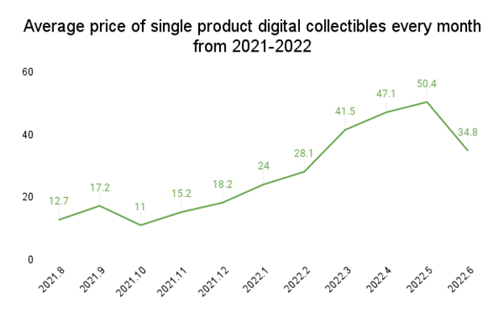
China
NFT is becoming a buzzing word

Slide 21
China: legislation
Article 127 of the Chinese Civil Code
-- it is a civil right to ‘data and virtual property’ (art 127 is under Book I ‘General Provisions’, Chapter 5 ‘Civil Right’)
-- it is not a ‘thing’ under Book II ‘Property Rights’
A purchaser acquires neither IP rights in the work nor the right to use the work

Slide 22
Common law approaches
The point on whether NFTs could be a form of property was more fully developed in AA v Persons Unknown [2019] (“AA”). Bryan J noted that the “English law traditionally views property as being of only two kinds, choses in possession and choses in action’’
Cryptocurrencies and tokens did not fall neatly into either category and thus could not be classified as a form of property
The UK Legal Statement states that the common law has the ability to stretch “traditional definitions and concepts to adapt to new business practices”

Slide 23
Common law approaches
Crypto assets were property, given that they met the four criteria set out in National Provincial Bank Ltd v Ainsworth [1965] (“Ainsworth”)
Ainsworth test:
definable
identifiable by third parties
capable in its nature of assumption by third parties, and
have some degree of permanence or stability

Slide 24
English High Court’s first decision on NFTs recognised NFTs as legal property against a fraudulent clone online brokerage (the D’Aloia case, decided on 24 June 2022)
This ruling demonstrates that the English courts are open to entertaining constructive trust claims concerning crypto assets, not only against the fraudsters themselves but also against third-party exchanges. (Law Commission's analysis in their Consultation Paper on Digital Assets, published on 28 July 2022 )

Slide 25
Common law approaches
Singapore’s first decision on NFTs (2022) SGHC 264
1. An NFT with its unique metadata is definable.
2. An NFT with its private keys would be an asset with an owner being capable of being recognised as such by third parties.
3. The ‘nature of the blockchain technology gives the owner the exclusive ability to transfer the NFT to another party, which underscores the “right” of the owner.’
4. An NFT has a relevant degree of permanence and stability.

Slide 26
summary of the common law appraoch
NFTs are intangible assets
Possessory rights in intangible assets: ownership of an interest in an artwork – an intangible legal abstraction in a tangible thing
NFTs can be used to transfer ownership of a work or to issue a copy of a work, which is dependent on the author’s decision
The artwork per se and its copies can be tokenised and traded in fragmentation

Slide 27
European approaches
The Regulation of the European Parliament and of the Council on Markets in Crypto-assets (MiCA) 24 September 2020 does not cover the legal nature, effects and admissibility of using asset-backed tokens to transfer property rights
According to a narrow approach, the object of property is limited to “corporeal things”, as is the case under German and Swiss law. This means that tokens could not be regarded as the object of property
Broader definition of the concept of a “thing” includes “patrimonial or valuable rights” or a broader definition of the concept of an “asset”, which makes the regulation of tokens as an object of ownership easier. For example, Spain and Italy

Slide 28
Overlapping property and intellectual property rights
Copyright and property rights may co-exist in one piece of artwork
Discuss: how to exercise the copyright in the work?

Slide 29
Mango case
VEGAP (Spanish collective society for artists) v Mango (fast fashion brand)
Commercial Law Court of Barcelona 2022
Facts:
Mango exhibited a series of artworks created by Farkas, an artist, in a virtual museum on the Decentraland
Mango legitimately owns the original copy of the works.
The collection was designed to reinterpret rather than directly reproduce the artworks
Holding: the right to display does not give the right to digitise the work, display and sell it as NFT. The right to tokenise a work protected by copyright belongs to the owner of the copyright or those who have the authorisation of the owner; beyond this hypothesis, this right belongs to the owner of NFTed work. Consequently, it is necessary to distinguish NFTs from NFTed artwork. The NFT is a mechanism for forming the ownership of a right of use and disposition of digital work in the hands of the person who registers the NFTs.

Slide 30

China: case law
The first court decision involving NFT (2022)
Holding: 1. NFTed work only confers a possessory interest in the copy, not the right to control the subsequent use and transfer
2. The sale of the NFTed work infringed on the right to disseminate work on information networks
3. There is copyright infringement

Slide 31
Convergence of law in digital assets?
The data must be stored securely on the blockchain ledger. The nature of blockchain technology gives the owner the exclusive ability to transfer the NFT to another party, which underscores the “right” of the owner.
The data should be capable of being recognised by third parties.
The data has intrinsic value that is respected and potentially desirable by third parties.
An NFT has a relevant degree of permanence and stability as money in bank accounts which, nowadays, exist mainly in the form of ledger entries and not cold hard cash.

Slide 32
Comparative remarks
Common law’s ability to stretch “traditional definitions and concepts to adapt to new business practices”.
In Europe, although some jurisdictions traditionally take a narrow approach concerning the scope of the property, which is limited to “corporeal things”, many others are more open to including incorporeal assets, such as patrimonial rights, into real rights.
China’s first Civil Code explicitly recognises virtual property as an object protectable by law. In the first NFT-concerned case, the court distinguishes the NFTed work from a physical object and holds that an NFTed work is a ‘digital commodity’, and NFTed copies of the work are digital assets

Slide 33
conclusions
Property is moving from a static concept to a concept of act and activity. At the same time, ownership is the link between the owner and the worthy interest to be realised and guaranteed.
The comparison between the legal systems implies an increasing level of convergence of law towards a harmonised concept of digital assets in a world built on blockchain and tokens.
NFTed artworks are considered incorporeal assets that confer quasi-property rights and interests.

Slide 34


Thank You!

