Slide 1
LABORATORIO LINGUISTICO 1 e 2
Giurisprudenza
«Scienze per i servizi giuridici»
Anno Accademico 2023-2024
Docente
Federica Paccaferri.

Slide 2
Specialized discourse
There is an ever greater interest by linguists in distinguishing the characteristics of the various genres which make up a language .
Specialized discourse (SD) is concerned predominantly with the language used in professional and institutional settings, e.g. in business, hospitals, schools, universities, the courts etc.
The major distinguishing feature of SD (with respect to general discourse) is its lexicon, i.e. the large number of specialized lexical items pertaining to a particular genre
The equivalent of SD in ltalian is linguaggi settoriali

Slide 3
The expression 'legal language' covers any sort of discourse which is concerned with legal matters (descriptive and prescriptive), whereas the expression 'the language of the law' is concerned with prescriptive legal discourse.

Slide 4
Different types of legal discourse
The legal discourse community is made up of lawyers, judges, and all those involved in drafting laws. These are the 'insiders'.
There are different types of legal discourse (subgenres): e.g. the language used between lawyer and client or between two lawyers; the language of
the courts (much of which is archaic); the language of Jaw
reports and academic texts on legal matters; the language of legal documents.

Slide 5
Archaic or rarely used words and expressions
1
Legal English sometimes uses archaic or rarely used words and expressions. Here are two examples. The first is the enactment clause to be found at the beginning of laws passed by Westminster. The second is typical of the language of contracts.
Be it enacted by the Queen's most Excel/ent Majesty, by and with the consent of the Lords Spiritual and Tempora/, and Commons, in this present Parliament assembled, and by the authority of the same, as follows:
NOW, THEREFORE, in consideration of the foregoing and the respective representations, warranties, covenants and agreements set forth in this Agreement and intending to be legally bound hereby, the parties hereto agree as follows:

Slide 6
Binomials and trinomials
Binomials and trinomials (also known as 'strings') are particularly common in the language of contracts and wills, e.g.
... the terms and conditions set forth in this agreement ...
This is the last will and testament of me ...
I give, devise and bequest all my property of every nature and kind ...
... the same may be amended, supplemented or modified in accordance with the terms hereof ...

Slide 7
Formulaic expressions
Legal language in general tends to use formulaic expressions, e.g.
Do you swear to tell the truth, the whole truth, and nothing but the truth?
Now, therefore , the parties agree as follows:
I,____ , of_____being of sound and disposing mind, do hereby make, publish and declare the following to be my Last Will and Testament ...

Slide 8
French words and Latinisms
Legal English sometimes contains words and expressions from Latin or French, e.g.
"The defense was that the plaintiff was not a de jure officer and that a de facto officer is not entitled to a salary."
"lf in case B a court with power to overrule case A says that case A is overruled, the ratio decidendi of case A ceases altogether to have any authority so far as the doctrine of precedent is concerned."
"The Czech Republic shall remove trade barriers in the coal market with the acquis by accession..."

Slide 9
Frequent repetition of particular words, expressions and structures
There is a lot of repetition in legal texts (pronouns are only rarely used), generally to avoid ambiguity, e.g.
Powers of vice-ch·air 11. Where (a) a member of a Board is appointed to be vice-chair either by the Assembly or under regulation 1O, and (b) the chair of the Board has died or has ceased to hold office, or is unable to perform the duties of chair owing to illness, absence from England and Wales or any other cause, the vice-chair shall act as chair until a new chair is appointed or the existing chair resumes the duties of chair, as the case may be; and references to the chair in Schedule 3 shall, so long as there is no chair able to perform the duties of chair, be taken to include references to the vice-chair.

Slide 10
Long complex sentences with intricate coordination and subordination
UN Resolutions are generally made up of one long sentence, e.g.
Resolution 2038 (2012)
Adopted by the Security Council at its 6726th meeting, on 29 February 2012 The Security Council,
Recalling its resolution 1966 (2010) adopted on 22 December 2010,
Having regard to Article 14,paragraph 4, of the Statute of the lnternational Residual Mechanism for Criminai Tribunals (the Mechanism), annexed to resolution 1966 (201O),
Having considered the nomination by the Secretary-General to appoint Mr.Hassan Bubacar Jallow as Prosecutor of the Mechanism (S/2012/112),
Noting that, according to article 7, paragraph (a) of the Transitional Arrangements annexed to resolution 1966 (2010), the Prosecutor of the Mechanism may also hold the office of Prosecutor of the lnternational Criminal Tribunal for Rwanda (ICTR),
Recalling that pursuant to resolution 1966 (2010) the Mechanism's branch for the ICTR
shall commence functioning on 1July 2012,
Decides to appoint Mr.Hassan Bubacar Jallow as Prosecutor of the lntemational Residuai Mechanism for Criminal Tribunals with effect from 1 March 2012 for a term of four years.

Slide 11
Syntactic discontinuities
Syntactic discontinuities are frequent in legal discourse. They interrupt the 'natural' flow of the sentence by inserting added information (highlighted here in blue), e.g.
lf, after informing the supervisory authority concerned under subsection (3), any measures taken by the supervisory authority against the insurance undertaking are, in the opinion of the regulatory authority, not adequate and the undertaking continues to contravene this Act, the regulatory authority may, after informing the supervisory authority of its intention, apply to the High Court far such an arder ...-
Developed country Members shall, if requested by other Members, previde copies of the documents or, in case of voluminous documents, summaries of the documents covered by a specific notification in English, French or Spanish.

Slide 12
Widespread use of the passive
The passive is very common in legal discourse, especially where it is not necessary to specify the agent, e.g.
The acronym EURES shall be used exclusively for activities within EURES. lt shall be illustrated by a standard logo, defined by a graphic design scheme. The logo shall be registered as a Community trade mark at the Office for Harmonisation in the Internal Market (OHIM). lt may be used by the EURES members and partners.
• lf any term or provision of this Agreement shall be deemed prohibited by or invalid under any applicable law, such provision shall be invalidated without affecting the re·maining provisions of this Agreement, the Originai Agreement o'r the Loan Doca-ments.

Slide 13
Impersonalstyle
The language of the law tends to use a highly formal, impersonal style, always in the third person, e.g.
No one may be subjected to slavery, servitude or forced labour.
Everyone has the right of access to a) any information held by the state and b) any information that is held by another person and that is required far the exercise or protection of any rights .
When a prisoner is found guilty of an infraction of the laws of this state or the rules of the department, gain-time may be forfeited according to law.
Members shall ensure that their sanitary or phytosanitary measures are adapted to the sanitary or phytosanitary characteristics of the area - whether all of a country, part of a country, or all or parts of several countries - from which the product originated and to which the product is destined.

Slide 14
Long lists
Long lists can be typically found in definition provis i ons, e.g.
"Governmental Rule" means any statute, law, treaty, rule, code, ordinance, regulation, license, permit, certificate or arder of any Governmental Authority or any judgment, decree, injunction, writ, arder or like action of any court or other judicial or quasi judi cial tribunal.
"Person" means an individuai , corporation, limited liability company, partnership (limited, generai or otherwise), association, trust, business trust, unincorporated organization, or other entity or group.

Slide 15
Nominalization
I
Nominalization is the process by which a grammat ical
expression (very often a verb phrase) is turned into a noun
phrase, e.g. to apply = to make an application. lt is a common feature of formal language in generai. For example,
An amendment to the Constitution of Canada may be made by proclamation issued by the Governar Generai ...
No restrictions may be placed on the exercise of these rights other than those imposed in conformity with the law
...
• In the preparation and application of sanitary or phytosanitary measures, Members shall take account of the special needs of developing country Members, and in particular of the least-developed country Members.

Slide 16
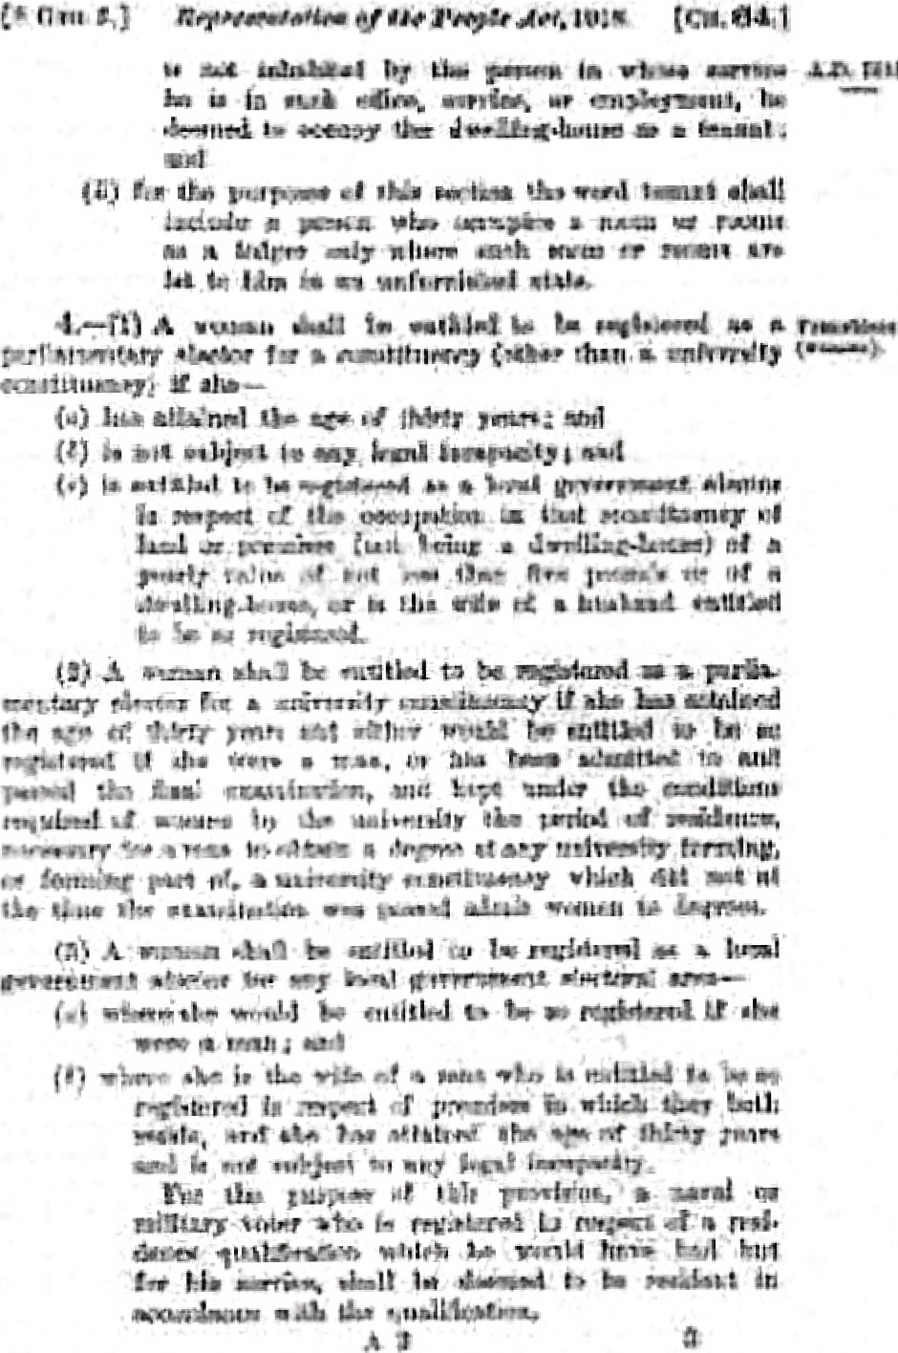
Characteristics of legal English
Repr. l1hatluu ut lht' PèOplv A&. IOJS.
AN ACT
Ameod 11 Lliw fth n.>ifpll!H to Parll·t.111enl1n.v n.1111
1,,....,.1 Gu\",.m1114"!1 l 1•rar.t1h1M;.-. nt11I thf! li ';;i"
tioo ol l'urliaunUnr.r llllil .IÀelil Govtomm •nl
Etooc nrid lha
ondo\)i t>f 'f!''k-Otiozu, Gnd -tu
pràridto t'ot thct tt9dkt."'lbutJuu ''' 7:;l•llll u l"nt­
U..U.•nlart Kl•ril'-llll. •tifi r.,r ''ii\l'IT lJUÌ'pOMI
eonooekd tllcnwitb.
Cllapter 64.
eth ro1mw"Y 19Ul

