Slide 1
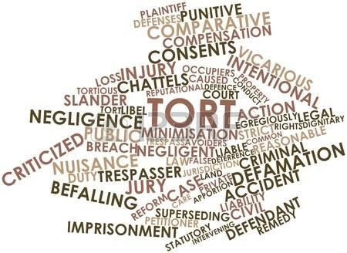

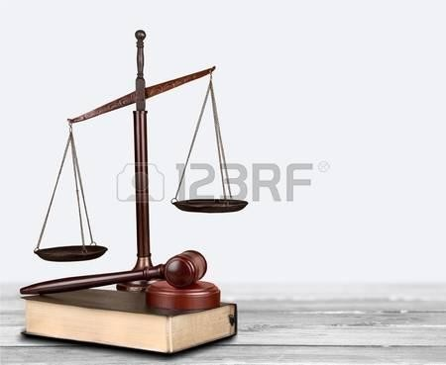


English Legal Language: An overview
J. Tessuto

Slide 2
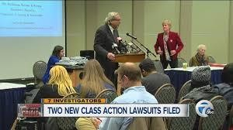


What is language and law about?
Law is found everywhere in the entire explosion of news that
journalists have to live in and explore in media outlets
Lawsuits (one person brings against another) > pain and suffering – punitive damages – loss of companionship – class action - etc…
Criminal trials (prosecutor brings a case against an alleged
criminal) > murder – manslaughter
handling stolen goods - etc....
Businesses going bunkrupt etc.
- impersonation –

Slide 3
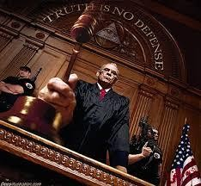
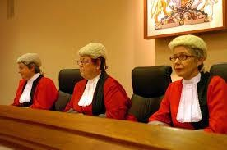
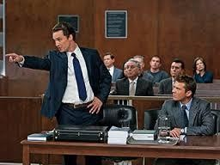
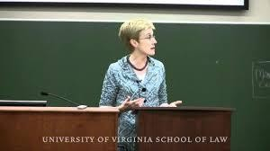
If law pervades our lives, its Language has an influence on law
shaped by users of the law > practitioners (e.g. lawyers, judges, legislators) > academics (e.g. law professors)

Slide 4
Legal implications of language
constitutions come into existence
laws and statutes are enacted
contractual agreements take effect
interactions between police and suspects
conversations between lawyers and their clients
making a defamatory statement, etc.

Slide 5
Language and Law: technical vocabulary (lexicon) is familiar to legal practitioners but foreign to the rest of us
court of first instance / first-instance court: a court in which proceedings are started
the reasons for going to court: the grounds
English or American lawyers argue a case in court: right of audience to have ownership of a property: the property belongs to you
injury, loss, or harm (caused to someone): damage compensation (sum of money): damages
compensation can be claimed (by the injured party)
awarded (by the court)

Slide 6
Regular use of lexicon and grammar within the particular socio-cultural area:
law is a specialized subject (like every discipline from Economics and Sociology to Medicine) >> ‘language users’ exclude others who are not expert of the discipline
law needs a specialized “variety of language” (Tiersma 1999)
or “legal register” (Kurzon 1999)
legal English or English legal language
to express / negotiate important meanings, propositional, social and functional meanings
including

Slide 7
Regular lexicon often used to highlight differences from the stereotypical interpretation of ordinary English language
Technical terms used in legal language only
acquittal – guilty plea – finding of guilty …
terms borrowed from
ordinary language contexts >
- operating in
semantically extended
acquiring specialized
meanings in law because of the proper conduct of law
consideration - nervous shock -
diminished responsibility - negligence recklessness actual / grievous bodily harm
actual / grievous >> premodifiers of crimes at different levels of seriousness and criminal liability

Slide 8
The characteristic of Legal English or English legal language is its use by experts in the field to communicate among each other
Sager (1990: 105) on the definition of special languages: “semi-autonomous, complex semiotic systems based on and derived from general language“

Slide 9
Specialist use of language by experts:
Discourse community (Swales 1990): a term used in composition studies and sociolinguistics for a group of people involved in and communicating about a particular topic or in a particular field
a group of people who share certain language-using practices typical of “registers” and “genres” (e.g. Swales 1990, 1998; Berkenkotter/Huckin 1995)
Specialized discourse (Gotti 2003) at all levels of language: lexical, morpho-syntactic, textual, pragmatic

Slide 10
Bhatia (1993: 14) extends Swales' definition of genre:
“it is a recognizable communicative event characterized by a set of communicative purpose(s) identified and understood by the members of the professional or academic community in which it regularly occurs”
contingent upon the discursive practices and methodology of the law discipline

Slide 11
Discursive practices and methodology of law: legal judgments
Highly conventionalised in communicative purpose > formal pronouncement of law in a dispute > compels a person to compensation of some harm suffered (civil judgments) or punishment for some other harm (emphasising the guilt of the offender in criminal judgments)
Patterns of rhetorical strategies associated with typical modes of expression – e.g.
Narrative writing / Reported speech as a factual recount of events On 26 November 2015 the appellant was convicted following a trial in the Crown Court …
Hypothesising and Speculating
The question we must answer is whether we consider this conviction justifiable in
the circumstances.
Conceding issues by use of concessive clauses
Irrespective of the expert witnesses, the claim did not succeed.
Direct / Indirect quote - Modality (tentative reasoning) - specialist lexis

Slide 12
Identifying ‘communicative purpose(s)’ as a genre determinant: legal letter
letters from a lawyer to a client and vice versa: to provide notifications and instructions for clients or record professional legal advice in a case >> informative/instructional + advisory purpose
letters to and from opponents and other lawyers: to persuade, compel, or threaten the other party(ies) or lawyer(s) to take certain action prior to court proceedings
Anglo-American civil law
letter written by the claimant’s lawyer to demand the other side whom he/she is considering taking action against to accept liability by paying damages (claim letter before action) or
a reply letter written by the defendant’s lawyer to defend or deny
liability raised (reply letter to defend or deny liability)

Slide 13
The ‘common ground’ of English legal language (use of language in conventionalized communicative settings - gives rise to specific set of communicative goals to a specialized disciplinary and social group)
>> inseparable relationship between language and law
>>> accuracy of wording is a desirable and important attribute for a good lawyer
......... distrust and derision for lawyer supposed abuses of ordinary language, e.g. deployment of archaic terms, over- elaborate syntax and high-sounding expressions
Problematic issues: drafting of legal language in the field of legal translation

Slide 14
Distinct ways of looking at English legal language
The way English language works in law (syntactic, semantic,
pragmatic constraints)
involves several research perspectives
shows how we perceive language in law
raises attention to the interdisciplinary study of the language of law
is system-bound – perceived as a product of a specific history and culture

Slide 15
Diverse and cumulative research perspectives
Legal register >>>> Discourse and Genre Semiotics (system of value-judgments for legal inquiry)
Forensic linguistics (the provision of linguistic evidence > issues of authorship)
Legal linguistics
Plain language
Legal translation/Interpreting Legal terminology Linguistic Human Rights

Slide 16
Different texts/discourses/genres of legal language
Legal language
a comprehensive term used to refer to any form of text, discourse, or genre, either spoken or written, employed by its users in a variety of legal contexts

Slide 17
A wealth of genres of legal language (not exhaustive) created by legislators, judges, lawyers, and others in a variety of academic or professional settings
legislation created at various levels (e.g. treaties, statutes, rules/regulations)
judicial decisions (e.g. judgments, orders)
private legal documents (e.g. contracts, deeds, licenses, wills)
courtroom discourse (e.g. lawyer-witness examination, judge’s summing-up)
out-of-court discourse (e.g. legal consultation between lawyer and client such as by letter writing or between lawyers, police investigation)
discourses of law in the social media (e.g. blogs)
academic writing (e.g. research articles, case notes, textbooks)

Slide 18
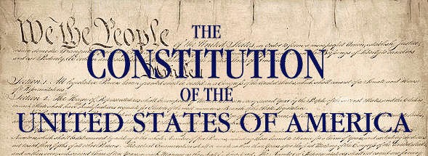

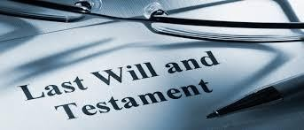
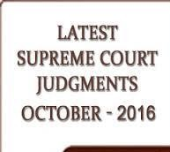
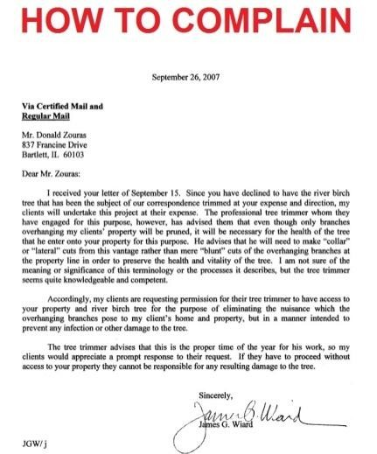
Some genres create binding, legal effects
>> authoritative treaties, constitutions, statutes, contracts, wills
create legal
analysis - expressing authoritative (binding)
pronouncement of the law >> judgments
express resolution of client’s case – e.g. lawyer-client advisory
letter

Slide 19
Each genre of legal text/discourse tends to have its own stereotypical format and is generally written in legal language or "legalese“
treaties, constitutions, legislation, statutes, regulations establish
rights and duties for people and institutions at large
Austin (1962) > “written performatives” vs operative/dispositive in lawyer’s parlance
contract contains one or more promises
In consideration of the covenants contained herein, the parties agree as follows....

Slide 20
will contains performative verbs that transfer property upon death
I revoke all former testamentary dispositions. (revocation clause)
I appoint as my executors my son Adam Smith of 4 Baker Street London and my daughter Sophie Smith of 4 Goodge Street London. (appointment of executors)
I give the residue of my estate after payment of all my debts equally to my two children. (residuary clause)
deed transfers property during the lifetime of its maker

Slide 21
statutes,
treaties, constitutions, regulations, contract, will, deed, .......
legislation,
Genres forming the considerably in terms of:
universe of legal language vary
modes of communication (written or spoken)
‘communicative purpose(s)’ achieved in their situational contexts
different participants involved in the genre production
linguistic features

Slide 22
Focal areas of legal language research : some examples
Courtroom discourse (e.g. lawyer-witness examination) >> turn allocation in courtroom (spoken interaction) constrained by power relations (lawyers and layfolk)
Coerciveness of courtroom questioning (Danet et al. 1980, Harris 1984, 2001; Lowndess 2002; Stygall 2012) during cross- examination with degrees of coercion in lawyers' questions ranging from the very open
"can you tell us anything about the incident?"
to the highly coercive
"you removed it, didn't you?" > leading questions significance of narrative account for the larger trial narrative

Slide 23
Focal areas of legal language research : some examples
From a linguistic perspective, discourse analysis also utilised to:
see how legal language is inherently vague/fuzzy (Bhatia, Engberg, Gotti, Heller 2005)
examine practices and attendant discourses of 'legal communities' and their elaboration of identities, roles and cultures (e.g. Bhatia, Candlin, Gotti 2003; Bhatia, Candlin, Engberg 2008; Bhatia, Candlin, Evangelisti 2008; Bhatia, Candlin, Gotti 2010/2012; Bhatia 2011; Tessuto 2012; Williams and Tessuto 2013; Bhatia, Garzone, Salvi, Tessuto, Williams 2014; Bhatia and Gotti 2015; Tessuto, Bhatia, Garzone, Williams 2016)
look into relations between discourse, power and ideology
(Wagner and Cheng 2011; Bhatia, Hafner, Miller, Wagner 2012)

Slide 24
Characteristics of English legal language
How did English legal language get to be the way that it is?
How did it develop?
the history of the language of lawyers

Slide 25
originated in ancient times from England’s shared body
of law – the ‘common law’ of the realm
Many such characteristics have their roots in the historical origins of English law influenced by two main language traditions:
Latin >> the language of the educated classes in England’s medieval times
French >> the Anglo-Norman’s French language used in legal pleadings later developed into Law French (i.e. royal courts at this time were conducted in French)
Other characteristics persist at different degrees in legal English usage of the modern day >> they are justifiable attempts to reach formality and precision

Slide 26
Legalese
Several authors (Mellinkoff 1963; Crystal and Davy 1969; Tiersma 1999; Mattila 2006) on:
lexical and syntactic complexities of English legal language used in legal documents over the centuries
identified a distinct ‘dialect’, derogatorily known as ‘legalese’: refers to the conventional language of the legal profession characterized by archaic usage, prolixity and redundancy for laymen to read and understand
Conservative and to some extent static language >> different from ordinary English language

Slide 27
Legalese
David Mellinkoff noted years ago
The Language of the Law (1963)
English legal writing includes ‘distinctive words, meanings,
phrases, and modes of expression’
credited with launching plain legal English in American law

Slide 28
Legalese: main features
Lexical features
Latin terms
ab initio, prima facie, obiter dicta
terms of French origin
appeal, complaint, counsel, damage, evidence, indictment, justice, party, sue, verdict
including unusual word order
Attorney General, accounts payable, malice aforethought
notary public
adjectives standing behind nouns they modify in phrases Adj + Nn > General Attorney

Slide 29
Terms of art (or legal jargon) with different origins borrowed from ordinary words
used with special meanings
consideration
duress
privity of contract
redemption

Slide 30
Archaic referential adverbs Here, There, Where + preposition
(pronominal adverbs) of Old English origin:
Hereby [adv.] modern equivalent ‘in this way’, ‘by this’
Hereof [adv.] modern equivalent ‘of this’
Thereby [adv.] modern equivalent ‘in that way’, ‘by that’
Whereof [relative adverb] modern equivalent ‘of what’, ‘of
which’
shorthand for presenting information already mentioned in
the text
the parties hereto … instead of the parties to this contract …

Slide 31
Other archaic, legalistic words
with
referential
value
(unfamilar pro-forms) > do not replace the noun (whole purpose of pro-forms) but used as adjectives to modify the noun
demonstrative adjectives said and such (or aforesaid) to refer back to a person or thing already mentioned (in place of ‘it’, ‘he’, ‘she’, etc.) > the said John Smith
-er, -or, and -ee name endings for agents in law
lessor and lessee (mis)representor and (mis)representee
reciprocal and opposite nature of the relationship is indicated by the use of alternative endings

Slide 32
Pleonasms: strings of (near)-synonyms in different parts of speech coming in two or three words
Doublets
aiding and abetting / agreed and declared / claim and demand / fit and proper / null and void / power and authority
/ use and enjoyment / terms and condition
Triplets
amend, vary or revoke / costs, charges and expenses / dispute, controversy or claim / lawful, valid and binding / right, title and interest
amplify the meaning and add rhetorical effect to the legal idea expressed

Slide 33
Ritualized word forms, or parallelisms
the truth, the whole truth and nothing but the truth
Vague words leading to uncertainty
reasonable man, reasonable care, proper
Overuse of shall modal auxiliary to express different meanings Status: "Full capacity" shall have the following meaning . . . Future action: If . . . then the contract price shall be increased . . .
Faulty imposing of obligation: The remaining oil shall be sold by lessee . . .
etc……
Phrasal verbs
... parties enter into a contract ...
... serve documents upon the parties ...

Slide 34
Syntactic features
Extremely long, complex sentences: many embedded clauses
Nominalizations: nouns constructed from verbs, usually by adding an ‘ing’, ‘tion’ or ‘al’ ending
after consideration of the facts
instead of
the court considered the facts
make an application instead of apply
Passive voice sentence structures instead of active forms

Slide 35
Lack of punctuation in legal documents (e.g. conveyances, deeds)
Poor paragraphing to aid reading and understanding of the information presented

Slide 36
England’s Common Law language seeping into distinct forms of legal English we know today
Other characteristics persist at different English usage of the modern day >>
degrees reflect
in legal historical
development throughout the centuries
England’s language and its system of law from the 11th to the
₁₈th
century and beyond made its headway with increasing
centralization
Main story of English common law language from the 18th to the 20th century was its exportation to other common law legal systems and language that operate today
(Common Law) English-speaking countries
UK, USA, Australia, New Zealand, Canada and some of the former colonies of England in Africa and Asia - e.g. Nigeria, Kenya, Malaysia and Hong Kong

Slide 37
Exportation of English law to other common law jurisdictions also means a distinctive development of legal English in other English-speaking countries
BrE | ScotE | AmE
chamber/set(of barristers) | stable | no equivalent
barrister | advocate | trial lawyer/appellate lawyer
contributory negligence | contributory negligence | comparative negligence
on the balance of probabilities | on the balance of probabilities | preponderance of evidence
representative action, group action | representative action, group action | class action

Slide 38
BrE | ScotE | AmE
company law | company law | corporate law
competition law | competition law | antitrust law
conditional fees | conditional fees | contingency fees (‘no win, no fee’)
material facts | material facts | key facts
postal rule (in contract law) | postal rule | mailbox rule
different terms for almost similar concepts exist today among English-speaking countries or native ‘localities’ of English – ENL (Kachru 1992: on the traditional cultural and linguistic bases of English)
Why?
necessary to suit national or locale-specific conditions and traditions of substantive and procedural law in ENL settings

Slide 39



From legalese to plain language
...... complexity and technicality of English legal language throughout centuries >>> pressures for reform by members of the Plain Language Movement from the major English- speaking countries
US-based movement (beginning in 1970s) promotes plain language in public and private sectors
inspiring source for other international associations

Slide 40
Plain language proponents = legal practitioners >> lawyers, judges and parliamentary draftsmen
argue for clarity, simplicity and directness in the drafting of legislation and other legal documents
believe that comprehensible lawyers
these documents need to be readily when legal
content is conveyed to non-

Slide 41
More recent addition to Plain Language Movement
Butt and Castle (2006) dig a hole through traditional legal language and its peculiar characteristics that make legal documents aloof from its users
Propose a step-by-step guide to drafting in the modern style, using examples from four types of legal documents
leases, company constitutions, wills and conveyances

Slide 42
Some plain language developments around the world
Success of plain language as a ‘movement’ (a quasi-political, society-changing cause) kicks on in law firms and in legislation in English-speaking countries
US & Australia: high profile in public and private sectors and law schools – legal writing focusing on clear communication
Canada and New Zealand: plain language practitioners and
advocates
UK: Plain English Campaign and Plain Language Commission lead the charge and provide rewriting services and training - major legislative developments in statutory writing - new rules for civil procedure - language used in court proceedings
South Africa: law firms establish plain language practices - government is active in plain legislation

Slide 43
Exceptions to plain language proposals: ‘enacting’ formula of UK statutes
BE IT ENACTED by the Queen’s most excellent Majesty, by and with the advice and consent of the Lords Spiritual and Temporal, and Commons, inthis present Parlament assembled, and the authority of the same as follows.
Enacting formula performatively gives statutory text force of law (binding) for people at large >> enactment ‘speech act’ of ‘parliamentary intention’
Antiquated words and infrequent expressions resulting from the historical tradition:
jussive/passive imperative (BE IT EMACTED) >> binding force of statutes prepositions (by and with) with similar meaning ('doublet') >> add rhetorical emphasis to the idea being expressed
use of same instead of the modern alternative pronoun (‘them’)

Slide 44
Plain language in the EU
Also, plain language standards applied by the European Union institutions - directed at people who have to write many different types of documents (genres)
legislation, minutes, speeches, press releases etc.
EU plain language principles: Joint Practical Guide - European
Parliament, the Council and the Commission
EU multilingual legislation must be made readily comprehensible to a variety of EU multicultural audiences for whom important rights and responsibilities are defined

