Slide 2
Preview
Development of the English legal system
Development of legal English
Characteristics of legal English
Legal English as a global language

Slide 3
England and Wales, Ireland, the United States,
Law created by courts
Common law - equity
Canada, Australia, New Zealand

Slide 4
Birth of Common Law
After the Norman conquest (1066)
To consolidate his dominance, the king sought to
centralise the justice system by establishing the
Royal Courts of Justice at Westminster
Powerful vassals resisted the centralisation of
justice
Royal Courts —able to adjudicate cases falling
clearly within the king s competence
Progressively, increasing categories of cases
transferred to these Courts

Slide 5
Birth of Common Law
Court judgments - importance that went beyond the particular cases in which they had been pronounced
To specify the conditions and limits of the binding effect of judgments, a refined rule of precedent was progressively created
The legal system built by case law
strengthened the position of judges

Slide 6
During the Middle Ages, Royal Courts —
archaic and formalistic judicial organs
The Chancellor began to recify judgments of
the Courts of Westmionster on the basis of
natural justice
Court of Chancery - created its own remedies
and legal concepts of highly technical nature,
maintaining only a distant link with fairness
and reasonableness

Slide 7
17th c. fierce struggles for power between the Courts of Westminster and the Court of Chancery
Ended in a compromise guaranteeing both
courts their proper field of competence
Division betweeen equity and common law was formed; maintained even after unification of the English justice system in the 19th c.

Slide 8
The English legal system today
The amount of English legislation —
comparable to that of continental countries
Statutes- considered to be incomplete until the moment when they are covered by numerous precedents specifying the interpretation of their main provisions

Slide 9
Divisions of law and legal concepts- different
from civil law
Common law equity division unknown in
continental countries
Many institutions, e.g. trust, foreign to civil-
law Europe

Slide 10
The English legal system today
Consists of an exceptionally large amount of detail
Explanation: originally developed by judges
Unlike the legislator, the courts have to draw very fine distinctions since they have to decide highly varied individual cases

Slide 11
The English legal system today
Rules of law induced from cases — remarkably
concrete
These rules — cannot be raised to a level of abstraction as rules formulated by legal science
Since case law is composed of a network of
rules, laws have to be written in the same way,
i.e. highly detailed to ensure compatibility of
the two types of rules

Slide 12
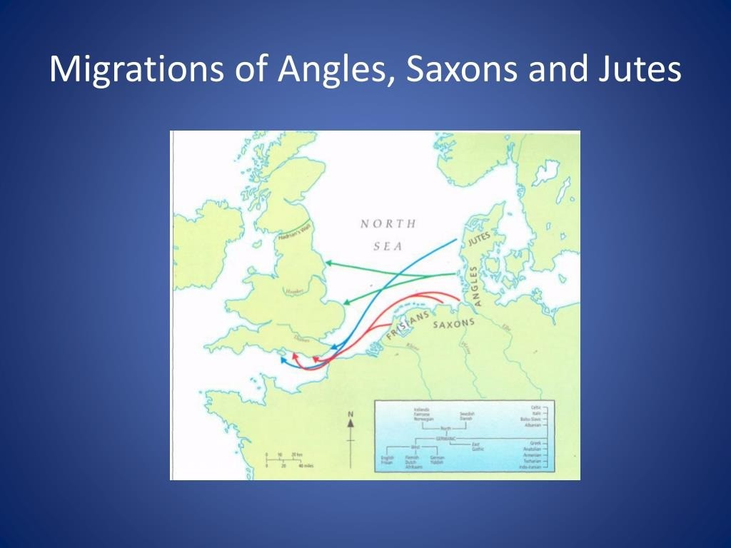

Slide 13
HISTORY OF THE ENGLISH LANGUAGE
OLD ENGLISH (c. 450- c. 1100)
MIDDLE ENGLISH (c. 1100- c.1450)
MODERN ENGLISH (c. 1450 - )

Slide 14
LATER OLD ENGLISH (c. 850 - c.1100)
Language Contacts
Nouns: birth, bull, dirt, egg, fellow, husband, leg, sister, skin, sky, skirt,
window
Adjectives ill, low. odd, ro rten, sly, weak
Verbs: coll, crowd, die, get, give, life, raise, scream, take.
Pronouns: they (their, them)
Conjunctions: tho ugh
Determiners: some, any
Auxiliaries: ore
Family names: -son: Johnson, Stevenson
Place names: -by ’Ie rm, town“. Derby, Rugby, Whitby; -thorp ’village’:
Althorp, Linthorp

Slide 15
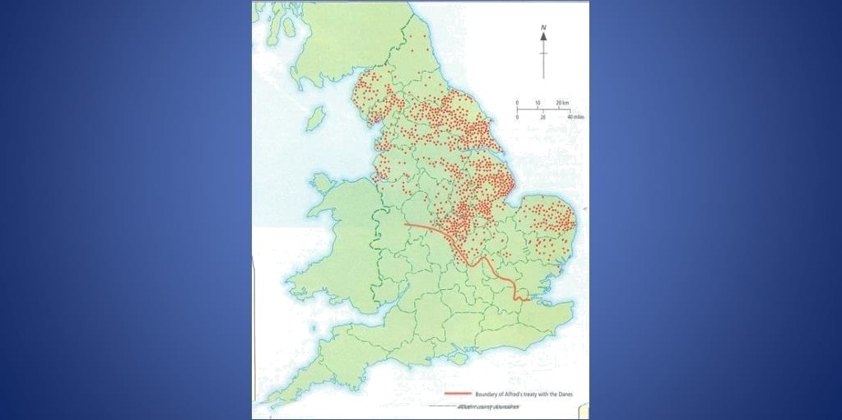
SCANDINAVIAN PLACE NAMES

Slide 16
MIDDLE ENGLISH (c. 1100-1450)
French Influence
Administration
Authority, bailiff, boron, chamberlain, choncellor, constoble, council, court,
crown, duke, empire, exchequer, government, liberty, mojesty, mayor,
messenger minister, noble, palace, parliament, prince, realm. reign,
revenue, royal, servant, sir, sovereign, statute, tax, traitor, treason,
treosurer, treat y
Łavv
Accuse, odvocate, oldest, arson, ossoalt, assize, attorney, boil, bar, blame, convict, crime, decree, depose, estate, evidence, executor, felon, fine, fraud, heir, indictment, inquest, joil, judge, jwy, justice, larceny, legoc/, libel, pardon, perjury, plaintiff, plea, prison, punishment, sue, summons, trespass, verdict. warrant
Military
Ambush, archer, army, battle, besiege, coptain, combat, de fend, enemy,
garrison, guard, lance, lieutenant, navy, retreat, sergeanI, siege, soldier,

Slide 17
The Statute of Pleading, 1362
“All lawsuits shall be conducted in English, because French is much unknown in the said realm”

Slide 18
R
Richard Mulcaster (1582)
“The English tongue is of small account, stretching no further than this island of ours, nay not there over all.”

Slide 19
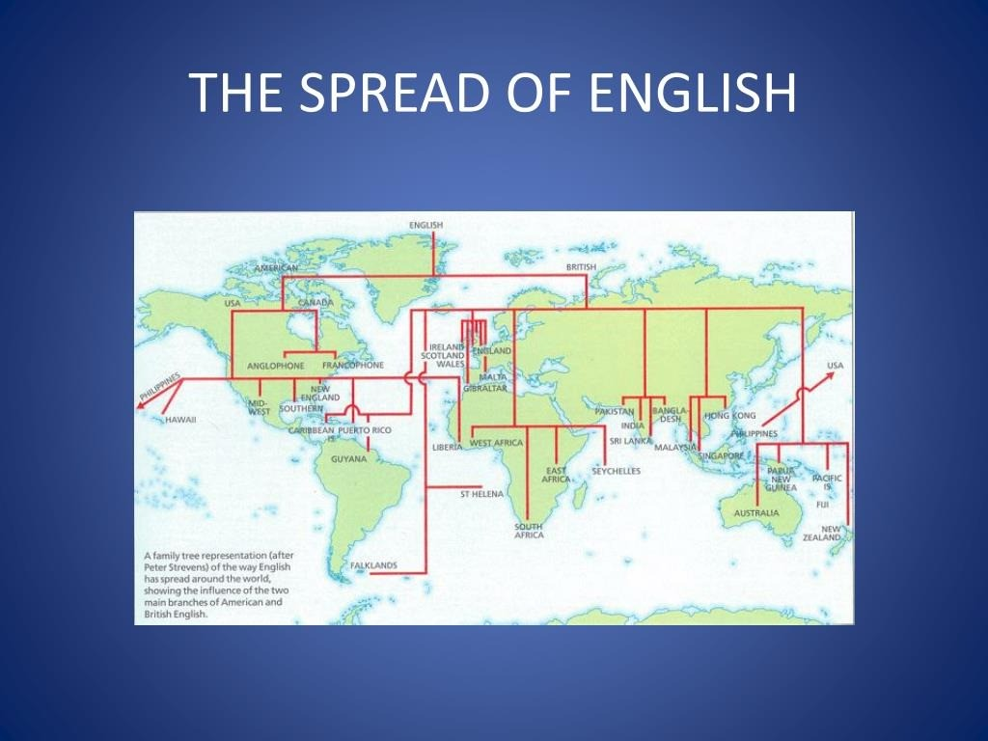

Slide 20
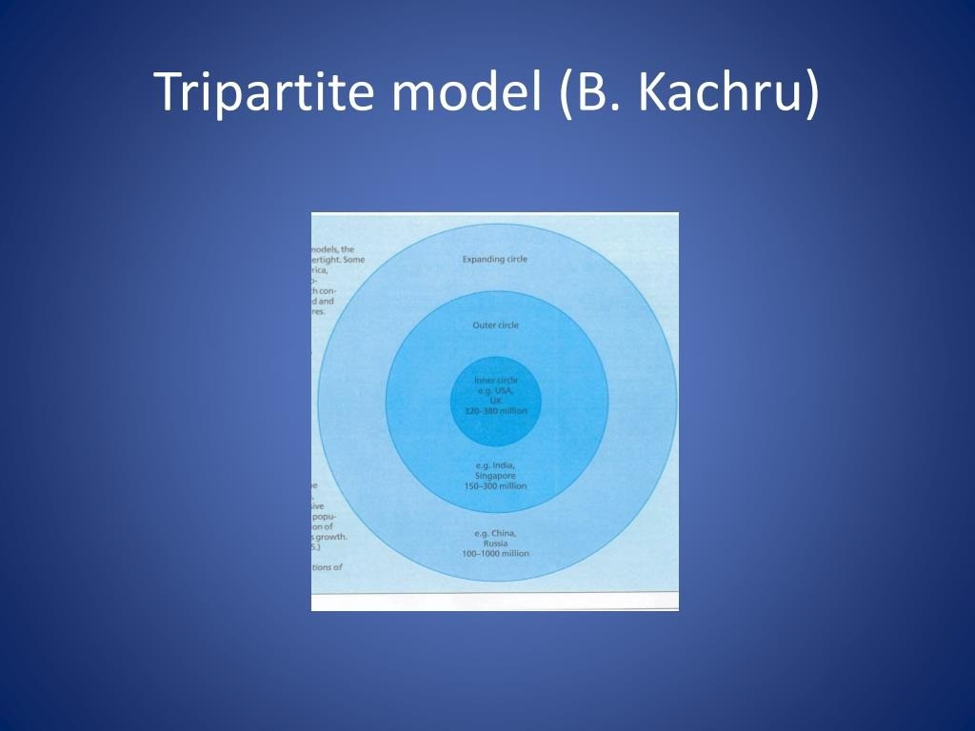

Slide 21
Development of legal English:
the Anglo-Saxon Period
Documents with seals to certify the sale of real estate or some other act of transfer: gewrit or writ
During the Norman era writs had an
important role in the creation of common law
Viking occupation — borrowing of
Scandinavian words: law, gift, loan, sale, trust

Slide 22
The Anglo-Saxon Period
Verbal magic
Acts of transfer required complicated and precise language rituals; a single mistake could nullify the act
Use of rhythmic expressions
Alliteration common in maxims and binary
expressions

Slide 23
eyes saw and with my ears heard
Inversion to strenghten the impact: / with my
Language gradually became more compIe›‹ syntactically but still contained elements of spoken language

Slide 24
Some Latin words
Royal legislation and spread of Christianity
Examples: convict, admit, mediate, legitimate

Slide 25
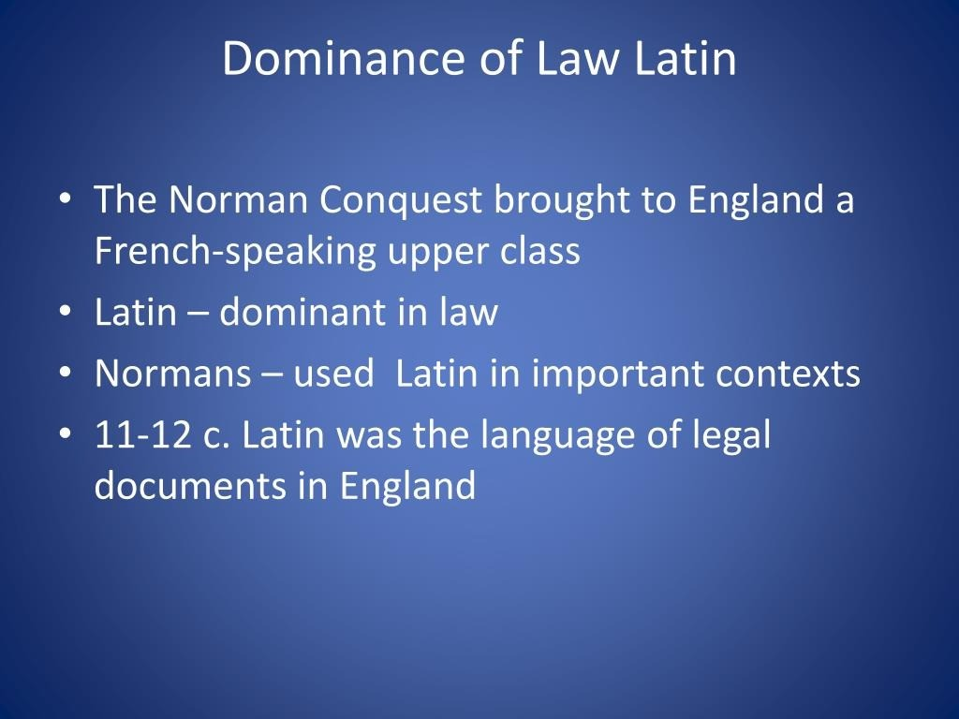

Slide 26
Dominance of Law Latin
In this period — common law was created
Many essential common law terms were
originally formulated in Latin (e.g. breve writ )
Meaning diverged from that of classical Latin
Often, Norman French or even English words were Latinised (e.g. morder > murdrum) dog Latin

Slide 27
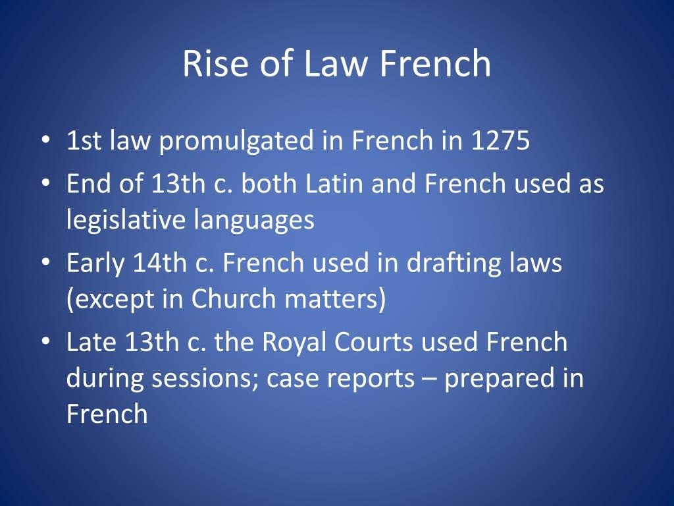

Slide 28
Rise of Law French
French became the legal language in England
from the late 13th c., both for legislation and
the law courts
The use of French in English legal circles —a strange phenomenon because in 13th c. French had already begun to disappear in England as a language of communication; yet the rise of French as language of the law only started at that time

Slide 29
Rise of Law French
Reasons:
A section of the English aristocracy — still French-speaking at the end of 13th c.
French as the language of culture
Centralisation of justice system consolidated
the status of French
Secularisation of the justice system — clerics
no longer operated as judges

Slide 30
Rise of Law French
With its general disappearance from England,
French had become the mark of the true elites
Legal profession monopoly of the elites
French guarantee that the people could not
meddle in the justice system because they
were unaable to follow the trial Iprocess
Law French even then a dead language: its
expressions had a clear legal meaning;
appropriate for use as legal terms

Slide 31
Decline of Law Latin and Law French
1362 Statute of Pleading — drafted in French!— prescribed that judges were to use English but that court minutes could still be prepared in Latin
According to Sir Edward Coke, it was better that the unlearned were not able to read legal materials because they would get it all wrong and harm themselves!

Slide 32
Decline of Law Latin and Law French
End of 14th c. parliamentarians were using
spoken English
Still in 17th c. possible to hear law French in the Inns of Court, and, occasionally, in the courts; a number of legal works — still written in law French
French and Latin finally abolished in 1731

Slide 33
Decline of Law Latin and Law French
Latin — declined in 16th and 17th c.; remained an important legal language: court records, writs and other legal documents written in Latin until 18th c.

Slide 34
Dominance of Latin, French and
English
1000
1200
1500
2000
Latin supremacy
Law French
supremacy
English
supremacy

Slide 35
Characteristics of Legal English
English a global language
Varies according to different situations; sometimes: stiff and conservative, sometimes innovative and creative
Difference between the spoken language of
court sessions and written legal language

Slide 36
Influence of other languages
Legal English -a language of interaction
between Old English (Anglo-Saxon, with
Scandinavian elements), Medieval Latin, Old
French
Latin and French expressions - part of the
most basic vocabulary of English law;
foundations of English legal thinking
Calques - translations from Latin and French
(originally, common law was comune ley)

Slide 37
Latin
Legal maxims: ubi jus, ibi remedium
Ratio decidendi, Obiter dicta
Ordinary Latin: versus; pro se (said of an individual representing themselves in court, i.e. without legal representation)= in propria persona, in forma pauperis (exempt from paying court costs) ex parte ( from one party only, for the benefit of one party only ), mens rea, scienter
(‘knowingly ), animus testandi ( intention to make
a will )

Slide 38
Latin
Technical meaning: amicus curiae
A private individual, a legal person, even the State that gives the court specific legal information

Slide 39
Latin
shortened expressions
Nisi prius ( unless before ) = a matter of
proceedings at first instance with a jury
present
Affidavit ( he affirmed ) = a written or printed
declaration confirmed by an oath
Habeas corpus ( you may have the body ) = a
judge s order to bring a prisoner before the
court to clarify the legality of detaining him

Slide 40
Latin
legal discourse markers
Aforesaid < predictus; said < dictus
In medieval England, when a person s name appeared for the 1st time preceded by quidem a certain ; later, the words predictus, dictus or idem were used

Slide 41
Law French
Real property law: pur autre vie for or during
the lifetime of a third party , terre-tenant
Most technical legal vocabulary goes back to Old French: assault, infraction, damage, action, counsel, defendant, judge, jury, party, process, verdict

Slide 42
Law French
Influence on word formation:
Old French past participle: -e or —ee (for the person obtaining sth or forming the object of an action
Doer of the action: -or/-er
Employer/employee, trustor/trustee,
vendor/vendee

Slide 43
Law French
Word order
Accounts payable, attorney general, court
martial, fee simple, letters patent

Slide 44
Ritual and formalism of language:
the tradition of verbal magic
Middle Ages: magical rites: parties had to recite the words necessary for the course of the trial with absolute accuracy, under penalty of forfeiting their rights

Slide 45
Repetition
Binary expressions: words with the same meaning existed at the same time in the form of Latin-French variants and Anglo-Saxon variants . Repetitions ensured that legal messages were understandable in a multilingual society
Acknowledge and confess, act and deed,
devise and bequeath, fit and proper, goods
and chattels, will and testament

Slide 46
Repetition
triple repetition:
null and void and of no effect, authorized,
empowered and entitled to
To tell the truth, the whole truth, and nothing
but the truth

Slide 47
Influence of case-law
Mylward v. Weldon (1596) the plaintiff
produced a pleading running to 120 pages
Examples of wordiness: (Mattila 2006: 235-
236)

Slide 48
Law of contract
Case law - fundamental
If the parties omit sth from the contract, they
cannot rely on the courts to insert it later on
their behalf by way of interpretation
Terms of a contract -always interpreted
narrowly: parol evidence rule: if the meaning
of a written contract is clear, then no other
evidence is allowed as to its content; the contract should contain all that is needed

Slide 49
Law of contract
The language of a contract governed by common law should be general enough to cover every situation, yet precise enough to ensure that the legal position of the parties is unambiguous
The contract should show with certainty what
it includes and what it does not (Ibid: 237)

Slide 50
Legal language —a tool of group cohesion, or
team spirit
French and Latin pronounced as English words
Oyez pronounced as oou-yes

Slide 51
Legal English as a Global Language:
Expansion of Common Law
Some 1,200-1,500 million people in command
of English; 670 million native speakers
English - official language in 75 states or
administrative territories
85% international organisations use English as
one of their languages
Dominance in international trade

Slide 52
Legal English in the United States
The influence of English law — terminated with the independence
Nevertheless, the approach to the legal order, fundamental principles and concepts of law, essential legal terminology - the same in England and the US

Slide 53
Fundamental ideas in line with the English
tradition
1) supremacy of the law (rule of law)
2) rule of precedent
3) adversarial procedure

Slide 54
Separation between private and public law less important than in civil law countries
Separation of powers
federalism

Slide 55
Characteristics of American legal
English
Institutions whose structure differs from those in England — original designation (e.g. names of courts: Federal justice system: district courts, courts of appeals, the Supreme Court)

Slide 56
Differences between UK and US
English
Corporation — company
Visiting rights — right of access

Slide 57
Similarities
Traditional expressions: hereafter, herein,
hereof, herewith
complexity

Slide 58
Legal English in the Indian Sub-
continent: Anglo-Indian law
Common law took root alongside the traditional systems of law: Hindu law and Muslim law -application limited to traditional branches of law (family law, inheritance)
19th c. a large number of laws came into force; prepared by the British, often in London
The highest judicial organ: the Judicial
Committee of the Privy Council (London)

Slide 59
Expansion and Change of legal English
in India
English - language of higher education and
colonial administration
1837 English became the official language in
India
From 1844 only those educated in English
could be appointed civil servants

Slide 60
Expansion and Change of legal English
in India
Republic of India - English remains the language of higher education and science; Hindi - National Official Language
English - language of government and the
higher justice system

Slide 61
Expansion and Change of legal English
in India
Pakistan - Urdu
Bangladesh - Bangla (formerly: Bengali)
Legal terminology and style in India and
Pakistan - essentially British
English sometimes operates as a linguistic tool
even of Islamic law; differences: terms
expressing original concepts of Islamic law
In Pakistan, the language of Islamic law is in
fact legislative English (N. Ahmad)

Slide 62
Legal English in International Trade
Lawyers in non-English speaking countries daily drawing up contracts in English; often contain language similar to traditional common law contracts - serious problems
Cultural collision
Civil law lawyers may copy common law
contracts without fully understanding them

Slide 63
a contract to adduce evidence as to the
While it is open to the parties in dispute over
meaning of specific foreign words, it is not possible at common law to adduce evidence as to the actual intention of the parties when the contract was executed

Slide 64
Contradictory interpretation
A contract in commercial law, with connectingh factors with different States is expressly submitterd or may be submitted by way of interpretation to a definite legal order
Legal disputes arising from the contract heard either by an arbitration tribunal or the courts of a State

Slide 65
Where litigation has to be heard by a State s court, the
interpretation may cause considerable surprise to one
of the parties
° A British or North American court tends to interpret
the terms of a contract drawn up in English in line with
traditional common law thinking
The terms may acquire a meaning completely different
from that imagined by the party from a continental
country
Efforts to develop terminology that is not too closely
linked to the legal orders of particular States

