Slide 1
BRITISH LEGAL CENTRE
General Legal English Course Lesson 2
Richard Brady,
Director,
British Legal Centre
https://www.british-legal-centre.com

Slide 2
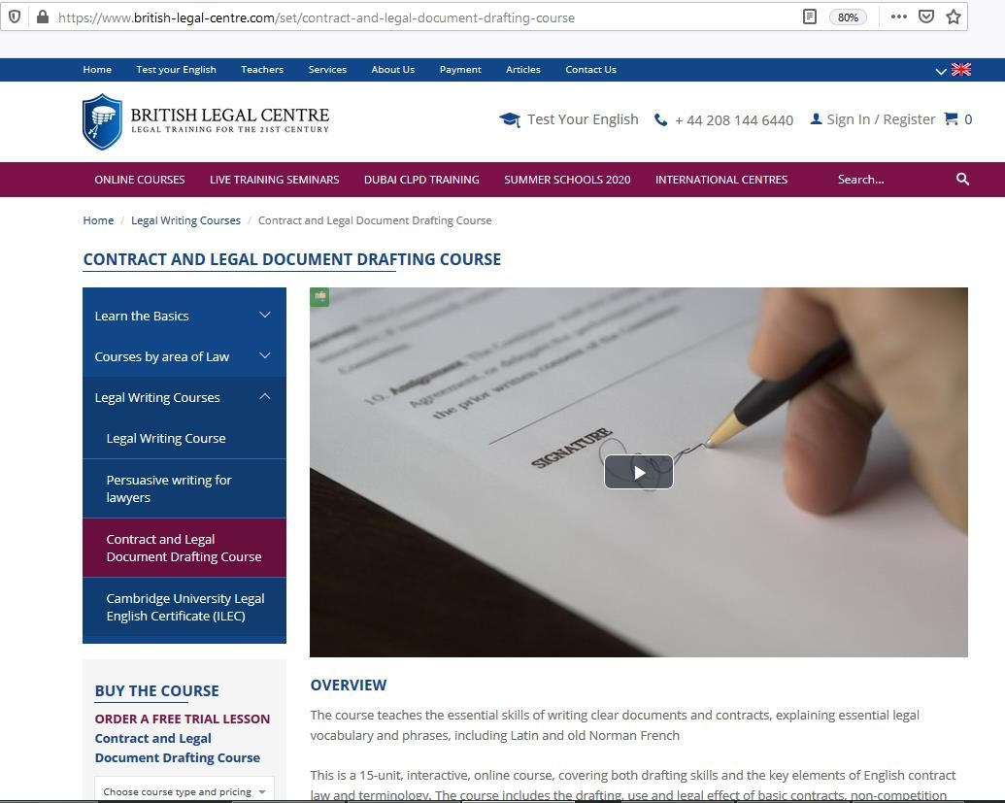
PART 1
Contract drafting

Slide 3

THE STANDARD STRUCTURE OF A COMMERCIAL CONTRACT
Signing a contract is serious for any party.
These are legally binding agreements.
You must write them to achieve your objectives, but remember: The content must protect your interests, even if things go wrong.

Slide 4

THE STANDARD STRUCTURE OF A COMMERCIAL CONTRACT
Not all contracts have to be in writing, although contracts for the sale of land or interests in land, and Insurance contracts are exceptions to this rule, along with pre-nuptual agreements!
All commercial contracts should be in writing, however, and you would probably be failing in your professional duties if you allowed your client to record a commercial deal – merely on the basis of a handshake and the power of their memory to remember the agreed terms.

Slide 5
THE STANDARD STRUCTURE OF A COMMERCIAL CONTRACT
To create a watertight written contract you must understand the nature of the first question you have to be confident about is: “What exactly is a contract”?
It is a voluntary agreement between two parties which, if valid, is binding on the parties and enforceable by the courts.

Slide 6
THE STANDARD STRUCTURE OF A COMMERCIAL CONTRACT
In other words one party can sue the other if they don’t do what they said they would do in the agreement.
A contract doesn’t need to be in writing. There are plenty of contracts entered into every day which are not in writing. In a commercial deal though, what better way is there to show that you intend to create contractual relations with the other party other than writing it down, calling the document a contract and signing it. This also is a written record of what was agreed.

Slide 7
THE STANDARD STRUCTURE OF A COMMERCIAL CONTRACT
Five Essential Elements of a Contract
If any is missing, the agreement will not be legally binding.
Offer
Acceptance
Intention of legal consequences
Consideration
Capacity

Slide 8
THE STANDARD STRUCTURE OF A COMMERCIAL CONTRACT
Most contracts, whether one or fifty pages follow the same basic format:
Preamble
Definitions section (if there is to be one)
Recital
Main Body Clauses
Liquidated Damages (if there is to be one)
Boilerplate Clauses
Signature Blocks

Slide 9
THE STANDARD STRUCTURE OF A COMMERCIAL CONTRACT
MUST HAVE
Identification of the Parties
Identification of the Consideration
Key Rights and Obligations
If the contract does not contain the key rights and obligations the Courts will say that agreement has not yet been reached and the contract has yet to come into existence.

Slide 10
THE STANDARD STRUCTURE OF A COMMERCIAL CONTRACT
SHOULD HAVE – for any commercial contracts:
The following are not strictly necessary in the law for a contract to be valid but as a lawyer you would be very unprofessional if you missed them out of the contract – you should be including these automatically.
Date of Contract – the day it was signed.
Date of commencement of contract – when the rights
and obligations become effective.
Definitions – what the jargon actually means. One day a judge, who knows nothing about your industry, may have to understand what you have agreed on.

Slide 11
THE STANDARD STRUCTURE OF A COMMERCIAL CONTRACT
SHOULD HAVE – for professional contracts:
Definition section – near the beginning of the contract
to explain exactly what the words and phrases mean.
A judge perhaps with little knowledge of your industry is going to have to try and understand what you mean in the contract.
If there are less than 5 words or phrases that need defining then leave it until immediately after the first time you mention them in the contract.

Slide 12
THE STANDARD STRUCTURE OF A COMMERCIAL CONTRACT
USEFUL TO HAVE
Indemnities – Promises by one or other party that the
other will not suffer a financial loss.
Warranties – Statements given by a seller to a buyer promising that certain things are true and promising to pay compensation if they turn out not to be true.
Guarantees – Collateral contracts by a 3rd party to one or both of the parties in the contract promising to perform an obligation/s if the contracting party fails to perform the obligation.

Slide 13
THE STANDARD STRUCTURE OF A COMMERCIAL CONTRACT
LET’S DRAFT OUT A CONTRACT AND GO THROUGH THE
PARTS.
THE PREAMBLE
THIS BUILDING CONTRACT made and entered into this ( ) day of (month) (year) and commencing on the ( ) day of (month) (year) (the Effective Date), by and between, RB Ltd, Reg No 12345678 a corporation, having its principal office located at [street address], (First Party), and XYZ Ltd, Reg No 87654321 having its principal office located at [street address], (Second Party).

Slide 14
THE STANDARD STRUCTURE OF A COMMERCIAL CONTRACT
The contract’s Preamble:
identifies the agreement through a title
identifies the parties to the agreement
identifies the date on which the agreement was
entered into
may contain a definitions section
for any commercial contract always use a Recital!

Slide 15
THE STANDARD STRUCTURE OF A COMMERCIAL CONTRACT
The contract then continues with Recitals that
provide an introduction to the agreement and
should explain why it is being entered into, and
identify important terms and possibly third parties.
The recitals/introduction are not usually considered to be part of the agreement and are therefore typically not enforceable.
Use these words to make it an enforceable part of the
contract: ‘This recital is a part of the contract and its
terms are binding.’

Slide 16
THE STANDARD STRUCTURE OF A COMMERCIAL CONTRACT
WHEREAS, First Party is engaged in the manufacture of construction products described on Schedule A hereto (the “Products”) for use in the building industry and Second Party is engaged in the business of marketing, selling and distributing construction products within Kenya (the “Territory”); and First Party desires that Second Party market, sell and distribute the Products in the Territory.
It’s a simple explanation of the background to the contract. You will notice we don’t add the details such as commission, length of contact. Leave these for the main body of the Contract.

Slide 17
THE STANDARD STRUCTURE OF A COMMERCIAL CONTRACT
MAIN BODY OF THE CONTRACT
The body of the contract contains the heart of the agreement – the reason why the contract was entered into. The things you are expecting from the other party and also what they are expecting from you.
It will include:
The key terms of the agreement
The type and amount of “consideration”
The parties’ on-going rights
The parties duties and responsibilities

Slide 18
THE STANDARD STRUCTURE OF A COMMERCIAL CONTRACT
NOW THEREFORE in consideration of the mutual covenants herein contained, and other good and valuable consideration, the parties hereto mutually agree as follows:
In fact a lot of the wording above is not really necessary. We know you agree to be bound because you signed the contract!
‘The Parties agree as follows’ is quite sufficient!

Slide 19
THE STANDARD STRUCTURE OF A COMMERCIAL CONTRACT
LIQUIDATED DAMAGES
There may or may not be a Liquidated Damages Clause – If there is then it will come at the end of the Main Body Clauses but before the Boilerplate clauses.
Liquidated damages – a genuine attempt by the parties to estimate future losses in the event of a breach of contract.
We will deal with these in a separate session later in
the course.

Slide 20
THE STANDARD STRUCTURE OF A COMMERCIAL CONTRACT
BOILERPLATE CLAUSES
Boilerplate clauses are typical clauses that are contained in the latter part of a contractual agreement.
What are they? When to use them?
Not all boilerplate clauses are appropriate for all types
of agreements – they play key administrative roles.

Slide 21
THE STANDARD STRUCTURE OF A COMMERCIAL CONTRACT
ENDINGS AND SIGNATURE BLOCKS
The contract concludes with a statement of the parties’ intention to create a legally binding agreement and signature blocks for the parties to the agreement.
IN WITNESS WHEREOF, the parties, intending to be legally bound, have executed this Agreement as of the date first above written.
FIRST PARTY
By: Name Title
SECOND PARTY
By: Name Title

Slide 22
PART 2
Grammar
Avoiding nominalisations

Slide 23
NOMINALISATIONS
For some reason lawyers prefer to write with nouns rather than verbs.
This causes many problems as well as needing more
words and sounding very pompous.
Lawyers seem to prefer the noun for the name of the process rather than to use the verb to state what is happening.

Slide 24
NOMINALISATIONS
Nominalisations
When a verb has been changed into a noun we say it has become “nominalised” and the process is called “nominalisation”:
Verbs - Nouns
Complete -
Introduce - Provide - Investigate -

Slide 25
NOMINALISATIONS
Nominalisations
When a verb has been changed into a noun we say it has become “nominalised” and the process is called “nominalisation”:
Verbs - Nouns
Complete - Completion
Introduce - Provide - Investigate -

Slide 26
NOMINALISATIONS
Nominalisations
When a verb has been changed into a noun we say it has become “nominalised” and the process is called “nominalisation”:
Verbs - Nouns
Complete
Introduce
Completion
Introduction
Provide -
Investigate -

Slide 27
NOMINALISATIONS
Nominalisations
When a verb has been changed into a noun we say it has become “nominalised” and the process is called “nominalisation”:
Verbs - Nouns
Complete Introduce Provide
Completion
Introduction
- Provision
Investigate -

Slide 28
NOMINALISATIONS
Nominalisations
When a verb has been changed into a noun we say it has become “nominalised” and the process is called “nominalisation”:
Verbs - Nouns
Complete Introduce Provide Investigate
Completion
Introduction
  Provision
  Investigation

Slide 29
NOMINALISATIONS
Nominalisations
The problem with nominalisations is that they are often used INSTEAD of the verbs from which they come.

Slide 30
NOMINALISATIONS
Nominalisations
The problem with nominalisations is that they are often used INSTEAD of the verbs from which they come.
Because they are the NAMES of things, it sounds as if nothing is really happening.

Slide 31
NOMINALISATIONS
Nominalisations
The problem with nominalisations is that they are often used INSTEAD of the verbs from which they come.
Because they are the NAMES of things, it sounds as if nothing is really happening.
They make writing very DULL and HEAVY.

Slide 32
NOMINALISATIONS
Nominalisations
We had a discussion about the matter.

Slide 33
NOMINALISATIONS
Nominalisations
We had a discussion about the matter. We discussed the matter.

Slide 34
NOMINALISATIONS
Nominalisations
We had a discussion about the matter. We discussed the matter.
The implementation of the program has been done by
the team.

Slide 35
NOMINALISATIONS
Nominalisations
We had a discussion about the matter. We discussed the matter.
The implementation of the program has been done by
the team.
The team has implemented the program.

Slide 36
NOMINALISATIONS
Nominalisations
We had a discussion about the matter. We discussed the matter.
The implementation of the program has been done by
the team.
The team has implemented the program.
Avoid nominalisations, especially when writing to
clients.

Slide 37
NOMINALISATIONS
Make sure you use the correct verb – be precise:

Slide 38
NOMINALISATIONS
Make sure you use the correct verb – be precise:
The diplomats worked at normalization of relations
between the countries.

Slide 39
NOMINALISATIONS
Make sure you use the correct verb – be precise:
The diplomats worked at normalization of relations
between the countries.
The diplomats tried to normalize relations between the countries.

Slide 40
NOMINALISATIONS
Make sure you use the correct verb – be precise:
The two cars drove at a fast pace down the road as
they each tried to outpace the other.

Slide 41
NOMINALISATIONS
Make sure you use the correct verb – be precise:
The two cars drove at a fast pace down the road as
they each tried to outpace the other.
The two cars raced down the road.
More precise and more descriptive in fewer words!

Slide 42
NOMINALISATIONS
The company's business was the importation of fine china.
His crime was a big surprise to his friends. He spoke to the crowd in a loud voice.
Mack gave a lecture to the court.
The court found that the company had committed discrimination against women.

Slide 43
NOMINALISATIONS
The company's business was the importation of fine china. The company imported fine china.
His crime was a big surprise to his friends. He spoke to the crowd in a loud voice.
Mack gave a lecture to the court.
The court found that the company had committed discrimination against women.

Slide 44
NOMINALISATIONS
The company's business was the importation of fine china. The company imported fine china.
His crime was a big surprise to his friends. His crime astonished his friends.
He spoke to the crowd in a loud voice.
Mack gave a lecture to the court.
The court found that the company had committed discrimination against women.

Slide 45
NOMINALISATIONS
The company's business was the importation of fine china. The company imported fine china.
His crime was a big surprise to his friends. His crime astonished his friends.
He spoke to the crowd in a loud voice. He shouted to
the crowd.
Mack gave a lecture to the court.
The court found that the company had committed
discrimination against women.

Slide 46
NOMINALISATIONS
The company's business was the importation of fine china. The company imported fine china.
His crime was a big surprise to his friends. His crime astonished his friends.
He spoke to the crowd in a loud voice. He shouted to
the crowd.
Mack gave a lecture to the court. Mack lectured the
court.
The court found that the company had committed
discrimination against women.

Slide 47
NOMINALISATIONS
The company's business was the importation of fine china. The company imported fine china.
His crime was a big surprise to his friends. His crime astonished his friends.
He spoke to the crowd in a loud voice. He shouted to
the crowd.
Mack gave a lecture to the court. Mack lectured the
court.
The court found that the company had committed discrimination against women. The court found the company had discriminated against women.

Slide 48
NOMINALISATIONS
By writing with precise verbs you will shorten your
sentences, creating greater impact!

Slide 49
NOMINALISATIONS - EXERCISE
Exercise 1. Change the following nouns into verbs.
Action
Consideration
Decision
Discussion
Investigation
Movement
Application
Payment
Reaction
Refusal

Slide 50

NOMINALISATIONS - EXERCISE
Exercise 1. Change the following nouns into verbs.
Here are the right answers:
Action – Act
Consideration – Consider
Decision – Decide
Discussion – Discuss
Investigation – Investigate
Movement – Move
Application – Apply
Payment – Pay
Reaction – React
Refusal – Refuse

Slide 51
NOMINALISATIONS - EXERCISE
Exercise 2. Find the nouns that should be changed to verbs in the following sentences.
An application to defer sitting an examination must be submitted within three working days of the examination.
Approval is only given for projects that will have
minimal impact on biodiversity values.
Upon your arrival at the premises, notify the
receptionist.
Make your submission online via the planning
portal.
Patient complaints were about the hospital’s food.

Slide 52
NOMINALISATIONS - EXERCISE
Exercise 2. Find the nouns that should be changed to verbs in
the following sentences. The right answers are in bold:
An application to defer sitting an examination must be submitted within three working days of the examination.
Approval is only given for projects that will have
minimal impact on biodiversity values.
Upon your arrival at the premises, notify the
receptionist.
Make your submission online via the planning
portal.
Patient complaints were about the hospital’s food.

Slide 53
NOMINALISATIONS - EXERCISE
Exercise 3. Rewrite the following sentences, using strong verbs to replace nouns and their weak verbs.
You must accept the offer before you can commence enrolment at XYZ University.
Applications for an export licence, and licence renewals can be made online.
The solution to the problem is to make changes to the regulations.
The web team leader undertook the editing of the new pages.
Residential water consumption in Melbourne was 164 litres per person per day.

Slide 54
NOMINALISATIONS - EXERCISE
Exercise 3. Rewrite the following sentences, using strong verbs to replace nouns and their weak verbs. Here are the right answers:
You must accept the offer before you can commence enrolment at XYZ University.
You must accept the offer before you can study at
XYZ University.
Applications for an export licence, and licence
renewals can be made online.
You can apply for an export licence, and licence
renewals online.

Slide 55
NOMINALISATIONS - EXERCISE
The solution to the problem is to make changes to the regulations.
Changing the regulations will solve the problem.
The web team leader undertook the editing of the new pages.
The web team leader edited the new pages.
Residential water consumption in Melbourne was
164 litres per person per day.
Melbourne residents consumed 164 litres of water per
person per day.

Slide 56
PART 3
Legal Vocabulary
Latin legal words

Slide 57
USE OF LATIN IN LEGAL WRITING
Now that we have entered the 21st century it is generally considered old-fashioned to sprinkle Latin words into your general legal writing. However, there are some Latin expressions which are what is known as ‘terms of art’, which means that the Latin expressions have a legal meaning. It is perfectly acceptable to use these Latin terms although it requires you to learn the legal meaning of each.
70% of the words in the English language are based on Latin words although it may not seem it sometimes. We already have accepted some Latin words into the language, et cetera, per annum, vice versa, e.g., i.e.

Slide 58
USE OF LATIN IN LEGAL WRITING
This lesson is going to look at some of the more frequently used Latin terms and to teach you what they mean in plain English. Then you will have a choice as to whether you use the Latin term or you use the plain English expression. The more plain English you use the more likely your texts will be understood by non-lawyers. My, purely personal, view is that we should avoid Latin whenever possible and use the plain English alternative.

Slide 59
USE OF LATIN IN LEGAL WRITING
Consensus ad idem = a meeting of minds - this is important in contract law and it means that both parties know and understand what they are agreeing to.
Res ipsa loquitur = the thing speaks for itself - this relates to a situation where the facts are so obvious that they need no explanation.
Locus in quo = the place where something
happened.
Mutatis mutandis = all the necessary changes have
been incorporated into the document.

Slide 60
USE OF LATIN IN LEGAL WRITING
ad hoc = for this purpose (often used as an adjective
before a noun).
et alii (et al) = and others (usually used to shorten a list of people - often a list of authors, appellants or defendants).
et cetera (etc.) = and other things of the same kind
(used to shorten a list of similar items).
exempli gratia (e.g.) = for example (used before one
or more examples are given).
id est (i.e.) = that is (used to signal an explanation or
paraphrase of a word preceding it).

Slide 61
USE OF LATIN IN LEGAL WRITING
per se = by itself (often used after a noun to indicate
the thing itself).
sic = thus (used after a word to indicate the original.
usually incorrect spelling or grammar in a text).
versus = against (versus is abbreviated to V: in case
citations, but to ‘vs.’ in all other instances).
de facto = in fact - the reality of the situation.
ipso facto = by this fact alone – just this single fact on
its own.
inter alia = amongst other things (usually used when
providing a list).

Slide 62
USE OF LATIN IN LEGAL WRITING
per annum = each year, annually.
pro forma = for the sake of protocol, e.g. providing an invoice for work which was done and paid six months before.
pro rata = proportionally, according to the proportion already existing.
quorum = the minimum number of people needed to be present for business or a vote to be taken.
sui juris = ability of a person to bring a legal action in
their own right.
ultra vires = beyond the lawful powers of the person
or organization - exceeding their lawful authority.
videlicet = already seen (usually written as ‘viz’).

Slide 63
USE OF LATIN IN LEGAL WRITING
There are, of course, hundreds more Latin words and phrases which I could show you, however, let me remind you that it is considered very old-fashioned to use Latin in your legal writing.

Slide 64
USE OF LATIN IN LEGAL WRITING
In general, you want to win arguments and persuade people by the logic of your argument, strength of the evidence, and correct reasoning of your legal ideas. Unfortunately, some lawyers try to win cases, negotiations and arguments by showing off their ability to use Latin. They are hoping that they can impress, or intimidate, their opponent by showing how learned they are. This may have worked in the 19th century and in the first half of the 20th century but now that we are in the 21st century this tactic is no longer so effective.
I want you to win your arguments because of the persuasive and logical way in which you have constructed your written texts.

Slide 65
LEGAL LATIN - EXERCISE
At the top of the next slide there are 15 different Latin phrases. Below it – their 15 modern translations, and 5 additional incorrect phrases, all of which are out of sequence.
Your task is to match the legal phrase with the correct definition.

Slide 66
LEGAL LATIN - EXERCISE
1. actus reus | 6. duces tecum | 11. de facto
2. in camera | 7. habeas corpus | 12. pro tem
3. Caveat emptor | 8. inter vivos | 13. prima facia
4. et al. | 9. ad litem | 14. affidavit
5. in re | 10. ex parte | 15. in loco parentis
a. among others | h. he has sworn | o. let the buyer beware
b. in the chamber | i. something that is, as a matter of law | p. for the time being
c. for the case | j. bring with you | q. first appearances
d. in the place of a parent | k. in the matter of | r. an inadmissible photograph
e. you have the body | l. in the absence of one party | s. between the living
f. in agreement | m. in fact or concerning fact | t. to continue forever
g. guilty act | n. a body of armed citizens

Slide 67
LEGAL LATIN - EXERCISE
Here are the right answers:
1. actus reus g | 6. duces tecum j | 11. de facto m
2. in camera b | 7. habeas corpus e | 12. pro tem p
3. Caveat emptor o | 8. inter vivos s | 13. prima facia q
4. et al. a | 9. ad litem c | 14. affidavit h
5. in re k | 10. ex parte l | 15. in loco parentis d
a. among others | h. he has sworn | o. let the buyer beware
b. in the chamber | i. something that is, as a matter of law | p. for the time being
c. for the case | j. bring with you | q. first appearances
d. in the place of a parent | k. in the matter of | r. an inadmissible photograph
e. you have the body | l. in the absence of one party | s. between the living
f. in agreement | m. in fact or concerning fact | t. to continue forever
g. guilty act | n. a body of armed citizens

Slide 68
BRITISH LEGAL CENTRE
Thank you for your attention
https://www.british-legal-centre.com

