Slide 1
TPCI B
a.a. 2022/2023
Francesca Raffi
f.raffi@unimc.it

Slide 2

Books on the reading list for this course
Only 1 adopted textbook: Somers (ed.) (2003)
H. SOMERS Computers and Translation: a Translator's Guide John Benjamins John Benjamins, Amsterdam/Philadelphia, 2003
12

Slide 3
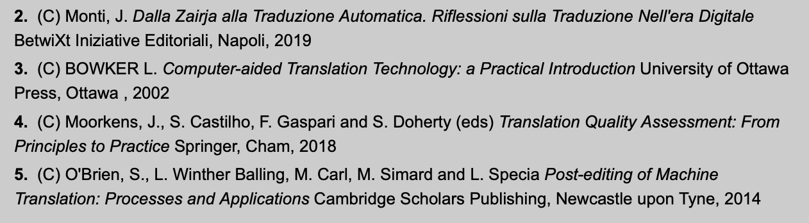
Books on the reading list for this course
Only 1 adopted textbook: Somers (ed.) (2003)
H. SOMERS Computers and Translation: a Translator's Guide John Benjamins John Benjamins, Amsterdam/Philadelphia, 2003
In addition, there are recommended/suggested books
12

Slide 4
«DISPENSA» → ACTIVITIES

Slide 5
The course
4 main topics
  the Internet, search engines and online resources for specialised translation/interpreting
  overview of computer-assisted translation (CAT)
tools: translation memory (TM) software and terminology management packages
  overview of machine translation (MT), including pre-, post-editing and controlled language
  corpora for specialised translation.
All students should have access to online computers outside and inside class

Slide 6
Housekeeping
Info: https://docenti.unimc.it/f.raffi/courses
If you have a problem, question or doubt, do not wait and get in touch!
How do we structure the class (2 sections)
  THEORY + PRACTICE
10

Slide 7
End-of-course exam –info
L'esame scritto finale, in lingua inglese, comporterà la verifica dell'acquisizione dei contenuti presentati nel modulo in merito all'impiego di una gamma di strumenti e tecnologie applicabili alla traduzione specialistica per la coppia di lingue inglese-italiano.
Criteri di valutazione: correttezza tecnica dei contenuti, esaustività e chiarezza, tenendo conto della qualità complessiva dell'inglese utilizzato.

Slide 8
FAREMO INSIEME DELLE SIMULAZIONI DURANTE LE
ULTIME LEZIONI ☺

Slide 9
OUR FIRST TOPIC:
THE INTERNET, SEARCH ENGINES AND ONLINE RESOURCES

Slide 10
Translation Technology
“much translation work is carried out in a computer‐assisted translation (CAT) environment, which may vary from a standard desktop equipped with word processing software and a browser to a full‐blown translator workstation consisting of a multiplicity of tools specifically created for translators of technical texts and localizers."
“Translation agencies organize their workflow around project management systems that distribute translation tasks, memories and terminologies to and around individual translators.”
(F. Zanettin 2014, “Corpora in Translation”)

Slide 11
Translation technologies
electronic dictionaries and terminological databases, the arrival of the Internet with its numerous possibilities for research, documentation and communication, and the emergence of computer-assisted translation tools.
Translation is a complex process which comprises tasks of various types.
Numerous computer tools can, or could, be used to enhance the efficiency, speed or quality of some of these tasks or their results.
Alcina A. (2008) «Translation technologies - Scope, tools and resources».
Target 20:1, 79–102

Slide 12
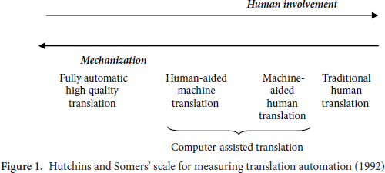
Degrees of Translation automation

Slide 13
Degrees of Translation automation
The term traditional human translation is understood to refer to translation
without any kind of automation
Fully automatic high quality translation (FAHQT) means translation that is performed wholly by the computer, without any kind of
human involvement, and is of “high quality”
Human-aided machine translation (HAMT) refers to systems in which the
translation is essentially carried out by the program itself, but aid required from
humans
Machine-aided human translation (MAHT) comprises any process or degree of automation in the translation process, provided that the mechanical intervention provides some kind of linguistic support.

Slide 14
Tools vs.Resources
The word tool refers to computer programs that enable translators to carry
out a series of functions or tasks with a set of data that they have prepared
and, at the same time, allows a particular kind of results to be obtained.
  Internet search engines
  Word processor
  Trados, Wordfast, Déjà Vu, Across, OmegaT, …
  Antconc, Wordsmith…
By resources we refer to all sets of previously gathered linguistic data which are organized in a particular manner and made available in some electronic format so that they can be used or looked up or used by translators used in the course of some phase of processing. Terminological databases (e.g. IATE), glossaries, …
  (online) dictionaries
  British National Corpus, …

Slide 15
WHY AND HOW CAN WE MINE THE WEB?
FIRST, THEORY…

Slide 16
Extended units of meaning
the study of words “by presenting them in the company they usually keep - that is to say, an element of their meaning is indicated when their habitual word accompaniments are shown”
“Extended units of meaning” at work in language
(Sinclair, 1996)
collocation
colligation
semantic preference
semantic prosody
Words must be studied in context rather than in isolation

Slide 17
Collocation
“Tendency of certain words to co-occur regularly in a given language”
(Mona Baker, 1992: 47)
  As observed in actual texts (vs. intuition)
Key features of collocations
o language-specific (collocations vary from language to language)
Collocations are not stable or fixed
o they may change diachronically (over time) in general language
o they may change in LSP vs. general language
o they may change across LSP domains
HOW DOES THE WORD “BORSA” COLLOCATE?

Slide 18
Semantic prosody
“A consistent aura of meaning with which a form is imbued by its collcates” (Louw 1993)
  “Feeling” or “aura” that is evoked by using certain words (reinforced by collocates, due to co-selectional implications and restrictions)
Usually this feeling is “positive or negative”
  “Provide” tends to occur with words denoting things which are desirable, necessary or good, such as “information”, “service(s)”, “support”, “help”, “money”, “protection”, “food”, “care”
    cf. Italian “fornire” and “elargire”
  “Cause” tends to occur with words denoting negative
repercussions/consequences, such as “pain”, “damage”, “harm”
    cf. Italian “causare”

Slide 19
Semantic preference
Relation between a lemma and a set of semantically related words (Stubbs, 2001: 65)
Lemma: base form (lexeme) or dictionary entry of a word
“Commit” is used with a group of semantically similar words, e.g. “murder”, “crime”, “suicide” (cf. Italian “commettere”)
“Revoke” is used with e.g. “licence”, “permit”, “authorization”
Semantic prosody → positive/negative evaluation
Semantic preference → relation to words belonging to a particular, definable semantic field

Slide 20
Colligation
Relation between a pair of grammatical categories or a pairing of lexis and grammar (Stubbs, 2001: 65)
  hear, notice, see, watch enters into colligation with the sequence of object + either the bare infinitive or the -ing form; e.g.Corr
  We heard the visitors leave/leaving.
  We noticed him walk away/walking away.
  We heard Pavarotti sing/singing.
  We saw it fall/falling.

Slide 21
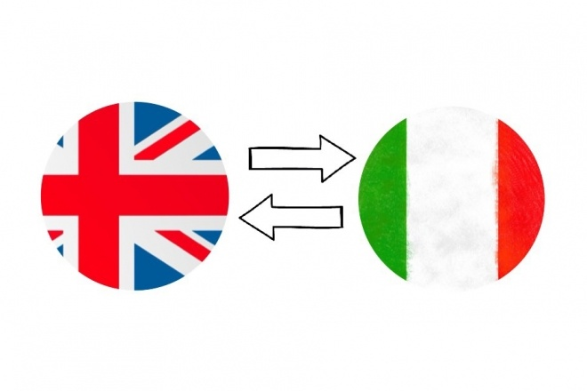
WHY AND HOW CAN WE MINE THE WEB?
THEN, PRACTICE!

Slide 22

’s a translator’s best friend
dictionaries are not always sufficient
Translators can use search engines to find/verify two kinds of things
o facts, pieces of information, knowledge (as an “encyclopaedia”)
o words, terms, phrases, expressions, instances of language use
We extract examples of real language in use, which we can analyse to infer repeated, common or typical linguistic behaviour
  e.g. we can use the Internet via a search engine to look for patterns and regularities
  COLLOCATIONS / COLLIGATIONS /
  SEMANTIC PROSODY / SEMANTIC PREFERENCE

Slide 23
After looking at repeated uses in context,
we can establish with a good degree of confidence the lexical profile of several words and lexical items,
(i.e a combination of all the above information, a sort of ID of a word, describing its typical behaviour and environment)
understand how they are used in extended units of meaning,
observe the environment in which they are primed to occur

Slide 24
Tips and tricks for effective Internet searches
Searches are not case sensitive
  “AAAA BBBB CCCC”
returns hits containing the words (as many as you want) in this exact sequence
  “XXXX * YYYY ZZZZ” (the * is known as wildcard)
returns hits containing the sequence of words XXXX, something unspecified in the middle – one or more word(s) – and then YYYY ZZZZ
Restricting the search to specific websites
  “AAAA BBBB CCCC” site:.uk
to search for a specific word sequence in .uk websites only
  “AAAA BBBB CCCC” site:www.visitbritain.com
to search for a specific word sequence within ONE specific website
Restricting the search to specific file formats
• +KKKK filetype:pdf
to limit the search to pdf files

Slide 25

More search options
“As you progress throughout the game, you’re faced with a variety of weapons, from sniper rifles to jet packs, from tanks to heavy artillery, each with its own special brand of characteristics and abilities.”
What’s a jet pack?
  Google define (define: jet pack)
  Google images (search in Images tab)

Slide 26
’s a translator’s best friend
ADJ-NOUN collocational patterns for a given NOUN
How can we translate into English “un’ampia/una vasta gamma di…”
Compare the collocates of two similar words (nouns)
  RANGE
  ARRAY
What patterns do we search for? Some possibilities to start with
“a * NOUN”
“this * NOUN”
“an * NOUN”
“such a(n) * NOUN”
“have a(n) * NOUN” - “has a(n) * NOUN”
“our * NOUN” - “their * NOUN”

Slide 27
Compare the collocates of two similar words (nouns)
ARRAY
– 1
– 2
– 3
– 4
– 5
– 6
– 7
– 8
– 9
– 10
RANGE
  A
  B
  C
  D
  E
  F
  G
  H
  I
  J

Slide 28
Preferred context-dependent uses and translating collocations into English
Are there any differences in the use of these two similar adjectives?
o powerful – potent
  search on google.co.uk for phrases such as “is a ADJ”, “this/these ADJ”, “very ADJ”, “extremely ADJ”, etc.
  pay special attention to the sources and surrounding words
  do these two adjectives seem to be used interchangeably?
  which one is more frequently found in medicine and/or chemistry?
Do you know what “al fresco” means in English? Find out in what
context this phrase is used in English, searching for it on google.co.uk

Slide 29
Investigating marked collocational uses
in L2 writing or translations
Think of the Italian adjective “suggestivo”, typical of tourism texts, e.g.
  “È situato a pochi minuti dalla stazione Termini ma in un angolo
suggestivo e tranquillo della città”
  “Portofino è una località molto esclusiva immersa in un paesaggio
suggestivo e in una natura incontaminata”
The problem is how to translate the adjective “suggestivo” into English
Under the entry for “suggestivo”, most bilingual Ita-Eng dictionaries
give e.g. “striking, attractive, evocative, charming, suggestive”, etc.
So it seems a safe bet to translate into English with “suggestive”, right?
First let’s check “in a suggestive” and “is a suggestive” on google.co.uk

Slide 30
Investigating marked collocational uses
in L2 writing or translations
Search for these exact phrases on the language-specific search engines:
  “suggestive environment”
  “suggestive setting(s)”
  “suggestive position”
  “suggestive scenery”
  “suggestive landscape”
When the phrases are attested on .uk webpages, what do they refer to?
What does this situation suggest?

Slide 31
(to) Set in - collocates
Semantic prosody?
☺ OR. ☹ ?
31

Slide 32
Homework – PAGINA DOCENTE
Exercise 2:
  on the brink of
  on the verge of
  on the cusp of
Exercise 5: unusual animal sounds
Exercise 6: groups/sets of animals and fruits

