Slide 1
TPCI B
a.a. 2022/2023
Francesca Raffi
f.raffi@unimc.it

Slide 2
Summary on using the Internet for specialised translation
What the Internet (and Google) can and cannot do for translators
We have used the Web
o to look for linguistic information (patterns), mono/bilingual dictionary-
style
o to check/verify culture-bound facts, encyclopaedia-style
o for specialised translation, as a quick-reference tool for technical translators
  and a range of language professionals, e.g. interpreters, revisers, etc.
We have used the Web to solve a variety of different problems
o linguistic: understand meaning, uses and associations of words/phrases
o translational: attested loans, confirm hypotheses on candidate equivalents
o cultural: items/references familiar in SC, unknown to translator and TC

Slide 3
Conclusion on using the Web
for specialised translation – Main advantages
massive amount of texts and multi-source information can be searched
content is constantly “refreshed” (i.e. updated and extended)
How to friend and unfriend someone on Facebook - Computer Hope
https://www.computerhope.com › ... › Facebook Help
24 gen 2018 - Before you can connect with another person on Facebook and view their full profile, you must first become friends. Below are the steps on how to find new friends on Facebook, add friends, and how to unfriend any of your current friends. How to find friends on Facebook; How to friend someone on ...

Slide 4
Conclusion on using the Web
for specialised translation – Main advantages
a lot of sources, text types and domains/topics are represented
many languages (English is dominant, good presence of Italian)
replicable search techniques across (your working/target) languages
it is available at any time, at virtually no cost!

Slide 5
The course
4 main topics
  the Internet, search engines and online resources for specialised translation/interpreting
  overview of computer-assisted translation (CAT)
tools: translation memory (TM) software and terminology management packages
  overview of machine translation (MT), including pre-, post-editing and controlled language
  corpora for specialised translation.
All students should have access to online computers outside and inside class

Slide 6
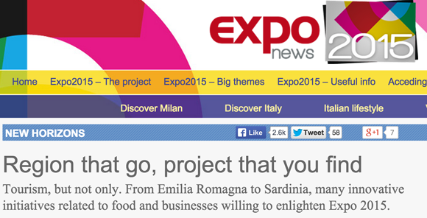
“L'inglese di Expo non sembra Google Translate,
è Google Translate”
From http://www.linkiesta.it/it/blog-post/2015/02/12/linglese-di-expo-non-sembra-google-translate-e-google-translate/22476/

Slide 7
Machine translation (MT):
definition and key terms
Definition of machine translation:
“computerised systems responsible for the production of translations
from one natural language into another, with or without human
assistance” (Hutchins & Somers, 1992: 3)
  Human intervention is not necessarily excluded, but if it does occur it is
  subordinated to the prevailing action of the computer
Some key terms:
  MT system / engine / service = the software that produces the translation
  input = the source text (i.e. original that we are trying to translate)
  [raw] output = [unedited] target text (i.e. the translation that we obtain)

Slide 8
MT – popular conceptions
Two extreme positions about MT:
MT is totally useless and a waste of time and money, as the quality o the output is generally very low (funny anedoctes)
MT will bring down language barriers;
Quality varies according to language pairs, integrated tools (MT that learns) and pre- editing

Slide 9
Machine translation (MT):
main architectures of MT systems
Parallel corpora: a collection of original texts in language L1 and their translations into a give L2
Texts in SL
Texts in TL

Slide 10
Sentence-aligned parallel texts
Texts in EN
Texts in IT
The red house is big.
This is my new house.
She lives in a big house.
I bought a new house.
This house is very expensive.
This house is very big.
La casa rossa è grande.
Questa è la mia nuova casa.
Lei vive in una casa grande.
Ho comprato una nuova casa.
Questa casa costa molto.
Questa casa è molto grande.

Slide 11
Texts in EN
Texts in IT
The red house is big.
This is my new house.
She lives in a big house.
I bought a new house.
This house is very expensive.
This house is very big.
La casa rossa è grande.
Questa è la mia nuova casa.
Lei vive in una casa grande.
Ho comprato una nuova casa.
Questa casa costa molto.
Questa casa è molto grande.
3 / 4

Slide 12
Machine translation (MT):
why is MT so difficult? Or why is translation difficult for computers?
So why is translation difficult for computers?
  Some blame the computer’s lack of “real-world knowledge”
  Focus on potential translation problems for EN-IT (with a computer!!)
  A simple example: lexical gaps and lexical asymmetries (concrete nouns)
    legno / bosco / foresta in IT (+ EN, FR, DE and your other languages…)
legno | bosco | foresta | IT
wood |  | forest | EN
bois |  | forêt | FR

Slide 13
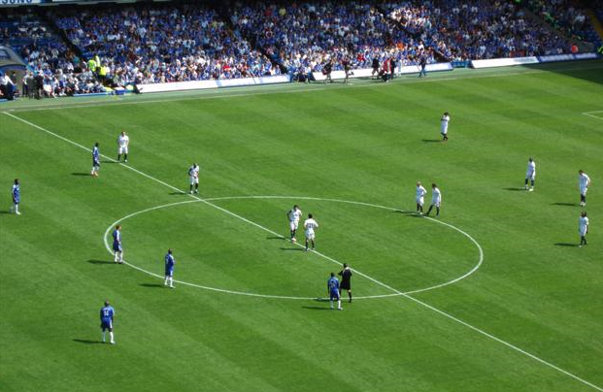
Machine translation (MT):
why is MT so difficult? Or why is translation difficult for computers?
Partly because the translation often depends on the context / situation,
which the computer is not able to take into account
“The ball is in your court”
“Il pallone è nella vostra metà campo”
(the manager to the players)

Slide 14
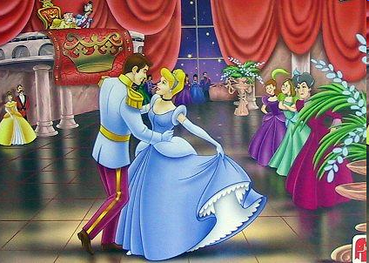
Machine translation (MT):
why is MT so difficult? Or why is translation difficult for computers?
Partly because the translation often depends on the context / situation,
which the computer is not able to take into account
“The ball is in your court”
“Il pallone è nella vostra metà campo”
(the manager to the players)
“Il ballo è nella vostra corte”
(the chamberlain to the king)

Slide 15
Machine translation (MT):
why is MT so difficult? Or why is translation difficult for computers?
Lexical ambiguities (gramm. category <-> meaning <-> translation)
for example, in EN: round
  My team was eliminated in the first round
  The cowboy started to round up the cattle
  We can use the round table for dinner
  Maggie is going on a cruise round the world
These sentences are ambiguous and very complex (for MT!):
  Time flies like an arrow
  Gas pump prices rose last time oil stocks fell
  (Noun: girone)
  (Verb: radunare)
  (Adjective: rotondo)
  (Preposition: intorno al)

Slide 16
Machine translation (MT):
some linguistic phenomena that are particularly difficult for MT
1) The chimp eats the banana because it is greedy.
2) The chimp eats the banana because it is ripe.
3) The chimp eats the banana because it is lunchtime.
__________
__
___________
__
__
?
The case / example of pronominal anaphora (resolution), difficult for MT

Slide 17
Machine translation (MT):
forms of human intervention in MT (the case of pre-editing)


1) The chimp eats the banana because it is greedy.
1a) The chimp eats the banana. The chimp is greedy.
1b) The greedy chimp eats the banana.
2) The chimp eats the banana because it is ripe.
2a) The chimp eats the banana. The banana is ripe.
2b) The chimp eats the ripe banana.
3) The chimp eats the banana because it is lunchtime.
3a) It is lunchtime and the chimp eats the banana.



Example of pre-editing: simplifying the input (eliminating anaphoras)

Slide 18
MT post-editing
The aim of post-editing is to make the revised output usable or
understandable, with the least possible effort (quickly)
The priority is to save time and money
The extent and the accuracy of post-editing are negotiated/specified
on a case by case basis, depending on the needs and requirements
Different “types” and levels of post-editing (in companies, organisations):
  no post-editing
    internal circulation, almost never external publication
  minimum post-editing
    internal circulation, rarely external publication
  full/complete post-editing (but… is it worth it?)
    very rarely internal circulation, mostly external publication

Slide 19
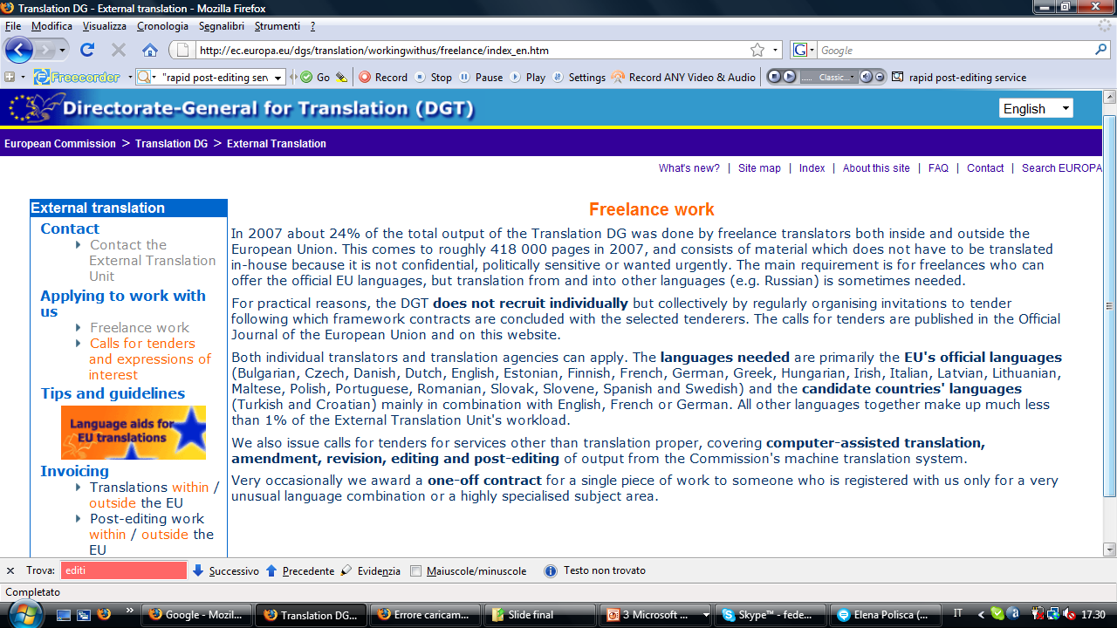
Source: http://ec.europa.eu/dgs/translation/workingwithus/freelance/index_en.htm

Slide 20
PRACTICE
MT

Slide 21
What you need to know to become a professional translator
Saper fare un preventivo di traduzione
Quanto tempo?
Quanti soldi?
CARTELLA
PAROLA
REVISORE
and much more!

Slide 22
What you need to know to become a professional translator
Saper fare un preventivo di traduzione
Quanto tempo?
Quanti soldi?
LA CARTELLA:
Come si calcola?
1 CARTELLA = X Euro

Slide 23
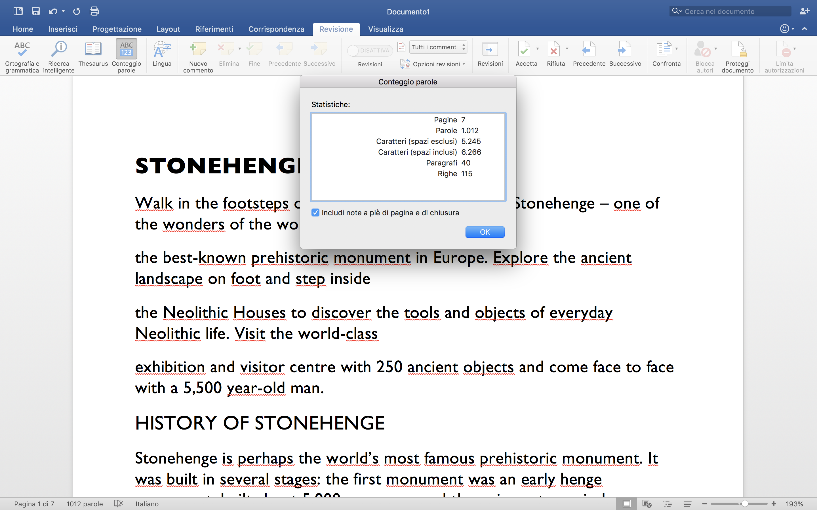
1 CARTELLA = 1.500 caratteri, spazi inclusi

Slide 24
NON SOLO CARTELLE
PAROLA
cartella da 1500:
italiano = 212-218
inglese = 240-250
francese = 212 (?)
tedesco = 200 (ma varia da 170 a 240 circa)

Slide 25
TARIFFE: difficult stuff…
ENG <> ITA
QUANTE CARTELLE RIESCO A TRADURRE IN UN’ORA?
QUANTO TEMPO HO DA DEDICARE ALLA TRADUZIONE (altri lavori in coda, ecc.)?
QUALI SONO LE MIE SCADENZE? E QUELLE DEL REVISORE? QUANTO TEMPO GLI/LE OCCORRE?
1 h = 2 cartelle (3.000 caratteri spazi inclusi)
HO 10 CARTELLE DA TRADURRE = 5 h di lavoro
https://translatorswithoutborders.org

