Slide 1


Lingua e traduzione inglese I - Mod. A "lingua e cultura"
Prof. ssa RAFFI f.raffi@unimc.it

Slide 2
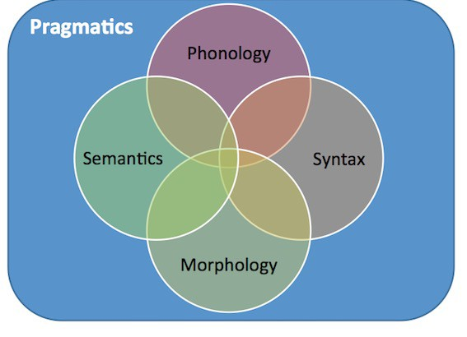

Slide 3
SUB-FIELDS OF LINGUISTICS
Phonology: The study of speech sounds.
PHONOLOGY VS PHONETICS

Slide 4
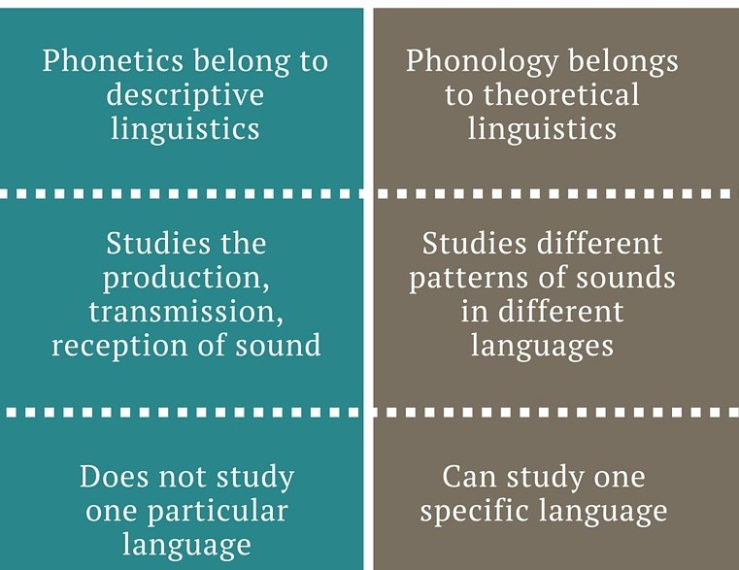
PHONETICS VS PHONOLOGY

Slide 5
PHONETICS VS PHONOLOGY
pèsca -> /ɛ/ = Peach (the fruit)
pésca -> /e/ = Fishing (the activity)
"the ear hears phonetics, but the brain hears phonology”

Slide 6
SUB-FIELDS OF LINGUISTICS
Semantics: The study of meaning (individual words/sentences).
“the meaning of a word is its use in the language”
???

Slide 7
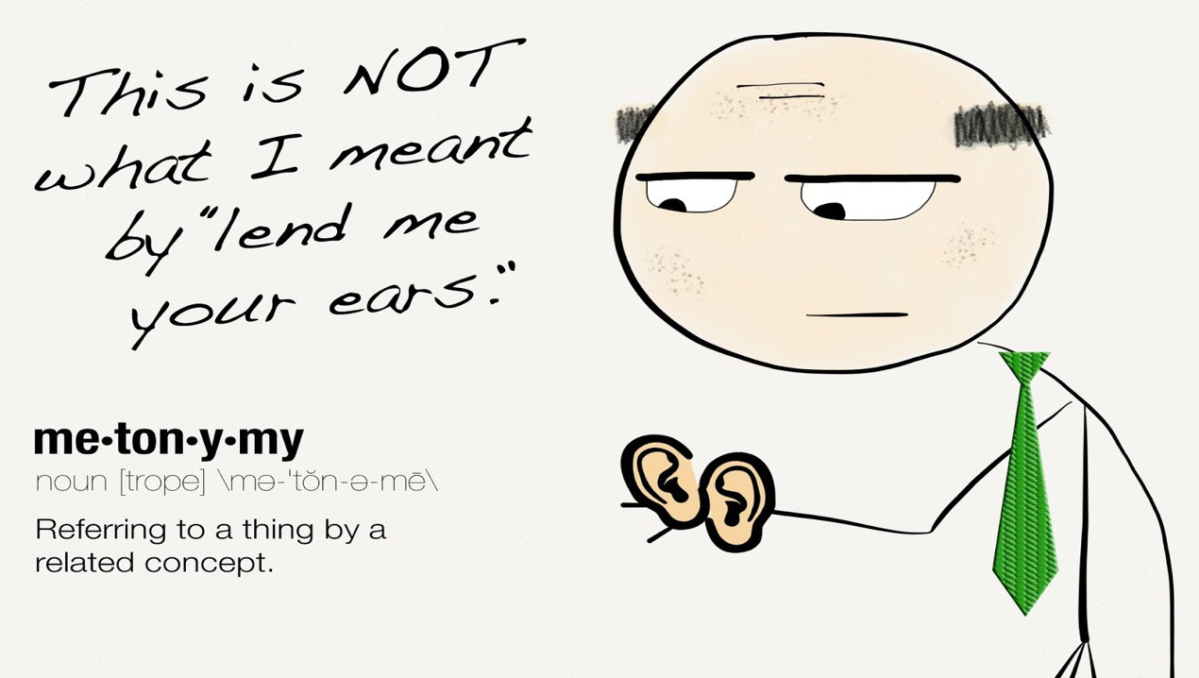
lend (one's) ear to (someone or something)
To listen carefully or pay close attention.

Slide 8
SUB-FIELDS OF LINGUISTICS
Pragmatics: a branch of Linguistics that studies the phrases and sentences in the actual context of discourse.
ACTUAL CONTEXT?

Slide 9
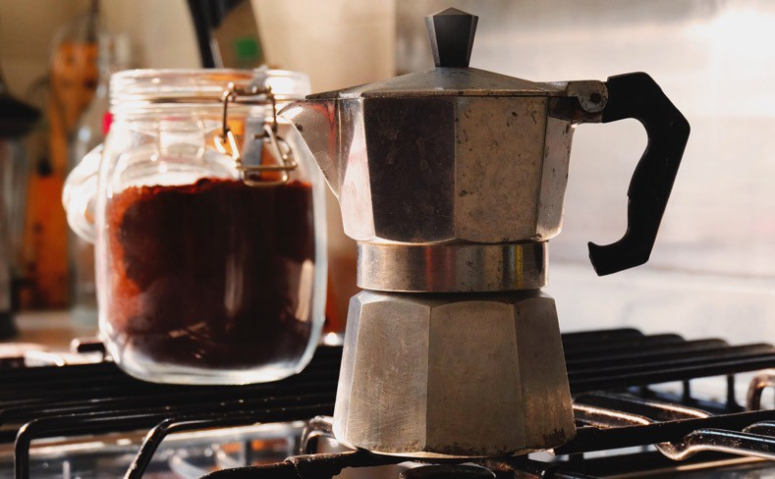
Have you ever asked someone to put the moka pot on and expected them to make you a cup of coffee?….

Slide 10
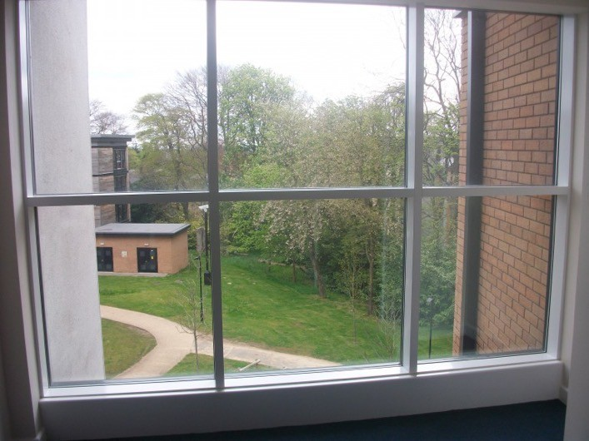
Have you ever told someone you are cold and intended for them to close the window?…

Slide 11
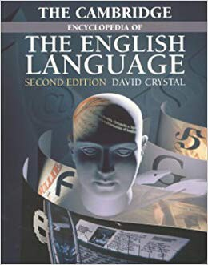
Sub-fields of Linguistics:
MORPHOLOGY: Ch. 14-15
SYNTAX: Ch. 16

Slide 12
SUB-FIELDS OF LINGUISTICS
Morphology: The study of the words of Language or deals with the internal structure of words.
WHAT IS A WORD?

Slide 13
WHAT IS A WORD?
They’re the smallest independent units of language
Independent:
do not depend on other words
can be separated from other units
can change position

Slide 14
“The man looked at the horses.”
Horses is a word: can occur in other positions or stand on its own.
EG:
The horses looked at the man.
– What is the man looking at? – Horses.

Slide 15
“The man looked at the horses.”
horse+S
SIMPLE/COMPLEX WORDS?

Slide 16
SIMPLE VS. COMPLEX WORDS
Words have internal structure: built of even smaller pieces
SIMPLE WORDS: Don’t have internal structure (only consist of one morpheme) eg work, build, run, horse. They can’t be split into smaller parts which carry meaning or function.
COMPLEX WORDS: Have internal structure (consist of two or more morphemes) eg worker: affix -er added to the root work to form a noun; hors+es (plural marker added).

Slide 17
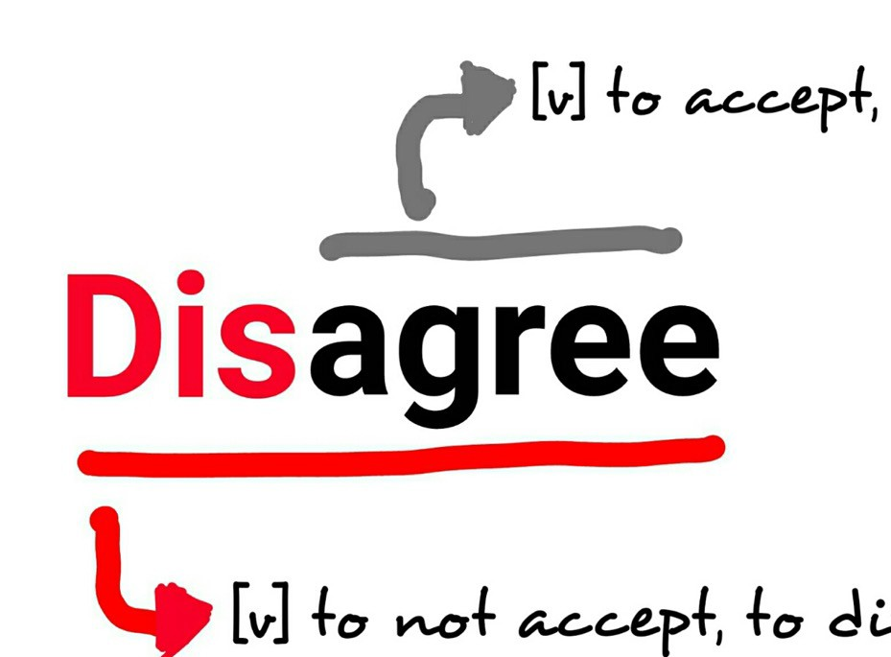
COMPLEX WORDS
prefix

Slide 18
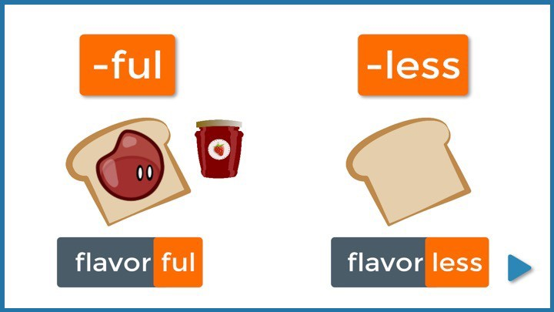
COMPLEX WORDS
suffix

Slide 19
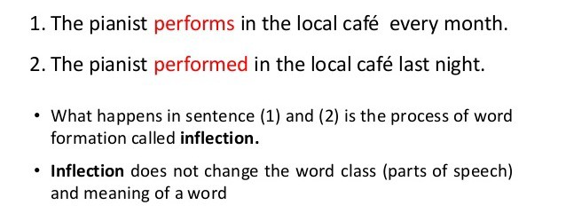
COMPLEX WORDS
inflection

Slide 20
WORD CLASSES
All words in the English language can be classified as one of the eight different word classes.
The eight word classes are:
nouns, pronouns, verbs, adjectives, adverbs, conjunctions, prepositions, and interjections.

Slide 21
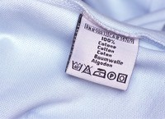
NOUNS
A noun is a word whose job is naming, or labelling (people, places, objects, concepts, ideas).
The most important division is into proper nouns and common nouns (count nouns/non- count nouns; concrete/abstract…)

Slide 22
PRONOUNS
The little old lady in a raincoat walked into the shop. She asked for a pint of milk. The shopkeeper gave her the milk and asked her if she wanted anything else.

Slide 23
WHY PRONOUNS?
In Latin, the word for ‘for’ is pro, so ‘pro- nouns’ mean “words which stand in for nouns”.
There are several different sorts of pronouns in English…

Slide 24



 | Pronoun Type | Members | Example
 | Possessive | mine, yours, his… | The white car is mine
 | Reflexive | myself, yourself, himself… | He injured himself playin g football
 | Reciprocal | each other, one another | They really hate each other
 | Relative | that, which, who… | The book that you gave me was really boring
 | Demonstrative | this, that, these… | This is a new car
 | Interrogative | who, what, why… | What did he say to you?
 | Indefinite | anything, anybody… | There's something in my shoe

Slide 25
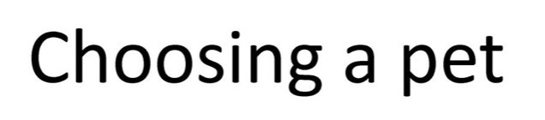
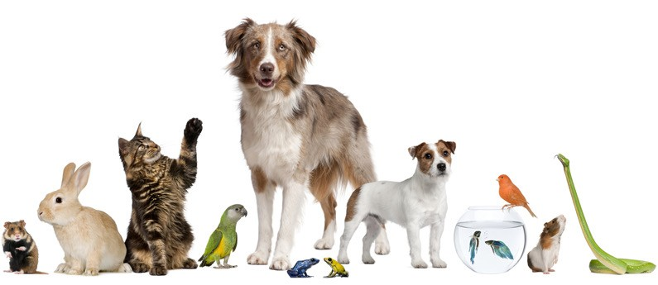

Slide 26

What is the right pronoun for instances where a person’s gender is unknown/unspecified?
Eg: “Every lawyer should bring his briefcase.”

Slide 27
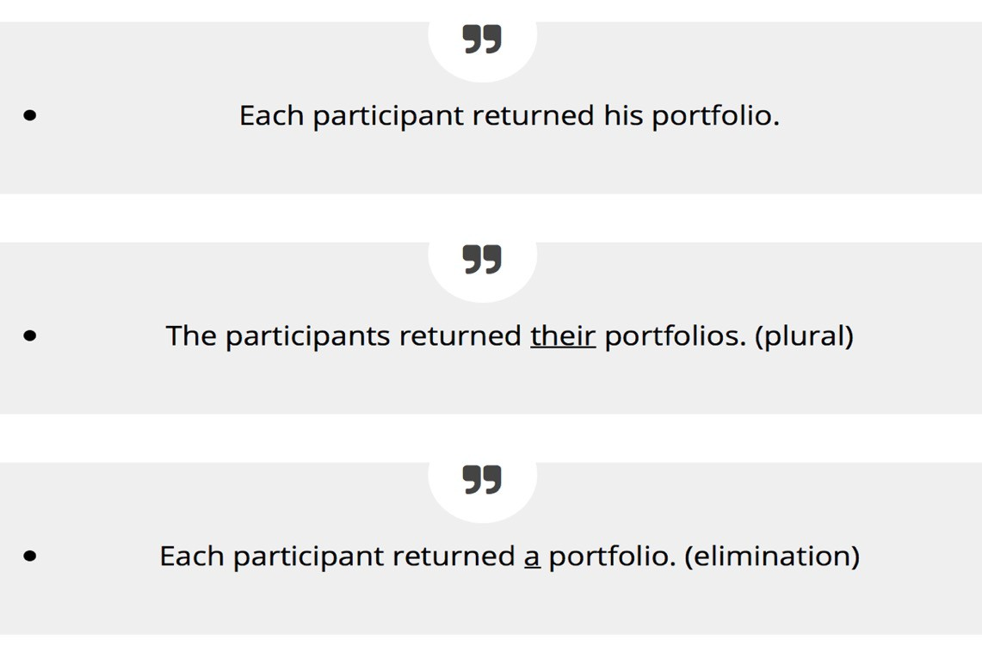
What about formal conversation/writing?

Slide 28
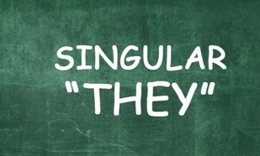
The pronoun they is a third
person singular form widely used in colloquial English when a person’s gender is unknown/unspecified (Grey, 2015).
In informal conversation, you would sound perfectly natural saying “Somebody forgot their coat.”

Slide 29

VERBS
The verb is the element which makes everything hold together.
HAVE YOU SEEN MY KEYS?

Slide 30


TYPES OF VERBS
stative verbs
action verbs

Slide 31
ADJECTIVES
Most adjectives can be used in front of a noun.
Most adjectives can be used on their own, after a verb (like to be.)
You can also put adverbs in front of many adjectives (like very).
And you can use adjectives to make comparisons.

Slide 32
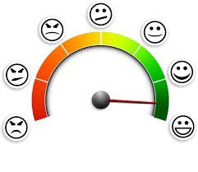

WHAT DO ADJECTIVES SAY?
Adjectives are the parts of speech that contain the most explicit sentiment (=subjective information).
A sentiment analysis is an analysis of the emotional content of a text.

Slide 33
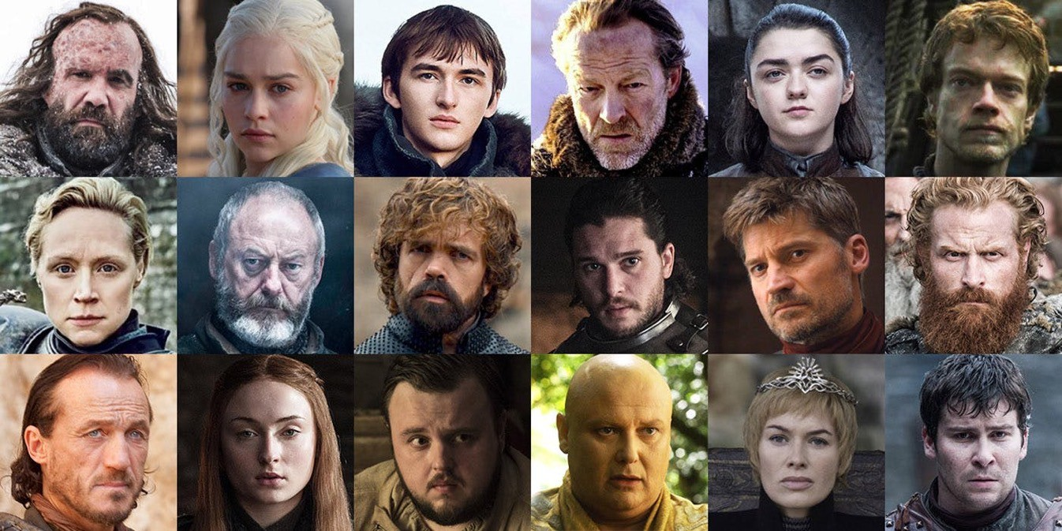
'Game of Thrones': The Top 30 Characters, Ranked
https://www.hollywoodreporter.com/live-feed/game-thrones-top-30-characters-ranked-957542

Slide 34
ADVERBS
give you further details about the action of a verb.
The usual way to make an adverb is to take an adjective and add -ly to it (examples?)
Not all adjectives! (examples?)

Slide 35
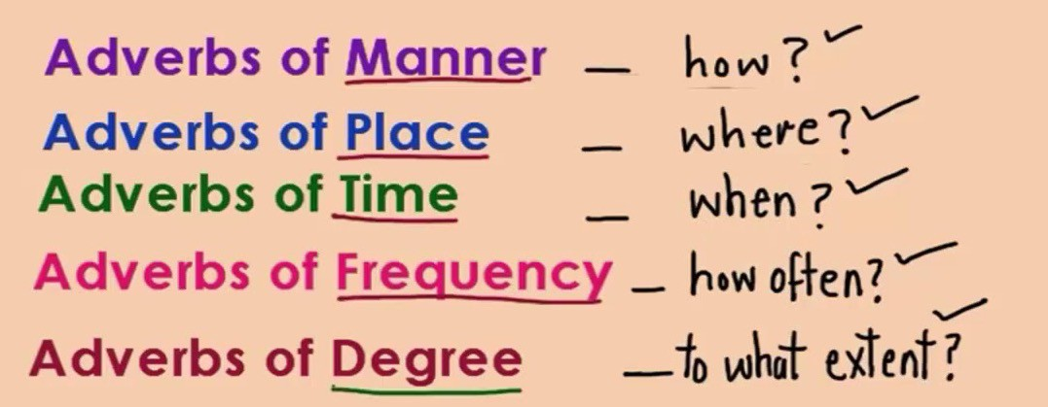
ADVERBS

Slide 36
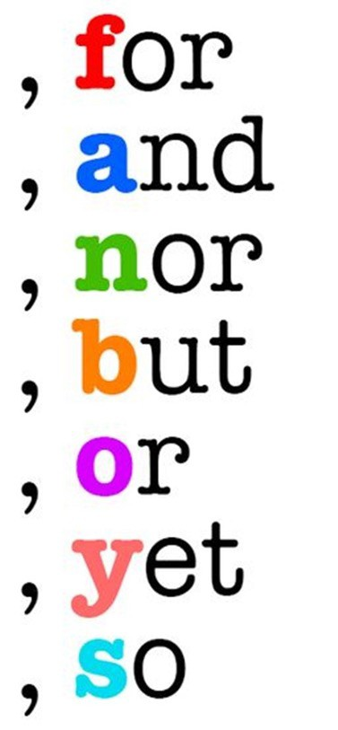
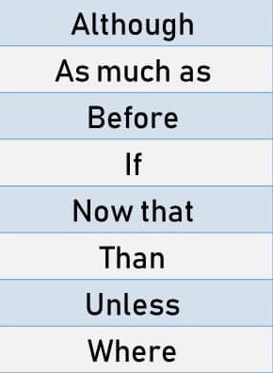
CONJUCTIONS
VS.

Slide 37
CONJUCTIONS
The ones which just ‘join together’ (or coordinate) words, phrases, and sentences are called coordinating conjunctions.
"I can't cook very well
but I make quite good pancakes"

Slide 38
CONJUCTIONS
The other conjunctions are called subordinating conjunctions. Their job is to show that one clause is part of another clause.
"I'll get you some stamps if I go to town"

Slide 39
PREPOSITIONS
they show how nouns relate to each other in space and time.
• + why/how/…
If you get the preposition wrong, it can be very misleading…

Slide 40


Slide 41

INTERJECTIONS
Used to express our emotions (surprise, pain, disgust...).
They don’t form part of a sentence.

Slide 42
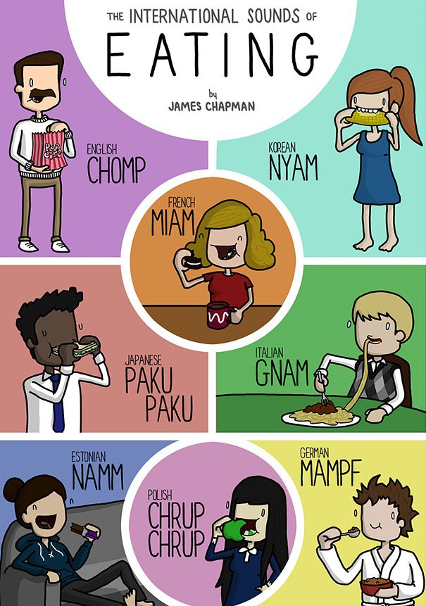

Slide 43
Sub-fields of Linguistics:
MORPHOLOGY: Ch. 14-15
SYNTAX: Ch. 16

Slide 44
SYNTAX
the way words go together to make sentences.
A sentence can stand on its own.
Because I haven’t got any money with me
Only certain combinations of words can be sentences. British the my sister is.
A sentence usually makes sense.

Slide 45
TYPES OF SENTENCES
major sentences: formed using the basic grammatical rules of the language.
minor sentences: don’t follow the grammatical rules found in the majority of other sentences.

Slide 46

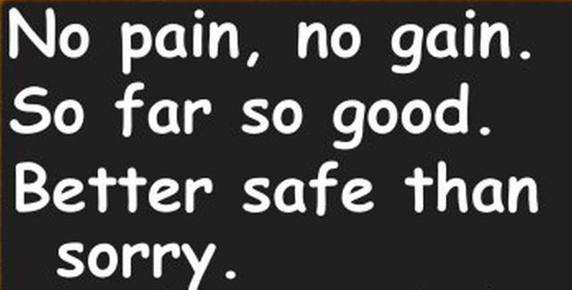

Slide 47
MAJOR SENTENCES
A simple sentence consists of only one clause.
EG: Joe waited for the train
A compound sentence consists of two or more independent clauses.
EG: Joe waited for the train, but the train was late.
A complex sentence has at least one independent clause plus at least one dependent clause.
Joe was reading a book because he was waiting for the train.

Slide 48
MAJOR SENTENCES
A simple sentence consists of only one clause.
EG: Joe waited for the train
A compound sentence consists of two or more independent clauses.
EG: Joe waited for the train, but the train was late.
A complex sentence has at least one independent clause plus at least one dependent clause.
Joe was reading a book because he was waiting for the train.

Slide 49
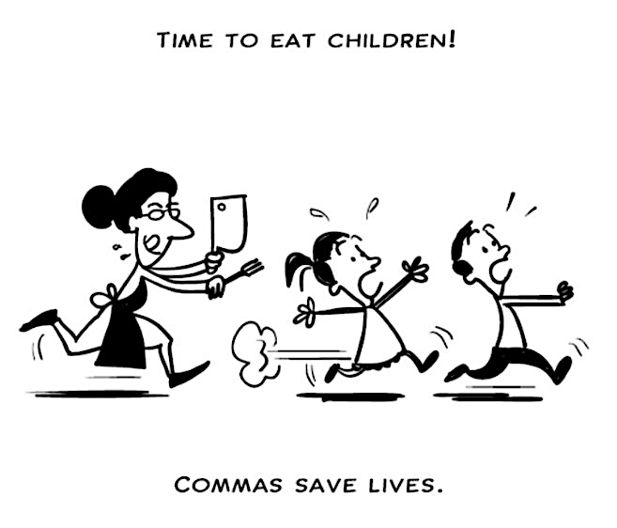

Slide 50
CLAUSES
A compound or complex sentence breaks down into smaller chunks: clauses.
You can have any number of clauses in a sentence.
Clauses join together in different ways (coordination and subordination ).

