Slide 1


Lingua e traduzione inglese I - Mod. A "lingua e cultura"
Prof. ssa RAFFI francesca.raffi@unimc.it

Slide 2
Testi (A)dottati, (C)onsigliati
(A) Crystal, D. The Cambridge Encyclopedia of the English Language Cambridge University Press, Cambridge University. 2003.
(C) Crystal, D. English as a Global Language Cambridge University Press, Cambridge University. 2002.
(C) Crystal, D. and Davy, D. Investigating English Style Routledge. Oxon, 2013.
(C) Halliday, M.A.K. and Matthiessen, C. An Introduction to Functional Grammar. Routledge, Oxon, 2013.

Slide 3
PRIMA LEZIONE
CHAPTER 8: THE NATURE OF THE LEXICON

Slide 4
WHAT IS A LEXEME?
Lexeme: the fundamental unit of the lexicon of a language.
Etymology: from the Greek, "word, speech”.
A lexeme is often (but not always) an individual word (e.g.
love).
It may have a number of inflectional forms or grammatical variants (e.g. loved; loving; lover).
A lexeme can be made up of more than one orthographic word.
Come, coming and come in are all lexemes.

Slide 5
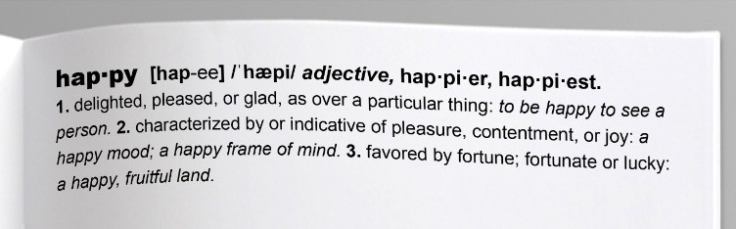
The headwords in a dictionary are all
lexemes
happy (the word in bold letters) is a lexeme

Slide 6

Abbreviations
Acronyms: a word formed from the initial letter or letters of each of the successive parts (e.g. RADAR – RAdio Detection And Ranging) or major parts of a compound term (e.g. MOTEL – MOTor HoTEL) .
Initialisms: an abbreviation formed from initial letters (e.g. BBQ).
Acronyms like 'scuba' ("self- contained underwater breathing apparatus") are pronounceable as words. Initialisms like 'FBI' (Federal Bureau of Investigation) are not.

Slide 7
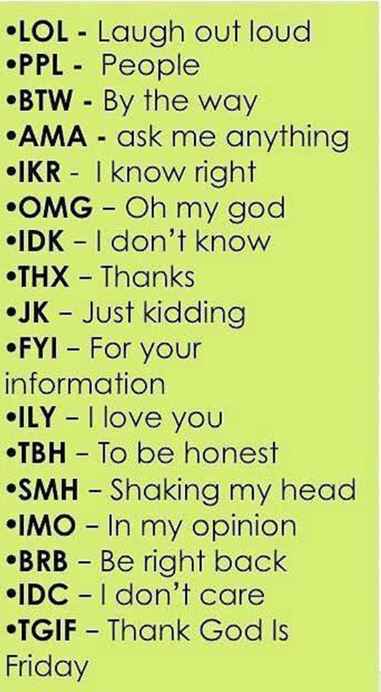

Slide 9
Abbreviations – cont’d
Clipping (clipped word, shortening, and truncation): the shortening of a longer word, often reducing it to one syllable (e.g. AD).
Blends: a word which is made up of parts of two or more other words (e.g. BRUNCH)
Latin abbreviations: etc.; et al.; etc…. ©

Slide 10
WORD FORMATION
In linguistics, word formation refers to the ways in which new words are made on the basis of other words.
Word-formation can be viewed either diachronically (through different periods in history) or synchronically (at one particular period in time)
Word formation is sometimes contrasted with semantic change, which is a change in a single word's meaning.

Slide 11
1. Abbreviations: a word or phrase is shortened (e.g. Dr.).
Remember?
Acronyms: a word formed from the initial letter or letters of each of the successive parts (e.g. RADAR) or major parts of a compound term (e.g. MOTEL) .
Initialisms: an abbreviation formed from initial letters (e.g.
BBQ).
Clipping (clipped word, shortening, and truncation): the shortening of a longer word, often reducing it to one syllable (e.g. AD).
Blends: a word which is made up of parts of two or more other words (e.g. BRUNCH)
Latin abbreviations: etc.; et al.; etc…. ©

Slide 12
Abbreviations: a word or phrase is shortened (e.g. Dr.).
Calque or loan translation: a word or phrase borrowed from another language by literal, word-for-word or root-for-root translation (e.g. It goes without saying).

Slide 13
Abbreviations: a word or phrase is shortened (e.g. Dr.).
Calque or loan translation: a word or phrase borrowed from another language by literal, word-for-word or root-for-root translation (e.g. It goes without saying).
Morphological derivation: the process of forming a new word from an existing word, often by adding a prefix or suffix (e.g. unhappy)

Slide 14
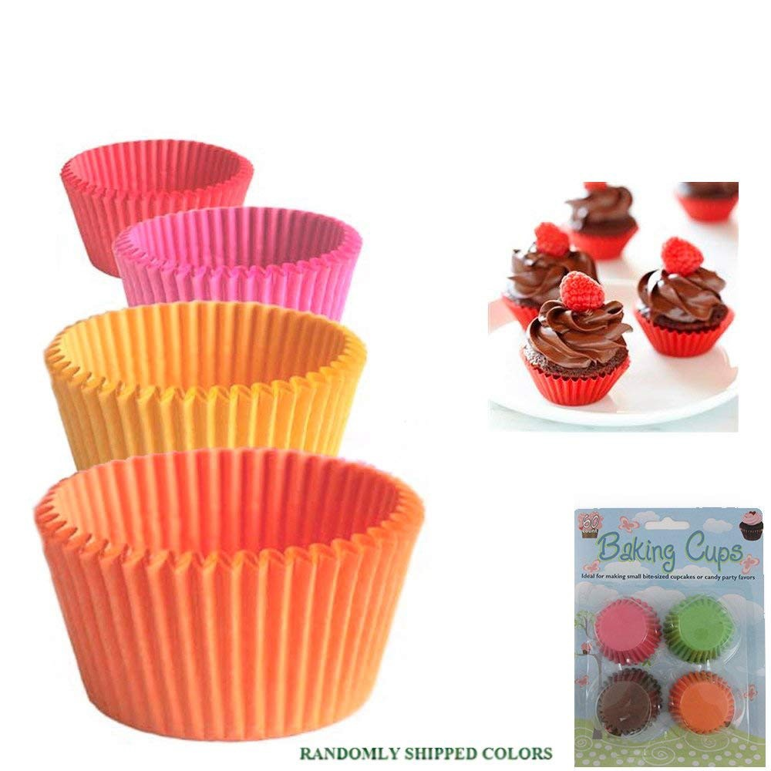
Abbreviations: a word or phrase is shortened (e.g. Dr.).
Calque or loan translation: a word or phrase borrowed from another language by literal, word-for-word or root-for-root translation (e.g. It goes without saying).
Morphological derivation: the process of forming a new word from an existing word, often by adding a prefix or suffix (e.g. unhappy)
Compounding: a lexeme that consists of more than one stem (e.g. cupcake)

Slide 15

Abbreviations: a word or phrase is shortened (e.g. Dr.).
Calque or loan translation: a word or phrase borrowed from another language by literal, word-for-word or root-for-root translation (e.g. It goes without saying).
Morphological derivation: the process of forming a new word from an existing word, often by adding a prefix or suffix (e.g. unhappy)
Compounding: a lexeme that consists of more than one stem (e.g. cupcake)
Conversion: change of a word from one word class to another (e.g. to friend someone).

Slide 16
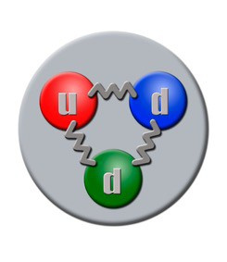
Abbreviations: a word or phrase is shortened (e.g. Dr.).
Calque or loan translation: a word or phrase borrowed from another language by literal, word-for-word or root-for-root translation (e.g. It goes without saying).
Morphological derivation: the process of forming a new word from an existing word, often by adding a prefix or suffix (e.g. unhappy)
Compounding: a lexeme that consists of more than one stem (e.g. cupcake)
Conversion: change of a word from one word class to another (e.g. to friend someone).
Neologism: forming a new word by coining (e.g. quark)

Slide 17
Abbreviations: a word or phrase is shortened (e.g. Dr.).
Calque or loan translation: a word or phrase borrowed from another language by literal, word-for-word or root-for-root translation (e.g. It goes without saying).
Morphological derivation: the process of forming a new word from an existing word, often by adding a prefix or suffix (e.g. unhappy)
Compounding: a lexeme that consists of more than one stem (e.g. cupcake)
Conversion: change of a word from one word class to another (e.g. to friend someone).
Neologism: forming a new word by coining (e.g. quark)
Back-formation: we remove part of a word - suffix or prefix (e.g. to enthuse).

Slide 18



BECOMING A PROFESSIONAL TRANSLATOR (?)

Slide 19


resources for translators!
ProZ.com: Freelance translators & Translation companies www.proz.com
TranslatorsCafé.com—Directory of Translators, Interpreters and Translation Agencies www.translatorscafe.com
Portal for translators and translation agencies www.translationdirectory.com
Find translators for your translation project www.traduguide.com

Slide 20
WORKING AS TRANSLATORS
UNITED NATIONS
https://careers.un.org/lbw/home.aspx?viewtype=LCEFD&FId=7
FREELANCE TRANSLATOR
http://www.proz.com/
VOLUNTEER AS TRANSLATOR/PROOFREADER
http://translatorswithoutborders.org/volunteer/ http://www.ted.com/participate/translate/get-started

Slide 21
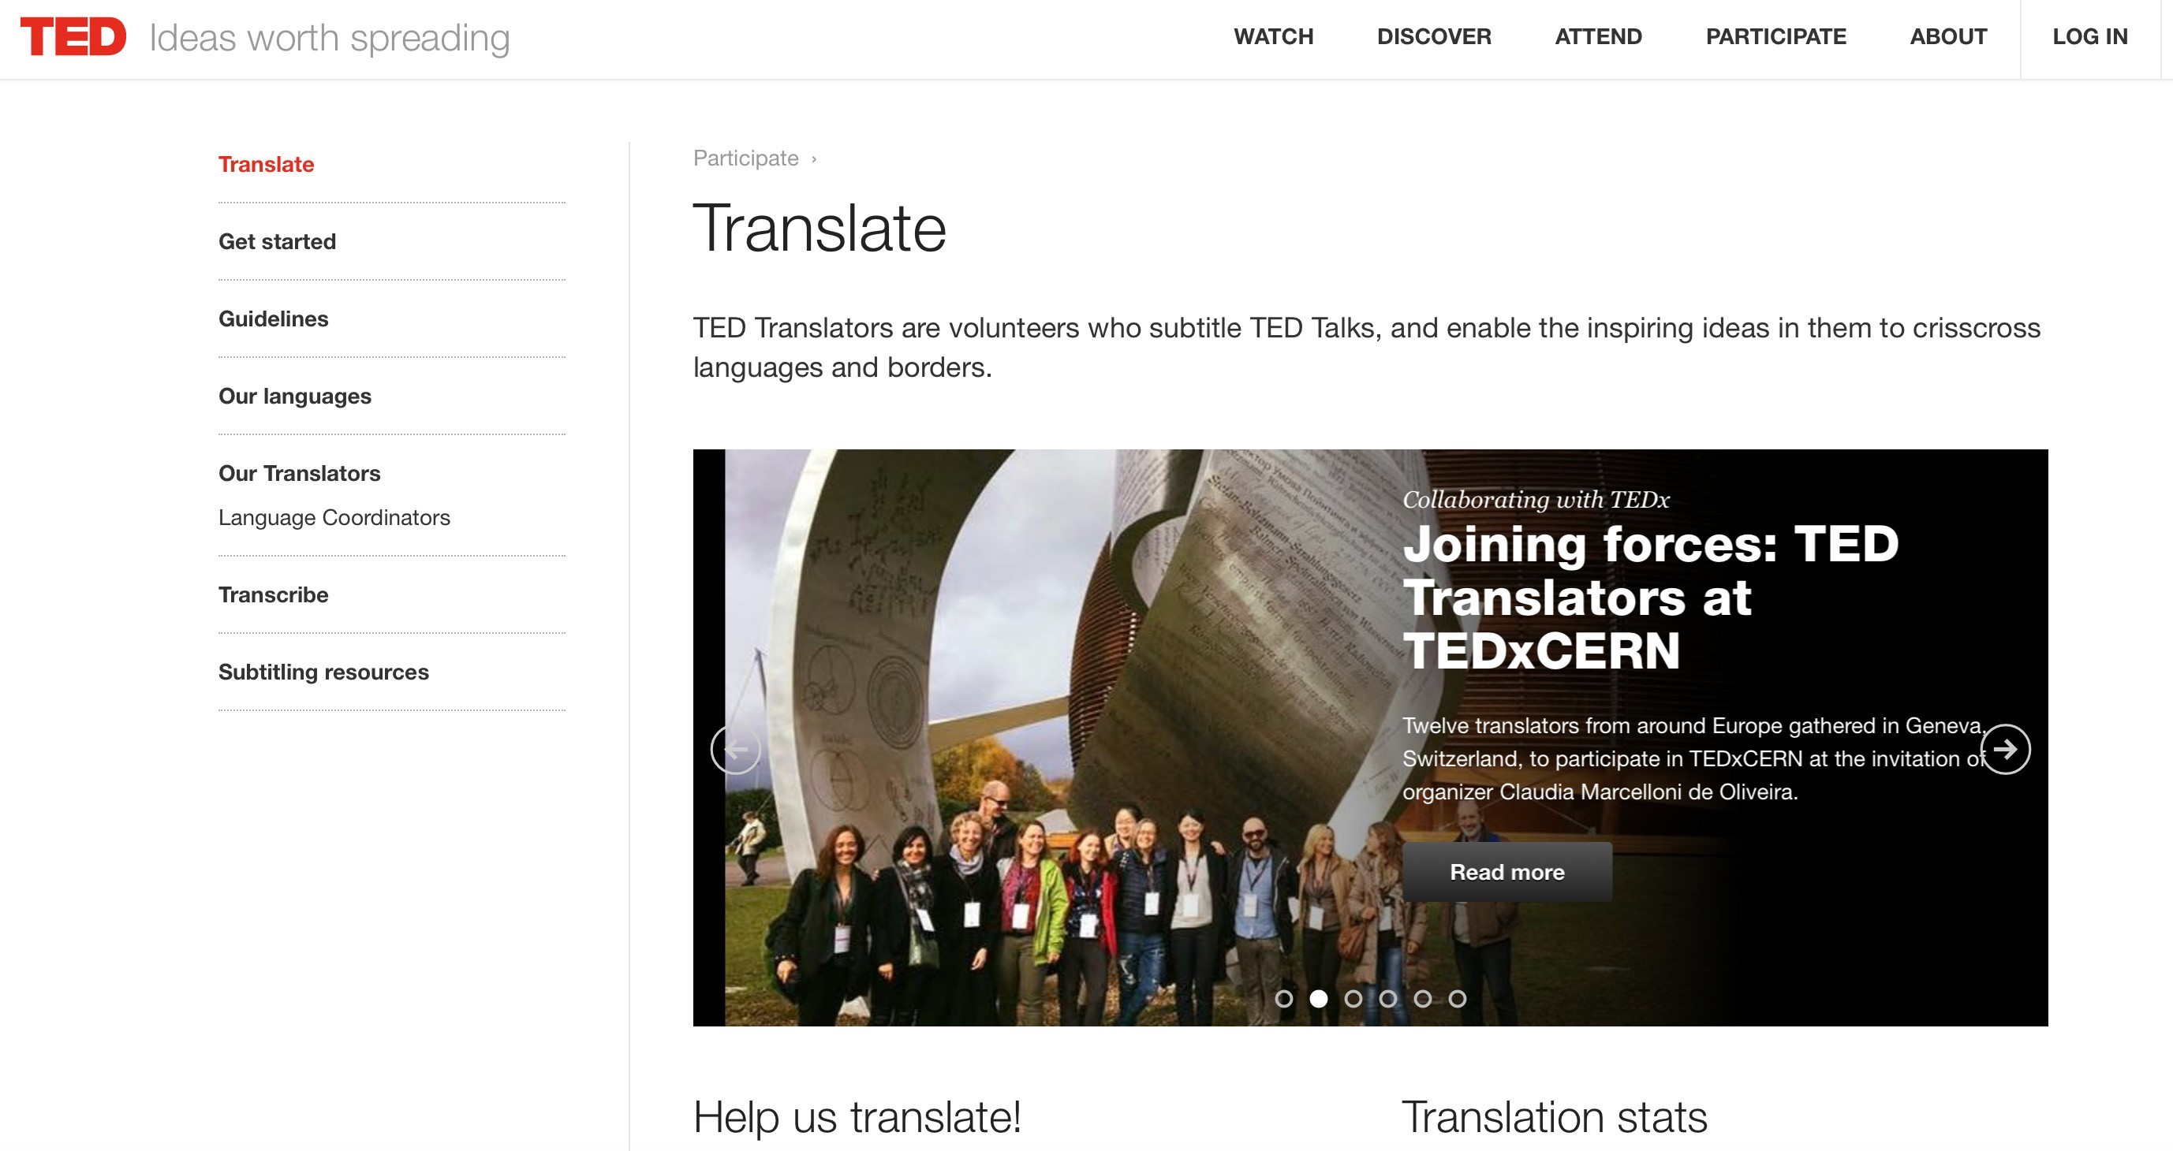

Slide 22
What you need to know
to become a professional translator
Saper fare un preventivo di traduzione
O Quanto tempo?
O Quanti soldi?
Utilità gruppi!
  CARTELLA
    PAROLA
  REVISORE
and much more!
6

Slide 23
What you need to know to become a professional translator
Saper fare un preventivo di traduzione
O Quanto tempo?
O Quanti soldi?
  LA CARTELLA:
Come si calcola?
1 CARTELLA = XEuro
7

Slide 24
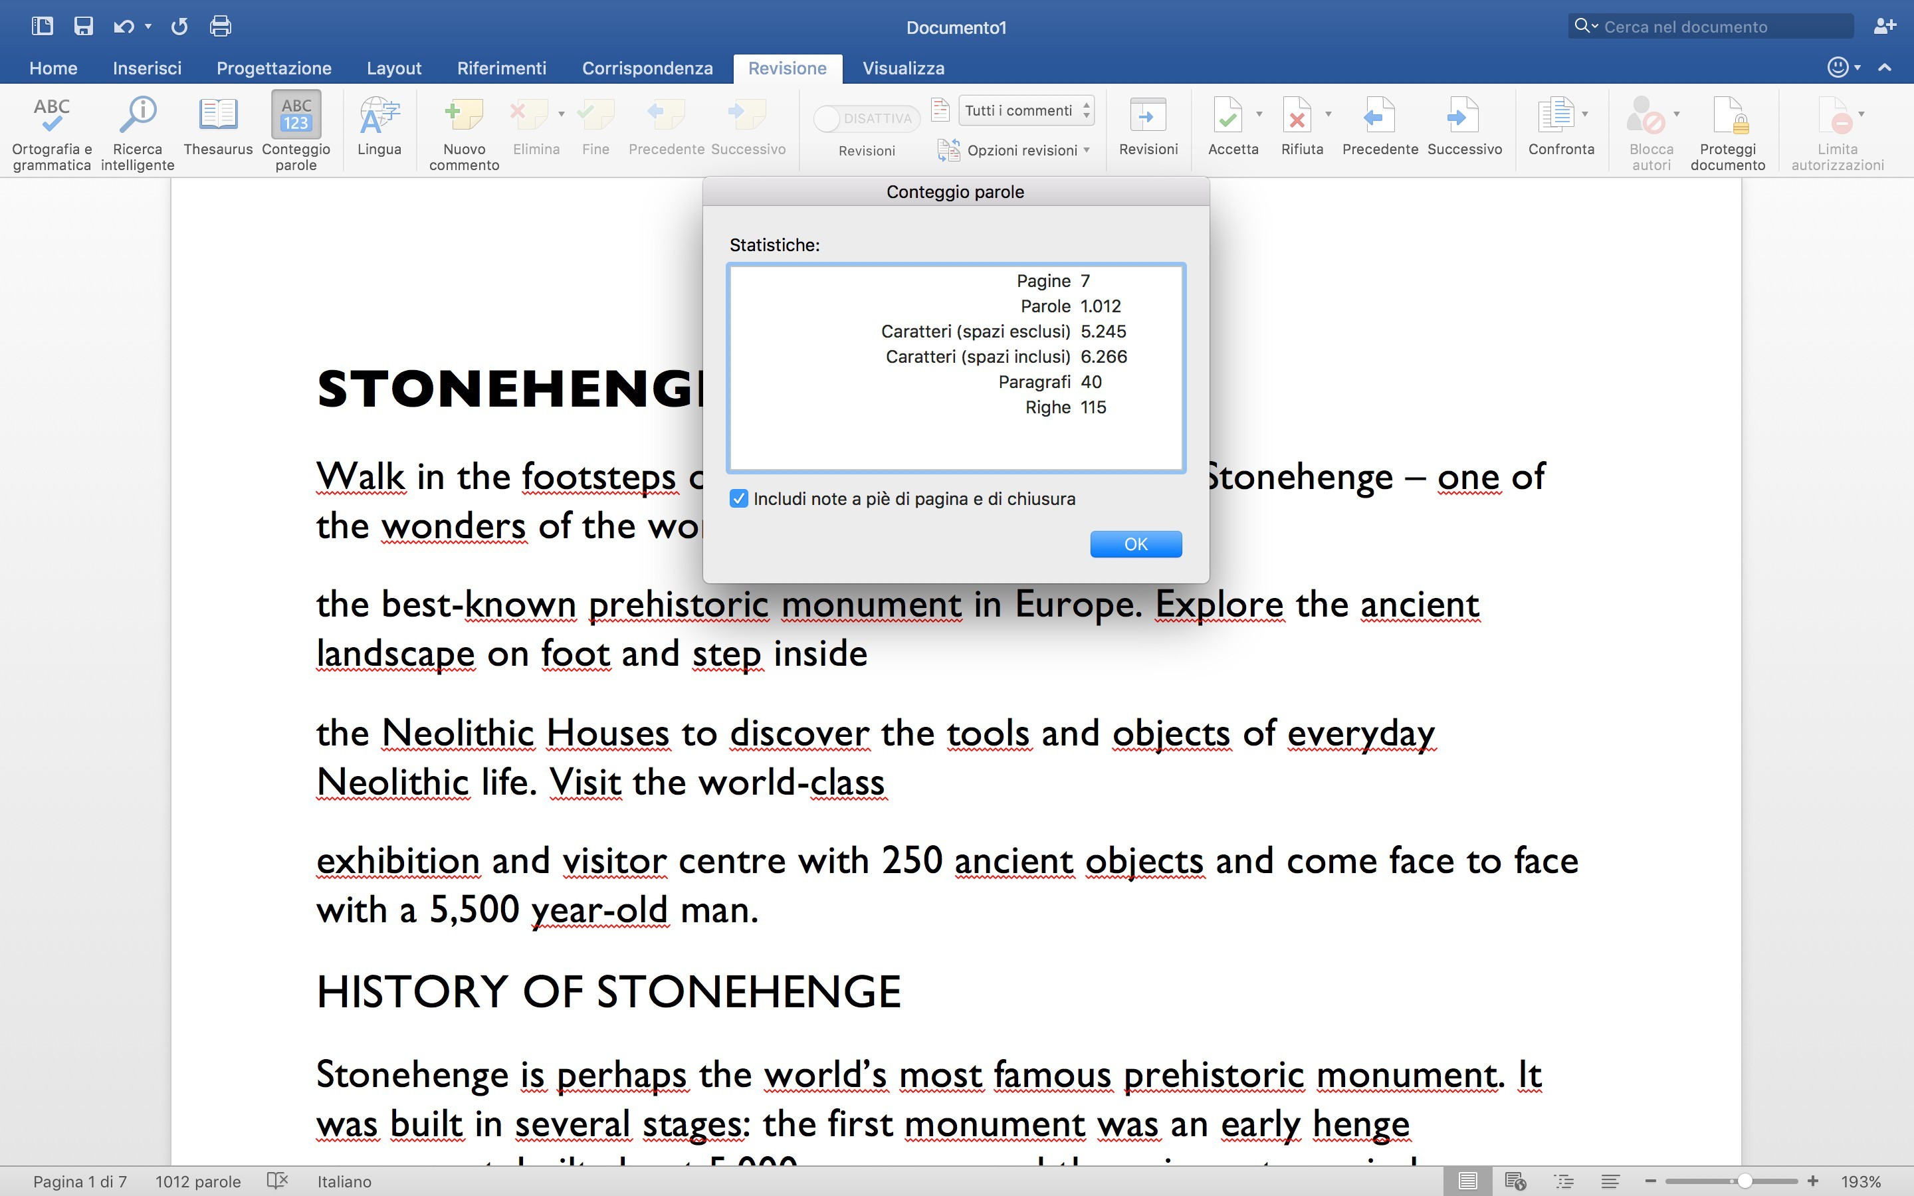
1 CARTELLA = 1.500 caratteri, spazi inclusi

Slide 25
NON SOLO CARTELLE
PAROLA
cartella da 1500:
italiano = 212-218
inglese = 240-250
francese = 212 (?)
tedesco = 200 (ma varia da 170 a 240 circa)

Slide 26
TARIFFE ENG <>ITA
QUANTE CARTELLE RIESCOA TRADURREIN UN’ORA?
QUANTO TEMPO HO DA DEDICAREALLA
TRADUZIONE (altri lavori in coda, ecc.)?
QUALI SONO LE MIE SCADENZE? E QUELLE DEL REVISORE? QUANTO TEMPOGLI/LE OCCORRE?
  1 h = 2 cartelle (3.000 caratteri spaziinclusi)
  HO 10 CARTELLE DA TRADURRE= 5 h di lavoro

Slide 27
TARIFFOM ETRO
TARIFFETRADUZIONE:
http://www.turner.it/Tariffometro-italia.htm
NB: le tariffe variano molto fra Nord e Sud, fra Milano e altre città. Queste sono solo delle indicazioni di massima. “LS” = lingua straniera (EN, FR, DE, ES). Per capire qualcosa di queste tariffe, leggi le NOTE. Cartelle da 1500 battute, tranne dove indicato. Le tariffe a riga e a parola (arrotondate e solo molto indicative) sono estrapolazioni, non cifre riportate dal mercato: "Riga" = la cifra a cartella divisa 27,273. "Parole" = le tariffa a cartella / 250 x 100 + 10% a sinistra, e / 200 x 100 + 10% a destra. "Editoriale" = narrativa e saggistica ma le tariffe di quest'ultima variano enormemente e possono arrivare vicine a quelle indicate per "cliente>traduttore".
Nota che le tariffe "alte" sono quelle minime: un testo finanziario può valere il doppio, per esempio, e un piccolo sito o un depliant istituzionale può valere €50-120 a cartella. Ricordati che ogni tariffa è il risultato di una trattativa - non di quello che sta scritto qui.La "Qualità minima" è solo quello che dice di essere: pagando una miseria si può anche ottenere una qualità eccelsa ma non sarebbe ragionevole aspettarsi molto di più di quello che è indicato.

Slide 28
VOCI DA INSERIRE IN PREVENTIVO: UN ESEMPIO*
VOCIDI PREVENTIVO | #
TIPOLOGIA DISERVIZIO | TRADUZIONE ITA>ING
TIPOLOGIA DITESTO | TECNICO-SCIENTIFICO/ACCADEMICO
N° DI CARTELLE | 42 (1 cartella = 1.500 caratteri spazi inclusi)
CONTEGGIO | Caratteri testo di partenza = 62.865 Calcolo: 62.865/1.500 = 41.9 = 42
TARIFFA/cartella*: (ITA>ING) * comprensiva di revisionemadrelingua | 19,00 Euro
TOTALE | 798,00 Euro
TEMPISTICHE | 1 (una) settimana
* le cifre proposte e le tempistiche sono puramenteindicative

Slide 29
PER TRADUTTORI FREELANCE SENZA PARTITA
IVA
Esempi Notula di pagamento per prestazioni di lavoro autonomo occasionale

