Slide 1


Lingua e traduzione inglese I
Mod. A
Prof. ssa RAFFI f.raffi@unimc.it

Slide 2
Sub-fields of Linguistics:
MORPHOLOGY: Ch. 14-15
SYNTAX: Ch. 16

Slide 3
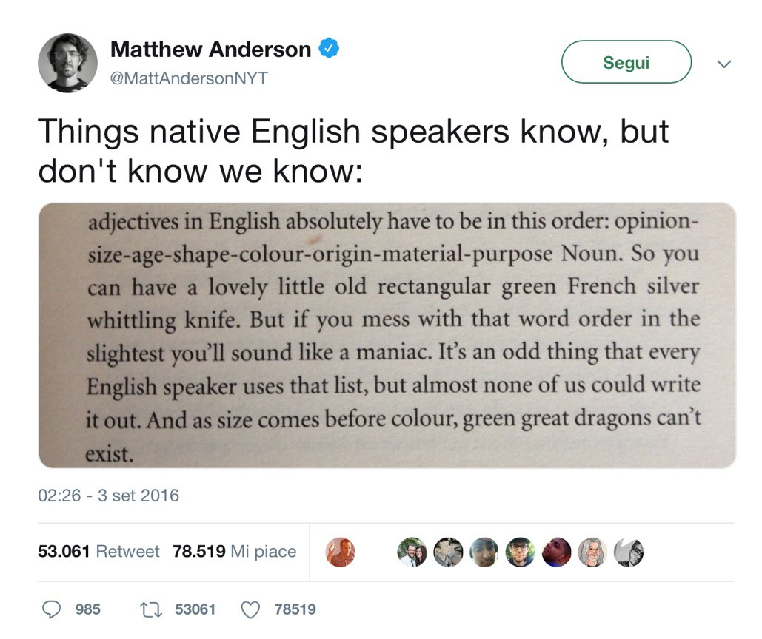
SYNTAX/ADJECTIVES: WHICH ORDER?

Slide 4

SYNTAX/ADJECTIVES: WHICH ORDER?
opinion, size, age, shape, colour, origin, material, purpose.
My Greek Fat Big Wedding X
My Big Fat Greek Wedding V

Slide 5
MORPHOLOGY/COMPOUNDING
REMEMBER? process of combining two words (free morphemes) to create a new word (e.g. cupcake).
VS Morphological Reduplication
part of a word or even the whole word is repeated exactly or with a slight change.
EXAMPLES?

Slide 6
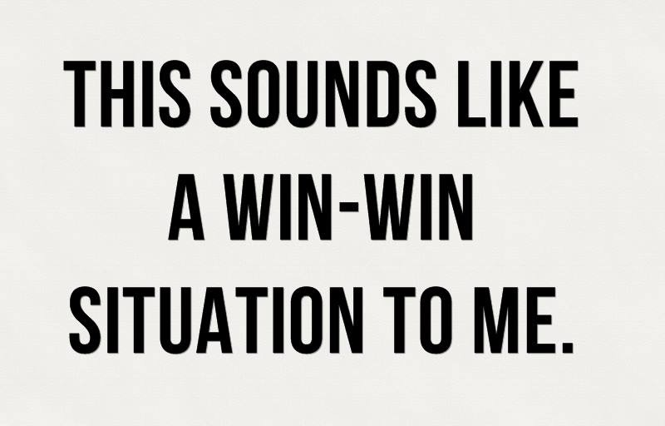
A win-win situation is one which guarantees a favourable outcome for everyone
involved

Slide 7

Alliterative type
"What did you talk about?" "Oh, just chit-chat.”
= informal conversation about matters that are not important.

Slide 8
THE STRUCTURE OF THE LEXICON: Ch. 11

Slide 9
Words must be studied
in context rather than
in isolation

Slide 10
Collocation
“Tendency of certain words to co-occur regularly in a given language”
As observed in actual texts (vs. intuition)
Key features of collocations
o language-specific (collocations vary from language to language)
Collocations are not stable or fixed
o they may change diachronically (over time) in general language
o they may change in LSP vs. general language
o they may change across LSP domains
HOW DOES THE WORD “BORSA” COLLOCATE?

Slide 11
LINGUISTIC
(AND TRANSLATION)
TOOLS

Slide 12

’s a translator’s best friend
dictionaries are not always sufficient
Translators can use search engines to find/verify two kinds of things
o facts, pieces of information, knowledge (as an “encyclopaedia”)
o words, terms, phrases, expressions, instances of language use
We extract examples of real language in use, which we can analyse to infer repeated, common or typical linguistic behaviour
  e.g. we can use the Internet via a search engine to look for patterns and regularities

Slide 13
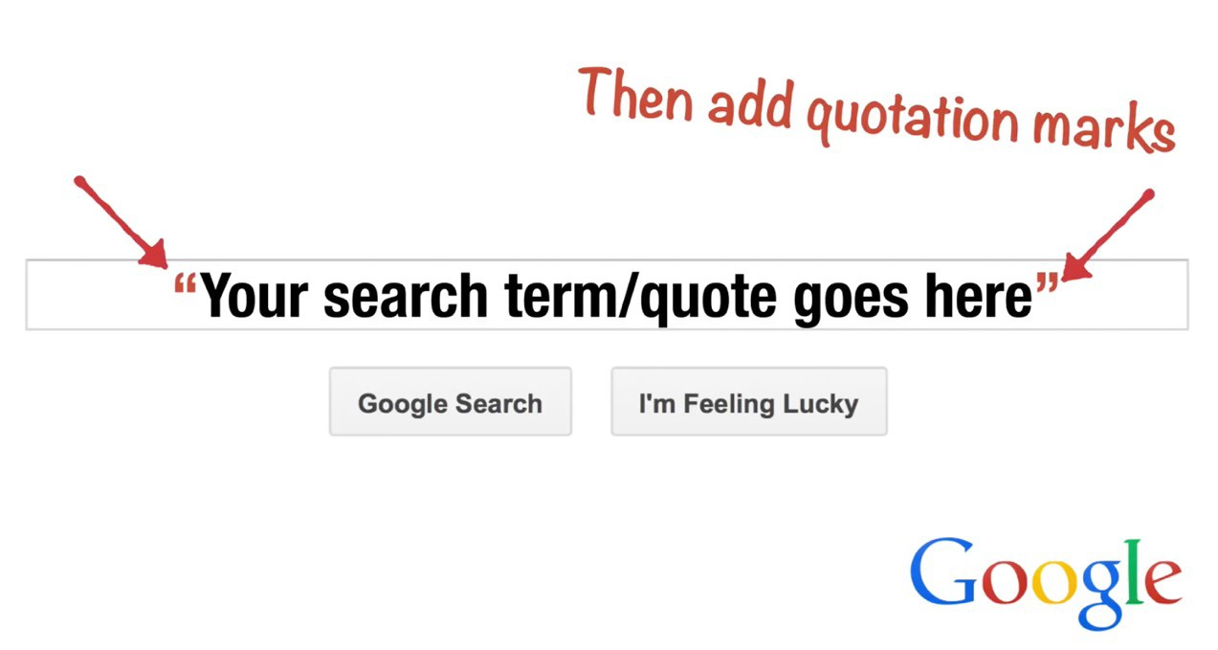
GOOGLE FOR COLLOCATIONS
(when you know the exact term/quote)

Slide 14

GOOGLE FOR COLLOCATIONS
(when you know the exact term/quote)

Slide 15
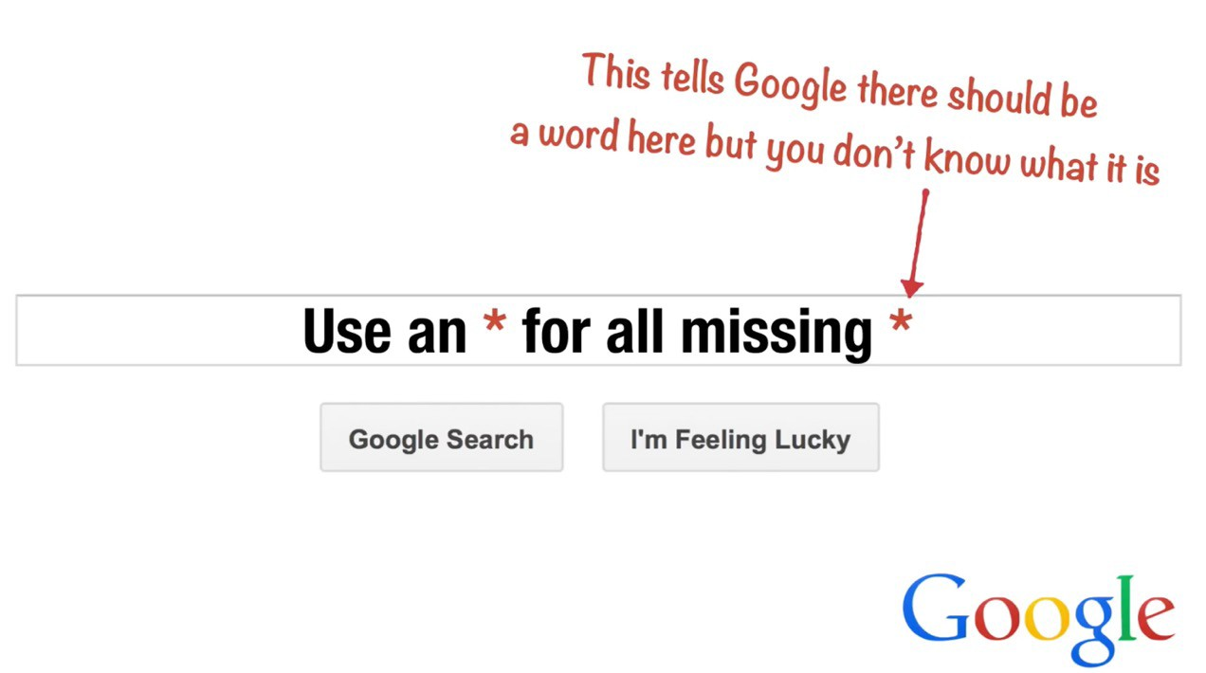

GOOGLE FOR COLLOCATIONS
(when you don’t know the exact term/quote)
“ ”

Slide 16
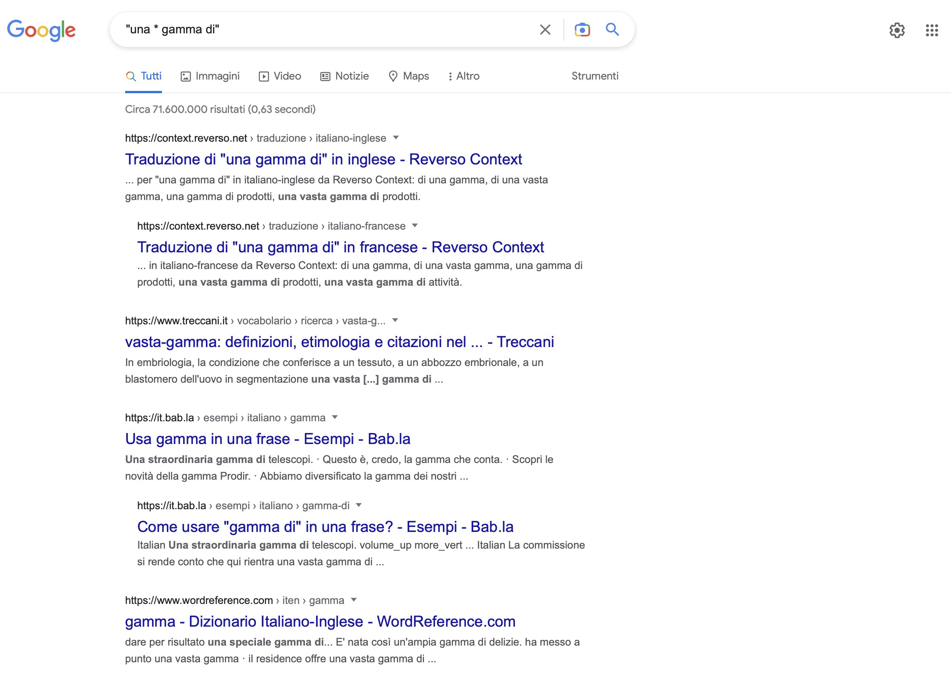
Quale aggettivo «funziona» con ‘gamma’?

