Slide 1


Lingua e traduzione inglese I - Mod. A "lingua e cultura"
Prof. ssa RAFFI francesca.raffi@unimc.it

Slide 2
NEW TOPICS: WEEK 5
USING ENGLISH:
VARIETIES OF DISCOURSE: Ch. 19
REGIONAL VARIATION: Ch. 20

Slide 3
VARIETIES OF DISCOURSE
Ch. 19

Slide 4
WHAT IS DISOCURSE?
“Discourse” applies to speech and writing.
text / discourse; text linguistics / discourse analysis.
analysis of the realities of monologue and dialogue in any mode of transmission (writing or speaking)

Slide 5
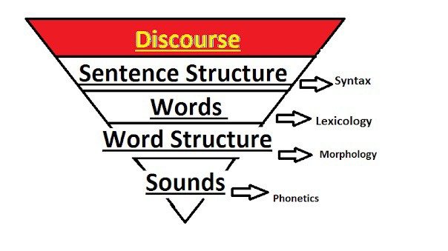
WHAT IS DISOCURSE?

Slide 6

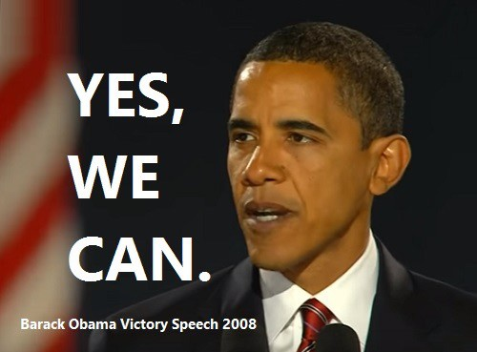


CONSTRUCTING DISCOURSE
EXAMPLE OF POLITICAL DISCOURSE

Slide 7
BARACK OBAMA’S LESSON IN AMERICAN RHETORIC
Commas to create points of pauses, which in turn create rhythm (+ repetitions):
It's the answer spoken by young and old, rich and poor, Democrat and Republican, black, white, Hispanic, Asian, Native American, gay,
straight, disabled and not disabled
Use of possessive adjectives to create a sense of community:
the dream of our founders is alive in our time, who still questions the power of our democracy, tonight is your answer.

Slide 8

CONSTRUCTING DISCOURSE
MEDIA DISCOURSE: interactions that take place through a broadcast platform, whether spoken or written, in which the discourse is oriented to a non- present reader, listener or viewer.

Slide 9
WHAT IS DISOCURSE?
“Discourse” applies to speech and writing.
text / discourse; text linguistics / discourse analysis.
analysis of the realities of monologue and dialogue in any mode of transmission (writing or speaking)

Slide 10
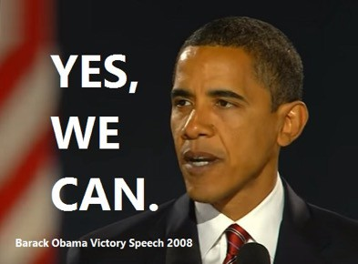


WHAT IS A MONOLOGUE?
when only one person does all the talking.

Slide 11
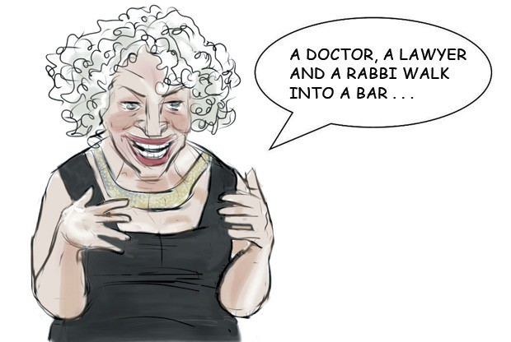
WHAT IS A MONOLOGUE?
when only one person does all the talking.
You can sometimes find stretches of monologue
within a dialogue.

Slide 12
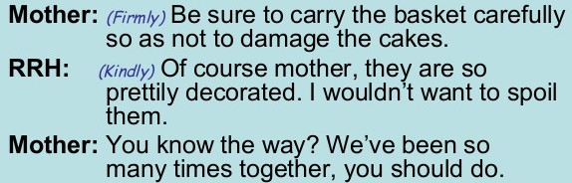
WHAT IS A DIALOGUE?
an exchange of language between two people.
spoken conversation, but it could be also written down.

Slide 13
WHAT IS A CONVERSATION?
everybody taking part must have a chance to say something.
conversations follow rules of etiquette = depend on social convention.
Cooperative principles.

Slide 14
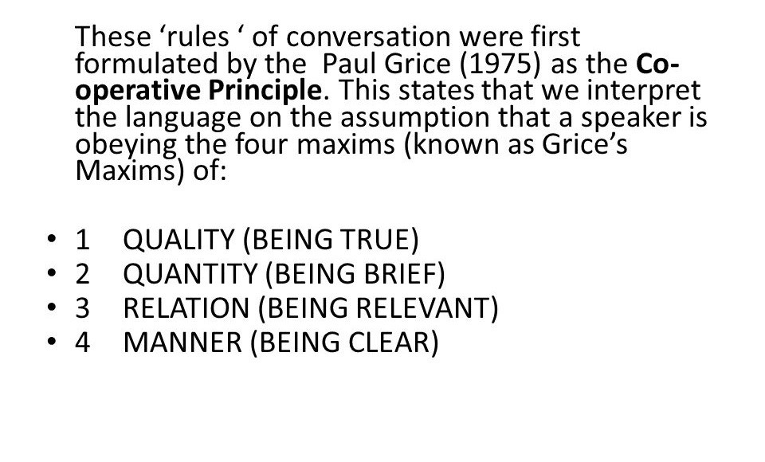

Slide 15
WHAT IS A CONVERSATION?
Conversations depend on social convention.
Sociolinguistics studies the correlation between language and social factors.
these social factors may be social stratification (status), role, age, sex, ethnicity, etc…
WHY?

Slide 16

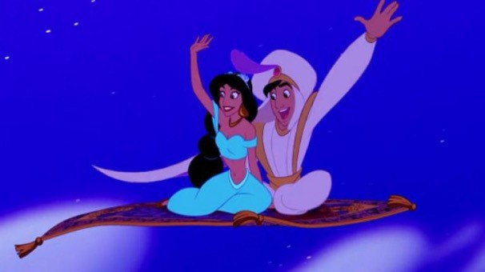
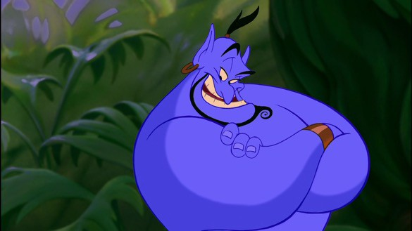
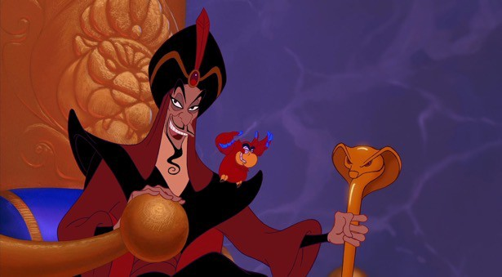
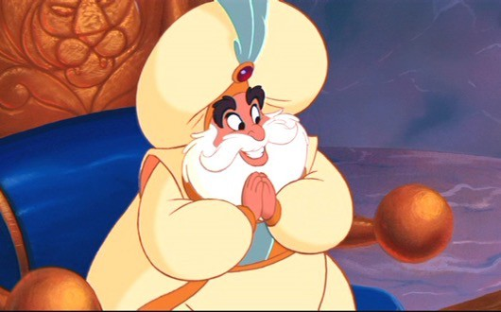
I’M FROM SAUDI ARABIA BUT
I SPEAK PERFECT AMERICAN-ENGLISH

Slide 17

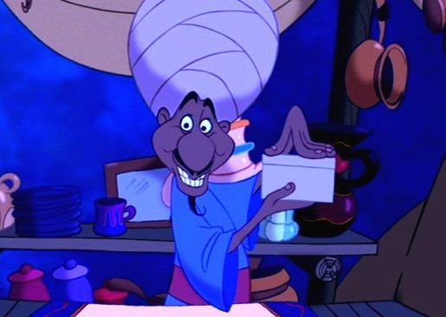
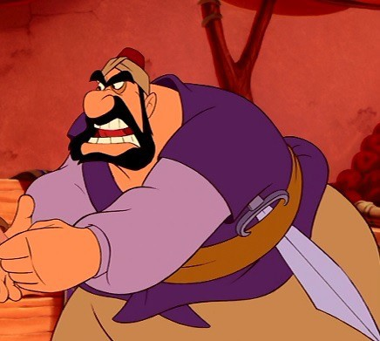
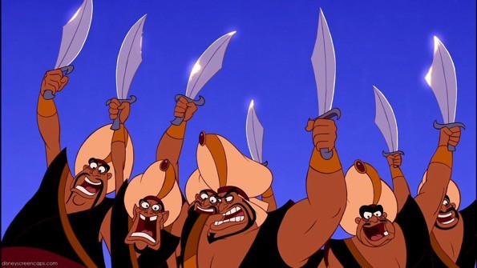
I’M FROM SAUDI ARABIA TOO!

Slide 18
LANGUAGE-BASED STEREOTYPES
Accents used to express the nature of the characters
Standard American-English is the desirable accent of characters who play a positive role in Disney’s animated films.
And Jafar? High-social status (he’s the “Grand Vizier”)

Slide 19
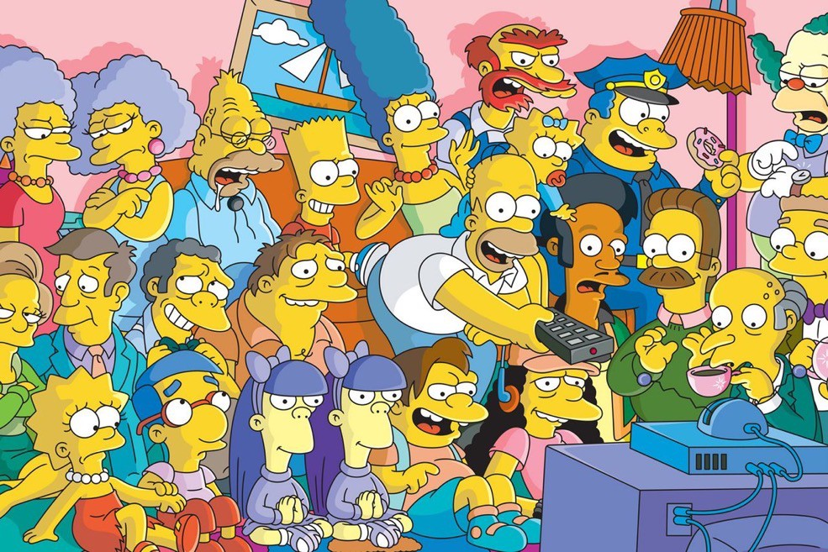
MANY OTHER EXAMPLES IN FILMS, TV SERIES, CARTOONS…

Slide 20
WHAT IS STYLE? (sociolinguistics)
A set of linguistic variants with specific social meanings.
linguistic variants: choices made from the repertoir of a language
Social meanings can include group membership, personal attributes, or beliefs.
A style is not a fixed attribute of a speaker.

Slide 21
LINGUISTIC VARIANT
A style which belongs to a particular written/spoken situation.
EXAMPLES?

Slide 22
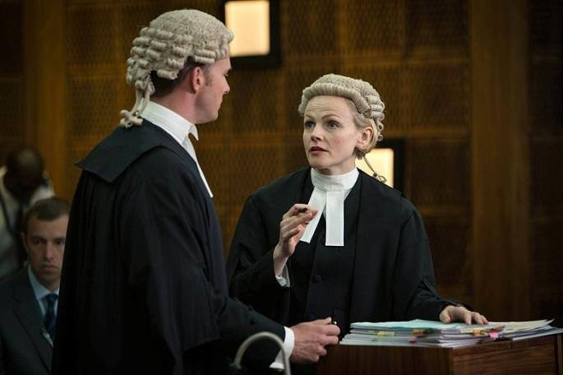
LEGAL ENGLISH

Slide 23
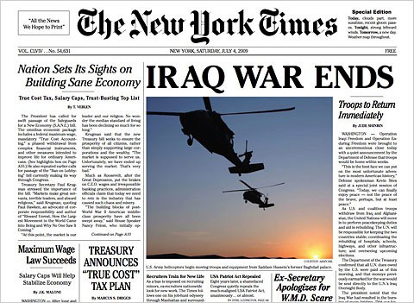
JOURNALESE

Slide 24

INFORMAL SPEECH

Slide 25
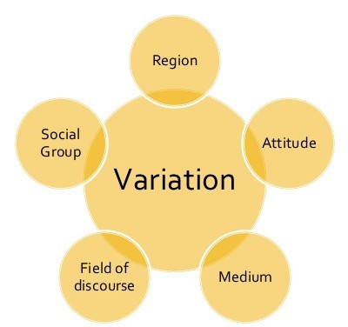
THOUSANDS OF VARIETIES….

Slide 26
REGIONAL VARIATION
Ch. 20

Slide 27
REGIONAL VARIATION
dialect (words and constructions) VS accent (pronunciation)
EXAMPLE?

Slide 28
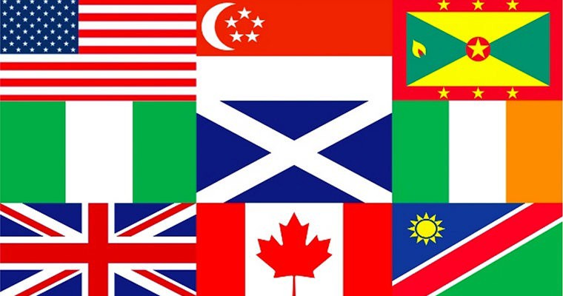
DIALECTS

Slide 29
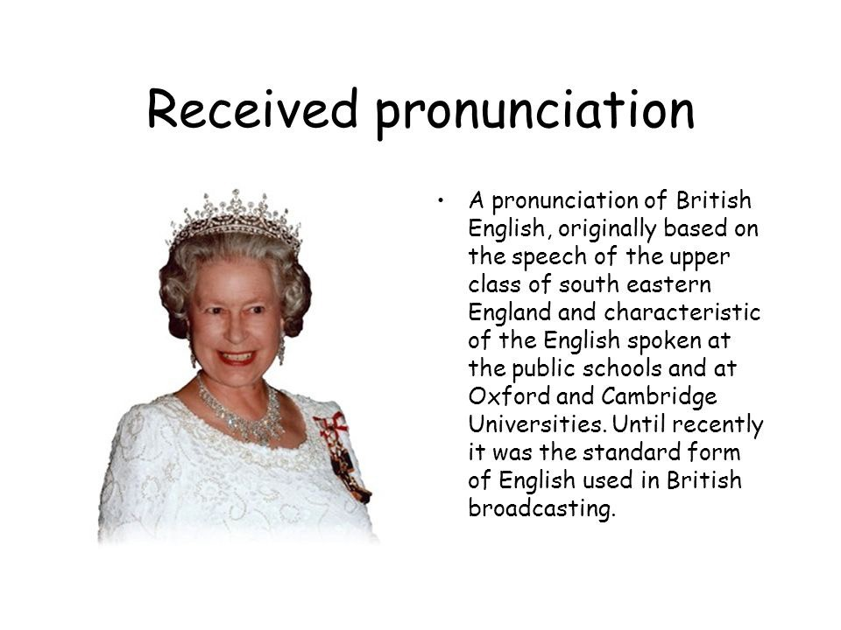
ACCENTS

Slide 30
DIALECT

Slide 31
DIALECTS
When people talk about dialects, they mean regional dialects
Show a person’s geographical origins in a particular country or locality or city.

Slide 32
INTERNATIONAL DIALECTS

Slide 33
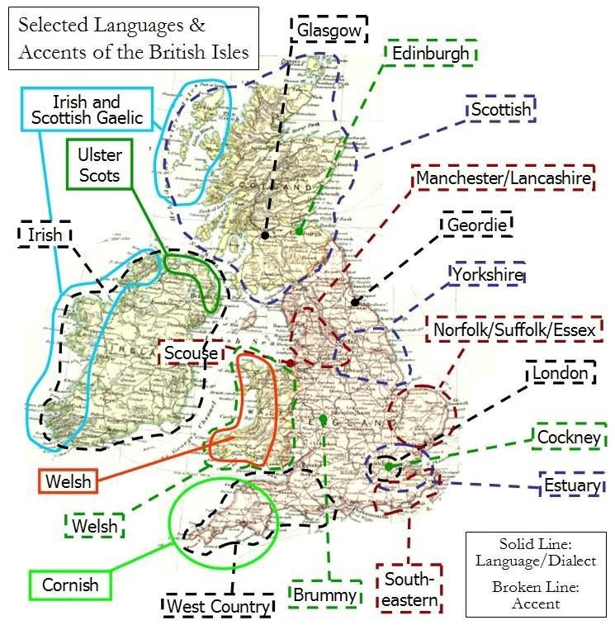
WITHIN BRITAIN

Slide 34

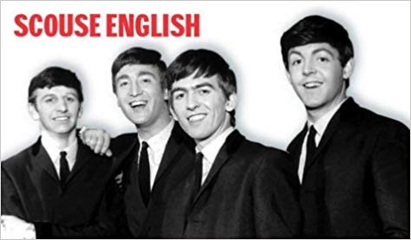
CITIES
Cockney English refers to the accent and dialect of English traditionally spoken by working- class Londoners.
Scouse English (or Liverpool English) is
an accent and dialect closely associated with the city
of Liverpool.

Slide 35
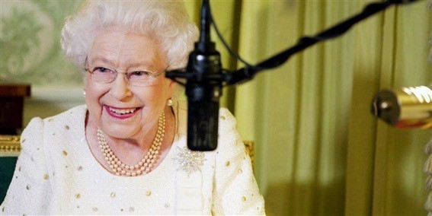
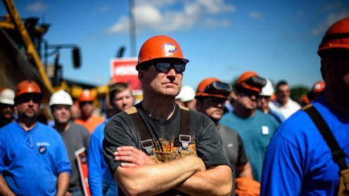
SOCIAL DIALECTS
or class dialects: tell you where the speakers are from socially.

Slide 36
OCCUPATIONAL DIALECTS
varieties of the language which tell you the sort of job a person does (speaking or writing like a politician, a priest, or a journalist).

Slide 37
ACCENT

Slide 38
ACCENT
“After the school trip to Paris, my friends said I came back sounding all French”.
the part of your voice which tells your listeners which country you come from and how you were educated.

Slide 39
RECEIVED PRONUNCIATION (RP)
accent which doesn’t give you any geographical information at all.
associated with royalty, government, Oxford and Cambridge, etc.
‘received’ because it has been passed down by the ‘elite’ groups in Britain.
Today “modified RP” more frequent.

Slide 40

ESTUARY ENGLISH
Spoken by a large and growing number of people in the South of England.
They say it will dominate general British pronunciation within 50 years.
Why do some scholars think it doesn’t exist?
Estuary English shares many features with Cockney

