Slide 1
SOCIAL VARIATION
Ch. 21

Slide 2
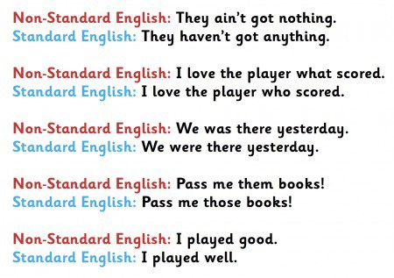
STANDARD VS NON-STANDARD ENGLISH

Slide 3
NON-STANDARD ENGLISH
When people don’t speak or write according to the rules of standard English = it’s non-standard English.
SUBSTANDARD (not polite).
SLANG

Slide 4
AMERICAN VS BRITISH SLANG
AM “The John”: an informal name for “the toilet”
e.g. Sarah ran straight to the John after
the long trip.
BRT “Loo”: an informal name for “the toilet”
e.g. Sarah ran straight to the loo after
the long trip.

Slide 5
RP (remember?)
accent which doesn’t give you any geographical information at all.
associated with royalty, government, Oxford, etc.
‘received’ because it has been passed down by the ‘elite’ groups in Britain.
despite the falling numbers, RP is still the chief prestige accent of the country. WHY?

Slide 6
WHY “STANDARD” ENGLISH?
Language standardization: process by which conventional forms of a language are established/maintained.
Standardization: natural development or even effort by members of a community.
Re-standardization: ways in which a language may be reshaped by its speakers and writers.
Eg. ESTUARY ENGLISH (remember?)

Slide 7
DOES “STANDARD” MEAN SUPERIOR?
Prescriptivism (or purism): one variety of a language is superior to others.
Emphasis on rules, "good," "proper," or "correct" usage. (style and usage guides, dictionaries, writing handbooks, and the like)
VS. Descriptivism: how language is actually spoken and written.

Slide 8
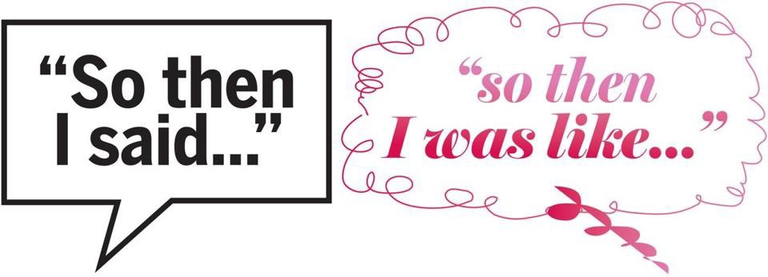
EXAMPLE
"was" (or "was all", "was like") for "said"

Slide 9
STYLE (remember?)
When you learn a language, you learn all kinds of styles of speaking and writing.
It’s a process that goes on all your life and it starts at a very early age.
EX: “Don’t talk like that to your father” = be polite/talk politely

Slide 10
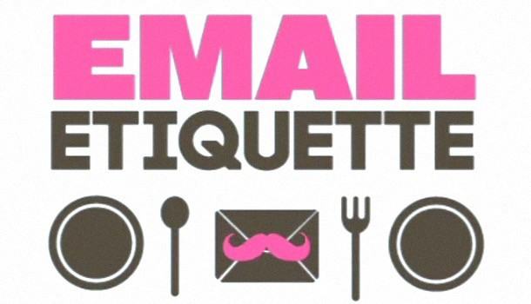
APPROPRIATE vs. INAPPROPRIATE
We judge styles to be appropriate or
inappropriate.
We write more carefully when we don’t know the person we’re writing to.
We speak more politely when addressing strangers or superiors.

Slide 11
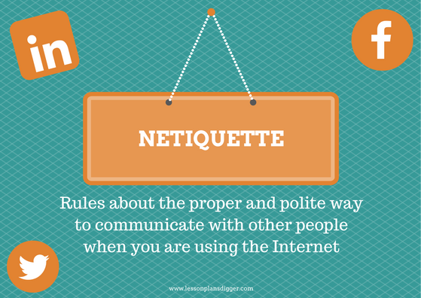
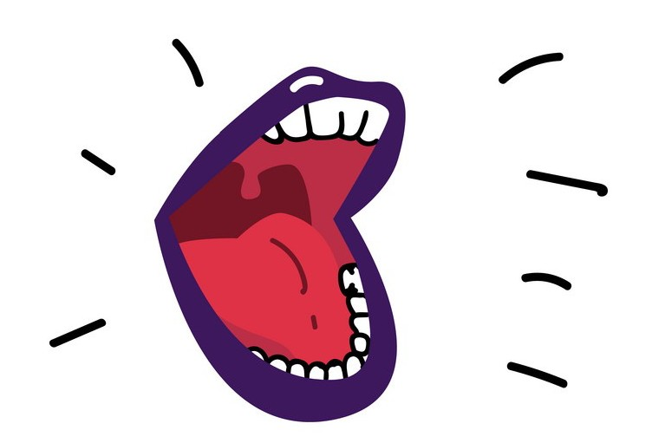
(e.g. HI, IT’S ME)
It’s bad netiquette!

Slide 12
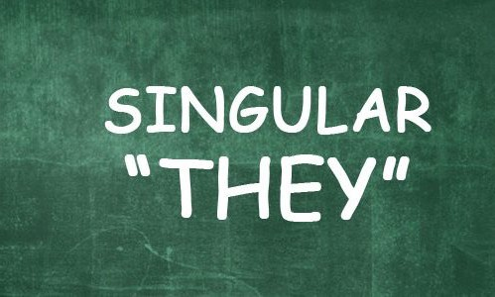
GENDER-NEUTRAL LANGUAGE
In informal conversation, you would sound perfectly natural saying “Somebody forgot their coat.”

Slide 13
GENDER-NEUTRAL LANGUAGE
JOB TITLES
a gender-neutral language is needed in job advertisements (gender is not in fact known).
bartender instead of barman or barmaid;
ﬁreﬁghter instead of ﬁreman.

Slide 14
GENDER-NEUTRAL LANGUAGE
HUMANS
Although the word man originally referred to both males and females, some feel that it no longer does so unambiguously = NO GENDER-NEUTRAL.
man and men may be replaced by human(s) or people
mankind may be replaced by humankind or humanity

Slide 15
GENDER-NEUTRAL LANGUAGE
HONORIFICS
Mr: regardless of marital status
Miss and Mrs: woman’s marital status = NO GENDER-NEUTRAL.
Ms can be used for women regardless of marital status = GENDER-NEUTRAL (only women)
Mx = GENDER-NEUTRAL 100%

Slide 16
PERSONAL VARIATION
Ch. 22

Slide 17
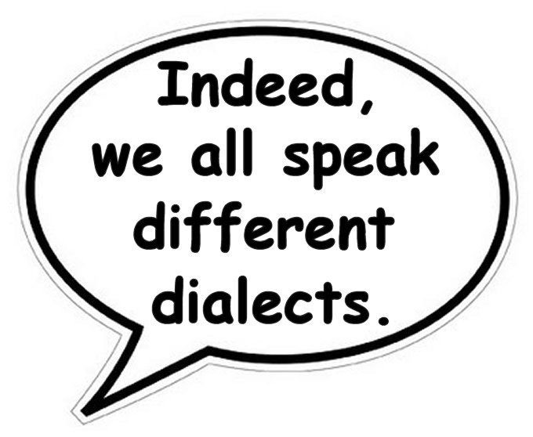
IDIOLECT
idiolect is your own personal dialect
you’d be very unlikely to ﬁnd two people who had exactly the same way of using language.

Slide 18
DEVIANCE
When a sentence breaks the rules of the English language we call it deviant.
To count as deviant, a sentence doesn’t have to be a total mess!
Deviance is quite common in speech (more than writing).

Slide 19
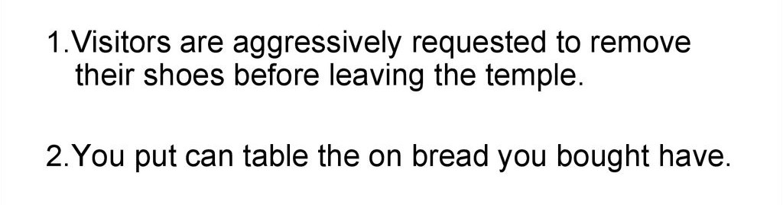
*
*

Slide 20
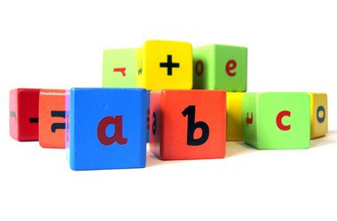
PLAYING WITH LANGUAGE
We play with language when we manipulate it as a source of enjoyment = for fun.
“Manipulate” in its literal meaning: we take some linguistic features and make them do what we want (breaking the rules of the language).

Slide 21
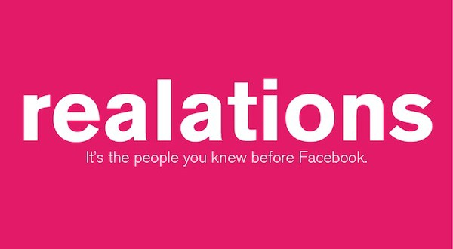
REAL + RELATIONS

Slide 22
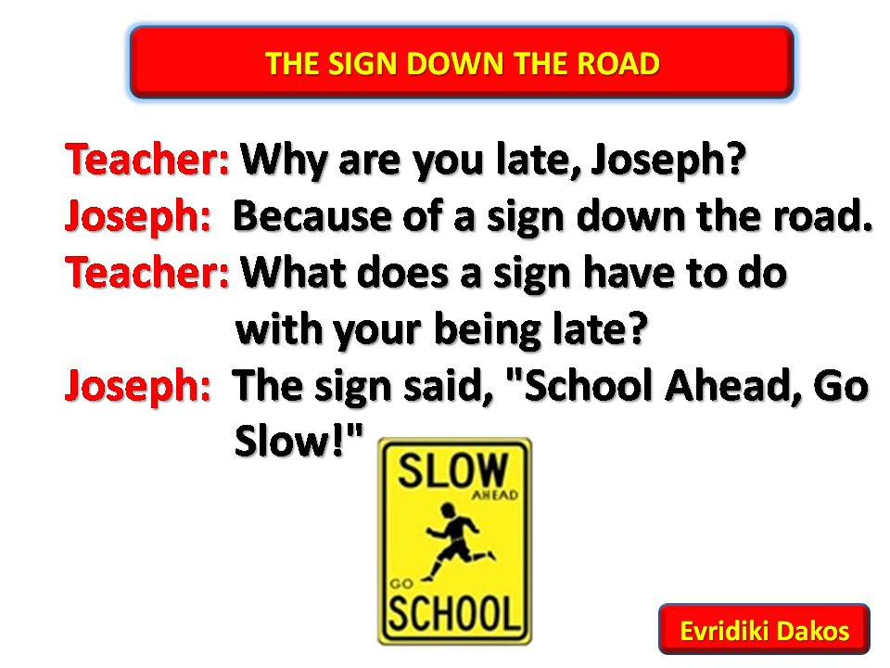
JOKES
said or done to provoke laughter.
especially a brief oral narrative with a climactic humorous twist
EXAMPLE:

Slide 23
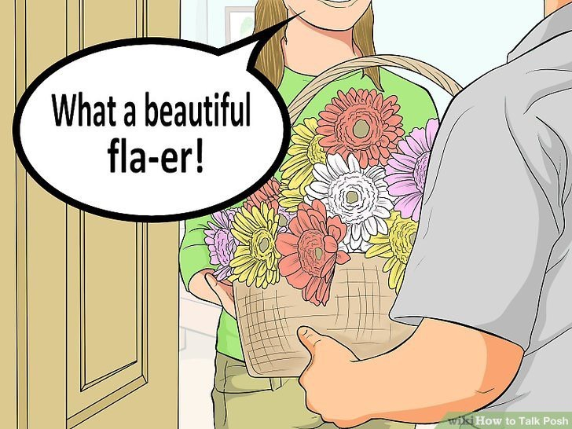
DIALECT HUMOR
Regional dialects and (especially in England) class dialects are a rich source of conversational language play.
BRT /flaʊə^{r}/
AM /ˈflaʊ.ɚ/

Slide 24
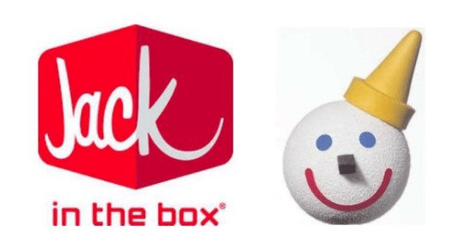
NONCE WORDS
New words, created ‘for a particular occasion’.
When a word is on the tip of the tongue an invented word can get our meaning across.
EXAMPLE: “She was too … Jack-in-the-boxy”.

Slide 25
