Slide 1


Lingua e traduzione inglese I - Mod. A "lingua e cultura"
Prof. ssa RAFFI f.raffi@unimc.it

Slide 2
THE STRUCTURE OF THE LEXICON
Ch. 11

Slide 3
SEMANTIC FIELD
“a named area of meaning in which lexemes interrelate and define each other in specific ways” (1995, p. 157).
classifications of words associated by their meanings.
EXAMPLES:

Slide 4
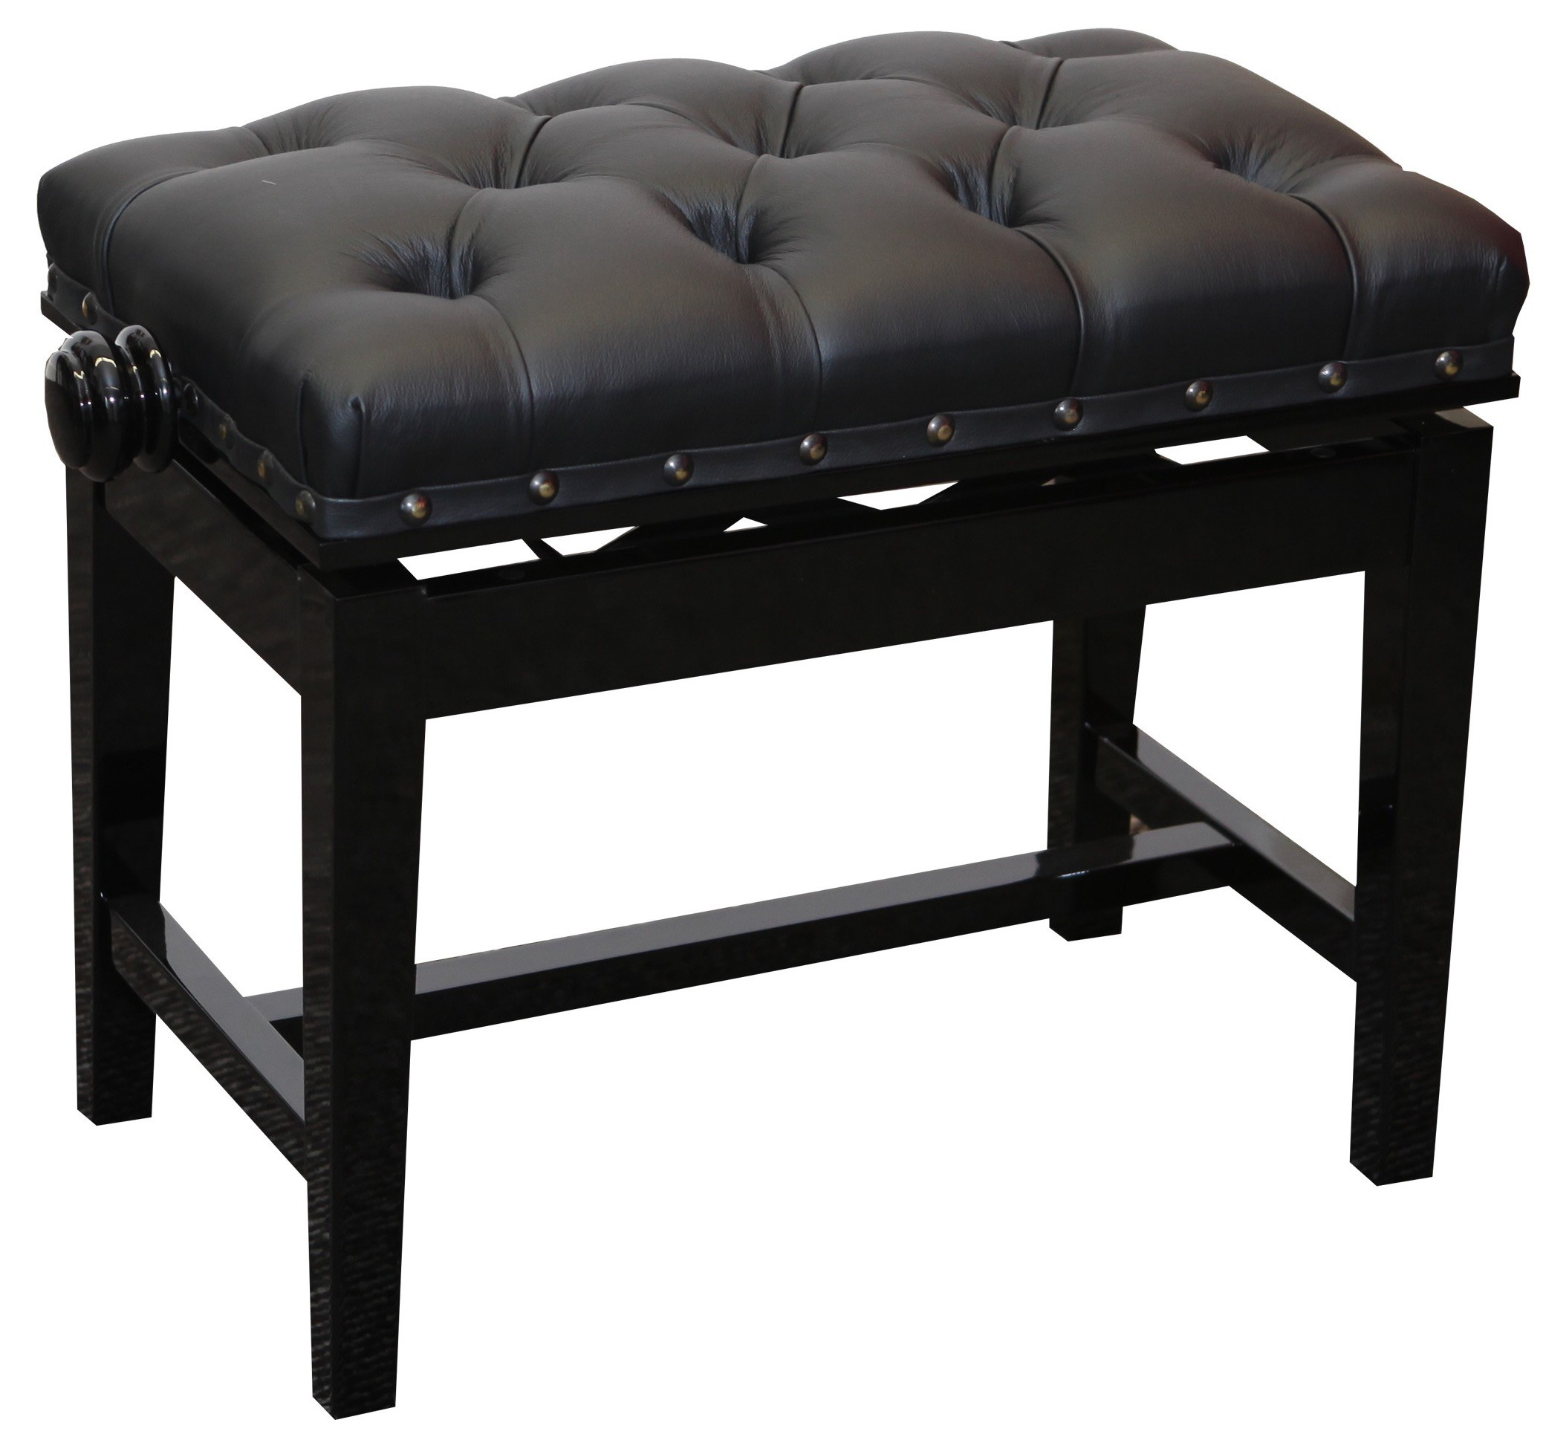
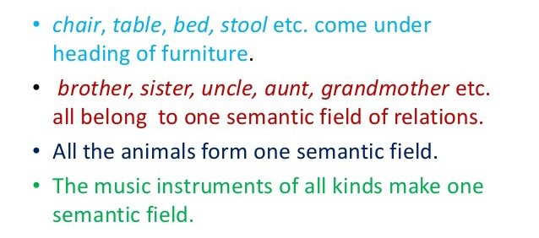

Slide 5
Nevertheless, it is not so straightforward
some lexemes belong to the fields which are difficult to define or vague: e.g. NOISE
Some lexemes may belong to more than one field
EXAMPLE

Slide 6

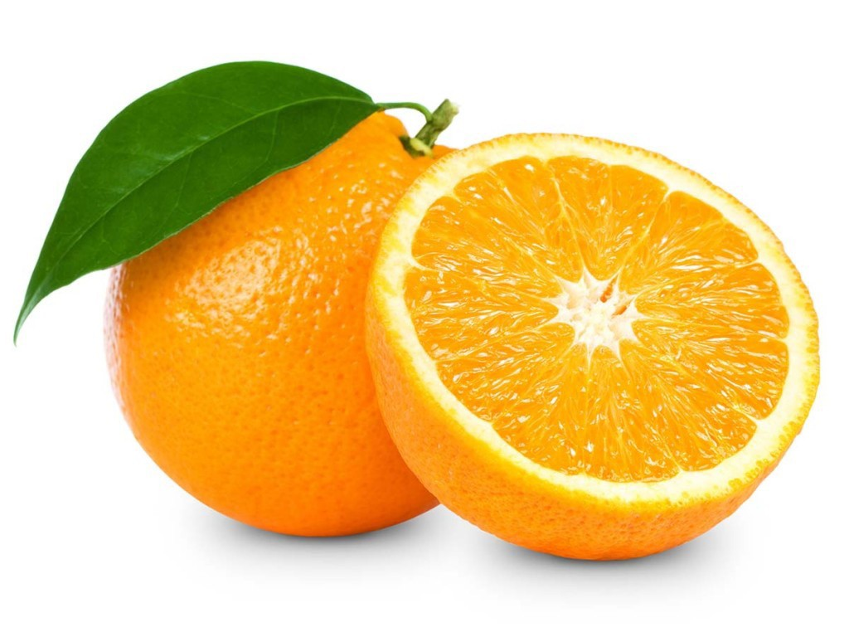
ORANGE?

Slide 7
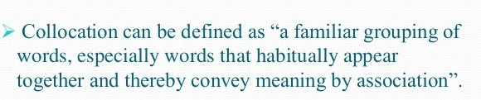
COLLOCATIONS (remember?)
We get to know the meaning and use of words by the company they keep.
words that usually go together (= co-occur)

Slide 8
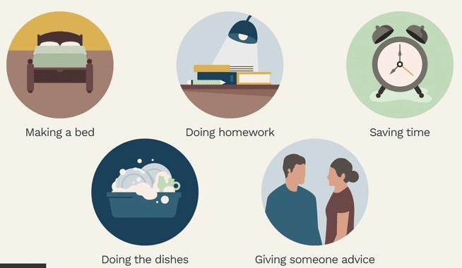

Slide 9
WE SAY…
a FAST train / a QUICK train
FAST food / QUICK food
a QUICK shower / a FAST shower
A QUICK breakfast / a FAST breakfast

Slide 10

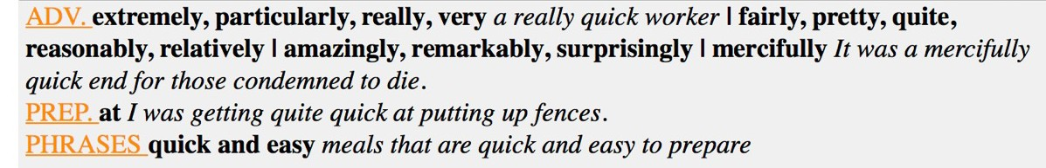
Online Collocation Dictionary
www.freecollocation.com

Slide 11
Togliere un dubbio o fugare un dubbio?
Il malcontento gira tra i partecipanti o
serpeggia tra i partecipanti?
Ammazzare il tempo o uccidere il tempo?

Slide 12
COLLOCATIONS
When a collocation becomes so predictable that it is, in effect, a fixed phrase, we talk about
  Idioms (“a group of words in a fixed order that have a particular meaning that is different from the meanings of each word on its own”)
  Clichés (a phrase that is overused)
  Proverbs

Slide 13
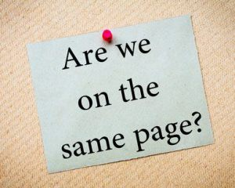
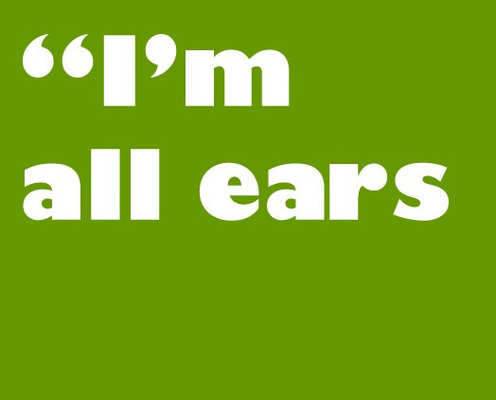
IDIOMS
To be in agreement about something
to be waiting eagerly to hear about something

Slide 14
Its meaning cannot be inferred from the meaning of the single words (SAME PAGE = AGREEMENT?)

Slide 15
IDIOMS vs LEXICAL PHRASES
Idioms: their meaning cannot generally be inferred from the meaning of the single words
Lexical phrases: their meaning can be inferred from the meaning of the single words

Slide 16
LEXICAL PHRASES
“TO BE BESIDE THE POINT”
=
not important:
The exact cost is beside the point; what’s important is that we get the job done.
BESIDE = not central

Slide 17
SYNONYMS
Words which differ in slight or subtle ways
Some words are synonyms, but only in a very restricted range of contexts
EXAMPLES

Slide 18
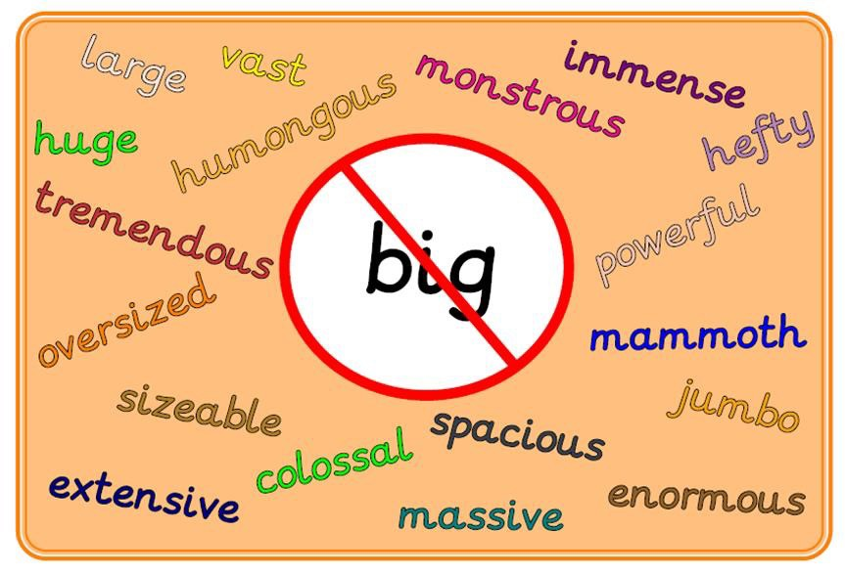

Slide 19
RANCID /ˈræn.sɪd/
butter or oil
CURDLED /ˈkɜː.d^{ə}l/
milk

Slide 20
SYNONYMS
English is rich in synonyms partly because of the way in which words came into the language over the centuries (kingly, royal, and regal)
HISTORY OF THE ENGLISH LANGUAGE
Other examples of this kind are brotherly and
fraternal, and buy and purchase = /ˈpɜː.tʃəs/

Slide 21

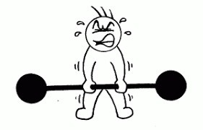
ANTONYMS = OPPOSITES
a word that means the opposite of another word
Several words have more than one possible opposite (depending on the context)
E.G. Two antonyms of "light" are "dark" and "heavy”

Slide 22
HYPONYM & HYPERNYM
“Horse” is a hyponym of “animal”.
The meaning of one word is included within the other.
“Animal” is a hypernym of “horse”.
A word whose meaning includes a group of other words

Slide 23
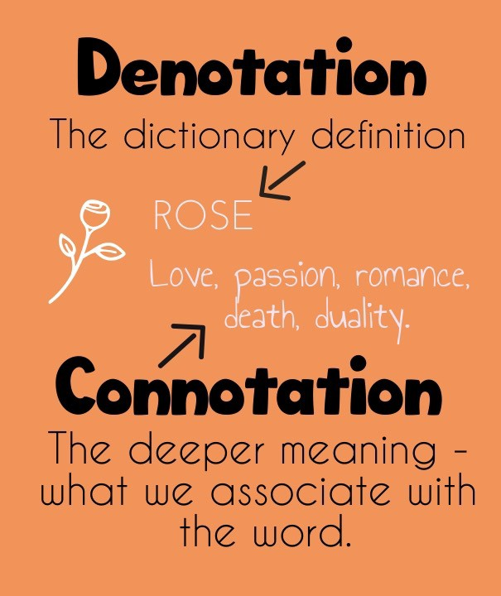
DENOTATION & CONNOTATION
meaning which everyone agrees on:
DENOTATION
personal meaning:
CONNOTATION

Slide 24
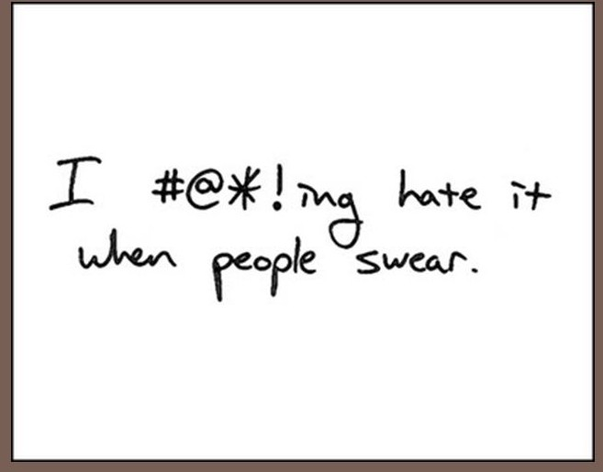
TABOO WORDS
Words that people don’t like to hear or read (e.g. swear words)

Slide 25

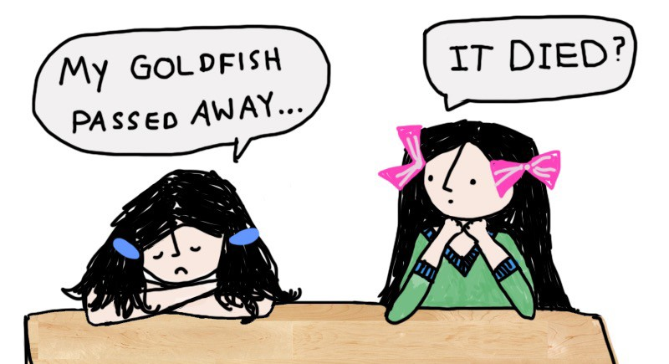


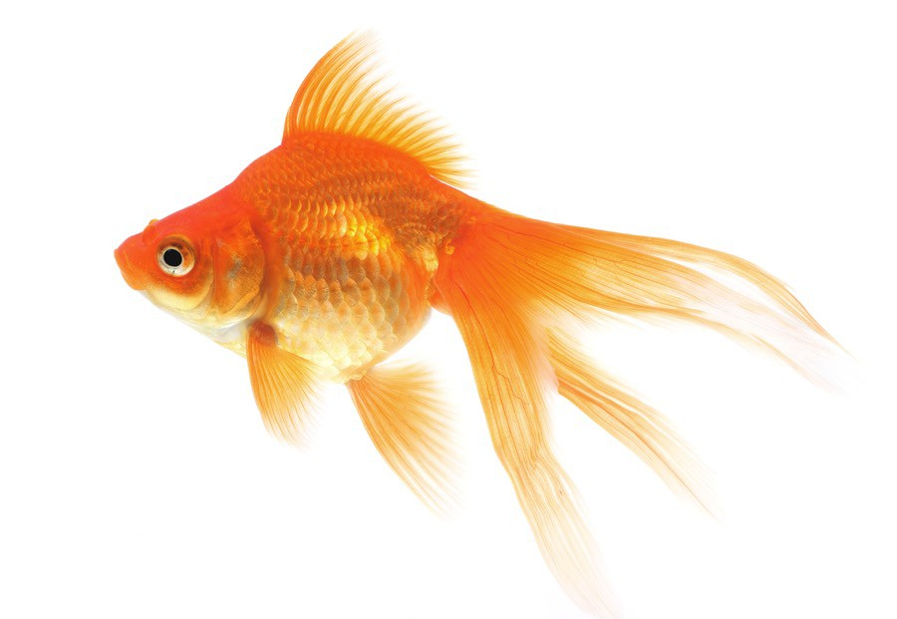
EUPHEMISMS
Words or phrases that talk indirectly about something unpleasant or offensive are called euphemisms.

Slide 26
WHAT’S MORE?
technical words, or jargon
doublespeak
political correctness
SLOGANS in advertising
dying and dead lexicon

