Slide 1


Lingua e traduzione inglese I - Mod. A "lingua e cultura"
Prof. ssa RAFFI f.raffi@unimc.it

Slide 2
THE STRUCTURE OF THE LEXICON
MORE ON Ch. 11

Slide 3
TECHNICAL WORDS/JARGON
Every specialised subject has got its own jargon: chemistry, maths, English language study, sport, etc…
Jargon helps specialists to be precise.
it adds not only precision but also economy to their communication (+ simple!)

Slide 4
PLAIN ENGLISH
easy to understand, clear, no overly complex vocabulary, no technical jargon.
appropriate to the audience’s educational level and familiarity with the topic.
When language is simplified, something is inevitably lost as well as gained.

Slide 5
DOUBLESPEAK
distorts, changes the meaning of words.
may take the form of euphemisms (remember?)

Slide 6

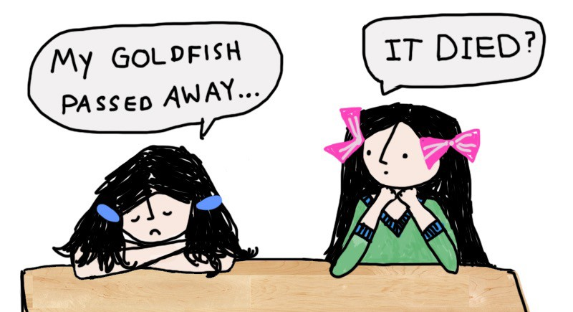



EUPHEMISMS
Words or phrases that talk indirectly about something unpleasant or offensive are called euphemisms.

Slide 7
DOUBLESPEAK
distorts, changes the meaning of words.
may take the form of euphemisms (remember?)
may also refer to intentional ambiguity in language or to actual inversions of meaning = political language.

Slide 8
"Politics and the English Language"
criticised the written English of his time and examines the connection between politics and language.
political language "is designed to make lies sound truthful and murder respectable, and to give an appearance of solidity to pure wind".

Slide 9

DOUBLESPEAK

Slide 10
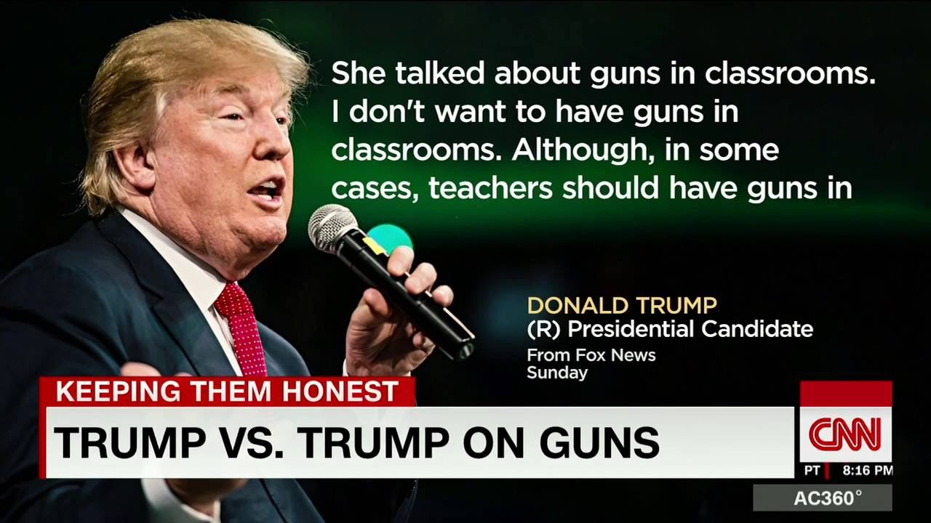
DOUBLESPEAK

Slide 11
POLITICAL CORRECTNESS
minimize offence to gender (REMEMBER?), racial, cultural, disabled, etc.

Slide 12
POLITICAL CORRECTNESS
minimize offence to gender (REMEMBER?), racial, cultural, disabled, etc.
“language creates categories for thought, and words can create either opportunities or boundaries.”
The problem arises when the linguistic constructs we use influence our way of thinking in negative ways.

Slide 13

LANGUAGE-BASED STEREOTYPES
Accents used to express the nature of the characters
Standard American-English is the desirable accent of characters who play a positive role/have a high social status in Disney’s animated films.

Slide 14
SLOGANS IN ADVERTISING
language play (remember last week?) is part of the essence of politics, and advertising.
LANGUAGE PLAY?

Slide 15


SLOGANS IN ADVERTISING

Slide 16
THE DYING AND DEAD LEXICON
"Know from whence you came. If you know whence you came, there are absolutely no limitations to where you can go.”
James Baldwin
“Joyful, joyful we adore thee, God of glory, Lord of love.”
Christian Hymn

Slide 17
THE DYING AND DEAD LEXICON
Some words and constructions are distinctly odd (WHENCE / THEE).
These forms are archaisms.
Now used only to give an old fashioned tone or in some specific contexts (church).

Slide 18
NEW WAYS OF STUDYING ENGLISH
Ch. 24

Slide 19
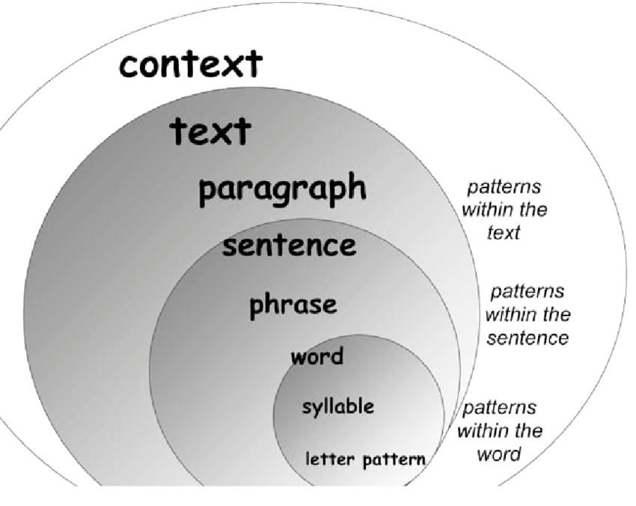

Slide 20
HOW LANGUAGE WORKS IN REAL LIFE
Make a collection of what people say or write, and analyse what they do.
It could be a collection of newspaper headlines, advertisements, news broadcasts, prayers, everyday conversation, anything!

Slide 21
When you make a collection of language data in this way, it’s called a CORPUS.

Slide 22
WHAT IS A CORPUS (= body)?
“a collection of naturally-occurring language text, chosen to characterize a state or variety of a language” (Sinclair, 1991:171)
“a collection of texts assumed to be representative of a given language, dialect, or other subset of a language, to be used for linguistic analysis” (Francis, 1992:7)

Slide 23

An example?
the British National Corpus

Slide 24
British National Corpus
100 m words of contemporary spoken and written British English
Representative of British English “as a whole”
Designed to be appropriate for a variety of uses: lexicography, education, research, commercial applications (computational tools)
Balanced with regard to genre, subject matter and style

Slide 25
Why and how is the BNC useful to learn English (and to become professional translators)?

Slide 26
“We have to keep an eye
on that issue...”

Slide 27
“keep an eye on” = ?
You can understand:
  Meaning
  Context(s) of use
  Semantic prosody
  Collocations
  And much more…

Slide 28
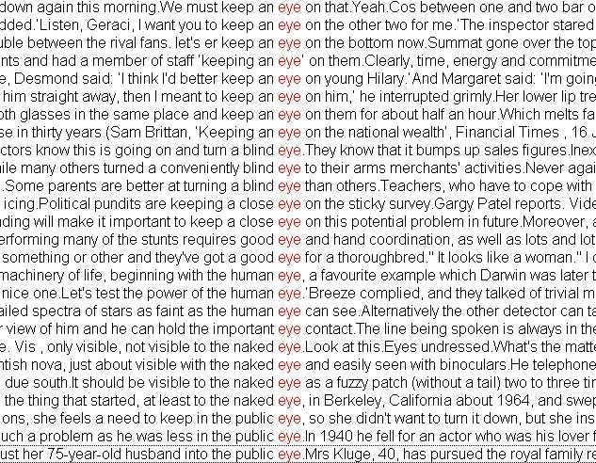

Slide 29
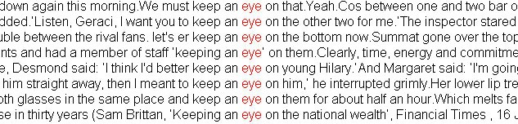
to watch someone or something or stay informed about the person’s behavior, esp. to keep someone out
of trouble

Slide 30
British National Corpus (BNC, British English)
  www.natcorp.ox.ac.uk
COCA (American English)
  http://corpus.byu.edu/coca/
The CORIS corpus (Italian)
  http://corpora.dslo.unibo.it/coris_ita.html
Leeds Internet corpora
  English, Chinese, Arabic, French, German, Italian, Japanese, Polish, Portuguese, Russian, Spanish: http://corpus.leeds.ac.uk/internet.html
Mannheim corpora (German)
http://corpora.ids-mannheim.de/ccdb
Corpus del Español (Spanish)
explore the Web to see what other corpora are available !
www.corpusdelespanol.org
CREA (Spanish)
http://corpus.rae.es/creanet.html

