Slide 1
Analytic Ontology
22-23

Slide 2
Lezioni 1-2
6/10/22

Slide 3
Classroom
Aula B: Mancini, seminario (triennale e magistrale) su filosofia africana
Problemi di sovrapposizione?

Slide 4
Program
1) Introduction to the main topics of ontology
what is ontology (or metaphysics)?
objects, properties, relations
propositions, events, states of affairs.
2) Temporal ontology
A-Eternalism, Pastism, Presentism, B-Eternalism
basics of relativity theory
Identity across time.

Slide 5
Textbook
M. J.Loux, T.M. Crisp, Metaphysics. A contemporary introduction, 4a ed., Routledge, Londra, 2017
  introduzione e capp. 1-8 (circa 250 pp.)

Slide 6
Grading
Modalità I
  Presentazione (possibilmente in classe) di circa 30 minutidi un argomento concordato con il docente e tesina scritta su argomento concordato con il docente di massimo 3000 parole (note e bibliografia incluse).
  Esame orale consistente nella discussione della tesina.
Modalità II
  Esame orale di circa mezz'ora sul testo adottato con almeno tre domande su argomenti diversi scelti dal docente.

Slide 7
Metaphysics, common sense, science

Slide 8
Naming a discipline
First philosophy = the study of being qua (as) being
Metaphysics
Ontology
Study of the most general kinds (categories) of being or reality, which ones they are, what they are (their nature), how they are structured, how they hang together
Continental vs. Analytic philosophy
Analytic Ontology (metaphysics)
Committing oneself to "an ontology" (Quine), i.e., to an inventory of what there is

Slide 9
Ontological/metaphysical issues (categories)
Being
Existence
Object or individual
Property
Relation
State of affairs
Event
meaning, concept, proposition
time
Space
Mind
Matter
God
emphasis on

Slide 10
Historical terminological note
"Metaphysics". Origin of the term in the fact that Andronicus of Rhodes (I cent. B.C.) placed certain Aristotelian writings after those about physics (tà metà tà physiká)
"Ontology". Origin of the term in the 17th century. From Wikipedia:
The compound word ontology combines onto-, from the Greek ὄν, on (gen. ὄντος, ontos), i.e. "being; that which is", which is the present participle of the verb εἰμί, eimí, i.e. "to be, I am", and -λογία, -logia, i.e. "logical discourse. While the etymology is Greek, the oldest extant record of the word itself, the New Latin form ontologia, appeared in 1606 in the work Ogdoas Scholastica by Jacob Lorhard (Lorhardus) ["ontology" used as synonymous with "metaphysics"] and in 1613 in the Lexicon philosophicum by Rudolf Göckel (Goclenius)

Slide 11
Attempts to distinguish
Castañeda (1980): "phenomenological ontology is the study of both the most general structure of the world one finds oneself in and the most pervasive patterns of one's experience and thinking of that word ... The study of the conjenctures about reality in itself may be called metaphysical ontology"
Laurence & MacDonald (Readings in the Foundations of metaphysics, 1998): "Metaphysics is concerned with the study of 'being qua being' ... being as such. ... questions about which metaphysical categories of entities there are and questions about the natures of different kinds of entities ... constitute the central questions in that part of metaphysics called 'ontology' ... the very foundations of metaphysics"
Varzi ("On doing ontology without metaphysics", Phil. Persp. 2011): "ontology understood as the study of what there is and metaphysics ... as the study of what it is ... ontology is in some way prior to metaphysics"

Slide 12
Aristotle vs. Kant
Aristotelian conception: investigation of reality
Kantian conception: investigation of "the most general structures at work in our thought about the world" (Loux 2006, Introduction)
Strawson (Individuals, 1959): descriptive (Kantian) vs. revisionary (Aristotelian) metaphysics

Slide 13

Methodology
Russell 1905; Castañeda 1980.
Protophilosophy: Collection of data (puzzles, paradoxes, intuitions)
  The most important and difficult task of collecting the relevant shared pre-theoretical data regarding a certain problem (or cluster of problems) and presenting them in a neutral (pre-theoretical) terminology (as far as possible).
Symphilosophy: Construction of theories that illuminate (explain, increase the understanding of) the data.
Diaphilosophy: Comparison of competing theories
Typical evaluative tool in theory comparison: Ockam's razor

Slide 14
Critical Commonsensism
Critical Commonsensism (Peirce 1960, Chisholm 1996)
(DC) A theory in line with commonsense (and ordinary language) enjoys prima facie Default Credibility, which can however be trumped by philosophical analysis/scientific inquiry that appears to prove it wrong and leads to an alternative theory.
(IPG) Innocent until proven guilty. The theory most in line with common sense should be accepted at least until philosophical analysis/scientific inquiry proves it wrong and an alternative theory can replace it.
(CL) Coherence of a theory with commonsense admits of degrees and the coherence level offers a criterion for theory choice; defeasible, subject to the results of philosophical analysis/scientific inquiry.

Slide 15
Common sense
Defense of common sense in Boulter 2007 based on evolutionism and cognitive psychology with appeal to Aristotle, Reid, Moore.
There is a list of common sense beliefs (pp. 29-30) (which does not include presentism) extracted from Reid and Moore (see next 3 slides).
Why is adequacy to common sense an indicator of truth?
Commmon sense is the result of evolutionary adaptation and is thus endowed with survival value (Castañeda 1980)

Slide 16
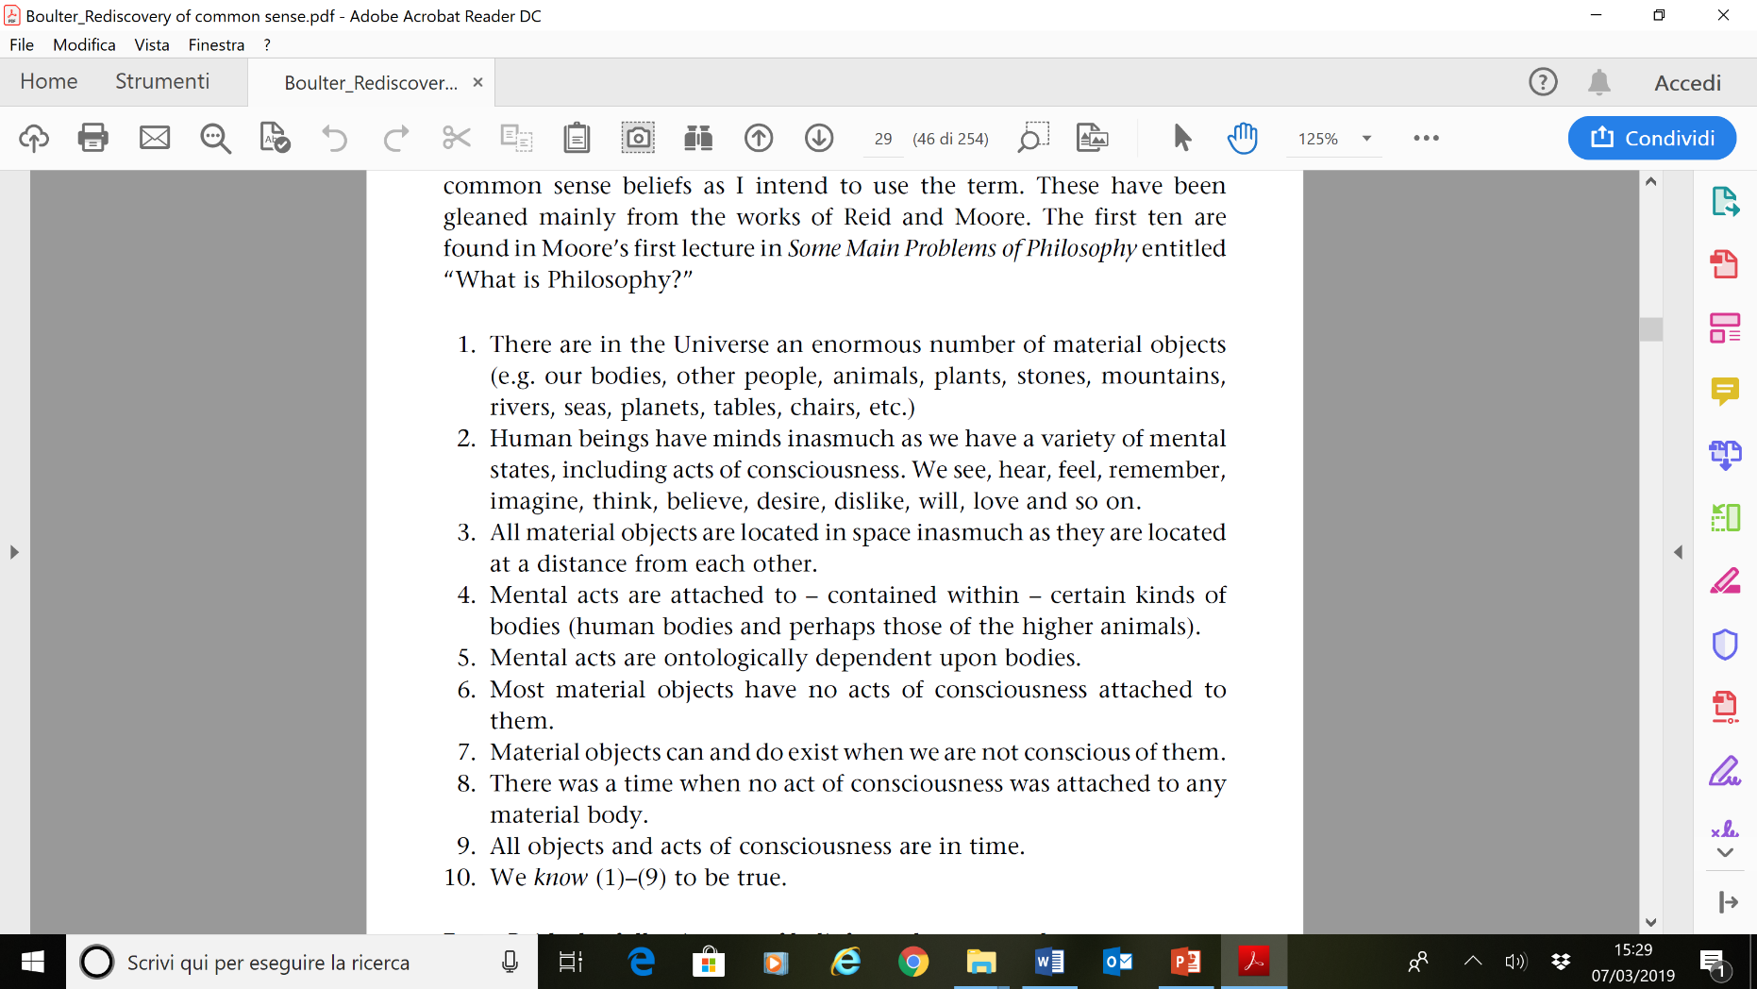

Slide 17
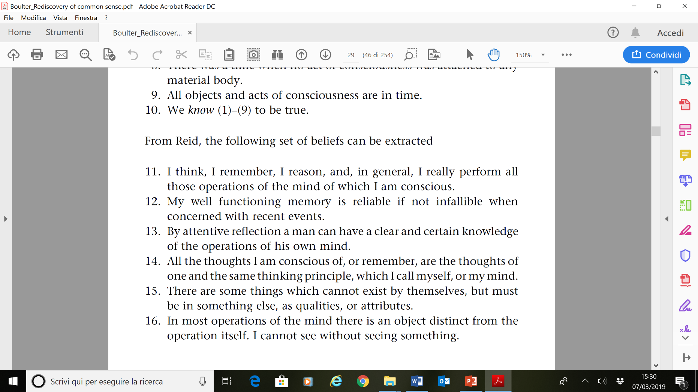

Slide 18
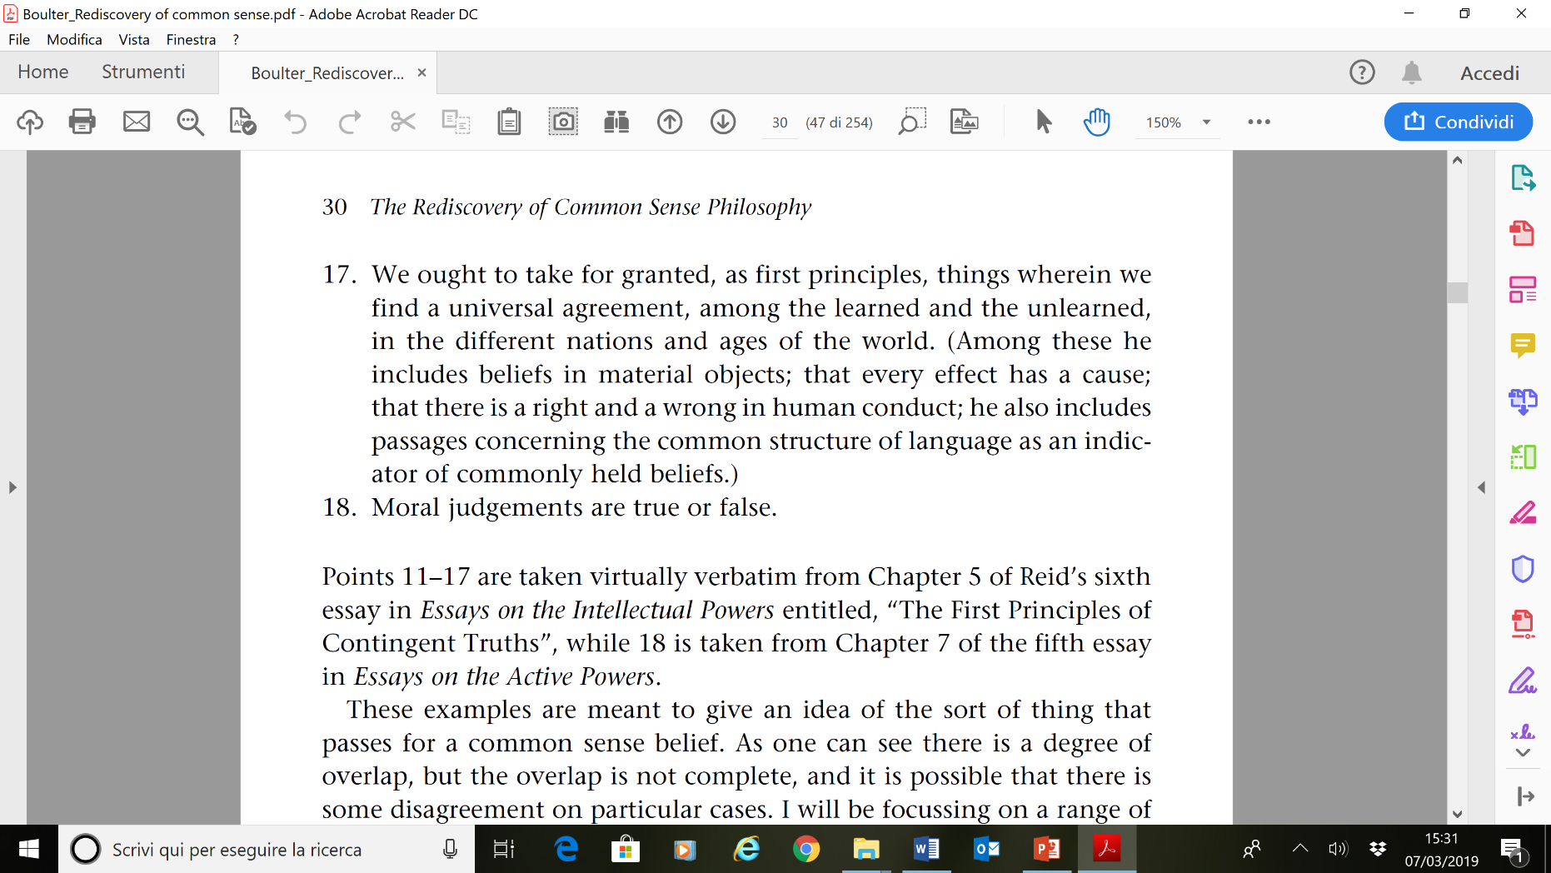

Slide 19
Lezione 3
7/10/22

Slide 20
Scientism
Ladyman and Ross (2007, Ch. 1 “In defense of scientism”) claim "analytic metaphysics" is completely misguided, unable to track truth, as it is based on unjustified appeal to (subjective) intuitions and insufficient knowledge of science.
They do not appear to attribute any value to commonsense ('as naturalists, we are not concerned with preserving intuitions at all' (p. 12)); metaphysics should be based only on science, by relying on this 'Principle of Naturalistic Closure' (PNC):
Any new metaphysical claim that is to be taken seriously at time t should be motivated by, and only by, the service it would perform, if true, in showing how two or more specific scientific hypotheses, at least one of which is drawn from fundamental physics, jointly explain more than the sum of what is explained by the two hypotheses taken separately.

Slide 21
Resisting scientism
Dorr (2010):
" What is puzzling about this is that it instructs us to ignore a very large class of arguments without telling us anything at all about where they fail. Consider a simple metaphysical argument that refers to no scientific hypotheses: 'the statue on my desk was made this morning; the lump of clay on my desk has existed for a long time; so the statue on my desk is distinct from the lump of clay on my desk; so distinct material objects sometimes spatially coincide'. Or an argument that appeals to only one scientific hypothesis: 'If presentism is true, simultaneity is absolute; but simultaneity is not absolute; so presentism is not true'. The PNC seems to say that these arguments are no good: they are the wrong kind of arguments to "motivate" belief in their conclusions. But how can that be? What are we supposed to do, if we initially believed the premises, and have just noticed that they entail the conclusion? Are we rationally required to stop believing at least one of the premises, so that we don't violate the PNC by coming to believe the conclusion? This seems absurd. "

Slide 22
The basic building blocks: objects, properties and relations

Slide 23
Objects (concrete particulars)
Se Loux 2006, Ch. 3
Object as bare substratum exemplifying properties (Aristotle, Locke)
Object as bundle of co-exemplified (compresent) properties (Plato, Hume, Russell)
Objects as Aristotelian substances, endowed with an essence, essentially belonging to a kind (Aristotle) (seems to be the option preferred by Loux, who says (4d ed., p. 106): "According to philosophers in the Aristotelian tradition, the root difficulty in the substratum and bundle theorists’ accounts is their appropriation of the framework of constituents and wholes.")

