Slide 1
Ontology 22-23
Lezz. 10-12

Slide 2
Lez. 12
27/10/22

Slide 3
TEMPORAL ONTOLOGY

Slide 4
Salteremo le lezioni di 10 e 11 Novembre
Programmare Recuperi

Slide 5
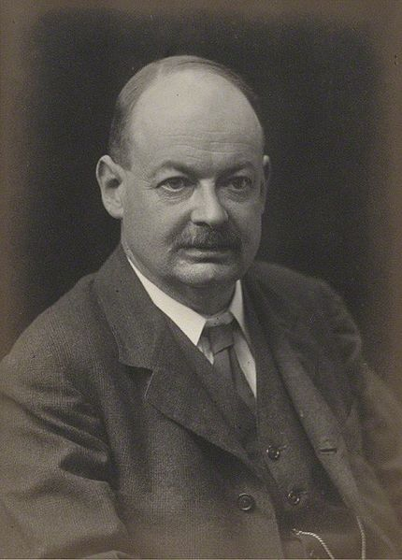
Preview
McTaggart's argument
A-theory vs. B-theory
The threat of deflationism
    John Ellis McTaggart (1866 -1925)

Slide 6
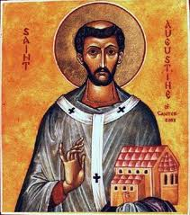
What is time?
Augustine (Confessions, XI, 14): "O allora che è il tempo? Se nessuno me lo domanda, lo so: se voglio spiegarlo a chi me lo domanda, non lo so più"
Entry time of Palazzi (1974): «la successione illimitata dei fatti e degli eventi umani, l’estensione nella durata … la durata delle cose, distinta e misurata a periodi; e principalmente secondo l’apparente corso del Sole».
Oxford English Dictionary: «‘durata indefinita e continua’, ..., nel quale tutti gli eventi si sono svolti, si stanno svolgendo, e si svolgeranno».

Slide 7
Does time exist?
We shall look at McTaggart's argument

Slide 8
McTaggart (1908, 1927)
John Ellis McTaggart (1866-1925)
J. Ellis McTaggart, 1908 , " The Unreality of Time", Mind, Vol. 17, No. 68, pp. 457-474
In ch. 33 of vol. II of The nature of existence (1927) the argument is the same, but McTaggart also replies to Russell and considers his ‘at-at theory of change’, and criticizes Broad's growing block theory (pastism)
A/B terminology starts here. Time permitting we shall look at the argument
Ingthorsson, D., McTaggart's Paradox, Routledge, 2016 (reviewed by Mozersky in Notre Dame Phil. Rev. 2016.12.11)

Slide 9
B-relations and/or A-properties
A-series
B-series
A-properties (A-determinations): present, past, future (now often called "tenses")
B-relations (B-determinations): simultaneous, earlier/later
A-theory
B-theory

Slide 10
metric A- and B-attributes
3 years ago
in 14 minutes and 10 seconds
3 hours before
after 4 hours since

Slide 11
Basic assumption 1: change is essential
According to MT, change is essential for time.
He means: change due to A-properties of "positions in time" (events or times) (I call it "tensional change")
But there are other kinds of change ...

Slide 12
Kinds of change
Tensional change: a time or event changing A-properties, e.g. time t was past; time t is present. Or my lecturing was future; my lecturing is present.
Qualitative change: any entity changing properties, eg., the stick was straight; the stick is bent/ the apple was unripe (sour); the apple is ripe.
Absolute (ontological, metaphysical) change (becoming): coming to exist; ceasing to exist.
Alethic change: change in truth value of a truth bearer (proposition, sentence or statement)

Slide 13
Basic assumption 2: A-properties are more fundamental
The A and B series are equally essential to time, which must be distinguished as past, present and future, and must likewise be distinguished,as earlier and later. But the two series are not equally fundamental. The distinctions of the A series are ultimate. We cannot explain what is meant by past, present and future. We can, to some extent, describe them, but they cannot be defined. We can only show their meaning by examples. " Your breakfast this morning," we can say to an inquirer, " is past; this conversation is present; your dinner this evening is future ". (1908, p. 463)
B-relations are just internal relations that connect two "positions in time" (events or times), on the basis of their A-properties (Oaklander, The Ontology of time 2004).

Slide 14
The argument in short
(M1) Each event has the A-properties ‘past’, ‘present’ and ‘future’.
(M2) The A-properties ‘past’, ‘present’ and ‘future’ are incompatible.
(M3) The propositions (M1) and (M2) are jointly inconsistent.
Hence,
(M4) time is unreal.

Slide 15
Lezioni 11-12
28/19/22

Slide 16
Salteremo le lezioni di 10 e 11 Novembre
Programmare Recuperi
PROPOSTA: 3 ore lunedì 28 novembre di mattina

Slide 17
A theory vs. B theory

Slide 18
A theory vs. B theory
MT's arguments has not been convincing, but has generated a subdivision into supporters of the
A theory (a.k.a tensed or dynamic)
and of the
B theory (a.k.a tenseless or static)

Slide 19
B theory (B-eternalism)
  Objective B-relations
  No objective A-properties
  All things of all times, they all exist (are equally real)
  No absolute becoming (no change in what exists)

Slide 20
A-theories
Objective A-properties
Objective becoming (more or less extended)
A-Eternalism
  past, present and future things, they all exist
Presentism
  only present things exist
Growing Block (pastism)
  past and present things, they all exist

Slide 21
Supporters of the A-theory
Broad (1923)
Findlay (1956)
Prior (1967, 1968a)
Sellars (1962a)
Strawson (1952).
Smith (1993)
McCall (1994)
Tooley (1997)
Ludlow (1999)
Craig (2000)
Bourne (2006)
Cameron (2015)
Correia and Rosenkranz (2018)
Before supporting the A-theory, Broad (1921) defended the B-theory (on Broad see Mundle 1959, and recently Oaklander, C.D. Broad’s philosophy of time, 2020).

Slide 22
Supporters of the B-theory
Russell (1903, 1915) (earliest supporter)
Bergmann (1960, pp. pp. 237-38)
Broad (1921)
Goodman (1951, CAP. 11)
Quine (1960, PAR. 36)
Reichenbach (1947, PAR. 50-51).
Dorato (1997)
Le Poidevin (1991)
Mellor (1981, 1998)
Oaklander (2004)

Slide 23
Abundant vs sparse and A vs B
A-properties and B-relations: we may take them for granted as abundant attributes.
Are there corresponding sparse attributes, or are they exemplified?
The answer may vary, depending on the different theories of time

Slide 24
A-Eternalism
PAST
FUTURE
NOW

Slide 25
Pastism (growing block theory)
PAST
NOW

Slide 26
Presentism
NOW

Slide 27
B-theory (B-eternalism)
Before After
Presentness is subjective: what is simultaneous to my saying these things

Slide 28
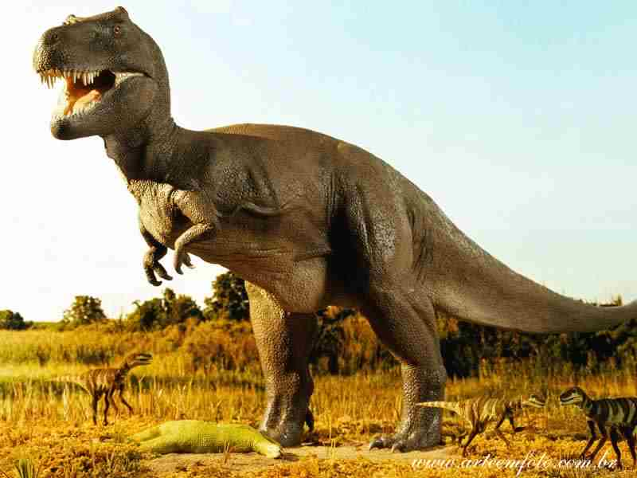
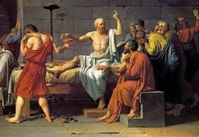
two actors and two moments
We shall focus on Dino, a dinosaur, on Socrates, and on two moments, t1 (at which Dino is roaming) and t2 (at which Socrates is drinking hemlock)

Slide 29
B-eternalist world
t1
t2

Slide 30
A-eternalist world at t1
t1
t2

Slide 31
A-eternalist world at t2
t1
t2

Slide 32
Presentist world at t1
t1
t2

Slide 33
Presentist world at t2
t1
t2

Slide 34
The threat of deflationism

Slide 35
Deflationism about temporal ontology
The debate is not substantial
Merely verbal dispute, based on ambiguity
  Callender (2000), Dolev (2007), Dorato (2006), Lombard (1999), Meyer (2005), Savitt (2002, 2006), Williams (1996)
Replies appealing to tenselessness and/or the proper understanding of quantifiers
  Crisp (2004a), Sider (2001, 2006), Carter (2002a, 2002b), Ludlow (2004), Oaklander (2008, 2014)).
New wave of deflationism
  Callender (2012, 2017), Deng (2018), Dolev (2018), Dorato (2018), Lombard (2010), Meyer (2013a, 2013b)
New substantialist replies appealing to tenselessness and/or the proper understanding of quantifiers
  Baron and Miller (2013), Mozersky (2011, 2015), Oaklander (2012, 2014), Torrengo (2012), Deasy (2017a), Sider (2011)
See these references in Graziani and Orilia (synthese 2021)
ETC.

Slide 36
Triviality of presentism?
(1) Whatever exists is present
'exists' is ambiguous
(1a) Whatever existed, or exists now, or will exist, is present
(1b) Whatever exists now is present
Interpretation (1a) is obviously false: instantiate, e.g., to Socrates to have a counterexample: he existed, but he is not present.
Interpretation (1b) is trivially true: it is a tautology, for 'is present' = 'presently exists' = 'exists now'

Slide 37
Triviality of eternalism?
(1) Whatever is past, or present, or future, exists
'exists' is ambiguous
(1a) Whatever is past, or present, or future, exists now
(1b) Whatever is past, or present, or future, existed or exists now or will exist
Interpretation (1a) is obviously false: instantiate, e.g., to Socrates; since he is past, he is either past, present, or future, but he does not exist now.
Interpretation (1b) is trivially true: it is a tautology, for 'is past' = existed, 'is present' = 'exists now', 'is future' = 'will exist'

Slide 38
Shifting the issue (i)
Williamson (2013), Modal Logic as Metaphysics, p. 23
" There is a widespread feeling of dissatisfaction with the eternalism–presentism distinction. ... what is it for something to be present? ... Although we might complicate the definitions of ‘presentism’ and ‘eternalism’ in attempts to construct a more sensible dispute, it is better to make a fresh start with fresh terminology and clearer distinctions. Thus the proposal is to abandon that debate as hopelessly muddled, and to get on with the clearer permanentism–temporaryism debate, and other clearer debates too, instead."
Permanentism: Always everything always exists
Temporaryism: Denial of permanentism

Slide 39
Shifting the issue (ii)
Deasy, "What is Presentism?", Noûs 2017, p. 379:
  "I argue that there are reasons to reject all of the most plausible candidate interpretations of the predicate ‘is present’ as it appears in the traditional definition of presentism ... it follows that there are also good reasons to reject the most plausible interpretations of the traditional definitions of the other A-theories. I then argue that there is a better way of defining the A-theories, in terms of the question of whether existence has a beginning and an end"
PERMANENTISM: Always, everything always exists
PRESENTISM: There is an absolute, objective present [!] instant (THE A-THEORY) & sometimes, something begins to exist and sometimes, something ceases to exist (TRANSIENTISM)
THE MOVING SPOTLIGHT THEORY: There is an absolute, objective present instant (THE A-THEORY) & nothing ever begins to exist and nothing ever ceases to exist (PERMANENTISM)

Slide 40
Shifting the issue (iii)
Focusing primarily on Deasy, and then also on other authors (Cameron, Correia and Rosenkranz, Ingram, Tallant, Orilia, ...) Tallant and Ingram ("The Rotten Core of Presentism", Synthese, online first 2020) argue that
"there is no theoretical core to presentism. There is no single view or family of views that is presentism" (from the abstract)

Slide 41
New ontological beasts
In fact what these issue shiftings have done is to bring forth new temporal ontologies
Not (yet) discussed in current textbooks (as far as I know)
A-permanentism
B-permanentism
Williamsonian presentism (so called by Cameron 2015, The Moving Spotlight, note 17, p. 146, and Ingram 2018, Thisness Presentism; not clear if attributed to Williamson)
Less Plausible, I think, than the more traditional views

Slide 42
A-permanentist world at t1
t1
t2
t2
t1

Slide 43
A-permanentist world at t2
t1
t2
t2
t1

Slide 44
Williamsonian presentist world at t1 (i)
t1
t2
t2

Slide 45
Williamsonian presentist world at t1 (ii)
t1
t2
t1

Slide 46
General Impression on rigor and formalization
The debate is is mainly conducted in English with occasional recourse to formulas (e.g. in Deasy)
In Williamson we also find a rich complex formalism (higher-order modal logic)
Precise definitions and rigor are a goal
Yet, there is much talking past each other, confusion, verbal issues
We may think that formalization by standard temporal logic could solve these problems, but it is not so …

