Slide 1
Ontology 22-23
Lezioni 13-15

Slide 2
Lezione 13
3 novembre 2022

Slide 3
Recupero
Saltiamo 10 e 11 Novembre
Recupero: 28 Novembre, ore 9-12, aula E
(con una pausa, potremmo finire intorno alle 11,30)

Slide 4
Standard temporal logic and its problems

Slide 5
Formal Ontology to the rescue?
To go out of these quandaries, it may seem apt to invoke the logical tools of formal ontology, whose goal is
“to bring together the clarity, precision, and methodology of logical analyses on the one hand with the philosophical significance of ontological analyses on the other” (Cocchiarella, Formal Ontology and Conceptual Realism, 2007).
The relevant logical tools here are those of temporal, or tense, logic, and yet this logic, as typically understood, appears to be unfit to provide a formal representation of the competing theses of temporal ontology.

Slide 6
Strange situation in current temporal logic
Tensed A-theoretic language in the object language
Tenseless B-theoretic language in the metalanguage
The impossibility of having tensed and tenseless language together in one language creates confusion and makes it impossible to state precisely the competing views in temporal ontology, A-theory, B-theory, presentism, eternalism, growing block, permanentism, etc.
This situation contributes to the currently fashionable claim that the debate in temporal ontology is not substantial

Slide 7
First-order logic (i)
(1) Socrates is a philosopher
(1a) philosopher(s)
(2) Trump is not European
(2a) ∼European(t)
(3) philosopher(s) & ∼European(t)
American(t) → ∼European(t)
American(t) v ∼European(t)
(4) 2 is even
(4a) even(2)
(5) 2 is not odd
(5a) ∼odd(2)
(6) something is a dinosaur
(6a) ∃x dinosaur(x)
(7) everything is a dinosaur
(7a) ∀x dinosaur(x)

Slide 8
FOL: proof theory
Natural deduction rules
Refutation trees
Axioms + MP + UG
Valid inferences
  A1, …, An ⊦ C
Theorems
  ⊦ A

Slide 9
FOL: model theory (i)
Models
  <D, I>
  D is a set of object, for each of which there is a distinct name, t.
  I assigns values to names and to predicates. I(a) is a member of D, I(F) is a property or relation that members of D may or may not have (it depends on the model)
Truth in a model
  M ⊨ F(t) iff I(t) has the property I(F), according to the model
  M ⊨ R(t1, …, tn) iff I(t1), …, I(tn) are in the relation I(R), according to the model
  M ⊨ ∼A iff it is not the case that M ⊨ A, in short M ⊭ A
  M ⊨ (A & B) iff M ⊨ A and M ⊨ B
  M ⊨ ∀x A(x) iff for every name t (of an object in D): M ⊨ A(x/t)

Slide 10
FOL: model theory (ii)
Logical consequence
  A1, …, An ⊨ C
Logical truth
  ⊨ A

Slide 11
Standard temporal logic (after Prior)
Only tensed language; all formulas of FOL are interpreted as present-tensed
philosopher(s) = Socrates is presently a philosopher
To obtain past- and future-tensed formulas, prefix eithe P or F
P philosopher(s) = Socrates was a philosopher
F philosopher(s) = Socrates will be a philosopher
Axioms and rules for the temporal operators are added to the axioms and rules of FOL

Slide 12
Standard temporal logic (cont.)
x exists = ∃y y = x; which really means there exists presently something equal to x
How to formulate presentism, i.e., whatever exists presently exists?
This appears to require this contrast: exists vs presently exists
A typical attempt is this:
∀x (P(∃y = x)) v (∃y = x) v F ∃y = x) ) → ∃y=x)
But it doesn't work, for it says that whatever existed, presenty exists or will exist, is: presently existing!

Slide 13
Semantics for temporal logic
It is stated in tenseless B-theoretical language
It is assumed there are times at which propositions are true (with respect to a model, involving the set of times T: <D, T, I>
t ⊨ philosopher(s) iff Socrates is a philosopher at time t
t ⊨ Pphilosopher(s) iff there is time t'<t such that Socrates is a philosopher at time t'
t ⊨ Fphilosopher(s) iff there is time t'>t such that Socrates is a philosopher at time t'
Quantifiers ...

Slide 14
Lezioni 14-15
4 Nov. 22

Slide 15
Constant domain alternative
t ⊨ ∀x Q(x) iff every object d of all times (Socrates, Napoleon, Roosevelt, Trump, ...) is such that t ⊨ Q(d)
t ⊨ ∃x Q(x) iff there is an object d of all times (Socrates, Napoleon, Roosevelt, Trump, ...) such that t ⊨ Q(d)
The SEP entry on temporal logic (Goranko et al.) calls it "eternalist semantics"
But in fact the "presentist" formula is logically valid ...

Slide 16
Constant domain alternative (ii)
∀x ((P ∃y = x v ∃y = x v F ∃y = x )) → ∃y y=x)
Valid since ∃y y = x is true for all values of x
E.g., even though " ∃y y=socrates " means "presently ∃y y=socrates", it is true because Socrates is in the domain and all members of the domain are possible values of the variables
Seems permanentism rather than eternalism (see Williamson)

Slide 17
variable domain semantics
t ⊨ ∀x Q(x) iff every object d of time t (Trump, Obama, Macron, ..., for t = 2020) is such that t ⊨ Q(d)
t ⊨ ∃x Q(x) iff there is an object d of of time t (Trump, Obama, Macron, ...) such that t ⊨ Q(d)
The SEP entry calls this "presentist semantics"
Let us look at the "presentist" formula ...

Slide 18
variable domain semantics (ii)
∀x ((P ∃y = x v ∃y = x v F ∃y = x )) → ∃y=x)
This is again logically valid. Imagine you evaluate it in 1789. You can take as value of x only objects of 1789, and for any of them ∃y=x is true in 1789:
1789 ⊨ ∃y (y = Robespierre)
Imagine you evaluate it in 2020. In this case you cannot take Robespierre as value of x. You may take, e.g., Trump, and
2020 ⊨ ∃y (y = Trump)

Slide 19
constant domain semantics with existence predicate
In the SEP entry you also find this alternative:
  Constant domain + "existence at the current time instant" (at the time of evaluation).
For instance:
1798 ⊨ exist(Napoleon)
1798 ⊨ ∃y P drinks the hemlock(y)
2020 ⊭ exist(Napoleon)
2020 ⊨ ∃x(∼ exist(x) & P wins at Austerlitz (x))

Slide 20
constant domain semantics with existence predicate (cont.)
We can now try to formulate presentism as follows:
∀x ((P exist(x) v exist (x) v F exist (x) )) → exist (x) )
This is false.
Consider instantiating to Socrates and evaluating at 2020:
2020 ⊨ (P exist(socrates) v exist (socrates) v F exist (Socrates) )) →
exist (socrates))
The antecedent is true, since 2020 ⊨ P exist(socrates), and the consequent false since 2020 ⊭ exist (socrates)

Slide 21
Let's take stock
Depending on the semantics, presentism is (trivially) true or false.
But we want a formal system in which no temporal ontology in particular is taken for granted, or rejected.
We want all the temporal ontologies AS COMPETITORS

Slide 22
Sketch of a proposal for a formal ontological approach to temporal ontology

Slide 23
Preview
Both tenselessness and tensedness in the same language
  inner-tensed strategy
  inner-tenseless strategy
Proper names and quantifiers
  Free logic strategy
  Denoting concepts strategy

Slide 24
Tenselessness
Assume that basic predication is tenseless
Socrates is a man
man(Socrates)
t1 is before t2
t1 < t2
In contrast, in standard tense logic, atomic propositions are taken to be tensed

Slide 25
Tensedness
Prefix tense operators to tenseless statements
(1) Socrates is (presently, now) drinking
(1a) !drinks(Socrates)
(2) Socrates drank
(2a) P!drinks(Socrates) (2b) Pdrinks(Socrates)
(3) Socrates will drink
(3a) F!drinks(Socrates) (3b) Fdrinks(Socrates)
Inner-tensed strategy vs. Inner-tenseless strategy
(2a) ⇎ (2b) (2a) ⇔ (2b)
(3a) ⇎ (3b) (3a) ⇔ (3b)

Slide 26
A-properties and B-relations
present(2022)
past(1972)
future(2343)
Derivatively, we also attribute these properties to events and objects
According to the B-theory, nothing exemplifies such properties. The B-theory admits only the exemplification of B-relations:
1972 < 2022

Slide 27
Propositions, events, objects and times
@(t, P) = proposition P is true at time t
occur(t, e) = event e occurs at time t
at(t, x) = object x is temporally located at time t

Slide 28
Events as truthmakers
Events (or state of affairs) are taken to be truthmakers of true propositions
Rather than having truth conditions stated in set-theoretical terms, I propose to have in the same language the option of asserting that there are events as truthmakers of propositions

Slide 29
Free logic strategy vs denoting concepts strategy
We beg the question against presentism, if we assume that all proper names are referring.
For example, the presentist would say that ‘Socrates’ does not now refer to anything (although it did refer to a philosopher)
Free logic
Denoting concepts

Slide 30
Free logic strategy
To avoid begging the question against the presentist we assume there are both denoting and non-denoting names. Thus, e.g., for the presentist, “Socrates” is non-denoting and “Trump” is denoting. The formula exist(a) tells us that “a” is denoting.
Basic ideas of free logic
  There is an existence predicate, which applies to referring names:
    exist(Biden)
    ∼exist(Pegasus)
  Universal exemplification and existential generalization can be performed only with referring names
    ∀xA(x), exist(a) ⇒ A(a)
    A(a), exist (a) ⇒ ∃xA(x)

Slide 31
I’d assume a negative free logic, so that all atomic wffs with non-denoting terms are false, including a = a. In a temporal context, however, a formula with non-denoting terms could be true.
For example, at 1860 “Garibaldi” is denoting and thus we take @(1860, Italian(Garibaldi)) to be true. Nevertheless, Garibaldi = Garibaldi and @(2022, Garibaldi = Garibaldi) are false for the presentist.

Slide 32
We assume existentially loaded quantifiers ∃ and ∀ , ranging over existent objects. For them, we have the usual restrictions on the quantifier rules of free logic.
(The intuition behind the acceptance of negative, rather than positive, free logic, is that ultimately a proper name can be viewed as a definite description to be interpreted à la Russell.)
We also assume general purpose quantifiers, ∃^{s} and ∀^{s} , which can be interpreted substitutionally, on the assumption that we have enough names , for all possible objects.
Given that @(1860, Italian(Garibaldi)), even the presentist can agree that ∃^{s}x@(1860, Italian(x)).
For the eternalist, Garibaldi tenselessly exists, so we have exist(Garibaldi), and Garibaldi = Garibaldi. However, Garibaldi exists only at some times and at other times he does not exist. Thus we assume @(1860, exist(Garibaldi)) and @(1860, Garibaldi = Garibaldi), and we deny @(2020, exist(Garibaldi)) and @(2020, Garibaldi = Garibaldi).

Slide 33
Denoting concept strategy
Proper names are taken to stand for individual denoting concepts. +exist([the F]) means [the F](exist), i.e. ∃¹x(Fx & ∃ y(y= x)).
The presentist assumes:
+exist([the Trump]) is true
+exist([the Socrates]) is false.
For the eternalist they are both true.

Slide 34
Back to Dino and Socrates
From the point of view of each theory, the propositions expressed by the basic tensed sentences of natural language are the same.
But the theories differ as regards the truthmakers they postulate for past-tensed and future-tensed sentences
They also differ as regards their tenseless ontological commitments, i.e., what tensellessly exist, at each time

Slide 35
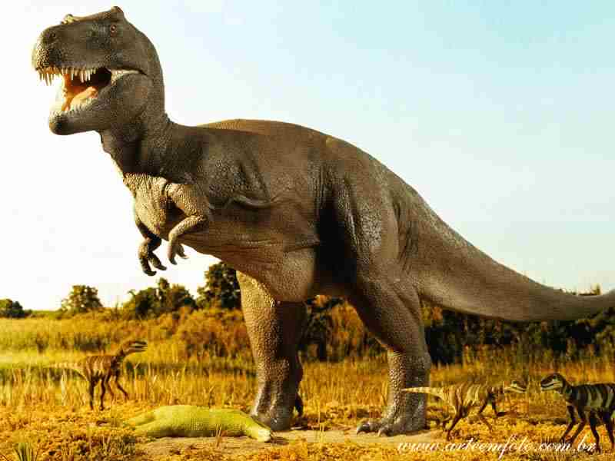
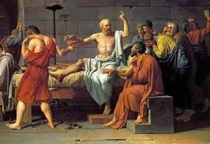
A-eternalist world at t1 (i)
t1
t2
Dino is roaming
!R(d)
∃e(event(e) & attribute(e, R) & agent(e, d) & occur(t1 , e) & present(t1))
Socrates will drink hemlock
F!D(s)
∃e(event(e) & attribute(e, D) & agent(e, s) & occur(t2 , e) & future(t2))

