Slide 1
Analytic Ontology 22-23
Lezioni 16-18

Slide 2
Lezione 16
17/11/22

Slide 3
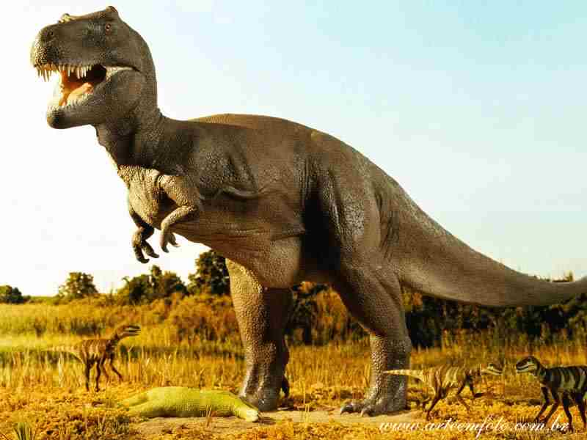
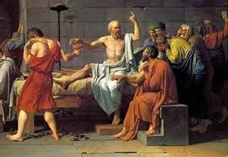
A-eternalist world at t1 (ii)
t1
t2
exist(d)
exist(s)
at(t1, d)
at(t2, s)
!exist(d)
F! exist(s)

Slide 4
A-eternalist world at t2 (i)
t1
t2
Dino roamed
P !R (d)
∃e(event(e) & attribute(e, R) & agent(e, d) & occur(t1 , e) & past(t1))
Socrates is drinking hemlock
!D(s)
∃e(event(e) & attribute(e, D) & agent(e, s) & occur(t2 , e) & present(t1))

Slide 5
A-eternalist world at t2 (ii)
t1
t2
exist(d)
exist(s)
at(t1, d)
at(t2, s)
!exist(s)
P! exist(d)

Slide 6
A-permanentist world at t1
t1
t2
t2
!exist(d)
!exist(s)
!concrete(d)
!abstract(s)
at(t1, d)
at(t2, d)
at(t1, s)
at(t2, s)
t1

Slide 7
A-permanentist world at t2 (ii)
t1
t2
t2
!exist(d)
!exist(s)
!concrete(s)
!abstract(d)
at(t1, d)
at(t2, d)
at(t1, s)
at(t2, s)
t1

Slide 8
Presentist world at t1 (i)
t1
t2
Dino is roaming
!R(d)
∃e(event(e) & attribute(e, R) & agent(e, d) & occur(t1 , e) & present(t1))
Socrates will drink hemlock
F!D(s)
No truthmaker

Slide 9
Presentist world at t1 (ii)
t1
t2
exist(d)
!exist(d)
at(t1, d)

Slide 10
Presentist world at t2 (i)
t1
t2
Dino roamed
P !R(d)
truthmaker: the proposition that Dino roames has the property
being-true-at-t1
Socrates is drinking hemlock
!D(s)
∃e(event(e) & attribute(e, drinking) & agent(e, s) & occur(t1 , e) & present(t1))
true-at-t1([roams(d)])

Slide 11
Lez. 17-18
18/11/22

Slide 12
Presentist world at t2 (ii)
t1
t2
exist(s)
at(t2, s)

Slide 13
B-eternalist world
d 's roaming is simul-
taneous with this token
d 's roaming is before this token
t1
t2
∃e(event(e) & attribute(e, R) & agent(e, d) & occur(t1 , e) & ∃t( ∃e'(event(e') & attribute(e', uttering) & patient(e', tok1) & occur(t, e') & t = t1)))
∃e(event(e) & attribute(e, R) & agent(e, d) & occur(t1 , e) & ∃e'(event(e') & attribute(e', uttering) & patient(e', tok2) & occur(t2 , e') & t1<t2)))

Slide 14
B-eternalist world (slide aggiunta dopo la lezione)
d 's roaming is simul-
taneous with this token
d 's roaming is before this token
t1
t2
∃e(event(e) & attribute(e, R) & agent(e, d) & occur(t1 , e) & ∃e'(event(e') & attribute(e', uttering) & patient(e', tok1) & occur(t1, e')) MI SEMBRA MEGLIO PER SPECIFICARE IL TRUTHMAKER RISPETTO ALLA FORMULA DELLA SLIDE PRECEDENTE USATA IN CLASSE
∃e(event(e) & attribute(e, R) & agent(e, d) & occur(t1 , e) & ∃e'(event(e') & attribute(e', uttering) & patient(e', tok2) & occur(t2 , e') & t1<t2)))

Slide 15
B-eternalist world (ii)
d 's roaming is simul-
taneous with this token
s 's drinking is simul-
taneous with this token
t1
t2
exist(d)
exist(s)
at(t1, d)
at(t2, s)

Slide 16
Definitions of presentism
This is the formulation in Baron and Miller 2019 (Intro to the Phil of Time):
“only entities that exist now, exist simpliciter” (p. 14)
This is the formulation in SEP:
“According to presentism, only present objects exist. More precisely, presentism is the view that, necessarily, it is always true that only present objects exist. Even more precisely, no objects exist in time without being present (abstract objects might exist outside of time).”

Slide 17
Definition of eternalism
Baron and Miller (intro to phil of time, p. 15)
‘Entities that exist now, exist in the past, and exist in the future, exist simpliciter’
Depending on how we interpret ‘past’, ‘now’, ‘future’, we get either A- or B-eternalism
We should also have a version with ‘always’:
‘It is always true that entities that exist now, exist in the past, and exist in the future, exist simpliciter’

Slide 18
Formulation of presentism (free logic with substitutional quantifiers) w/out ‘always’
∀^{s}x(exist(x) → !exist(x))
1) this thesis is not a tautology, and it is not trivial
2) no obvious falsehood can be inferred
Suppose we instantiate to Socrates:
(exist(s) → !exist(s))
The presentist (contra eternalism) does not accept the antecedent
Hence, the presentist does not infer the (disastrous) consequent

Slide 19
Formulation of A-eternalism (free logic with substitutional quantifiers), w/out ‘always’
Whatever is past, or present, or future, exists
∀^{s}x((P !exist (x) v !exist (x) v F !exist(x)) → exist(x))
1) this thesis is not a tautology
2) no obvious falsehood can be inferred
Suppose we instantiate to Socrates
(P !exist (s) v !exist (s) v F !exist(s)) → exist(s))
The eternalist accepts the antecedent, since she accepts its 1st disjunct (like the presentist), and thus she can infer the consequent, which is OK for the eternalist (contra presentism)

Slide 20
Formulation of presentism (free logic with substitutional quantifiers) with ‘always’
A ∀^{s}x(exist(x) → !exist(x))
Suppose we instantiate to 2000 and Napoleon:
@(2000, (exist(n) → !exist(n))
The presentist (contra eternalism) does not accept the antecedent
(1) @(2000, exist(n))
Hence, the (disastrous) consequent
(2) @(2000, !exist(n))
cannot be inferred
NB: We are assuming that ‘!’ within a temporal context makes a difference, otherwise (1) and (2) would be equivalent

Slide 21
Accepted by the eternalist and rejected by the presentist:
@(2000, exist(napoleon))
Rejected by both
@(2000, !exist(napoleon))
Accepted by both:
@(1800, !exist(napoleon))
@(1800, exist(napoleon))

Slide 22
Formulation of A-eternalism (free logic with substitutional quantifiers), with ‘always’
Whatever is past, or present, or future, exists
A ∀^{s}x((P !exist (x) v !exist (x) v F !exist(x)) → exist(x))
Suppose we instantiate to 2000 and Napoleon
@(2000, (P !exist (n) v !exist (n) v F !exist(n)) → exist(n))
The eternalist accepts the antecedent
@(2000, (P !exist (n) v !exist (n) v F !exist(n))
since she accepts its 1st disjunct (like the presentist), and thus she can infer the consequent
@(2000, exist(n))
which is OK for the eternalist (contra presentism)

Slide 23
An alternative formalization
In order to make ‘!’ redundant within a temporal context
we could introduce a detemporalization operator, #, which allows one to make a tenseless claim from within a temporal context. Thus, @(t, #Fx), means that Fx is true as of time t, inasmuch as it is tenselessly true.
In particular, @(t, #exist(s)) asserts the existence of Socrates on the ground that Socrates tenselessly exists, without the implication that Socrates exists qua located at t.
The presentist and eternalist theses now become
A ∀^{s}x(#exist(x) → !exist(x))
A ∀^{s}x((past(x) ∨ present(x) ∨ future(x)) → #exist(x))

Slide 24
By instantiating from the eternalist thesis to 2020 and Socrates, we get
@(2020, #exist(s)).
This is a claim that the eternalist accepts, as it implies not so much that Socrates is temporally located at 2020, but rather simply this:
exist(s), i.e., that Socrates tenselessly exists.
We now need logical rules governing this new operator.
We can assume that, for any wff A not in a temporal context, the operator is redundant: #A iff A.
@(t, #A) iff A, or P#A iff A (for the eternalist)

Slide 25
P ….
F ….
@(t, …)
Occur(t, e)
At(t, ….)
present(t)
past(t)

Slide 26
Accepted by the eternalist and rejected by the presentist:
@(2000, exist(napoleon))
Rejected by both
@(2000, !exist(napoleon))
Accepted by both:
@(1800, !exist(napoleon))
@(1800, exist(napoleon))
Accepted by the eternalist and rejected by the presentist:
@(2000, #exist(napoleon))
Rejected by both
@(2000, exist(napoleon))
Accepted by both:
@(1800, exist(napoleon))
@(1800, #exist(napoleon))

