Slide 1
Ontology 22-23
Lezioni 22-24

Slide 2
Lezioni 22-24
28/11/22

Slide 3
Eternalist problems

Slide 4
Preliminary list
Relativity theory: taken to favor B-eternalism and to go against A-eternalism and A-theory in general. Yet, according to relativity theory, there is no univocal B-relational ordering
Perdurantism: eternalism (and more generally no-presentism) seems committed to perdurantism (although not everybody agrees; see forthcoming slides for references), and perdurantism is not in line with common sense
No open future: eternalism seems to imply logical fatalism
No libertarian free will: this seems to follow from logical fatalism

Slide 5
A Problem from relativity

Slide 6
'earlier than' is not univocal
relativity theory is problematic for the B theory because space-like separated events are NOT univocally ordered by 'earlier than'
Only time-like separated events are univocally ordered by 'earlier than'
The time-like separated events are the events in the past and future light cones of a given event e; intuitively, the events that could be causally influenced by e, given that the speed of light is the maximum velocity
(the space-time distance between two events in Minkowski space-time is objective, independent from any frame of reference)
Invasion from Andromeda example (Penrose, The emperor's new mind, p. 261) ...

Slide 7
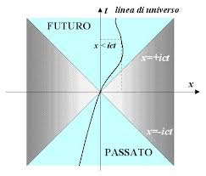
Coni di luce

Slide 8
Cono di luce passato: io, Sirio e il treno
Il mio (hic et nunc) cono di luce passato contiene tutti gli eventi che in linea di principio potrebbero avermi influenzato o mi hanno influenzato considerando che la velocità della luce è insuperabile
Inizio a cantare "valzer per un amore" al lume di una candela mentre vedo la stella Sirio e sento il fischio di un treno
La partenza da Sirio dei fotoni che hanno raggiunto il mio occhio è nel limite estremo del mio cono di luce passato
Dentro questo cono di luce c'è l'emissione del fischio del treno (emissione che possiamo considerare successiva alla partenza dei fotoni, se il treno è sufficientemente vicino a me)

Slide 9
Cono di luce futuro: io e Anna
Il mio cono di luce futuro contiene tutti gli eventi che in linea di principio potrei influenzare, o influenzo, considerando che la velocità della luce è insuperabile.
i fotoni emessi dalla candela raggiungono Anna mentre apre una bottiglia di martini: Anna che apre la bottiglia è nel limite estremo del mio cono di luce futuro (potrei stare con lei mentre compie quell'azione se mi mettessi in viaggio alla velocità della luce)
il mio canto raggiunge Anna mentre beve il martini (dopo aver aperto la bottiglia). Anna che beve è all'interno del mio cono di luce futuro (potrei stare con lei mentre compie quell'azione se mi mettessi in viaggio alla velocità del suono)

Slide 10
Relatività e teoria B
Se due eventi sono nei miei coni di luce, il loro ordine temporale è lo stesso per qualsiasi osservatore.
Quindi , per chiunque:
partenza fotoni da Sirio che mi raggiungono mentre inizio a cantare > emissione del fischio del treno che mi raggiunge mentre inizio a cantare > io che inizio a cantare a lume di candela > Anna che apre il martini > Anna che beve il martini
Questo piace molto ai teorici B. Ma ...

Slide 11
La spedizione da Andromeda
Se un evento è all'esterno dei miei "coni di luce", la collocazione temporale che gli assegno è diversa da quella che gli assegnano altri osservatori
Supponiamo che io e Anna camminiamo l'uno verso l'altra e ci incrociamo (abbiamo velocità relative differenti)
Nella galassia di Andromeda (km 20 000 000 000 000 000 000 dalla Terra), parte una spedizione verso la Terra.

Slide 12
La spedizione da Andromeda (ii)
Per me la spedizione è già partita
partenza da Andromeda < incontro tra me e Anna
Per Anna deve ancora partire
incontro tra me e Anna < partenza da Andromeda
Ma per la teoria B, la realtà oggettiva del tempo consiste nell'ordinamento degli eventi in base a prima/dopo e Einstein non consente questo in senso assoluto
Einstein sembra favorire la tesi (idealista) dell'irrealtà del tempo

Slide 13
Rovelli
Rovelli (L'ordine del tempo, 2017, p. 96, criticando il B-eternismo): "il fatto che non possiamo ordinare l'universo come un'unica successione ordinata di tempi non significa che nulla cambia. Significa che i cambiamenti non sono ordinati lungo un'unica successione ordinata: la struttura temporale del mondo è più complessa di una semplice successione lineare di istanti. Non per questo non esiste o è un'illusione"

Slide 14
4-dimensionalism and the B-theory

Slide 15

Approaches to persistence
3-dimensionalism
  cum endurantism (cum genuine identity) (Strawson, Wiggins, Lowe)
  cum sequentialism (conventionalism) (Chisholm in "identity through time")
4-dimensionalism
  cum perdurantism (cum "genidentity") (objects as mereological sums of stages) (Quine, Lewis)
  cum sequentialism (conventionalism) (Chisholm in "Problems of identity"; Sider's stage view; Katherine Hawley (sep entry on temporal parts)
I am using "sequentialism" as in Varzi, Parole, Oggetti, Eventi (2001, pp. 126-131)
(Quasi-)Nihilism: there are no composite objects (except persons and pehaps other living beings (Van Inwagen, Material beings; Merricks, Objects and persons)
Notes:
Lewis in On the plurality of words
Quine in From a logical point of view, "id., ost, hyp" (Varzi anthology) and W&O?
for the origin of "genidentity" see Orilia 2002, p. 202, n. 4
for the origin of "genidentity" see Orilia 2002, p. 202, n. 4
Lewis in On the plurality of worlds

Slide 16
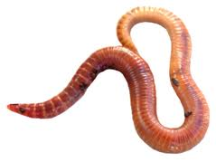
The Block theory
The B theory is often thus called
But in A-eternalism as well there is a "big block" containing all events and thus various "temporal worms"
What is there in the big block?

Slide 17

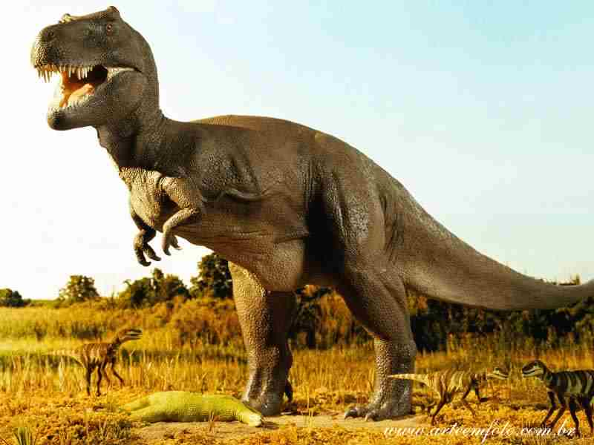
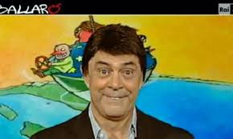
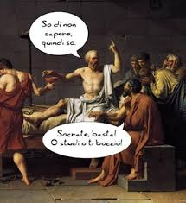


Slide 19
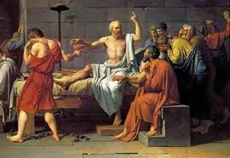
But also Socrates who drinks hemlock, and ...

Slide 20
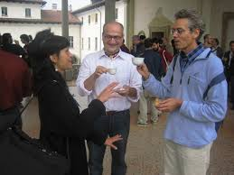
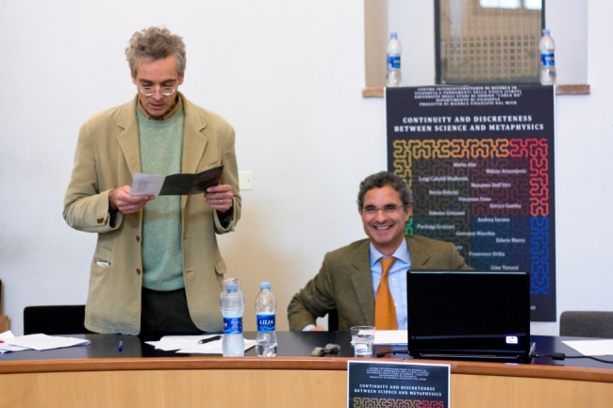
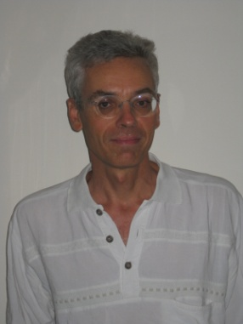
How many I are there?

Slide 21
Are we temporal worms?
Is each of us a temporal worm with both spatial and temporal parts?

Slide 22
Eternalism without 4-dimensionalism?
Mellor (1998, p. XII, and ch. 8) says yes
I think however that Merricks (1995) is right when he argues that the answer must be NO (some eternalists have argued that this is an advantage; see Loux, 2006, ch. 6)
But see "multilocationism" in Costa (JP, 2017): 3-D objects having multiple time locations. In this way the eternalist may be perhaps be said to buy endurantism.

Slide 23
From Costa 2017
Figure 2. Multilocationism and unilocationism. A three-dimensional entity occupies a four-dimensional region by being multilocated through it, while a four-dimensional entity occupies it by being exactly located at it.

Slide 24
No open future

Slide 25
Fixed past and open future
Intuitively, the past is fixed, we cannot change it
In contrast, the future is open, and we contribute to bringing it about
Yet, eternalism seems to lead to logical fatalism, which seems incompatible with the open future

Slide 26
"prefixed" propositions
neutrally dated proposition: Garibaldi says "obbedisco" at 8:30 a.m. 26/10/1860.
In brief: @(m, G)
G is the "internal" (undated) proposition
m is the date

Slide 27
prefixed propositions
A prefixed proposition is a true proposition of the type
  @(t, P),
such that there is a time t' < t, such that
@(t', @(t, P))
is also true.
We may say that @(t, P) is future-dated if t is a future time

Slide 28
Open future vs logical fatalism
We can then define the thesis of the open future as the claim that, for at least some future-dated proposition @(t, P), where P is atomic and undated, neither @(t, P), nor its internal negation @(t, ∼P), is prefixed.
Logical fatalism (as I define it) is the denial of the thesis of the open future

Slide 29
Eternalism => logical fatalism
Consider a dated proposition @(t, P), with P atomic, i.e. a proposition of the sort that can be made true by an appropriate event, such as the proposition that on August 21, 2020 at noon John is kissing Mary.
Given eternalism, all past and future events are real just as much as the present ones.
Hence, even if t is not the present moment, there are nevertheless all the events of time t. Among them, either there is, or there isn’t, an event p that works as truthmaker of @(t, P), which leads to fatalism
Let's consider both options

Slide 30
John kisses Mary at t
This event p is part of reality tout court and it is thus real from the point of view of t just as much as it is real from the point of view of any previous moment t’.
Hence, p can be considered not only a truthmaker for @(t, P), but also a truthmaker for @(t’, @(t, P)).
t': John and Mary have never met
t: John kisses mary
t': at t John kisses Mary

Slide 31
John does not kiss Mary at t
the events of t constitute a totality which, by lacking a truthmaker for @(t, P), functions as truthmaker for @(t, ∼P).
this totality is real from the point of view of t just as much as it is real from the point of view of t’, and thus is also a truthmaker for @(t’, @(t, ∼P)).
See Orilia 2016 for details
t': John and Mary have never met
t: many events but no John-kisses-Mary event among them
t': at t John does NOT kiss Mary

Slide 32
Eternalism and libertarian free will
Compatibilism: I am free (inasmuch as my volitions cause my actions) even though I could not have done (willed) otherwise
Libertarianism: I am free only if I could have done (willed) otherwise
There is a sense of necessity that has to do with prefixation: if a dated proposition @(t, P) is prefixed, true at a date t'<t, then it is necessary at t'. It is impossible at t' that P fails to be true at t.
If so, eternalism is incompatible with libertarian free will
Let us see this with an example ...

Slide 33
the Garibaldi example
Given eternalism, @(m, G) is true at a time m' < m:
@(m', @(m, G)).
Then, @(m, G) is prefixed
Hence, @(m, ∼G) could not have been true at m'.
Hence, it could not have been the case that Garibaldi did not say "obbedisco" at time m.
Hence, Garibaldi could not have done (willed) otherwise, when he decided to say "obbedisco"

