Slide 1
Inglese
Lezioni 28-30

Slide 2
Lezione 28
15/1/22

Slide 3
Presentazioni degli studenti
  Saulo Galvao Martins, Pietro Megni, Paolo Fermani, su Lewis, «survival and identity»
  presentazione di Luca Casmiri, Ch. 5 Russell PoP
  Seguono le slides su Lewis utilizzate da Saulo Galvao Martins, Pietro Megni, Paolo Fermani ….

Slide 4
Survival and Identity
By David Lewis

Slide 5
What matters in survival: mental continuity vs identity.
“What is it that matters in survival? I answer, along with many others: what matters in survival is mental continuity and connectedness. When I consider various cases in between commonplace survival and commonplace death, I find that what I mostly want in wanting survival is that my mental life should flow on. My present experiences, thoughts, beliefs, desires, and traits of character should have appropriate future successors. My total present mental state should be but one momentary stage in a continuing succession of mental states.”
“The problem begins with a well-deserved complaint that all this about mental connectedness and continuity is too clever by half. I have forgotten to say what should have been said first of all. What matters in survival is survival. If I wonder whether I will survive, what I mostly care about is quite simple. When it’s all over, will I myself - the very same person now thinking these thoughts and writing these words - still exist? Will any one of those who do exists afterward be me? In other words, what matters in survival is identity - identity between the I who exists now and the surviving I who will, I hope, still exists then.”

Slide 6
Parfit’s argument.
“Derek Parfit has argued that the two answers cannot both be right, and we must therefore choose (he chooses the first). His argument is as follows:
(a) Identity is a relation with a certain formal character. It is one-one and it does not admit of degree.
(b) A relation of mental continuity and connectedness need not have that formal character. We can imagine problem cases in which any such relation is one-many or many-one, or in which it is present to a degree so slight that survival is questionable.
Therefore, since Parfit believes as I do that what matters in survival is some sort of mental continuity or connectedness,
(c) What matters in survival is not identity. At most, what matters is a relation that coincides with identity to the extent that the problem cases do not actually arise.”
“Parfit thinks that if the problem cases did arise, or if we wished to solve them hypothetically, questions of personal identity would have no compelling answers. They would have to be answered arbitrarily, and in view of the discrepancy stated in (a) and (b), there is no answer that could make personal identity coincide perfectly with the relation of mental continuity[…].”

Slide 7
Lewis’s reply to Parfit.
“My task is to […]show that the opposition between what matters, and identity is false. We can agree with Parfit (and I think we should) that what matters in questions of personal identity is mental continuity or connectedness, and that this might be one-many or many-one and admits of degree. At the same time, we can consistently agree with common sense (and I think we should) that what matters in questions of personal identity - even in the problem cases - is identity.”
“I do not attack premises (a) and (b). We could, of course, say “identity” and just mean mental continuity and connectedness. Then we would deny that “identity” must have the formal character stated in (a). But this verbal maneuver would not meet the needs of those who think, as I do, that what matters in survival is literally identity: that relation that everything bears to itself and to no other thing. As for (b), the problem cases clearly are possible under Parfit’s conception of the sort of mental continuity or connectedness that matters in survival […].”
“But what does that show? Only that the two relations are different. And we should have known that from the start, since they have different relata. He who says that what matters in survival is a relation of mental continuity and connectedness is speaking of a relation among more or less momentary person-stages […]. He who says that what matters in survival is identity, on the other hand, must be speaking of identity among temporally extended continuant persons with stages at various times […]. Identity among stages has nothing to do with it, since stages are momentary. Even if you survive, your present stage is not identical to any future stage.”

Slide 8
The R-relation…
“[…]we have some definite relation of mental continuity and connectedness among person-stages in mind as the relation that matters in survival. Call it the R-relation, for short. If you wonder whether you will survive the coming battle or what-not, you are wondering whether any of the stages that will exist afterward is R-related to you-now, the stage that is doing the wondering.”
“Or so say I. Common sense says something that sounds different: in wondering whether you will survive the battle, you wonder whether you—a continuant person consisting of your present stage along with many other stages—will continue beyond the battle. Will you be identical with anyone alive then?”.

Slide 9
…and The I-relation
“Of course, the R-relation among stages is not the same as identity either among stages or among continuants. But identity among continuant persons induces a relation among stages: the relation that holds between the several stages of a single continuant person. Call this the l-relation. In wondering whether you will survive the battle, we said, you wonder whether the continuant person that includes your present stage is identical with any of the continuant persons that continue beyond the battle.”
“[…]if common sense is right that what matters in survival is identity among continuant persons, then you have what matters in survival if and only if your present stage is I-related to future stages.”
“If ever a stage is R-related to some future stage but I-related to none, or if ever a stage is I-related to some future stage but R-related to none, then the platitude that what matters is the I-relation will disagree with the interesting thesis that what matters is the R-relation. But no such thing can happen, I claim; so there can be no such disagreement. In fact, I claim that any stage is l-related and R-related to exactly the same stages. And I claim this not only for the cases that arise in real life, but for all possible problem cases as well. […] Then I claim that the I-relation is the R-relation.”

Slide 10
The definition of personhood.
“A continuant person is an aggregate of person-stages, each one I-related to all the rest (and to itself). For short: a person is an I-interrelated aggregate. Moreover, a person is not part of any larger I-interrelated aggregate; for if we left out any stages that were I-related to one another and to all the stages we included, then what we would have would not be a whole continuant person but only part of one. For short: a person is a maximal I-interrelated aggregate.”
“[…] if the I-relation is the R-relation, we have something more interesting: a noncircular definition of personhood. I claim that something is a continuant person if and only if it is a maximal R-interrelated aggregate of person-stages.”

Slide 11
I-relation and Identity.
“Now although the admitted discrepancy between identity and the R-relation is harmless in itself, and although the I-relation is not identity, still it may seem that the I-relation inherits enough of the formal character of identity to lead to trouble. For suppose that S₁, S₂... .are person-stages; and suppose that C₁ is the continuant person of whom S₁ is a stage, C₂ is the continuant person of whom S₂ is a stage, and so on. Then any two of these stages S_{i} and Sj are I-related if and only if the corresponding continuant persons C_{i} and Cj are identical. The I-relations among the stages mirror the structure of the identity relations among the continuants.”
“I reply that the foregoing argument wrongly takes it for granted that every person-stage is a stage of one and only one continuant person. That is so ordinarily […]. In the problem cases, however, it may happen that single stage S is a stage of two or more different continuant persons.”
“It would be wrong to read my definition of the I-relation as saying that person-stages S₁ and S₂ are I-related if and only if the continuant person of whom S₁ is a stage and the continuant person of whom S₂ is a stage are identical.”
“We should substitute the indefinite article: S₁ and S₂ are I-related if and only if a continuant person of whom S₁ is a stage and a continuant person of whom S₂ is a stage are identical.”

Slide 12
The R-relation and The I-relation: in sintesi.
La R-relazione è una relazione tra due stadi personali (stadi-persona) S₁ e S₂, che corrisponde alla relazione di continuità e connessione tra stati mentali.
La I-relazione è una relazione tra stadi personali che appartengono ad una stessa persona. Più precisamente: “S₁ and S₂ are I-related if and only if a continuant person of whom S₁ is a stage and a continuant person of whom S₂ is a stage are identical.”
In base alle definizioni della I-relazione e della R-relazione si arriva alla definizione di persona come aggregato massimale di stadi personali R-interrelati e I-interrelati.
Si può dimostrare che sia la R-relazione che la I-relazione sono riflessive e simmetriche.
Problema: la I-relazione è anche transitiva?

Slide 13
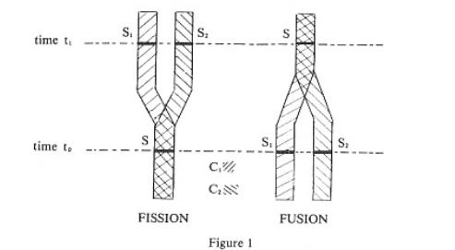
Problem case n.1 : Fission and Fusion.
“Identity is one-one, in the sense that nothing is ever identical to two different things. Obviously neither the I-relation nor the R-relation is one-one in that sense. You-now are a stage of the same continuant as many other stages and are R-related to them all. Many other stages are stages of the same continuant as you-now and are R-related to you-now. But when Parfit says that the R-relation might be one-many or many-one, he does not just mean that. Rather, he means that one stage might be R-related to many stages that are not R-related to one another, and that many stages that are not R-related to one another might all be R-related to one single stage. […]In short, the R-relation might fail to be transitive.”

Slide 14
The I-relation is not transitive: the overlap problem.
“Identity must be transitive, but the I-relation is not identity. The l-relation will fail to be transitive if and only if there is partial overlap among continuant persons. More precisely: if and only if two continuant persons C₁ and C₂ have at least one common stage, but each one also has stages that are not included in the other. If S is a stage of both, S₁ is a stage of C₁ but not C₂, and S₂ is a stage of C₂ but not C₁, then transitivity of the I-relation fails.”
“In order to argue that the I-relation, unlike the R-relation, must be transitive […] The further premise is needed that partial overlap of continuant persons is impossible.”
“The trouble with overlap is that it leads to overpopulation. To count the population at a given time, we can count the continuant persons who have stages at that time; or we can count the stages. If there is overlap, there will be more continuants than stages”

Slide 15
Tensed identity.
“The way out is to deny that we must invariably count two non-identical continuants as two. We might count not by identity but by a weaker relation. Let us say that continuants C₁ and C₂ are identical-at-time-t if and only if they both exist at t and their stages at t are identical. I shall speak of such relations of identity-at-a-time as relations of tensed identity.”
“If we count continuants by tensed identity rather than by identity, we will get the right answer—the answer that agrees with the answer we get by counting stages—even if there is overlap. How many persons entered the duplication center yesterday? We may reply: C₁ entered and C₂ entered, and no one else; although C₁ and C₂ are not identical today, and are not identical simpliciter, they are identical yesterday. So, counting by identity-yesterday, there only one. Counting by identity-today, there were two; but it is inappropriate to count by identity-today when we are talking solely about the events of yesterday. Counting by identity simpliciter there were two; but in talking about the events of yesterday it is as unnatural to count by identity as it is to count by identity today. There is a way of counting on which there are two all along; but there is another way on which there are first one and then two. The latter has obvious practical advantages.”

Slide 16
Problem case n.2: Longevity and the intransitivities of R- relation and I-relation.
“I turn now to a different problem case. Parfit has noted that mental connectedness will fade away eventually. If the R-relation is a matter of direct connectedness as well as continuity, then intransitivities of the R-relation will appear in the case of a person (if it is a person!) who lives too long.”
“Suppose, for simplicity, that any two stages of Methuselah that are separated by no more than 137 years are R-related; and any two of his stages that are separated by more than 137 years are not R-related. […] If the R-relation and the I-relation are the same, this means that two of Methuselah’s stages belong to a single continuant person if and only if they are no more than 137 years apart. (Therefore, the whole of Methuselah is not a single person.). […] whence it follows that all and only the segments that are exactly 137 years long are maximal R-interrelated aggregates; so all and only the 137-year segments are continuant persons.”
“Let S1 be a stage of Methuselah at the age of 400; let S2 be a stage of Methuselah at the age of 500; let S3 be a stage of Methuselah at the age of 600. By hypothesis S1 is R-related to S2 and S2 is R-related to S3, but S1 and S3 are not R-related […] Since S1 and S2 are linked by a 137-year segment (in fact, by infinitely many) they are I-related; likewise, S2 and S3 are I-related. But S1 and S3 are not linked by any 137-year segment, so they are not I-related. The R-relation and the I-relation are alike intransitive.”

Slide 17
Longevity: the overpopulation problem and how tensed identity saves the day (again).
“Methuselah spends his 300th birthday alone in his room. How many persons are in that room? There are infinitely many different 137-year segments that include all of Methuselah’s stages on his 300th birthday. One begins at the end of Methuselah’s 163rd birthday and ends at the end of his 300th birthday; another begins at the beginning of his 300th and ends at the beginning of his 437th. Between these two are a continuum of other 137-year segments. No two of them are identical. […] Every one of them is a continuant person […].”
“Tensed identity to the rescue once more. True, there are continuum many nonidentical continuant persons in the room. But, counting by the appropriate relation of tensed identity, there is only one. All the continuum many non-identical continuant persons are identical-at-the-time-in-question, since they all share the single stage at that time. Granted that we may count by tensed identity, there is no overcrowding.”

Slide 18
Problem case n.3 : Degrees of personal identity (1)
“We turn now to the question of degree. Identity certainly cannot be a matter of degree. But the I-relation is not defined in terms of identity alone. It derives also from personhood: the property of being a continuant person. Thus, personal identity may be a matter of degree because personhood is a matter of degree, even though identity is not.”
“Parfit suggests, for instance, that if you fuse with someone very different, yielding a fusion product mentally halfway between you and your partner, then it is questionable whether you have survived. Not that there is a definite, unknown answer. Rather, what matters in survival - the R-relation - is present in reduced degree. There is less of it than in clear cases of survival, more than in clear cases of non-survival. If we want the I-relation and the R-relation to coincide, we may take it that C₁ and C₂ (see fig. 1.1 for cases of fusion) are persons to reduced degree because they are broken by abrupt mental discontinuities.”.
Il problema ora diventa come definire il grado di identità personale in modo tale che concordi con il grado di R-interrelazione e di I-interrelazione degli aggregati di stadi personali.

Slide 19
Problem case n.3 : Degrees of personal identity (2)
Un primo modo potrebbe essere il seguente:
“[…]the degree of R-interrelatedness of an aggregate is the minimum degree of R-relatedness between any two stages in the aggregate. (Better: the greatest lower bound on the degrees of R-relatedness between any two stages.)”
Questo tuttavia sembra generare la conseguenza indesiderata, come nel caso di Matusalemme, che negli aggregati nei quali è presente un alto grado di R-interrelazione fra gli stadi personali è presente allo stesso tempo un basso grado di massimalità e quindi di identità personale (essendo le persone definite come aggregati massimali di stadi personali).
“Take the case of Methuselah. Assuming that R-relatedness fades out gradually, every segment that passes the R-interrelatedness test to a significant degree also flunks the maximality test to almost the same degree (if the fadeout is continuous, delete “almost”). So, no segment of Methuselah passes both tests for personhood to any significant degree. No two stages, no matter how close, are stages of some one continuant that is a person to high degree. Rather, nearby stages are strongly I-related by being common to many continuants, each one of which is strongly R-interrelated, is almost as strongly non-maximal, and therefore is a person only to a low degree.”

Slide 20
Problem case n.3 : Degrees of personal identity (3)
Un modo migliore secondo Lewis consisterebbe nello stabilire un confine arbitrario, che lui chiama delineation, in un dato insieme di valori e valutare il grado di R-relazione (e quindi di I-relazione) in base a tale confine.
“Every delineation yields a decision as to which stages are R-related. It thereby yields a decision as to which continuants are R-interrelated; a decision as to which continuants are included in larger R-interrelated aggregates; a decision as to which continuants are persons, given that persons are maximal R-interrelated aggregates; and thence a decision as to which stages are I-related. We can say that a certain continuant is a person, or that a certain pair of stages are I-related, relative to a given delineation.”
E secondo Lewis
“On this proposal the I-relation admits of degree; and further, we get perfect agreement between degrees of I-relatedness and degrees of R-relatedness, regardless of the degrees of personhood of continuants.”
Dato che, se due stadi sono R-relati secondo un grado espresso da una delineation, allora apparterranno anche ad un aggregato R-interrelato e massimale di stadi quindi ad una persona e, per tanto, saranno anche I-relati secondo lo stesso grado espresso da quella delineation.

Slide 21
16/12/22

Slide 22
presentazioni degli studenti
  Maria Cappello, Camilla Gallo e Diego Bongiovanni, cap 27 di "An Outline of Philosophy" di Russell
  Nicola Mancini, Federico Pirani e Federico Cardoni, capitolo 15, The value of philosophy, da Russell, The Problems of Philosophy

Slide 23
Da Russell, An Outline of Philosophy (1927)
Ch. 16, self-observation

Slide 24
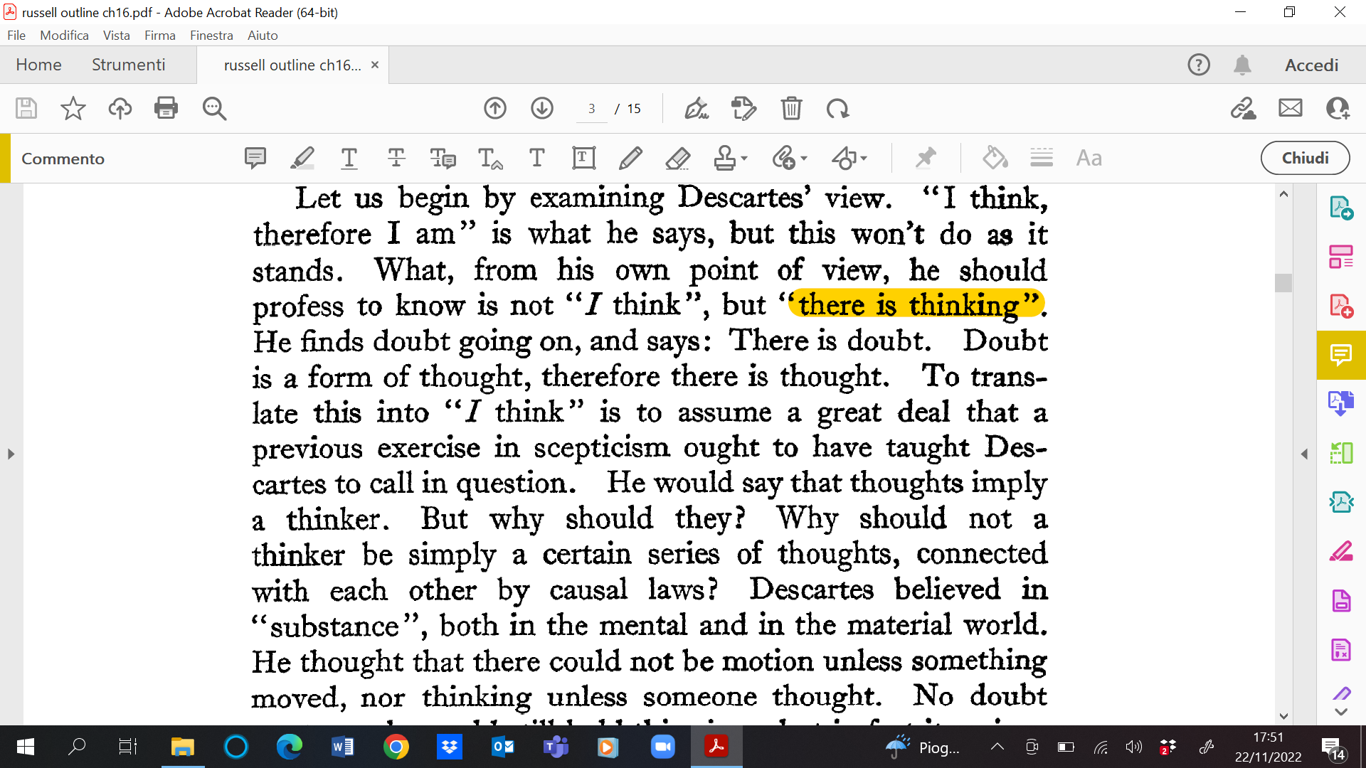

Slide 25
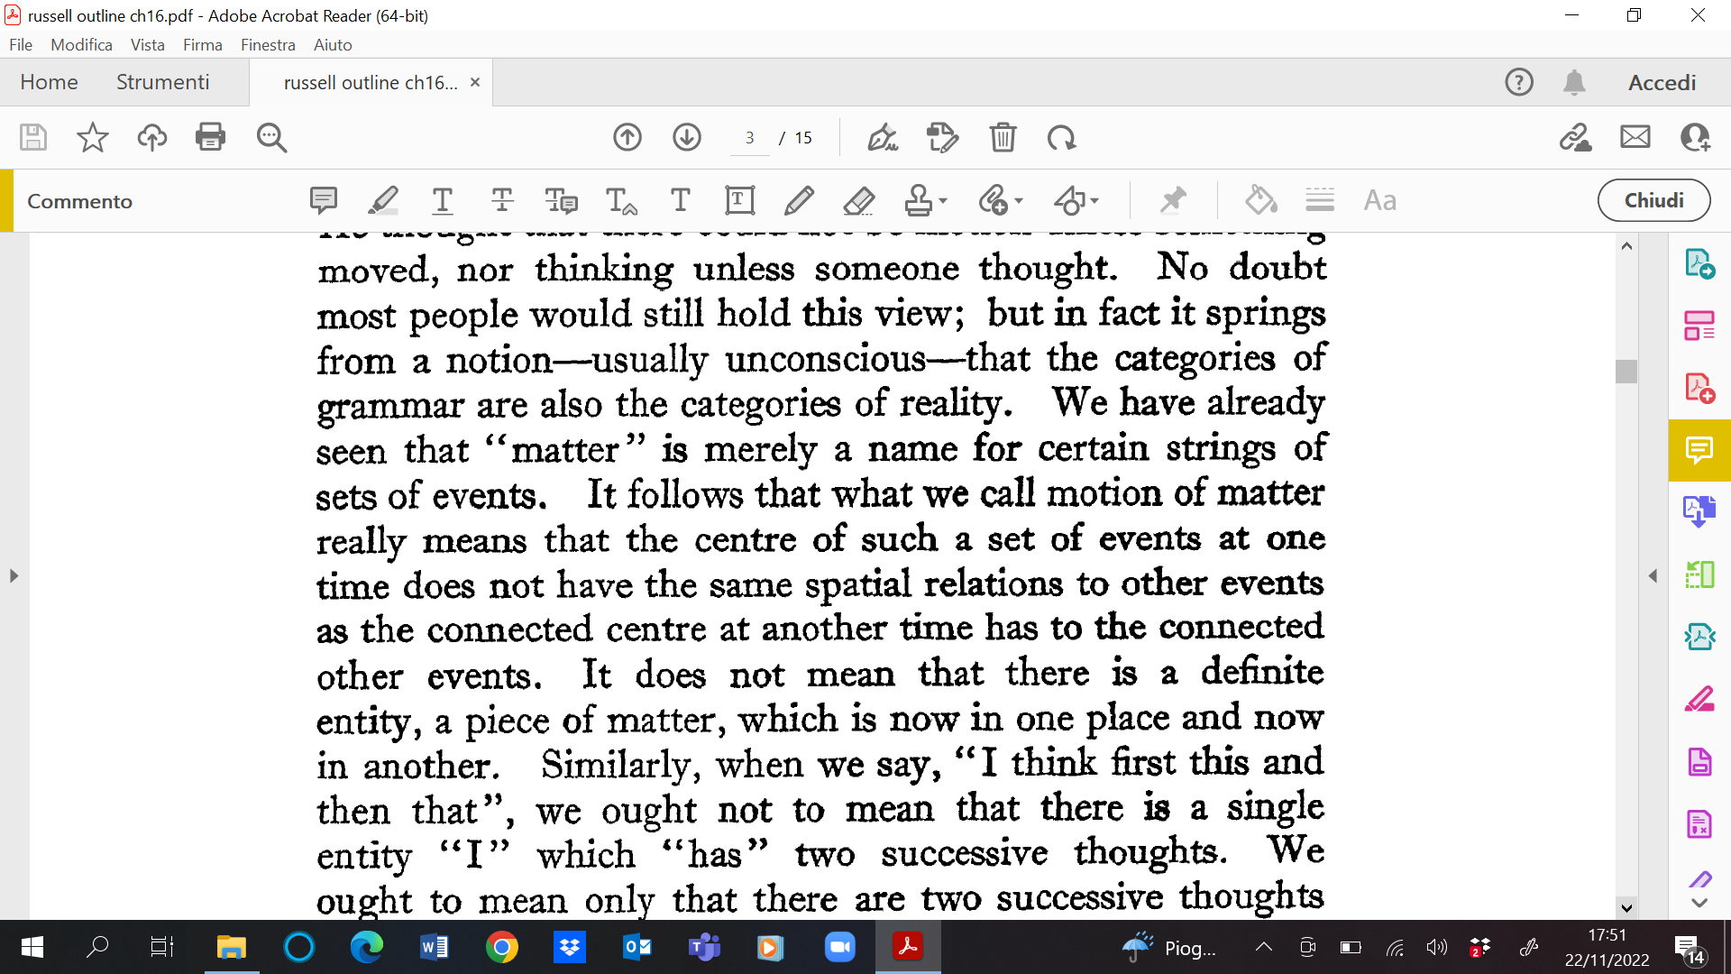

Slide 26
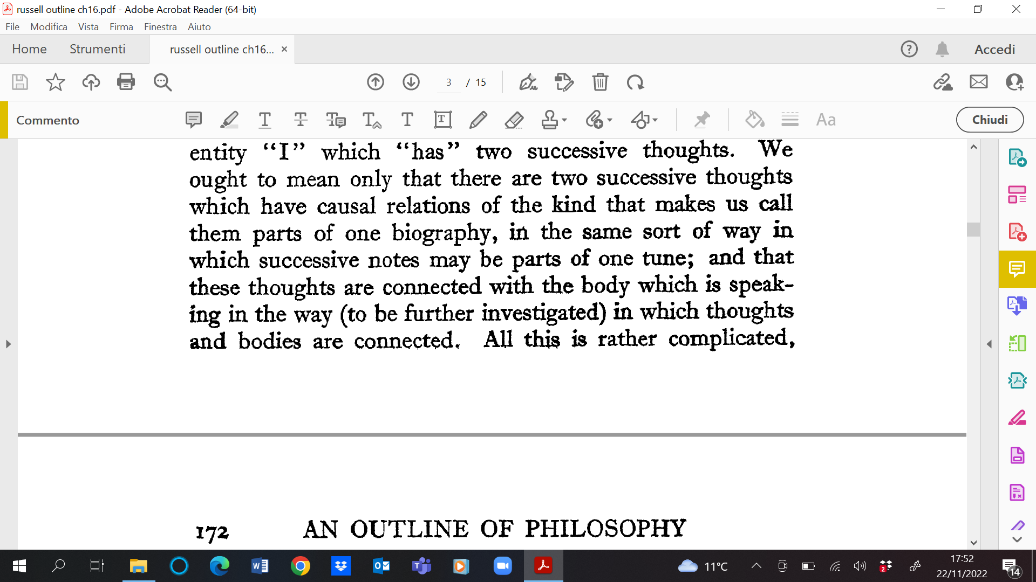

Slide 27
