Slide 1
Inglese 23-24
lezioni 17-20

Slide 2
lezioni 17-18
21/2/24

Slide 3
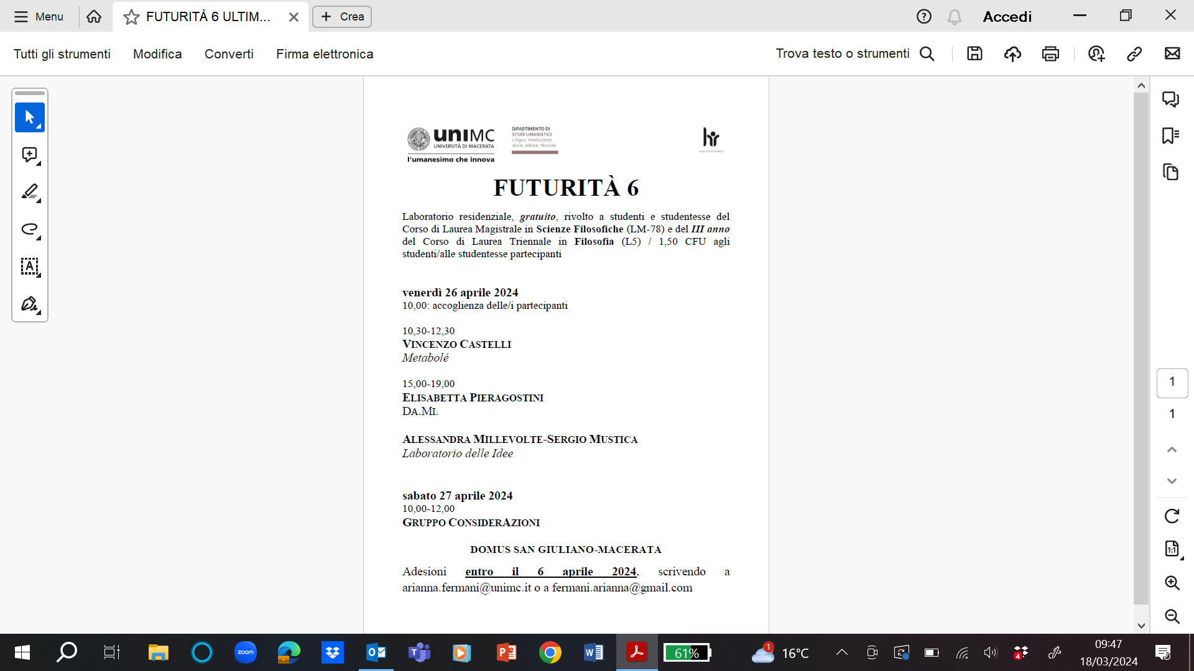

Slide 4
Cap. 5 Laws of nature
Saltiamo una lunga parte dove vengono forniti complessi dettagli sulla teoria delle leggi di natura come relazioni tra universali.
Passiamo alla parte finale del cap. sulla causalità (p. 44):
Causation.We have introduced a new theme in this discussion:
causation. …
LEGGIAMO DAL LIBRO

Slide 5
Letto fino a p. 46:
(And we don’t have
to think, as Hume seems to assume, that this would have to
be a necessary connection. It could be contingent.)

Slide 6
Lezioni 19-20
22/3/24

Slide 7
riprendiamo da p. 46
Incidentally, Hume also denies that we experience causality
in connection with willing our actions (in many places in his
Treatise and Enquiries). I think he may be wrong here also.
There seems to be direct introspective awareness of causes
here, once again. We can be aware, with the usual caution
that we might be mistaken, that we have successfully acted in
a certain situation, that what we did sprang from our will as
cause. (I’ll try to cast some further light on this in the last
chapter – about the mind.)

Slide 8
I have already suggested that the ‘fundamental tie’ might
be construed as an objective necessity that universals must
always be instantiated somewhere, and particulars must have
properties. They need states of affairs to live in. It would
be nice to have a further addition. Universals must be subject
to laws, so must link up with universals in nomic
(law-like) fashion in the way we have just discussed. But,
at the same time, what particular laws the world obeys
would be contingent.

Slide 9
The attraction of introducing this necessity into the world is that it would outlaw epiphenomenal
universals – universals that exist, are instantiated, but have
no nomic links to other universals, and so, according to my
theory of laws of nature, no power in the world. How would
we know of their existence?

Slide 10
Chapter 6
Reacting to Dispositionalism
Lo saltiamo
contiene una critica al dispositionalism e una difesa del categoricalism

Slide 11
Chapter 7
Particulars
Leggiamo dal libro fino a:
There are of course cases
where the change is so great that we will not be prepared
to speak of sameness of particular even in this ‘loose and
popular’ sense. If a drinking glass shatters into a myriad of
small pieces, there is no drinking glass left. Ideally, conditions
for ‘loose and popular’ identity would need to be spelt out.
But that is a rather detailed investigation that will not be
pursued further here.

