Slide 1





Transnational civil litigation and International commercial arbitration
Arbitral Process – Provisional and Protective Measures in International Arbitration
Prof. Marco Farina
Università di Macerata
International European Comparative Legal Studies
7th NOVEMBER 2023

Slide 2



ARBITRAL PROCESS
Party Autonomy
Parties are free to agree on the rules of procedure that must be applied by the arbitrators (art. 19 UNCITRAL Model Law – Art. 816-bis c.p.c.)
Parties may exercise their freedom to select the rules of procedure
  usually, in international arbitration, by referring in their arbitration agreement to the rules of arbitration of an arbitral institution, or
  by drafting themselves in their arbitration agreement (or in another written agreement concluded before the commencement of the arbitral process) the rules of procedure, or
  giving the arbitrators the power to use their discretion in determining the rules of procedure
In determining the rules of procedure applicable to the arbitral process parties and arbitrators must respect some mandatory procedural requirements
Each party must be given the right to be heard and to present his/her case (due process)
Procedural fairness and equal treatment (art. 18 UNCITRAL Model Law)

Slide 3
ARBITRAL PROCESS
Party Autonomy
Rules of procedure agreed upon by the parties or determined by the arbitrators may refer to
  the number, timing, sequence and format of the written submissions
  the scope and modalities of the production of documents and the filing by the parties of witness and expert evidence
  the organization and timing of the evidentiary hearings
Adversarial principle and equal treatment of parties imply, in essence
  balancing the parties’ right of defence with the efficient management of the proceedings, in the context of a transparent and foreseeable procedure
  granting each party an equivalent procedural status in respect of, inter alia, filing submissions, offering evidence and being present when evidence is gathered commenting on the counterparty’s submissions and requests for admission of evidence commenting on any legal, factual or technical issue that the tribunal wishes to raise ex officio or that it believes relevant for its decision

Slide 4
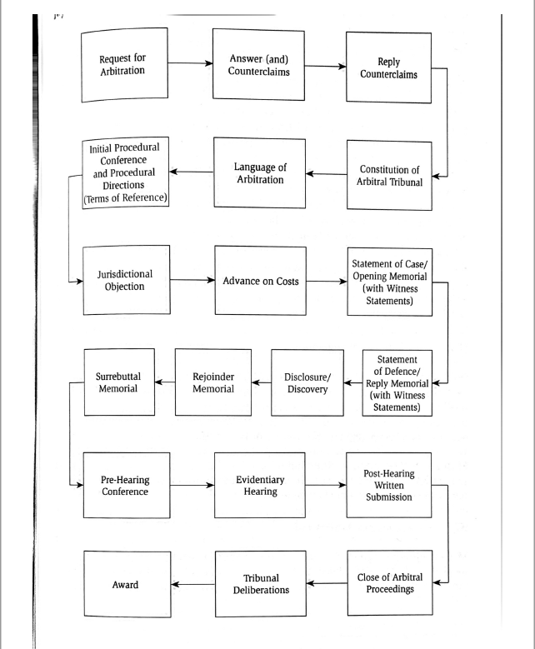
MAJOR PROCEDURAL STEPS IN INTERNATIONAL ARBITRATION

Slide 5
REQUEST FOR ARBITRATION
Even though the procedural rules set out by arbitral institution vary in much relevant aspects, an “average” arbitral proceedings governed by institutional rules of arbitration may be normally commenced by:
  issuing a request for arbitration containing, inter alia
    details of each of the parties
    a description of the nature and circumstances of the parties’ dispute and of the legal basis upon which the claims are made
    a statement of the relief sought
    indication of the arbitration agreement
    applicant’s position as regards the place and the language of the arbitration and the composition of the Arbitral Tribunal
    nomination of an arbitrator if it is so required by the arbitration agreement or by the rules

Slide 6
ANSWER TO REQUEST FOR ARBITRATION
Even though the procedural rules set out by arbitral institution vary in much relevant aspects, an “average” arbitral proceedings governed by institutional rules of arbitration may provide that the respondent shall reply to the request of arbitration by:
  filing an answer to the request for arbitration containing, inter alia
    name and all other relevant details of the respondent
    comments as to the nature and circumstances of the dispute giving rise to the claims and the basis upon which the claims are made
    Response to the relief sought
    observation as regards the place and the language of the arbitration and the composition of the Arbitral Tribunal
    nomination of an arbitrator if it is so required by the arbitration agreement or by the rules
    Any counterclaim, together with the indication as to the nature and circumstances of the dispute giving rise to the counterclaim and the basis upon which the counterclaim is made

Slide 7
PROCEDURAL ORDER
Once the arbitral tribunal was constituted, it is customary for arbitration rules set out by the major arbitral institutions to provide for the issuance of a procedural order by the arbitral tribunal, which usually contains indication as to
      the number of exchanges of written submissions between the parties
      the time limits for those exchanges
      the way in which documentary evidence should be filed
      the way in which witness (including expert witness) evidence should be presented
      the need for organizing a hearing
      To any other measures that may be adopted in respect of disputed procedural matters (bifurcation/ consolidation of arbitral proceedings, adding new claims)

Slide 8
PROVISIONAL AND PROTECTIVE MEASURES IN INTERNATIONAL ARBITRATION
Introductory Remarks
A great variety of terms, including ‘interim measures’, ‘conservatory measures’, ‘provisional measures’, ‘protective measures’, are used to describe the issue we will be discussing
  All these terms, however, describes a situation where, prior to the final settlement of the case by the arbitral tribunal, the latter may be asked to render orders which have the aim of protecting and securing the rights of the parties just provisionally, during the time needed for the conclusion of the proceeding
Provisional and protective measures are instruments to protect the rights of the parties while the final decision on the merits is pending
Article 17 (2) Uncitral Model Law offers a general and broad definition of what is meant by provisional or interim measures that may be granted by the arbitral tribunal

Slide 9
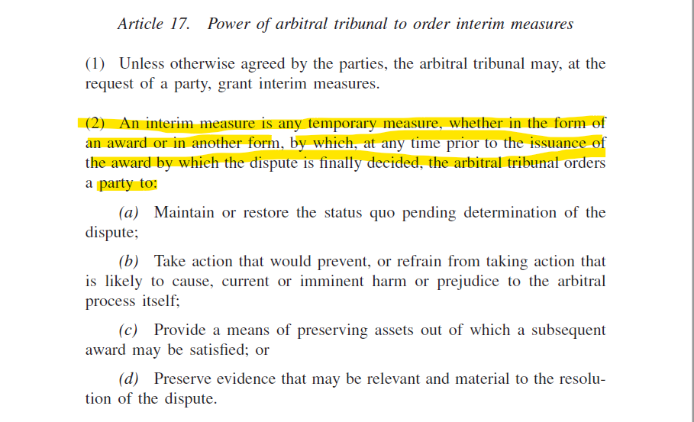
PROVISIONAL AND PROTECTIVE MEASURES
Powers of Arbitrators

Slide 10
PROVISIONAL AND PROTECTIVE MEASURES
Powers of Arbitrators
In principle, it is up to the lex arbitri to determine if, to what extent and under which conditions arbitrators have the power to grant provisional measures
When parties opt for institutional arbitration, the rules set out by the chosen institution may provide for the power of arbitrators to grant provisional measures
If arbitrators do not have the power to grant interim measures in connection with disputes referred to arbitration, national state court will have jurisdiction to hear and decide such applications
If arbitrators are given the power to render provisional measures, does it mean that state courts are prohibited from exercising jurisdiction in relation to an application for interim measures ? Or the either arbitrators and state court may exercise jurisdiction in this matter ?

Slide 11
PROVISIONAL AND PROTECTIVE MEASURES
National laws provisions
Article 17(1) and article 17(J) of Uncitral Model Law
Article 818 of Italian code of civil procedure (c.p.c.)
Article 1449 and article 1468 of French Code of civil procedure (see art. 1506(1) for international arbitration)
Article 183 (1) of Swiss Private International Act and article 374 of Swiss code of civil procedure
Article 1041 of German Code of Civil Procedure (ZPO)
Article 11 and article 23 of the Spanish Arbitration Act 2023 and article 722 of the Spanish Code of Civil Procedure (Ley de enjuiciamiento civil 2000)

Slide 12
PROVISIONAL AND PROTECTIVE MEASURES
Institutional Rules of Arbitration
Article 26 of UNCITRAL Arbitration
Article 26 of Arbitration Rules of Milan Chamber of Arbitration (CAM)
Article 28 of Arbitration Rules of the International Court of Arbitration of the International Chamber of Commerce (ICC)
Article 29 of Swiss Rules of International Arbitration
What happens if the seat of arbitration is in a State whose laws prohibit arbitrators from granting provisional measures and parties selected an arbitral institution whose rules give the arbitrators the powers to grant such measures ?

Slide 13
PROVISIONAL AND PROTECTIVE MEASURES
Emergency Arbitrator
In recent times almost all the arbitral institution have inserted in their arbitration rules specific provisions about emergency arbitrators
Emergency arbitrators may be appointed for granting urgent interim relief before the constitution of an arbitral tribunal
    Article 44 of CAM Arbitration Rules
    Article 29 of ICC Arbitration Rules

Slide 14
PROVISIONAL AND PROTECTIVE MEASURES
Enforcement
Arbitrators lack power to coercively enforce provisional measures absent voluntary compliance by the aggrieved party
To enforce provisional measures rendered by arbitral tribunals against the will of the aggrieved party assistance from State courts is needed
As far as domestic arbitral proceedings is concerned, national laws may in principle provide for two main ways of enforcing provisional measures:
  Allowing parties to obtain direct and immediate enforcement by state authorities, without the need of any intermediate proceedings (article 819-ter of Italian Code of Civile procedure)
  Requiring parties to first obtain an exequatur from the State Courts and solely thereafter proceed to actual enforcement (art. 17H and 17I of UNCITRAL Model Law)

