Slide 1

Educational Tourism – LM49 Degree
Marta Brunelli
Associate Professor in General and Social Education
Deputy Director of “Paolo & Ornella Ricca” Museum of School History
7. School Tourism

Slide 2
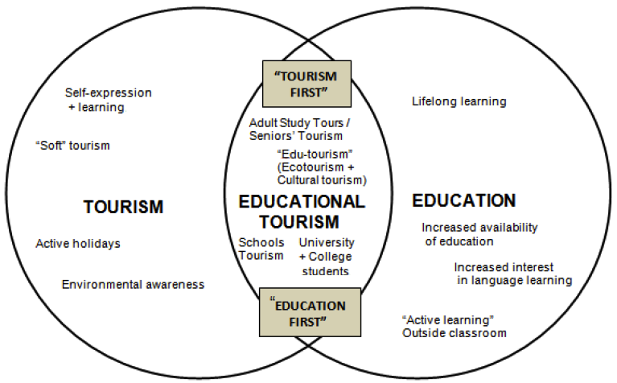
School Tourism: definitions
Ritchie (2003)
- All school/field trips organised by primary and secondary schools for children between 5 and 18 years of age (+ trips organized by language schools
- Sub-type of Educational Tourism
- Education-first motivation
OBSERVATORY ON ITALIAN SCHOOL TOURISM (Italian Touring Club, 2008)
School Tourism is an aid/support tool for student’s learning, which can be carried out by combining study activity with playful and recreational moments, thus alternating moments of curricular training with experiences outside the classroom

Slide 3
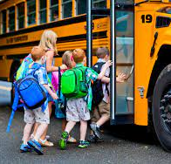

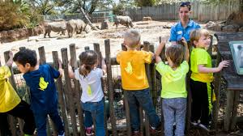
Different nature and purposes of school trips/excursions
Based on their purposes, SCHOOL TRIPS can have different nature:
extra-curricular trips: they are designed without being linked to the curriculum demands
curriculum-based trips = structured around lessons taught in the classroom and strictly linked to the curriculum contents.
CURRICULUM-BASED trips have different impacts, in terms of:
Cognitive outcomes (course-related trips)
= subject-based knowledge and understanding s (within one subject or across many subjects)
= subject-based practical skills
General learning intended as general education and maturation process of the child
= soft skills (e.g. social or inter-personal skills),
= attitudes (self-esteem) and values (cultural understanding)
= enjoyment-inspiration-creativity (fulfilment and satisfaction)

Slide 4
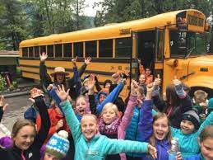
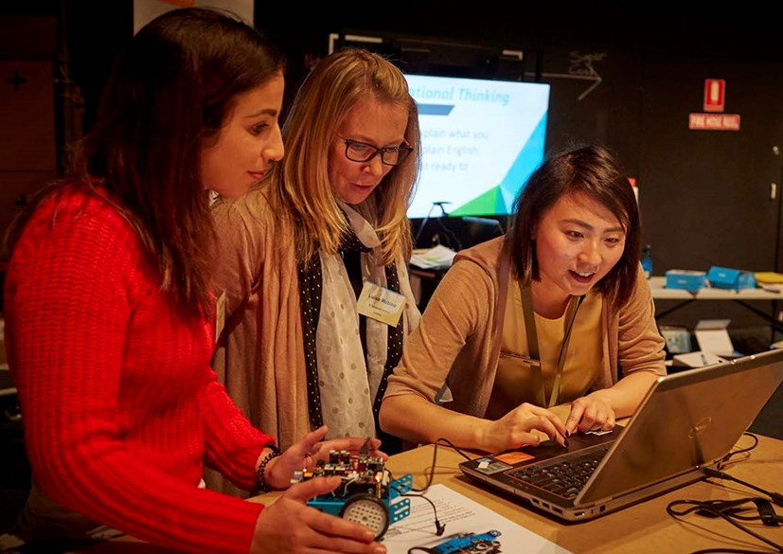
Benefits for schools
Benefits for children:
Experiential learning consolidates and enhances academic learning in the classroom
Children’s perception of the self and self-confidence
New perception of the others and the environment
International field-trip: expand students’ understanding of their home country in a global context
Benefits for teachers:
Insights into how to link classroom teaching to hands-on education
→ heritage-based education – in museums and heritage sites
→ environmental education – natural heritage, parks and natural areas (life sciences = Biochemistry, Microbiology, Botany, Zoology, Ecology)
→ science and technology education – science centres and museums

Slide 5

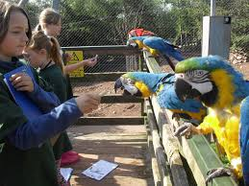
Demands for schools’ tourism
This market experienced an expansion, with a growing demand for residential trips (even from primary schools)
Factors of growth in school tourism:
Parents’ desire to provide their children with the best educational opportunities possible
Student’s desire to escape from boredom school environment
Decline in the numbers of school-age children in the more economically developed countries
  → increasing competition among schools offering appealing exotic and high-quality trips,
Increasing availability of cheaper and easier travel options.

Slide 6
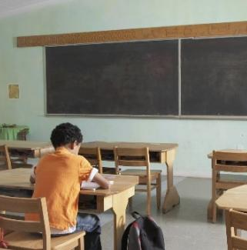

But… critical issues of field-trips
Issues for families:
increased pressure on families who cannot easily afford expensive excursions
some field trips become a signs of status
fear of stigmatisation of excluded children
Issues for students:
research has revealed that students work and save money to pay for field trips
negative impact on schoolwork

Slide 7
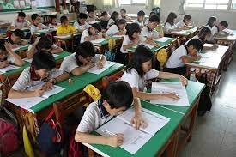
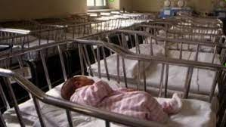
Global expansion vs local differences
Success of school tourism →← socio-demographic changes
Demographic situation
= constant increase in school population at global level BUT:
more marked increase in developing countries and emerging economies (e.g. Africa and Asia)
Rising school population
Increased economic wealth of societies/families
→ HUGE potential for growth
lower increase in developed countries (e.g. Europe) due to the declining birth rates
Sector expected to decline
Negative economic impact

Slide 8


School tourism: major threats
Financial threats
Low funding and increasing economic pressure on education systems
Major focus on core educational services – and minor focus on optional services like field trips
Financial burdens is moved onto parents → more pression on families → social frictions (wealthy – less well-of families)
Planning fails
Difficulty in linking the trip to curriculum requirements
Learning outcomes expected by educational authorities
questioning on the effectiveness of school trips
Teachers’ responsibility for the safety of children
All these threats led to:
. Turn the school-trip into a facultative experience (no longer compulsory),
. Decrease in offering field-trips by many schools.

Slide 9
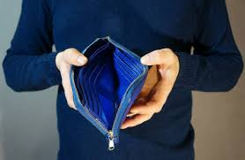
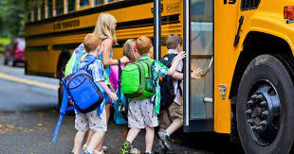
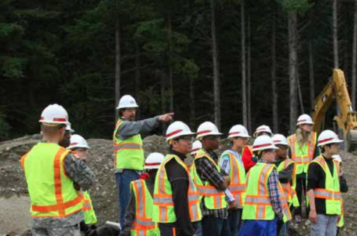
Existing and latent demand: barriers to School tourism
In tourism marketing researchers distinguish between:
Existing demand = people participating
Latent demand = people interested but not participating
Main barriers to school visits
ECONOMIC: financial barriers
SPACE: distance to travel
LACK OF INFORMATION about excursions (ex. range of attractions, access for the disabled etc.)
LOGISTICAL ORGANISATION: lack of time, staff shortage or unwillingness, availability of transport or appropriate accommodation
ACCESSIBILITY and SAFETY (access for the disabled, medical facilities etc.)

Slide 10
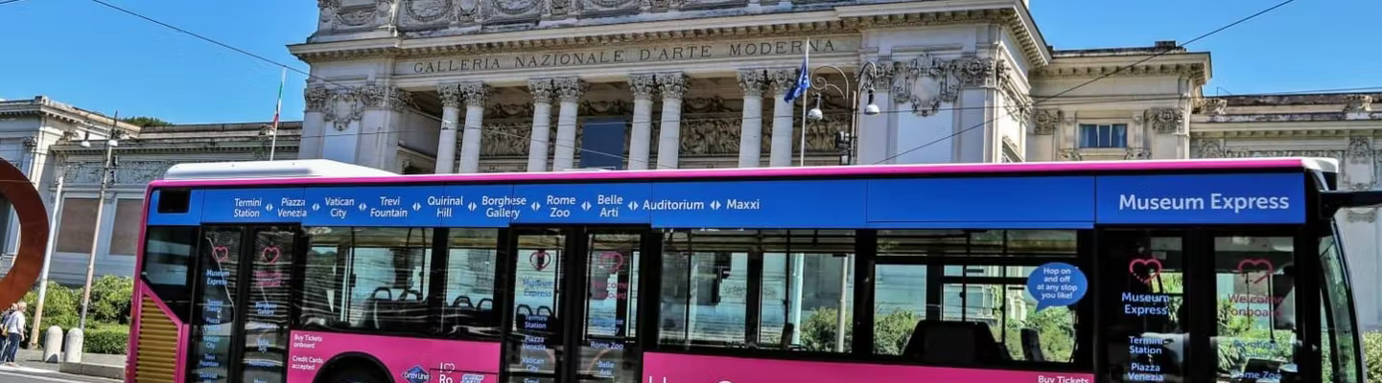

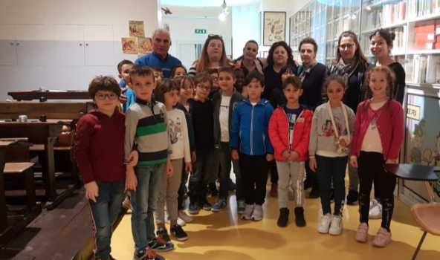
Some solutions to logistic constraints: cooperation with public transport
Collaborations between local authorities and museums for the enhancement of trips to reach cultural attractions
the case of Rome: hop-on hop-off buses connecting the most important museums of the city
other towns, like Cagliari (temporary initiatives) and others
No-cost initiative at the
Museum in Macerata:
Logistic information
Walking distance from the railway station
Special discounted rates for minors
Schools on the railway line

Slide 11
Educational Tourism – LM49 Degree
Marta Brunelli
Associate Professor in General and Social Education
Deputy Director of “Paolo & Ornella Ricca” Museum of School History
School Tourism:
Supply of primary and secondary school’s tourism

Slide 12
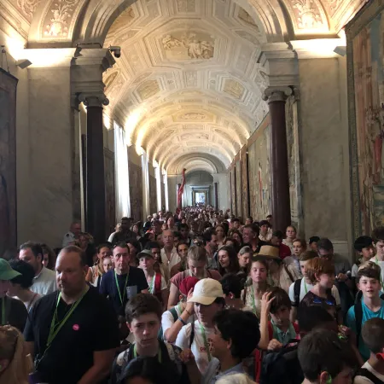
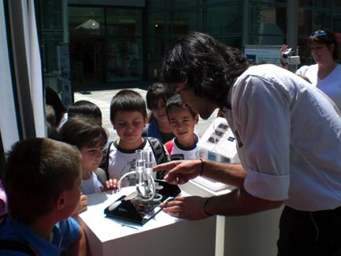
Primary and secondary schools’ tourism
This is a niche market but interesting for service providers for many aspects:
loyal market
children often repeat visits with families,
children are the adult market of the future
school market can ease the general tourism pressure, in off-peak seasons and times of the day.
Purposes of field-trips overlap with educational mission of cultural sites like museums:
Programmes to complement academic learning:
  In specific subjects:
  In a cross-curricular perspective = which is the typical approach of Heritage Education

Slide 13
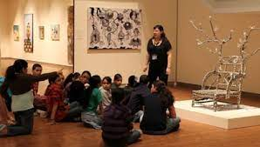
Providing for school visits: day-visit or overnight stays
School managers and service providers (tour operators, travel agencies) are involved in:
focusing of the visit (curricular subject or cross-curricular theme)
managing transportation
managing accommodation
3 key principles characterising the supply of school tourism:
the school curriculum
the needs of children
preparing the school trip
Difference between
- Day-visits
- Overnight stays (outsourced organisation)

Slide 14
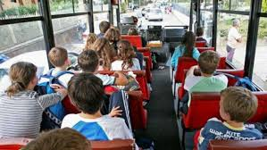
1. School Curriculum
Nature and aims of the curriculum must be clearly understood
Some National curriculums encourage schools to complement formal education with travels and experiences out of school a/o out of students’ hometown
Italian National Guidelines for the curriculum (2012)
To facilitate the knowledge and comprehension of historical roots, the national heritage must be valorized to enrich students’ daily experience with material cultures, artistic expressions, ideas and values inherited from past times and spaces.
Clear alignment between the visits’ educational objectives and objectives/aims of the curriculum
The visit must be justified in front of authorities/families

Slide 15

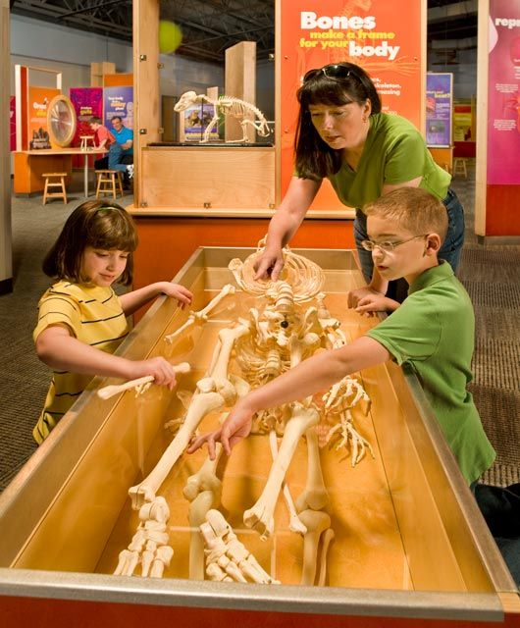
2. Children’s needs
The market of 9-14 years is one of the most relevant, but presenting different constraints:
for older children: they are bound by formal examinations
for younger children: logistical difficulties in organising visits
Different learning needs = school year, level, order
Variable needs determined by intellectual development, cognitive characteristics and learning styles.
  Different attention spans (different based on age a/or individual inclinations)
  Need for practical, interactive and fun activities different from teaching/learning in the classroom (to provoke curiosity, motivation and enjoyment = recreational learning)
  Kinaesthetic intelligence of younger learners (need for hands-on and multisensory activities)
  Audio-visual intelligence of older learners, and verbal intelligence
  Preparatory materials (to create expectations) and/or follow-up materials (to consolidate learning)

Slide 16
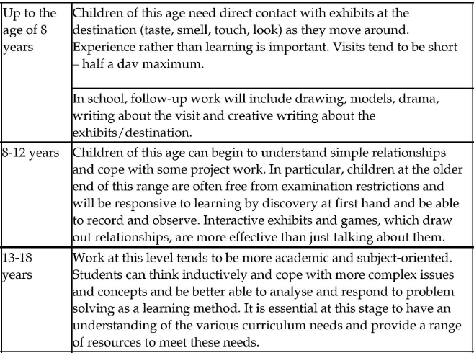

Alignment to Curriculum and
Needs of different age group
Ritchie (2003, p. 211)

Slide 17
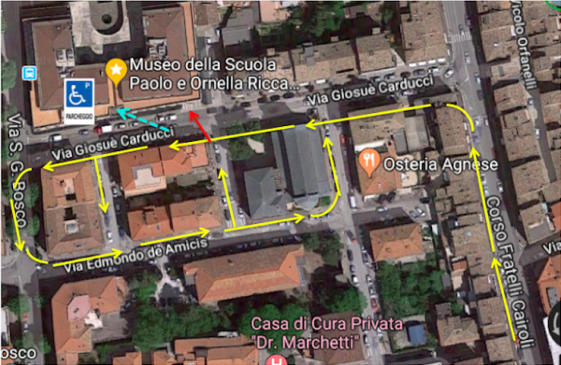
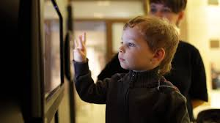
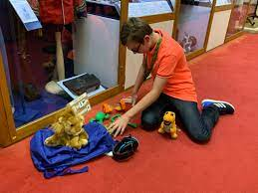
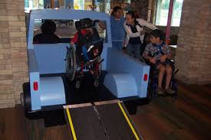
Other needs
Other specific needs:
easy access/parking area for the coach or bus
catering facilities or the provision of lunchrooms and/or picnic areas (to eat packed lunches)
short time limits = within 2-4 hours, to allow children come back to school on time
Information and logistical support = pre-visit information sheets, maps, good signposting, website and timing estimates
Supports to activities:
dedicated areas for activities and (technological facilities, workrooms, cloakrooms, restrooms)
facilities for different disabilities
= wheelchair access, rest-areas, secluded/quiet areas
= resources for the sight/hearing impaired or for intellective disabled children
= specific workshops, activities, protocols for guided tours

Slide 18
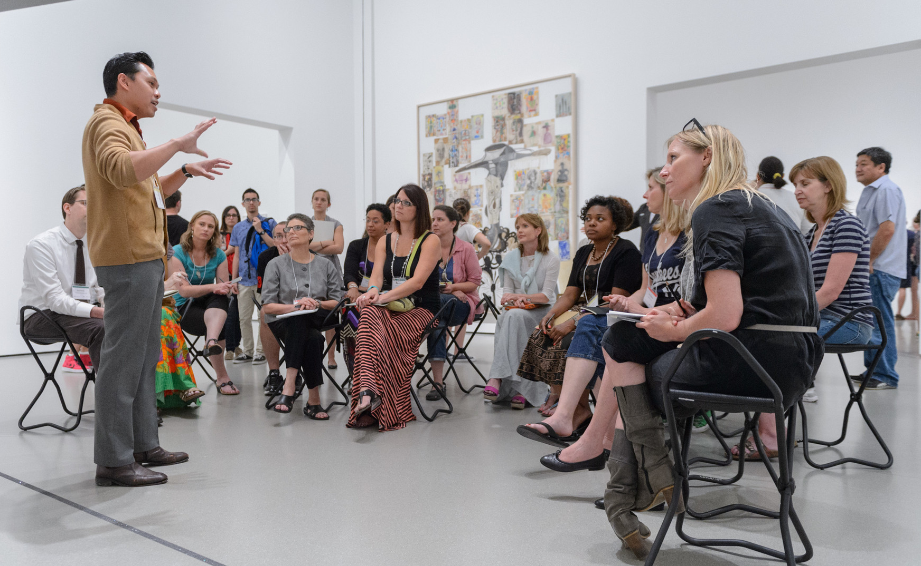

3. Preparing the school trip
Before the visit/trip, some services are typically provided for a better arrangement:
Free familiarisation visits for teachers
Pre-visits material with logistical information
Activities for youngest children (games, crosswords, quizzes, puzzles, comics, etc.) and targeted at the curriculum
Pupil education packs including maps, photos, documents, sources, web-link, cd-rom etc.
Teacher education packs including pre-visit, on-site and post-visit material
Printed or digital catalogue of educational programs and services

Slide 19
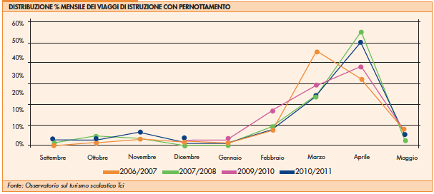
Marketing to schools: needs/constraints
Distance/time-travel
= 70 km/1 hour with young pupils (9-13)
= day-visit (the most popular solution)
= reach destination around 10 am (onwards)
Timing of trips = April-July (April-June in Italy)
(possible seasonal adjustment of the market: discounts/packages for schools)
Key-times for visit-decisions
= at the beginning of the academic year (September/October)
= or even May of the previous year (educational planning)
Monthly percentage distribution of trips with overnight stays.
Source: Italian touring club 2011

Slide 20


The visit-decision process
Different roles:
Deputy head = manages the process
Subject teachers = make proposals of trips related to their teaching needs (yearly planning)
Teachers’ councils = verify, approve and ratify the decision
In Italy: stages of the decision process:
Council for each school year/class (teachers, students and parents) = teachers make proposals of one-day visits or school trips (with overnight stays), and the entire councils discusses it;
Teachers’ Council for all school years = verifies the presence of educational requirements, perfections modalities of implementation;
Plenary School Council (teachers, parents, students, officers) = definitely ratifies the decision
Call for tenders → specialist tour operators/travel agencies

Slide 21
Educational Tourism – LM49 Degree
Marta Brunelli
Associate Professor in General and Social Education
Deputy Director of “Paolo & Ornella Ricca” Museum of School History
Managing school tourism:
Operators’ and teachers’ perspectives

Slide 22
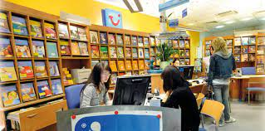
How many operators are specialised in school tourism?
Weakness: discrepancy between the demand arising from schools and the small number of specialised tour operators
The school tourism is the sector of the tourism chain most neglected and least talked about
Even the number of travel agencies specialised in school tourism is not sure, but only estimated, in Italy:
Category associations in 2022 estimated that - out of 8,000 travel agencies – around 1,000 offer also school tourism products (including language school tourism, school field trips)
But a variable number (from 100 to 300) have their core-business in school tourism

Slide 23



Travel agencies/tour operators
Travel and Tourism Agencies (based on their license type) can:
Work as intermediaries between schools and various service providers
Create and sell their own products and packages (travels, accommodation, educational programs) = Tour operators
Some agencies/operators have a long experience and specialised departments able to help schools in managing trips:
Caldana international: generalist tour operator with a department for school tourism
Elensophi: specialised in school tourism in Sicily
Caravantours: society gathering some tours operators and offering a range of educational tourism – with a special office
A specialised department is necessary to fulfil bureaucratic formalities:
Call for tenders = 2 hrs / 2 specialised people
Other requirements = a minimum annual turnover in the previous 3 years, absence of pending disputes with the tax authorities, registration in the MEPA-digital market where public administrations launch their call for tenders

Slide 24
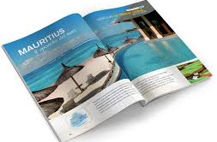
The viewpoint of travel agencies:
1. Standardisation as a weak point
Main weaknesses emerged from some interviews carried out with teachers and travel agencies (academic year 2020/2021)
1st Weakness: Standardisation of products for schools
Educational trips constitute a good percentage of the annual sale/turnover of travel agencies
BUT
being the economic income based on the quantity of trips provided,
in order to satisfy the demand from many schools in the same
period of the year, agencies and operators:
sell the product to different schools
reuse the product year after year
  no improvement
  no customisation
  law quality

Slide 25
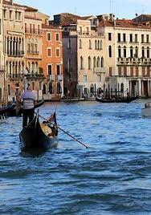
The viewpoint of agencies:
2. Genericness as a weak point
2nd Weakness : generic nature of products for schools
Products for school can present generic and non-specific characteristics:
Similarities between an educational trip and a generic organized trip (same destinations, accommodation)
Repetitive destinations i.e. chosen on the criterion of a general notoriety (with no specific relevance to the curriculum)
Minimum flexibility of the itinerary: agencies often reuse ready-made programs (just changing dates, adding or cancelling some steps etc.)
Simplistic presentation of the travel program and contents

Slide 26

The viewpoint of agencies:
3. Low customization as a weak point
3rd Weakness: Difficulty in customizing the product
Teachers can present specific requests for products that fit better with their curriculum or inherent to a specific project:
BUT
preparing a tailor-made itinerary for a specific institution takes time
agencies do not have time or resources, especially in the high season
already-made programs:
  save human resources and time,
  lower the budget
  and finally, they allow to win schools’ call for tenders

Slide 27
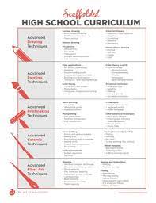

The viewpoint of teachers:
More collaboration would be needed
The travel agency is the place where supply and demand should meet – but also where problems add up.
standardisation of products offered by agencies/tour operators
tendency of schools to be satisfied with the proposals offered.
More dialogue/collaboration is required by teachers in order:
To meet the curricular needs of teachers/pupils
To focus on cultural/educational elements of destinations
Decrease the stages of the journey:
  less fatigue
  more concentration
  better learning

Slide 28
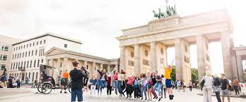
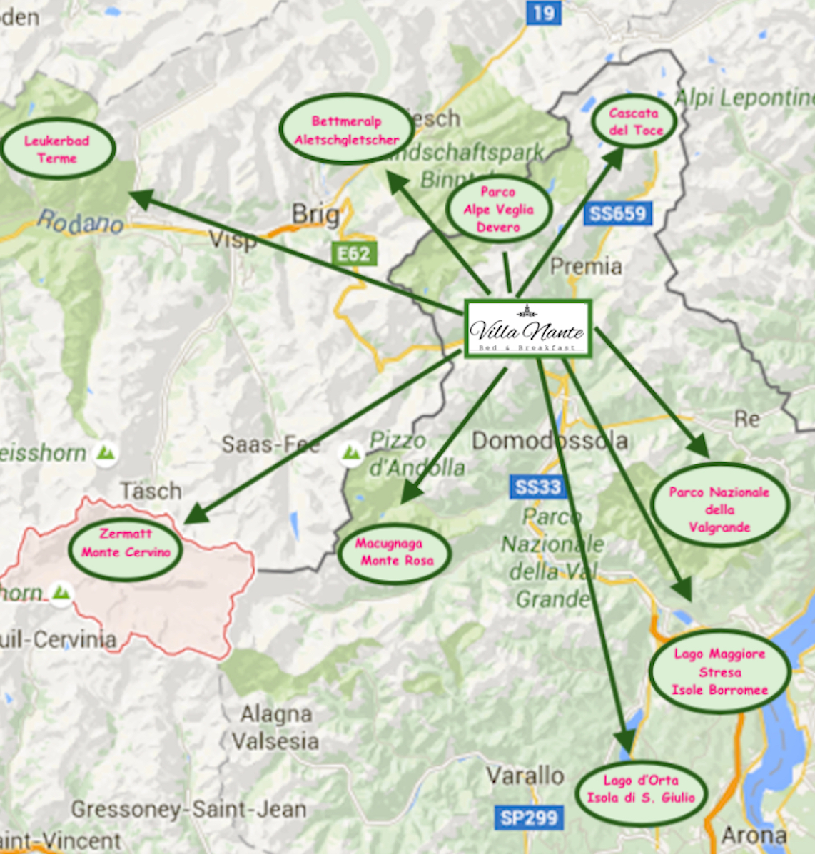
Risks: choosing the wrong product
The difficulty of appropriately matching:
demand
with a quality supply
is determined by various causes, including the inability to choose the product that best suits the school needs.
When choosing between an international or a domestic (even one-day) trip, several pros and cons should be kept in mind.

Slide 29
PROS & CONS: International trips
The international school trip
PROS
1. Great attraction for travel abroad: perceived as a valuable and qualitatively superior experience to a domestic or day trip
CONS
Expensive, distracting, tiring
High "tourist" component compared to the cultural and educational component
The "entertainment" component cannot be appreciated by the students themselves, due to fatigue in facing the numerous stages (in a few days).

Slide 30
PROS & CONS: Domestic trips
Domestic trips:
PROS
Importance of the great cities of art, easy to reach and to visit in depth
Wide presence of different cultural attractions on the local territory
Direct management by the teachers
Easy cooperation with the managers of cultural sites/attractions in programming the trip
CONS
Often perceived as a less valuable experience
Weakness of cultural attractions (museums) in communicating and promoting their services, and the gap between some museums rather than others;
Reduced number of services offered by the territory.

Slide 31
Educational Tourism – LM49 Degree
Marta Brunelli
Associate Professor in General and Social Education
Deputy Director of “Paolo & Ornella Ricca” Museum of School History
School Tourism: Matching demand and supply
Analysis of Didatour

Slide 32
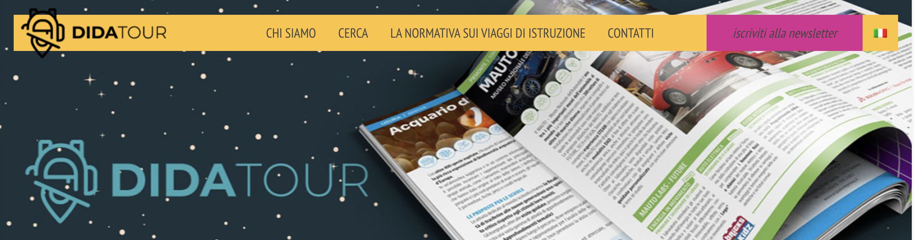
An interesting (and transferable?) experience
What is Didatour?
What are its objectives and aims
What services and tools are being offered to match demand and supply?^
How does it work?
Pros and cons for schools (and destinations?)

Slide 33

1. Promoting cultural attractions
To face the problem of communicating destinations/services to schools, a project was born in 2004 by Bandusia publishing house: the Didatour project.
WHO
Didatour is part of the multinational group La Fabbrica, a communication and advertising agency based in Milan, and specialised in designing and implementing educational events in schools.
They define themselves as: “An independent creative agency specialized in the development of brand reputation programs through edutainment and institutional initiatives.”https://www.lafabbrica.net/?lang=en.

Slide 34

2. Why Didatour
Didatour aims at effectively presenting destinations/services to schools across Italy, when they are engaged in organizing trips.
Cultural attractions can:
Reach the teachers at Italian schools
Promote their educational/cultural services
Use a mix of solutions to better communicate with schools
Increase the educational-tourism potential of their area.
To be included within the informative material issued by Didatour, museums and other cultural attractions must subscribe to the service: depending on the fee, they will appear on the website, in the catalogue or in the newsletter

Slide 35
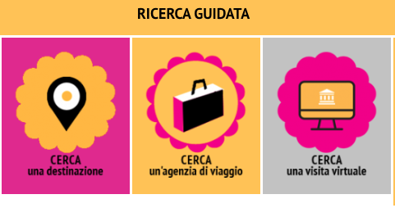
3. What Didatour offers
Tools implemented to reach schools and teachers:
The magazine “Didatour. School tourism and education”,
The Didatour portal,
The Newsletter service.
All these tools present services and programs by museums and other cultural attractions, which can be searched by destination, Region, subject, or by travel agency etc.
These services:
Compensate for the poor communication of museums
Facilitate communication between teachers and cultural attractions
Allow travel agencies/tour operators to develop new itineraries and enrich their products for schools

Slide 36
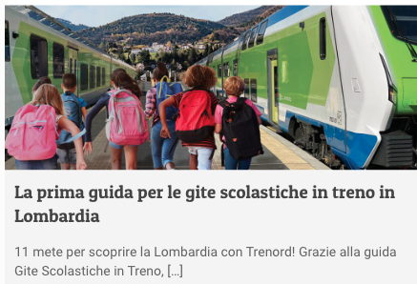
4. Other services by Didatour
The DIRECT EMAIL MARKETING service
Museums can send communications directly to teachers by profiling the type of schools, school orders and grades, geographical areas and thematic interests.
SPECIAL PROJECTS
Organization of educational event for teachers, to promote services of a specific destination,
Submission of printed materials to schools,
Creation of itineraries for schools on behalf of regions and local authorities;
Implementation of interactive web portals (e.g. for the Ministry of Agriculture),
Creation of special educational kits like ”On school trip with Trenitalia”, aimed at encouraging the use of trains for school trips.

Slide 37




5. A new section: online workshops
This section of the portal was created during the lockdown.
The catalogue was significantly entitled “ON A SCHOOL TRIP ANYWAY” presents a selection of:
digital workshops,
virtual tours,
digital toolkits
which were offered by museums, parks and cultural associations to enrich children’s and teachers’ remote teaching and learning during the lockdown.
Initiatives born after the campaigns promoted by the ministry of culture “I stay at home: Culture doesn’t stop” and “Museums: closed but not stopped”.
Today these online products have become integrant part of educational offer from cultural attractions.
Complementary / alternative
to the visit
Free / Paid products

Slide 38
Educational Tourism – LM49 Degree
Marta Brunelli
Associate Professor in General and Social Education
Deputy Director of “Paolo & Ornella Ricca” Museum of School History
Analysis of two museum products

Slide 39


Analysis of two museums’ products for schools:
The Victoria & Albert Museum in London
https://www.vam.ac.uk/
The Science and Industry Museum in Manchester
https://www.scienceandindustrymuseum.org.uk/
Analyse and compare the two sites: what specific school needs are being met?
What services and products are available for schools?
What resources are available for students/teachers?
Do they offer logistical support in planning the visit?
Other services/resources are provided?

