Slide 1
GlobeTrotter Travel
Adventure Tours

Slide 2
Contact Details
GlobeTrotter Travel, 111 Bridge Street, Cambridge, CB2 1LR, UK.
Tel./fax: + (44) 1223 51723
Info@GlobeTrotterTravel.co.uk
www.GlobeTrotterTravel.com

Slide 3
Mission
To provide affordable adventures in little-known parts of the world
To travel in a sustainable way, respecting the local environment

Slide 4
Vision
We will encourage friendly social contact between travellers and local communities
We will stimulate the local economy by using local personnel and resources

Slide 5
The Story So Far
Founded in 2015 by Terry and Tammy Trotter
Started with tours to South East Asia
Now covers South East Asia, Central Asia and the Far East

Slide 6
Common Problems
Impersonal tours
Disappointment
Overcrowded destinations
Local communities do not benefit
Mass tourism causes environmental damage

Slide 7
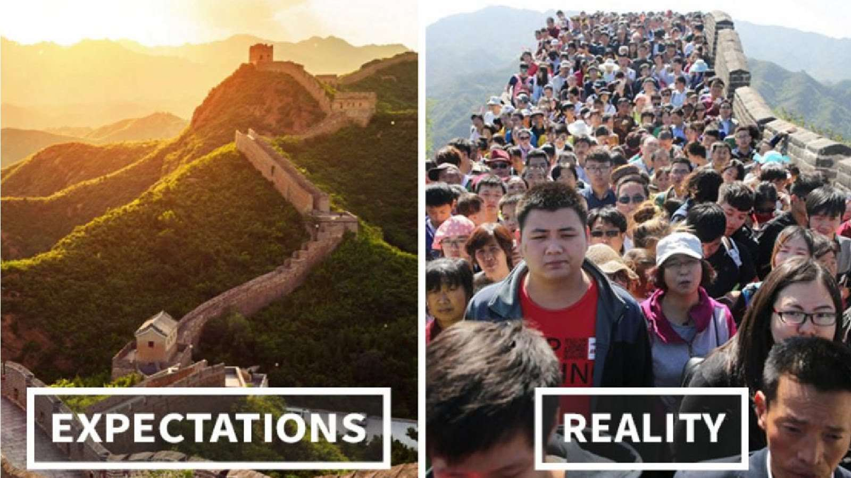

Slide 8
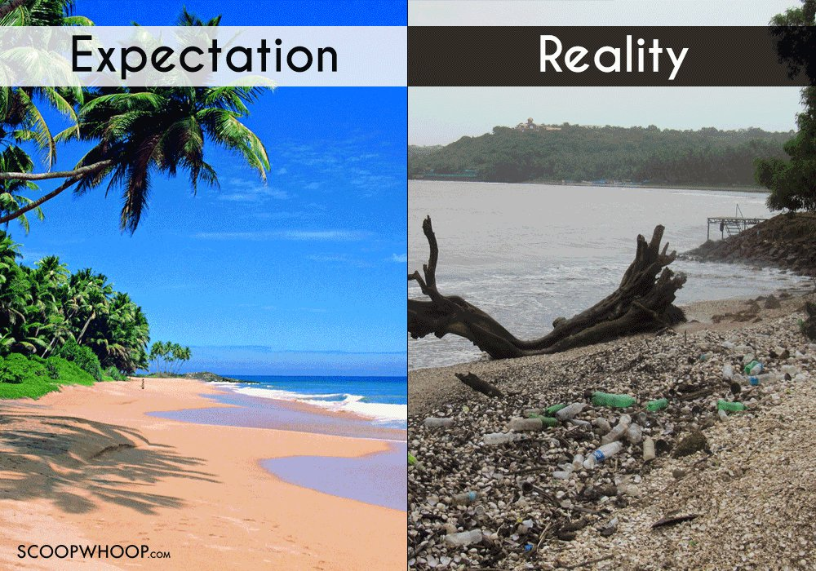

Slide 9
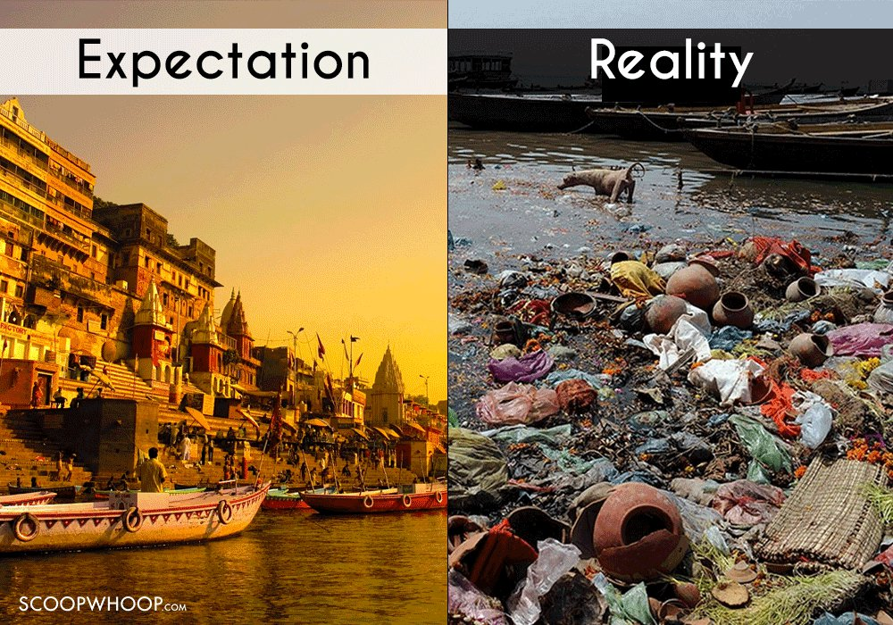

Slide 10
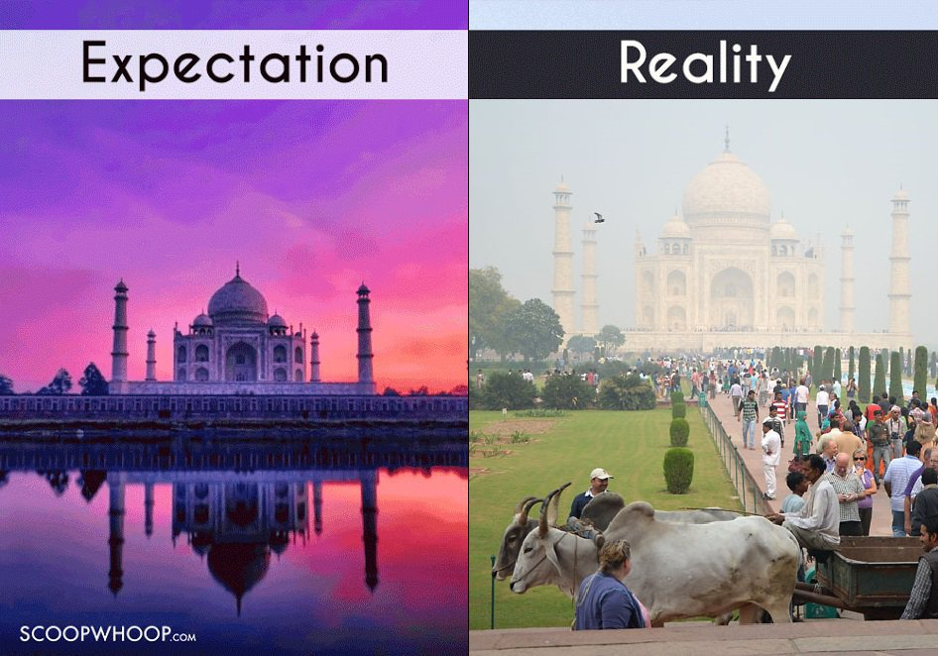

Slide 11
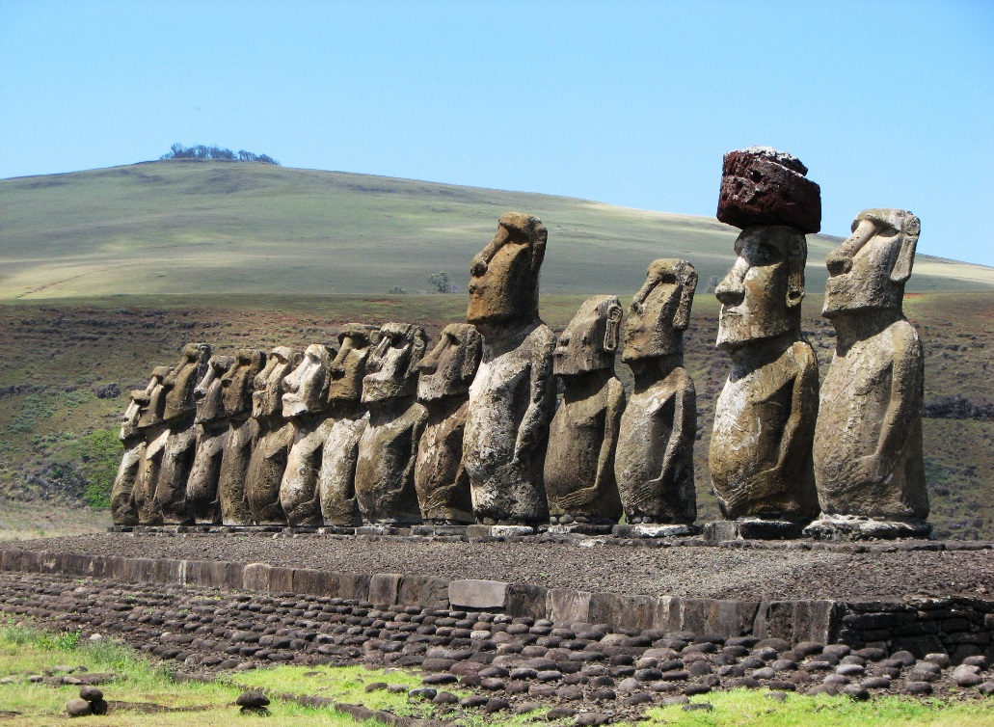
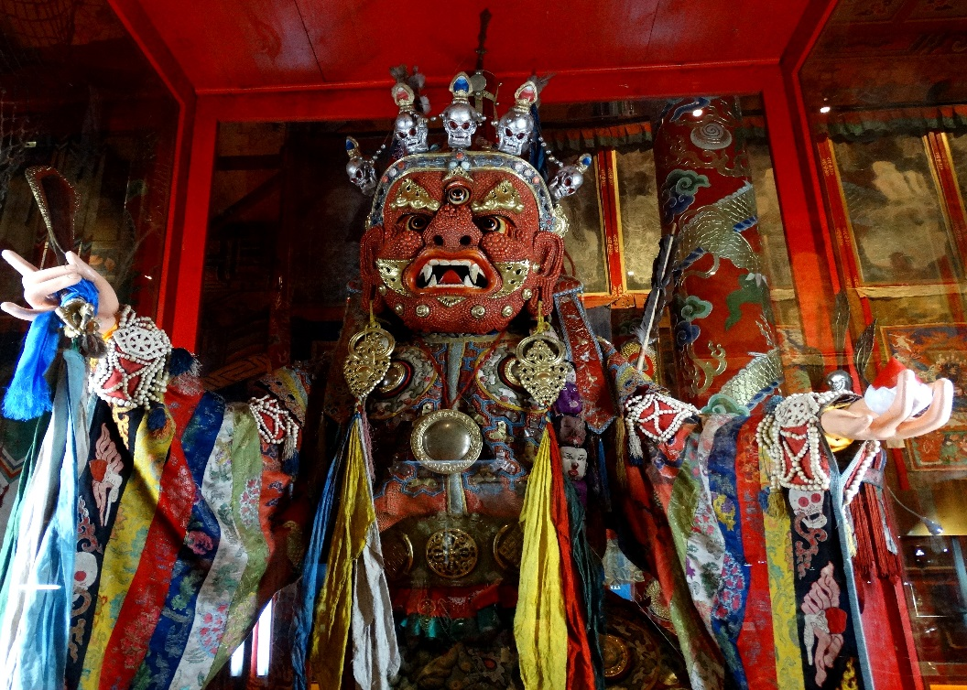
GlobeTrotter Adventure Tours
Easter Island
Tibet

Slide 12
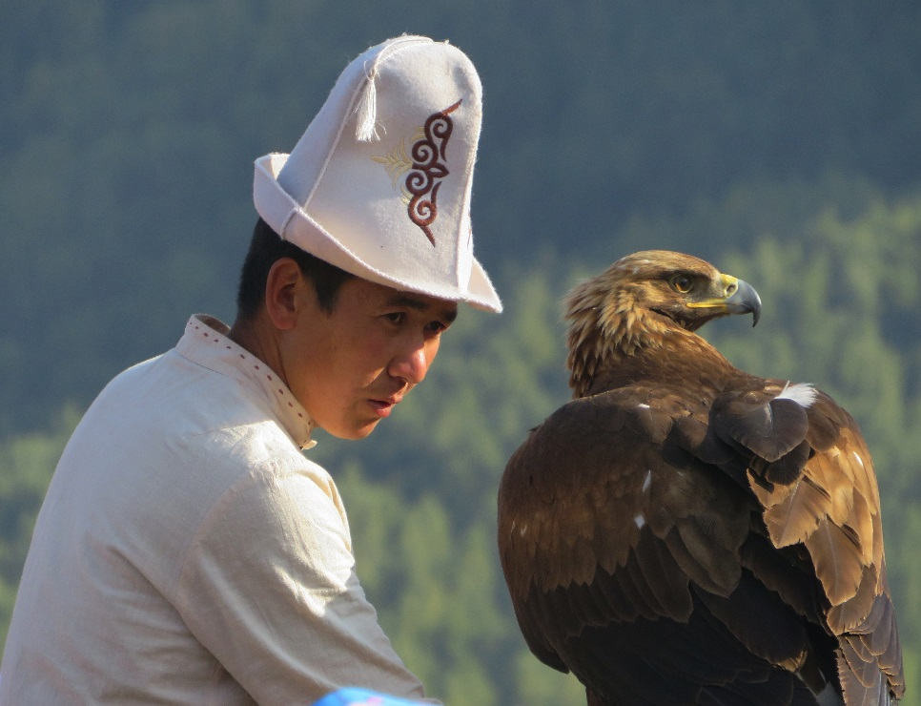
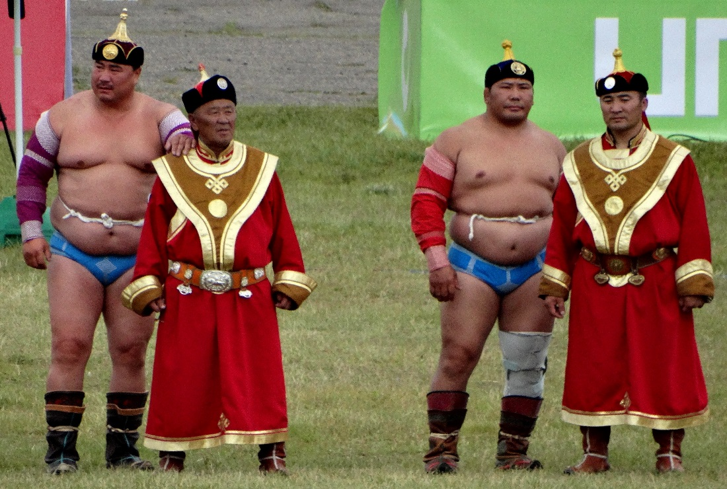
GlobeTrotter Adventure Tours
The World Nomad Games
The Nadaam Festival

Slide 13
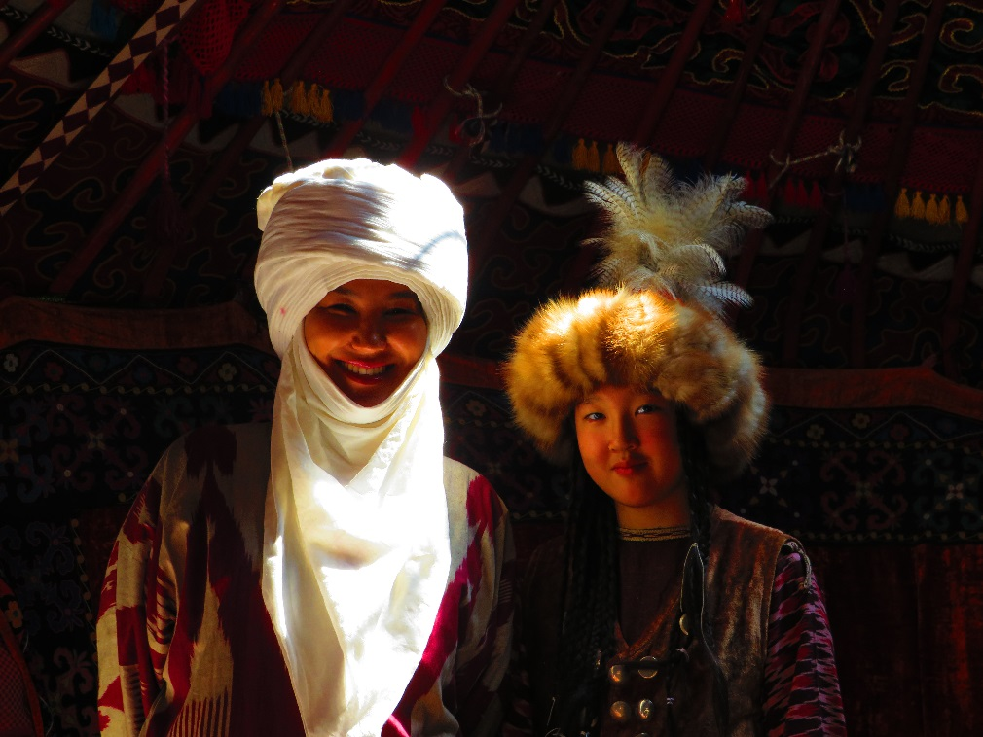
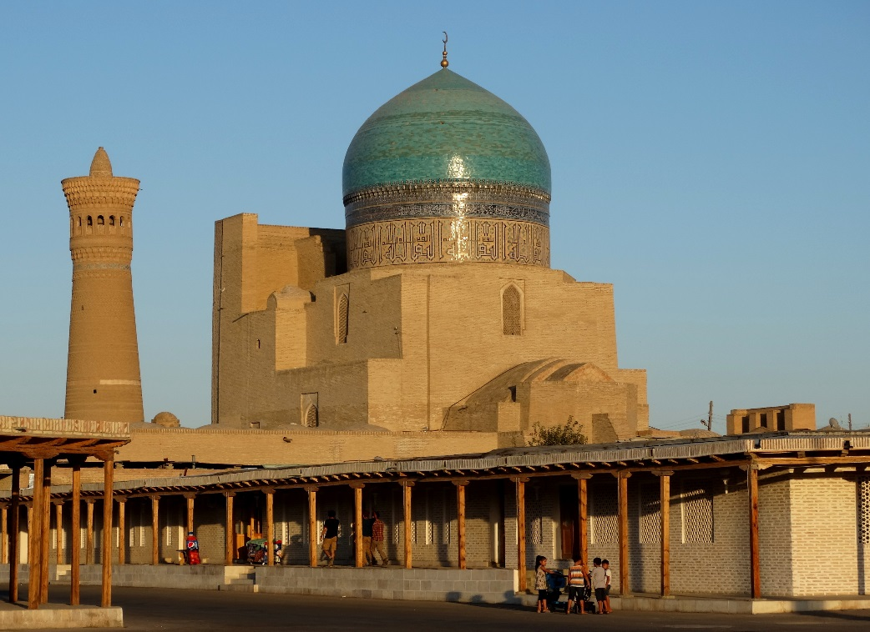
GlobeTrotter Adventure Tours
Kirghizstan
Uzbekistan

Slide 14
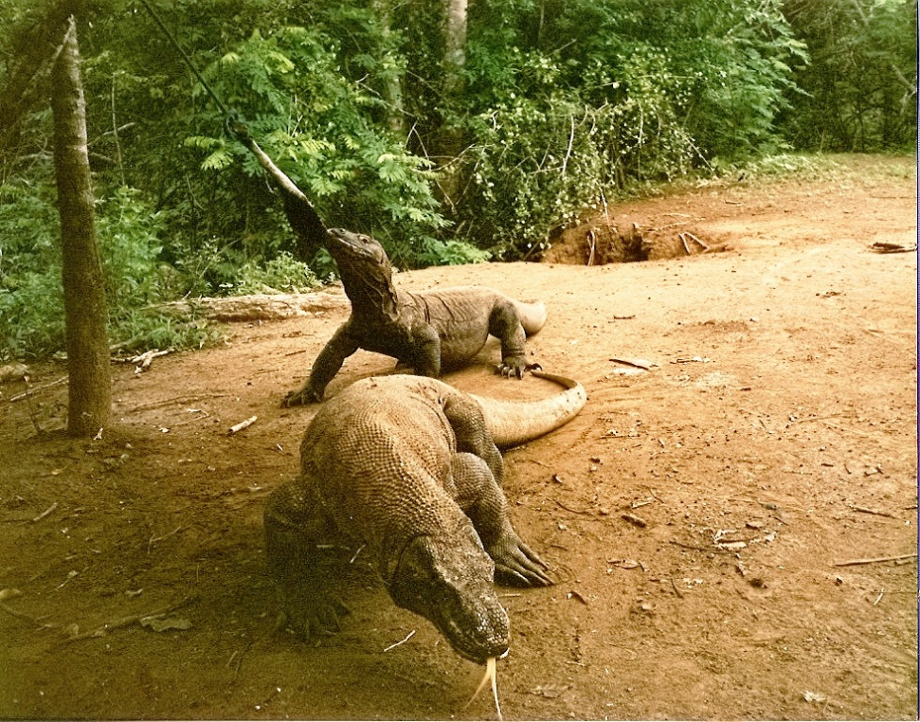
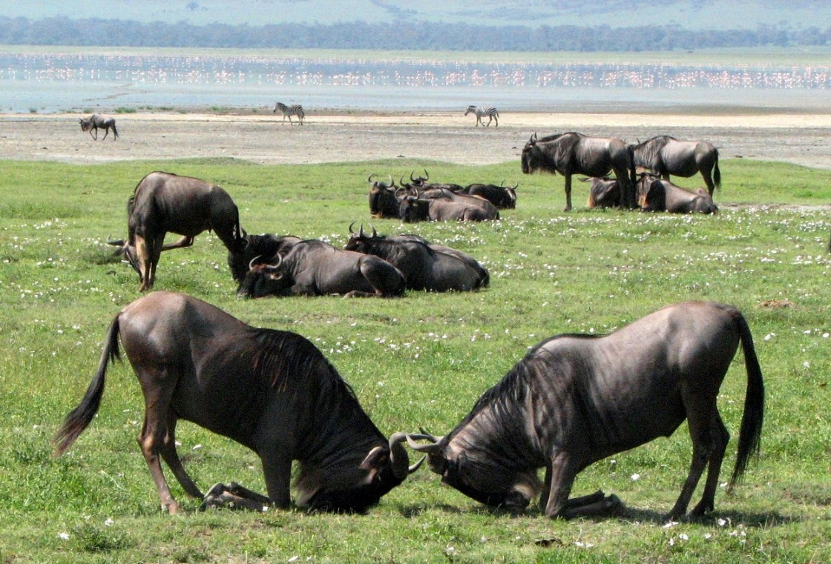
GlobeTrotter Adventure Tours
Komodo
The Serengeti

Slide 15
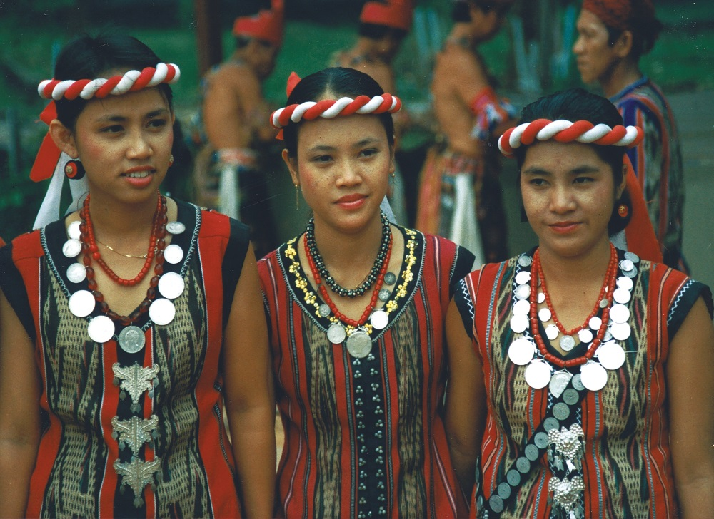
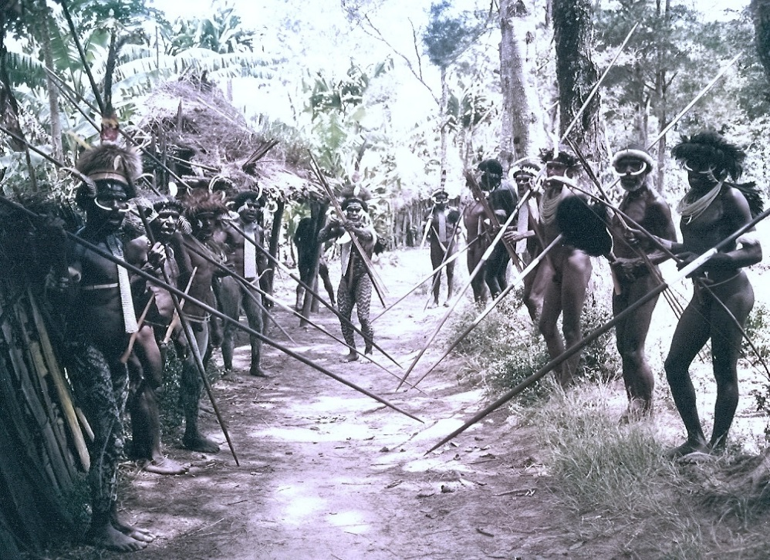
GlobeTrotter Adventure Tours
Borneo
Papua New Guinea

Slide 16
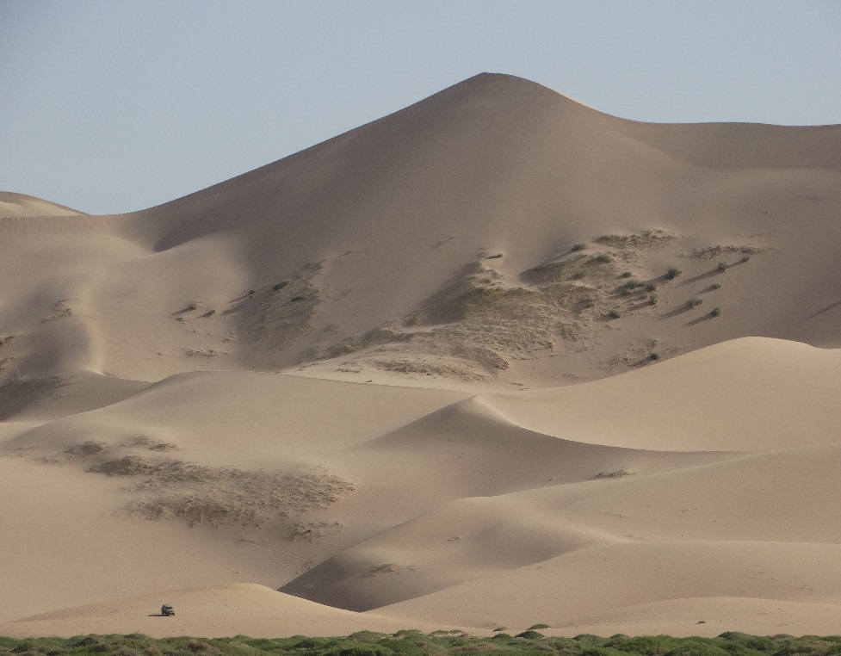
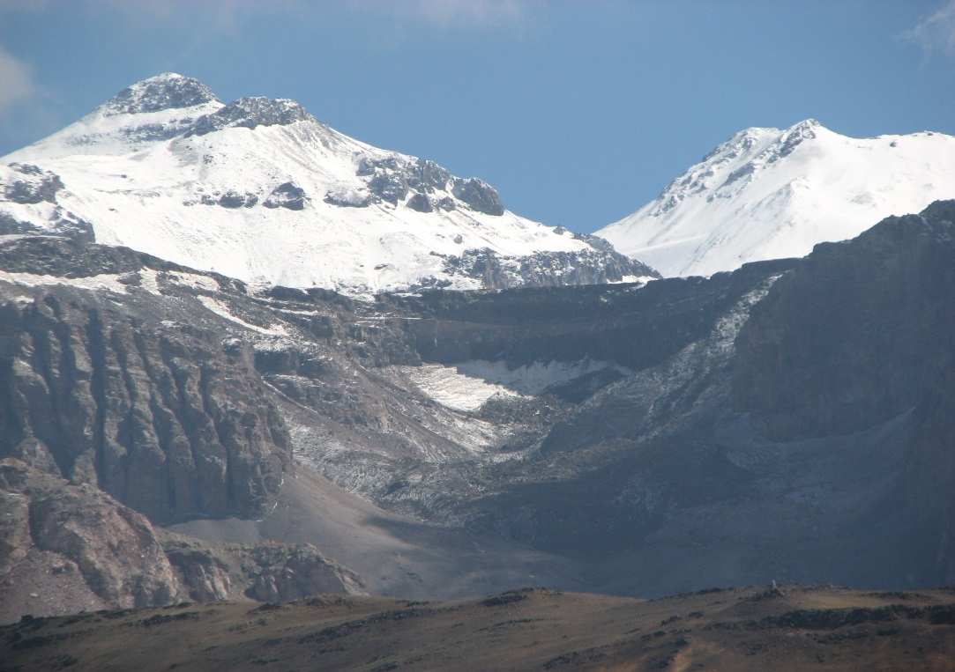
GlobeTrotter Adventure Tours
The Gobi Desert
The Pamir Mountains

Slide 17
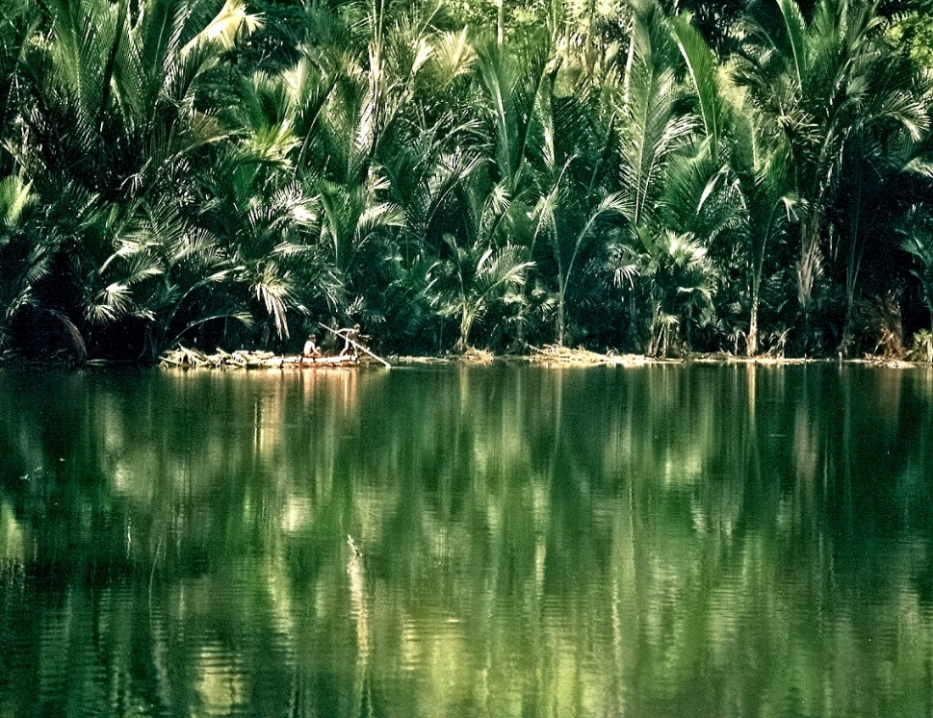
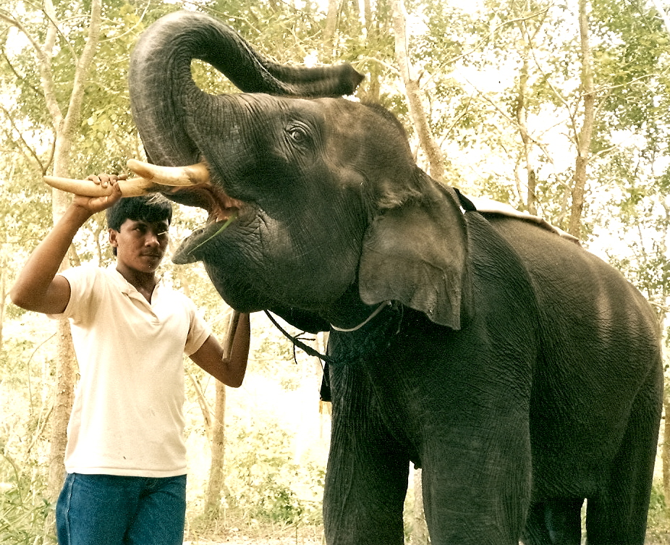
GlobeTrotter Adventure Tours
Java
Sumatra

Slide 18
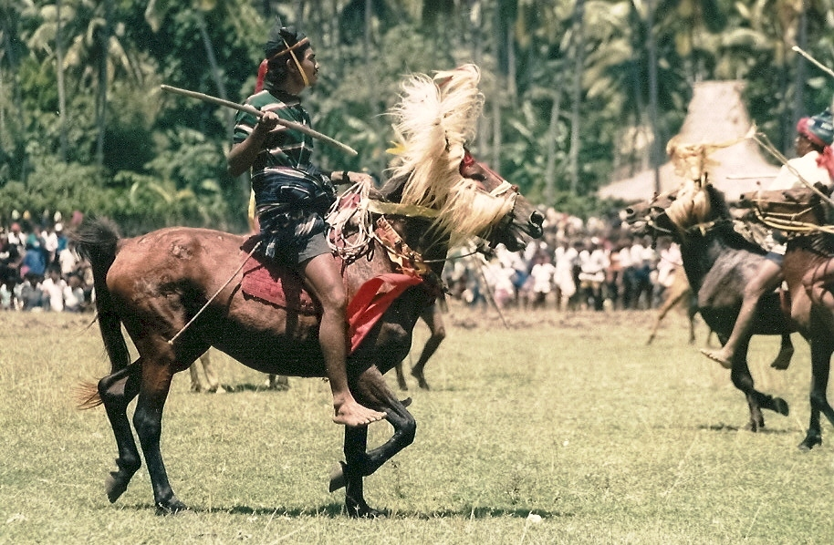
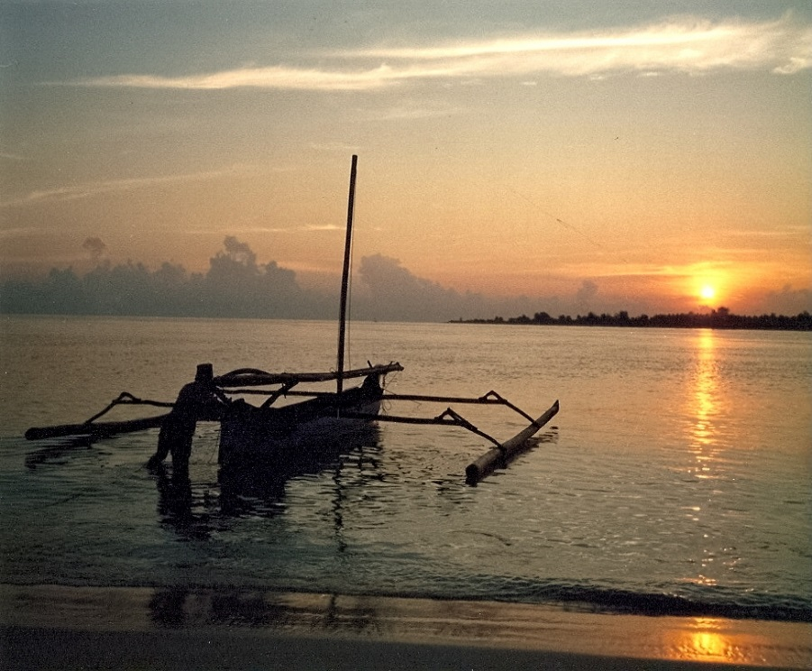
GlobeTrotter Adventure Tours
Sumba
Bali

Slide 19
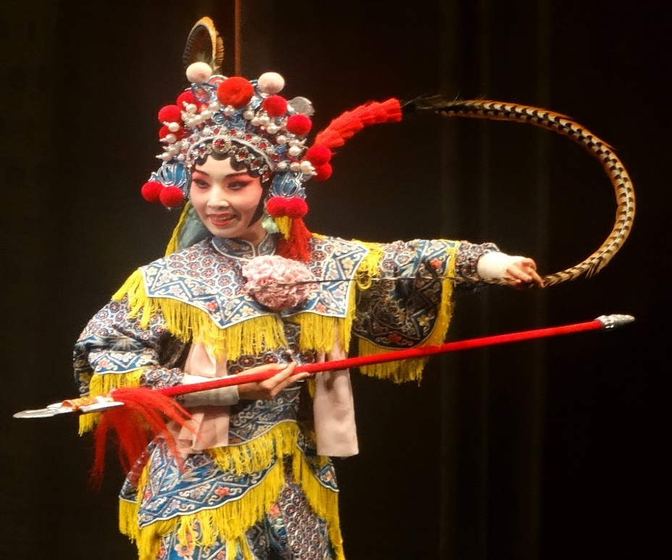
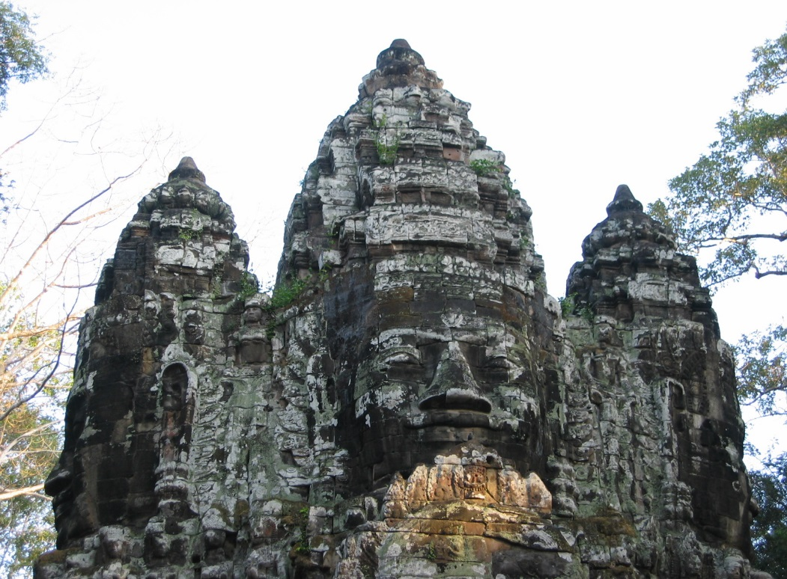
GlobeTrotter Adventure Tours
China
Cambodia

Slide 20
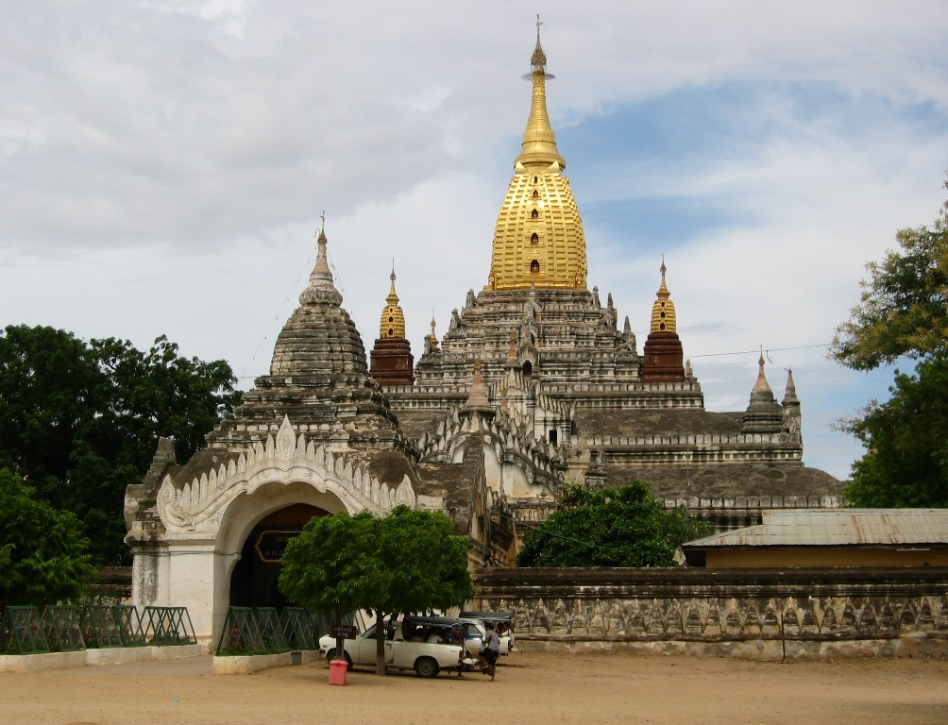
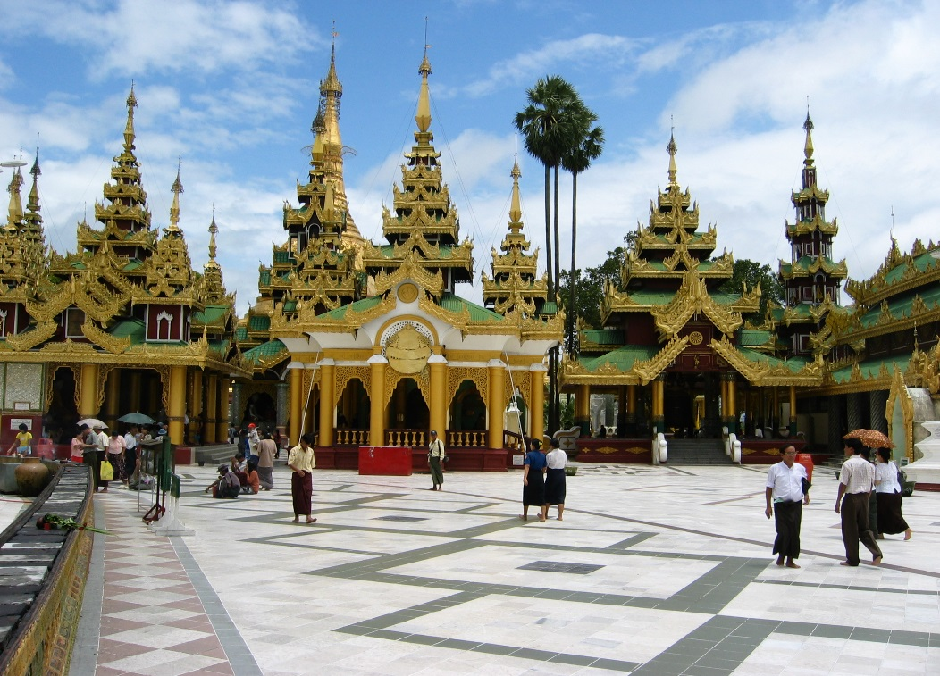
GlobeTrotter Adventure Tours
Bagan
Yangon

Slide 21
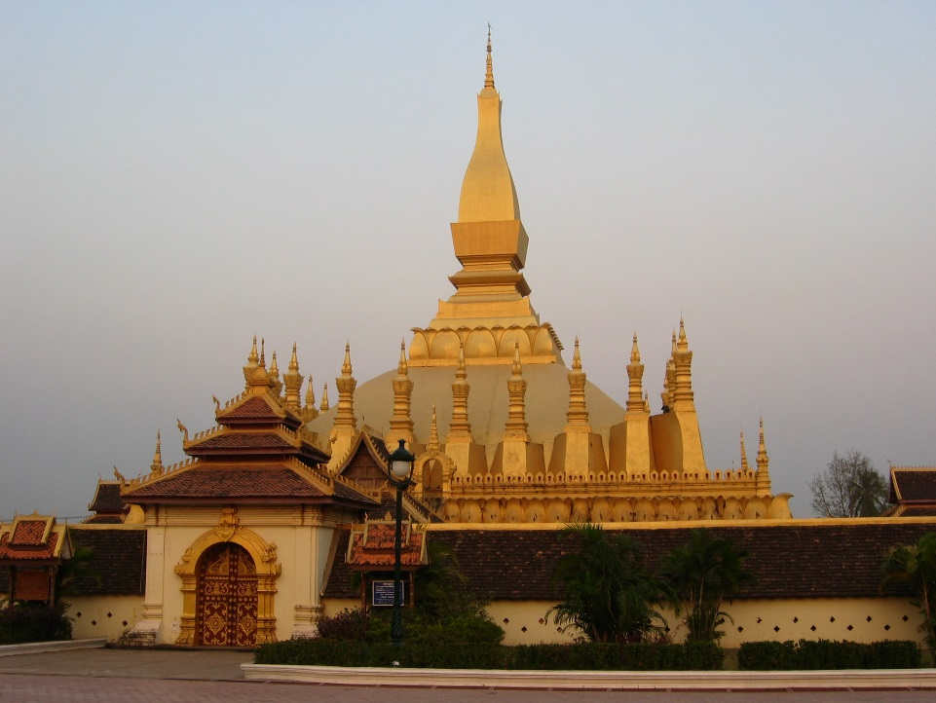
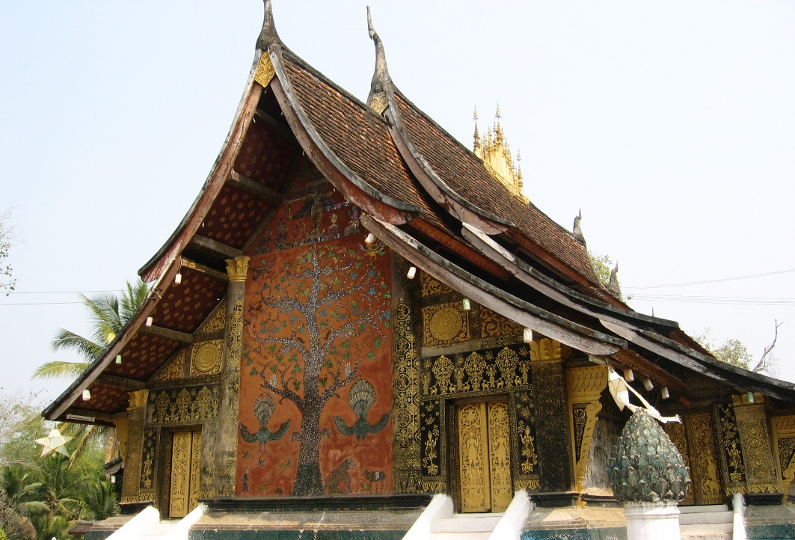
GlobeTrotter Adventure Tours
Vientiane
Louang Prabang

Slide 22
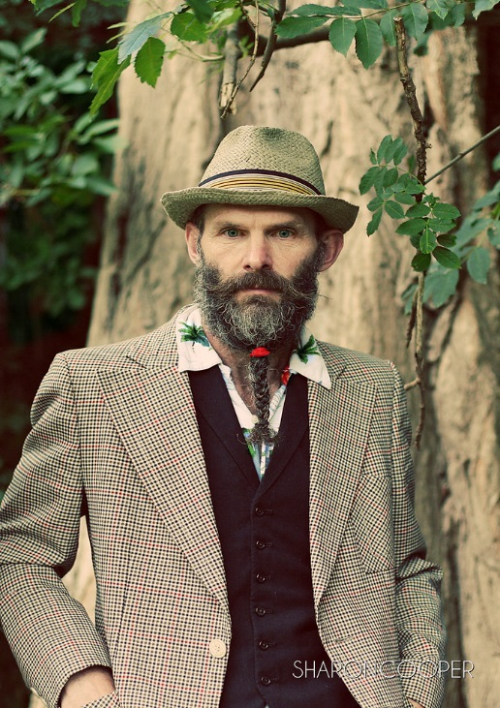
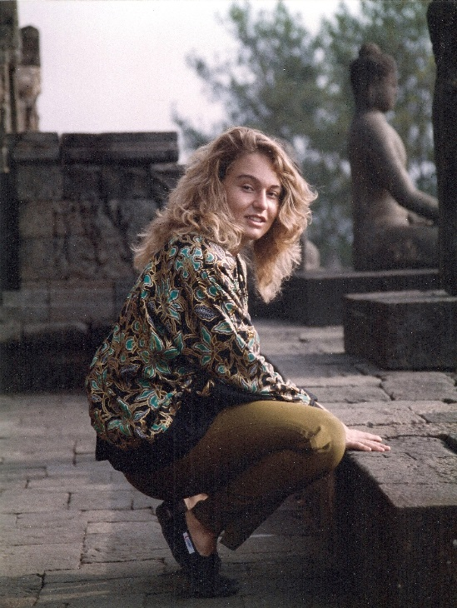
The Team: Key Personnel
Terry Trotter – Chairman
Tammy Trotter - CEO

Slide 23
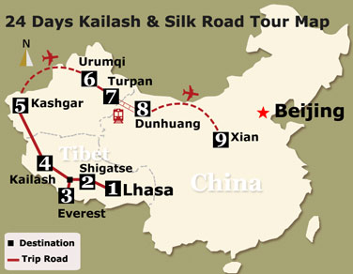
Call to Action
Our New Project
Funding Required
€300,000

Slide 24
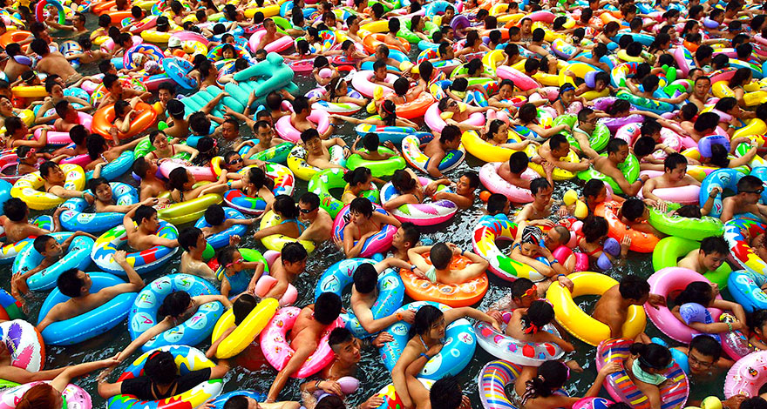
Any Questions ?

