Slide 1
UNIMC
LABORATORIO INGLESE I
Week 3

Slide 2
AT THE END OF THE LESSON YOU WILL BE ABLE TO:
TALK ABOUT FAMILY AND RELATIVES
TALK ABOUT FUTURE EVENTS (SCHEDULE /ˈʃedʒ.uːl/ , PREDICTIONS, PROMISES, ARRANGEMENTS AND INTENTIONS, TIMETABLE)

Slide 3


Slide 4
TRADITIONAL AND MODERN FAMILY
What does this picture show?
What do you see?
Try to describe it in pairs!!!
Guiding questions:
Is it a family? Is it a traditional or modern one?
Are they happy/sad/worried/surprised?
What do they look like? (appeareance)
Speculate: why are they in that position? Why are they posing for a photo and who is taking it? Was it taken by releasing the self-timer shutter?

Slide 7
FROM CAMBRIDGE DICTIONARY
Father /ˈfɑː.ðər/: a male parent
Parents /ˈpeə.rənt/: a mother or father of a person or an animal, or someone who looks after a person in the same way that a parent does.
Stepmother /ˈstepˌmʌð.ər/: the woman who is married to someone's biological (= related by birth) parent but who is not their biological mother

Slide 8
SIBLINGS noun [ C ] UK /ˈsɪb.lɪŋ/ =
BROTHERS AND SISTERS IT IS A MORAL FORMAL WORD AND IS USED FOR BOTH GENDERS
IMMEDIATE FAMILY = IT REFERS TO PARENTS, CHILDREN, BROTHERS AND SISTERS.
EXTENDED FAMILY= IT REFERS TO ANYONE RELATED TO YOU WHO IS NOT YOUR IMMEDIATE FAMILY AS FOR EXAMPLE UNCLES, AUNTS, COUSINS, GRANDPARENTS…

Slide 9
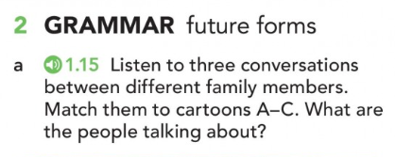
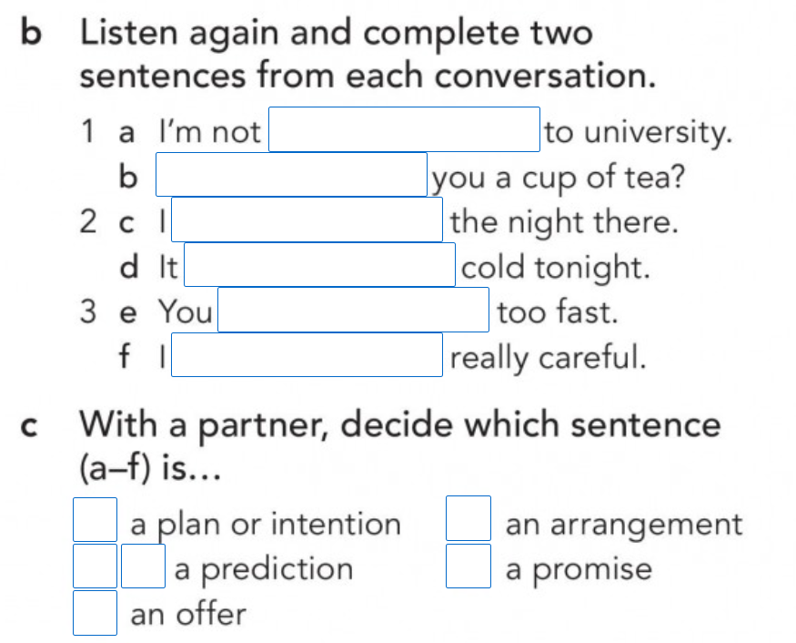
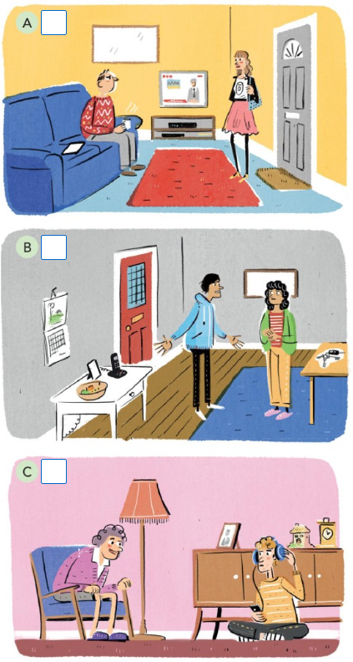

Slide 10
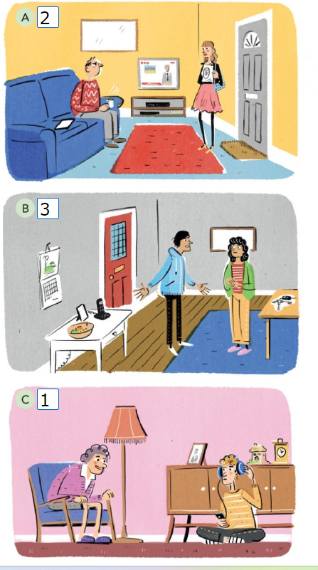
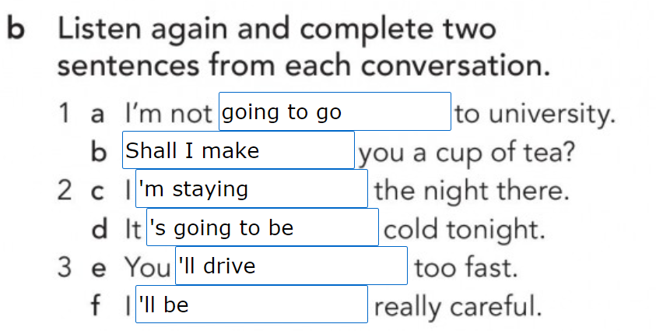
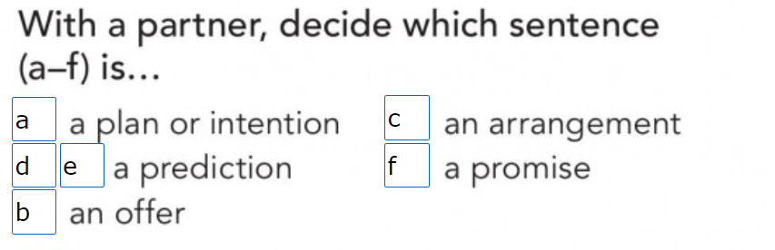

Slide 12
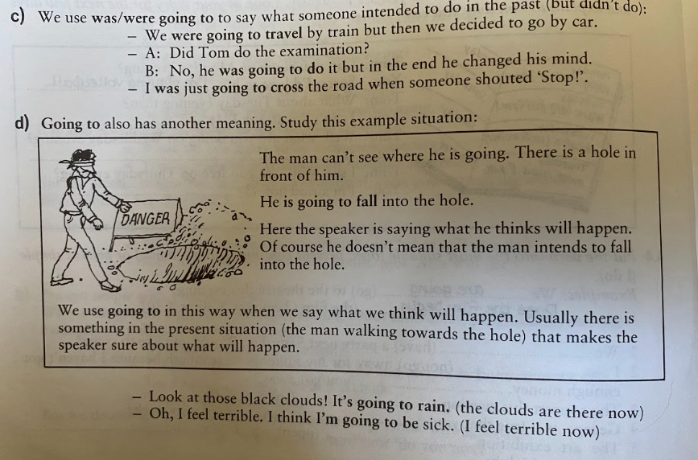
WATCH OUT!
TO BE GOING TO FOR PREDICIONS MEANS THAT WE USE GOING TO (NOT WILL) WHEN THERE IS SOMETHING IN THE PRESENT SITUATION THAT SHOWS WHAT WILL HAPPEN IN THE FUTURE (ESPECIALLY THE NEAR FUTURE).
THE SPEAKER FEELS SURE ABOUT WHAT WILL HAPPEN BECAUSE OF THE SITUATION NOW:
LOOK AT THOSE BLACK CLOUDS, IT’S GOING TO RAIN!
I FEEL TERRIBLE, I THINK I’M GOING TO BE SICK
BUT: ACCORDING TO THE WEATHER FORECAST TOMORROW IT WILL RAIN.

Slide 13
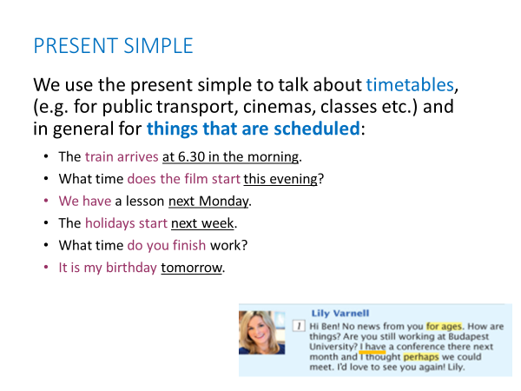

Slide 14
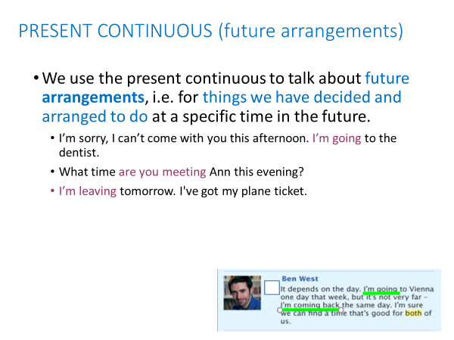

Slide 16
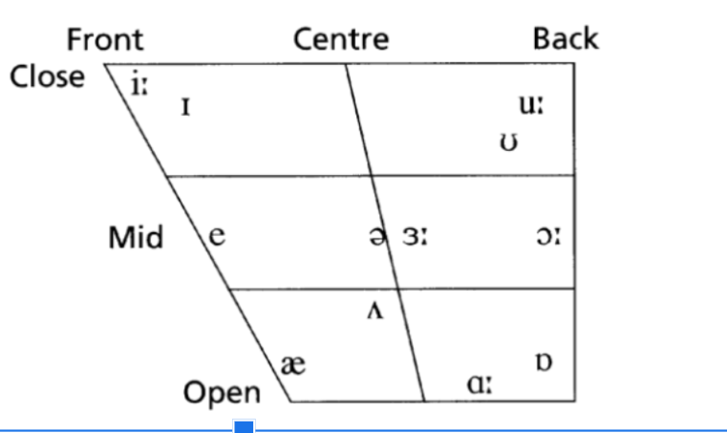
PHONETIC CHART: VOWEL SOUNDS

Slide 17
WORD STRESS ( = SYLLABLE STRESS)
Video lesson: https://www.oxfordonlineenglish.com/syllables-and-stress
To communicate clearly when you are speaking in English, it is important to stress the correct syllables in each word.
This is called word stress, which means pronouncing one syllable of a multisyllabic word with greater emphasis (stress) than the other syllables in the word.
A stressed syllable combines these features:
It is l-o-n-g-e-r - com p-u ter
It is LOUDER - comPUter
It usually has a higher pitch than the syllables coming before and afterwards.
It is said more clearly -The vowel sound is purer.
Remember: the unstressed (weak/quiet) syllables of a word
have the opposite features of a stressed syllable!
Stress is always on a vowel!
Notes:
https://www.teachingenglish.org.uk/article/word-stress
Video lesson – interrompere a 5.10 più o meno, poi slide, poi continua con regole (video lesson + next slides)

Slide 18
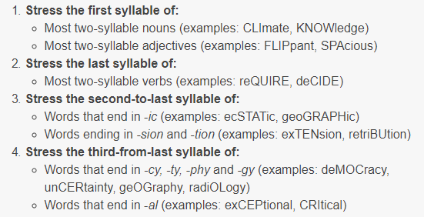
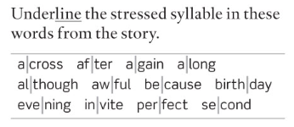
WORD STRESS – some general rules
TWO-SYLLABLE WORDS
BUT: hotel, respect
Many two-syllable prepositions and connectors (examples: beHIND, beFORE, beCAUSE)
Compound nouns: stronger stress on the first part (examples: HAIRbrush, FOOTball)
Exercise 2a (p.17)
Notes:
https://www.toeflgoanywhere.org/learn-these-4-word-stress-rules-improve-your-pronunciation
https://www.teachingenglish.org.uk/article/word-stress
Es. 2a pag. 17

Slide 19
WORD STRESS – some general rules (2)
LONGER WORDS
Notes:
https://www.toeflgoanywhere.org/learn-these-4-word-stress-rules-improve-your-pronunciation
https://www.teachingenglish.org.uk/article/word-stress

Slide 20
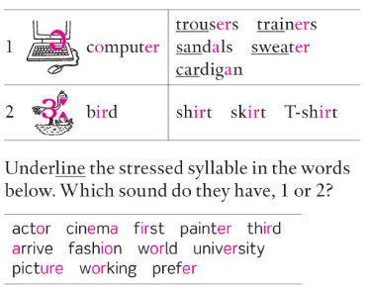
Pronunciation notes
1C
/Ə/ (schwa) is the most common sound in English. It is a short sound, and always occurs in an unstressed syllable, e.g. doctor, address.
  Unstressed -er or -or at the end of a word are always pronounced /Ə/, e.g. teacher, better
  Same sound in -tion
/3:/ is a similar sound, but it is a long sound and is always in a stressed syllable, e.g. nurse, worker
Notes:
exercise 2a-b p.8

Slide 21
Pronunciation notes
1C
Exercise 2b (p.8)
Notes:
exercise 2a-b p.8

Slide 22
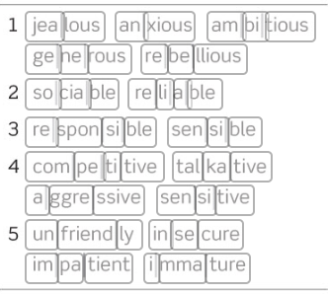
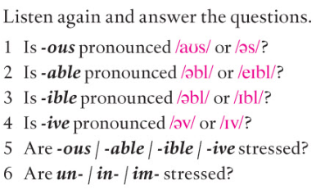
WORD STRESS – more practice
Notes:
https://www.toeflgoanywhere.org/learn-these-4-word-stress-rules-improve-your-pronunciation
https://www.teachingenglish.org.uk/article/word-stress
Exercise 7a (p.11 B1/+)
1. /es/
2. /ebl/
3. /ebl/
4. /IV/
5+6: no, never

Slide 23
OVER TO YOU – PART 1
Oxford Online English – Pronunciation Lessons
Sounds and spelling: https://www.oxfordonlineenglish.com/sounds-and-spelling
Silent letters: https://www.oxfordonlineenglish.com/silent-letters
(others)
Pronunciation exercises in Units 1A, 1B, 1C, 2C
VB p. 150 + supplementary material about personality-related adjectives.

