Slide 1
UNIMC
LABORATORIO INGLESE I
A.A. 2023/2024, LM85-BIS
(1° ANNO, 2° SEMESTRE)
Prof.ssa Nicoletta Moretti
Nicoletta.moretti3@unimc.it

Slide 2
ABOUT THE COURSE
20 hours, 2 CFU
This is the first of a series of Labs for students and it is aimed at:
Reaching level B1+ of the Common European Framework of Reference for Languages (CEFR)
- What’s the CEFR?
- The CEFR levels

Slide 3
COURSEBOOK AND SUPPLEMENTARY MATERIALS
Reference book: English File Digital Gold B1/B1+. Oxford University Press
Slides+supplementary materials (always check the course webpage)
Min. 70% attendance
Final exam: written text (to test use of English, reading and writing skills) + oral test (to test speaking and listening)

Slide 4
Watch out!
Don’t miss the
«Lettorato di livello B1»
Secondo semestre, tenuto dalla Prof.ssa Iris Black
Il corso si terrà il lunedì, nella fascia oraria 8.30-11.30

Slide 5
EXAM
(in May - in September - in January)
WRITTEN TEST:
Multiple choice exercises, reading and comprehension, writing.
ORAL TEST:
During the exam you will be expected to:
Talk about yourself and answer some personal questions;
Describe a picture and discuss about one of the topic connected to the picture (ex: if in the picture there is a man playing a musical instrument you may be asked to express your opinion about music and your relationship with music).
MODALITA’ DI VALUTAZIONE
La prova finale del corso si compone di due parti, entrambe in lingua inglese:
1. una prova scritta, con quesiti a risposta chiusa per grammatica e lessico, esercizi di lettura/comprensione e scrittura breve. Non è ammesso l'uso di dizionari o altre risorse;
2. una prova orale, sulla base del programma svolto durante il corso.
La valutazione della produzione scritta e orale, livello B1/B1+, viene effettuata in base ai parametri del QCER.

Slide 6
TODAY’S LESSON
PRACTISE FOOD VOCABULARY
REVISION OF PRESENT TENSES (PRESENT SIMPLE AND PRESENT CONTINUOUS)
PREPOSITIONS OF TIME
STATIVE VERBS
LEARN HOW TO DESCRIBE PICTURES
OBSERVE THE PHONETIC CHART AND UNDERSTAND THE USE OF STRESSED AND UNSTRESSED SYLLABLES.

Slide 7

LET’S GET STARTED!!!

Slide 8
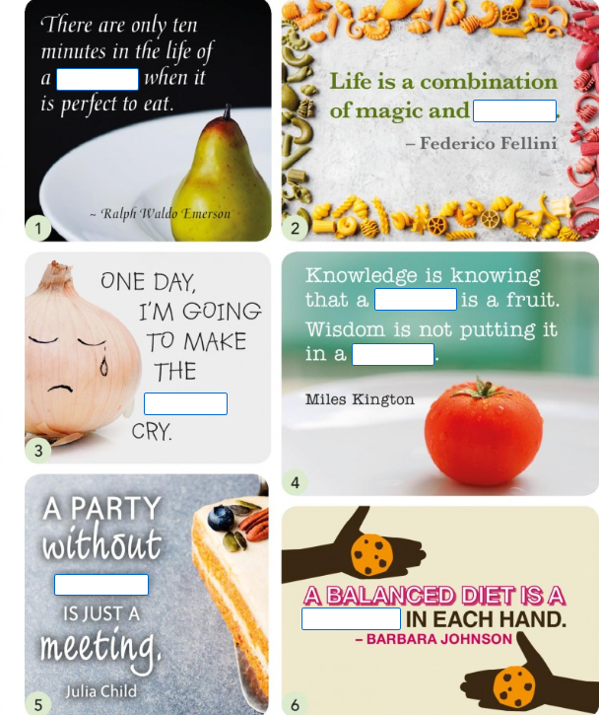
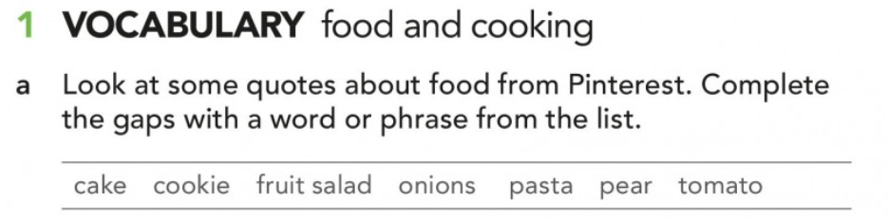
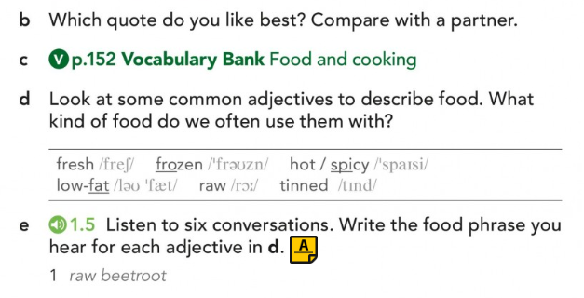
FOCUS ON VOCABULARY

Slide 9
COOPERATIVE LEARNING:
FOOD PROFILE: ANSWER QUESTIONS EX N°3 AT PAG 6:
FIRST: DO IT INDIVIDUALLY AND WRITE THEM ON A PAPER;
AFTER THAT: COMPARE YOUR ANSWERS WITH YOUR COLLEGUES AND TALK TO EACH OTHER (TRY TO TALK ONLY IN ENGLISH AND IF YOU DON’T KNOW SOME WORDS LOOK THEM UP INTO A FREE ONLINE DICTIONARY «CAMBRIDGE» «OXFORD»).
FINALLY: SHARE YOUR IDEAS WITH THE WHOLE CLASS TO PRACTICE SPEAKING SKILLS

Slide 10
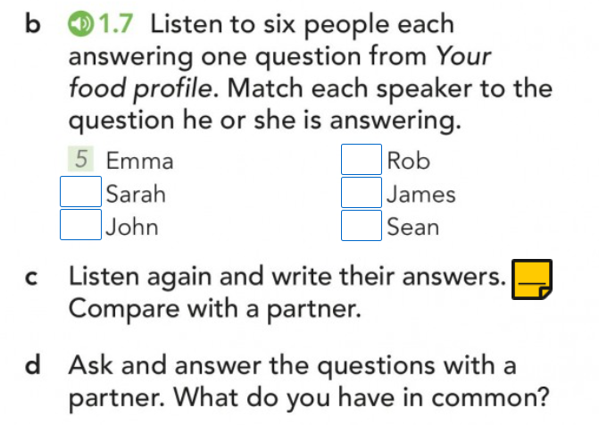
BOTH OF US DRINK TEA FOR BREAKFAST
NONE OF US DRINKS TEA FOR BREAKFAST

Slide 11
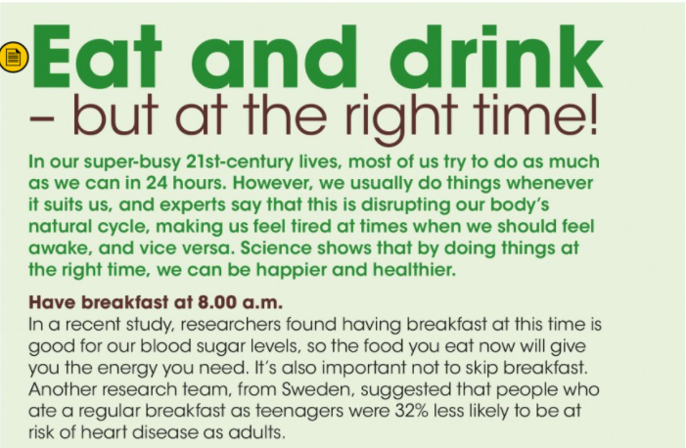

Slide 12
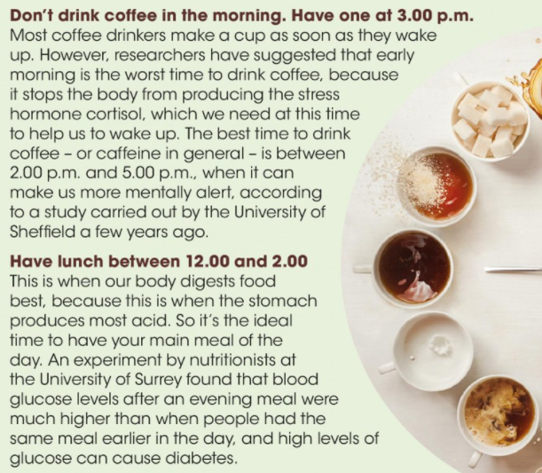
Notes:
Hormone: /ˈhɔː.məʊn/
Cortisol: /ˈkɔː.tɪ.zɒl/
Caffeine: /ˈkæf.iːn/
Diabetes: /ˌdaɪ.əˈbiː.tiːz/

Slide 13
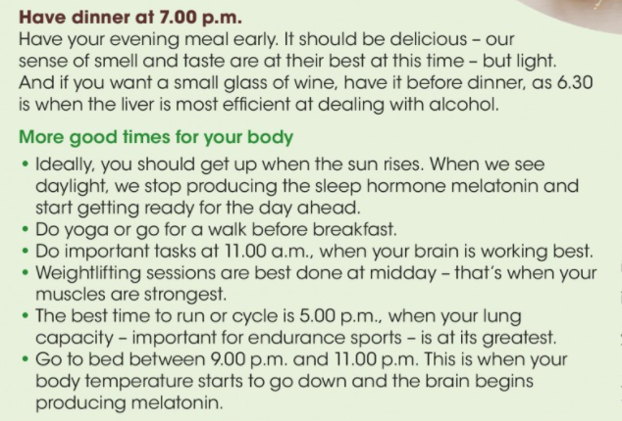
Notes:
Melatonin: /mel.əˈtəʊ.nɪn/
a hormone in the body that produces changes in skin colour and is involved in controlling biorhythms such as our sleep pattern
Weightlifting: /ˈweɪtˌlɪf.tɪŋ/

Slide 14
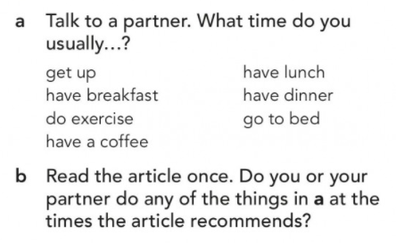
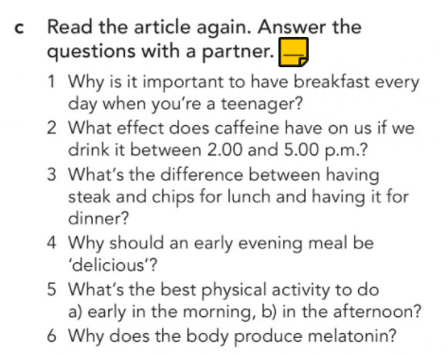
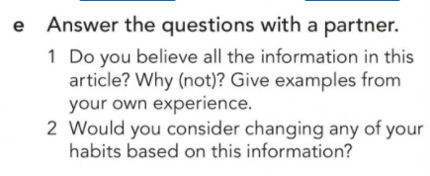

Slide 15
COOKING METHODS
ROASTING VS BAKING
GRILLING VS BARBECUING
FRYING VS DEEP-FAT FRYING
LOOK THE DEFINITIONS UP INTO THE DICTONARY

Slide 16
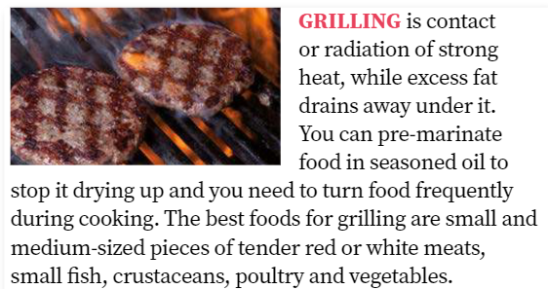
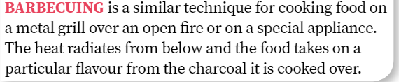

Slide 17
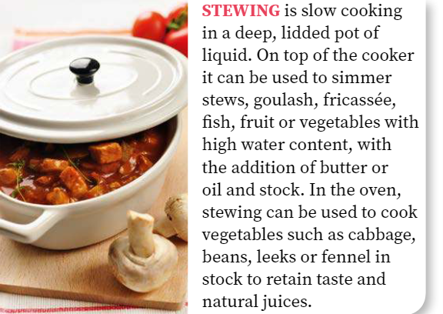
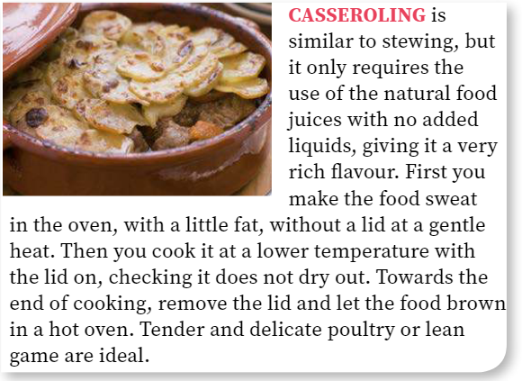

Slide 18
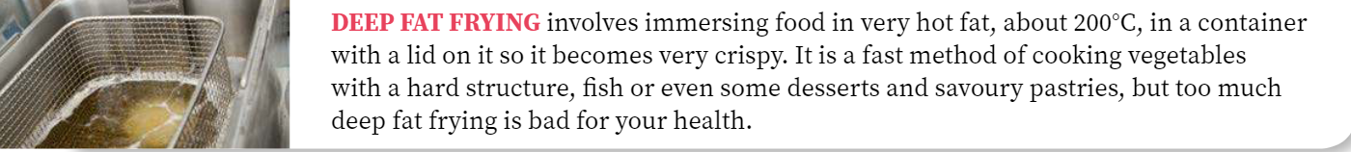
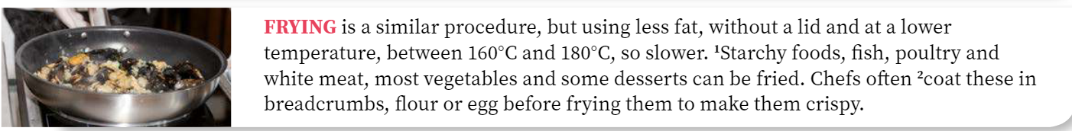
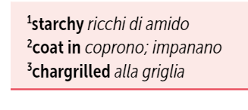

Slide 19
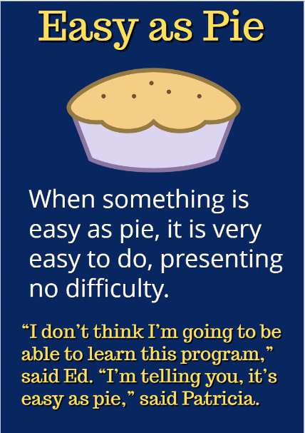
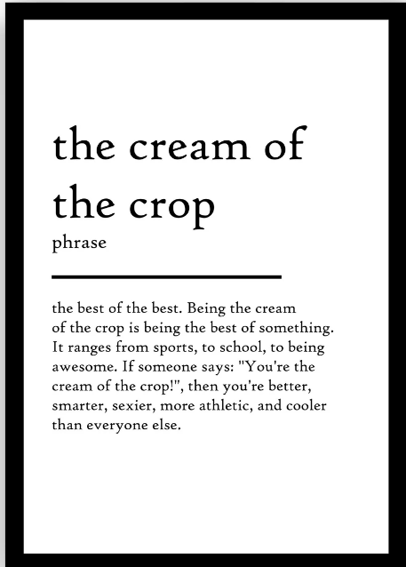
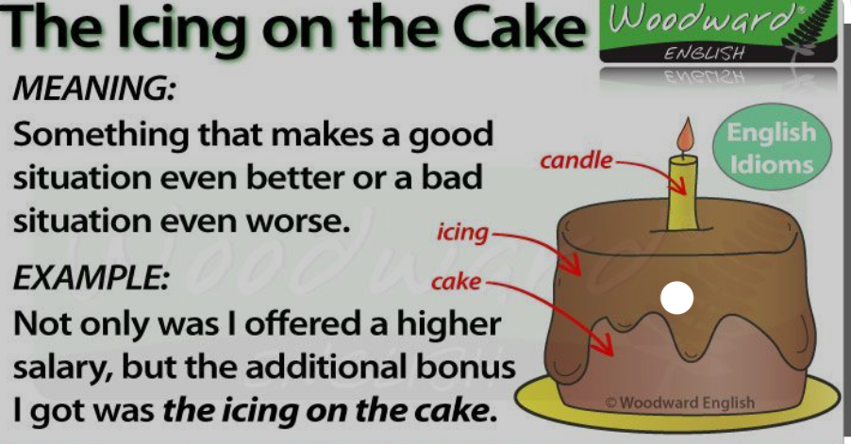
IDIOMS /ˈɪd.i.əm/
EASY AS A PIE
(FACILE COME BERE UN BICCHIER D’ACQUA)
THE CREAM OF THE CROP
(IL FIORE ALL’OCCHIELLO)
THE ICING ON THE CAKE
(LA CILIEGINA SULLA TORTA)

Slide 20
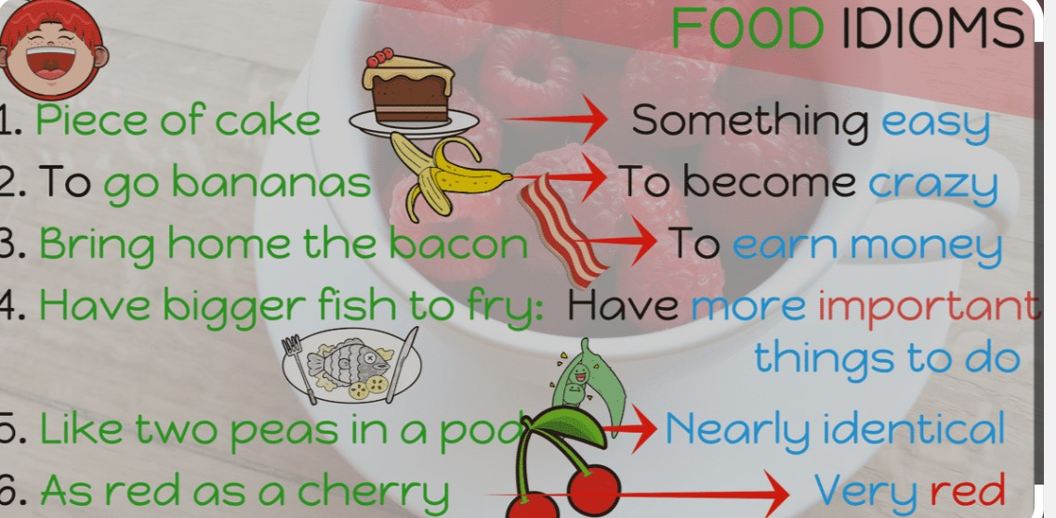

Slide 21
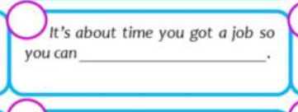
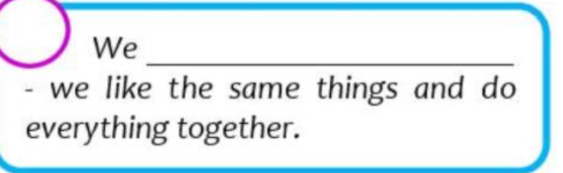
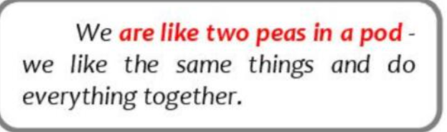
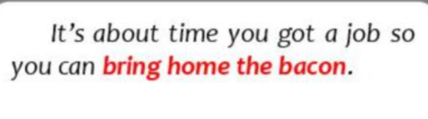
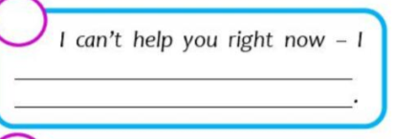
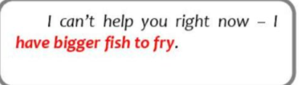
She’ll …………. when you tell her the news.
She’ll go bananas when you tell her the news.

Slide 22
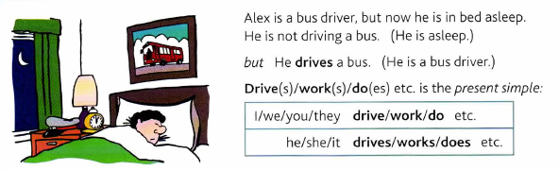
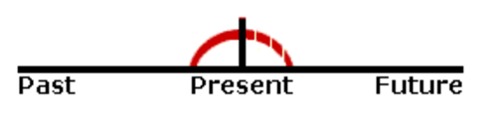
PRESENT SIMPLE
HABITUAL / PERMANENT ACTIONS
To say that something is true in general, or that something happens all the time or repeatedly (and how often we do things):
The cafe opens at 7.30 in the morning / I get up at 8 o'clock every morning.
We usually go home at weekends / We don’t go abroad very often.
Nurses look after patients in hospitals. / The Earth goes round the Sun / Rice doesn’t grow in cold climates.
What does this word mean? / Where do they live?
Notes:
We use the present simple to talk about things in general.

Slide 23
always | sempre
usually | di solito
often | spesso
sometimes | qualche volta
seldom | ogni tanto
rarely | raramente
hardly ever | quasi mai (+ verbo nella forma affermativa)
never | mai ( + verbo nella forma affermativa)
ever | mai (nelle frasi interrogative)
TIME EXPRESSIONS
in the morning
in the afternoon
in the evening
at night
every day
every Monday
on Mondays
at weekends at the weekend
once a week
twice a month
three times a year
FREQUENCY ADVERBS: S + AVV + VSS
Usually at the end of sentences
(can be at the beginning in affirmative sentences)
Notes:
FREQEUNCY ADVERBS
They usually go in mid position.
They sometimes go in front position. (Sometimes she wore a woollen hat.)
They can also go in end position. (We don’t see them very often.)
In inglese le espressioni di tempo vanno solitamente messe alla fine della frase.
Esempio:
Vado al cinema TUTTI I SABATI con i miei amici.
b) I go to the cinema with my friends ON SATURDAYS.
a) ON SATURDAYS I go to the cinema with my friends.
Nelle frasi interrogative e negative vanno messe sempre alla fine della frase, es:
Do you go to the cinema ON SATURDAYS?
I don’t often go to the cinema ON SATURDAYS.
They sometimes go in front position especially if we want to emphasise the adverb. Today, I’m going to clean the house.

Slide 24
PRESENT CONTINUOUS
Something happening (or true) at the time of speaking
John is in his car. He is driving to work.
Let's go out now. lt isn't raining any more.
ACTIONS TAKING PLACE NOW
simple present TO BE + present participle (base +ing)
Affirmative: You are watching TV.
Interrogative: Are you watching TV?
Negative: You are not watching TV.
Notes:
In 1-2 the subject is in the middle of doing - or not doing – something at the time of speaking, and the action is not finished.
Se il verbo deve essere messo in forma negativa o interrogativa, si fa la forma negativa o interrogativa del verbo to be mentre il verbo nella -ing form rimane invariato al suo posto.

Slide 25
PRESENT CONTINUOUS
NOW = this second, today, this month, this year, this century… (→ longer actions in progress now)
Something happening (or true) in a period around now
(talking on the phone) I'm reading a really good book about…
You are studying to become teachers.
Kate wants to work in Italy, so she’s learning Italian.
You’re working very hard today. – Yes, I have a lot to do.
Are you working on any special projects at work?
Is your English getting better now that you’re studying harder?
The population of the world is increasing very fast.
At first I didn't like my job, but I'm beginning to enjoy it now.
Notes:
Sometimes, we use the Present Continuous to say that we are in the process of doing a longer action which is in progress; however, we might not be doing it at this exact second.

Slide 26
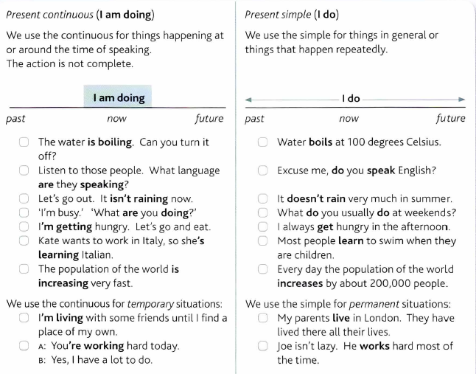
SAME VERBS - DIFFERENT TENSE, DIFFERENT MEANING
Notes:
Grammar in use p.6

Slide 27
NB: NON-CONTINUOUS VERBS!
There are verbs you don’t normally use in the present continuous: usually these are things you cannot see somebody doing. E.g.:
Abstract Verbs
to be, to want, to cost, to seem, to need, to care, to contain, to consist, to know, to realize, to suppose, to mean, to understand, to believe, to agree, to forget, to remember, to exist…
Possession Verbs: to possess, to own, to belong...
Emotion Verbs: to feel, to like, to love, to hate, to prefer, to dislike, to fear, to envy, to mind...
Perception Verbs: to see, to hear, to smell
Examples:
He is needing help now. Not Correct vs. He needs help now. Correct
He is wanting a drink now. Not Correct vs. He wants a drink now. Correct

Slide 28
PRESENT CONTINUOUS + ALWAYS
The Present Continuous with words such as "always" or "constantly" expresses the idea that something irritating often happens.
  → the meaning is like Simple Present, but with a negative connotation.
Examples:
She is ALWAYS coming to class late.
I’m ALWAYS losing my keys.
He is CONSTANTLY talking. I wish he would shut up.
I don't like them because they are ALWAYS complaining.
Remember to put the words "always" or "constantly" between "be" and "verb+ing”

Slide 29
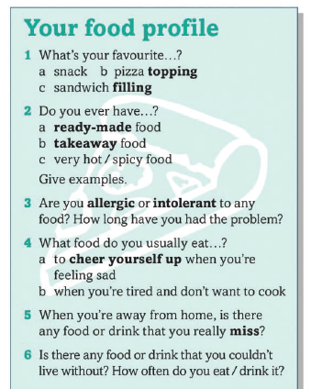
HOMEWORK
OVER TO YOU
Student’s book: unit 1A (p. 6-9)
Grammar bank: p.132
Vocabulary bank: p.152
Workbook: p. unit 1A (p. 4-6)

Slide 30
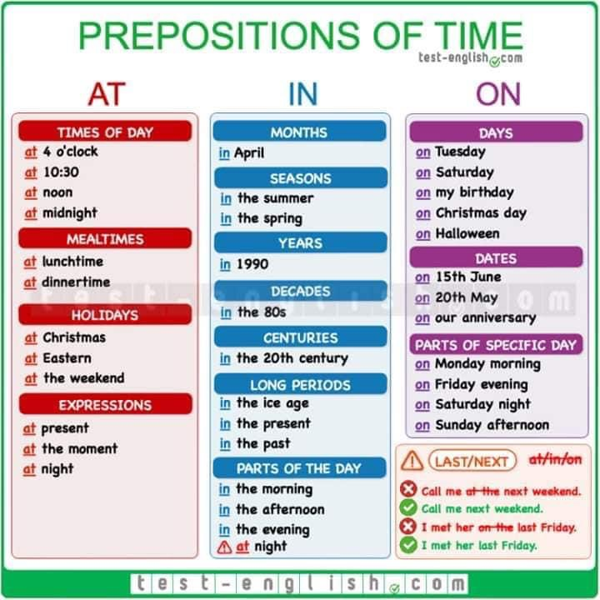

Slide 31
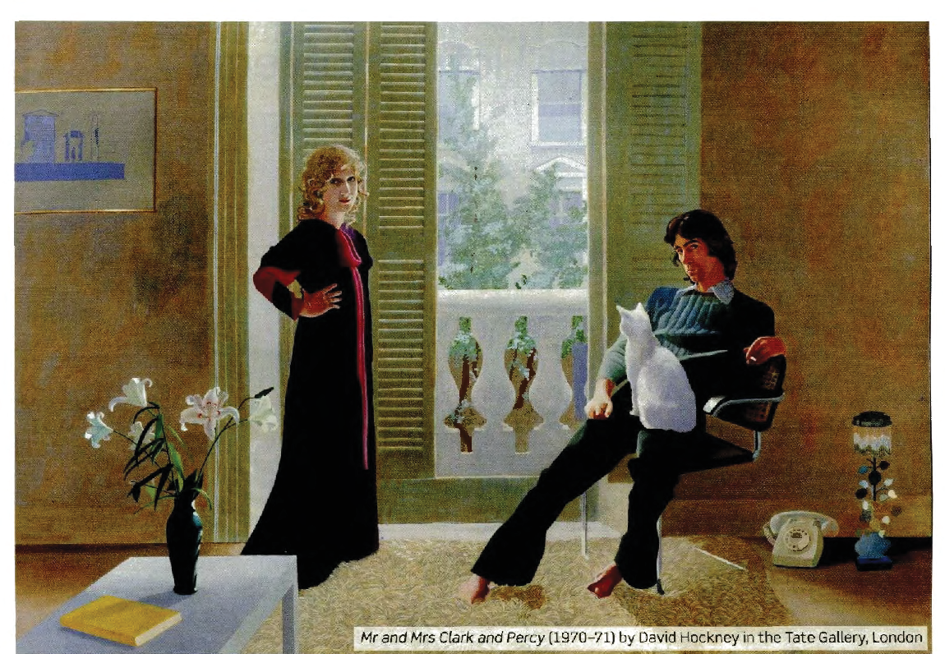
DESCRIBING PEOPLE and PICTURES

Slide 32
LET’S PRACTISE!!!

Slide 33
HOW TO DESCRIBE PICTURES
Start with a summary, giving a general description of what’s in the picture and what you can see. You may want to summarize what you see in one or two simple sentences.
  There is / There are…
  The picture shows…
After your summary, you can
start providing more details about
what you see in the picture.
To start giving details, you can:
  describe things/people
  and where they are in the picture
  talk about what people are doing
  describe what people look like
  speculate about the situation
How to Describe a Picture in English – Video Lesson
https://www.oxfordonlineenglish.com/describe-pictures
Notes:
What’s the best way to start your description?

Slide 34
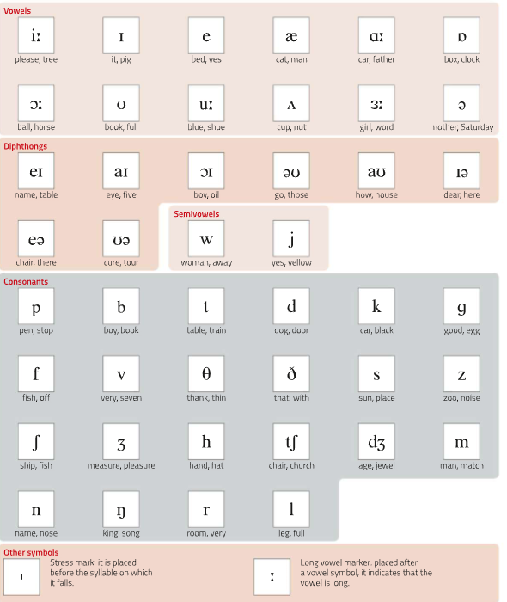
Phonetic chart

Slide 35
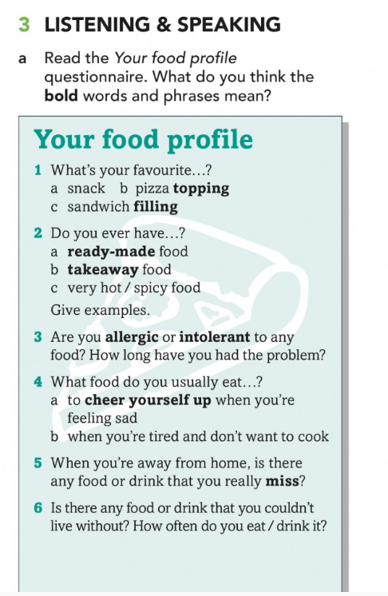
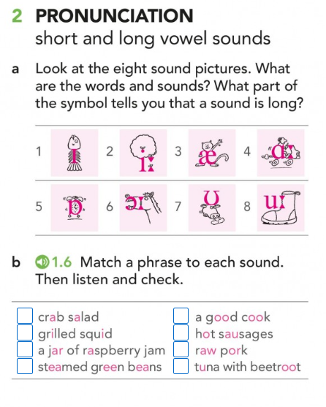

Slide 36
PRONUNCIATION
REMEMBER:
THIRD PERSON ENDING IN –S
/s/ for verbs ending in an unvoiced consonant (e.g. cooks, eats)
/z/ verbs ending in a vowel sound or voiced consonant, (e.g. watches, finishes)
IRREGULAR PRONUNCIATION:
HE,SHE,IT SAYS /sez/
DOES /d˄s/

Slide 37
HOMEWORK
Grammar exercises
Listenining exercises
Writing: describe one of the pictures uploaded in the following slides.
OVER TO YOU
Student’s book: unit 1A (p. 6-9)
Grammar bank: p.132
Vocabulary bank: p.152, p.160
Workbook: p. unit 1A (p. 4-6)

Slide 38
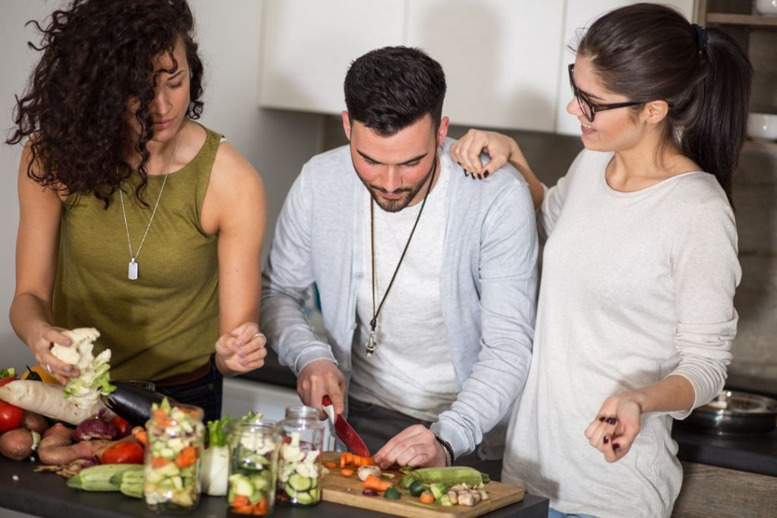
SPEAKING ACTIVITY: DESCRIBE THE PICTURE BELOW

Slide 39
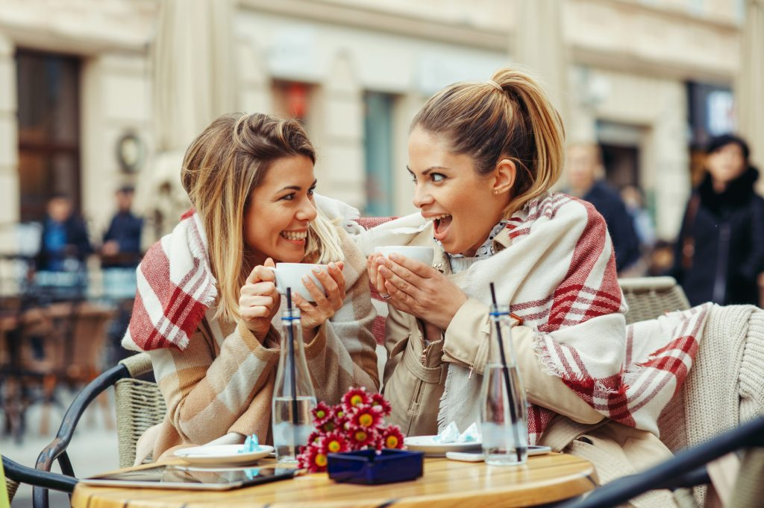

Slide 40
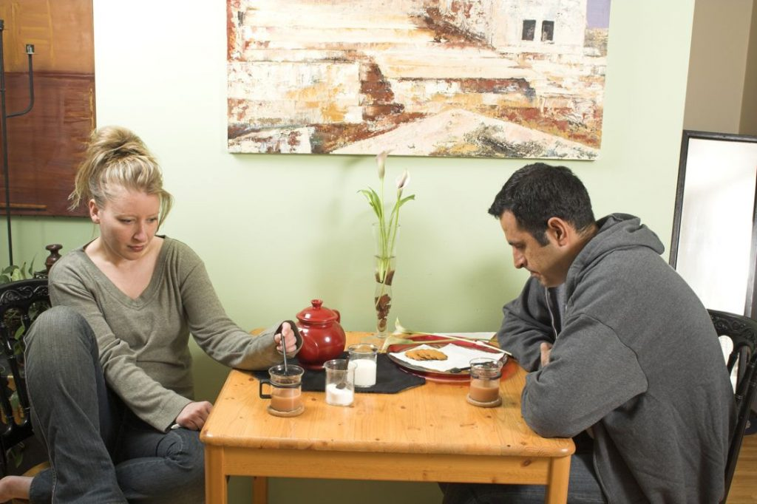
Notes:
Probably, the person who took this photo took it because of the people. So, you should focus your description on the two people.
What do they look like, and what are they doing?
You could say:
The two people both look unhappy or irritated.
They’re sitting at the kitchen table together, but they aren’t talking to each other.
The man is staring down at the table, while the woman is stirring her tea with a spoon.
Speculating means talking about possibilities. you’re talking about possibilities and giving your opinion about the picture.
I suppose…
Maybe they…
Give a summary of what you see.
Talk about where things are in the picture.
Add details.
Speculate about what’s in the picture.
Speculate about the context of the picture.
In the picture, there are two people sitting at a table, looking unhappy. There’s a woman on the left and a man on the right. In the middle of the picture, we can see some things on the table, like cups of tea, biscuits, milk and so on. The two people look sad or irritated, and they aren’t speaking to each other. They’re both looking down at the table. I suppose they had a fight and now they aren’t talking to each other, or they might just be bored and not have anything to talk about.

Slide 41
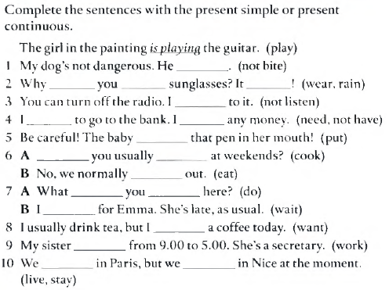
Present tenses: ex. 1C-b p. 127
1C
127

Slide 42
WORD STRESS ( = SYLLABLE STRESS)
Video lesson: https://www.oxfordonlineenglish.com/syllables-and-stress
To communicate clearly when you are speaking in English, it is important to stress the correct syllables in each word.
This is called word stress, which means pronouncing one syllable of a multisyllabic word with greater emphasis (stress) than the other syllables in the word.
A stressed syllable combines these features:
It is l-o-n-g-e-r - com p-u ter
It is LOUDER - comPUter
It usually has a higher pitch than the syllables coming before and afterwards.
It is said more clearly -The vowel sound is purer.
Remember: the unstressed (weak/quiet) syllables of a word
have the opposite features of a stressed syllable!
Stress is always on a vowel!
Notes:
https://www.teachingenglish.org.uk/article/word-stress
Video lesson – interrompere a 5.10 più o meno, poi slide, poi continua con regole (video lesson + next slides)

Slide 43
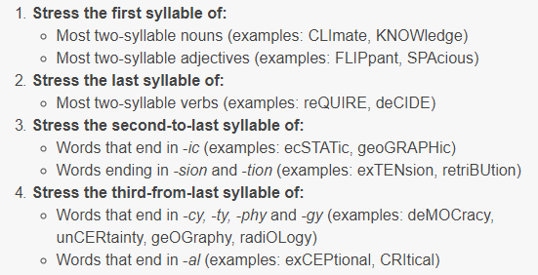
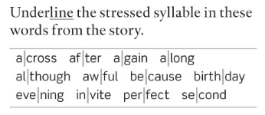
WORD STRESS – some general rules
TWO-SYLLABLE WORDS
BUT: hotel, respect
Many two-syllable prepositions and connectors (examples: beHIND, beFORE, beCAUSE)
Compound nouns: stronger stress on the first part (examples: HAIRbrush, FOOTball)
Exercise 2a (p.17)
Notes:
https://www.toeflgoanywhere.org/learn-these-4-word-stress-rules-improve-your-pronunciation
https://www.teachingenglish.org.uk/article/word-stress
Es. 2a pag. 17

Slide 44
WORD STRESS – some general rules (2)
LONGER WORDS
Notes:
https://www.toeflgoanywhere.org/learn-these-4-word-stress-rules-improve-your-pronunciation
https://www.teachingenglish.org.uk/article/word-stress

Slide 45
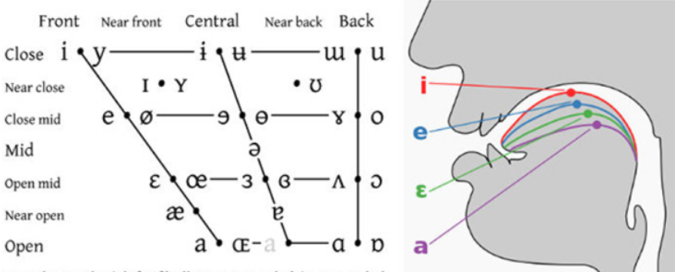
Phonetic chart

Slide 46
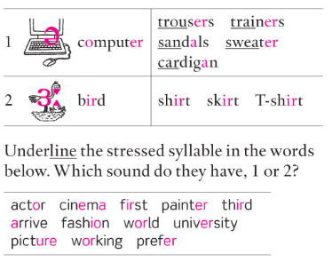
Pronunciation notes
1C
/Ə/ (schwa) is the most common sound in English. It is a short sound, and always occurs in an unstressed syllable, e.g. doctor, address.
  Unstressed -er or -or at the end of a word are always pronounced /Ə/, e.g. teacher, better
  Same sound in -tion
/3:/ is a similar sound, but it is a long sound and is always in a stressed syllable, e.g. nurse, worker
Notes:
exercise 2a-b p.8

Slide 47
Pronunciation notes
1C
Exercise 2b (p.8)
Notes:
exercise 2a-b p.8

Slide 48
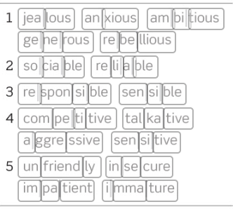
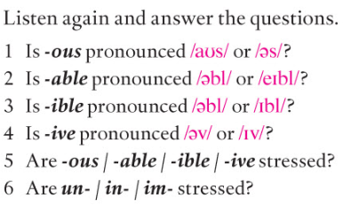
WORD STRESS – more practice
https://www.youtube.com/watch?v=Vu6UVwkUgzc
Notes:
https://www.toeflgoanywhere.org/learn-these-4-word-stress-rules-improve-your-pronunciation
https://www.teachingenglish.org.uk/article/word-stress
Exercise 7a (p.11 B1/+)
1. /es/
2. /ebl/
3. /ebl/
4. /IV/
5+6: no, never

Slide 49
OVER TO YOU – PART 1
Oxford Online English – Pronunciation Lessons
Sounds and spelling: https://www.oxfordonlineenglish.com/sounds-and-spelling
Silent letters: https://www.oxfordonlineenglish.com/silent-letters
(others)
Pronunciation exercises in Units 1A, 1B, 1C, 2C
VB p. 150 + supplementary material about personality-related adjectives.

Slide 50
EXTRA MATERIALS

Slide 51
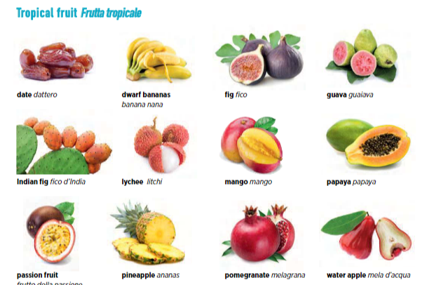
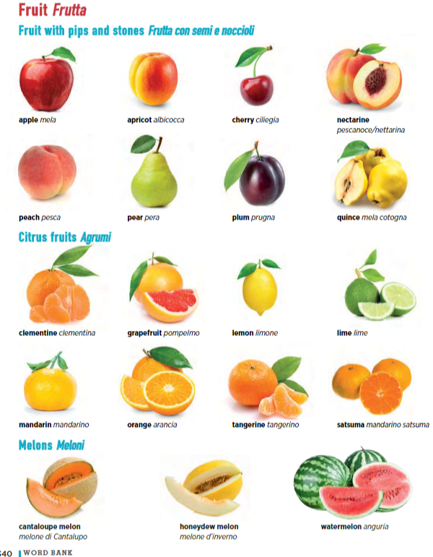
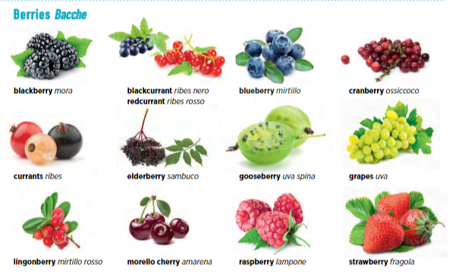
Notes:
There are three people cooking in a kitchen.
The picture shows three young friends cooking together.
On the left, there’s a girl with dark, curly hair. She’s holding half a cauliflower.
In the middle, there’s a man who’s chopping vegetables.
At the bottom, we can see a counter with many different vegetables on it.

Slide 52
