Slide 1
A.A. 2023/24, LM-85bis
(1° anno, 2° semestre)
LABORATORIO DI LINGUA INGLESE I
week VI/VII
Notes:
‹#›

Slide 2
TODAY’S CLASS
TALKING ABOUT PAST EXPERIENCES, EVENTS AND HABITS
GRAMMAR: PAST TENSES
  past simple, past continuous, past perfect (5A)
  used to (5B)
  Comparatives and superlatives
PRONUNCIATION
  -ed endings
VOCABULARY
  Food, holidays, travel, sports
  prepositions at, in, on (time)

Slide 3
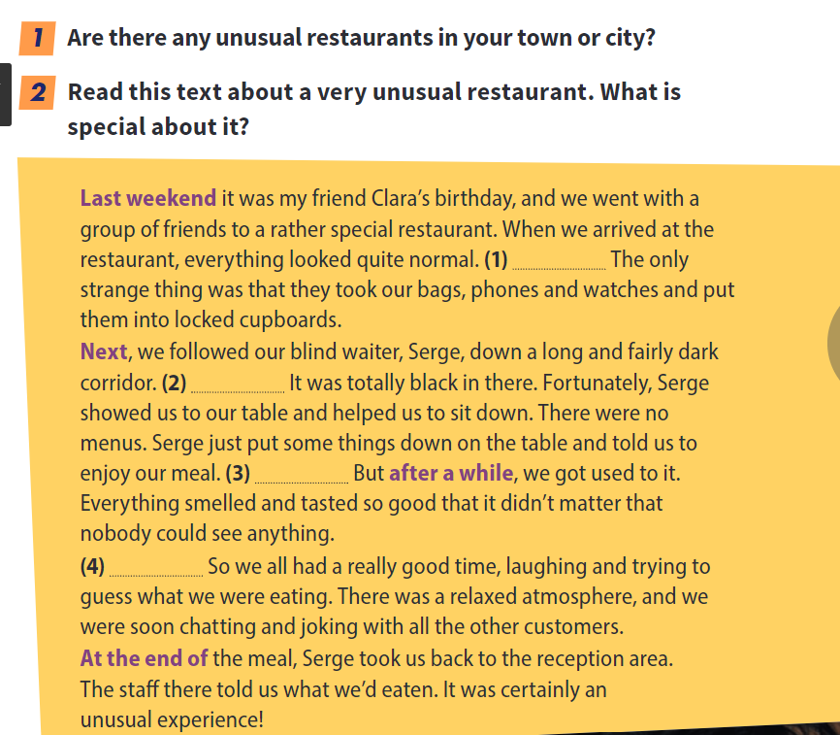
Reading and comprehension
Read the text and answer the two questions

Slide 4
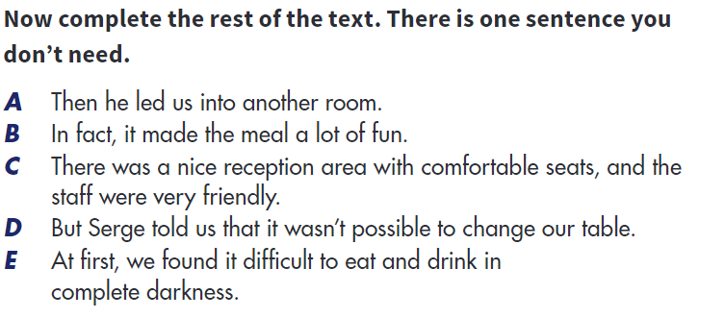
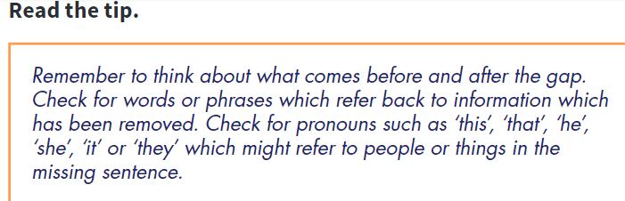

Slide 5
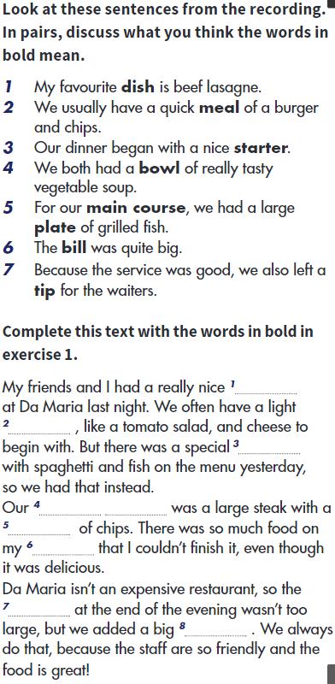
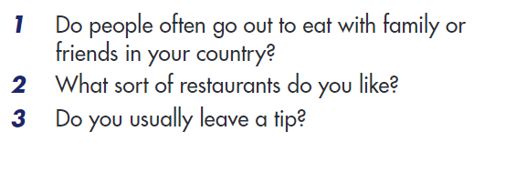

Slide 6
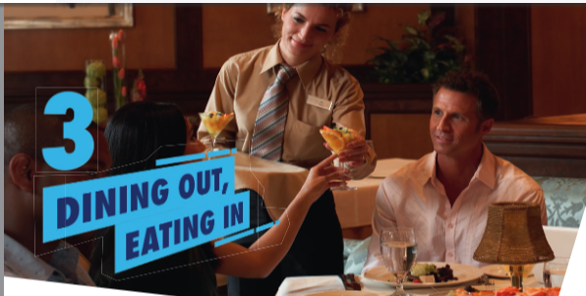
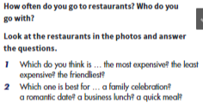
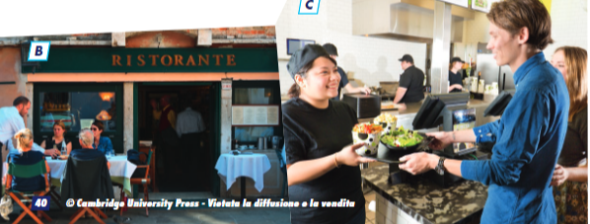

Slide 7
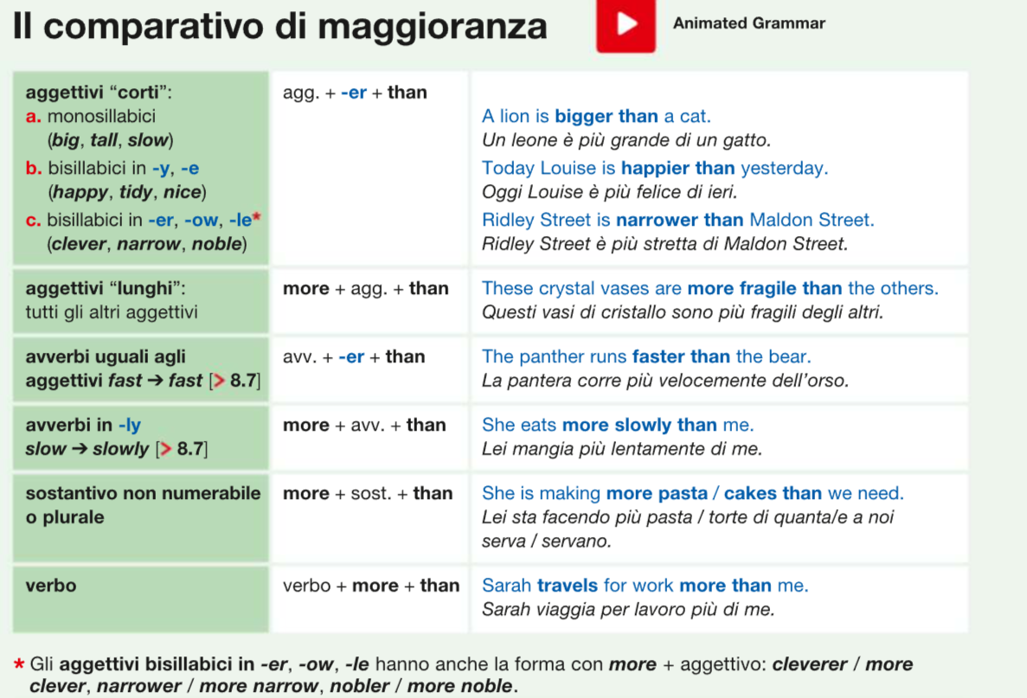

Slide 8
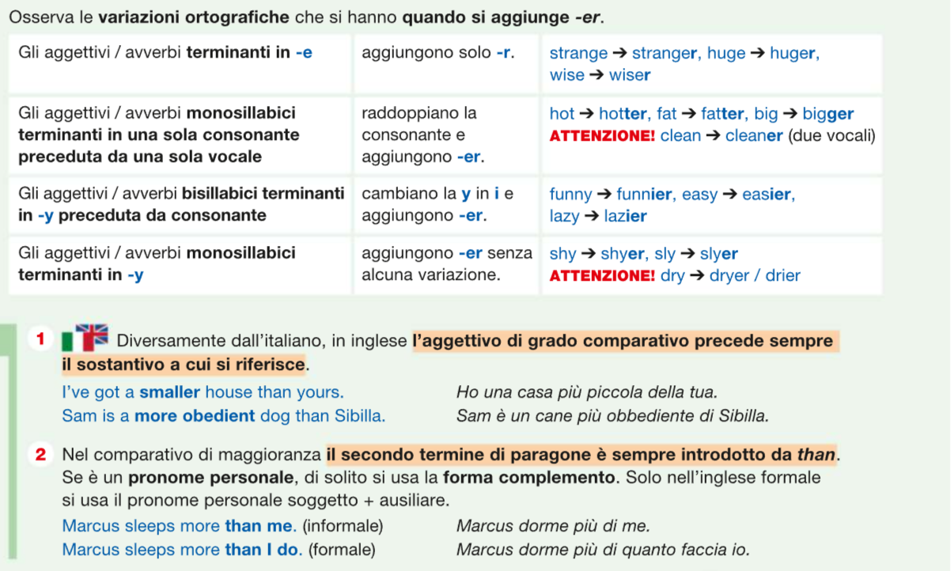

Slide 9
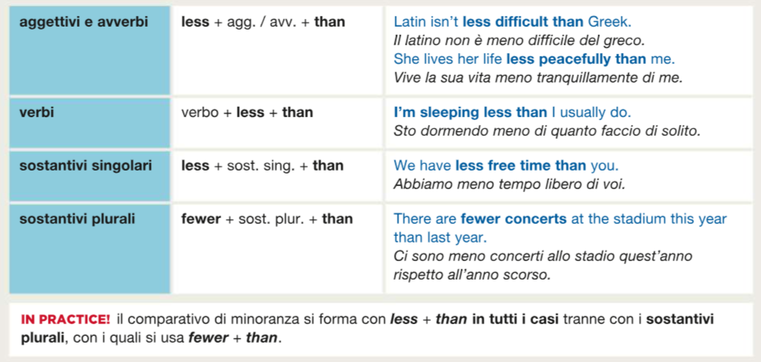

Slide 10
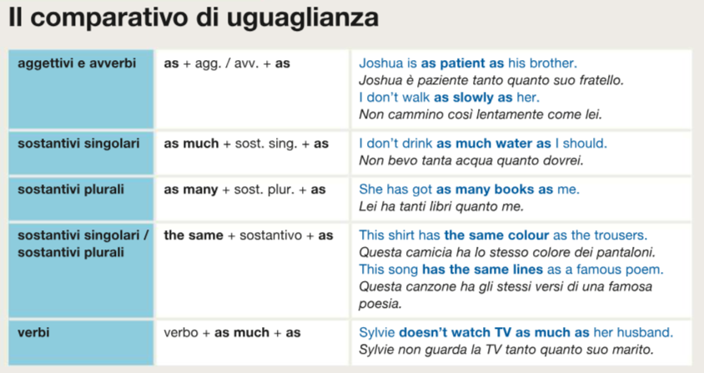

Slide 11
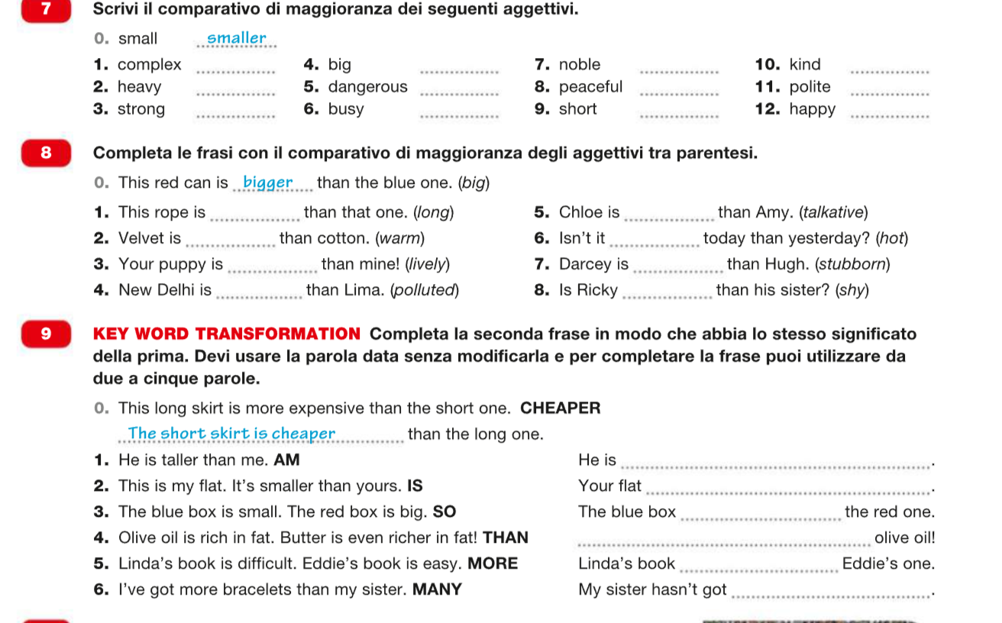

Slide 12
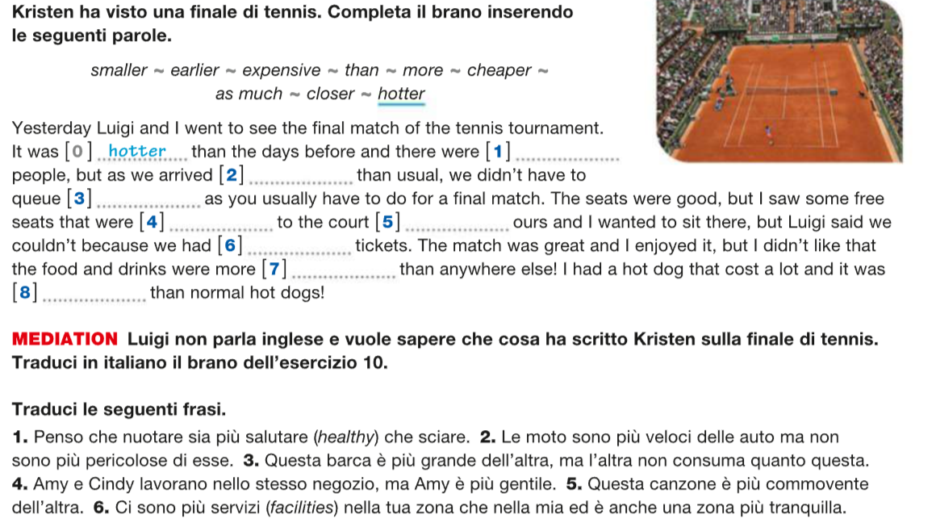

Slide 13
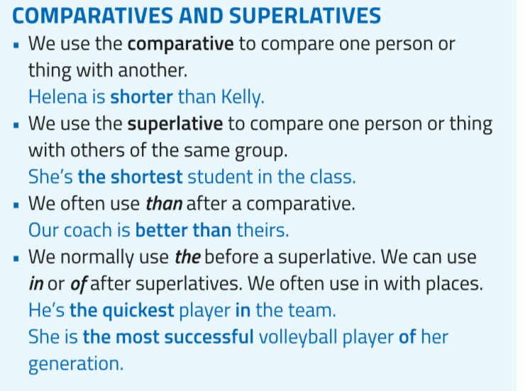
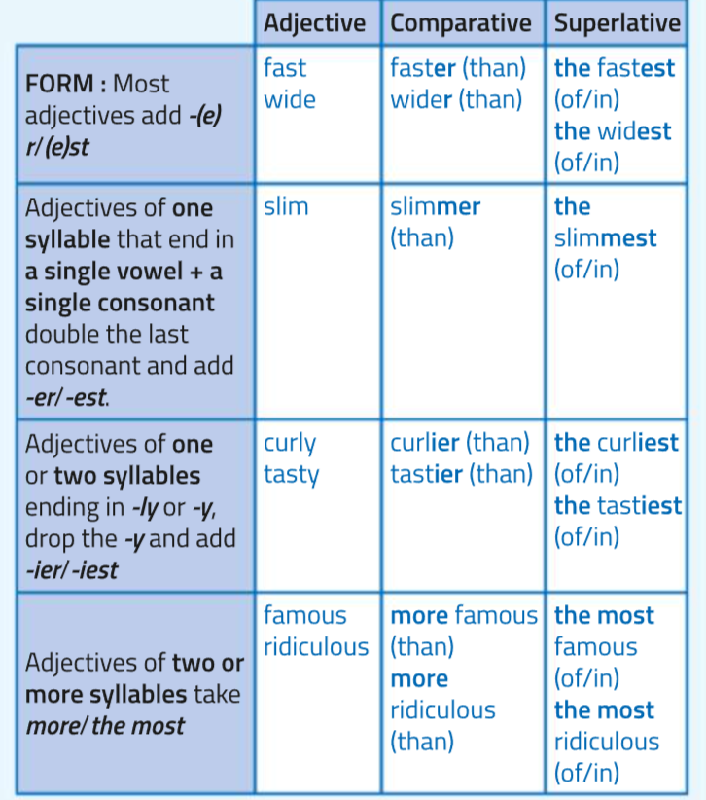
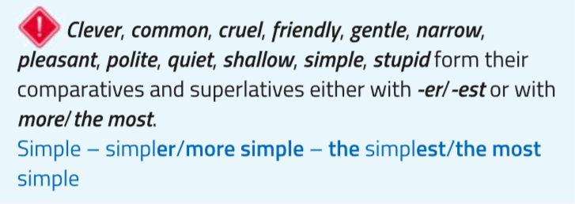

Slide 14
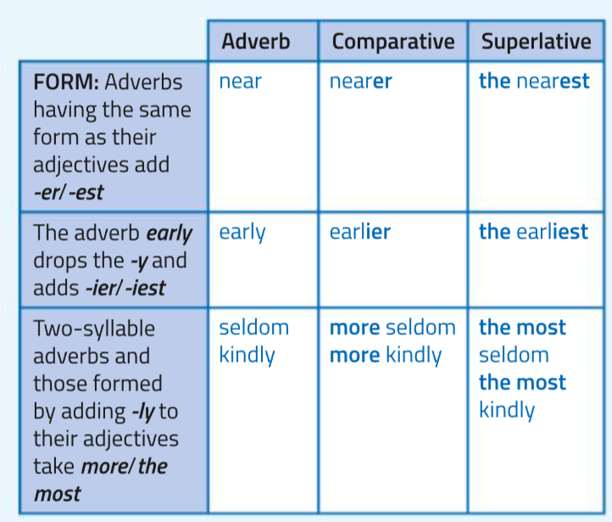
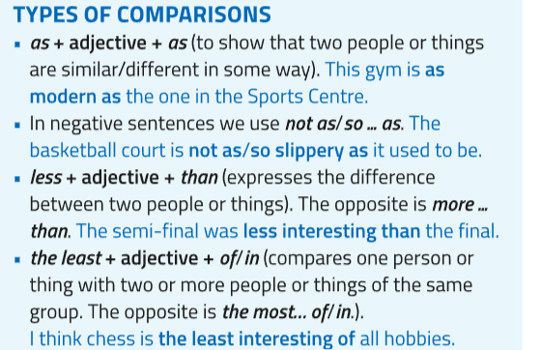
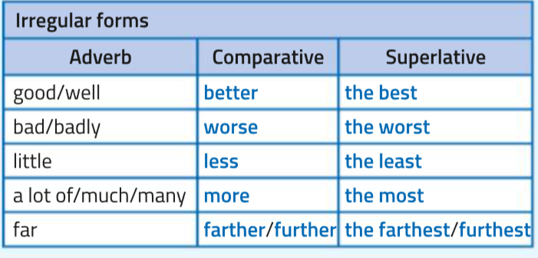

Slide 15
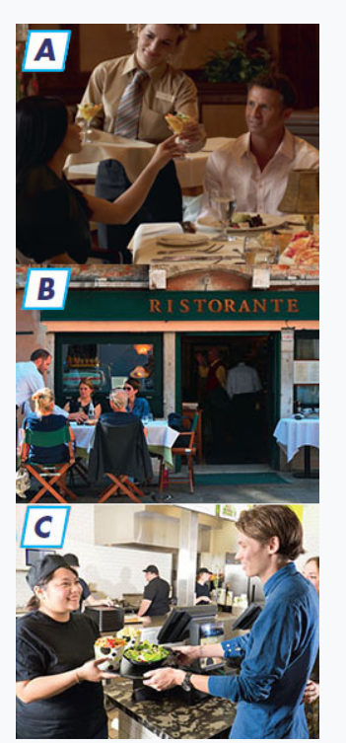
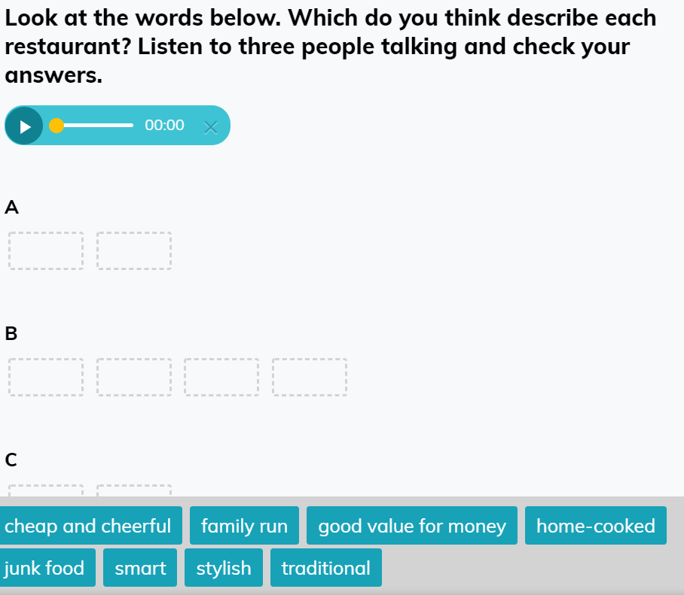
Bsmar: open word preliminary pag 41 Listening

Slide 16
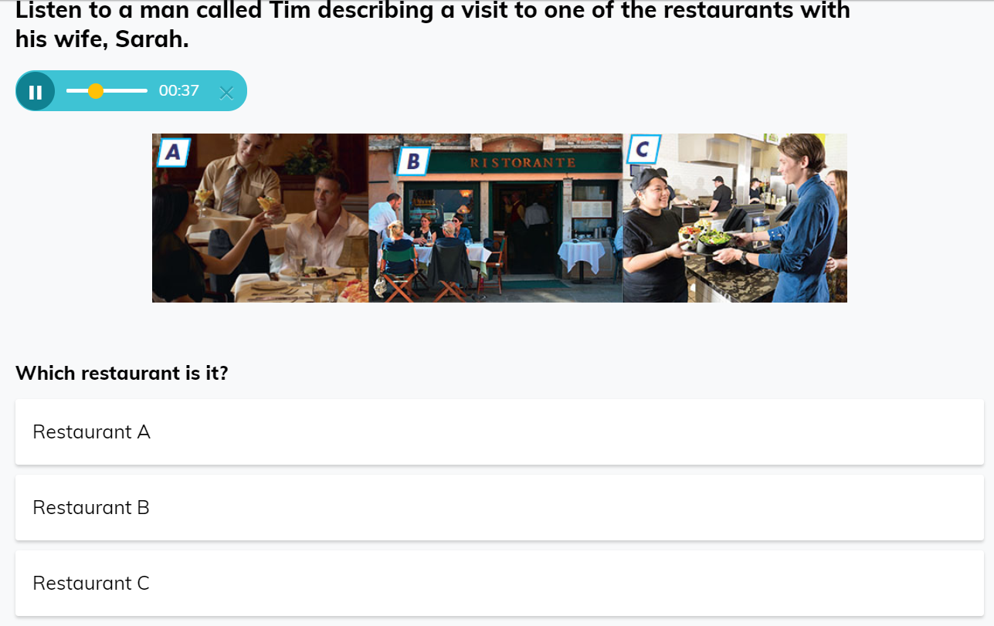
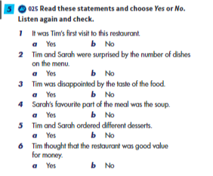
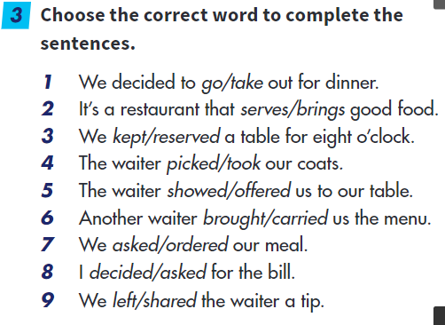

Slide 17

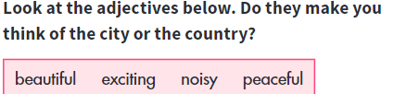
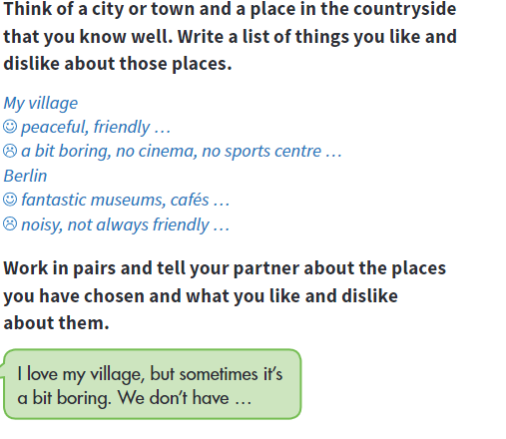

Slide 18

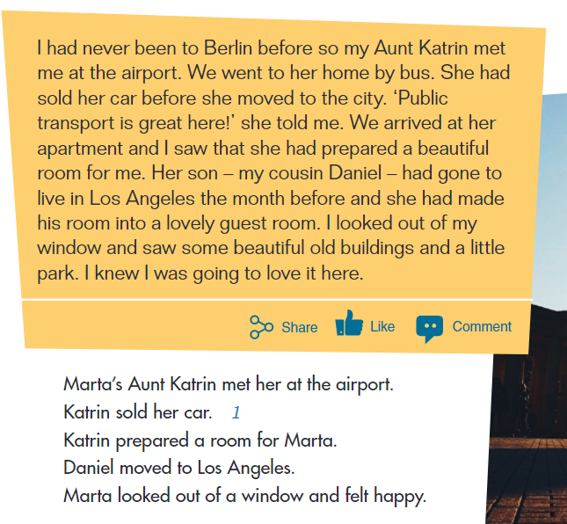

Slide 19
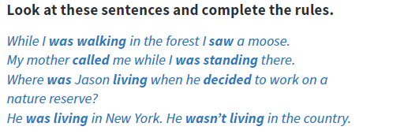
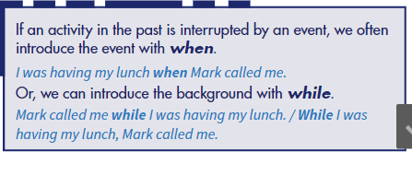
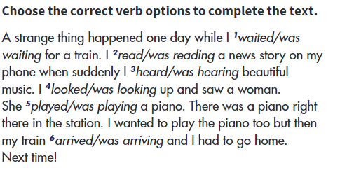


Slide 20
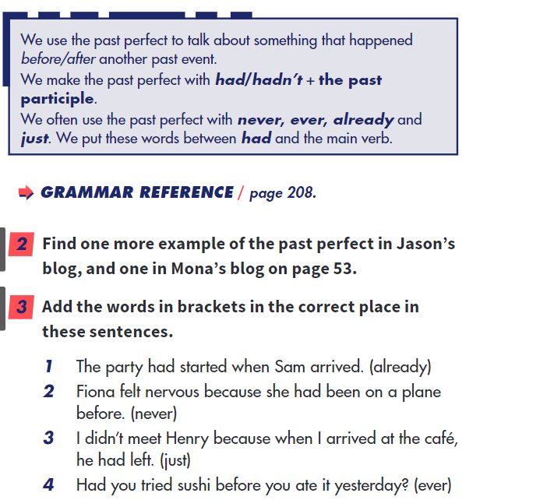
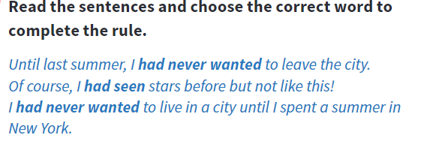

Slide 21
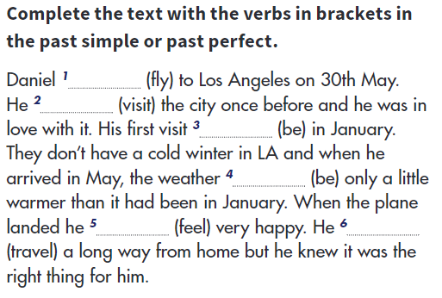

Slide 22
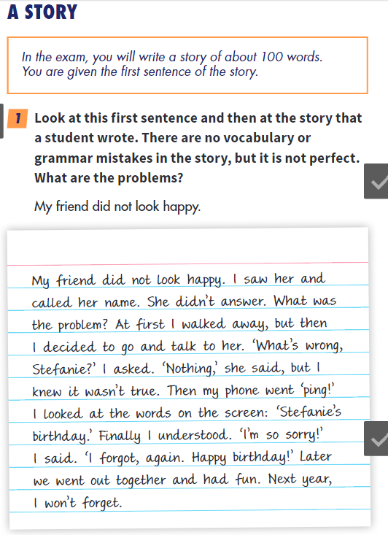
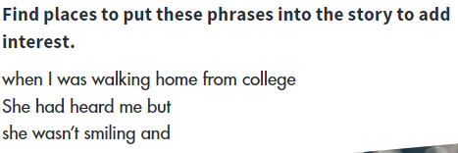
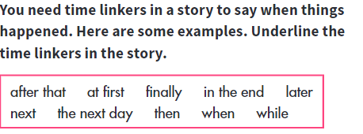

Slide 23
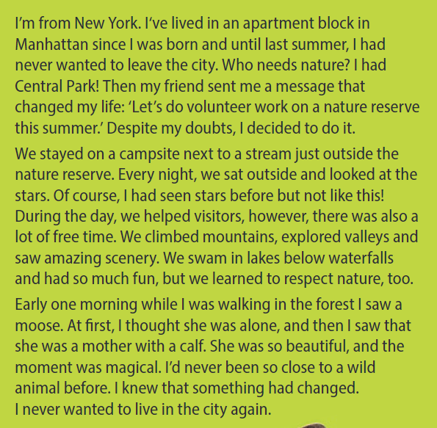
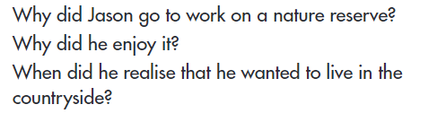

Slide 24
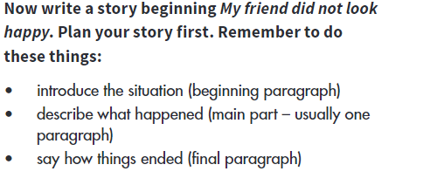
Write an interesting story!

Slide 25
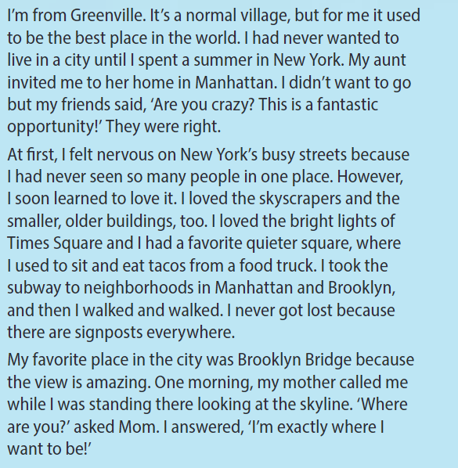
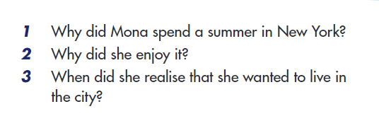

Slide 26

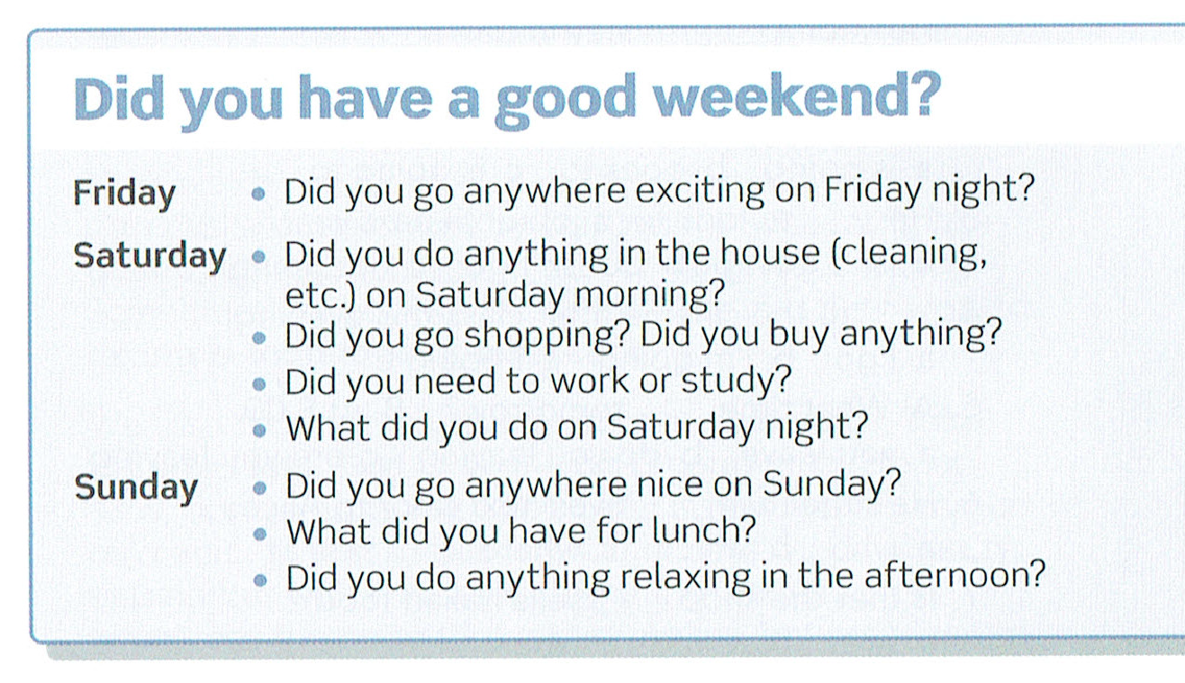
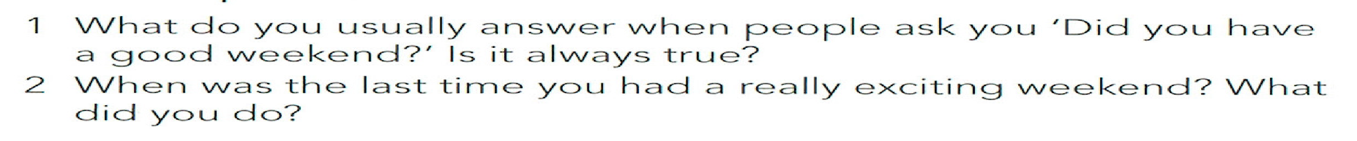
Something to talk about
What did you do at the weekend?
Notes:
Chiedere a qualche coppia

Slide 27
THE PAST SIMPLE: stating a definite time in the past
We use the past simple to talk about finished actions in the past.
If you want to say that an event occurred at a particular time in the past:
  The Italian Prime Minister flew into New York yesterday.
  Our teacher went to Canada last year.
  NB: a time expression is necessary to specify the particular time in the past you are referring to (e.g. two years ago, last month, yesterday). The time reference can be established in a previous clause:
  The house was damaged by fire yesterday. However, no-one was injured.

Slide 28
THE PAST SIMPLE: stating a definite time in the past
If you want to say that a situation existed in the past / over a period of time in the past:
  When I was a kid, all the streets in this part of Watford looked alike.
  He lived in Paris during his last years.
  Throughout his life he suffered from epilepsy
If you want to talk about an activity that took place regularly or repeatedly in the past, but that no longer occurs:
  We walked a lot when I was a boy.
  Each week we trekked to the big house.

Slide 29

Using the simple past for storytelling: Jack and the Beanstalk
ON OLAT!
Once upon a time there was a boy called Jack. He _____ with his mother. They ____ very poor. All they ____ was a cow.
One morning, Jack’s mother ____ Jack to take their cow to market and sell her. On the way, Jack ____ a man. He ____ Jack some magic beans for the cow. Jack ____ the beans and ____ back home. When Jack’s mother ____ the beans she ____ very angry. She ____ the beans out of the window.
The next morning, Jack ____ out of the window. There ____ a giant beanstalk. He ____ outside and ____ to climb the beanstalk. He ____ up to the sky through the clouds and ____ a beautiful castle.
(….)
With the golden eggs and the magic harp,
Jack and his mother ____ happily ever after.
http://learnenglishkids.britishcouncil.org/en/short-stories/jack-and-the-beanstalk

Slide 30
THE PAST SIMPLE: stating a definite time in the past
If you want to say that a situation existed in the past / over a period of time in the past:
  When I was a kid, all the streets in this part of Watford looked alike.
  He lived in Paris during his last years.
  Throughout his life he suffered from epilepsy
If you want to talk about an activity that took place regularly or repeatedly in the past, but that no longer occurs:
  We walked a lot when I was a boy.
  We used to walk a lot when I was a boy.
  Each week we trekked to the big house.
  We used to trek to the big house every week.

Slide 31
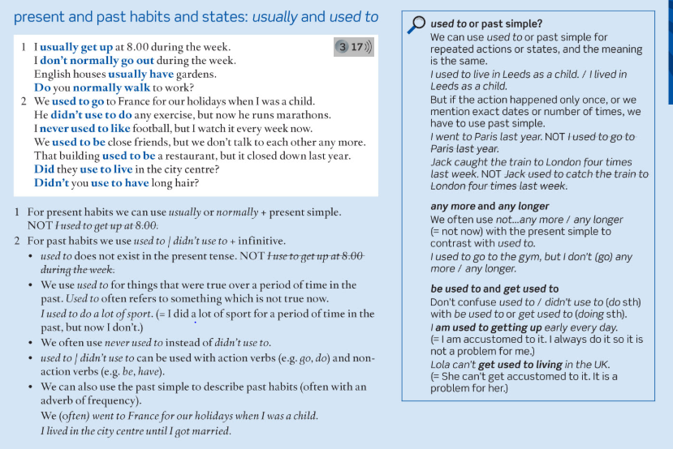

Slide 32
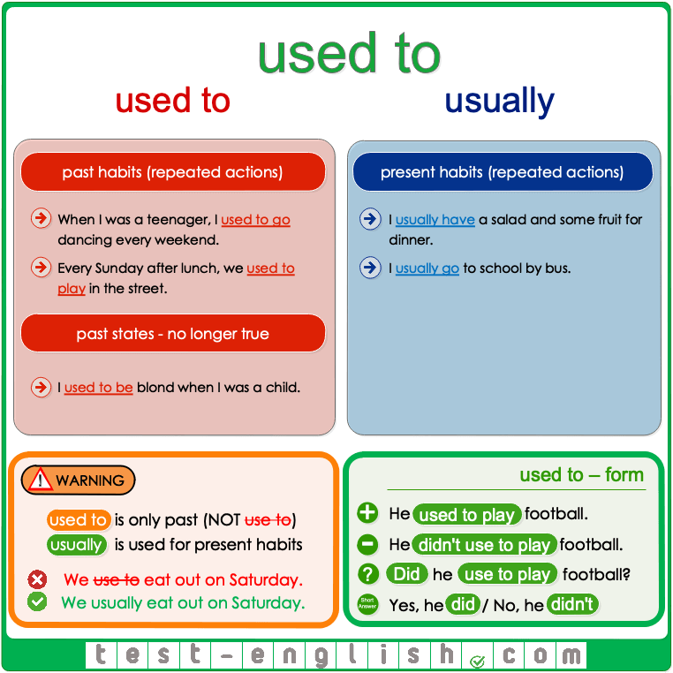

Slide 33
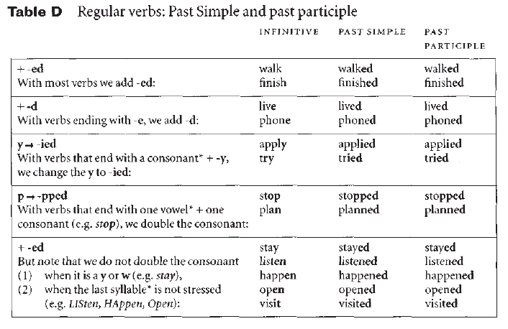
With most verbs the past simple is formed by adding -ed:
But there are a lot of irregular verbs (p.165)

Slide 34
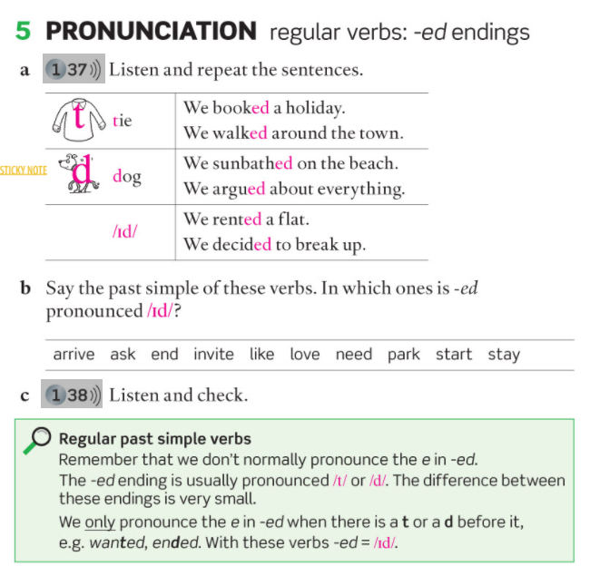
(See also: -ed pronunciation lesson)

Slide 35
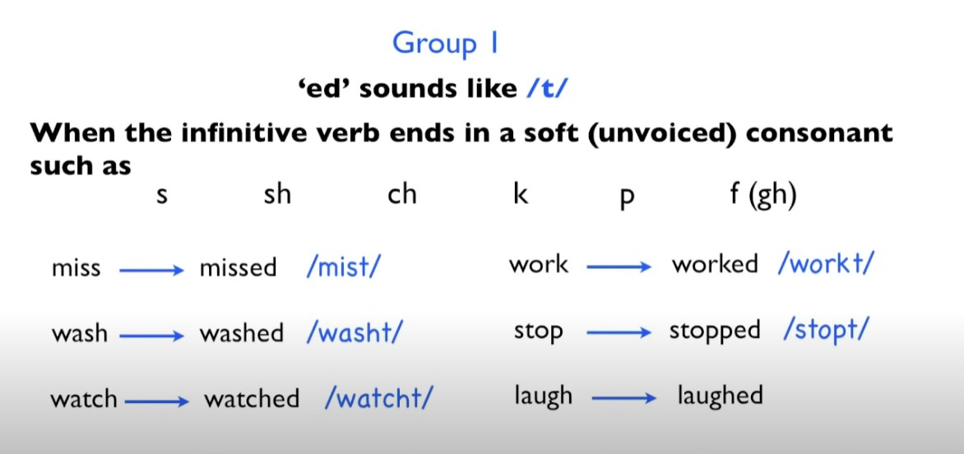

Slide 36
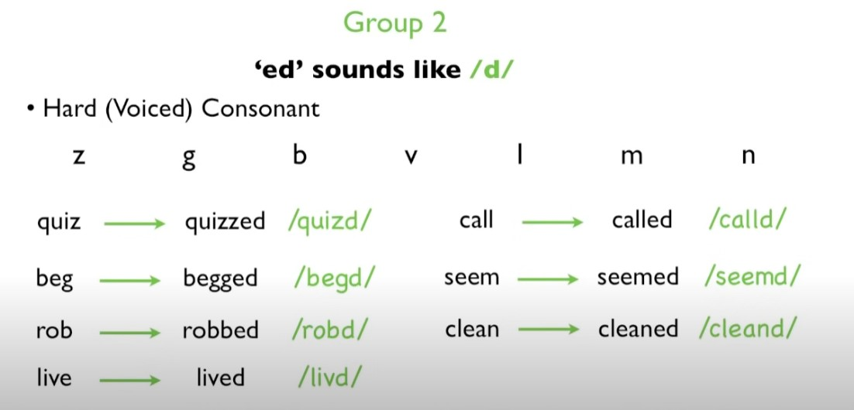

Slide 37


Slide 38
PAST SIMPLE: - and ?
We use didn’t (did not) + base form to make negatives:
  They didn’t go to Spain this year.
  We didn’t get home until very late last night.
  I didn’t see you yesterday.
We use did (+ subj + base form) to make questions:
  When did you meet your wife?
  Where did you go for your holidays?
  Did she play tennis when she was younger?

Slide 39

PAST SIMPLE AND PAST CONTINUOUS
WHEN I TOOK THIS PHOTO….
to have a coffee;
to fight;
to ride a bike;
to read;
to talk on one’s mobile phone
If you want to focus on actions which were in progress in the past, you use the past continuous (or progressive).

Slide 40


PAST CONTINUOUS
1. To talk about an action that was in progress in a specific moment in the past.
  «What were you doing at 10 am this morning?»
  «I was having coffee with a friend»
Or, to talk about two actions that were in progress at the same time in the past.

Slide 41

PAST CONTINUOUS
To talk about an action that was temporary but stretched over a certain period in the past.
  I was studying in London when my parents brought home a new dog, so he didn’t consider me as part of the family. [= in that period]
  I remember when I moved to Rome. I was dating Pauline at that time / at the time [= in that period] and I missed her a lot.

Slide 42

PAST CONTINUOUS (with past simple)
To describe an activity or a situation that was interrupted by another action in the past.
past continuous to describe the situation (or the longer action in progress)
past simple to describe the event that interrupts it

Slide 43
Example
Affirmative form
I was reading
You were reading
He/she/it was reading
We were reading
You were reading
They were reading
Negative form
I wasn’t reading
You weren’t reading
He/she/it wasn’t reading
We weren’t reading
You weren’t reading
They weren’t reading
Interrogative form
Was I reading?
Were you reading?
Was he/she/it reading?
Were we reading?
Were you reading?
Were they reading?

Slide 44


Notes:
Exercise 1b WB p.181 (3° edition)

Slide 45


Notes:
Exercise 1c WB p.181 (3° edition)

Slide 46



Notes:
Page 49

Slide 47



Slide 48



Slide 49

PAST PERFECT

Slide 50


Slide 51
SPEAKING PRACTICE
Interview your partner about her/his (their) last holiday.
  Where / go?
  How / go there?
  Why / go there?
  When / go?
  Who / go with?
  Where / stay?
  What / the food (/weather) like?
  What / do during the day (/at night)?
  / have a good time?
  / have any problems?
  What / like most?
  / anything special/funny happen?
See: adverbs of time

Slide 52





Slide 53




Your perfect holiday – Do you prefer… ?
Notes:
Seaside (sunbathe)
Mountains (going for walks)
tourist city (go sightseeing)

Slide 54








Your perfect holiday – Do you prefer… ?
going abroad
Do you agree?
I agree / don’t agree
(with you)
I’m (not) agree
staying in Italy
Notes:
Remare = row, using poles, standing at the back end of the gondola
Pretend to kick
Niagara falls (waterfall, North America, on the border between Canada and US)
Eiffel Tower
Going abroad – foreign countries

Slide 55

DISASTROUS HOLIDAYS
EXTRA PRACTICE
Notes:
Far questo

Slide 56

DISASTROUS HOLIDAYS
EXTRA PRACTICE
Notes:
Questo per casa

Slide 57

DISASTROUS HOLIDAYS
EXTRA PRACTICE
Where did Joe/ Laura go on holiday?
Who did he/she go with?
Where did he/she stay?
What was the weather like?
Why didn’t he/she enjoy the holiday?
LET’S LISTEN TO THE OTHER SIDE OF THE STORY…
What does Mia say about: (track 34)
  Her relationship with Joe before they went
  The places where they stayed
  Talking to other travellers
  Photos
  Going on holiday with a boyfriend
What does Linda say about:
Venice
What they did there
The cost of her holiday
Her next holiday
(track 35)

Slide 58

Indefinite pronouns
Indefinite pronouns (Cambridge grammar)

Slide 59


Slide 60


Slide 61



Slide 62
Thank you!

