Slide 1
UNIMC
LABORATORIO INGLESE I
A.A. 2023/2024, LM85-BIS
(1° ANNO, 2° SEMESTRE)
Prof.ssa Nicoletta Moretti
Nicoletta.moretti3@unimc.it

Slide 2
Lesson II
AIMS : AT THE END OF THE LESSON YOU WILL BE ABLE TO
USE THE PRESENT SIMPLE AND THE PRESENT CONTINUOUS
TO USE ADVERBS OF FREQUENCY
TO DESCRIBE PICTURES USING PRESENT CONTINUOUS

Slide 3
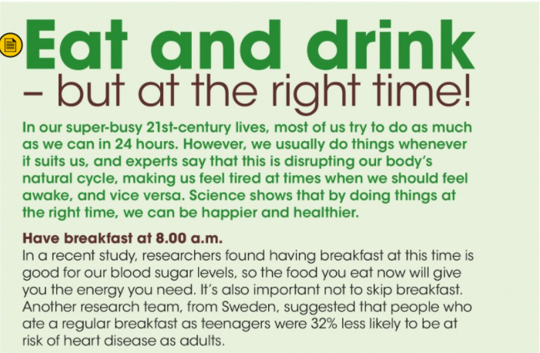
When we use most before articles (a/an, the), demonstratives (this, that), possessives (my, your) or pronouns (him, them), we need of:
the information was useful. Some of it wasn’t relevant.
Not: Most of the information …
They sold most of
their apartments quite quickly.
every or
any time
Warning:
When there is no article, demonstrative or possessive pronoun, we don’t usually use of:
There hasn’t been much rain.
Most of rivers are below their normal levels.

Slide 4
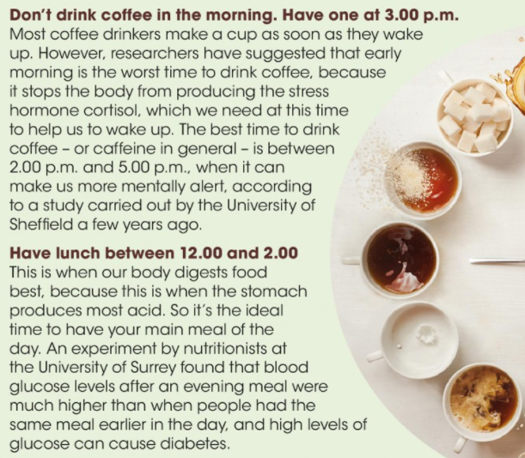
Notes:
Hormone: /ˈhɔː.məʊn/
Cortisol: /ˈkɔː.tɪ.zɒl/
Caffeine: /ˈkæf.iːn/
Diabetes: /ˌdaɪ.əˈbiː.tiːz/

Slide 5
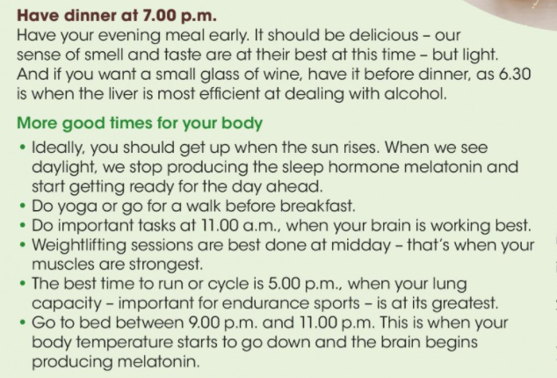
Notes:
Melatonin: /mel.əˈtəʊ.nɪn/
a hormone in the body that produces changes in skin colour and is involved in controlling biorhythms such as our sleep pattern
Weightlifting: /ˈweɪtˌlɪf.tɪŋ/

Slide 6
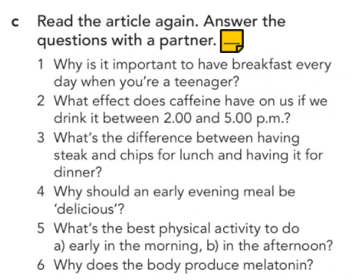
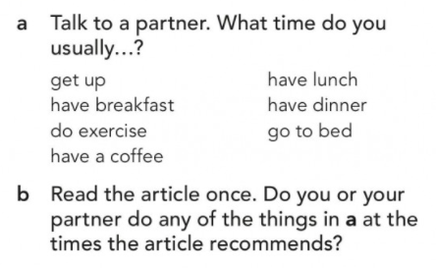
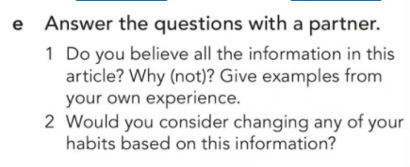

Slide 7
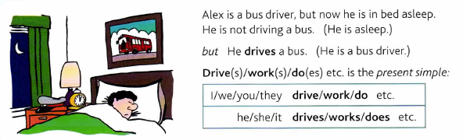
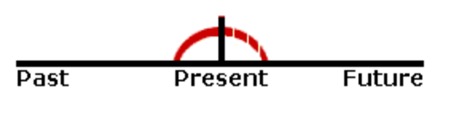
PRESENT SIMPLE
HABITUAL / PERMANENT ACTIONS
To say that something is true in general, or that something happens all the time or repeatedly (and how often we do things):
The cafe opens at 7.30 in the morning / I get up at 8 o'clock every morning.
We usually go home at weekends / We don’t go abroad very often.
Nurses look after patients in hospitals. / The Earth goes round the Sun / Rice doesn’t grow in cold climates.
What does this word mean? / Where do they live?
Notes:
We use the present simple to talk about things in general.

Slide 8
always | sempre
usually | di solito
often | spesso
sometimes | qualche volta
seldom | ogni tanto
rarely | raramente
hardly ever | quasi mai (+ verbo nella forma affermativa)
never | mai ( + verbo nella forma affermativa)
ever | mai (nelle frasi interrogative)
TIME EXPRESSIONS
in the morning
in the afternoon
in the evening
at night
every day
every Monday
on Mondays
at weekends at the weekend
once a week
twice a month
three times a year
FREQUENCY ADVERBS: S + AVV + VSS
Usually at the end of sentences
(can be at the beginning in affirmative sentences)
Notes:
FREQEUNCY ADVERBS
They usually go in mid position.
They sometimes go in front position. (Sometimes she wore a woollen hat.)
They can also go in end position. (We don’t see them very often.)
In inglese le espressioni di tempo vanno solitamente messe alla fine della frase.
Esempio:
Vado al cinema TUTTI I SABATI con i miei amici.
b) I go to the cinema with my friends ON SATURDAYS.
a) ON SATURDAYS I go to the cinema with my friends.
Nelle frasi interrogative e negative vanno messe sempre alla fine della frase, es:
Do you go to the cinema ON SATURDAYS?
I don’t often go to the cinema ON SATURDAYS.
They sometimes go in front position especially if we want to emphasise the adverb. Today, I’m going to clean the house.

Slide 9
PRESENT CONTINUOUS
Something happening (or true) at the time of speaking
John is in his car. He is driving to work.
Let's go out now. lt isn't raining any more.
ACTIONS TAKING PLACE NOW
simple present TO BE + present participle (base +ing)
Affirmative: You are watching TV.
Interrogative: Are you watching TV?
Negative: You are not watching TV.
Notes:
In 1-2 the subject is in the middle of doing - or not doing – something at the time of speaking, and the action is not finished.
Se il verbo deve essere messo in forma negativa o interrogativa, si fa la forma negativa o interrogativa del verbo to be mentre il verbo nella -ing form rimane invariato al suo posto.

Slide 10
PRESENT CONTINUOUS
NOW = this second, today, this month, this year, this century… (→ longer actions in progress now)
Something happening (or true) in a period around now
(talking on the phone) I'm reading a really good book about…
You are studying to become teachers.
Kate wants to work in Italy, so she’s learning Italian.
You’re working very hard today. – Yes, I have a lot to do.
Are you working on any special projects at work?
Is your English getting better now that you’re studying harder?
The population of the world is increasing very fast.
At first I didn't like my job, but I'm beginning to enjoy it now.
Notes:
Sometimes, we use the Present Continuous to say that we are in the process of doing a longer action which is in progress; however, we might not be doing it at this exact second.

Slide 11
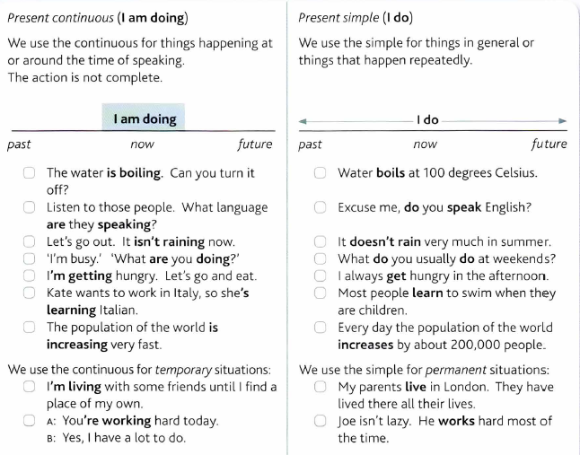
SAME VERBS - DIFFERENT TENSE, DIFFERENT MEANING
Notes:
Grammar in use p.6

Slide 12
NB: NON-CONTINUOUS VERBS!
There are verbs you don’t normally use in the present continuous: usually these are things you cannot see somebody doing. E.g.:
Abstract Verbs
to be, to want, to cost, to seem, to need, to care, to contain, to consist, to know, to realise, to suppose, to mean, to understand, to believe, to agree, to forget, to remember, to exist…
Possession Verbs: to possess, to own, to belong...
Emotion Verbs: to feel, to like, to love, to hate, to prefer, to dislike, to fear, to envy, to mind...
Perception Verbs: to see, to hear, to smell
Examples:
He is needing help now. Not Correct vs. He needs help now. Correct
He is wanting a drink now. Not Correct vs. He wants a drink now. Correct

Slide 13
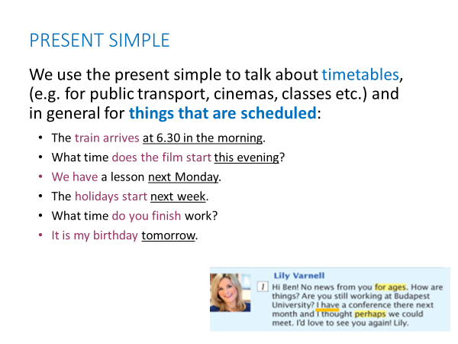

Slide 14
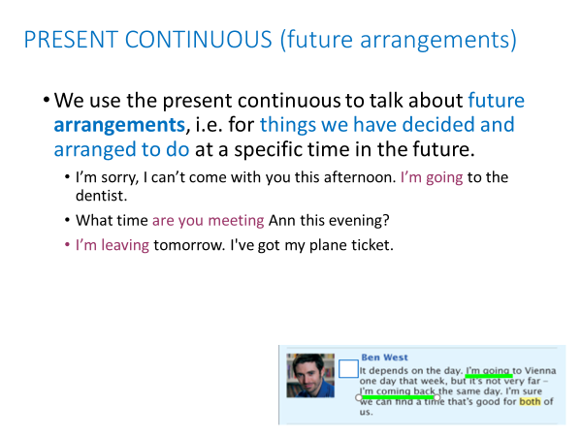

Slide 15
PRESENT CONTINUOUS + ALWAYS
The Present Continuous with words such as "always" or "constantly" expresses the idea that something irritating often happens.
  → the meaning is like Simple Present, but with a negative connotation.
Examples:
She is ALWAYS coming to class late.
I’m ALWAYS losing my keys.
He is CONSTANTLY talking. I wish he would shut up.
I don't like them because they are ALWAYS complaining.
Remember to put the words "always" or "constantly" between "be" and "verb+ing”

Slide 17
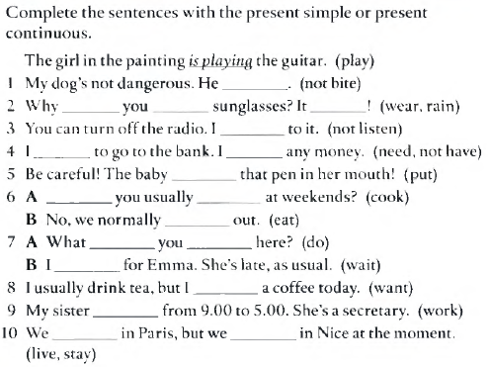
Present tenses: ex. 1C-b p. 127
1C
127

Slide 24
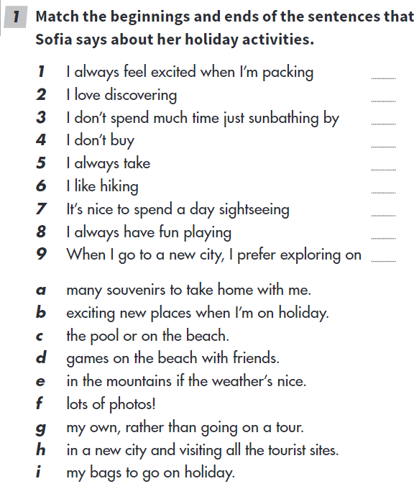

Slide 25
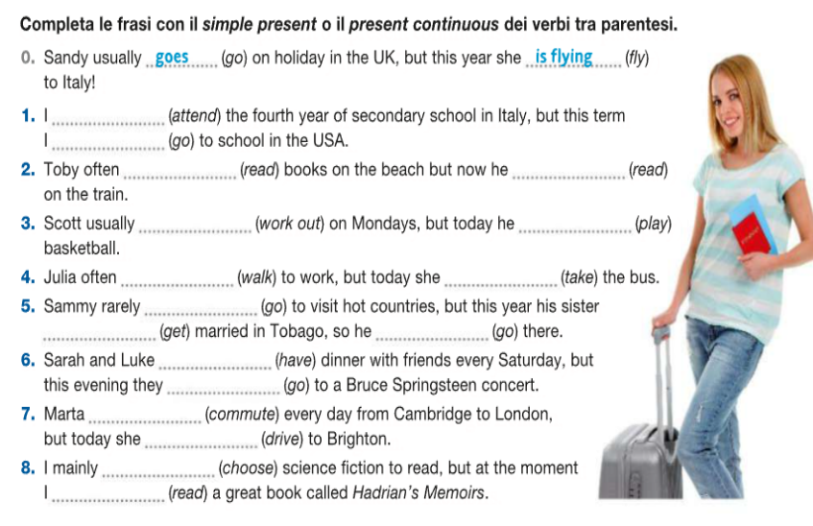

Slide 26
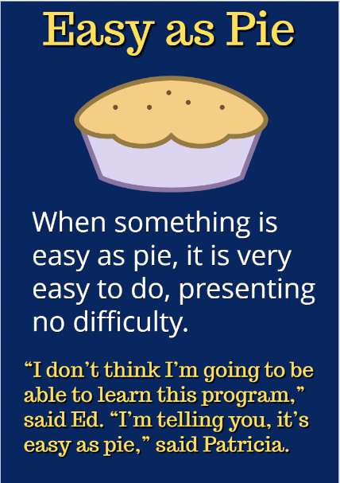
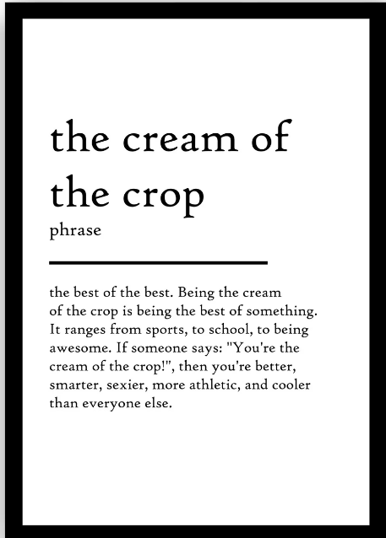
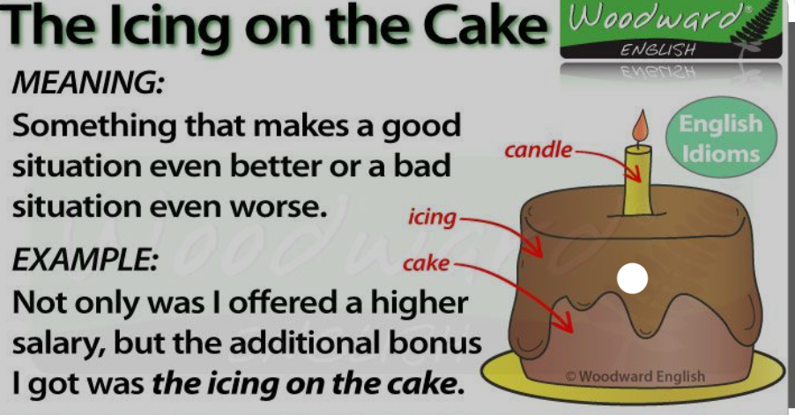
IDIOMS /ˈɪd.i.əm/
EASY AS A PIE
(FACILE COME BERE UN BICCHIER D’ACQUA)
THE CREAM OF THE CROP
(IL FIORE ALL’OCCHIELLO)
THE ICING ON THE CAKE
(LA CILIEGINA SULLA TORTA)

Slide 28
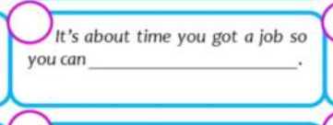
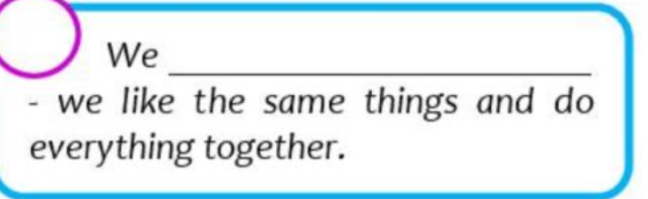
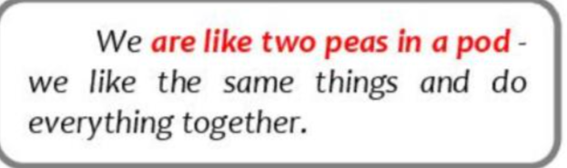
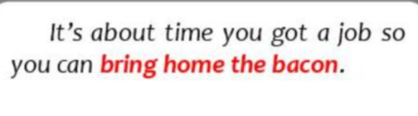
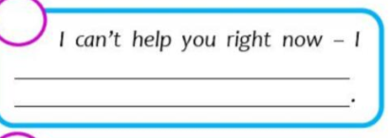
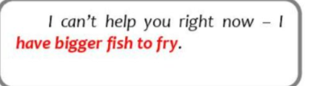
She’ll …………. when you tell her the news.
She’ll go bananas when you tell her the news.

Slide 30
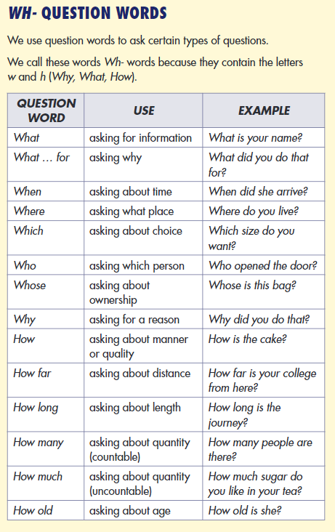
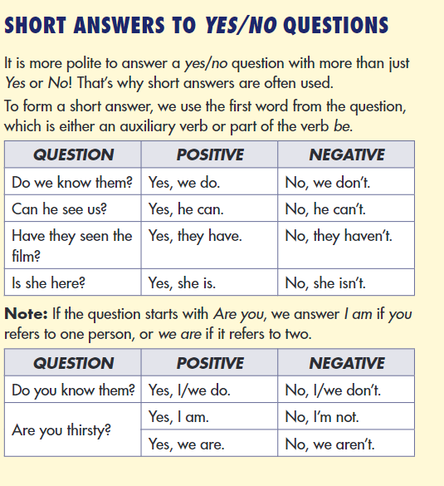

Slide 32
REMEMBER:
THIRD PERSON ENDING IN –S
/s/ for verbs ending in an unvoiced consonant (e.g. cooks, eats)
/z/ verbs ending in a vowel sound or voiced consonant, (e.g. watches, finishes)
IRREGULAR PRONOUNCIATION:
HE,SHE,IT SAYS /sez/
DOES /d˄s/

Slide 35
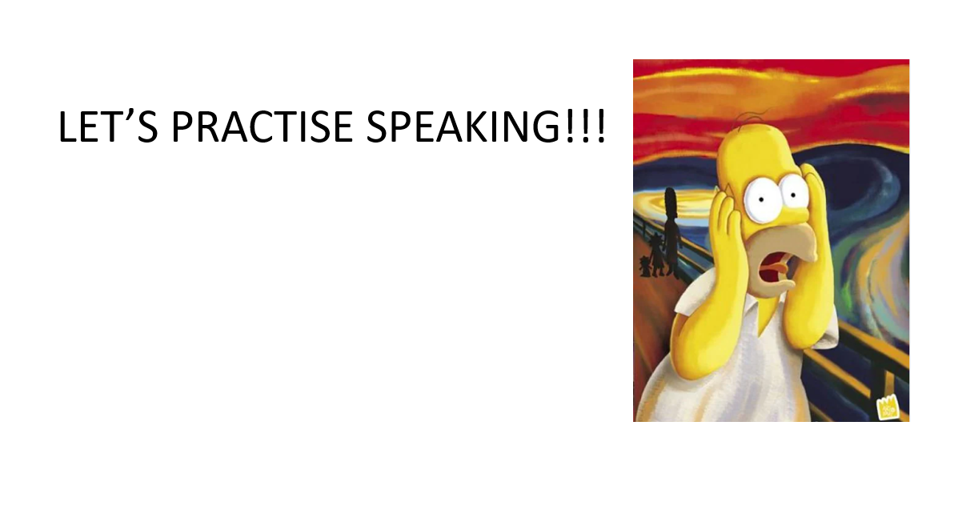

Slide 36
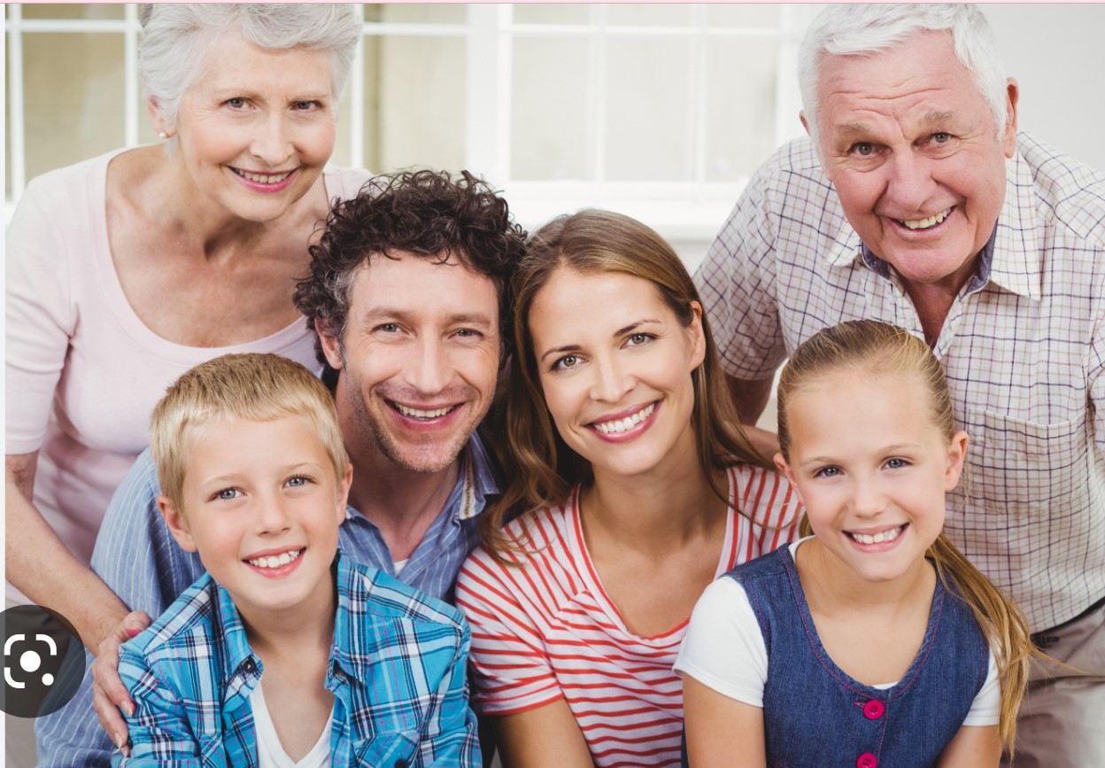
SAMPLE OF A PHOTO DESCRIPTION
This picture shows a group of 6 people posing for a photo.
They look like a family, on the left there is a young boy and behind him there is a an old lady, who may be his grandma. Between the boy and the lady there is a middle-aged man, who is probably the boy’s father.
On the right there is a young girl, she may be 10 years old and behind her there is an old man who is smiling and looks to be is grandpa. They are smiling and look very happy. In the background there is a big door o window and I think they are all in the living room that is very bright. It must be summer because they are wearing short-sleeve shirts.
I think they are posing to have a picture of the happy moment and maybe they have just celebrated a birthday or an anniversary.

Slide 37
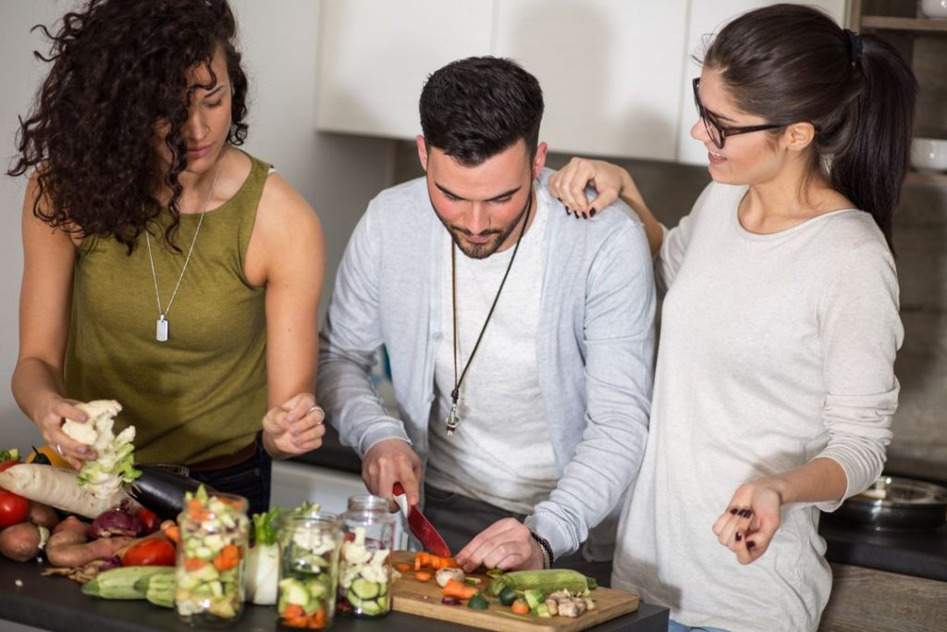
SPEAKING ACTIVITY: DESCRIBE THE PICTURE BELOW
How many people are there?
What are they doing?
Where are they?
What do you see in the forground?
What do you see in the background?
Speculate about the weather/season/part of the day (morning/evening…)
What are they wearing?
Speculate about the reasons of their actions (why are they cooking? Who are they cooking for?...
How are they feeling? Are they happy/sad/worried?

Slide 38
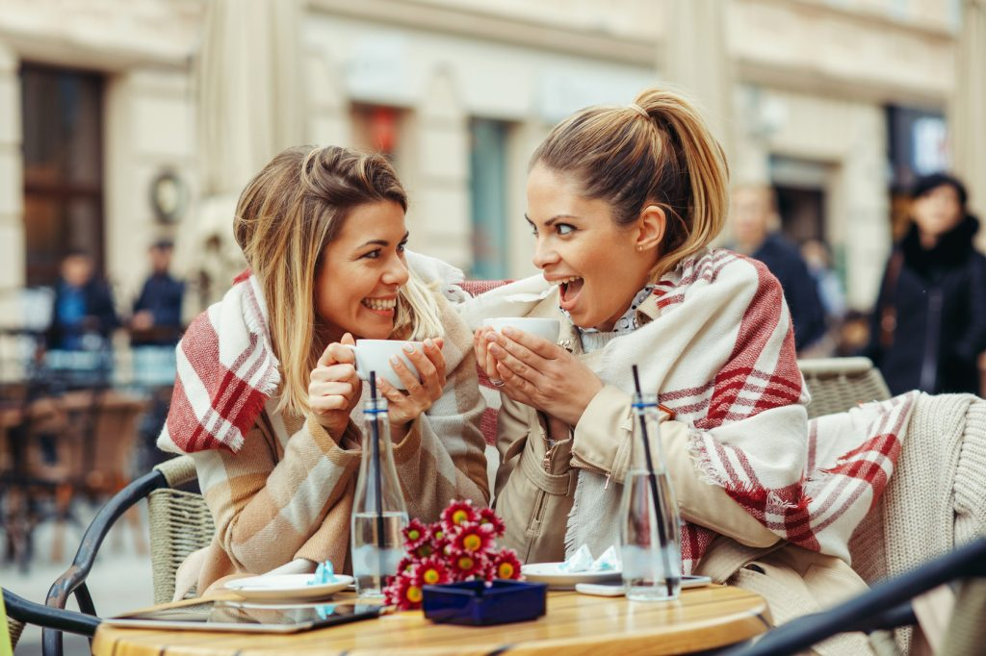

Slide 39
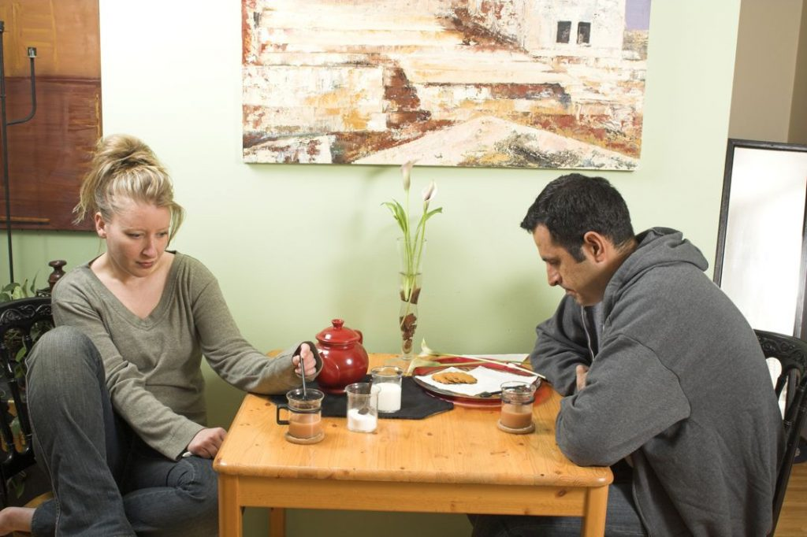
Notes:
Probably, the person who took this photo took it because of the people. So, you should focus your description on the two people.
What do they look like, and what are they doing?
You could say:
The two people both look unhappy or irritated.
They’re sitting at the kitchen table together, but they aren’t talking to each other.
The man is staring down at the table, while the woman is stirring her tea with a spoon.
Speculating means talking about possibilities. you’re talking about possibilities and giving your opinion about the picture.
I suppose…
Maybe they…
Give a summary of what you see.
Talk about where things are in the picture.
Add details.
Speculate about what’s in the picture.
Speculate about the context of the picture.
In the picture, there are two people sitting at a table, looking unhappy. There’s a woman on the left and a man on the right. In the middle of the picture, we can see some things on the table, like cups of tea, biscuits, milk and so on. The two people look sad or irritated, and they aren’t speaking to each other. They’re both looking down at the table. I suppose they had a fight and now they aren’t talking to each other, or they might just be bored and not have anything to talk about.

