Slide 1
UNIMC
LABORATORIO INGLESE III
A.A. 2024/2025, LM85-BIS
(3° ANNO, 1° SEMESTRE)
Prof.ssa Nicoletta Moretti
n.moretti3@unimc.it

Slide 2
TODAY’S LESSON
GRAMMAR:
CLAUSES OF CONTRAST AND PURPOSE
PLURALS AND UNCOUNTABLE
QUANTIFIERS: ALL, EVERY, BOTH…
ARTICLES
VOCABULARY:
WORD BUILDING: PREFIXES AND SUFFIXES
SCIENCE
COLLOCATIONS: WORD PAIRS

Slide 3

LET’S GET STARTED!!!

Slide 4
COOPERATIVE LEARNING:
FIRST: DO IT INDIVIDUALLY AND WRITE THEM ON A PAPER;
AFTER THAT: COMPARE YOUR ANSWERS WITH YOUR COLLEAGUES AND TALK TO EACH OTHER (TRY TO TALK ONLY IN ENGLISH AND IF YOU DON’T KNOW SOME WORDS LOOK THEM UP INTO A FREE ONLINE DICTIONARY «CAMBRIDGE» «OXFORD»).
FINALLY: SHARE YOUR IDEAS WITH THE WHOLE CLASS TO PRACTICE SPEAKING SKILLS

Slide 5
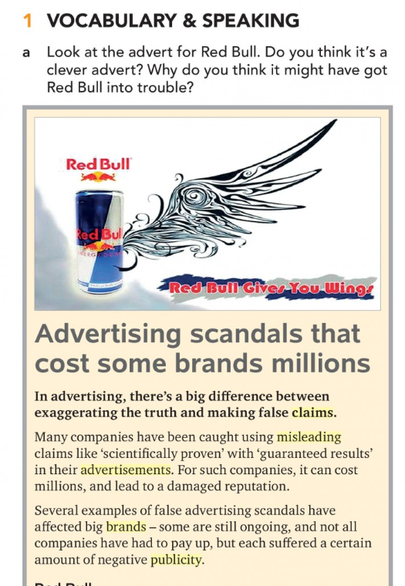
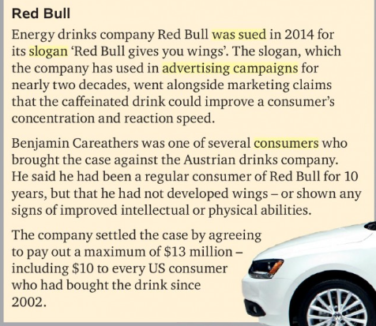
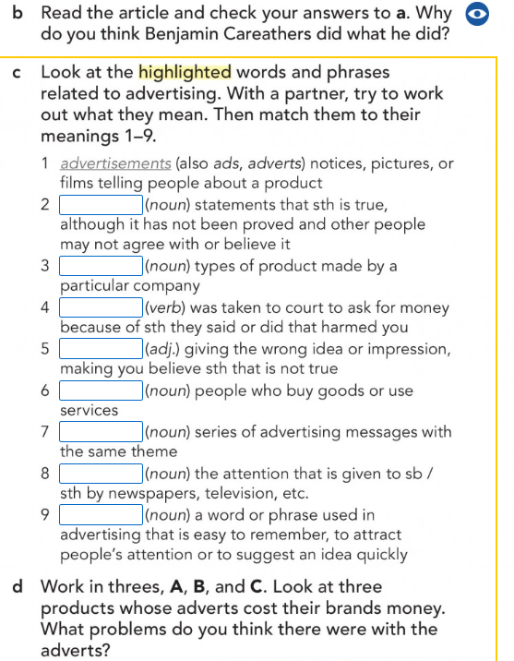
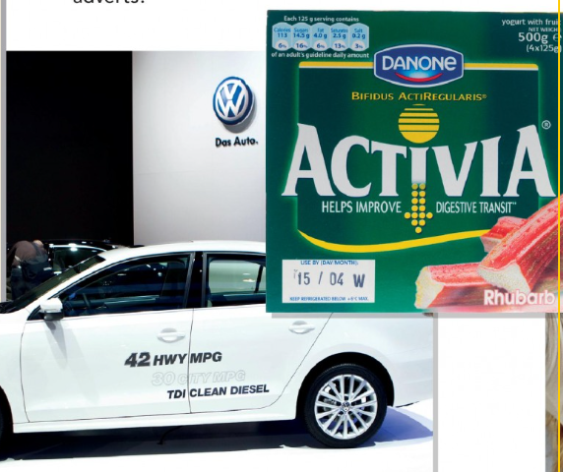

Slide 6
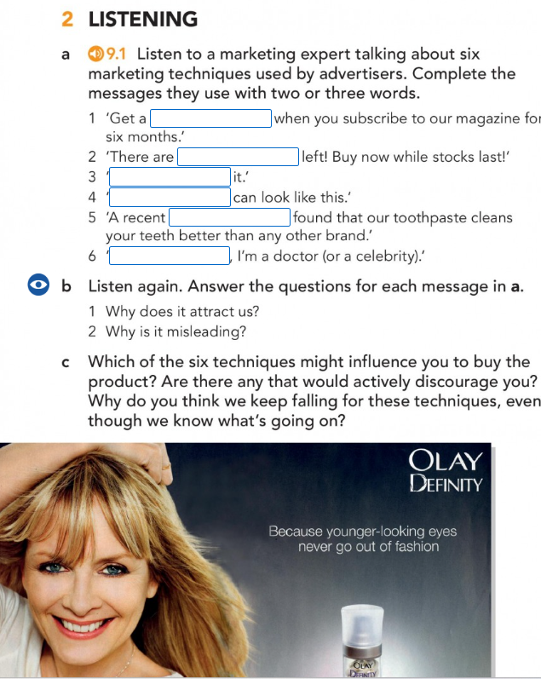
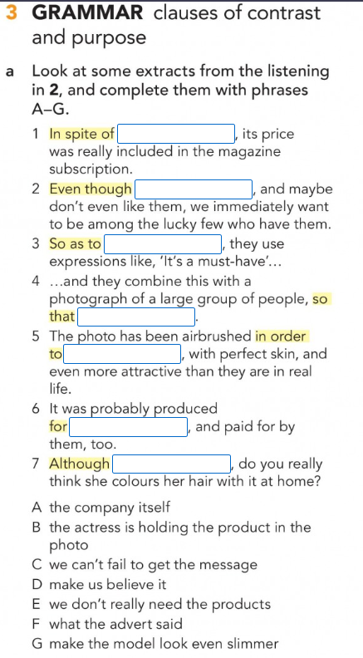
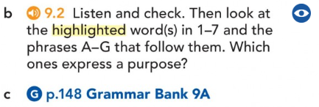

Slide 7
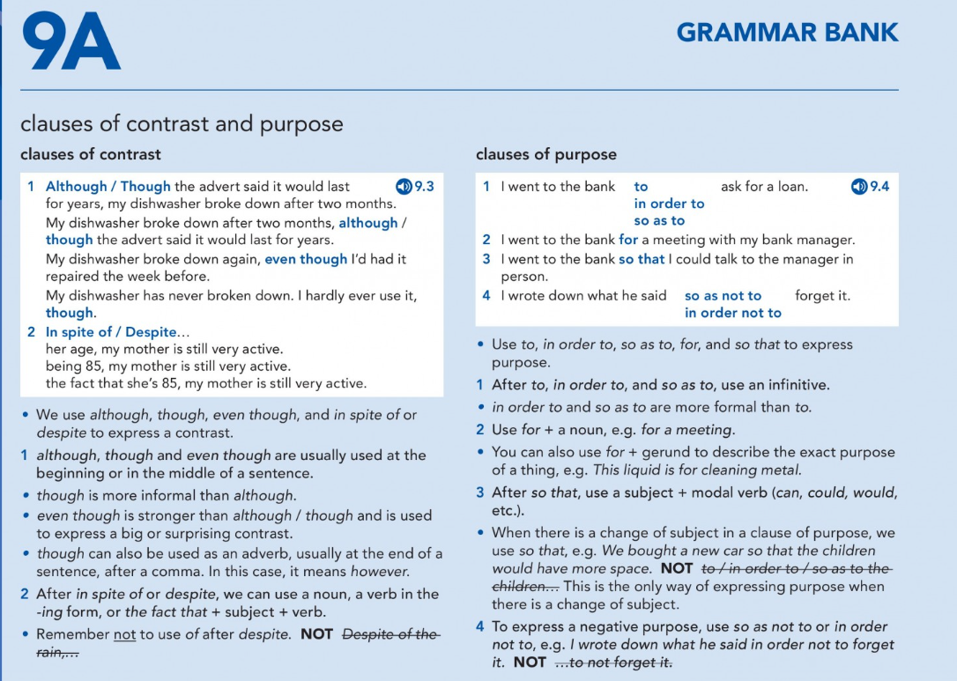

Slide 8
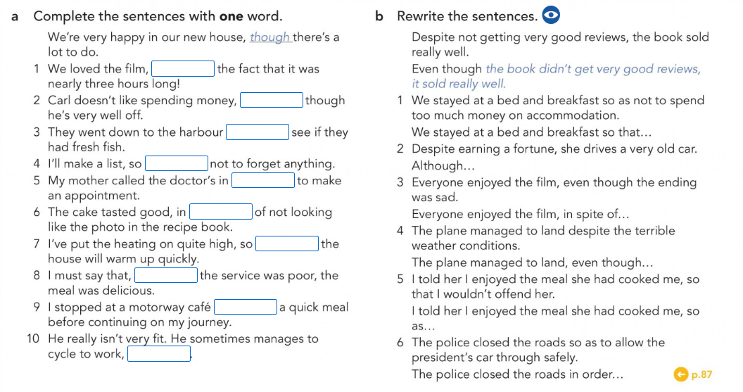

Slide 9
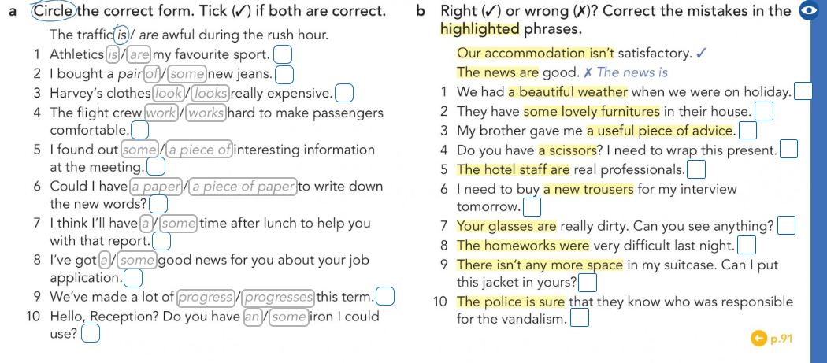

Slide 10
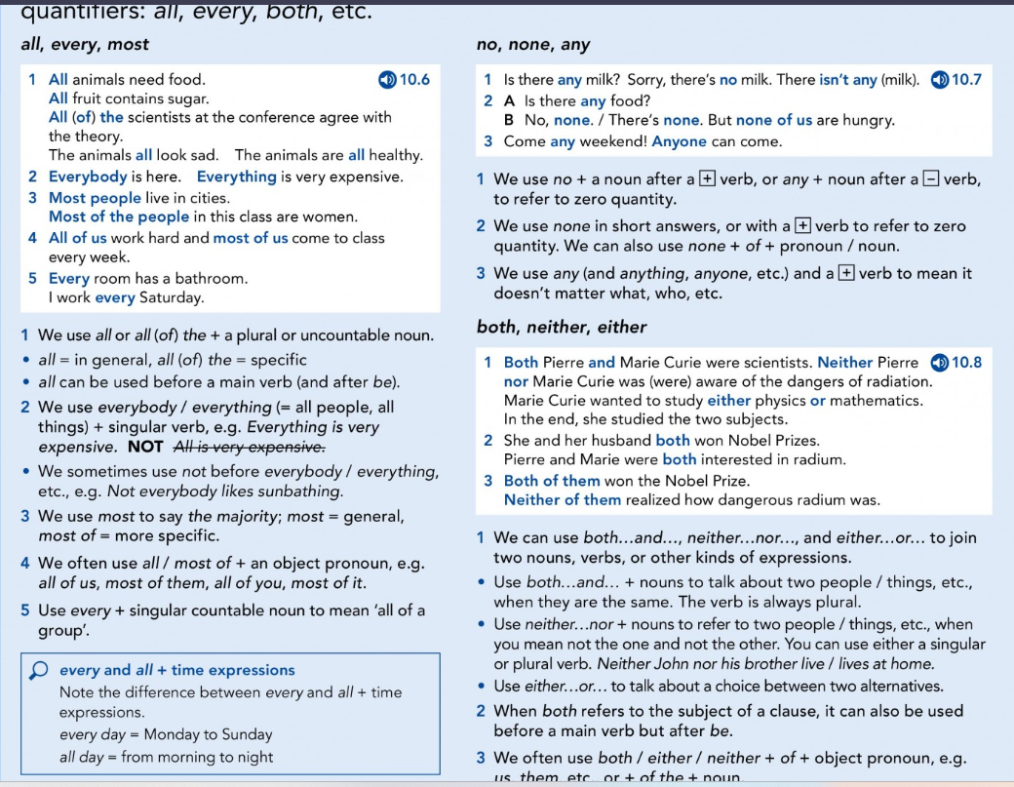

Slide 11
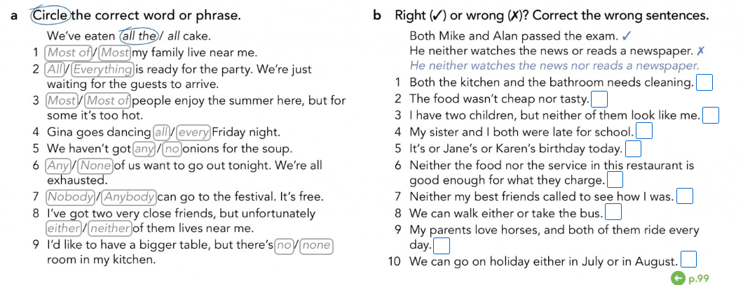

Slide 12
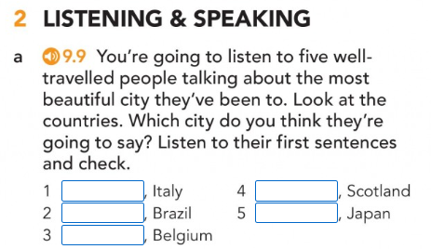
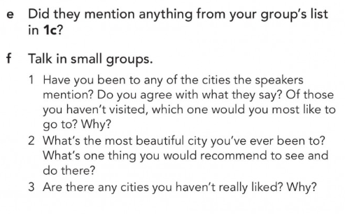
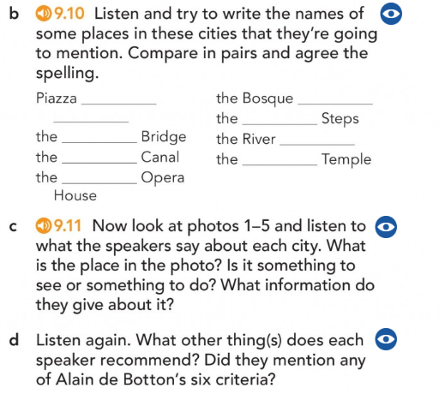
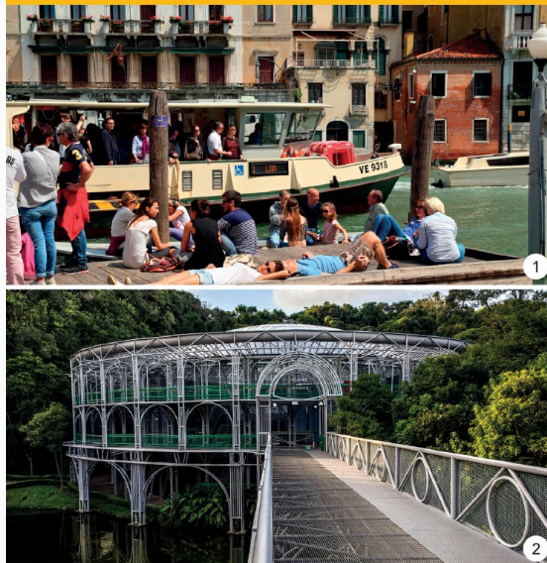
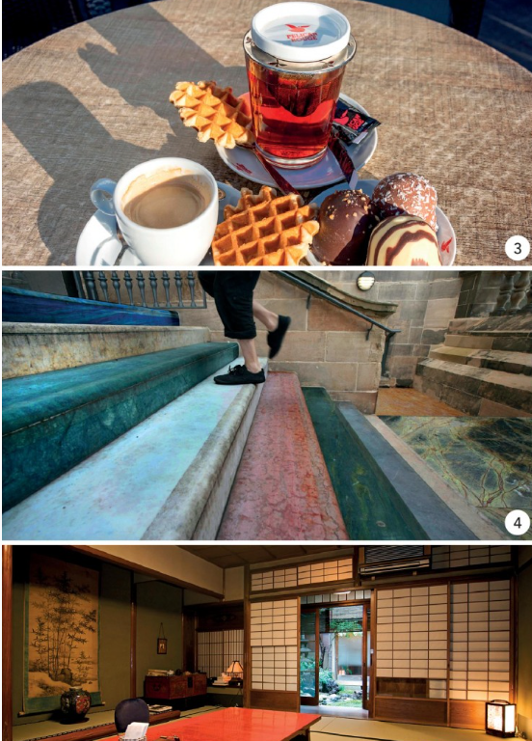

Slide 13
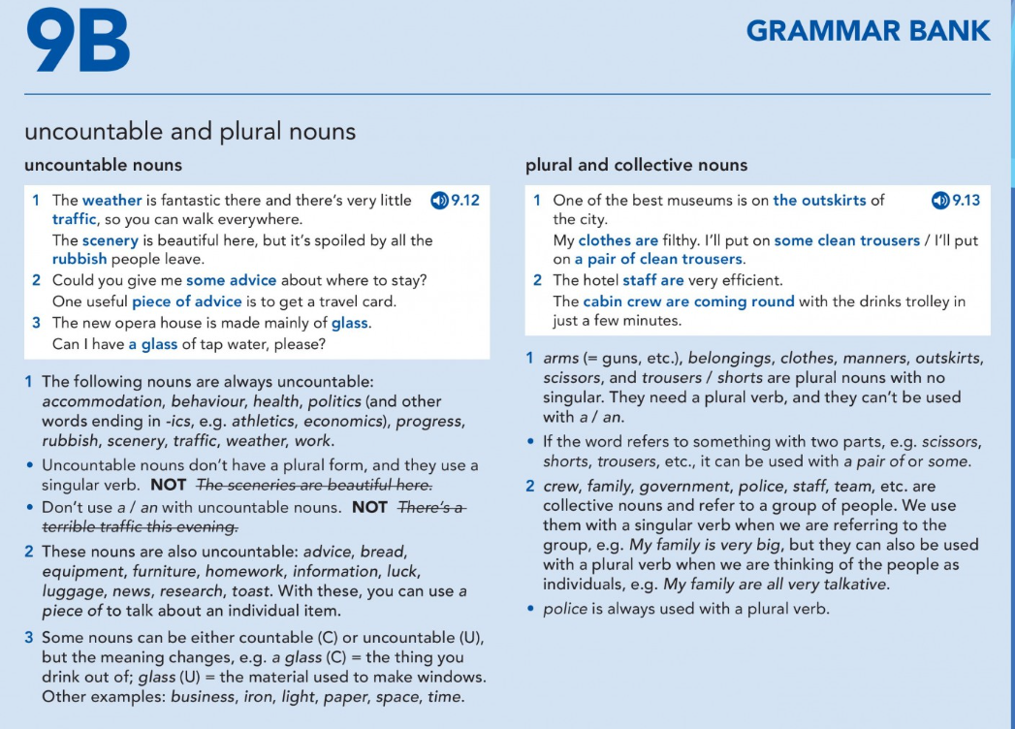

Slide 14
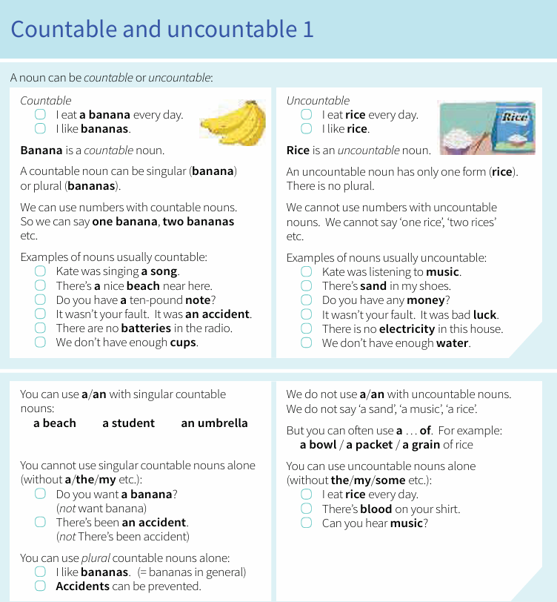
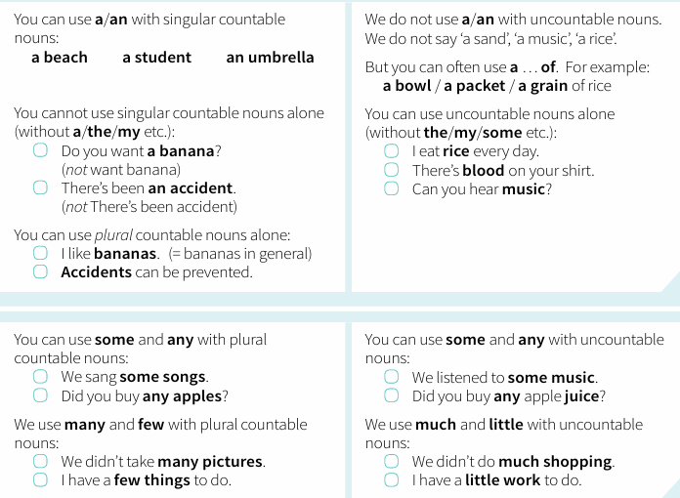

Slide 15
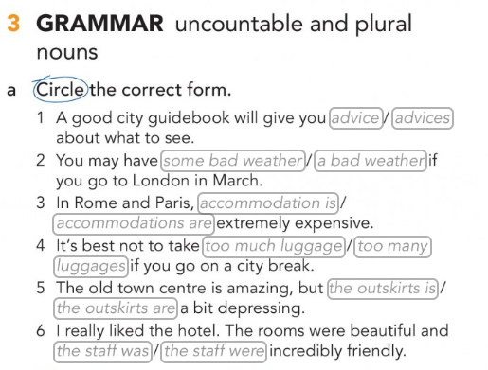

Slide 16
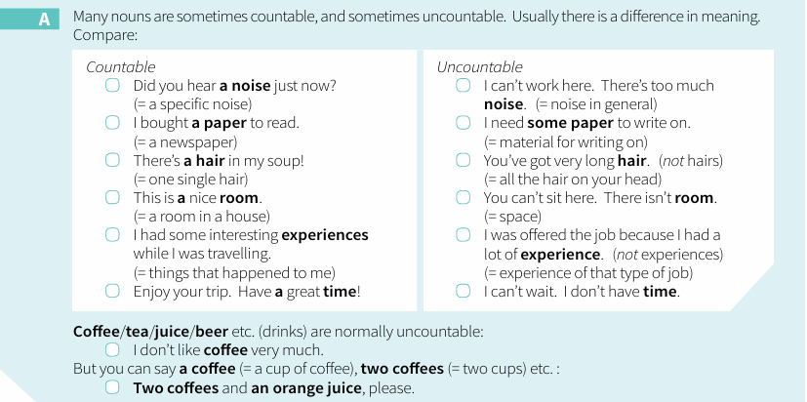
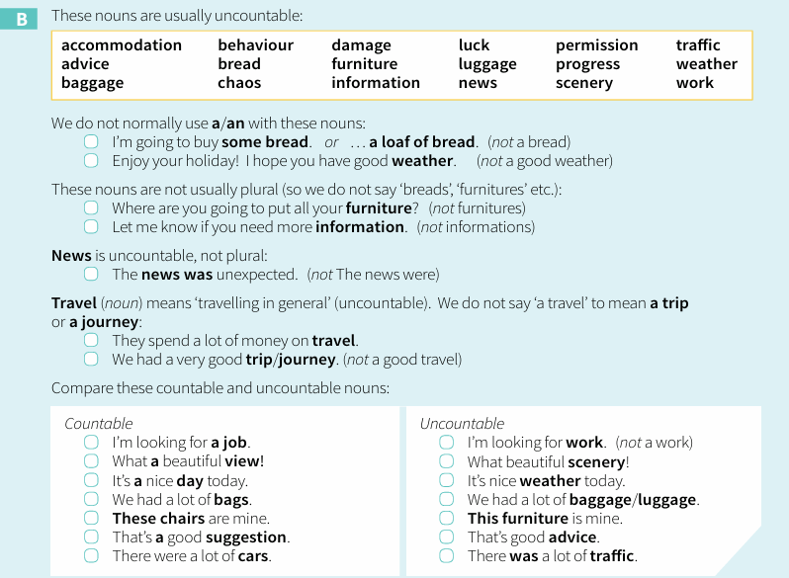

Slide 17
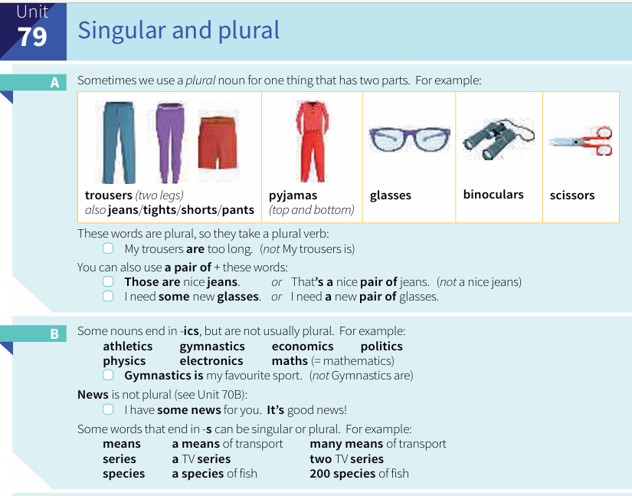
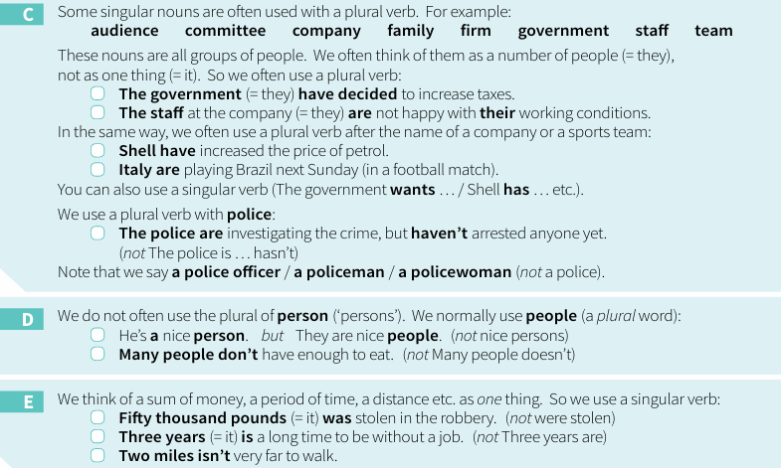

Slide 18
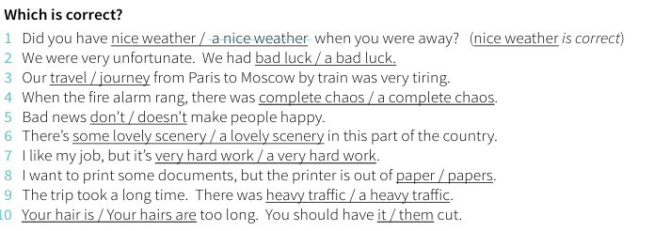
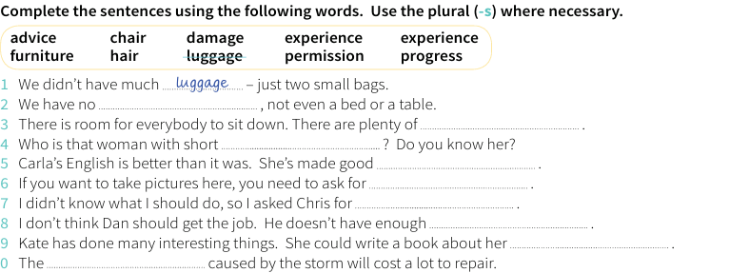
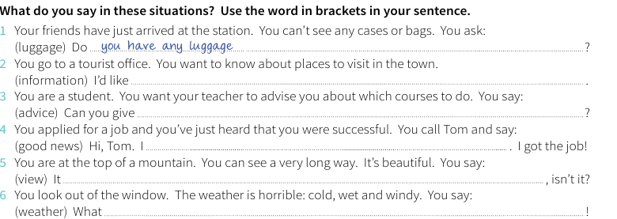

Slide 19
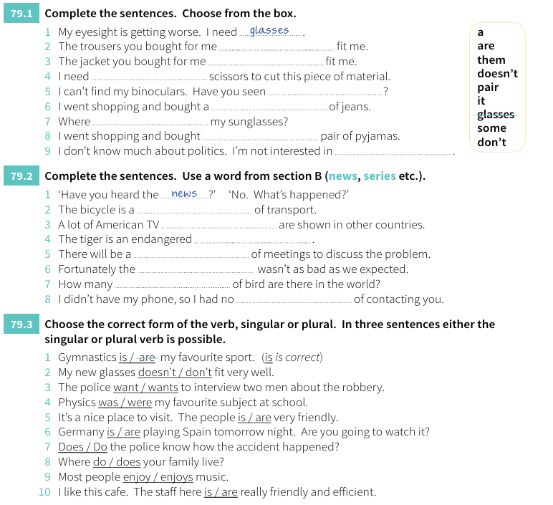

Slide 20
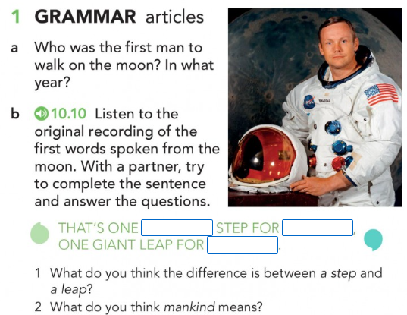
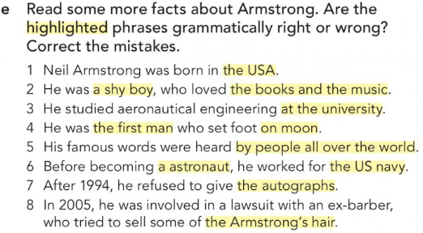

Slide 21
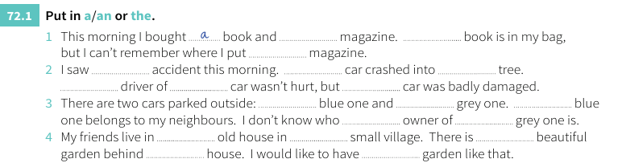
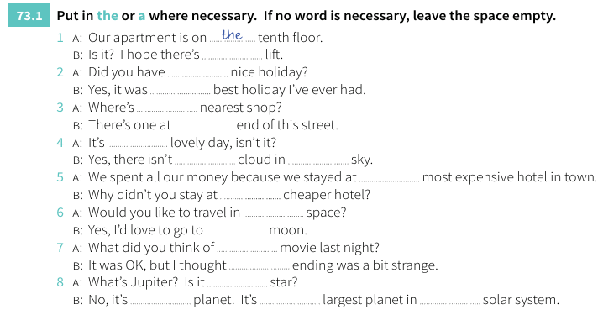
First: do the exercises
Then: check with your colleagues
After that: revise the rules
Finally: go back to your answers and try to understand why it was right or wrong.

Slide 22
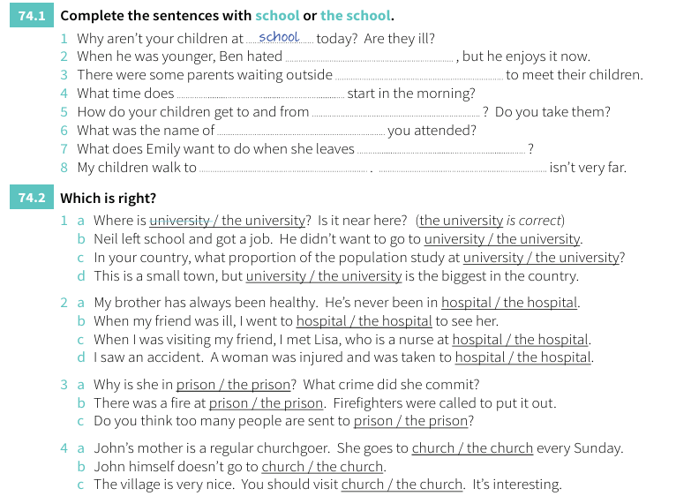

Slide 23
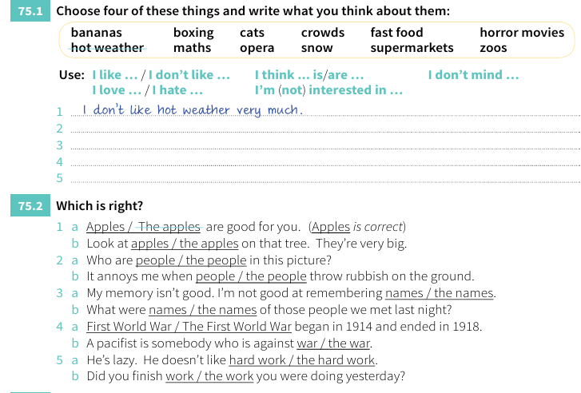
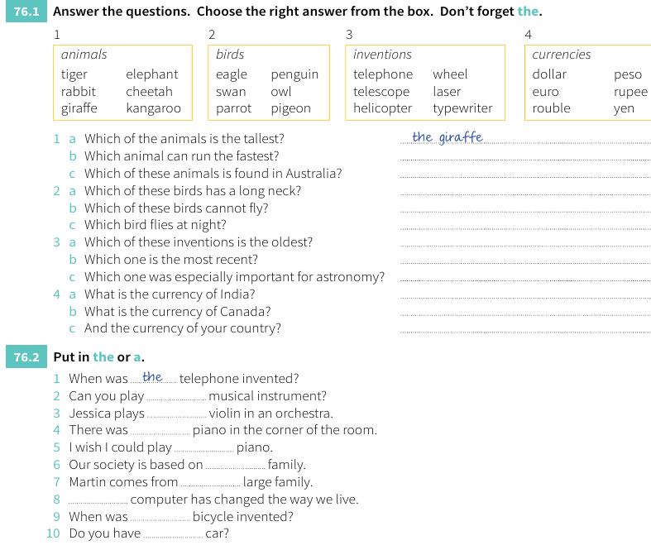

Slide 24
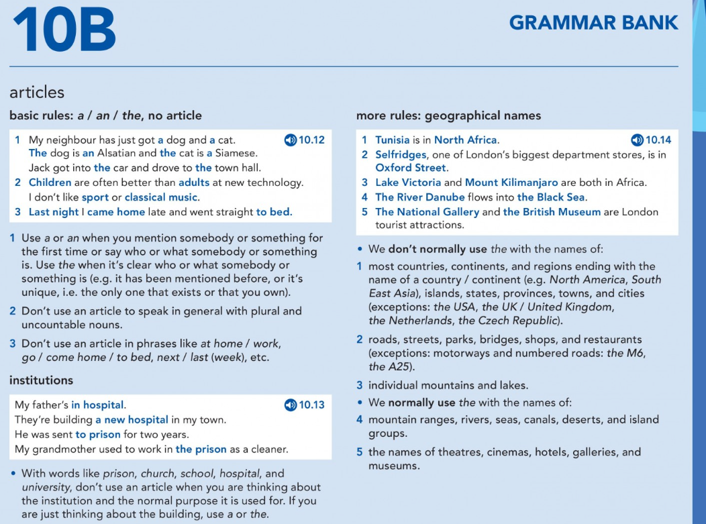

Slide 25
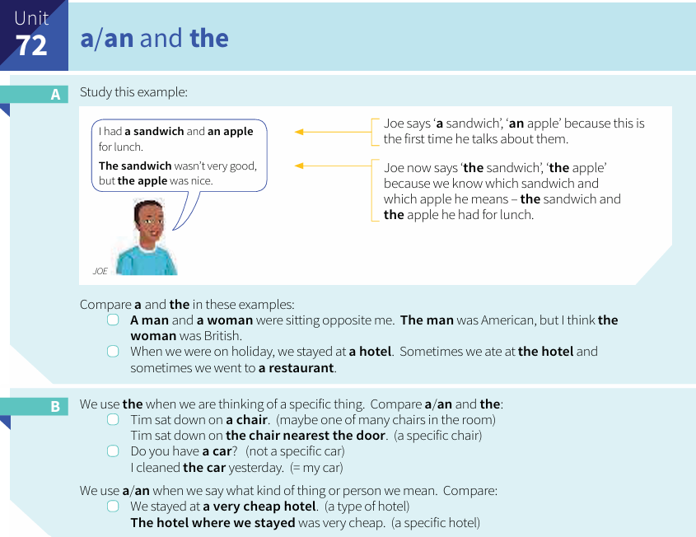
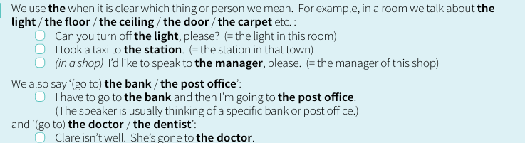


Slide 26
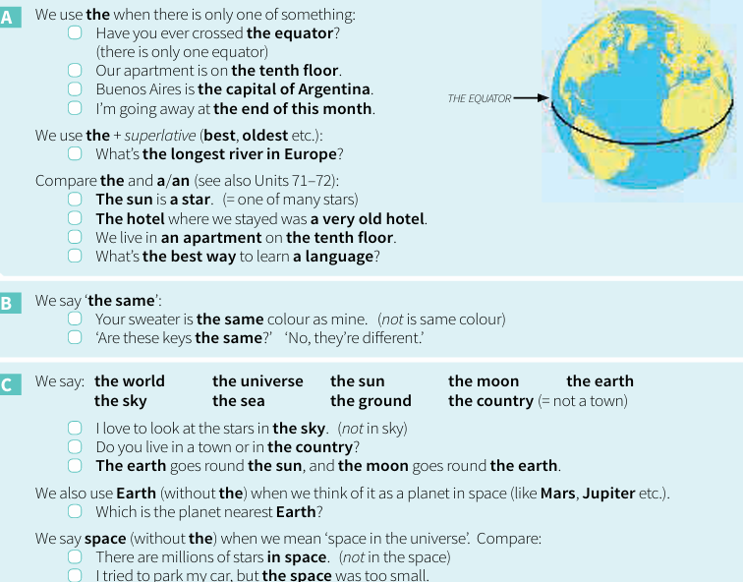
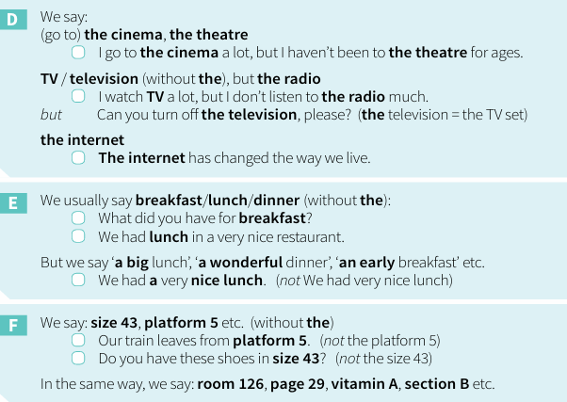

Slide 27
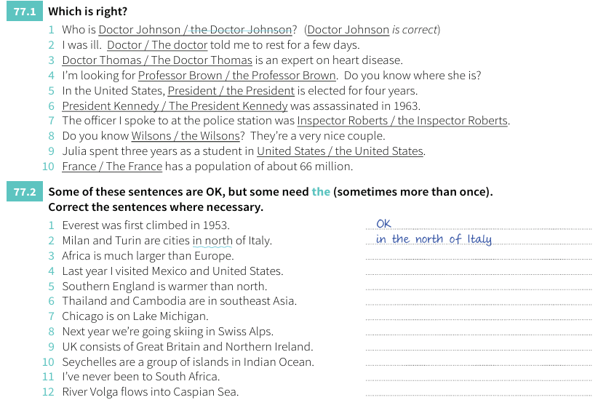
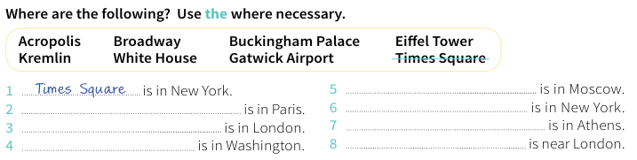

Slide 28
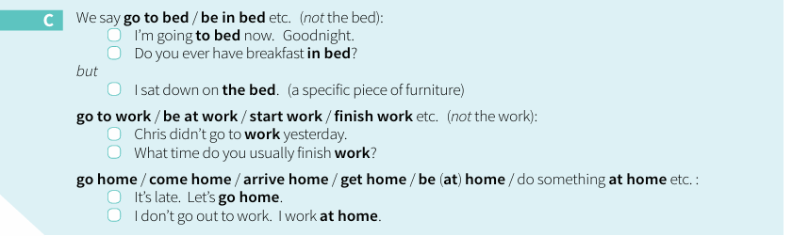
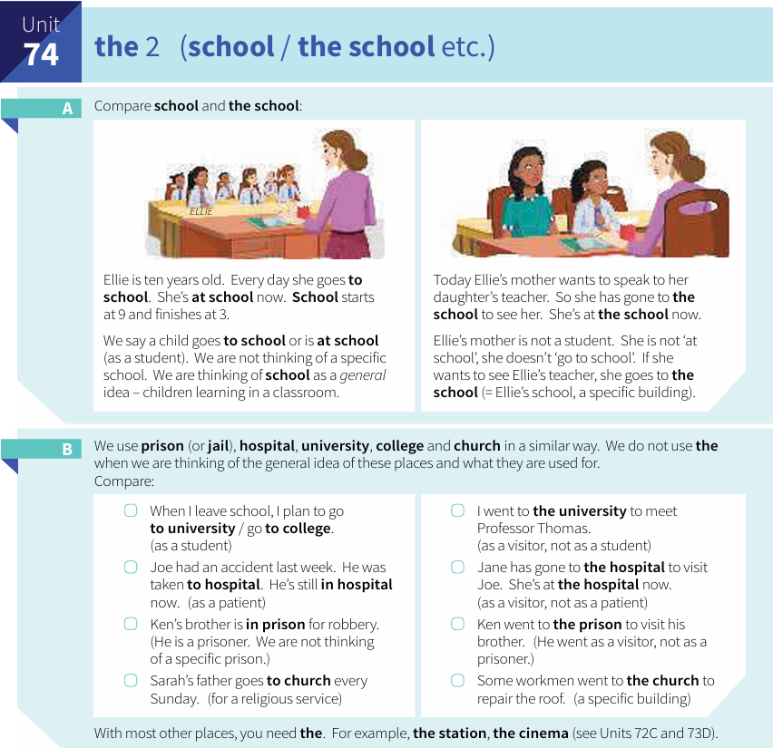

Slide 29

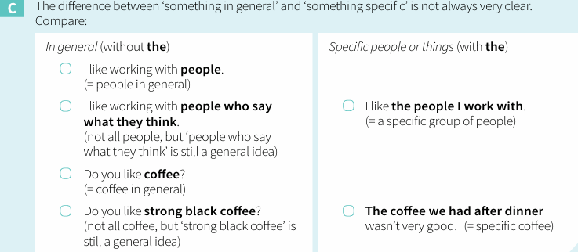

Slide 30
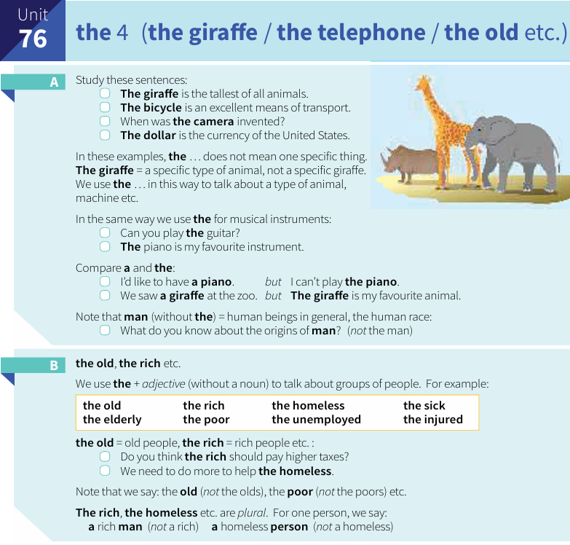
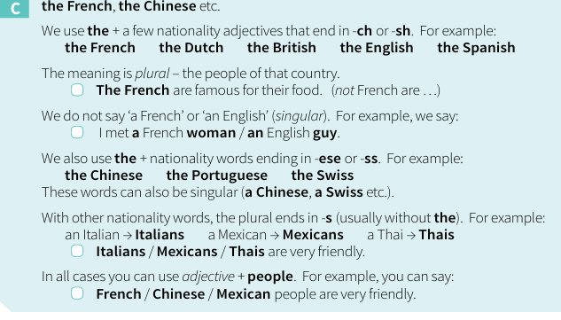
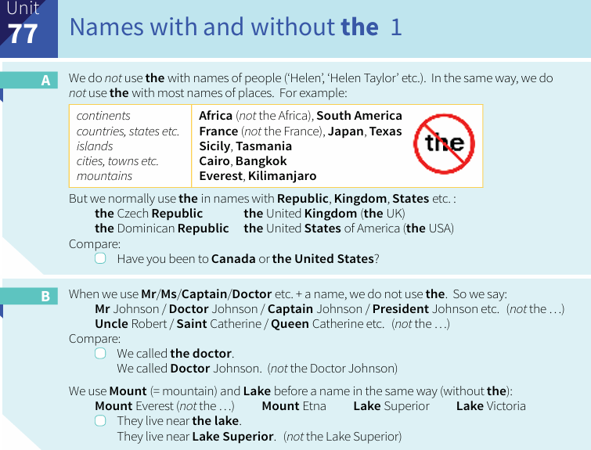

Slide 31
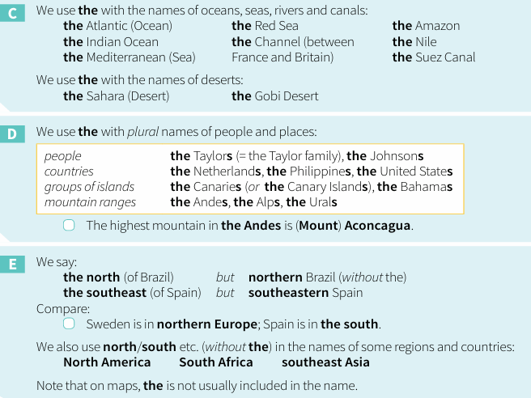


Slide 32


Slide 33


Slide 34

VOCABULARY: COLLOCATIONS

Slide 35



Slide 36






Slide 37
KEEP PRACTISING AT HOME!!!
THANK YOU FOR THE ATTENTION!!!

