Slide 1
LABORATORIO INGLESE III
A.A. 2024/2025, LM85-BIS
(3° ANNO, 1° SEMESTRE)
LEZIONE 6 15/11/2025

Slide 2
TODAY’S LESSON
GRAMMAR: direct/indirect speech; reporting verbs
VOCABULARY: the media

Slide 3
Read these short news reports. Which strategies do the journalists use to report the sportmen’s words?
DIRECT and INDIRECT / REPORTED SPEECH
Gold medalist Noah Lyles says he'd race Tyreek Hill — but only on his own terms
Lyles, the world's fastest man, also vowed he'll be back in 2028 for "my greatest Olympic ever.“
Olympic gold medalist Noah Lyles, the world’s fastest man, said Wednesday he'd be up for racing football player Tyreek Hill — but only for 100 meters and under conditions he set. “I mean, if somebody wants to sponsor the event and we’re racing for millions of dollars and it’s on a track and we’re running 100 meters, then sure, we can race” Lyles told NBC News. While Lyles argued he’s confident he’d beat Hill at a shorter distance, such as 50 yards or the NFL (National Football League) metric of 40 yards, he insisted he’d race only at 100 meters. “You want to challenge me, ‘the world’s fastest man,’ if you want to challenge that, you have to challenge that in his event.”
Notes:
p. 82 + https://www.nbcnews.com/sports/olympics/noah-lyles-race-tyreek-hill-rcna167457

Slide 4
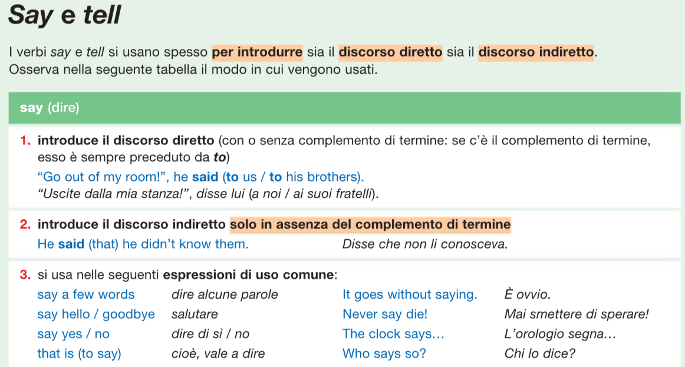
SAY vs TELL
«I’ll beat Hill» said Lyles (to the journalist)
«I’ll beat Hill» Lyles told the journalist
Lyles said (that) he will beat Hill
Lyles told the journalist (that) he will beat Hill
Notes:
Never say never. Notare le differenze opposte tra i due verbi

Slide 5
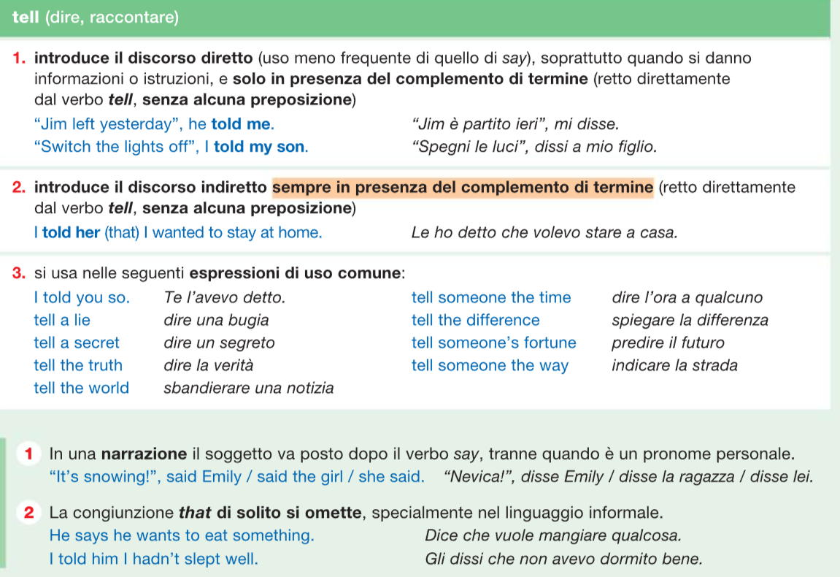

Slide 6
Speak and talk (parlare)
They never introduce direct / indirect speech
SPEAK
Can you speak Chinese? (ability)
The President is going to speak to the Nation (public formal settings)
I’d like to speak to James, please (permission)
TALK
Julia, when can I talk to you? (informal settings)
They are always talking about* sport! (discuss, talk about something)
John is talking on the phone (activity)
*To introduce the topic of a text we use the expression «be about»:
The text is about a journey to India → il testo parla di un viaggio in India
Notes:
Zanichelli p. 414

Slide 7
Direct vs Indirect (reported) speech: backshifts
Indirect speech is used to report what somebody else said
“I work in a bank,” said Daniel.→Daniel said that he worked in a bank.
In indirect speech, we often use a tense which is 'further back' in the past (e.g. worked) than the tense originally used (e.g. work). This is called 'backshift’. Moreover, the personal pronoun changes too.
Other elements change accordingly (e.g. possessive adjectives and pronouns, adverbs of time).
Notes:
Adattato da https://learnenglish.britishcouncil.org/grammar/b1-b2-grammar/reported-speech-statements

Slide 8
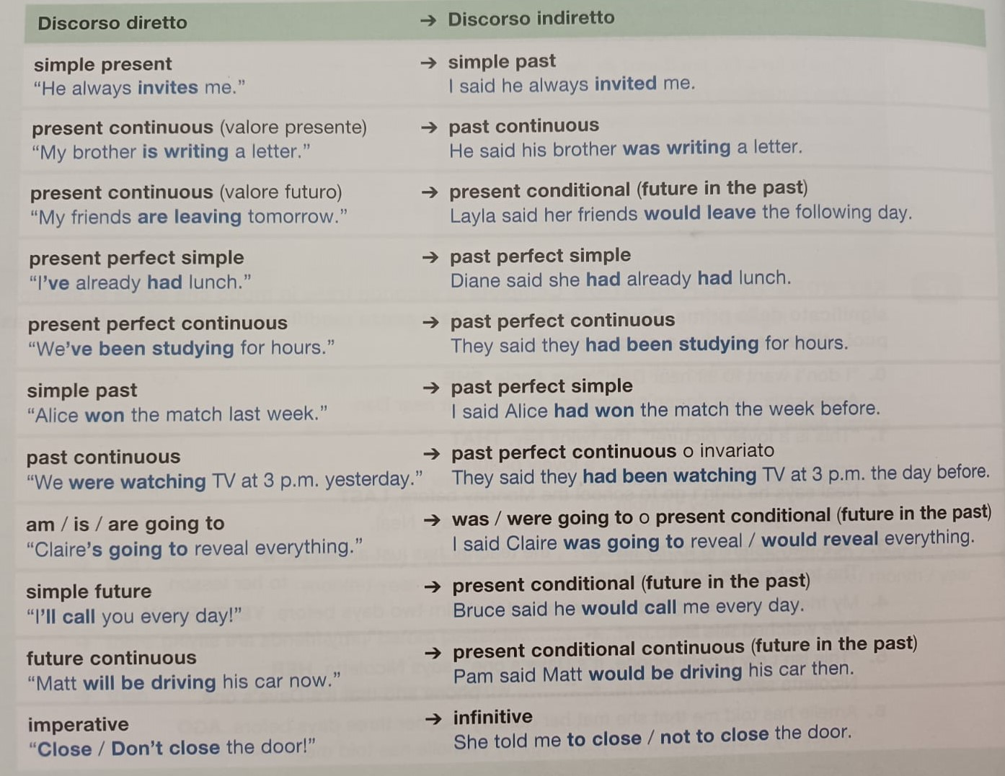
Questions «Have you listened to the news?» → He asked me if I had listened to the news
«What are they saying?» → She asked me what they were saying
Notes:
Il PAST PERFECT non cambia perché non si può andare indietro più di così. Attenzione alle domande / risposte: NO inversione soggetto / verbo

Slide 9
Adverbs of time
DIRECT SPEECH | INDIRECT SPEECH
I’ll do it today. | She said she would do it that day.
I’ll do it this week. | He said he would do it that week.
I’ll do it tomorrow. | She said she would do it the next / following day.
I’ll do it next week. | He said he would do it the next / following week.
I did it yesterday. | She said she had done it the day before.
I did it last week. | He said he had done it the previous week.
I’m not available now. | She said she wasn’t available at the time.
I’ve never been here before. | He said he had never been there before.
If it is still the same day, for instance, we don’t change the adverb:
I’ll do it today → She said she would do it today
Notes:
https://www.britishcouncil.it/blog/discorso-indiretto-in-inglese

Slide 10
Modals
DIRECT SPEECH | INDIRECT SPEECH
Can help you with the party. | She said she could help me with the party.
You must be at the station by 10.00. | He said I had to be at the station by 10.00.
Shall we leave? | She asked if they should leave.
Fiona may arrive late | She told me that Fiona might arrive late
Notes:
Alcuni modali cambiano

Slide 11
Still true or relevant facts
If what the speaker has said is still true or relevant, it's not compulsory to change the tense. But we have to change other elements when appropriate.
“I likes cats” → He said he likes cats
“Tigers swim very well” → The vet said tigers swim very well
Notes:
p. 418 Zanichelli

Slide 12
Complete the second sentence so that it means the same as the first
0. 'We've seen four elephants already and it's only our first day.' → He said that they had seen four elephants on their first day.
1. 'My best friend at school became a nurse first, then a paramedic.' → He told me that…
2. 'I had lived in four countries by the age of ten.' → She said that…
3. ‘It takes me 45 minutes to go to work.' → She told me that…
4. ‘I'm just leaving.' → When I got there I saw him, but he said…
5. ‘I told Dom to email my colleague three days ago.' → She said that ....
6. ‘We are leaving for France next week’ → They told that…
7. ‘My brother will call you tomorrow’ → She said that…
8. ‘Open the window’ → He told me…
9. ‘Does she work in a hospital?’ → He asked me…
10. ‘Louis can drive very well’ → They said…
Notes:
Adattato da https://learnenglish.britishcouncil.org/grammar/b1-b2-grammar/reported-speech-statements
His best friends / Had become; had lived; it took her…; was just leaving; had told Dom to email his colleague three days before; would leave for France the following/next week; her brother would call you/me the following/next day; to open; if she worked; that Louis could drive very well

Slide 13
For further practice
0. «I don’t know how to make this cake» (Kim said that…) Kim said that she didn’t know how to make that cake.
«Jill has just opened her second shop» (Jill sister said that…)
«The working system is described in this brochure» (The shop assistant told me that…)
«He is brushing his dog now» (Laura said that Pete…)
«Go past the hospital and then turn left» (The taxi driver told us…)
«I will become an astronaut» (When she was little, Katie said that…)
«We’ve been waiting for you for hours» (They told me that…)
«I’m going to give my parents a big surprise» (Andrew told his friends…)
«Will you finish your report in time?» (The boss asked Aaron…)
«What shall I do to help you?» (Stephanie asked David…)
Notes:
Adattato da Zanichelli p. 419. Fare attenzione a this that. quelle aggiunte: she would become; they had been waiting for me; if he would finish his report; what she should do to help him

Slide 14
Reporting verbs
To report what other people have said, we use say / tell or a reporting verb
Notes:
p. 81.

Slide 16
Notes:
p. 147 e 81.
ESERCIZIO B: To suggest: in relation to giving advice, means to propose something or someone for consideration. To recommend: in relation to giving advice, means to propose something or someone as a preferred course of action. Alla numero 5 INVITED è più specific di ASKED

Slide 17
Harris faces challenge of translating convention joy to fall momentum
(The New York Times 08/23/2024)
Notes:
p. 82 e 161. Categories nel senso di generi mediali (es. cronaca). https://www.nytimes.com/2024/08/23/us/politics/harris-dnc-momentum.html

Slide 18
Interviewer
Interviewee
the person who asks the questions during an interview
the person who answers the questions during an interview
Notes:
p. 161. Se viene fuori: host: a person who introduces guests and performers in a TV / radio show (es. talkshows); presenter (es. quiz)

Slide 19
Actor / actress
Camera
Character
Comedy
Director
Documentary
Drama
Dubbing
Protagonist
Script
Soundtrack
TV series
Protagonist
Romance
Science fiction
Soundtrack
Special / visual effects
Thriller
Write the meaning of the following media-related terms
Advertisement (ad)
Article
Billboard
Broadcaster
Caption
Commercial
Front page
Leaflet
Magazine
Media / news outlet
Notes:
Adattato da scheda A42 Zanichelli. Media outlet = media, (se si parla di TV) emittente; news outlet = organo di stampa https://dictionary.cambridge.org/it/dizionario/inglese/outlet

Slide 20
Reading and comprehension
Notes:
p. 83

Slide 21
Complete the headings with a word from the list:
addresses date fake images name sense spellings trust
b.
c. Can you think of any examples of exaggerated or fake news?

Slide 22
KEEP PRACTISING AT HOME!!!
THANK YOU FOR YOUR ATTENTION!!!

