Slide 1
LABORATORIO INGLESE III
A.A. 2024/2025, LM85-BIS
(3° ANNO, 1° SEMESTRE)
LEZIONE 2 11/10/2024
Prof.ssa Nicoletta Moretti

Slide 2
TODAY’S LESSON
GRAMMAR: future perfect and continuous; conditionals; wish
VOCABULARY: environment; expressing feelings

Slide 3
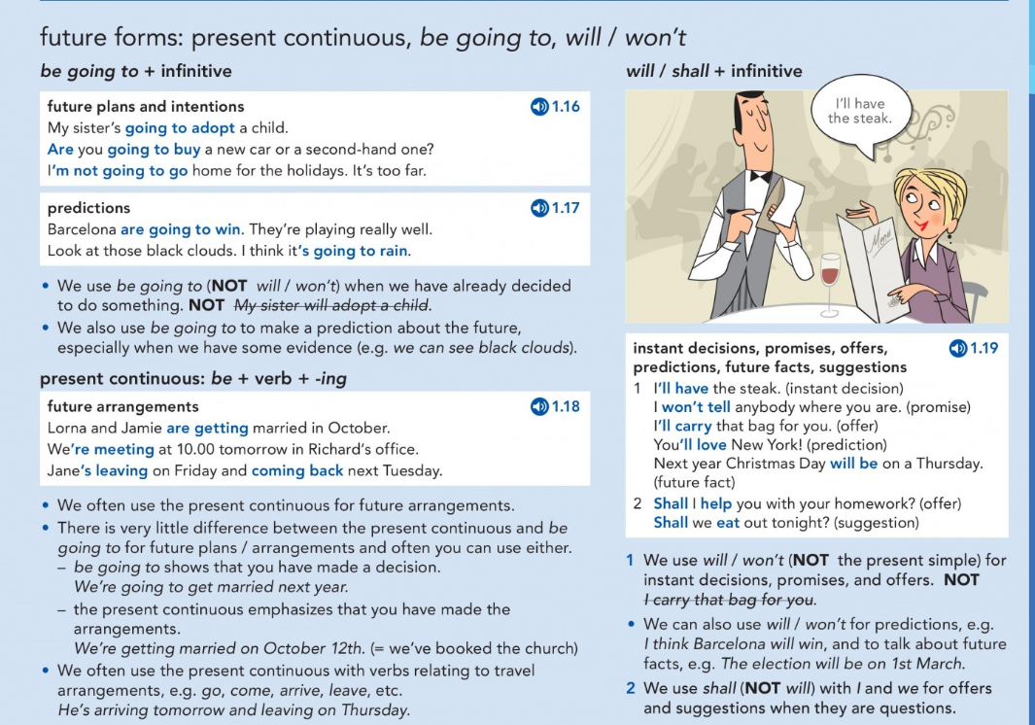
A quick revision of the future before observing the future perfect and future continuous

Slide 4
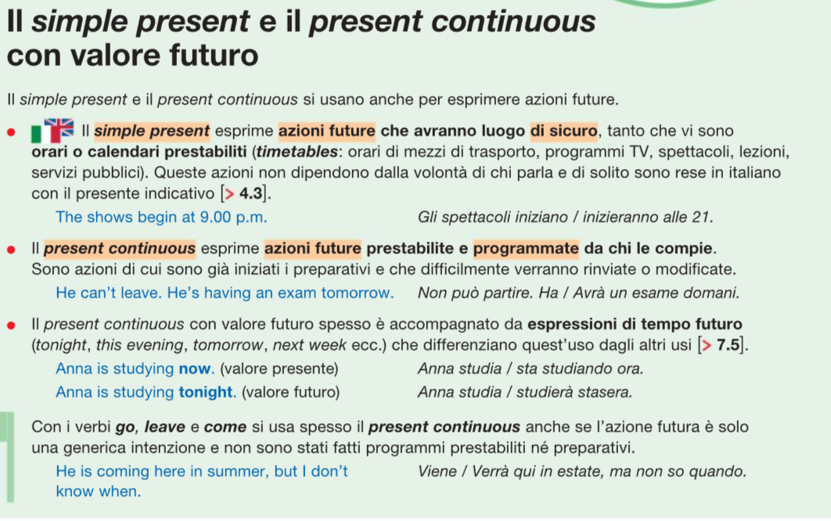

Slide 5
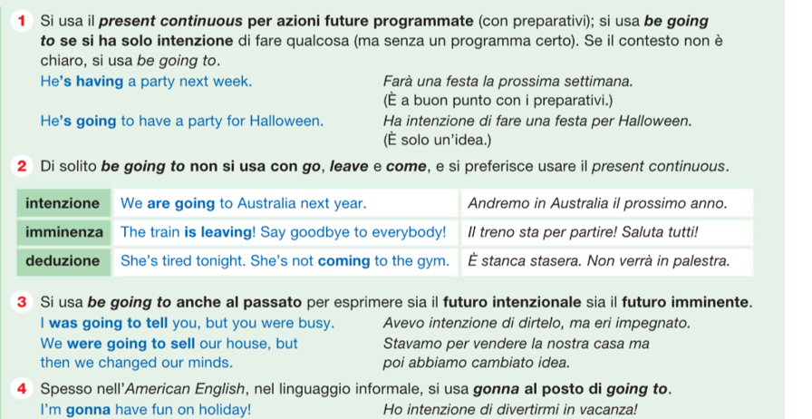

Slide 6
FUTURE PERFECT – FUTURE CONTINUOUS

Slide 7
See also Vocabulary bank: slide NUMERO
Notes:
p. 37

Slide 8
First work individually (ex. A) and then share your ideas with the whole class.
Then work in small groups (2-3 people) (ex. B). Practice your English! If you don’t know the meaning of a word, look it up into a free online dictionary.
Future perfect
Future continuous
Notes:
p. 37
Esercizio B: elicit some ideas from the class.
Esercizio C: whole-class activity

Slide 9
THIS IS THE KEY WORD THAT MAKES YOU UNDERSTAND THE DIFFERENCE BETWEEN THE FUTURE SIMPLE WITH WILL
AND THE FUTURE PERFECT «WILL + HAVE + PAST PARTICIPLE»
At this time, the future activity will be completed
PAST
PRESENT
FUTURE

Slide 10
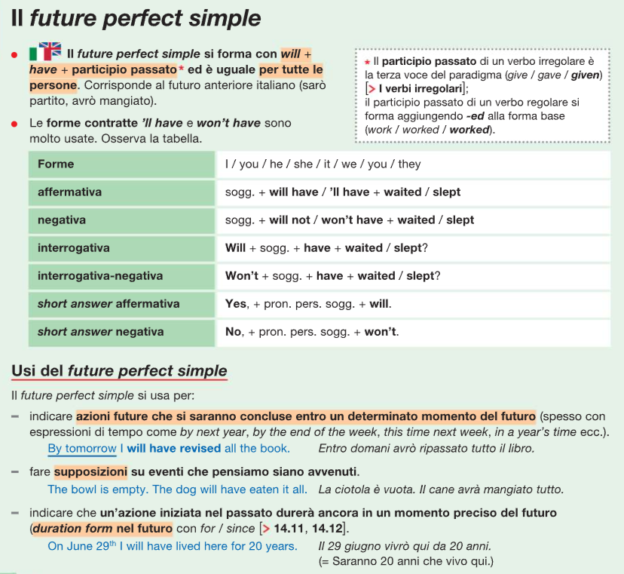
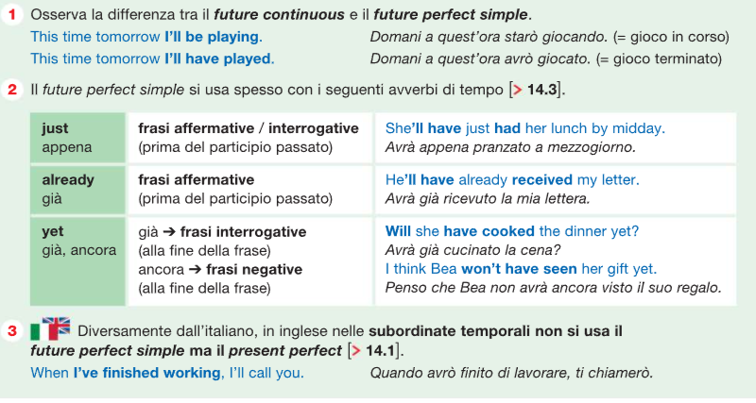
More in detail

Slide 11
Example: Future perfect del verbo "to arrive"
Affermativa | Negativa | Interrogativa | Negativa interrogativa
I will have arrived | I won't have arrived | Will I have arrived? | Won't I have arrived?
You will have arrived | You won't have arrived | Will you have arrived? | Won't you have arrived?
He will have arrived | He won't have arrived | Will he have arrived? | Won't he have arrived?
We will have arrived | We won't have arrived | Will we have arrived? | Won't we have arrived?
They will have arrived | They won't have arrived | Will they have arrived? | Won't they have arrived?
Notes:
https://www.ef-italia.it/risorse-inglese/grammatica-inglese/future-perfect/

Slide 12
At this time, the future activity will be in progress
PAST
PRESENT
FUTURE

Slide 13
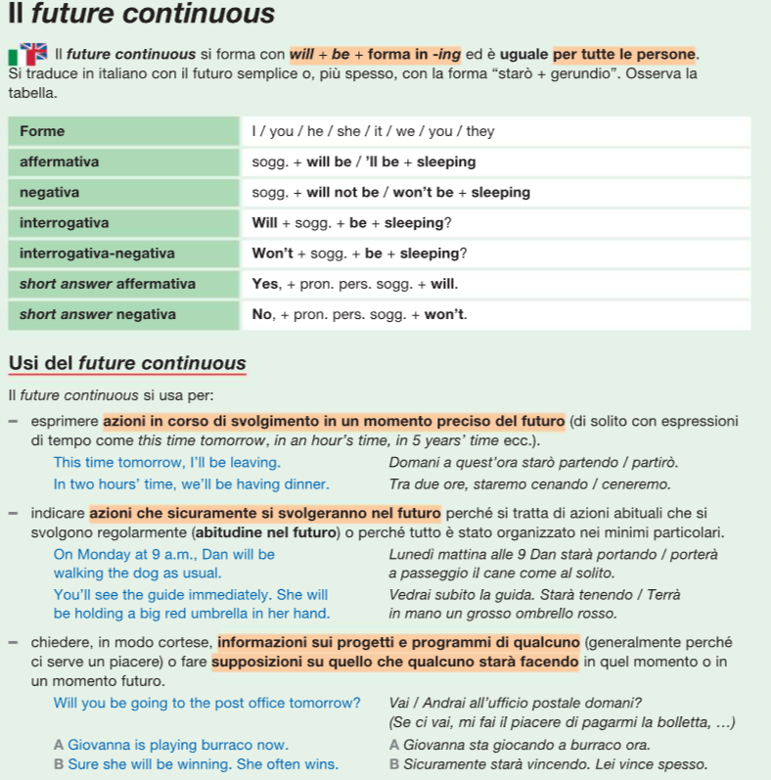

More in detail
See «non-continuous verbs» from Lesson 1

Slide 14
Example: Future continuous del verbo "to stay"
Affermativa | Negativa | Interrogativa | Negativa interrogativa
I will be staying. | I won't be staying. | Will I be staying? | Won't I be staying?
You will be staying. | You won't be staying. | Will you be staying? | Won't you be staying?
He will be staying. | He won't be staying. | Will he be staying? | Won't he be staying?
She will be staying. | She won't be staying. | Will she be staying? | Won't she be staying?
It will be staying. | It won't be staying. | Will it be staying? | Won't it be staying?
We will be staying. | We won't be staying. | Will we be staying? | Won't we be staying?
They will be staying. | They won't be staying. | Will they be staying? | Won't they be staying?

Slide 15
Notes:
p. 138
Ricorda loro di fare attenzione alla grafia dei past participle e delle –ing form https://normasteaching.com/imparare-linglese/grammatica-inglese/verbi-in-inglese/present-continuous/

Slide 16
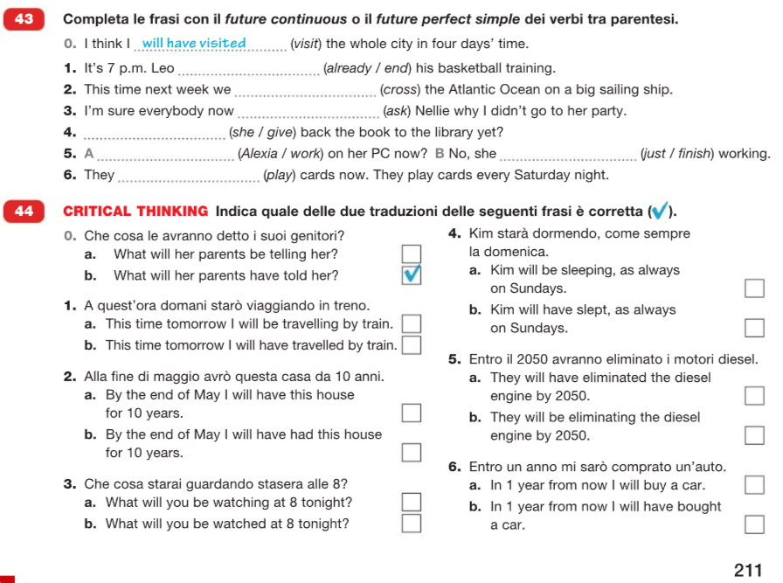
For further practice
Notes:
p. 211 zanichelli
Da fare a casa, le risposte saranno date all’inizio della prox lezione
Soluzioni: will have just ended; will be crossing; will be asking; will she have given; will Alexiaa be working, she will have just finished; will be playing. 1a, 2b; 3a; 4a; 5a; 6b

Slide 17
CONDITIONALS:
IF CLAUSES

Slide 18
Zero and first conditionals; future time clauses
Notes:
p. 41. Dopo Esercizio C: questa alternativa (verità assolute vs possibili) è ben evidenziata nel periodo ipotetico di tipo 0 e 1

Slide 19
Verità universali, condizioni abituali, processi fisici/scientifici
If you heat water, it boils.
If you lie in the sun too long, you get sunburnt.
If-clause→present tense Main clause→present tense
Ipotesi realistiche, situazioni molto probabili, eventi altamente possibili
If Julie loses the game, she will be very disappointed.
If you don’t wear a sweater, you will be cold.
If-clause→present tense Main clause→future tense /imperative

Slide 20
Typical mistakes: double future
I’ll be ready as soon as I’ll have had a shower
I’ve had a shower
I wont’ leave until you’ll arrive
you arrive
As soon as, when, until, unless, before, after, in case + PRESENT TENSE

Slide 21
Notes:
p. 139

Slide 22
Second and third conditionals: unreal conditionals
Ipotesi o situazioni irreali (spesso accompagnate da rammarico, rimpianto o critica) che sarebbero potute accadere o meno nel passato
If you had been honest, I would have forgiven you.
If we had had more time to revise, we would have done the test much better.
If-clause→past perfect Main clause→would+have+p.p. =perfect conditional
Ipotesi poco probabili o fatti che difficilmente potranno realizzarsi
If I had a house with a big garden, I would have ten dogs.
If Prisca was in Rome, she would visit St. Peter’s.
If-clause→past simple Main clause→would+inf. =present conditional
Notes:
Tipo 0 e 1 fanno riferimento a eventi che sicuramente o molto probabilmente accadranno. Tuttavia, ci sono altri tipi di periodi ipotetici che fanno riferimento a condizioni irrealistiche

Slide 23
Notes:
p. 140

Slide 24
To sum up: zero, first, second and third conditionals
0. Situations that are generally true | If you pour oil on water, it floats
1. Situations that are real, or highly possible to happen | If I meet him, I’ll tell him.
2. Situations that are impossible or unlikely to happen | I would buy a big house if I won a lot of money
3. Situations that did not happened in the past | I wouldn’t have got lost if I had followed the map
If-clause , main clause
Main clause + if-clause

Slide 25
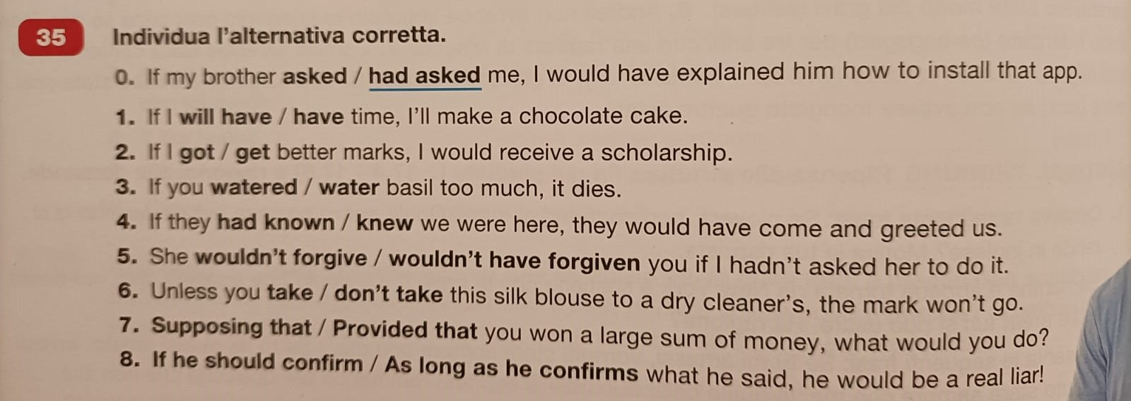
For further practice
Notes:
p. 322 zanichelli

Slide 26
WISH FOR PRESENT / FUTURE
WISH
WISH FOR PAST REGRETS

Slide 27
WISH FOR PRESENT / FUTURE
Wish you were here
PAST SIMPLE
After wish, you can use was (informal) or were (formal) with I, he/she/it
WOULD(N’T) + INF.
Notes:
p. 50 Ask the students to express a wish and then a thing that annoys them

Slide 28
WISH FOR PAST REGRETS
Mary wishes we had told her the truth
I wish I had worked less last week
I wish he had danced with me
Notes:
Ask the students to express a regret

Slide 29
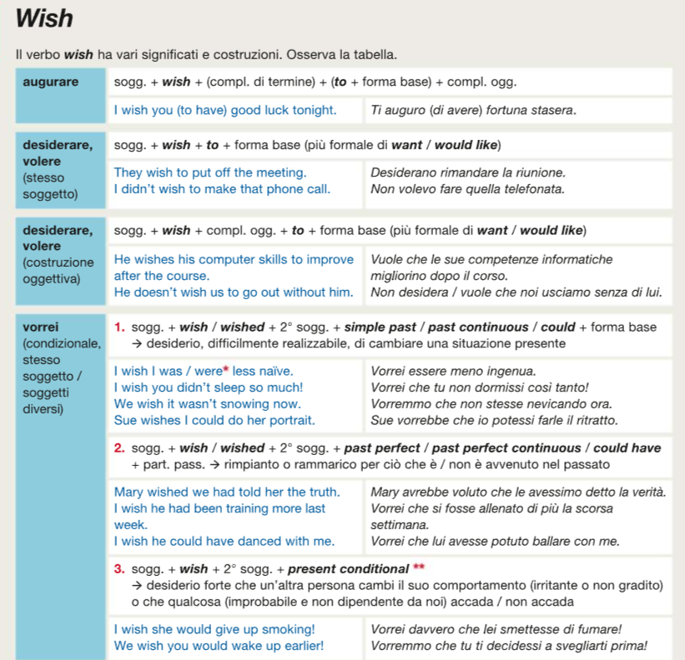

Slide 30
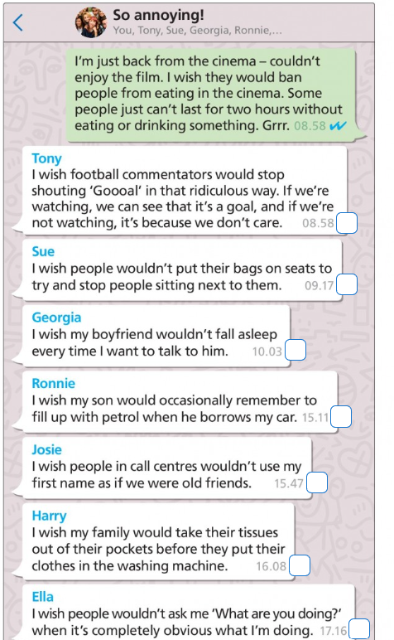
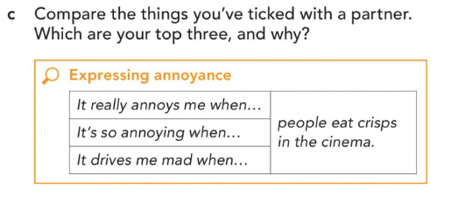

Slide 31
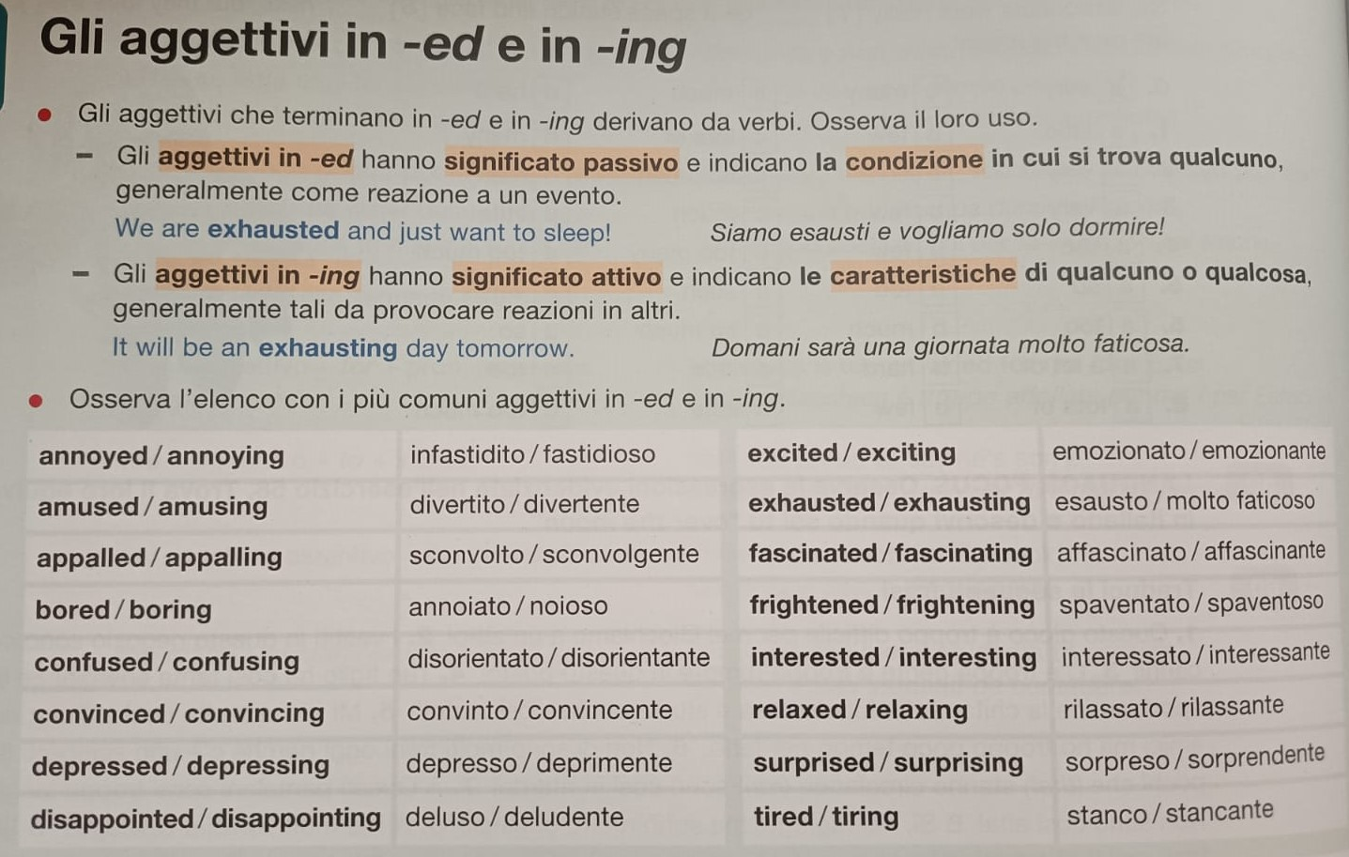
Notes:
P. 51 We’ve just said that «wish+would + inf» is used to talk about things that annoy us

Slide 32
Vocabulary: Environment and ecology
Write the meaning of the following terms
Biodiversity
Carbon dioxide emissions
Carbon footprints
Climate change
To consume / consumption
Deforestation
Desertification
Eco- / environmentally friendly
Ecosystem
Global warming
Greenhouse effect
Holes in the ozone layer
Impact
Organic
Pollution
Recycle
Recycling
Resources
Sustainable development
Waste
Agenda 2030
Notes:
Scheda A42 Zanichelli

Slide 33
KEEP PRACTISING AT HOME!!!
THANK YOU FOR YOUR ATTENTION!!!

