Slide 1
UNIMC
LABORATORIO INGLESE I
Week 3

Slide 2
AT THE END OF THE LESSON YOU WILL BE ABLE TO:
TALK ABOUT FAMILY AND RELATIVES
TALK ABOUT FUTURE EVENTS (SCHEDULE /ˈʃedʒ.uːl/ , PREDICTIONS, PROMISES, ARRANGEMENTS AND INTENTIONS, TIMETABLE)

Slide 3


Slide 4
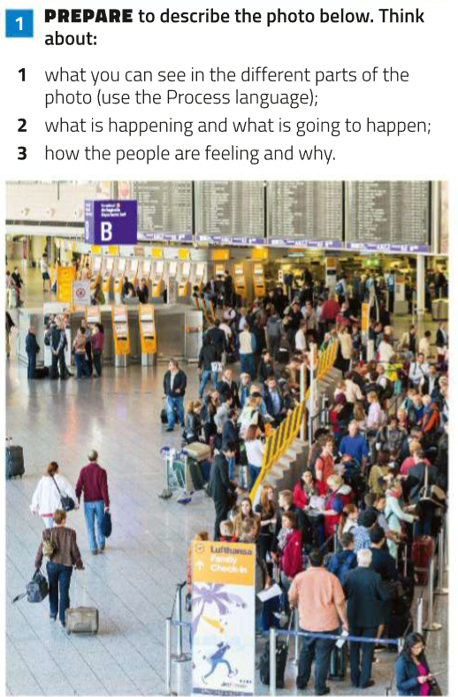
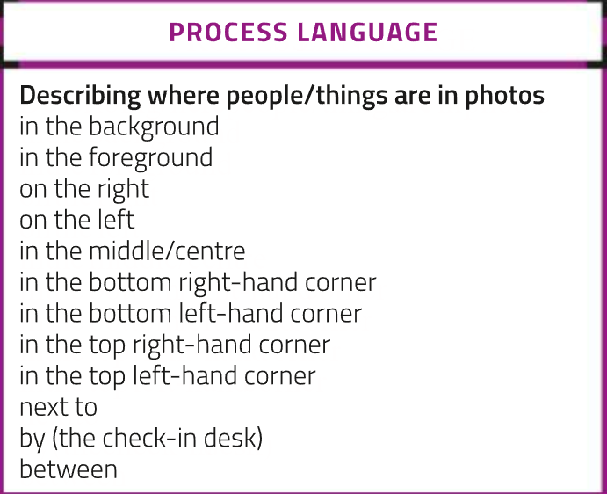
TIPS TO DESCRIBE A PICTURE

Slide 5
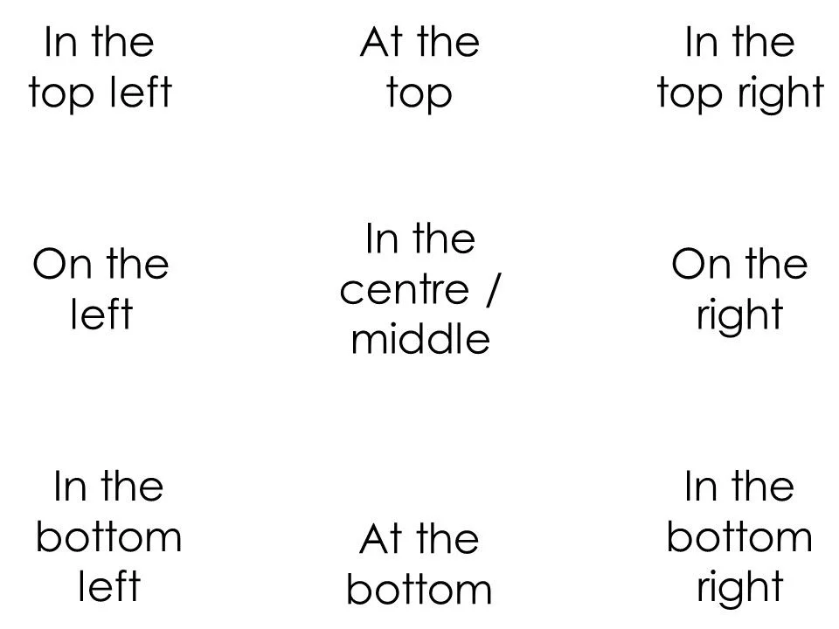
IN THE BACKGROUND / IN THE FOREGROUND

Slide 6
TRADITIONAL AND MODERN FAMILY
What does this picture show?
What do you see?
Try to describe it in pairs!!!
Guiding questions:
Is it a family? Is it a traditional or modern one?
Are they happy/sad/worried/surprised?
What do they look like? (appeareance)
Speculate: why are they in that position? Why are they posing for a photo and who is taking it? Was it taken by releasing the self-timer shutter?

Slide 7
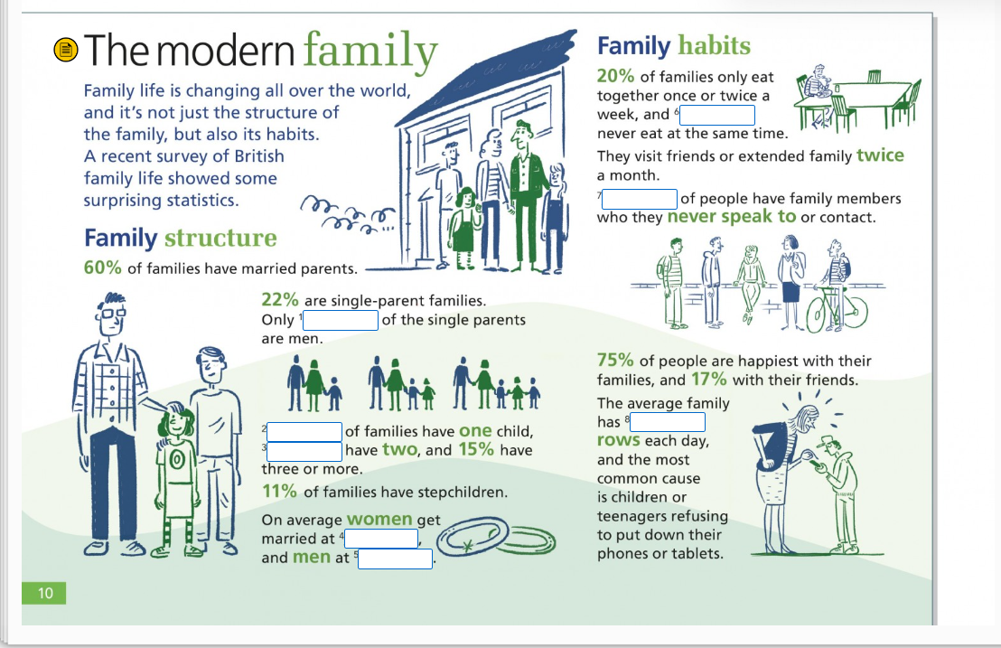

Slide 8
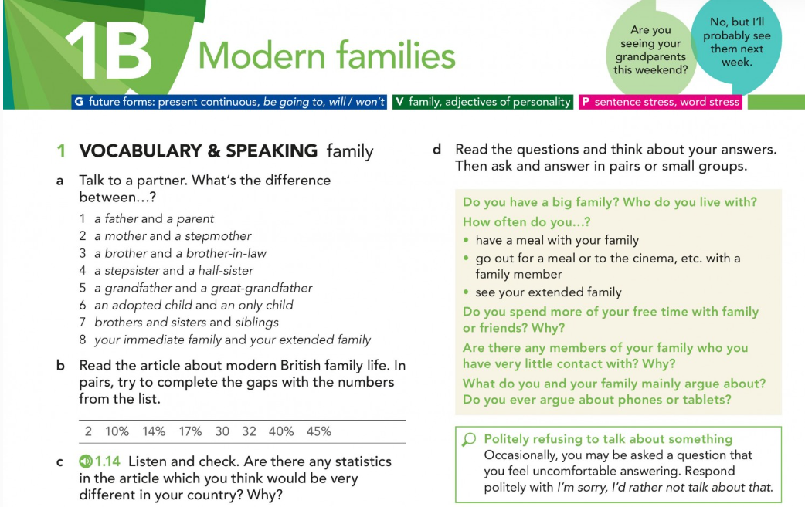

Slide 9
FROM CAMBRIDGE DICTIONARY
Father /ˈfɑː.ðər/: a male parent
Parents /ˈpeə.rənt/: a mother or father of a person or an animal, or someone who looks after a person in the same way that a parent does.
Stepmother /ˈstepˌmʌð.ər/: the woman who is married to someone's biological (= related by birth) parent but who is not their biological mother

Slide 10
SIBLINGS noun [ C ] UK /ˈsɪb.lɪŋ/ =
BROTHERS AND SISTERS IT IS A MORE FORMAL WORD AND IS USED FOR BOTH GENDERS
IMMEDIATE FAMILY = IT REFERS TO PARENTS, CHILDREN, BROTHERS AND SISTERS.
EXTENDED FAMILY= IT REFERS TO ANYONE RELATED TO YOU WHO IS NOT YOUR IMMEDIATE FAMILY AS FOR EXAMPLE UNCLES, AUNTS, COUSINS, GRANDPARENTS…

Slide 11
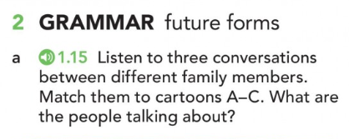
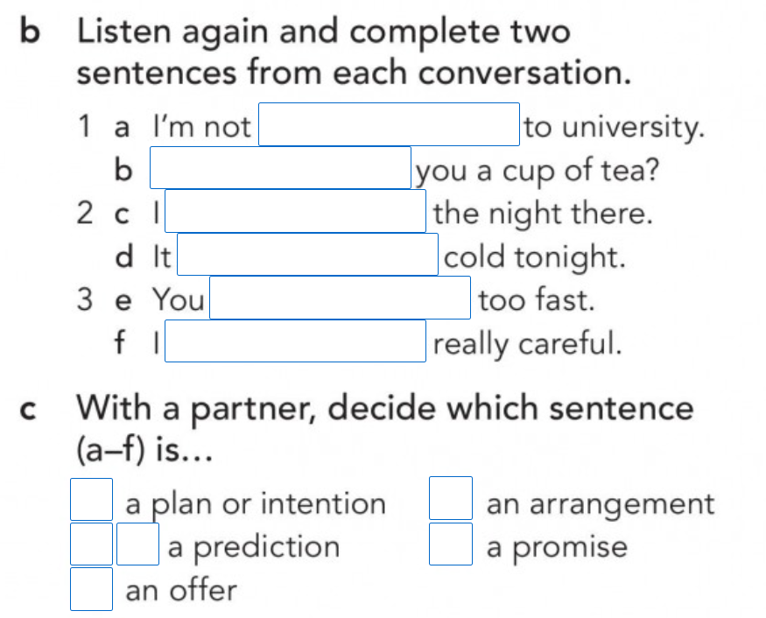
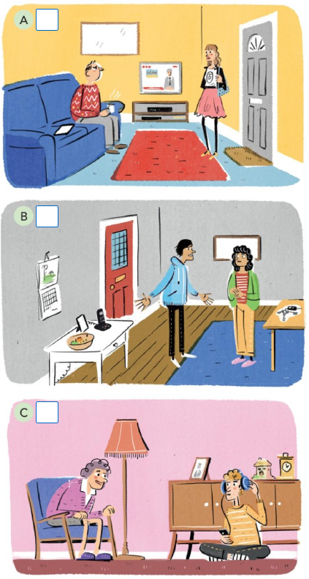

Slide 12
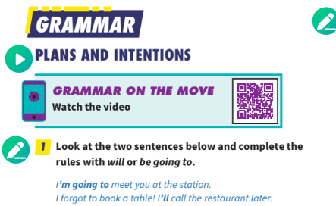
Open world pag 80

Slide 13
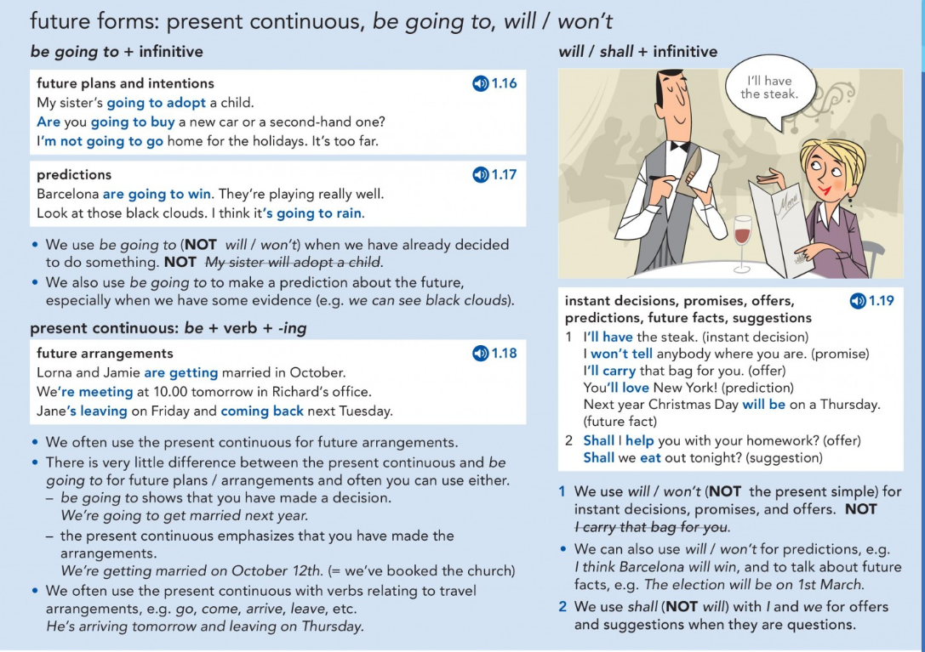

Slide 14
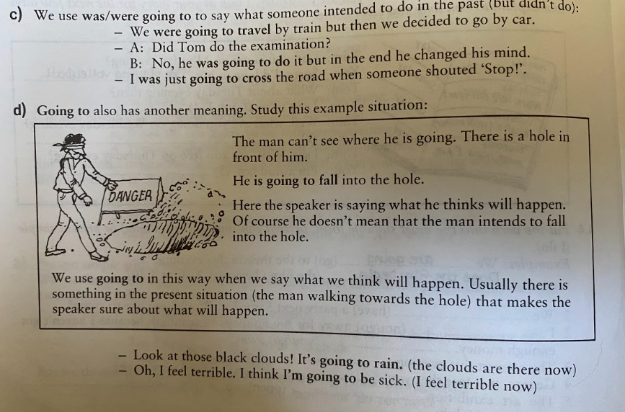
WATCH OUT!
TO BE GOING TO FOR PREDICIONS MEANS THAT WE USE GOING TO (NOT WILL) WHEN THERE IS SOMETHING IN THE PRESENT SITUATION THAT SHOWS WHAT WILL HAPPEN IN THE FUTURE (ESPECIALLY THE NEAR FUTURE).
THE SPEAKER FEELS SURE ABOUT WHAT WILL HAPPEN BECAUSE OF THE SITUATION NOW:
LOOK AT THOSE BLACK CLOUDS, IT’S GOING TO RAIN!
I FEEL TERRIBLE, I THINK I’M GOING TO BE SICK
BUT: ACCORDING TO THE WEATHER FORECAST TOMORROW IT WILL RAIN.

Slide 15
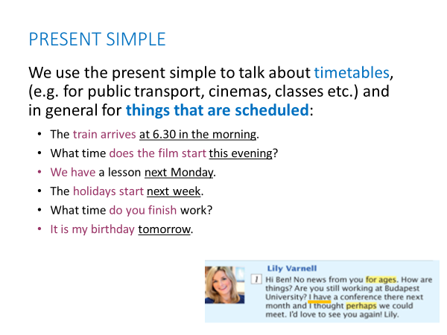

Slide 16
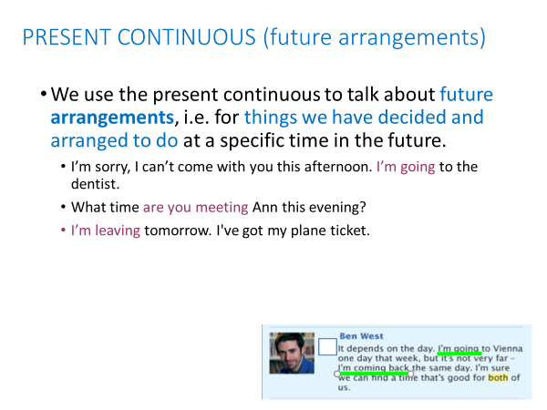

Slide 17
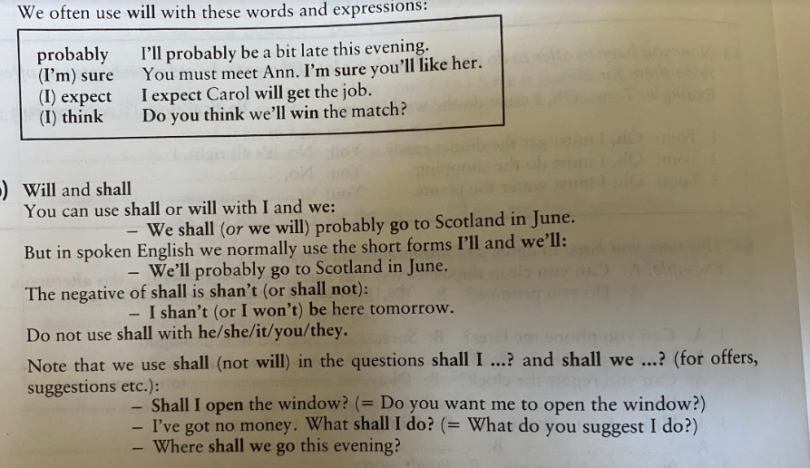

Slide 18
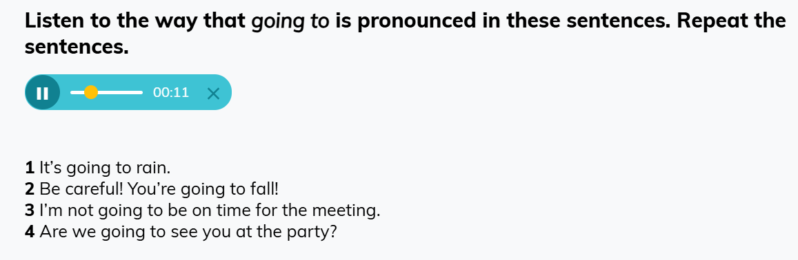
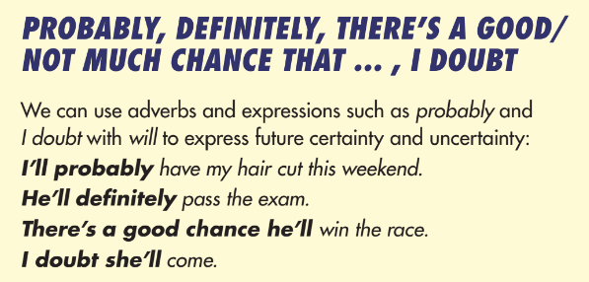
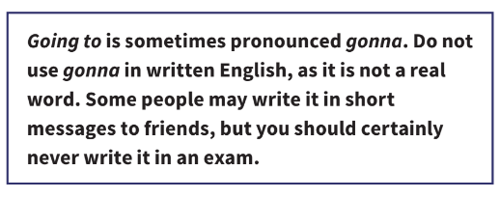
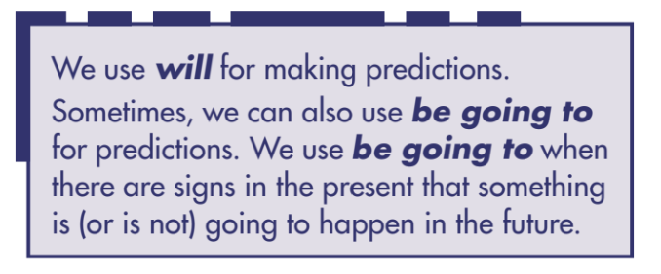
Open world pag.82

Slide 19
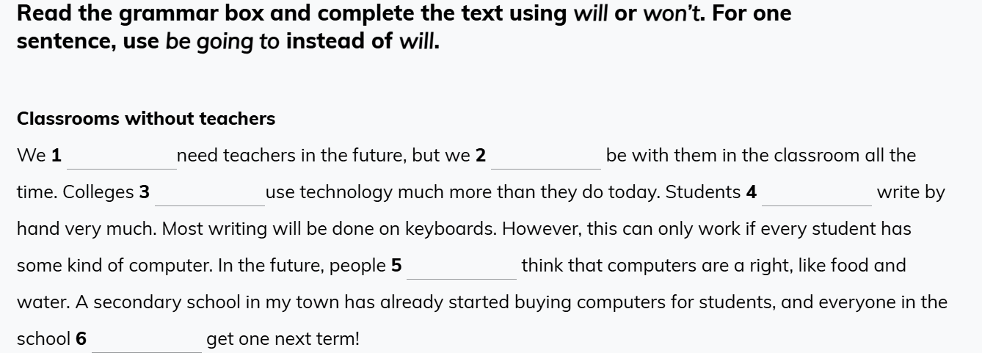

Slide 20
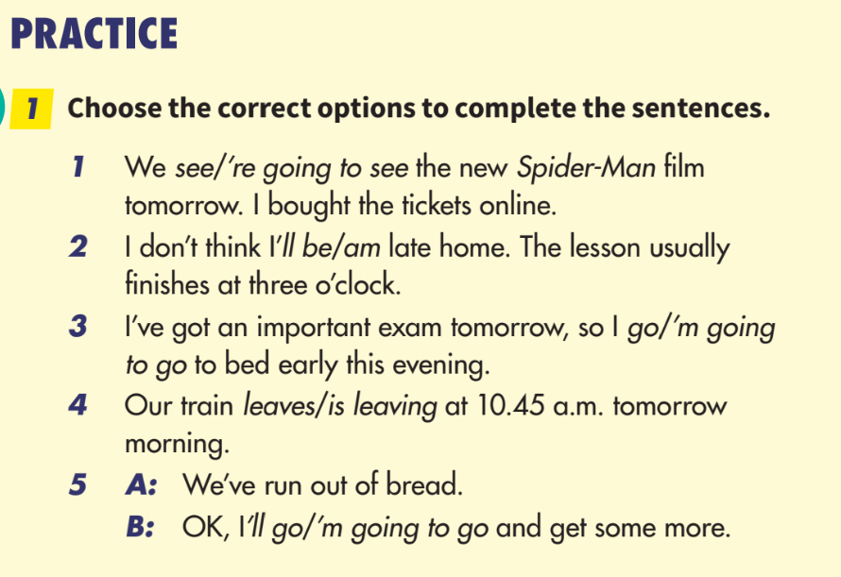
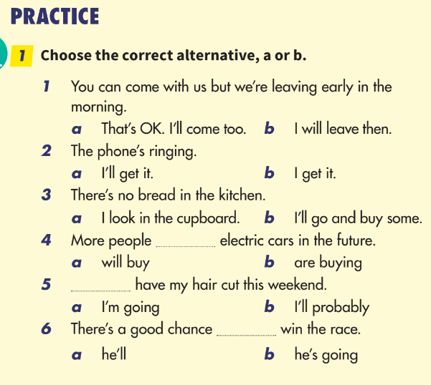

Slide 21
Write 3 or more sentences about your future resolutions and your predictions
E.g. next year I’m going to buy a new car
I think that tomorrow it won’t rain.

Slide 22
PRONUNCIATION

Slide 23
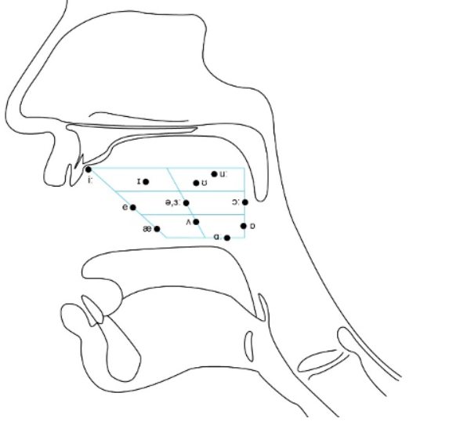
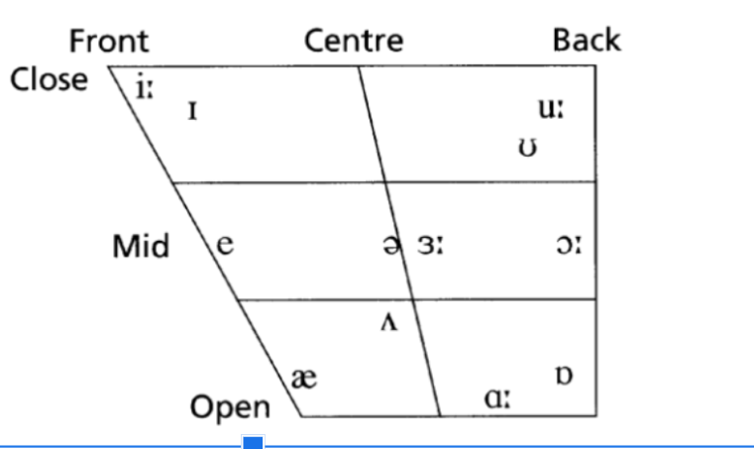
PHONETIC CHART: VOWEL SOUNDS

Slide 24
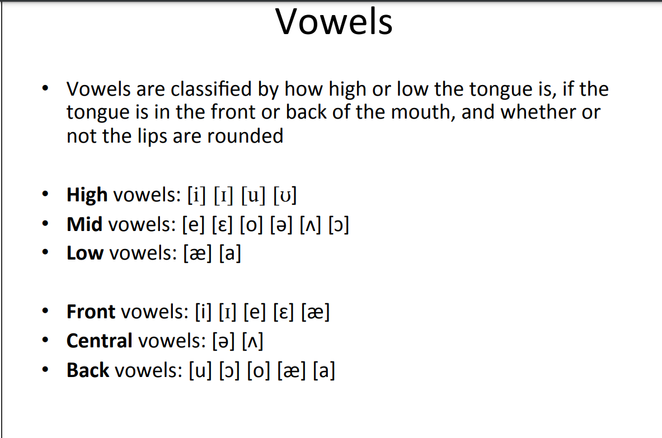

Slide 25
WORD STRESS ( = SYLLABLE STRESS)
Video lesson: https://www.oxfordonlineenglish.com/syllables-and-stress
To communicate clearly when you are speaking in English, it is important to stress the correct syllables in each word.
This is called word stress, which means pronouncing one syllable of a multisyllabic word with greater emphasis (stress) than the other syllables in the word.
A stressed syllable combines these features:
It is l-o-n-g-e-r - com p-u ter
It is LOUDER - comPUter
It usually has a higher pitch than the syllables coming before and afterwards.
It is said more clearly -The vowel sound is purer.
Remember: the unstressed (weak/quiet) syllables of a word
have the opposite features of a stressed syllable!
Stress is always on a vowel!
Notes:
https://www.teachingenglish.org.uk/article/word-stress
Video lesson – interrompere a 5.10 più o meno, poi slide, poi continua con regole (video lesson + next slides)

Slide 26
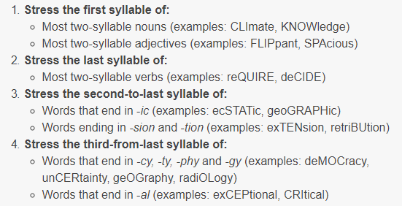
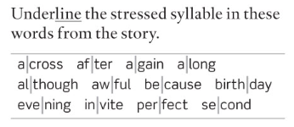
WORD STRESS – some general rules
TWO-SYLLABLE WORDS
BUT: hotel, respect
Many two-syllable prepositions and connectors (examples: beHIND, beFORE, beCAUSE)
Compound nouns: stronger stress on the first part (examples: HAIRbrush, FOOTball)
Exercise 2a (p.17)
Notes:
https://www.toeflgoanywhere.org/learn-these-4-word-stress-rules-improve-your-pronunciation
https://www.teachingenglish.org.uk/article/word-stress
Es. 2a pag. 17

Slide 27
WORD STRESS – some general rules (2)
LONGER WORDS
Notes:
https://www.toeflgoanywhere.org/learn-these-4-word-stress-rules-improve-your-pronunciation
https://www.teachingenglish.org.uk/article/word-stress

Slide 28
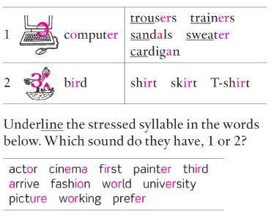
Pronunciation notes
1C
/Ə/ (schwa) is the most common sound in English. It is a short sound, and always occurs in an unstressed syllable, e.g. doctor, address.
  Unstressed -er or -or at the end of a word are always pronounced /Ə/, e.g. teacher, better
  Same sound in -tion
/3:/ is a similar sound, but it is a long sound and is always in a stressed syllable, e.g. nurse, worker
Notes:
exercise 2a-b p.8

Slide 29
Pronunciation notes
1C
Exercise 2b (p.8)
Notes:
exercise 2a-b p.8

Slide 30
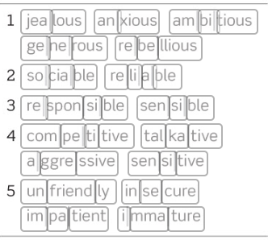
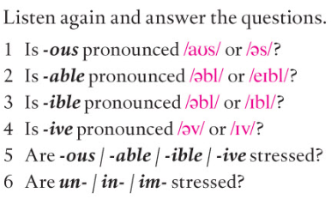
WORD STRESS – more practice
Notes:
https://www.toeflgoanywhere.org/learn-these-4-word-stress-rules-improve-your-pronunciation
https://www.teachingenglish.org.uk/article/word-stress
Exercise 7a (p.11 B1/+)
1. /es/
2. /ebl/
3. /ebl/
4. /IV/
5+6: no, never

Slide 31
OVER TO YOU – PART 1
Oxford Online English – Pronunciation Lessons
Sounds and spelling: https://www.oxfordonlineenglish.com/sounds-and-spelling
Silent letters: https://www.oxfordonlineenglish.com/silent-letters

Slide 32
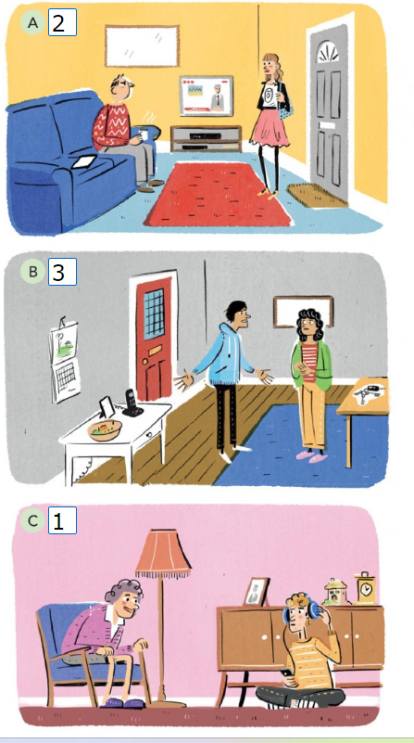
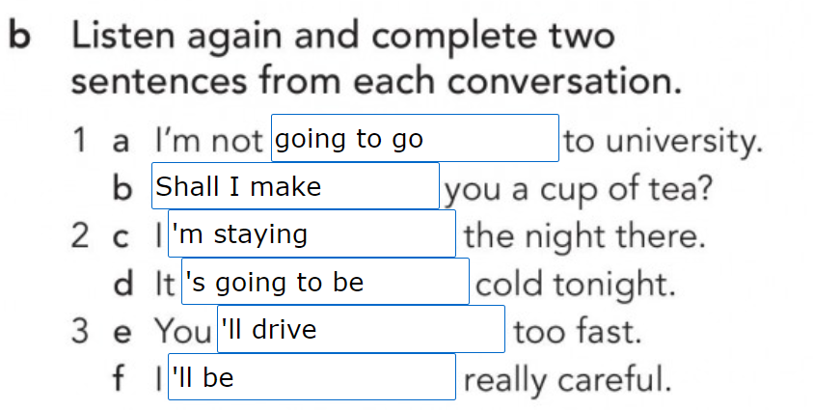
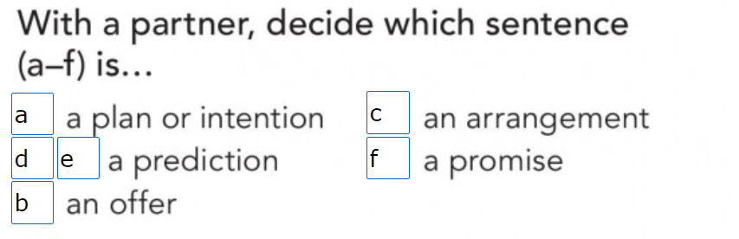

Slide 33
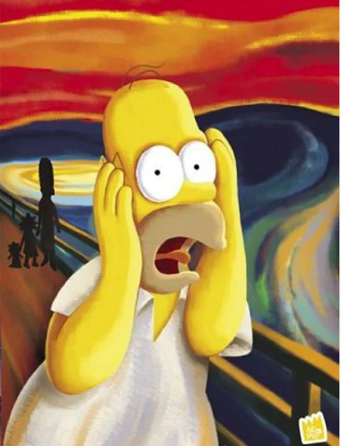
LET’S DO SOME MORE PRACTICE !!!

Slide 34
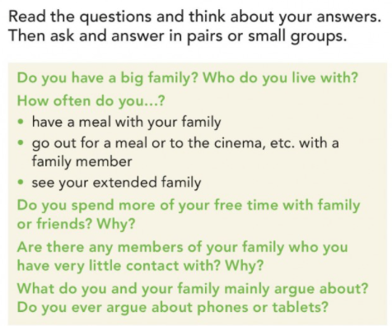

Slide 35
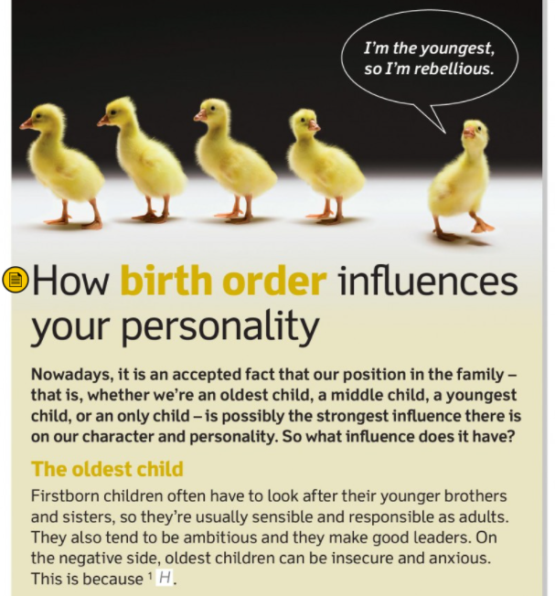
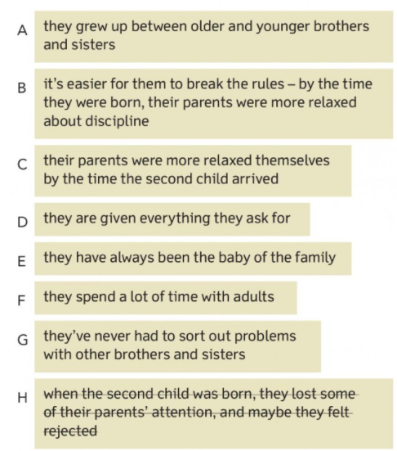

Slide 36
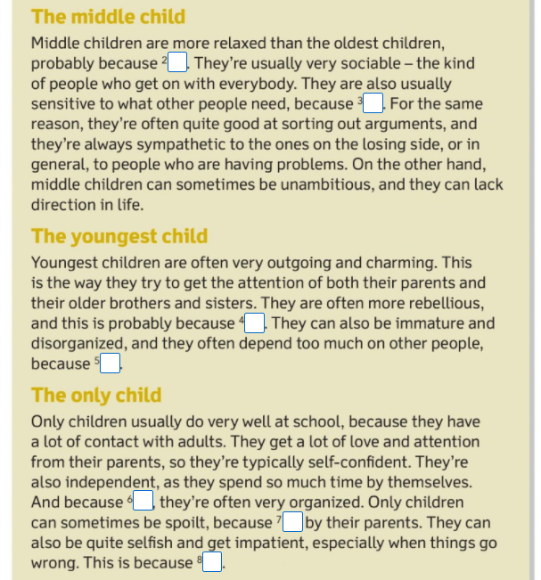
Notes:
Do you think these descriptions are sound? Do you think the description of personality is true for you?

Slide 37
SAMPLE OF A PHOTO DESCRIPTION
This picture shows a group of 6 people posing for a photo.
They look like a family, on the left there is a young boy and behind him there is a an old lady, who may be his grandma. Between the boy and the lady there is a middle-aged man, who is probably the boy’s father.
On the right there is a young girl, she may be 10 years old and behind her there is an old man who is smiling and looks to be is grandpa. They are smiling and look very happy. In the background there is a big door o window and I think they are all in the living room that is very bright. It must be summer because they are wearing short-sleeve shirts.
I think they are posing to have a picture of the happy moment and maybe they have just celebrated a birthday or an anniversary.

Slide 38
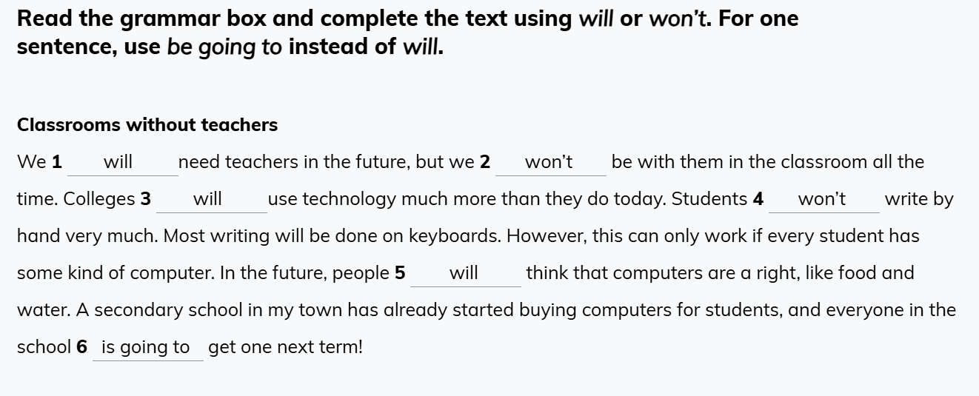

Slide 39
THANK YOU FOR THE ATTENTION AND DO NOT HESITATE FOR ANY QUESTIONS OF FURTHER INFORMATION

