Slide 1
A.A. 2024/25, LM-85bis
(1° anno, 2° semestre)
LABORATORIO DI LINGUA INGLESE I
week V (integrazione past tenses)
Prof.ssa Nicoletta Moretti
Notes:
1

Slide 2
TODAY’S CLASS
GRAMMAR: PRESENT PERFECT
  present perfect
    vs. past simple
  present perfect continuous
  Past perfect
  Superlatives and comparatives
Notes:
ESERCIZI: 1C – 1a, 1b; 2a, 4

Slide 3
PAST SIMPLE
We use the past simple to talk or to ask about
specific finished actions in the past
when the time is mentioned
(e.g. yesterday, last year)
or understood
Notes:
1. The simple past is used to talk about completed actions in the past
2. The simple past is often used with expressions that refer to points of time in the past

Slide 4

Using the simple past for storytelling: Jack and the Beanstalk
ON OLAT!
Once upon a time there was a boy called Jack. He _____ with his mother. They ____ very poor. All they ____ was a cow.
One morning, Jack’s mother ____ Jack to take their cow to market and sell her. On the way, Jack ____ a man. He ____ Jack some magic beans for the cow. Jack ____ the beans and ____ back home. When Jack’s mother ____ the beans she ____ very angry. She ____ the beans out of the window.
The next morning, Jack ____ out of the window. There ____ a giant beanstalk. He ____ outside and ____ to climb the beanstalk. He ____ up to the sky through the clouds and ____ a beautiful castle.
(….)
With the golden eggs and the magic harp,
Jack and his mother ____ happily ever after.
http://learnenglishkids.britishcouncil.org/en/short-stories/jack-and-the-beanstalk

Slide 5
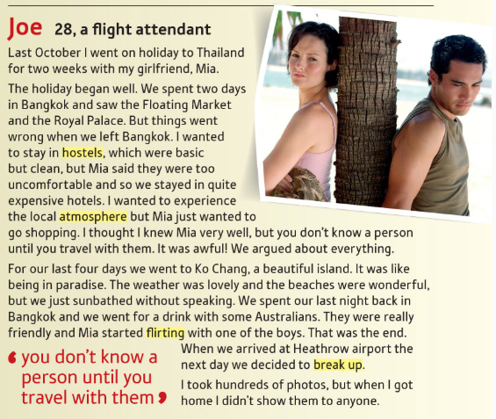
DISASTROUS HOLIDAYS
EXTRA PRACTICE
Notes:
Far questo

Slide 6
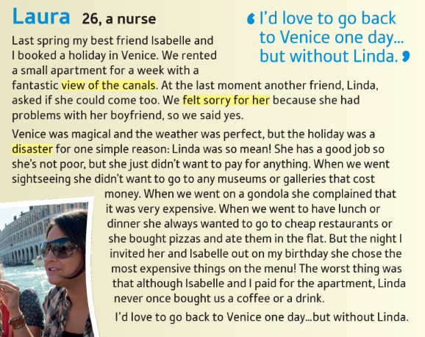
DISASTROUS HOLIDAYS
EXTRA PRACTICE
Notes:
Questo per casa

Slide 7

DISASTROUS HOLIDAYS
EXTRA PRACTICE
Where did Joe/ Laura go on holiday?
Who did he/she go with?
Where did he/she stay?
What was the weather like?
Why didn’t he/she enjoy the holiday?
LET’S LISTEN TO THE OTHER SIDE OF THE STORY…
What does Mia say about: (track 34)
  Her relationship with Joe before they went
  The places where they stayed
  Talking to other travellers
  Photos
  Going on holiday with a boyfriend
What does Linda say about:
Venice
What they did there
The cost of her holiday
Her next holiday
(track 35)

Slide 8

The past in relation to the present: the PRESENT PERFECT
We use the present perfect to talk about actions and experiences that happened at a non-specified time in the past (🡪 in our lives up to now):
  “Have you travelled a lot, Jane?”
  “Yes, I’ve been to lots of places.”
  “Have you driven an automatic car (before)?”
  “No, I haven’t.”
  “Have you ever been to Canada? “
  “No, I have never been to Canada.”
  I haven’t attended any English class so far.
  I haven’t seen anything similar in (all) my life.
  That was the best holiday I’ve ever had! (in my life)
We can use expressions of frequency like often, once, twice, several times to say how often:
  I’ve eaten in that restaurant several times.
  My parents have visited Canada twice.
Dave and Jane talking about the places Jane has visited in her life, which is a period that continues until now
Notes:
Ricordate che ho tanto insistito sul fatto che il Simple Past è un passato concluso. Oggi vediamo la forma verbale del passato che, invece, conclusa non è: il Present Perfect. Già il nome lo suggerisce: il fatto che gli inglesi lo chiamino Present perfect significa che la cosa importante di questa forma è il legame col presente.
1. Here, Dave and jane are talking about the places Jane has visited in her life, which is a period that continues until now.
rispetto al tempo più simile in italiano (il passato prossimo) vi risparmiate di dover imparare quali verbi vogliono essere e quali avere, perché nel Present Perfect l’ausiliare è SEMPRE AVERE!

Slide 9
SPEAKING PRACTICE
Interview your partner about her/his (their) last holiday.
  Where / go?
  How / go there?
  Why / go there?
  When / go?
  Who / go with?
  Where / stay?
  What / the food (/weather) like?
  What / do during the day (/at night)?
  / have a good time?
  / have any problems?
  What / like most?
  / anything special/funny happen?
See: adverbs of time

Slide 10

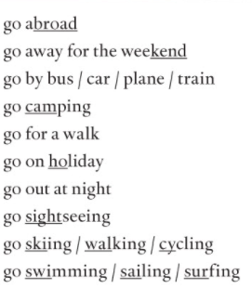
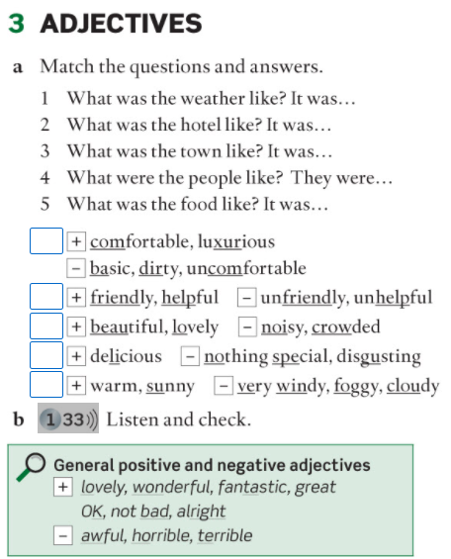
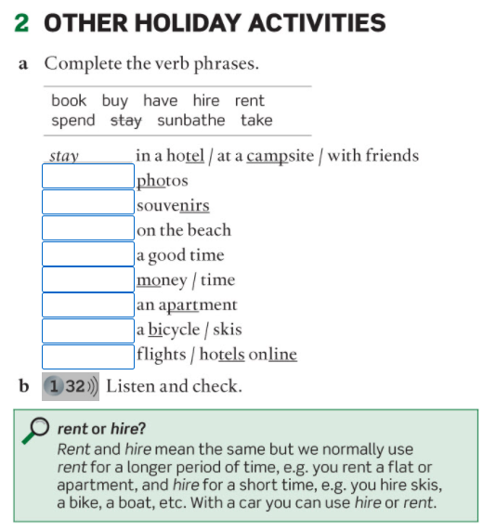

Slide 11
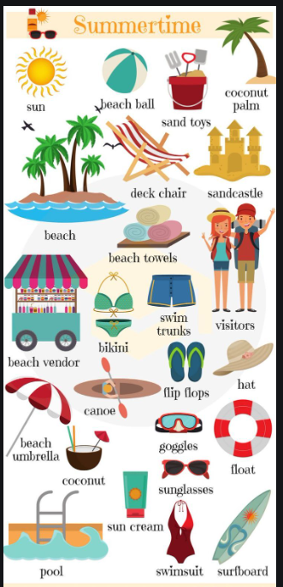
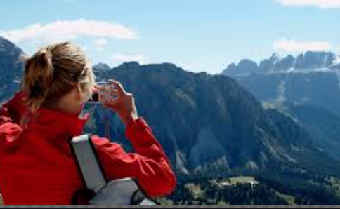
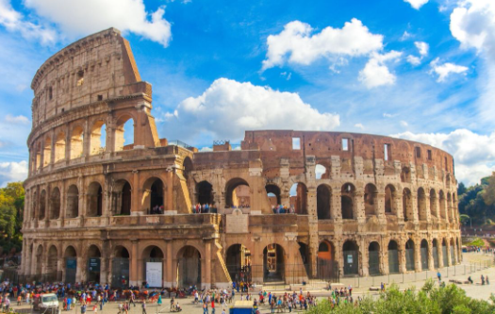

Your perfect holiday – Do you prefer… ?
Notes:
Seaside (sunbathe)
Mountains (going for walks)
tourist city (go sightseeing)

Slide 12
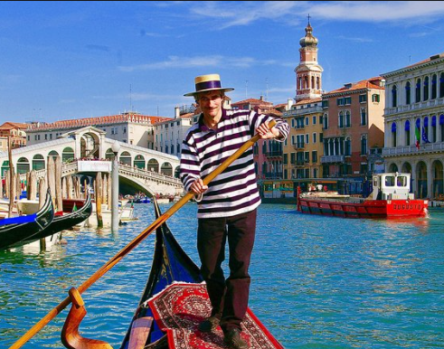
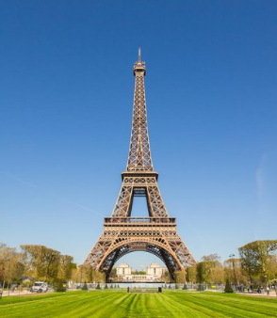
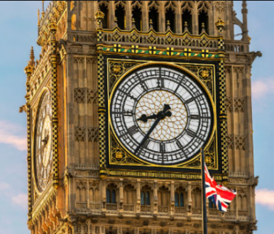
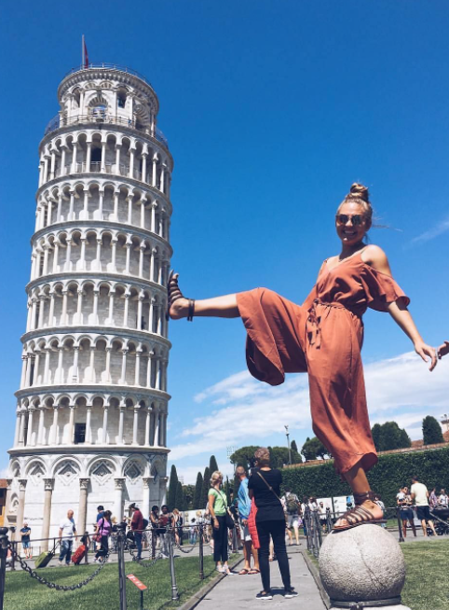
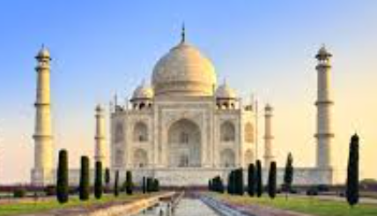
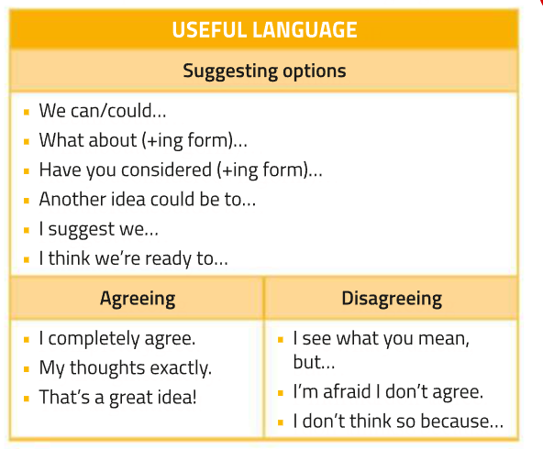

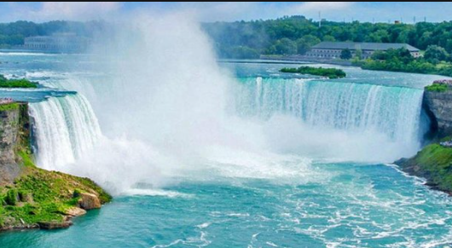

Your perfect holiday – Do you prefer… ?
going abroad
Do you agree?
I agree / don’t agree
(with you)
I’m (not) agree
staying in Italy
Notes:
Remare = row, using poles, standing at the back end of the gondola
Pretend to kick
Niagara falls (waterfall, North America, on the border between Canada and US)
Eiffel Tower
Going abroad – foreign countries

Slide 13
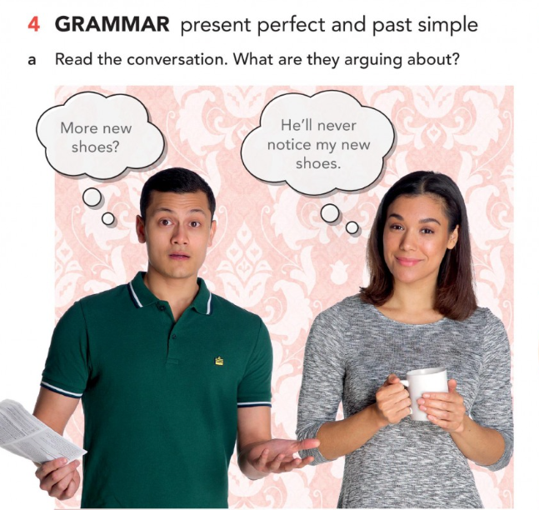
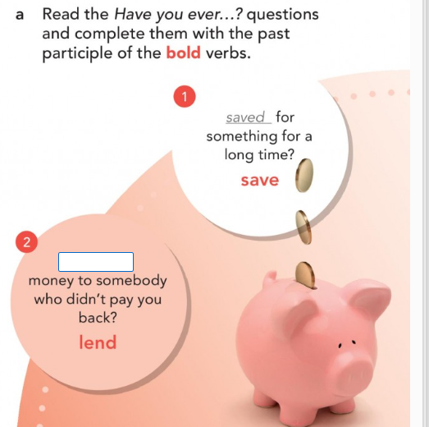
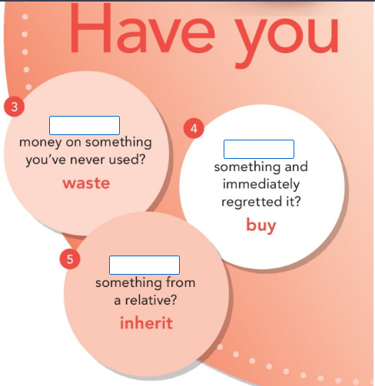
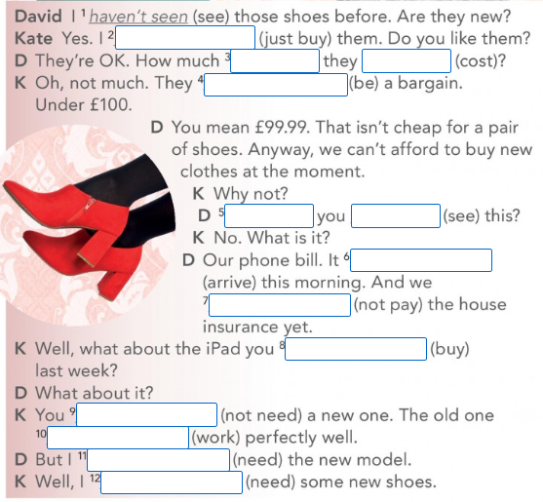
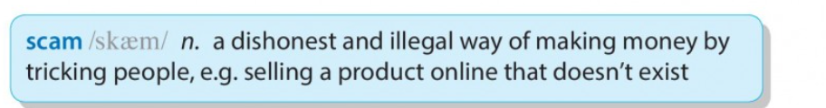

Slide 14
2. We use the present perfect to talk about an action in the (recent) past which has a result/some relevance in the present.
I have lost my keys. I can’t get into the house.
Jenny has found a new job. She works in a supermarket now.
He told me his name but I’ve forgotten it (and I can’t remember it now)
«What happened?»
«I’ve broken my leg» (maybe one month ago, but it is still in plaster)
«I broke my leg last week»
(giving news) Mary’s had her baby!
(giving news) Julian has passed his driving test > (giving details) He took it on Monday.
Mike has been to Paris vs. Mike has gone to Paris
(he went and came back) (he is in Paris now)
Notes:
2. Present perfect is used to talk about a present situation which is a result of something that happened at a non-specified time in the past.
Se in una frase si parla di un’azione passata con conseguenze sul presente (= Present Perfect) e compare un’espressione di tempo come last week (= Simple Past) chi la vince?? IL SIMPLE PAST! Perché la presenza di un’espressione di tempo passato concluso vi obbliga ad usare il Simple Past.
+ Introduce new information

Slide 15
To refer to the recent past, with adverbs such as already, just, lately/recently; still, yet (tra l’ausiliare e il verbo)
  “Are you coming to the cinema?” “I’ve already seen that movie” [+]
  “Are you coming with us?” “No, I’ve just had lunch, thank you” [+]
  Have you done your homework yet? [?] / I haven’t finished yet. [-]
  Have you been to the cinema lately/recently?
  We still haven’t had our exam results.
To refer to actions occurred in a time period which is not over yet :
I've drunk four cups of coffee today.
vs. I drank four cups of coffee this morning (said at 4pm)
We haven’t taken any exam this year.
  I’ve made a lot of new friends in the last few days.
  We haven’t had dinner together for a long time.
Notes:
Yet in questions to ask about something we expect to happen around now, but which hasn’t happened at the time of speaking.
Yet and still in negative sentences when we expected something to happen before now.
Yet alla fine della frase, vs. already and just before the main verb
l’azione avviene in un tempo determinato ma non ancora concluso
We can use the present perfect with time expressions which include the present time such as today, this morning/year/ month, etc. to talk about events or states that may not be finished at the time of speaking, e.g.
I’ve answered the phone six times this afternoon.
Have you seen Andy today?
Jack has been really unwell this term.
However, if we think of this morning/week, etc. as a past, completed time period, then we must use the past simple.

Slide 16
To talk about activities/situations that started in the past, continued and are still true/happening now:
  How long has David worked in Mexico? (we know he’s still there)
    David has worked in Mexico for many years / for a long time.
      He has worked there for all his life.
    David has worked in Mexico since 2001.
    David has worked in Mexico since he left school.
    He has always worked there.
PLEASE NOTICE:
use the present perfect to talk about a period of time from the past until now
use the past simple to talk about a finished period of time in the past.
Jack has been married for 20 years (he is married now)
Jack was married for 20 years (now he is divorced, or a widower, or dead)
Notes:
things are seen as long-term or permanent OR stative verbs

Slide 17
The past in relation to the present: the PRESENT PERFECT
With superlatives
That was the worst film I’ve ever seen!
That was the best holiday I’ve ever had!
With “the first time” and similar expressions
  This is the third time I’ve visited China, but it’s the first time I’ve travelled in business class.

Slide 18
COMPARATIVES and SUPERLATIVES 3° pag.26
We use comparative and superlative adjectives and adverbs to compare people or things.
One syllable adjectives and adverbs
add -er for comparative and -est for superlative
      cheap - cheaper - cheapest fast - faster - fastest
      great - greater – greatest
if the adjective or adverb ends in -e, then just add -r or -st
    nice - nicer – nicest safe - safer - safest
    rude - ruder - rudest
if the adjective ends in a vowel + consonant, double the last letter before adding -er/-est, unless it ends in -w.
    big - bigger – biggest hot - hotter - hottest
    new - newer - newest

Slide 19
Adjectives/adverbs with two syllables
adjectives/adverbs ending in -y: change the y to i before adding -er/-est.
    happy - happier – happiest early - earlier - earliest
    busy - busier – busiest funny - funnier - funniest
some other two-syllable adjectives (especially those ending in an unstressed vowel sound) can also take the -er/-est.
    quiet – quieter (more quiet) – quietest (most quiet)
    narrow – narrower (more narrow) – narrowest (most narrow)
adjectives ending in –ful: more/most
  useful - more useful – most useful
Adjectives/adverbs with three or more syllables
use more in the comparative and the most in the superlative.
      expensive - more expensive - most expensive
      fluently - more fluently - most fluently

Slide 20
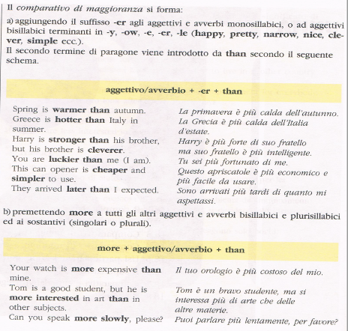

Slide 21
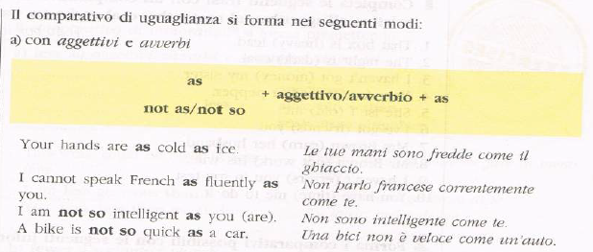
COMPARATIVES: (=) AS … AS

Slide 22
      NB_1: use in after superlatives:
      - it’s the longest bridge in the world.
      it’s the best beach in Italy.
      NB_2: after than you can use
        - an object pronoun (me, him etc.)
        - a subject pronoun + auxiliary verb
      She’s taller than me OR she’s taller than I am
      than you than you are
      than him / her than he / she is
      than us than we are
      than you than you are
      than them than they are

Slide 23
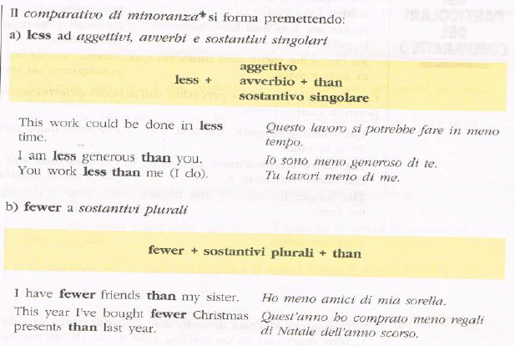
COMPARATIVES: (-)
more > less
That way of calculating the figures seems less complicated to me.
(the) most > (the) least
If you are going on holiday as a group, the least expensive option is to rent an apartment or villa.

Slide 24
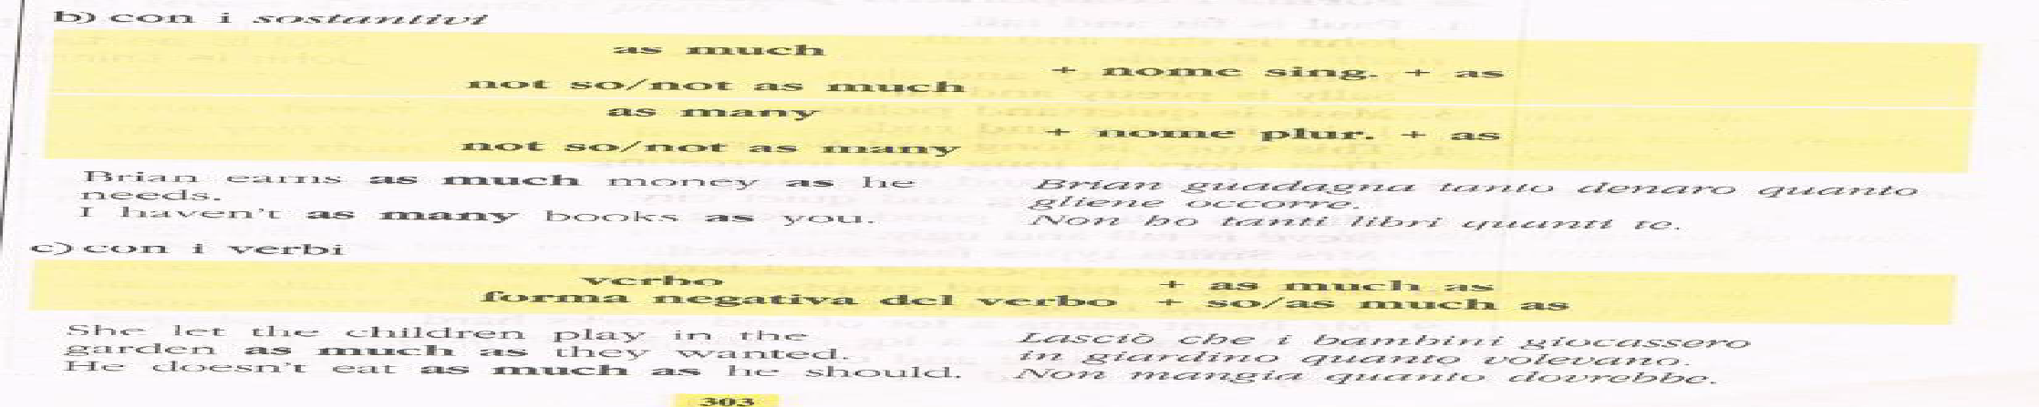
COMPARATIVES - VERBS
We work more than they do
We work less than they do
We work as much as they do

Slide 25
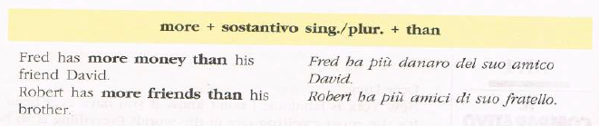
COMPARATIVES - NOUNS
con sostantivi singolari (= uncountable)
less + sostantivi singolari (= uncountable)

Slide 26
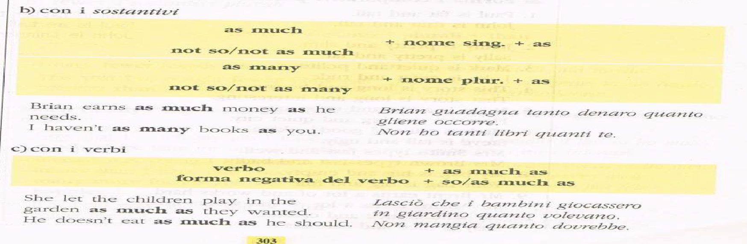
COMPARATIVES - NOUNS
COUNTABLE vs. UNCOUNTABLE NOUNS (Cambridge Grammar)
COUNTABLE vs. UNCOUNTABLE NOUNS (LearnEnglishTeens, British Council)

Slide 27
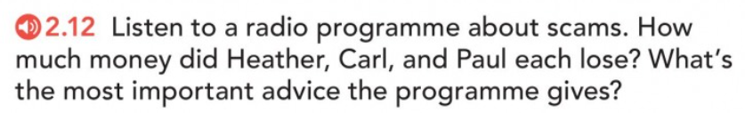
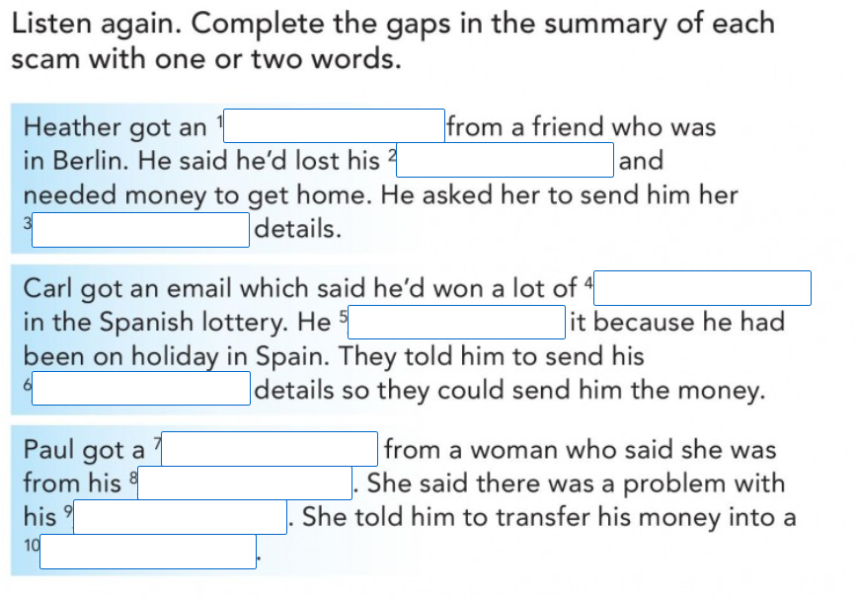
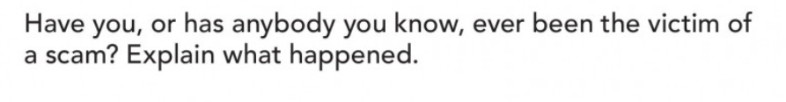

Slide 28
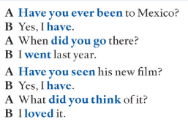
PRESENT PERFECT – PAST SIMPLE
Conversations often begin in the present perfect
(with a general question; you don’t know whether something has happened in the past)
and then change to the past simple
to ask for or give specific details (e.g. when, what, where, who with etc.)

Slide 29
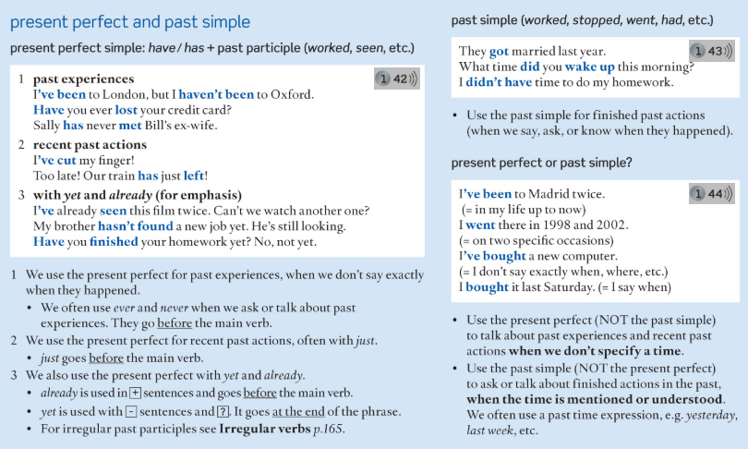
PRESENT PERFECT vs. PAST SIMPLE - summing up

Slide 30
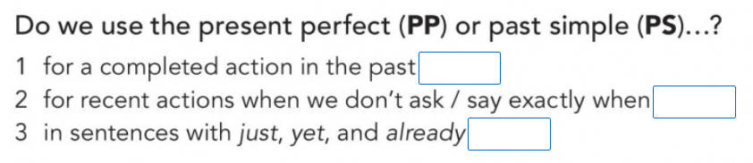
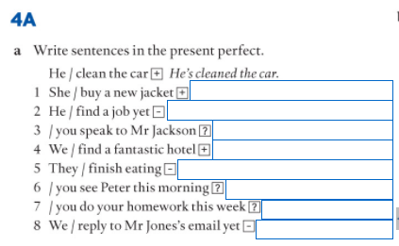
Exercise 4Aa GB p.133
Notes:
Sempre ausiliare avere!

Slide 31
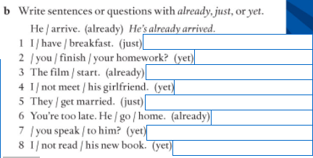
Exercise 4Ab GB p.133

Slide 32
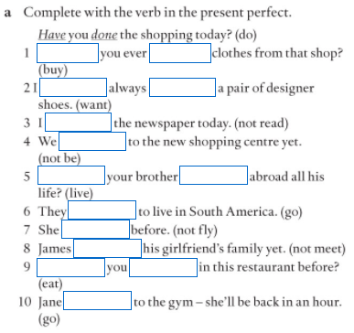
+ exercise on OLAT
Notes:
Exercise 4Ba GB p.133

Slide 33
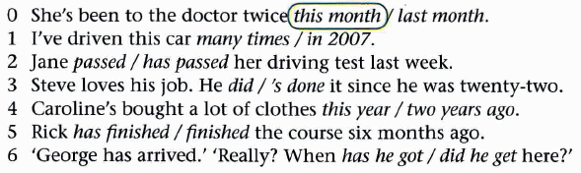

Slide 35
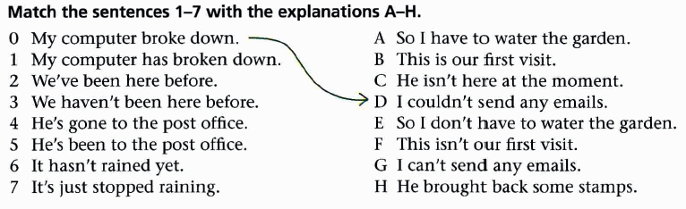

Slide 37
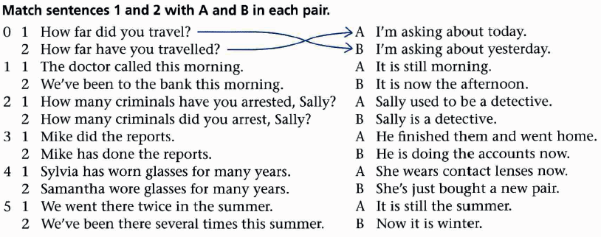

Slide 39
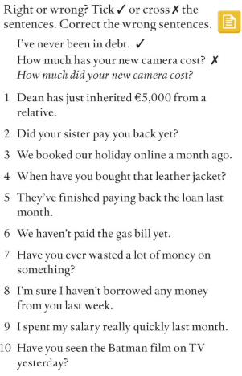

Slide 40



Slide 41
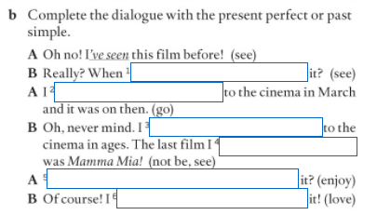
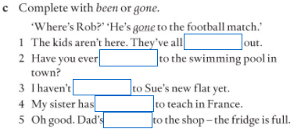
Notes:
Exercise 4Bb GB p.133

Slide 42
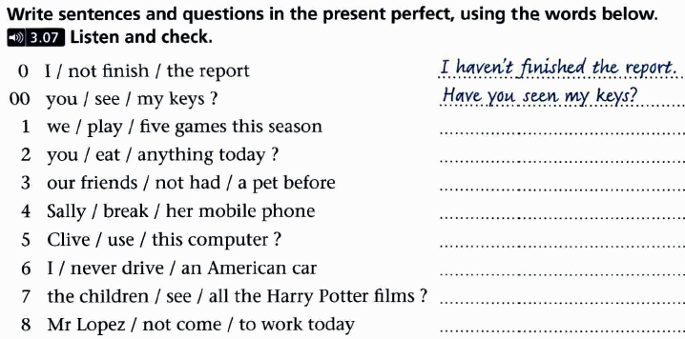
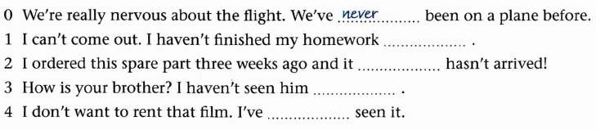
Notes:
Già fatto

Slide 43
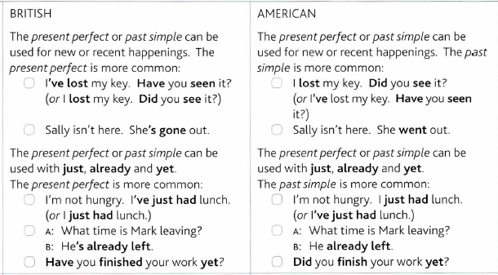
NB: the PRESENT PERFECT in
British vs American English

Slide 44
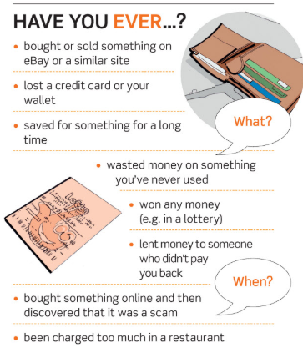
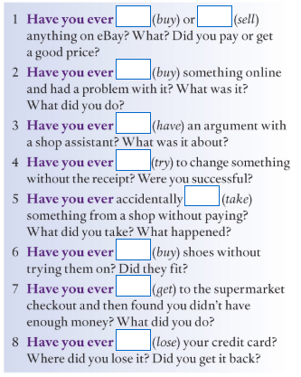
Let’s pratice!
Notes:
Listening and speaking p. 31
Listening exercise 3a-b
Speaking exercise 6
VB p. 155

Slide 45
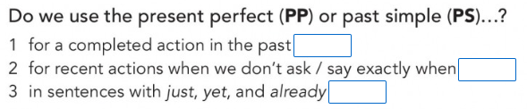
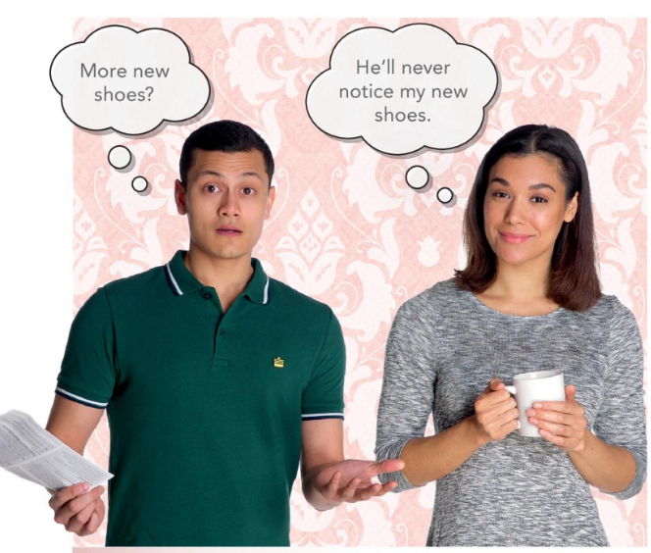
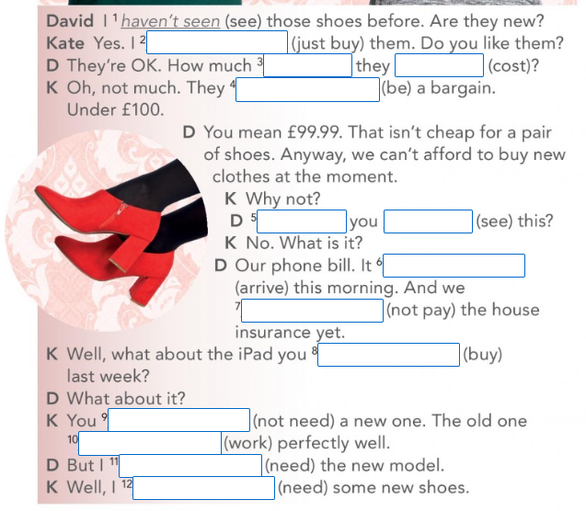

Slide 46
PART 2
GRAMMAR: more on the PRESENT PERFECT
  present perfect continuous
Notes:
ESERCIZI: 1C – 1a, 1b; 2a, 4

Slide 47
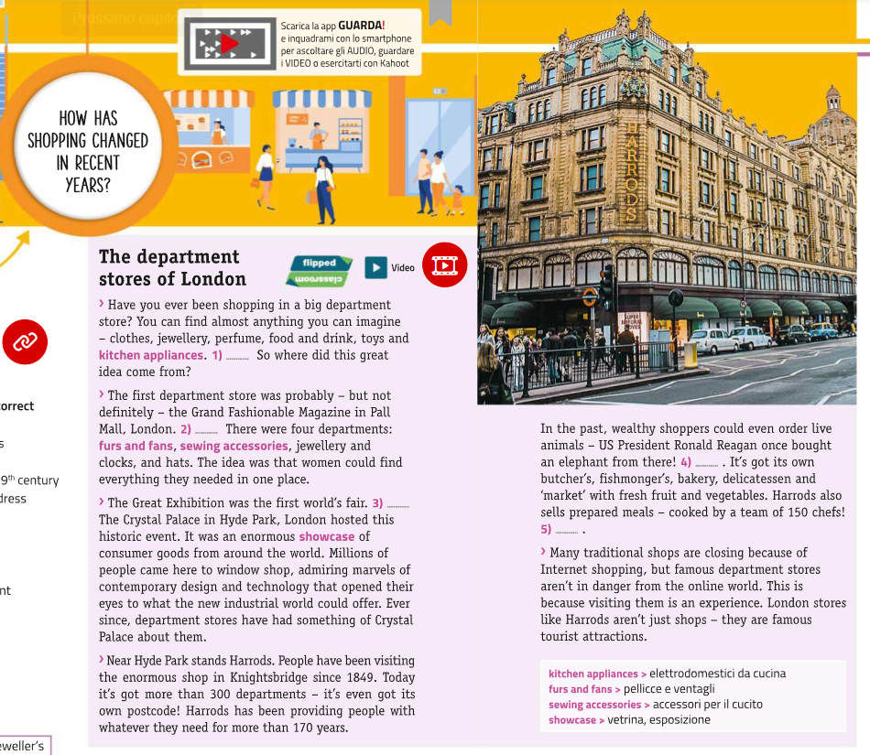


Slide 48
PRESENT PERFECT CONTINUOUS
The present perfect continuous is used to describe a situation or activity which began in the past and is still true at the time of speaking.
It is used to emphasise the duration of the event/situation.
with action verbs (vs. non-action, stative verbs)
with time expressions which indicate how long an activity has been in progress, e.g. I’ve been working at home all day.
  How long has David been working in Mexico?
    David has been working in Mexico for many years.
    David has been working in Mexico since 2001.
He’s been writing to her every day since he left.
(action repeated over a period of time, still happening )
We’ve been going out together for about three years.
Notes:
The present perfect continuous is used to describe a situation or activity which began in the past and was in progress until recently or until the time of speaking. It is often used to emphasise the duration of an event, occurring with time expressions which indicate how long an activity has been in progress, e.g. I’ve been working at home all day.
The present perfect continuous is often used to describe repeated actions which have occurred up until the time of speaking, e.g. He’s been writing to her every day.
Action verbs, also called dynamic verbs, express an action whether it be physical or mental.
To determine if a word is an action verb, look at the sentence and ask yourself if the word shows something someone can do or something someone can be or feel. If it is something they can do, then it is an action verb (if it is something they can be or feel, it is a non-action, or stative, verb).

Slide 49

PRESENT PERFECT CONTINUOUS
We also use the present perfect continuous for continuous or repeated actions which have been happening very recently, when the actions have just finished or have visibly present results.
I’ve been waiting for you for two hours! Where have you been?
I’ve been playing tennis.
(long action which has just finished)
Your eyes are red. Have you been crying?
No, I’ve been chopping onions.
Notes:
The present perfect continuous is used to describe a situation or activity which began in the past and was in progress until recently or until the time of speaking. It is often used to emphasise the duration of an event, occurring with time expressions which indicate how long an activity has been in progress, e.g. I’ve been working at home all day.
The present perfect continuous is often used to describe repeated actions which have occurred up until the time of speaking, e.g. He’s been writing to her every day.
Action verbs, also called dynamic verbs, express an action whether it be physical or mental.
To determine if a word is an action verb, look at the sentence and ask yourself if the word shows something someone can do or something someone can be or feel. If it is something they can do, then it is an action verb (if it is something they can be or feel, it is a non-action, or stative, verb).

Slide 50

PRESENT PERFECT SIMPLE vs
PRESENT PERFECT CONTINUOUS
We use the present perfect continuous when we want to focus on the process
I’ve been washing the car and I’m soaked.
We use the present perfect simple when we want to focus on the result of an activity
I’ve washed the car and it looks much better now.

Slide 51


Slide 52


Notes:
Exercise 9C GB p.143
b 1 has he lived, moved
2 did Picasso die, did he live, left
3 have they been, 've been, met, was

Slide 53
Notes:
Exercise 9C GB p.143
b 1 has he lived, moved
2 did Picasso die, did he live, left
3 have they been, 've been, met, was

Slide 54


Exercise 9B GB p.143

Slide 55

Notes:
9C present perfect or past simple?
1 've loved; wasn't; started
2 Has", finished; finished; hasn't decided
3 've lived; lived; did . .. leave; retired

Slide 56

Notes:
4 saw; told; Have .. .lived; 've never been; 's visited
5 Have ... heard; 've separated; thought
6 's been; fell; got; were

Slide 57

LET’S PRACTICE
Notes:
Grammar bank p.135
1 We've known each other since we were children.
2 The children have been playing computer games for two hours.
3 Has your sister had that hairstyle for a long time?
4 I've loved her since the first day we met.
5 My internet connection hasn't been working since yesterday.
6 How long have you been waiting?
7 I've been a teacher for three years.
8 It's been snowing since five o'clock this morning.
9 Sam hasn't been studying enough recently.
10 Have you been living in London for a long time?

Slide 58

LET’S PRACTICE
Notes:
Grammar bank p.135
1 We've known each other since we were children.
2 The children have been playing computer games for two hours.
3 Has your sister had that hairstyle for a long time?
4 I've loved her since the first day we met.
5 My internet connection hasn't been working since yesterday.
6 How long have you been waiting?
7 I've been a teacher for three years.
8 It's been snowing since five o'clock this morning.
9 Sam hasn't been studying enough recently.
10 Have you been living in London for a long time?

Slide 59
Present perfect simple and continuous
Exercise: Correct the mistakes
LET’S PRACTICE!
Example:
Harry is unemployed since last year 🡪 Harry has been unemployed since last year
We've had our new flat since six months.
Hi Jackie! How are you? I don't see you for ages!
How long are you knowing your husband?
Emily has been a volunteer for ten years ago.
Paul doesn't eat anything since yesterday because he's ill.
It hasn't rained since two months.
How long has your parents been married?
They're having their dog since they got married.
l haven't had any emails from my brother for last Christmas.
My grandmother lives in the same house all her life.
Notes:
1 We've had our new flat for six months.
2 Hi Jackie! How are you? I haven't seen you for ages!
3 How long have you known your husband?
4 Emily has been a volunteer for ten years.
5 Paul hasn't eaten anything since yesterday because he’s ill.
6 It hasn't rained for two months.
7 How long have your parents been married?
8 They've had their dog since they got married.
9 I haven't had any emails from my brother since last Christmas.
10 My grandmother has lived in the same house all her life.

Slide 60



Slide 61
Any questions?
Thank you
and
see you next week!!!

