Slide 1
UNIMC
LABORATORIO INGLESE I
HOW TO WRITE AN EMAIL AND A STORY
PROF.SSA NICOLETTA MORETTI
n.moretti3@gmail.com

Slide 2
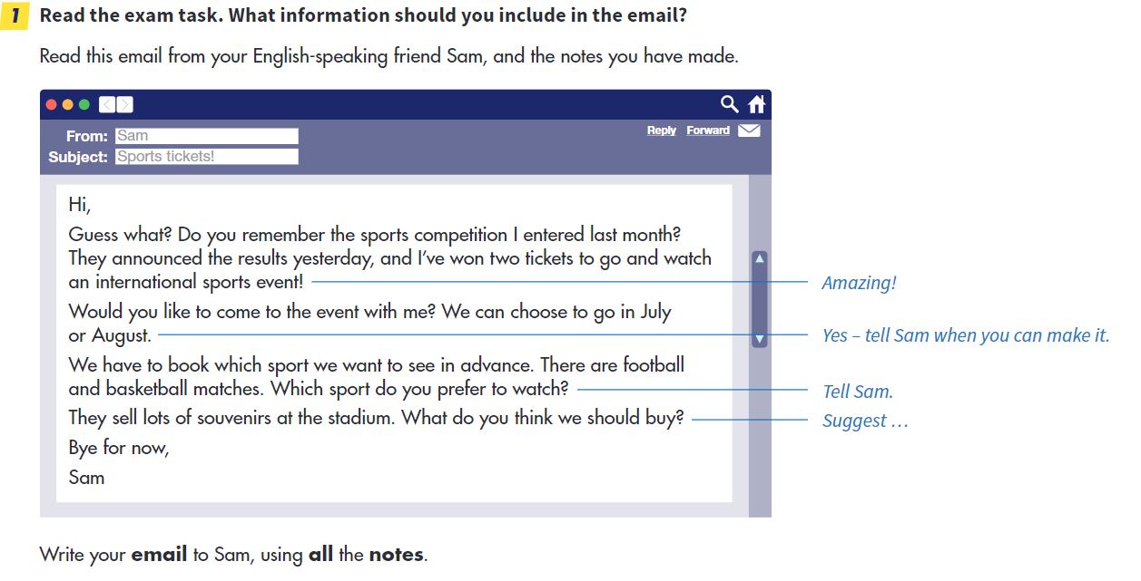

Slide 3
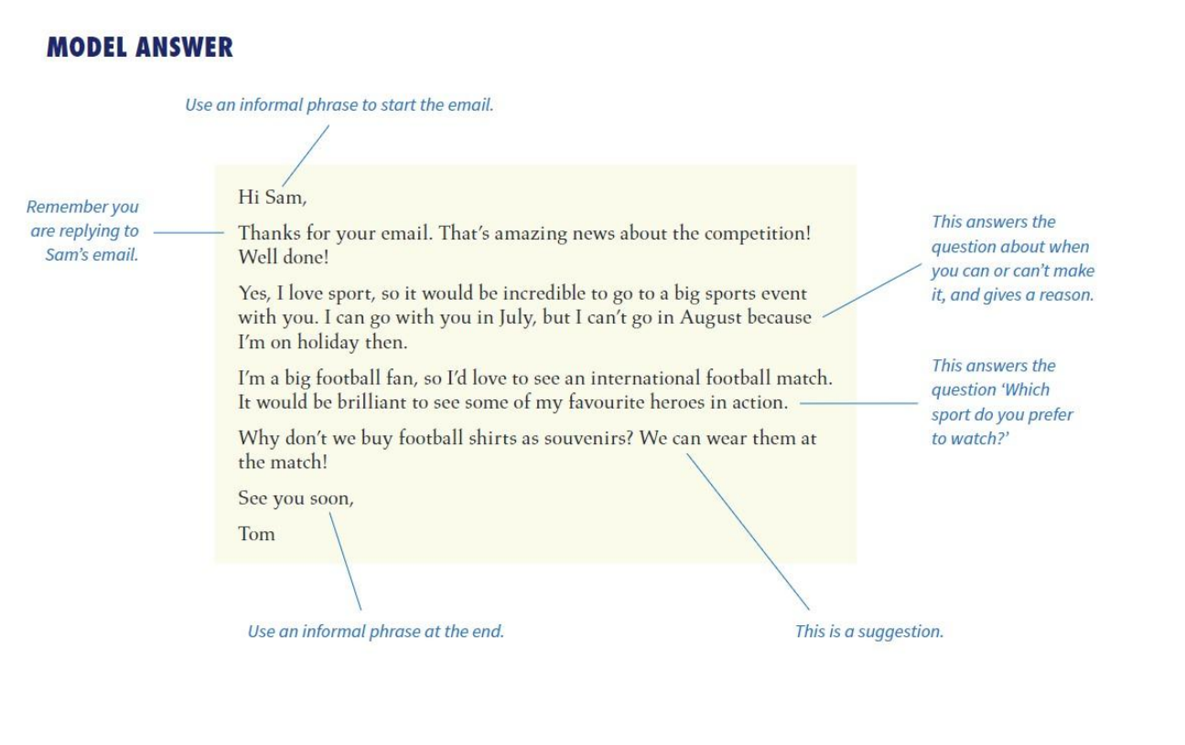

Slide 5
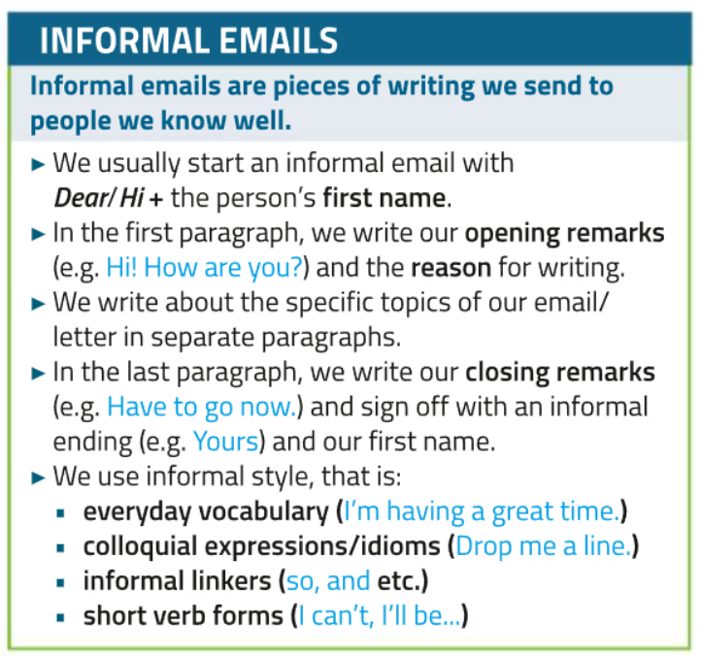
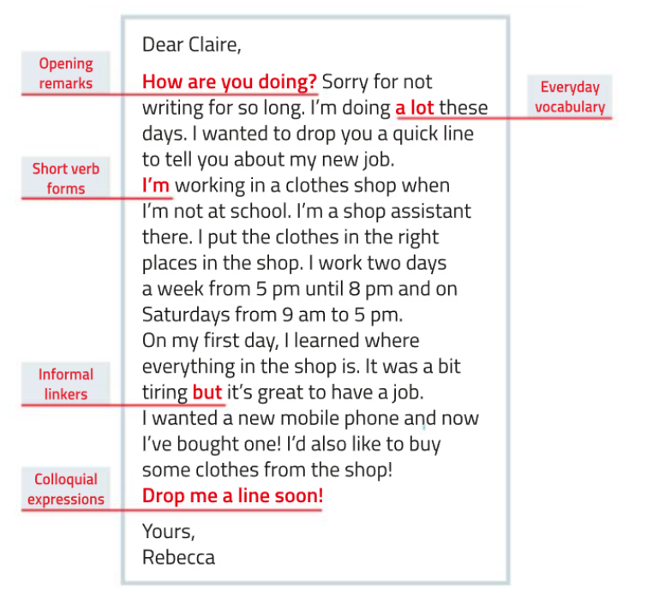

Slide 6
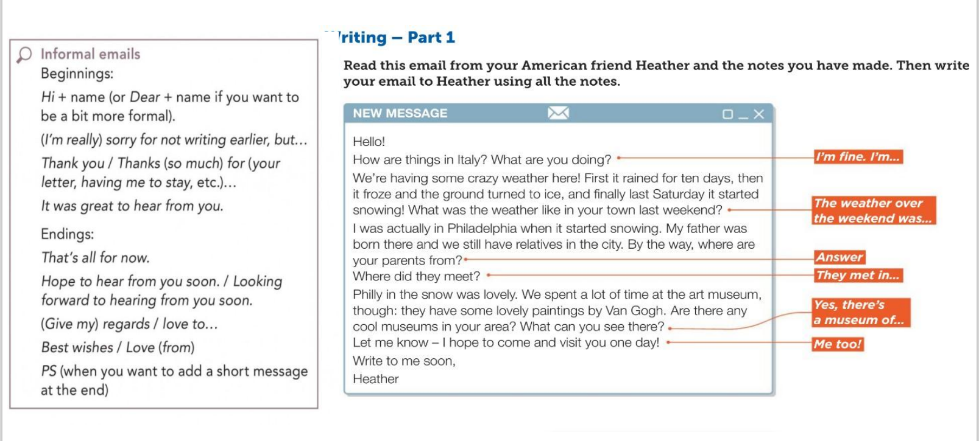

Slide 7
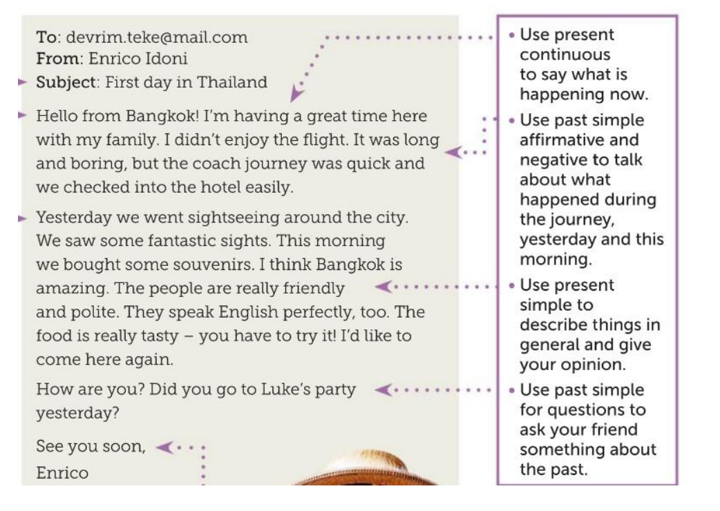

Slide 8
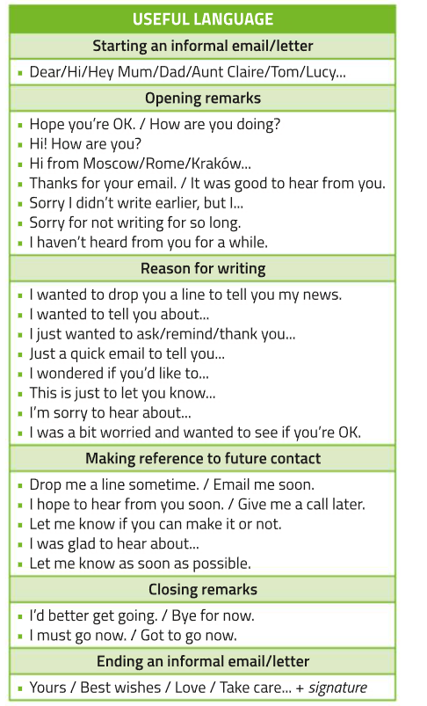

Slide 9
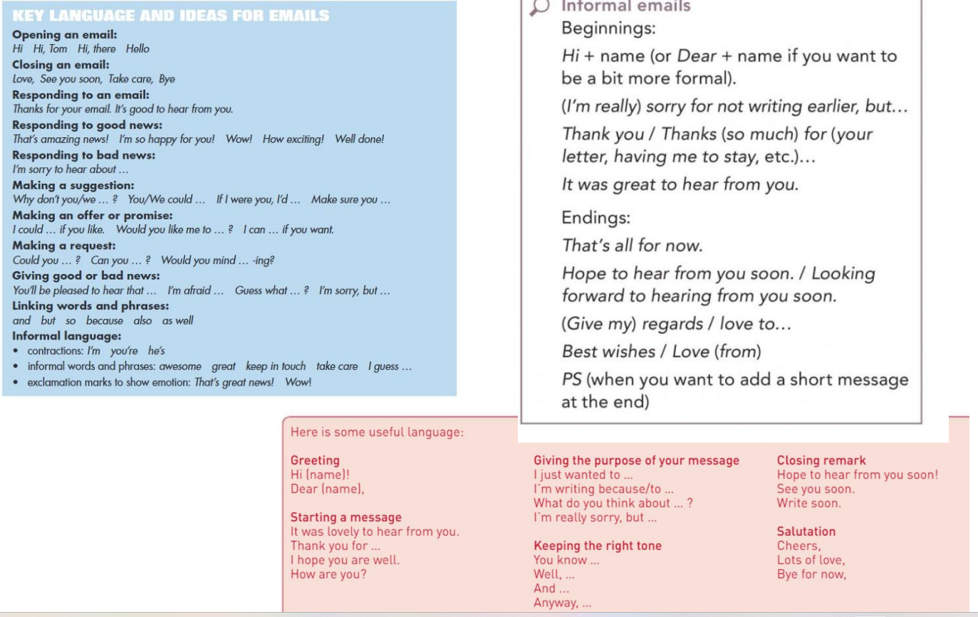

Slide 10
HOW TO WRITE A STORY

Slide 11
HOW TO ORGANISE YOUR STORY
YOU CAN ORGANISE IT FOLLOWING THESE SIMPLE TIPS:
A GOOD STORY USALLY HAS A BEGINNING, A MAIN PART AND AN ENDING.
THE MAIN PART IS THE MOST IMPORTANT ONE SO YOU CAN MAKE IT LONGER THAN THE OTHER ONES.
MOST OF THE TIME WE GET TO A STRUCTURE THAT LOOKS LIKE THIS:
FIRST SENTENCE/BEGINNING
MAIN PART PARAGRAPH 1
MAIN PART PARAGRAPH 2
ENDING
YOU MAY HAVE THREE OR MORE MAIN PART PARAGRAPHS, BUT IN MOST TASKS THE STRUCTURE WITH ONLY TWO OF THEM WORKS VERY WELL!

Slide 12
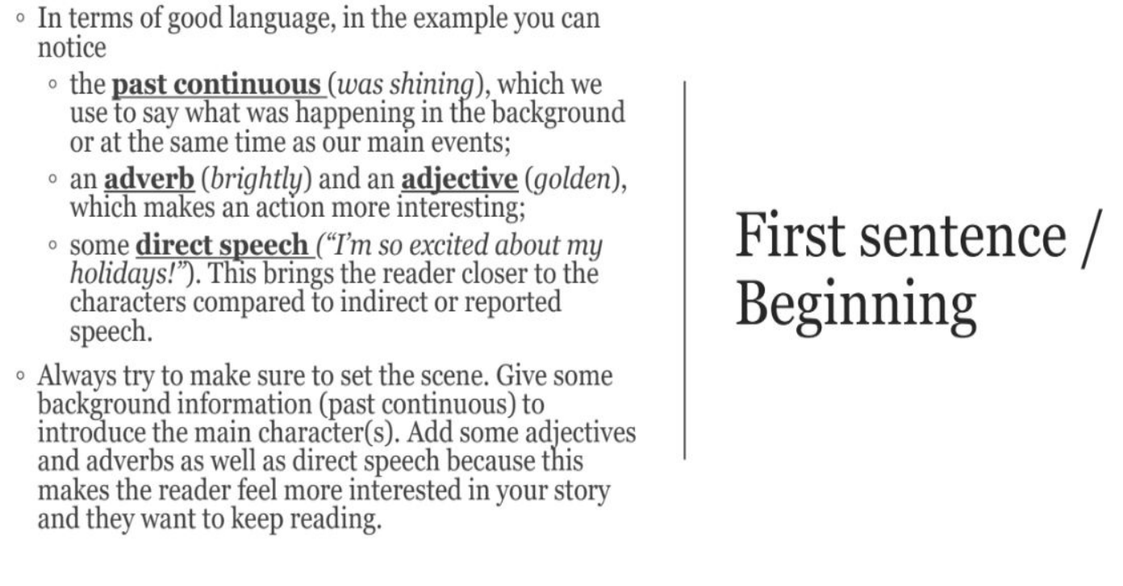

Slide 13
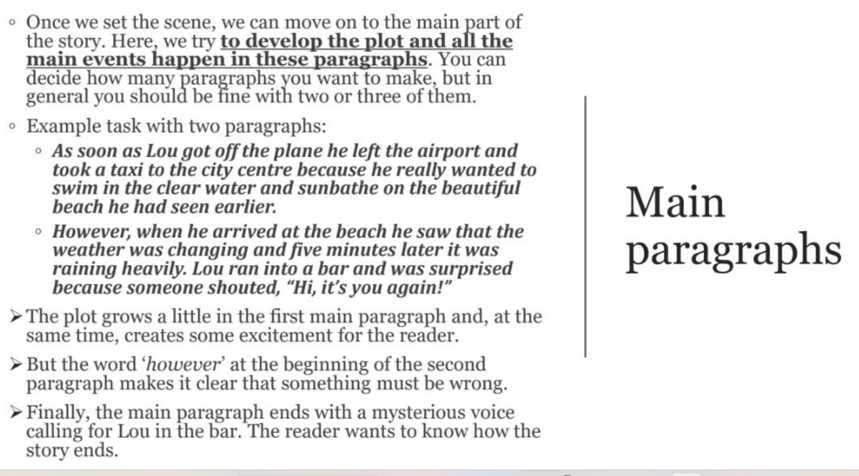

Slide 14
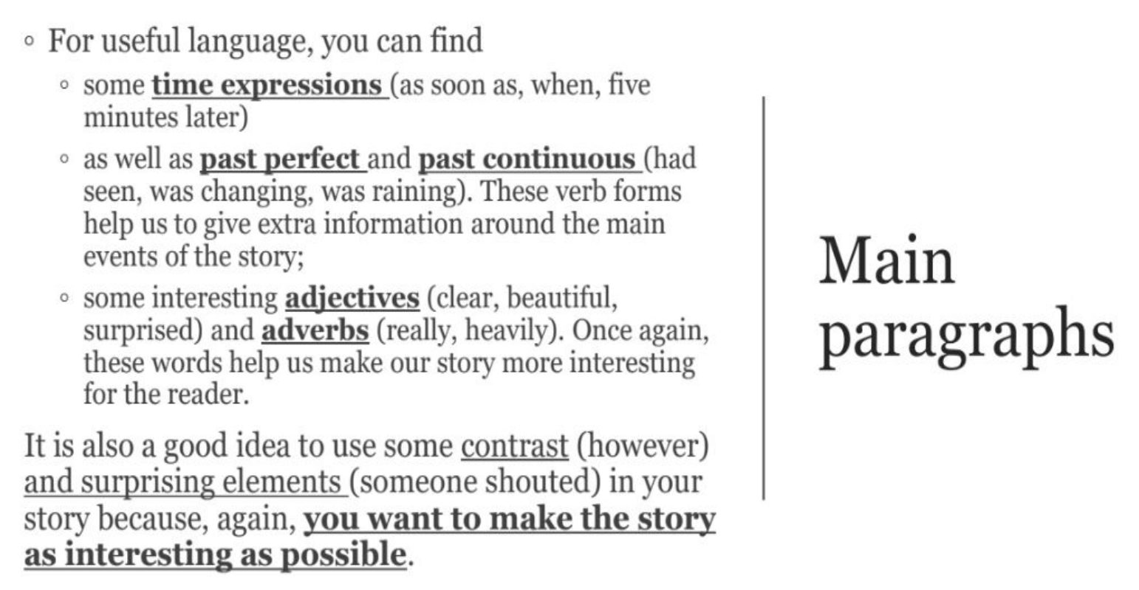

Slide 15
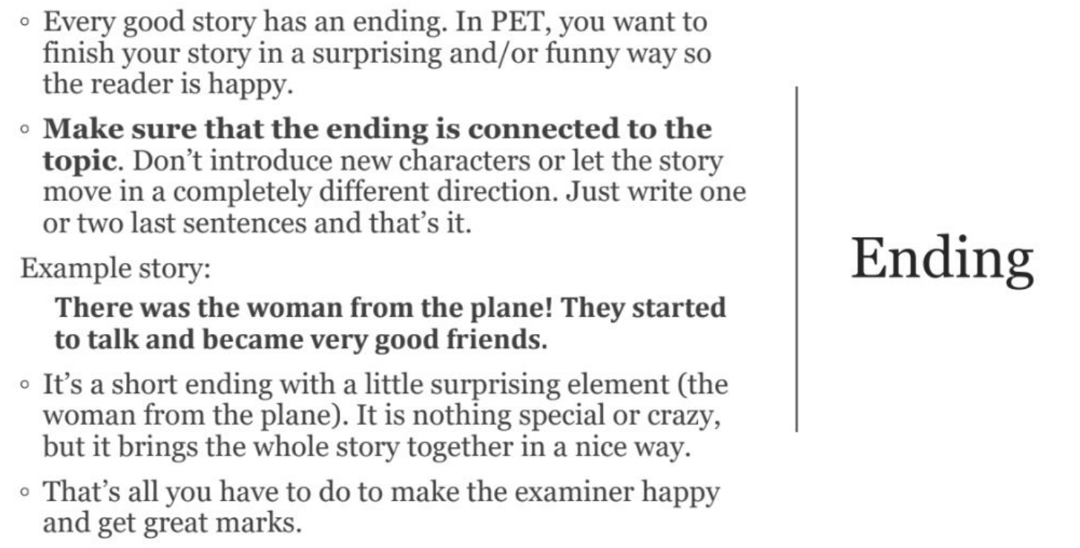

Slide 16
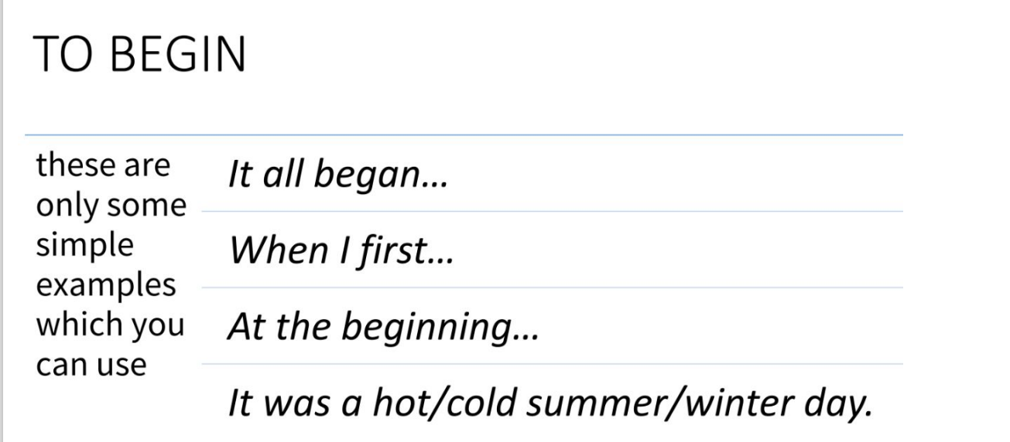
USEFUL LANGUAGE FOR STORY WRITING

Slide 17
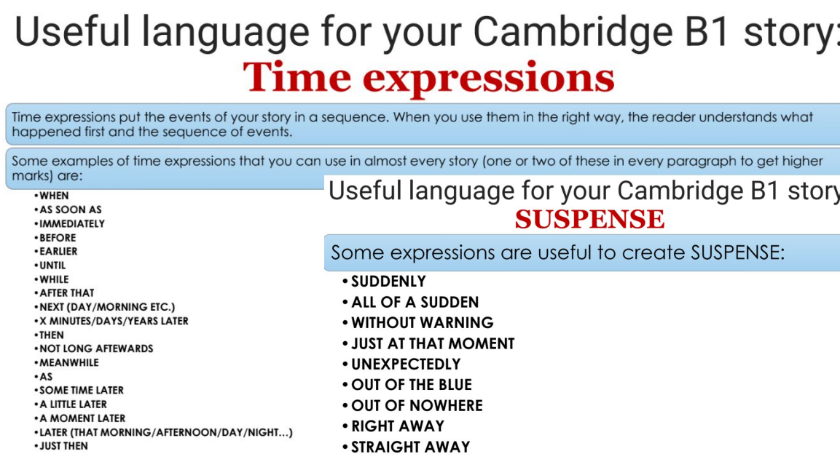
1 IMPROVVISAMENTE
2 ALL’IMPROVVISO
3 SENZA PREAVVISO
4 PROPRIO IN QUEL MOMENTO
5 INASPETTATAMENTE
6 DEL TUTTO INASPETTATAMENTE
7 DAL NULLA
8 -9 IMMEDIATAMENTE

Slide 18
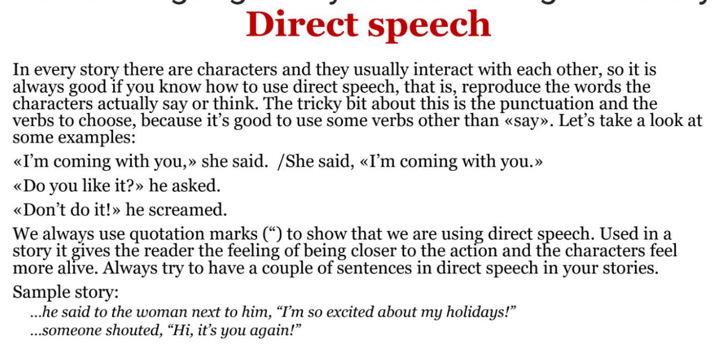

Slide 19
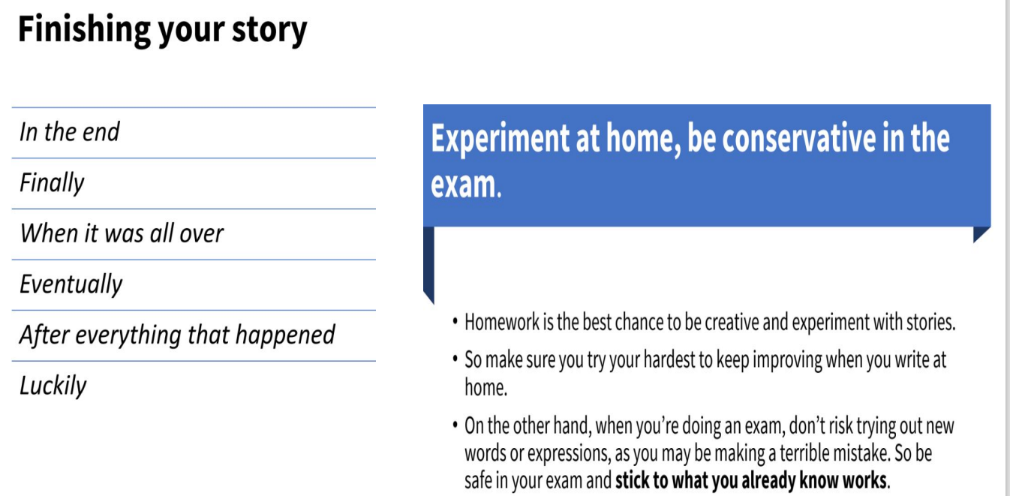

Slide 20
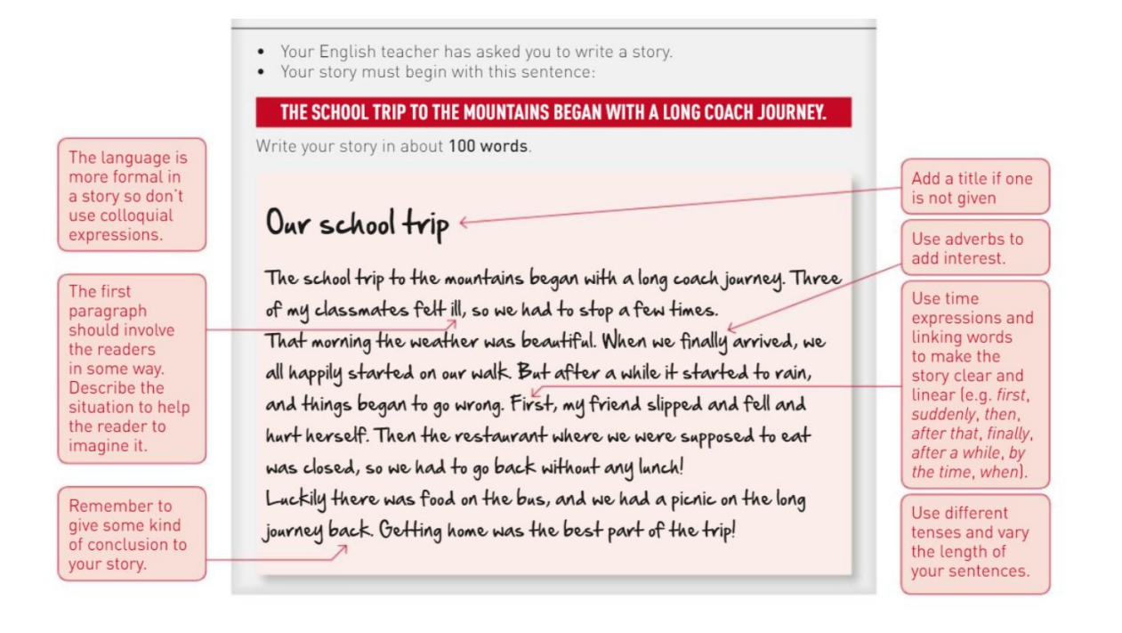

Slide 21
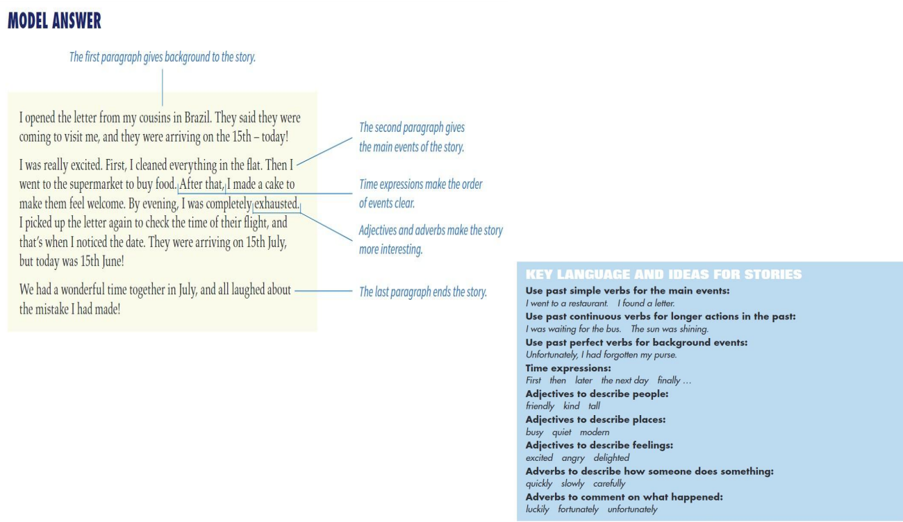

Slide 22
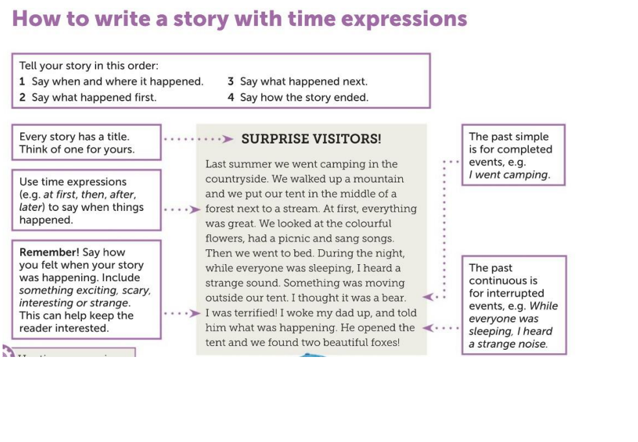

Slide 23
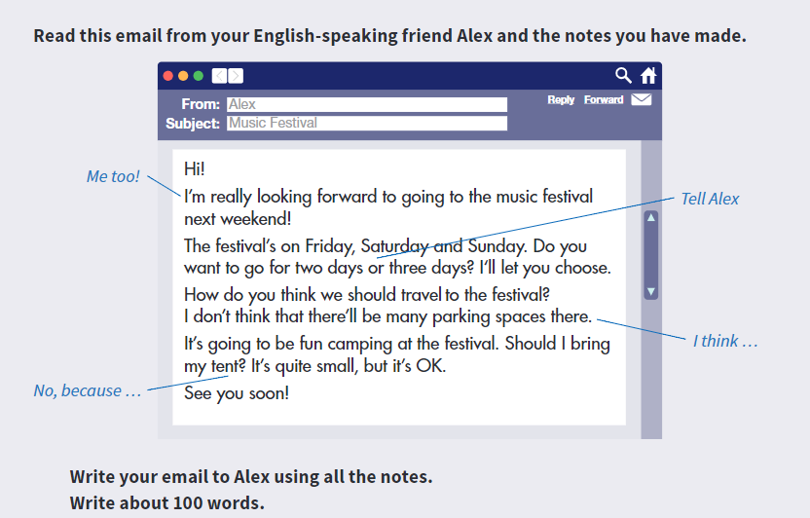
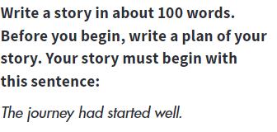
LET’S PRACTICE NOW!

Slide 24
THANK YOU FOR YOUR ATTENTION!

