Slide 1

The evolution of international environmental law
Prof.ssa Sveva Del Gatto

Slide 2

How we can define I.E.L.?
We can define international environmental law:
A set of principles and Legal provision
That establishes rules of conduct for states in order to achieve environmental protection and the balanced use of natural resources in a context of economic and social development.

Slide 3
How we can define I.E.L.?
It is a law that has gradually assumed a global vocation, aimed at solving problems that affect the entire international community.

Slide 4

Environmental protection in international law: the two stages
The international community has recognized the need for adequate responses to ecological problems since the second half of the 20th century, through instruments aimed at reducing the main causes of pollution and protecting the Earth's environment and natural resources.

Slide 5
Environmental protection in international law: the two stages
In this context, there has been a rapid evolution of international environmental law, which we can divide into two phases:

Slide 6
Environmental protection in international law: the first phase
The first: began with the 1972 United Nations Stockholm Conference on the Human Environment.
It is characterized by the conclusion of numerous sectoral treaties based on the principle of damage prevention (stage of environmental functionalism).

Slide 7
Environmental protection in international law: the second phase
The second: inaugurated by the 1992 Rio de Janeiro Conference on Environment and Development.
It coincides with the extension of international cooperation to global environmental issues.
Governed by conventions with a universal vocation based on the precautionary principle (phase of environmental globalism).

Slide 8

The recent developments
The attention of states becomes more convincingly focused on international environment only during the last decades of the 20th century, when a common interest in mitigating growing environmental degradation, the transboundary nature of which is more accurately perceived, begins to consolidate.

Slide 9

Several factors lead to a reversal of the previous laissez faire approach
These include the alarm of the world scientific community over the spread of pollution, the rise of environmental movements, and the occurrence of serious accidents, such as that of March 18
1967.

Slide 10

Several factors lead to a reversal of the previous laissez faire approach
On March 18 1967, the tanker Torrey Canyon poured into the sea between the Isles of Scilly and Land's End in the English Channel a cargo of 120,000 tons of oil, destroying much of the marine biological resources between the southern part of the British coast and Normandy.

Slide 11
The inadequacy of the emergency measures
The event demonstrated the total inadequacy of the emergency measures taken to deal with the situation, some of them lethal, such as the massive use of chemical solvents.

Slide 12
The inadequacy of the emergency measures
The factors indicated contribute to a rapid change of course, marked by the conclusion of numerous international environmental conventions, in which the emphasis is on preventing marine pollution.

Slide 13

Conference of Stockholm
The culmination of this process is the Conference on the Human Environment convened in Stockholm by the UN General Assembly in June 1972, which adopted the Declaration of Principles and the World Environmental Action Plan.

Slide 14
Conference of Stockholm
With it, the international community for the first time clearly affirmed the seriousness of the environmental degradation and the need for states to address it through policies and international, regional and national regulations tending to prevent the major causes of pollution of natural resources.

Slide 15
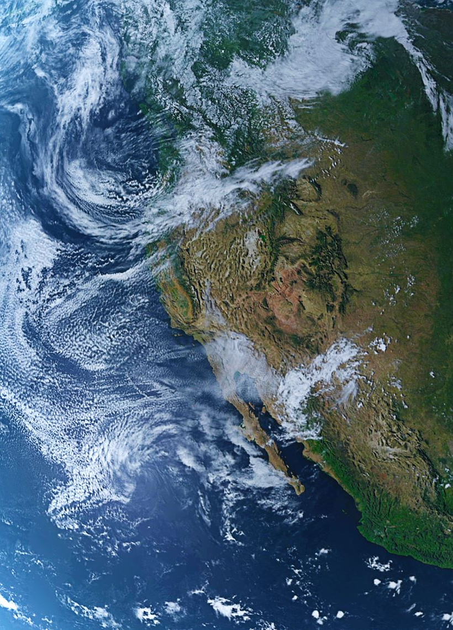
World Charter for Nature
The UN General Assembly also completed its contribution to the establishment of general principles in the environmental field with the adoption of the World Charter for Nature on October 28, 1982.

Slide 16
World Charter for Nature
The World Charter for Nature, although drafted in declamatory terms, introduces some new concepts, such as precaution, which calls for the avoidance of activities likely to cause irreversible damage to nature.

Slide 17
UNEP
As a result of the Stockholm Conference, the first international body of universal character with specific competence in the environmental field, the United Nations Environment Programme (UNEP), established by General Assembly resolution 2997 (XXVII) of December 15, 1972 as a subsidiary body with strong autonomy and its own structure (Executive Director and Board of Directors).

Slide 18
UNEP
UNEP is entrusted with study and operational functions, for the provision of technical assistance to developing states, including the area of environmental legislation.
In addition, the Programme is entrusted with the task of adopting non-binding acts (recommendations and guidelines) and draft environmental conventions for submission for ratification by States.

Slide 19

The Vienna Convention for The Protection of the Ozon Layer
In 1982, negotiations were launched at UNEP.
It will lead to the conclusion, on March 22, 1985, of the Vienna Convention for the Protection of the Ozone Layer, followed, as an implementing measure, by the Montreal Protocol of September 16, 1987 on substances that deplete the ozone layer (chlorofluorocarbons).

Slide 20
Other programs by UNEP
Also attributable to UNEP are the Montevideo Program on the Development of Environmental Law and the Program on the Protection of Regional Seas, from which originated the Barcelona Convention of February 16, 1976 on the Protection of the Mediterranean Sea.

Slide 21

Expansion of UNEP's Functions
UNEP's functions were further expanded with the so-called Cartagena Package, adopted in 2002 by the Governing Council meeting in special session, in order to strengthen its role in the UN's activities in the environmental field.

Slide 22
Expansion of UNEP's Functions
In this context, it is framed by the proposal made by the European Union (EU) in 2005 to transform UNEP into a specialized UN institute with specific expertise in the area of environmental protection and sustainable development (United Nations Environmental Organization, UNEO).

Slide 23
The diffusion of the Treaties
In the span of two decades, treaties to protect the environment multiplied, partly due to pressure from the global scientific community and environmental movements, operating globally through international nongovernmental organizations, such as the World Wildlife Fund, Greenpeace and the International Union for the Conservation of Nature (IUCN).

Slide 24

The second phase: international environmental law and sustainable development
In the late 1980s, the United Nations inaugurated the second phase of evolution of international environmental law, entrusted a commission of independent experts.

Slide 25

The second phase: international environmental law and sustainable development
The Brundtland Commission drew up a report, called Our Common Future, that incorporated the emerging concept of sustainable development.

Slide 26

The United Nations Conference on Environment and development
It marks the beginning of this second phase, aimed at making the imperatives of economic development compatible with the requirements of environmental protection

Slide 27
The United Nations Conference on Environment and development
It also aim to extend international cooperation to the solution of environmental problems of a global nature, such as climate change, loss of biological diversity and deforestation.

Slide 28
The new approach
The acts adopted at the conclusion of the conference, the first to be convened by the UN since the fall of the Berlin Wall, enshrine this new approach:
first, the Rio Declaration on Environment and Development, consisting of twenty-seven general principles;

Slide 29

The new approach
Agenda 21, an action program designed to identify the actions needed to achieve sustainable development by directing recommendations to states to regulate their behavior in all relevant areas;

Slide 30
The new approach
Finally, the authoritative, legally non-binding Declaration of Principles for a global consensus on sustainable forest management, conservation and development.

Slide 31

The Rio Declaration
The Rio Declaration on Environment and Development, often shortened to Rio Declaration, was a short document produced at the 1992 United Nations "Conference on Environment and Development" (UNCED), informally known as the Earth Summit.

Slide 32
The Rio Declaration
The Rio Declaration consisted of 27 principles intended to guide countries in future sustainable development.
It was signed by over 175 countries.

Slide 33
The Rio Declaration
With the Rio Declaration, environmental law took on a connotation by general principles, aimed at harmonizing the multifaceted variety of objects and translating into concrete conventional regimes.
The consensus view is that Rio constituted a starting point, in the context of a dynamic vision of the results to be achieved.

Slide 34
The Rio Declaration
Indeed, international environmental protection
standards were consolidated and partly adapted to the new approach of sustainable development.

Slide 35
The Rio Declaration
First, the Rio Declaration formulated the general guidelines for environmental legislation, at the various levels, forming the indispensable legal basis for implementing legislation.

Slide 36
The Rio Declaration
The main outcome of the Rio Conference was to integrate the objectives of economic development in the context of the principles applicable to international environmental protection.
The participating states had the conviction of the value that it could have assumed, in fact, the text reflects the broader consensus of the international community.

Slide 37
The Social Doctrine
On these issues a relevant contribution has also been made by some documents of the Social Doctrine of the Church and the Encyclical Laudato Si', which emphasize how environmental protection constitutes a duty, common and universal, to respect a collective good.

Slide 38
The Social Doctrine
Responsibility toward the environment, common heritage of humankind, extends not only to the needs of the present, but also to those of the future.
Climate is recognized as a common good, while humankind is called to combat the human causes that produce warming.

Slide 39

Human rights dimension of sustainable development
Principle 1 of the Rio Declaration accommodates an anthropocentric conception, proclaiming that human beings are at the center of sustainable development concerns and have the right to a healthy and productive life in harmony with nature.

Slide 40

Principle 1
Human beings are at the centre of concerns for sustainable development. They are entitled to a healthy and productive life in harmony with nature.

Slide 41

Human rights dimension of sustainable development
The importance of aspects related to the protection of human rights appears to be confirmed by Principle 5 of the Rio Declaration, which considers the elimination of poverty an essential requirement of sustainable development.

Slide 42
Principle 5
All States and all people shall co-operate in the essential task of eradicating poverty as an indispensable requirement for sustainable development, in order to decrease the disparities in standards of living and better meet the needs of the majority of the people of the world.

Slide 43
Human rights dimension of sustainable development
The cornerstone of the Rio Declaration on human rights, however, is contained in Principle 3, which states that the right to development must be realized in such a way as to meet the needs of development and environmental protection of present and future generations (intergenerational responsibility).

Slide 44
Principle 3
The right to development must be fulfilled so as to equitably meet developmental and environmental needs of present and future generations.

Slide 45
Human Rights dimension of sustainable development
On the other hand, the right to the environment as a fundamental human right is not explicitly enshrined, in line of discontinuity with that trend that, starting with the Stockholm Declaration, has seen affirmed such a right in numerous state constitutions and some international treaties.

Slide 46

Human Rights dimension of sustainable development
Such as the African Charter on Human and Peoples' Rights (Nairobi, June 28 1981) and the Additional Protocol to the Inter-American Convention of San José, Concerning Human Rights in the Field of Economic, Social and Cultural Rights (San Salvador, November 17, 1988).

Slide 47
Citizens Participation
Principle 10 of the Rio Declaration simply merely states that environmental issues should be handled by ensuring the participation of all concerned citizens.

Slide 48

Principle 10
Environmental issues are best handled with the participation of all concerned citizens, at the relevant level. At the national level, each individual shall have appropriate access to information concerning the environment that is held by public authorities, including information on hazardous materials and activities in their communities, and the opportunity to participate in decision-making processes.

Slide 49
Principle 10
States shall facilitate and encourage public awareness and participation by making information widely available. Effective access to judicial and administrative proceedings, including redress and remedy, shall be provided.

Slide 50
Citizens Participation
Thus, the concept is that of making environmental decision-making democratic and transparent, in accordance with the more precise indications contained in various chapters of Agenda 21, but without qualifying access to environmental information and participation in decision-making processes in terms of fundamental rights.

Slide 51
Citizens Participation
This is evidence of the difficulty that still exists on the universal level of combining the environment with human rights, while more obvious manifestations of this connection can be derived in the context of regional systems, such as that European Convention for the Protection of Human Rights and Fundamental Freedoms of 1950 (ECHR).

