Slide 1

The environmental principles
The sustainable development principle
Prof.ssa Sveva Del Gatto

Slide 2

The principle of sustainable development
The principle of sustainable development constitutes the foundation of environmental law as it embodies its matrix of dutifulness and the constraint placed on current generations to guarantee future generations.

Slide 3
The environment as an object of duty
To fully understand the principle of sustainable development it is important to focus on the concept of the environment as an object of duty.
In the Italian constitution, articles 2 and 3 relating to solidarity and the full development of the human person are relevant.

Slide 4
The environment as an object of duty
The fulfillment of the duties of environmental solidarity constitutes a prerequisite for the realization of the development of the human person, solidarity and also intergenerational solidarity and this immediately refers to the notion of sustainable development
Faced with challenges in the environmental field, the legislator applies the principle of sustainable development with a view to protecting future generations.

Slide 5

Future generations
By sustainable development we mean development that meets both the needs of the current and future generations.

Slide 6
The pastoral constitution Gaudium et spes
The first historical reference to the concept of "intergenerational" sustainability is found in the pastoral constitution Gaudium et spes published at the conclusion of the Second Vatican Council in 1965

Slide 7

Understanding the sustainable development principle
Economist Herman Daly defined sustainable development as " [...] developing by keeping within the carrying capacity of ecosystems," and thus according to the following general conditions concerning human use of natural resources:
the burden of anthropogenic impact on natural systems must not exceed the carrying capacity of nature;

Slide 8
Understanding the sustainable development principle
the rate of utilization of renewable resources must not exceed their rate of regeneration;
the input of pollutants and wastes must not exceed the absorption capacity of the environment;
the withdrawal of non-renewable resources must be offset by the production of an equal amount of renewable resources that can replace them.

Slide 9

A link among the protection and enhancement of natural resources to the economic, social and institutional dimensions
This process thus links, in a relationship of interdependence, the protection and enhancement of natural resources to the economic, social and institutional dimensions in order to meet the needs of current generations while avoiding compromising the ability of future generations to meet their own needs.

Slide 10
A link among the protection and enhancement of natural resources to the economic, social and institutional dimensions
In this sense, "sustainability of development" is incompatible
first and foremost with the degradation of heritage and natural resources (which are in fact exhaustible)
but also with the violation of human dignity and freedom, poverty and economic decline, and the failure to recognize rights and equal opportunities.

Slide 11

Three basic components of sustainability
Sustainability thus revolves around three basic components:
Economic sustainability: understood as the ability to generate income and employment to sustain the population.
Social sustainability: understood as the ability to ensure conditions of human well-being (security, health, education, democracy, participation, justice) equitably distributed by class and gender.
Environmental sustainability: understood as the ability to maintain quality and reproducibility of natural resources.

Slide 12
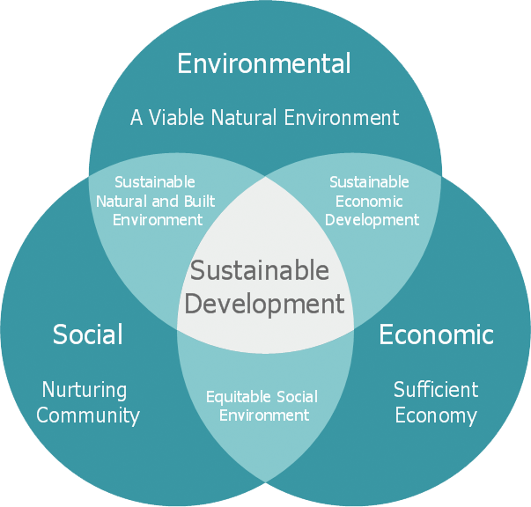
Sustainable development
The area resulting from the intersection of the three components ideally coincides with sustainable development.

Slide 13
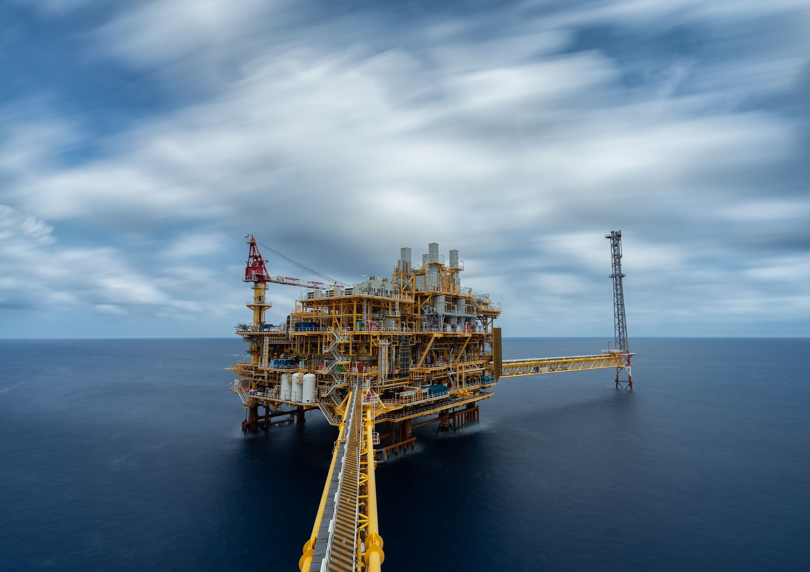
The origin of the principle of sustainable development
The oil crisis
In 1973, the oil crisis shocked the world economy, as a result of the war between Israel and Arab countries, the latter decided to decrease oil exports to the West and increase the price of oil in order to pressure the United States and Europe in favor of the Palestinian cause.

Slide 14
The origin of the principle of sustainable development
The oil crisis
Several countries in the world faced a serious financial crisis; in fact as a consequence of the increase in the cost of oil, energy costs and thus inflation increased. The consequence of the '73 energy crisis was the implementation of austerity policies by various countries around the world, which took drastic measures to limit energy consumption.

Slide 15
The origin of the principle of sustainable developmente
An opportunity for the west
The oil crisis represented an opportunity for the West to reflect on the use of renewable sources, which were considered for the first time as an alternative to fossil fuels such as oil.
The crisis, therefore, led Western countries to question for the first time about the foundations of industrial civilization and about the problematic nature of its relationship with the planet's limited resources.

Slide 16
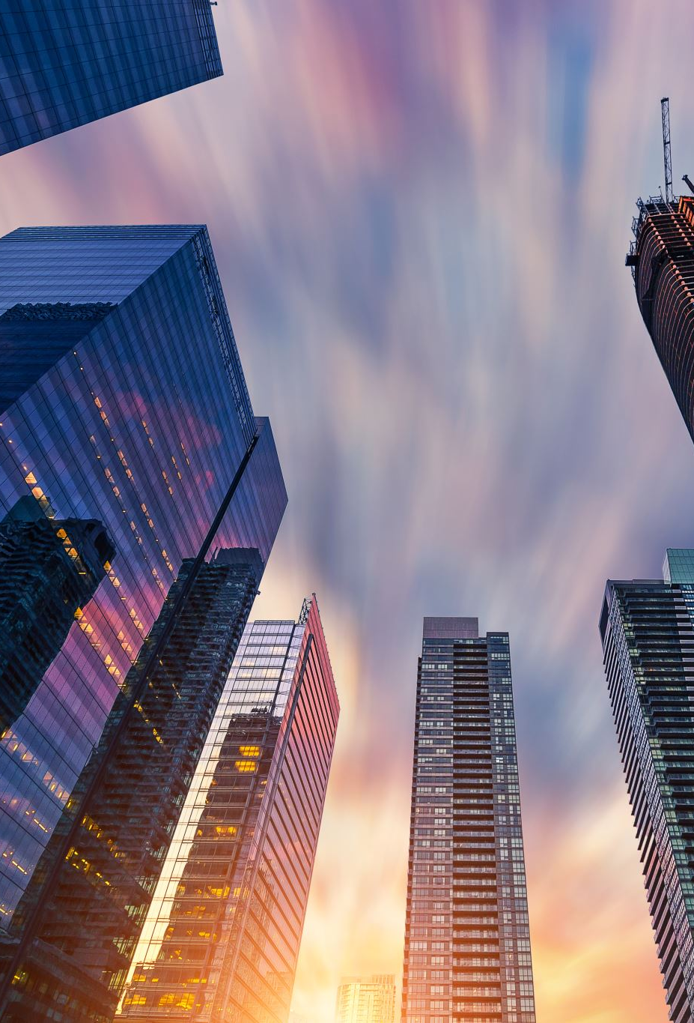
An opportunity for the West
Also in 1972, the Limits to Development report, commissioned by the Club of Rome, had been published by scholars at the Massachusetts Institute of Technology.
That report reported the outcome of a computer simulation of the interactions between world population, industrialization, pollution, food production and resource consumption under the assumption that these were growing exponentially with time.

Slide 17
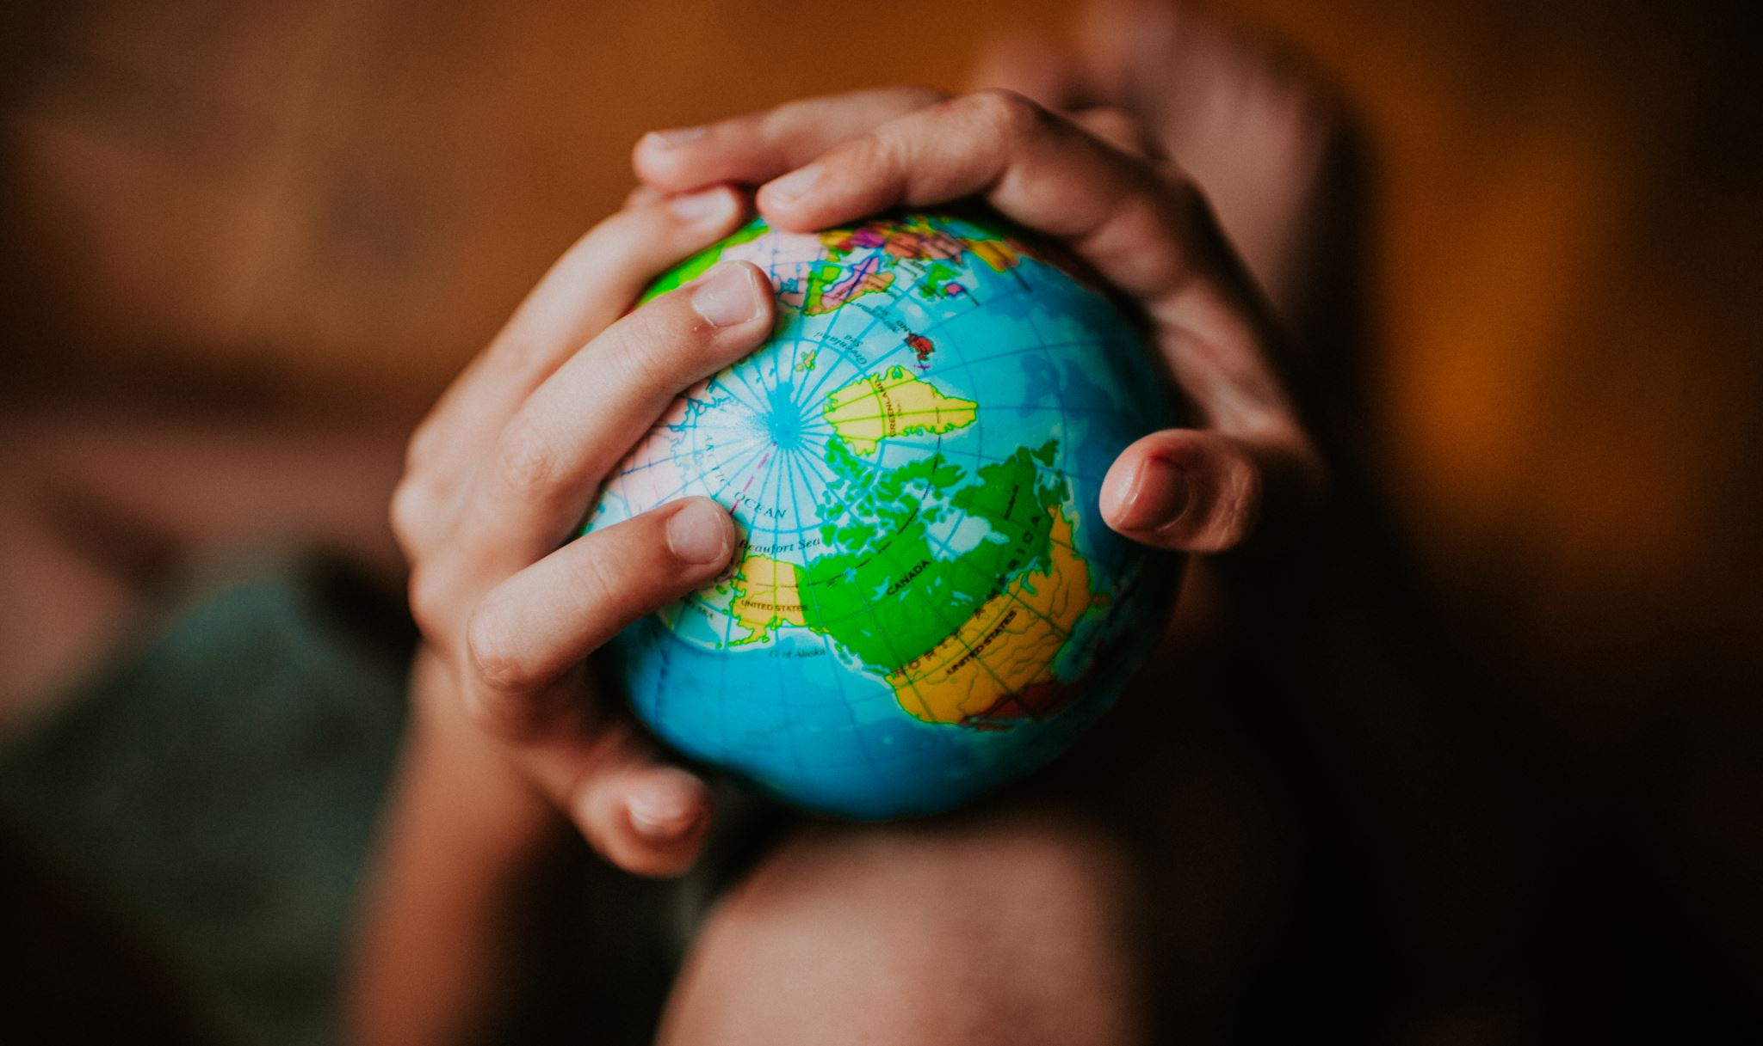
The definition of the principle of sustainable development
The most important and famous definition of the principle of sustainable development is owed to an international commission (the World Commission on Environment and Development: WCED or Brundtland Commission) established in 1983 by the United Nations and composed of representatives from 21 countries:

Slide 18
The definition of the principle of sustainable development
Its work was concluded in 1987 with the issuance of the report Our Common Future in which sustainable development was defined as:
"Development which meets the needs of the present generation without compromising the ability of the future generation to meet theirs."

Slide 19

Our Common Future
The report also affirmed that:
"Sustainable development, far from being a definitive condition of harmony, is rather a process of change such that the exploitation of resources, the direction of investment, the orientation of technological development and institutional changes are made consistent with future needs as well as current ones."

Slide 20
Our Common Future
The document contextually emphasizes the protection of the needs of all individuals, with a view to universal legitimacy to aspire to better living conditions;

Slide 21
Our Common Future
Just as it stresses the need and importance of greater citizen participation, to implement a truly democratic process that contributes to choices at the international level:

Slide 22
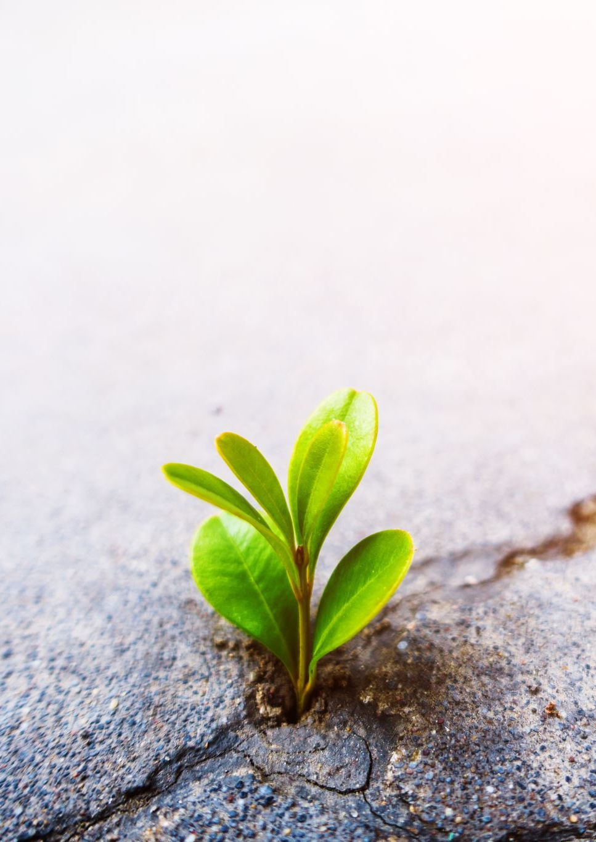
Our Common Future
"Sustainable development requires meeting the basic needs of all and extending to all the possibility of realizing their aspirations for a better life (...) Meeting basic needs requires not only a new era of economic growth for nations in which the majority of the inhabitants are poor but also ensuring that those poor have their fair share of the resources needed to sustain that growth. "

Slide 23
Our Common Future
"Such equity should be assisted both by political systems that ensure the effective participation of citizens in decision-making and by greater democracy at the level of international choice."

Slide 24
In depth analysis: the Bruntland Report
The Bruntland Report was called by the General Assembly of the UN to pursue some important goals.
As Bruntland says, we can hope that environmental issues are not going to be kept aside but are going to become central.
Co-operation is essential to find paths to achieve sustainable development, and the time has come for pursuing a common future together.

Slide 25
In depth analysis: the Bruntland Report
The environment must not be analyzed like an independent sphere, as it must be considered together with human action and ambitions.
We need an era of economic growth to eliminate poverty and degradation while keeping the environment clean at the same time.

Slide 26
03
01
04
02
Goals of the report
Consideration of ways and means by which the international community can deal more effectively with environmental concerns
Proposal of long-term environmental strategies to achieve sustainable development by the year 2000
Help in defining a long term agenda for action during the coming decades by sharing perceptions of long term environmental issues
Promotion of cooperation among developing countries and between countries at different stages of development

Slide 27
Structure of the report
The global challenge
The policy directions
International cooperation
A call for action
A focus on the crisis we are facing
Analysis of policies and suggestion to decisionmakers
Different perspective in which global cooperation is needed
An exhortation to take action to change the situation

Slide 28
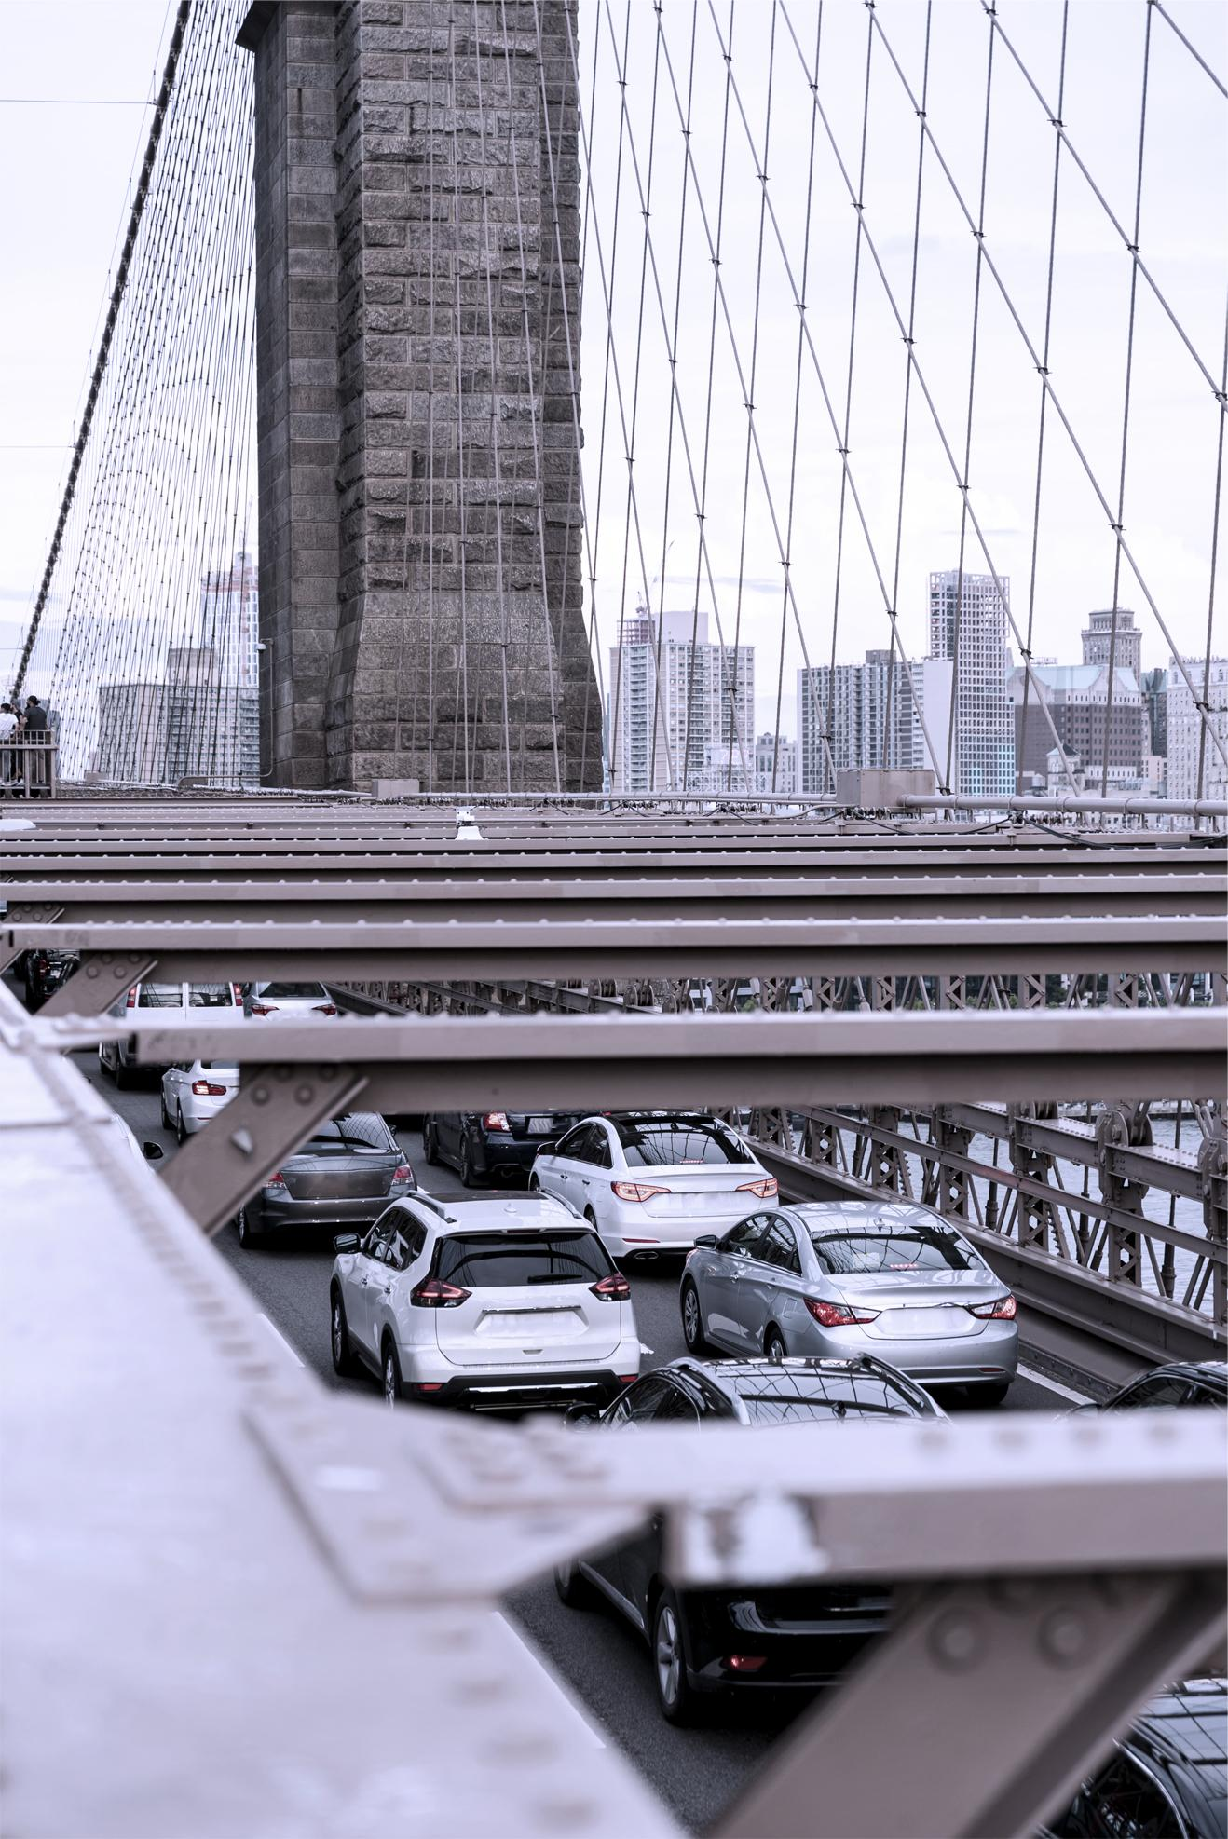
Failure of development
Failure of human environment
It’s impossible to separate economic development issues from environment issues. These concerns brought to the establishment, in 1983, of the World Commission on Environment and Development, whose researches highlight how many development trends cause poverty and environmental degradation.

Slide 29
—Gro Harlem Bruntland
To change society, you need to organize with others who share your views.

Slide 30
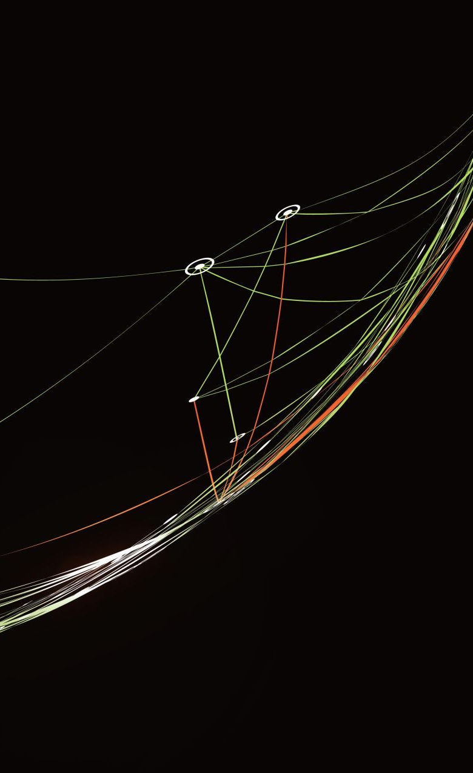
The evolution of the principle
The concept was later developed at the conference held in Rio de Janeiro in 1992 and concluded with the Declaration on Environment and Development, which took up the definition given by the Brundtland report and specified that:
"In order to achieve sustainable development Environmental Protection shall constitute an integral part of the development process and cannot be considered in isolation from it ( principle 4)"

Slide 31
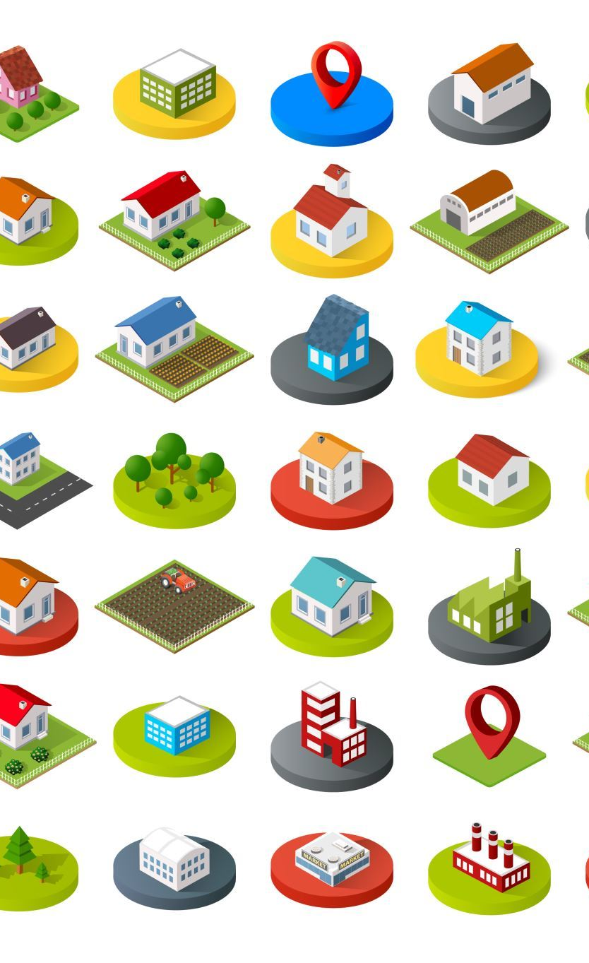
The ICLEI definition of sustainable development
The (International Council for Local Environmental Initiatives) ICLEI, defines sustainable development as
development that provides ecological, social elements and economic opportunities to all inhabitants of a community without creating a threat to the vitality of the natural, urban and social systems that depend on these opportunities.

Slide 32
The ICLEI definition of sustainable development
In this definition, a concept of a desirable "balance" between man and ecosystem is also introduced, underlying an idea of economics for which the consumption of a given resource should not exceed its production in the same period.

Slide 33
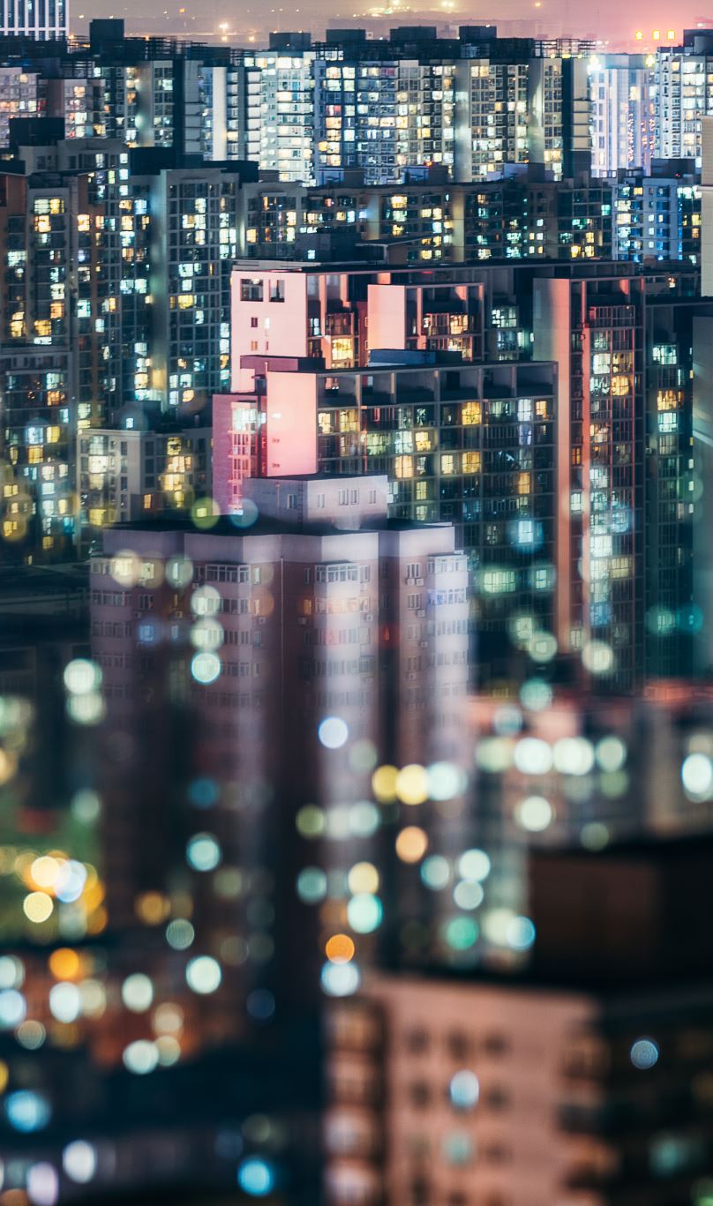
The ICLEI definition of sustainable development
In 1994, the ICLEI provided a further definition of sustainable development: "Development that provides basic environmental, social and economic services to all members of a community without threatening the operability of the natural, built and social systems on which the provision of such services depends."

Slide 34
The ICLEI definition of sustainable development
This means that the three dimensions, economic, social and environmental, are closely interrelated, and any planning intervention must take into account their mutual interrelationships.

Slide 35
In 2001, UNESCO expanded the concept of sustainable development by indicating that:
" [...] cultural diversity is as necessary for humanity as biodiversity is for nature (...) cultural diversity is one of the roots of development understood not only as economic growth, but also as a means of leading a more intellectually, emotionally, morally and spiritually satisfying existence." (Art 1 and 3, Universal Declaration on Cultural Diversity, UNESCO, 2001). In this view, cultural diversity becomes the fourth pillar of sustainable development.

Slide 36
The sustainable development in the EU Treaty
At the Community level with the signing of the Treaty of Amsterdam in 1997, it was included in the original text of the Treaty on European Union with reference to a balanced and sustainable harmonious development of economic activities
In addition, the principle of integration of environmental requirements in the definition and implementation of Community policies and actions was linked to the perspective of sustainable development (Art. 6)

Slide 37
The sustainable development in the EU Treaty
The Lisbon Treaty, which entered into force on December 1, 2009, did not substantially change the previous framework.
Article 3 states that the union shall work for the sustainable development of Europe based on "balanced economic growth and price stability a highly competitive social market economy aiming at full employment and social progress and a high level of protection and improvement of the quality of the environment."

Slide 38
The sustainable development in the EU Treaty
Not only that: the standard also recalls solidarity and provides that the Union shall promote social and territorial economic cohesion and solidarity among states;
the concept of solidarity is taken up by the Charter of Fundamental Rights of the European Union, which within its Title IV on solidarity also regulates environmental protection Article 37.

Slide 39

The Charter of Fundamental Rights of the European Union
Article 37 stipulates that "a high level of environmental protection and the improvement of its quality must be integrated into the Union's policies and ensured in accordance with the principle of sustainable development."

Slide 40
Article 191 of the Treaty on the Functioning of the Union
Article 191 of the Treaty on the Functioning of the Union on the subject of the community's policy on the environment in paragraph 3 requires consideration of, among others, socio-economic development profiles as well as consideration of available scientific and technological data and an analysis of "the benefits and burdens that may result from action or lack of action."

Slide 41
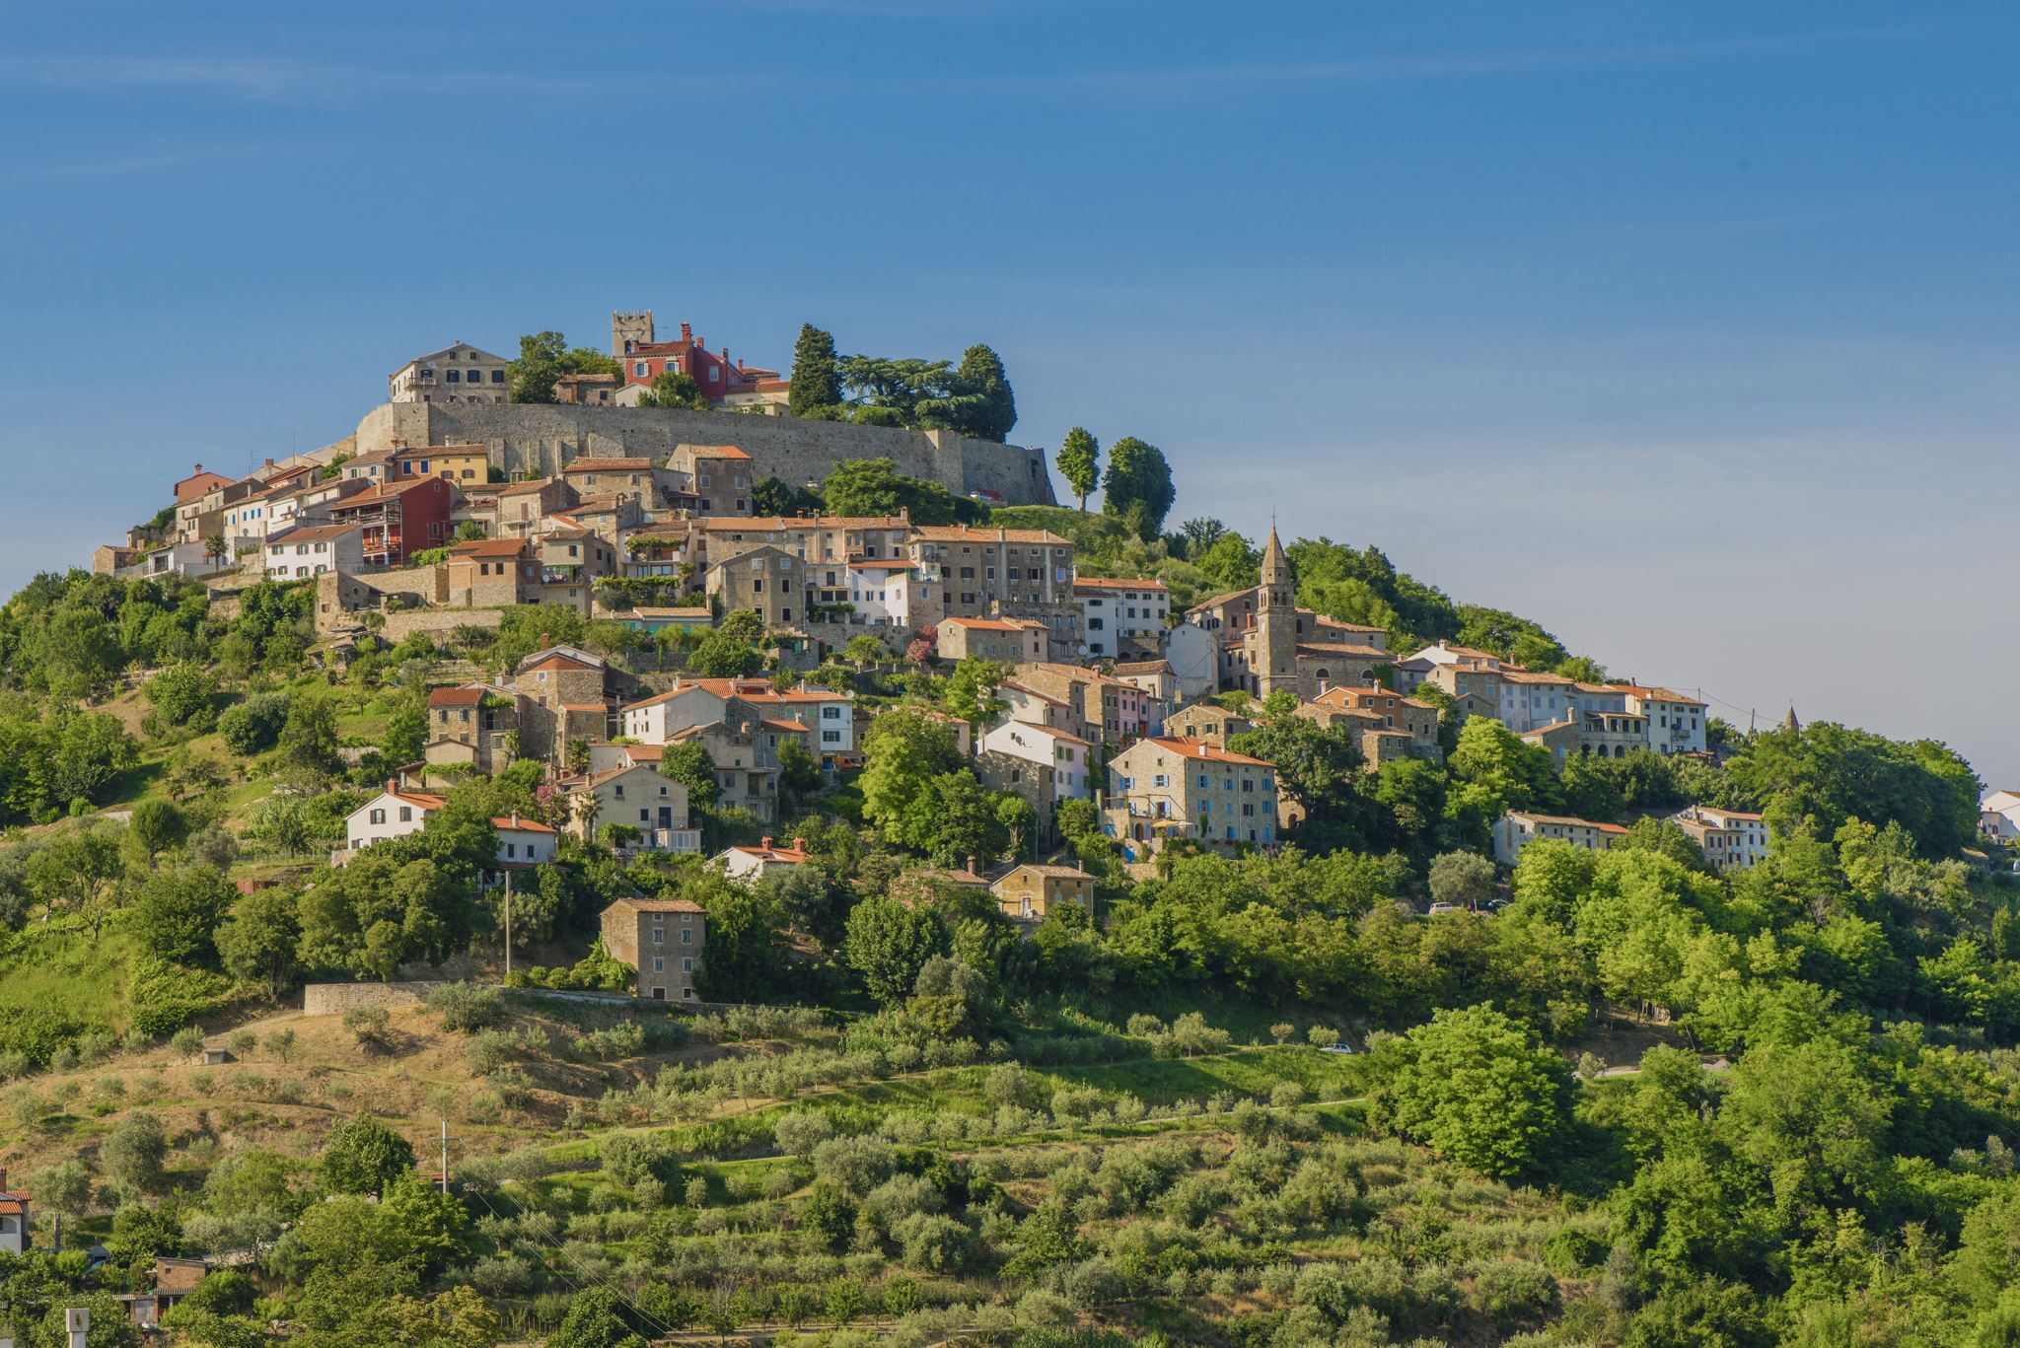
The Italian Environment Code
The Italian Environment Code introduced into our legal system in 2006 in its first version contained no mention either of sustainable development or in a systematic way of the other environmental principles point only with one of the subsequent corrective amendments they were codified after, that is, through the previous decrees the sectoral discipline had already been defined.

Slide 42
The Italian Environment Code
Article 3 quater devoted to sustainable development states that any human activity legally relevant under this Code must comply with the principle of sustainable development in order to ensure that the satisfaction of the needs of present generations cannot compromise the quality of life and opportunities of future generations.

Slide 43

Different meanings of sustainability
Two different meanings of sustainability can be identified:
the weak one and the strong one, both linked to the concept of resource sustainability.
The latter are in fact divided into: capital produced by man and natural capital.

Slide 44
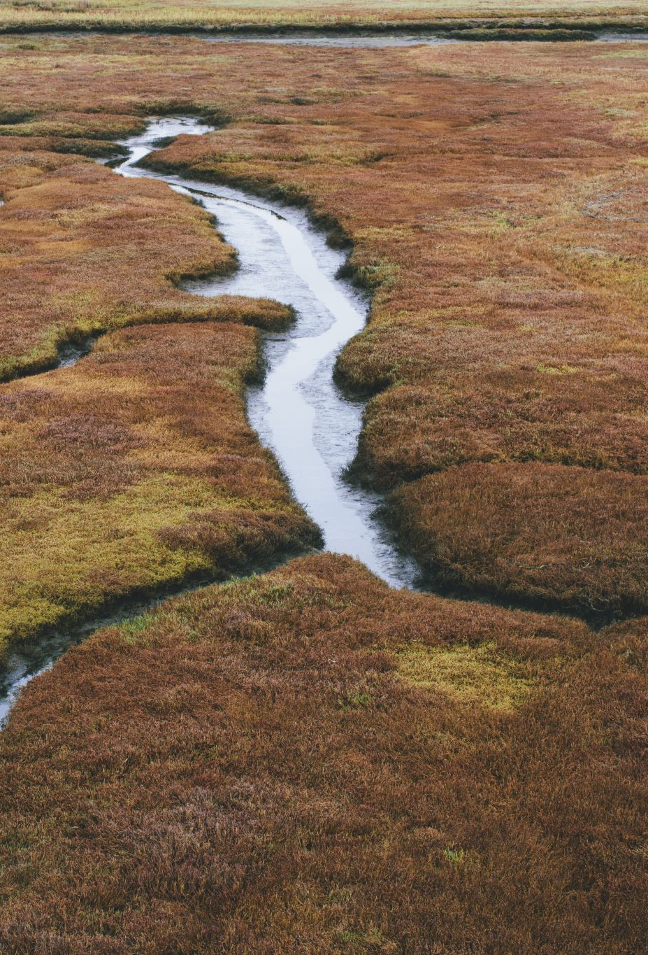
Different meanings of sustainability
The first clearly includes all the works of human ingenuity while the second, in addition to natural resources (seas, rivers, lakes, forests, flora, fauna, territory) understood in a productive sense, such as agricultural, hunting, fishing, it also includes natural resources that can be used from other points of view, such as the beauty of landscapes, biodiversity, artistic and cultural heritage.

Slide 45
Different meanings of sustainability
According to the vision of the proponents of weak sustainability, the desirable development model should guarantee a non-decreasing stock of resources (human and natural) until the next generation.

Slide 46
Different meanings of sustainability
This theory, however, appears to be easily refuted by the much more established strong sustainability, which instead starts from the assumption not of substitutability but rather of complementarity between human capital and natural capital, whereby each component of the stock must be kept constant, since the production of one depends on the availability of the other.

Slide 47

A model of sustainable development
An unbridled use of natural resources is therefore not permissible, as they are not replaceable like human ones, but their impoverishment gives rise to the opposite and in most cases to irreversible processes (for example the extinction of animal species) or reversible ones. , but only over a very long period, not coinciding with human times (such as the process of reforestation of forests).

Slide 48

A model of sustainable development
A model of sustainable development must therefore include a policy for the protection and safeguarding of natural resources, which must be managed rationally by balancing the need for socio-economic development with that of respect for the ecosystem.

Slide 49
The principle of sustainable development in two minutes
https://www.youtube.com/watch?v=jfsWI8XgQyo

