Slide 1

Environmental Law Sources
Prof.ssa Sveva Del Gatto

Slide 2
Environmental Law Sources
The difficulty of reconstructing a system of sources of law for the protection of the "environment" corresponds to the difficulty of defining the legal dimension of the concept of environment itself.

Slide 3
Environmental Law Sources
Environmental interests have gradually emerged as an autonomous object of protection; but legislation, doctrine and jurisprudence still manifest uncertainties in defining whether it is an asset subject to specific legal discipline or whether it is a value and an end that cuts across all the different areas of the Law.

Slide 4
Complex, cross-cutting and multireferential notion
It is a complex notion
The environmental system is complex, precisely because it defines the interrelationships, in continuous adaptation, among its components

Slide 5
Complex, cross-cutting and multireferential notion
It's cross-cutting
because environmental interests assume prominence in almost all other areas of legally relevant interests.

Slide 6
Complex, cross-cutting and multireferential notion
It's multireferential
because the environmental system refers to all the realities of our coexistence and to all levels of government that represent and manage it.

Slide 7
Complex, cross-cutting and multireferential notion
With such characters, the legal discipline on the environment constitutes a paradigmatic example of the crisis of the
"system of sources.”

Slide 8

Indeed, the environment highlights:
- the crisis of the general and abstract law as the core of the regulatory system

Slide 9
Indeed, the environment highlights:
This is because it requires choices that are both strategic and punctually concrete, not ascrivable to the schemes of the recognition of subjective rights, and only partly framed in the functional schemes of the duties.

Slide 10
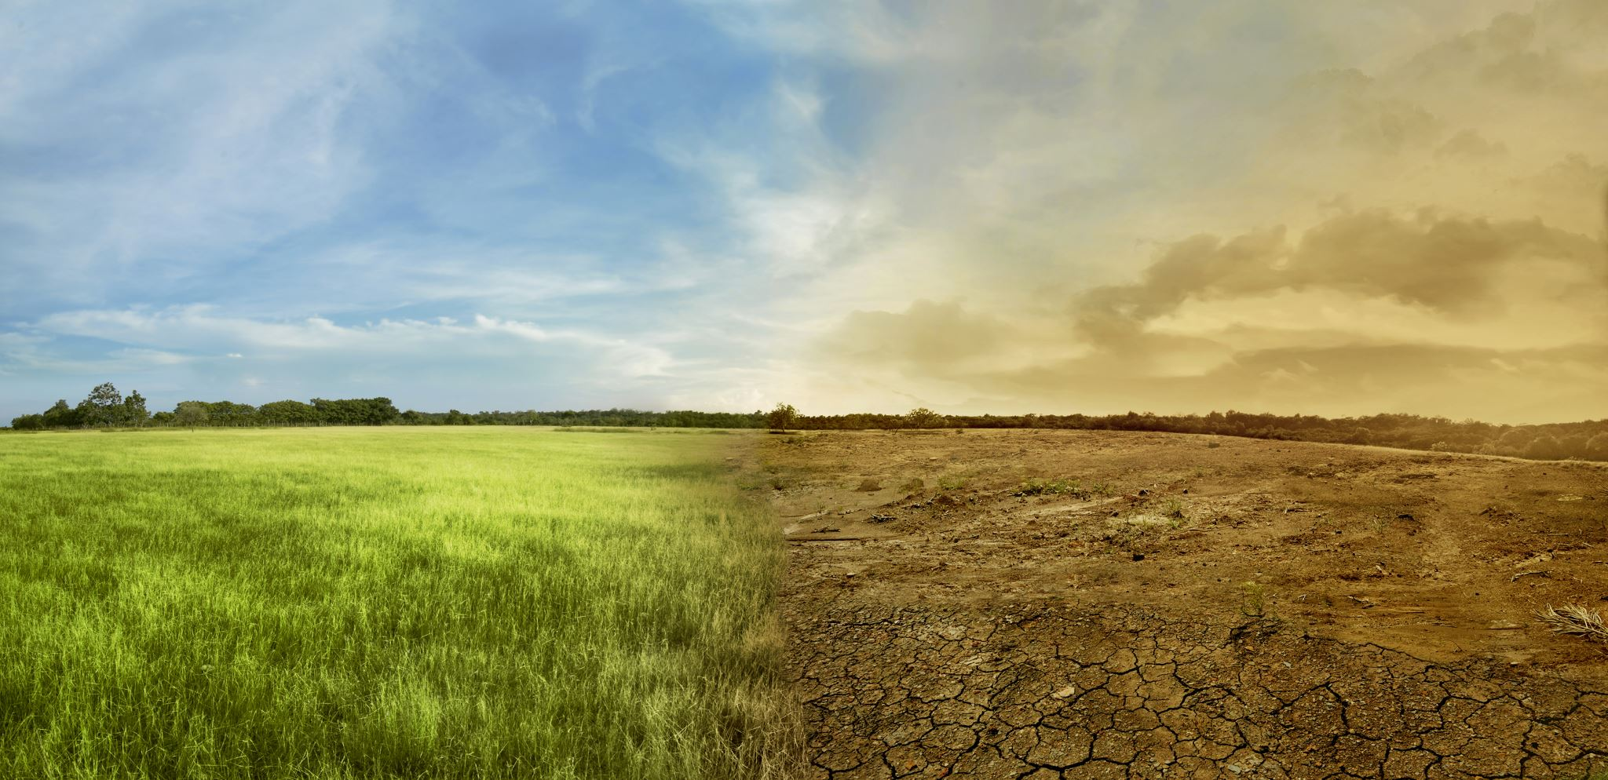
The environment highlights:
- The general and abstract law is inadequate to deal with the often exceptional and unforeseeable situations posed by environmental issues.

Slide 11
Who makes the choice?
The risk is to force the regulatory source to chase the phenomena with essentially provisional acts which are then often challenged before the administrative judge.​

Slide 12
The crisis of normative policy decision-making in the face of the (sometimes imperative) indications of the science and technology
This is a crisis factor accentuated, in the field of the protection of the environment, by the need to operate under conditions of scientific uncertainty, based on data changeable over time and social reactions that cannot be easily assumed or controlled;

Slide 13

The crisis of sovereignty
Sovereignty understood as undivided power held by the nation-state, which must instead come to terms with the articulation, on various territorial levels, of problems and environmental emergencies;

Slide 14
The crisis of sovereignty
- International law,
European supranational law,
National law (and in the domestic system, of laws and regulations - or otherwise secondary norms - state;
Regional laws and regulations;
Regulations of local authorities).

Slide 15

The crisis of sovereignty
Norms of technical origin of public and even private bodies, with the difficulty of untangling the knots arising from the overlap between the different legal systems and the contextual intervention of a plurality of subjects and regulatory sources.

Slide 16

Multiple sources
The sources of law for the environment are multiple and difficult to classify.
Precisely because they must make up for the inadequacy of the traditional system of norms, constructed according to the classic pyramid scheme characterized by the principles of hierarchy and competence.

Slide 17

Different levels and different types
There are in environmental law sources of different levels and different types.
There are (in direct relation to the elements of crisis mentioned above):
- sources from the constitutional level, to define the principles on which to set the relationship between human and resources natural resources (with the necessary presence of sources of general international law; of the Treaties of the European Union; of the Constitution);

Slide 18
Different levels and different types
- Legislative sources that specify choices to ensure the protection of various natural resources and the resilience of the environmental system, with interventions that are characterized and articulated in extremely diverse terms by their intense technical content, with the need for continuous adjustments that are difficult to predeterminable.
(EG: delegated regulations, technical standards and guidelines and, in very many cases, emergency ordinances).

Slide 19
Different levels and different types
About the most different levels of government, we can see:
The necessary presence of international law,
European supranational law,
National law,
And in the domestic system, of laws and norms secondary.

