Slide 1

The Environmental Principles
- The principle of prevention
- The precautionary principle
- The polluter pays principle
Prof.ssa Sveva Del Gatto

Slide 2

Environmental principles
Environmental principles inform legal frameworks that relate to environmental protection or sustainable development.
They act as guidance for national legislators, judges and decision-makers, giving the EU law specific shape and meaning.

Slide 3
Environmental principles
They are used in a whole host of government and public authority decisions, including planning applications, management of marine protected areas and dealing with contaminated land.

Slide 4
Environmental principles
Since the principles of EU environmental law are embodied in a vast array of binding legal regulation, acting against them (even incorrect interpretation) is contra legem and may constitute a violation of EU law.
Article 191(2) of Treaty on the Functioning of the European Union (TFEU) sets out four main environmental principles that must guide policy within the scope of EU law:

Slide 5
Environmental principles
Article 191(2) of Treaty on the Functioning of the European Union (TFEU) sets out four main environmental principles that must guide policy within the scope of EU law:
"Union policy on the environment shall aim at a high level of protection taking into account the diversity of situations in the various regions of the Union.
It shall be based on the precautionary principle and on the principles that preventive action should be taken, that environmental damage should as a priority be rectified at source and that the polluter should pay."

Slide 6
The principles of prevention and precaution
The principles of prevention and precaution constitute two of the pillars of environmental law.
Let's see how they are characterized and how they differ from each other.

Slide 7

The principle of prevention
The principle of prevention in the context of environmental law provides for the need to prevent the harmful event where there is with certainty a risk of its occurrence.

Slide 8
The principle of prevention
It is, in essence, the instruction to work to prevent harm that is certain to occur.
What characterizes the principle in question, it should be pointed out from the outset, is precisely the profile of the certainty of the potential damage.

Slide 9

The principle of prevention
The principle of prevention refers to the need to act promptly to prevent the occurrence of damage
because, when environmental damage has already occurred, it becomes more costly to repair it as well as in many cases technically impossible.

Slide 10
The principle of prevention
In general terms, the principle of prevention has been ascribed the objective of preventing the harm resulting from the exercise of activities known to be dangerous to the environment and thus taking into account known risks.

Slide 11

The precautionary principle: no absolute certainty about the damage
The precautionary principle operates where there is no absolute certainty about the damage.
In essence, then, the principle is intended to avoid potential environmental damage even where there is no scientific evidence about its occurrence.

Slide 12
A risk management tool
The precautionary principle is a risk management tool that comes into play when there is scientific uncertainty about a suspected risk to human health or to the environment emanating from a certain action or policy.

Slide 13

A risk management tool
For instance, should doubts arise about the potentially harmful effects of a product, and should – following an objective scientific evaluation – uncertainty persist, this principle calls for the product to be removed from the market.
Such measures must be non-discriminatory and proportionate, and must be reviewed once more scientific information is available.

Slide 14
A risk management tool
The precautionary principle can be invoked when a phenomenon, product or process may have potentially dangerous effects, identified through scientific and objective assessment, if this assessment does not allow the risk to be determined with sufficient certainty.

Slide 15
A risk management tool
Recourse to the principle is therefore part of the general framework of risk analysis (which includes, in addition to risk assessment, risk management and risk communication) and more particularly within the framework of risk management, which corresponds to the decision-making stage.

Slide 16

The definition of "risk"
"Risk" has been effectively defined as "the likelihood that an adverse effect will affect a human being or the environment as a result of exposure to a hazard, which may be biological, physical, or chemical"; while "uncertainty" is a "situation of doubt about the reliability, accuracy, or relevance of a piece of information"

Slide 17

The purpose of the precautionary principle
Its purpose is to ensure a high level of environmental protection through preventive stances in case of risk.
However, in practice, the scope of the principle is much broader and also extends to consumer policy, European food law, human, animal and plant health.

Slide 18
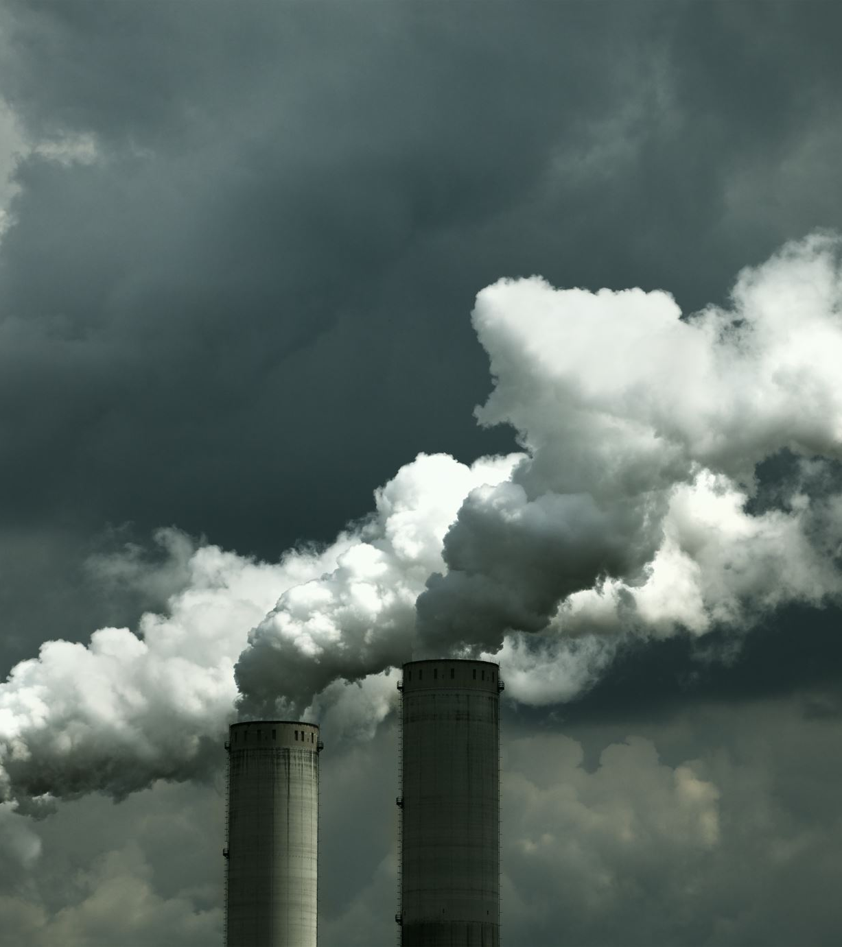
The origin of the precautionary principle
The oldest expression of the precautionary principle is generally traced back to the Swedish Environmental Protection Act of 1969. During the 1970s, the expression Vorsorgeprinzip was used mainly in Germany in the context of air pollution regulations and guidelines .

Slide 19
The origin of the precautionary principle
One of the earliest elaborate traces of the precautionary principle in international law seems to be found in the 1984 Bremen Declaration concerning the International Conference of Ministers on the Protection of the North Sea, which states that affected states should not "wait for certain proof of harmful events before acting." Subsequently, several other international treaties-for example, the Montreal Protocol of September 16, 1987 - have expressed themselves in a similar direction.

Slide 20

The 1992 UN Conference on Environment and Development in Rio de Janeiro
The universal recognition of the precautionary principle came at the 1992 UN Conference on Environment and Development in Rio de Janeiro.
And it is significant that it was there-along with the most solemn proclamation of the principle that the first warnings came regarding the limits of its possible application and the cautions (precautions?) that must be used in handling it .

Slide 21

The 1992 UN Conference on Environment and Development in Rio de Janeiro
As a result of the 1992 United Nations Conference on Environment and Development (Earth Summit) in Rio de Janeiro, attended by more than one hundred and eighty government delegations from around the world, the Rio Declaration was ratified, a set of non-binding principles concerning the responsibilities and rights of states in an attempt to bring together the needs of development with those of environmental protection.

Slide 22
The precautionary principle was defined by Principle 15 as follows:
"In order to protect the environment, the precautionary approach shall be widely applied by States according to their capabilities. Where there are threats of serious or irreversible damage, lack of full scientific certainty shall not be used as a reason for postponing cost-effective measures to prevent environmental degradation."

Slide 23
The scope of the precautionary principle
The text explicitly speaks only of environmental protection, but over time and in practice the scope has broadened to include the policy of consumer protection, human, animal and plant health.
This point of view was promoted by the European Union, ratifying the Rio de Janeiro Convention on Biological Diversity (93/626/EEC), and making Community policy explicit in Commission Communication COM(2000) 1 Final (February 2, 2000).

Slide 24
The risk is uncertain
That document states (§ 1):
"Whether or not to invoke the precautionary principle is a decision exercised under conditions where scientific information is insufficient, inconclusive or uncertain and there are indications that the possible effects on the environment and the health of humans, animals and plants may be potentially dangerous and incompatible with the chosen level of protection."

Slide 25

The Maastricht Treaty
The Maastricht Treaty introduced the precautionary principle currently enunciated in Art. 191 of the Treaty on the Functioning of the European Union, where it is argued that the Union's policy on the environment aims at a high level of protection and "is based on the precautionary principle and the principle of preventive action, the principle of rectifying, as a priority, damage caused to the environment at source, and the polluter pays principle."

Slide 26
The Maastricht Treaty
The EU Treaty contains only one explicit reference to the precaution, and more specifically, in the title devoted to the protection of the environment. However, in practice, the scope of the principle is much broader and also extends to consumer policy and to human, animal or plant health.

Slide 27

Legislative Decree 152/2006 - Environmental Italian Code
On the domestic law front, however, Legislative Decree 152/2006 provides that:
When environmental damage has not yet occurred, but there is an imminent threat of it occurring, the operator concerned shall, within twenty-four hours and at his own expense, take the necessary preventive and safety measures.

Slide 28
Three conditions
The precautionary principle can be invoked only in the hypothesis of a potential risk, and that it cannot under any circumstances justify arbitrary decision-making.
Therefore, recourse to the precautionary principle is justified only when it brings together three conditions, namely:
the identification of potentially adverse effects;
the assessment of the available scientific data;
the extent of scientific uncertainty.

Slide 29
Three conditions
The Commission stresses that the precautionary principle can be invoked only in the event of a potential risk, and that it cannot under any case justify an arbitrary decision-making.
Recourse to the precautionary principle is therefore justified only when it brings together three conditions, namely: the identification of potentially adverse effects, the evaluation of available scientific data, and the extent of scientific uncertainty.

Slide 30
Three specific principles must underlie the use of the precautionary principle:
As complete a scientific evaluation as possible and a determination, to the extent possible, of the degree of scientific uncertainty;
An assessment of the risk and potential consequences of inaction;
The participation of all interested parties in the study of precautionary measures, as soon as the results from the scientific evaluation and/or risk assessment are available.

Slide 31
The five principles
In addition, the general principles of risk management remain applicable when the precautionary principle is invoked. These are the following five principles:
proportionality between the measures taken and the level of protection sought;
non-discrimination in the application of measures;

Slide 32
The five principles
3. consistency of the measures with those already taken in similar situations or making use of similar approaches;
4. the examination of the benefits and burdens resulting from action or lack of action;
5. the review of measures in the light of scientific developments.

Slide 33
Measures resulting from recourse to the precautionary principle
With regard to the measures resulting from recourse to the precautionary principle, they can take the form of a decision to act or of not acting. The response chosen depends on a policy decision, which is a function of the level of risk considered as "acceptable" by the society that has to bear said risk.
When acting without waiting for more scientific information seems to be the appropriate response to a risk by virtue of the application of the precautionary principle, one must still determine the form that should take this action.

Slide 34
Guidelines for the use of the precautionary principle
- any decision to act or not to act under the precautionary principle should be preceded by an assessment of the risk and the consequences potential consequences of inaction;
- as soon as the results from the scientific evaluation and/or risk assessment are available, all stakeholders should be given the opportunity to participate in the study of various foreseeable actions in the most transparent possible.

Slide 35

Criticisms of the precautionary principle
Opponents of this principle criticize it as being too much of a brake on the development and diffusion of new technologies.
According to some, the precautionary principle would stand in contrast to the scientific method.
In fact, the precautionary principle is not based on the availability of data proving the presence of a risk, but on the absence of data assuring the opposite.

Slide 36
Criticisms of the precautionary principle
This generates the problem of clearly identifying the amount of data needed to prove the absence of risk, especially in light of the impossibility of science to provide ultimate and definitive certainties.
Furthermore, it should be emphasized that the precautionary principle is neither a research method nor a scientific principle, but rather a policy instrument of risk management.

Slide 37
Scope and effects of the principles of environmental protection (precaution and proportionality) in the T.U.A. as amended.
TAR Campania, n. 3727/10
The precautionary principle, according to which the P.A. is allowed to take the necessary measures where it fears the risk of an injury to a protected interest, even in the absence of a concrete risk, must harmonize with the principle of proportionality, according to which public authorities may not impose, through regulatory and administrative acts, obligations and restrictions on citizens' freedoms to an extent greater than is strictly necessary to achieve the purpose.

Slide 38
Scope and effects of the principles of environmental protection (precaution and proportionality) in the T.U.A. as amended. TAR Campania, no. 3727/10
On the report of the local ASL, and following an ARPAC monitoring carried out on the levels of ammonia in the air near the company, the municipality had concluded that the processing carried out in the plant was at the origin of the acid and sulfur compounds constituting the odoriferous fractions with the greatest olfactory impact, the cause of the harassment found in the surroundings of the settlement, which could not be abated even under the best conditions of use.

Slide 39
Scope and effects of the principles of environmental protection (precaution and proportionality) in the T.U.A. as amended. TAR Campania, no. 3727/10
It follows that all decisions taken by the authorities, competent in environmental matters, must be assisted by a particularly rigorous motivational apparatus, taking into account an equally unexceptionable preliminary activity.

Slide 40
Scope and effects of the principles of environmental protection (precaution and proportionality) in the T.U.A. as amended. TAR Campania, no. 3727/10
The imputation of the harmful event, moreover, can never disregard the verification of the etiological link between the company's activity and the injury to the environmental/health asset. The demonstration of the existence of the causal link in concreto must be based on a prior, rigorous scientific investigation, which identifies causes and effects of the natural phenomena on which the Authority's determinations must be made, behind weighted administrative assessment, without unacceptable intermingling between the two levels - the scientific and the political-administrative discretionary one.

Slide 41
Scope and effects of the principles of environmental protection (precaution and proportionality) in the T.U.A. as amended. TAR Campania, no. 3727/10
In the technical consultancy, the G.A. notes, it emerged, however, that the highest value of ammonia was found 500 m from the plant while in the vicinity of the plant the concentration of the substance was lower and that the pH of the sulfuric acid solution presented, upon determination, a value compatible with the prescriptions of the plant's operating manual.

Slide 42
Scope and effects of the principles of environmental protection (precaution and proportionality) in the T.U.A. as amended. TAR Campania, no. 3727/10
In addition, the circumstance that from monitoring it was not possible to establish whether the actual source of the malodor was attributable to the plaintiff company or to the neighboring context - an agricultural area where manure is used and on which slurry and RDF disposal plants insist - led the G.A. to exclude the demonstration of a causal link between conduct and the event).

Slide 43
Scope and effects of the principles of environmental protection (precaution and proportionality) in the T.U.A. as amended. TAR Campania, no. 3727/10
In the case in point, the G.A. annulled municipal measures to suspend any production cycle related to the activity of a company that recovers organic biomass by means of natural microbiological processing methods.

Slide 44
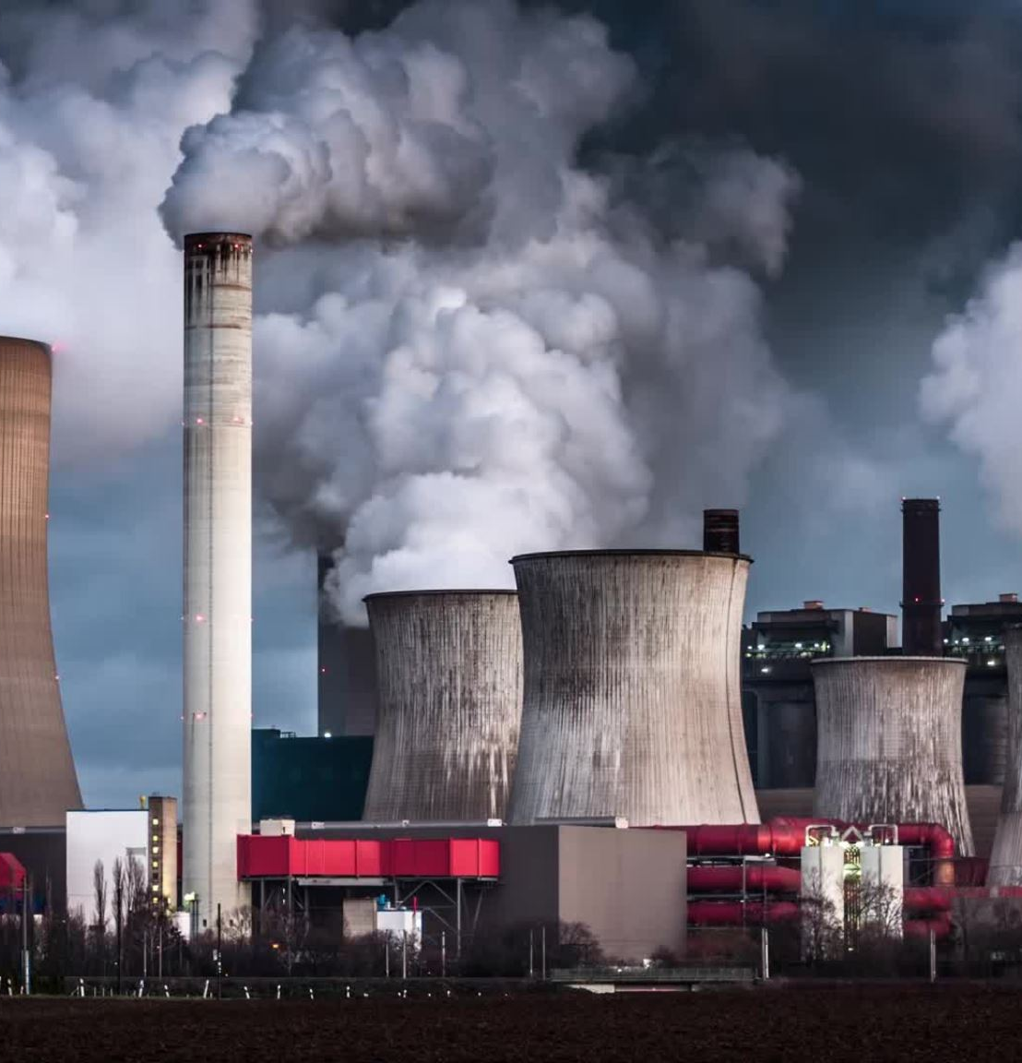
The polluter pays principle
The polluter pays principle is a fundamental principle underlying the environmental policy of the European Union (EU).
By virtue of this principle, polluters are required to bear the costs of the pollution caused, including the costs of the measures adopted to prevent, reduce and remedy pollution as well as the costs this entails for society.

Slide 45
The polluter pays principle
The application of this principle ensures that polluters are incentivized to avoid environmental damage and are considered responsible for the pollution caused.
It is always the polluter, and not the taxpayer, who has to bear the costs of restoring the sites to their original conditions.

Slide 46
The polluter pays principle
Before the recognition and implementation of PPP, air and water resources were used as "sink sinks" for pollution, and damage to human health and property was paid for by society, rather than the polluter.

Slide 47
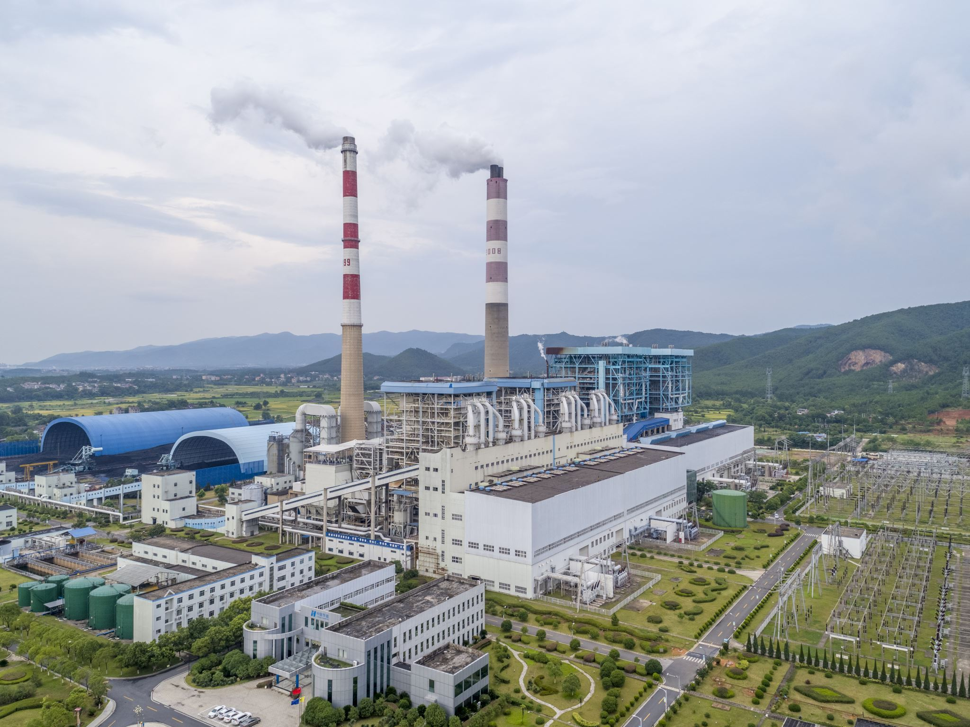
The origin of the polluter pays principle
As Europe sought to incorporate common solutions to reduce environmental pollution, the PPP emerged in the 1968 “Declaration of Principles” on air pollution control, adopted by the Committee of Ministers of the Council of Europe.
Principle 6 on financing states:
“The cost incurred in preventing or abating pollution should be borne by whoever causes the pollution. This does not preclude aid from Public Authorities.”

Slide 48
The origin of the polluter pays principle
Later, in response to similar concerns for the environment, it was included in a non-binding instrument of the OECD: the 1972 Recommendation on Guiding Principles concerning International Economic Aspects of Environmental Policies, which is recognized as the first international document that regulates the PPP.

Slide 49
The origin of the polluter pays principle
The Polluter-Pays Principle (PPP) was adopted by OECD in 1972 as an economic principle for allocating the costs of pollution control.
Under the 1972 and 1974 OECD Recommendations, the Polluter-Pays Principle means that the polluter should bear the "costs of pollution prevention and control measures", the latter being "measures decided by public authorities to ensure that the environment is in an acceptable state".

Slide 50

The polluter pays principle
In other words the polluter has to bear the cost of steps that he is legally bound to take to protect the environment, such as measures to reduce the pollutant emissions at source and measures to avoid pollution by collective treatment of effluent from a polluting installation and other sources of pollution.

Slide 51
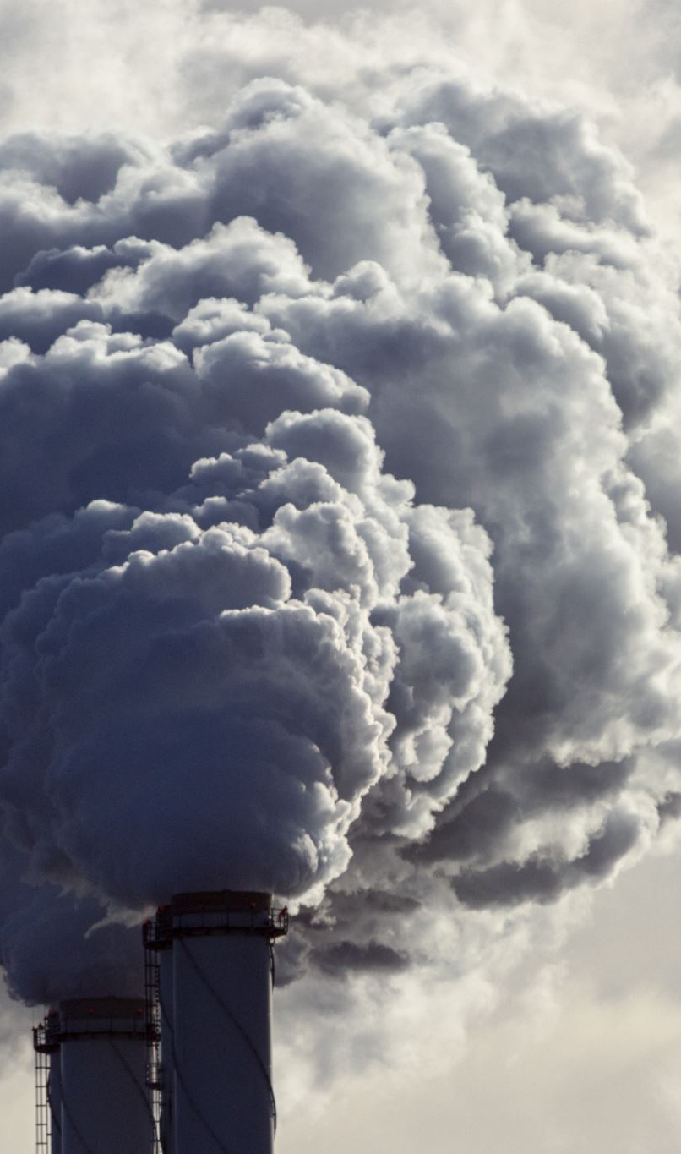
The polluter pays principle
Generally speaking, a polluter has to bear all the costs of preventing and controlling any pollution that he originates.

Slide 52
The polluter pays principle
Pollution represents a significant cost to society and is of great concern to EU citizens. By virtue of the "polluter pays" principle, polluters are incentivized to avoid environmental damage and are considered responsible for the pollution caused.

Slide 53

The polluter pays principle
Before the polluter pays principle had been established, the disproportionate social and private costs of pollution were "externalized" by the polluter to society at large.
PPP aims to overcome these problems by requiring polluters to “internalize” the cost of potential pollution into the production process (embedded costs), so that society does not have to bear subsequent costs.

Slide 54
The polluter pays principle
The Principle, as defined in 1972, has progressively been generalised and extended.
From being a principle of partial internalisation, it is increasingly become a principle of full internalisation .

Slide 55
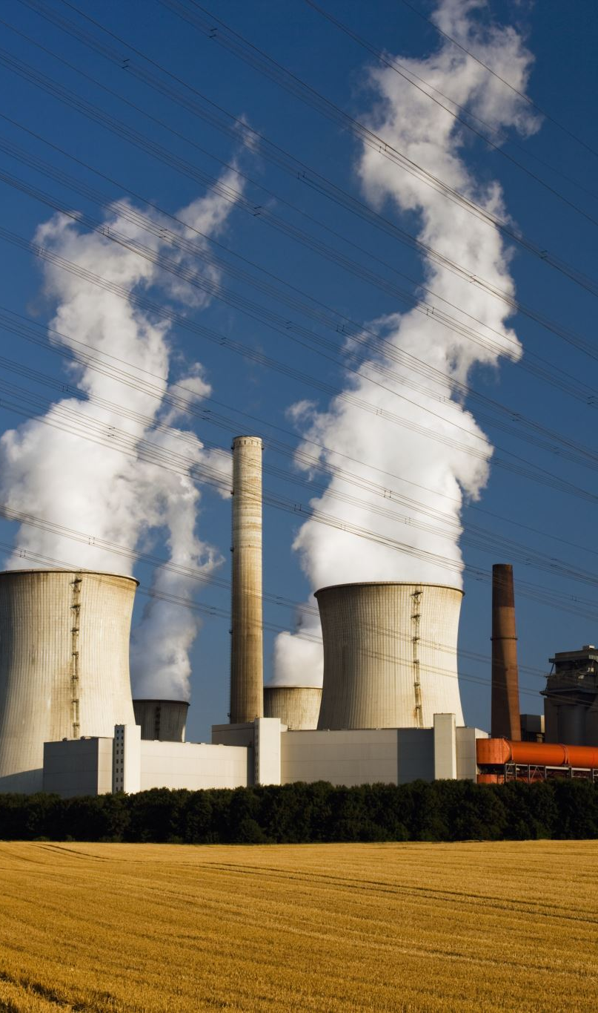
Inclusion of the costs of administrative measures
At the outset the Principle related essentially to measures taken by polluters to reduce pollution, that is to say, measures to reduce the emission of pollutants into the environment.
The first extension made polluters liable for the costs of administrative measures taken by the authorities as a result of pollutant emissions.

Slide 56
Inclusion of the costs of administrative measures
Under a number of EC directives, a polluter may be required to pay for special measures taken by government, analyses for instance, and monitoring and control systems, insofar as the costs can be assigned directly to specific polluting activities.

Slide 57
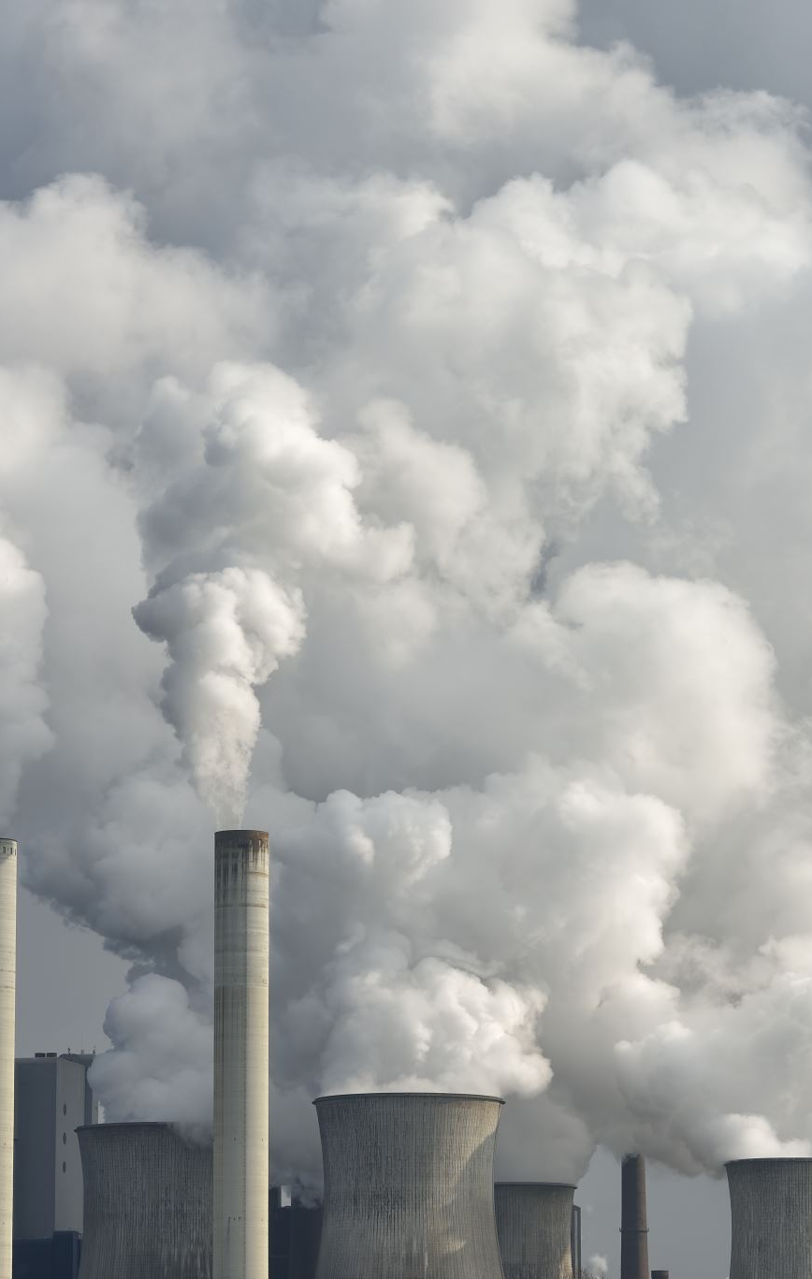
Inclusion of the costs of administrative measures
The administrative cost of waste management can accordingly be charged by authorities to generators of waste. Similarly, the cost of a regional system for monitoring air pollution can be charged to the economic agents causing such pollution there.

Slide 58

The implementation of the PPP
The European Union articulated the application of the PPP progressively:
in 1973 with its Program of action on the environment;
in 1975 with its Recommendation 75/436, regarding cost allocation and action by public authorities on environmental matters;
and in 1986 with the Single European Act.

Slide 59
The implementation of the PPP
In the latter, the PPP guides and applies the environmental policy of the European Union as a key principle and as a hard law standard of the European legal system.
Even though the principle is not widely used outside the EU and the US, other countries, such as Australia, Ghana, and Zimbabwe, have incorporated the principle into
policy and/or regulation.

Slide 60
Current Debate
Despite its potential to be applied to many global environmental issues, the PPP is still not recognized as a customary international norm.
This is due to the myriad ways states define the PPP and configure its implementation in their internal legal systems—a complexity that emerges precisely because the PPP relates to so many wide-ranging areas, including the protection of the environment and human health, with incentives for economic activities.

